Slide 1
Mexico, 1821-1846
What the fuck is going on?

Slide 2
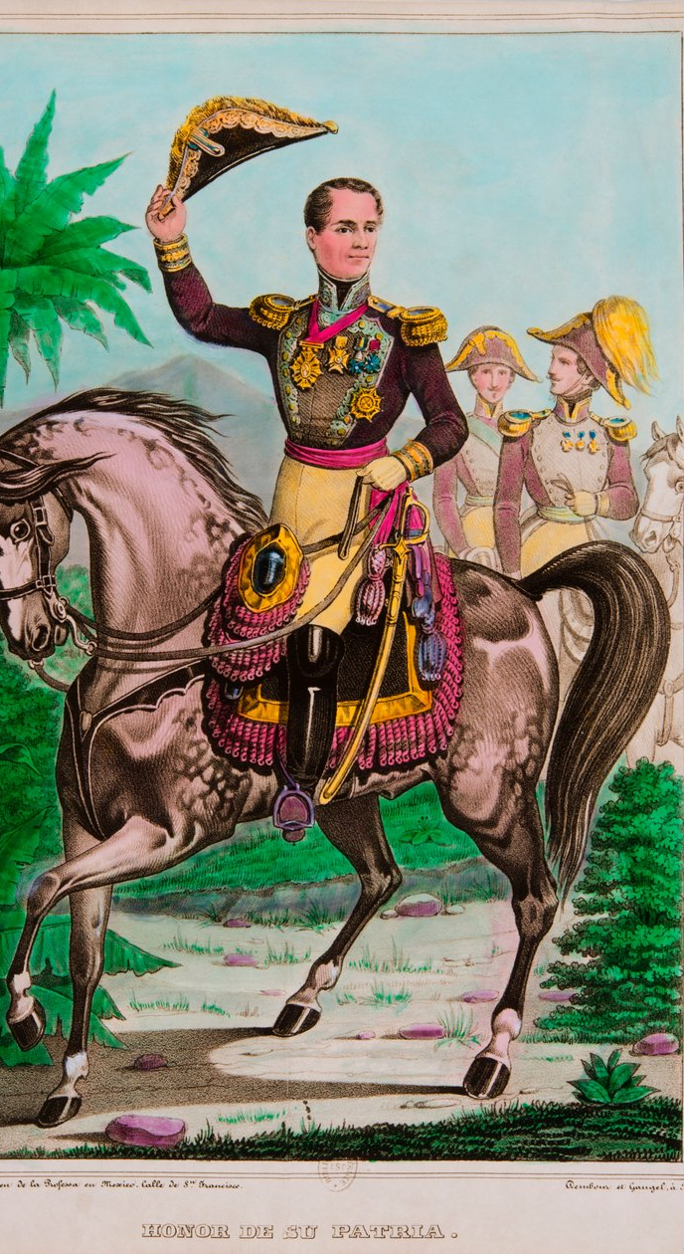
Mexican history during the first years of independence can look chaotic.
There were changes in government 75 times between 1821 and 1876 or around once every 8 months.
The country experimented with republican government (federal and central), dictatorship, home-ruled and foreign-ruled empire.
It was invaded by Spain (1829 and 1862), France (1838 and 1862), Britain (1862), and the United States (1836 and 1846).
How should we think about this period?

Slide 3
1) High Politics
Independence left Mexico with two main political schools of thought.
  Former royalists.
    Believe in centralized government,
    maintained role of colonial church,
    limited suffrage, protection of Spaniards
    BUT also protectionist trade and against U.S. influence.
    By 1830s they are termed centralists.
  Former pro-Independence fighters.
    Believe in local autonomy,
    limited church influence,
    full male suffrage,
    anti-Spanish
    BUT also free trade and sympathy with U.S. revolutionaries.
    By 1830s they are termed federalists.

Slide 4
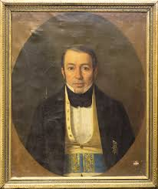
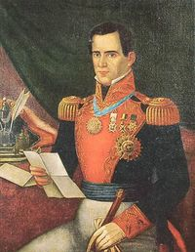
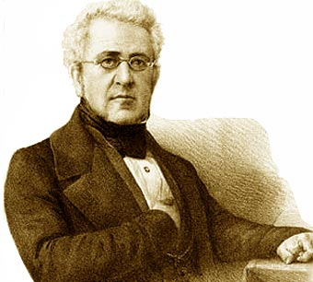
Centralists

Slide 5
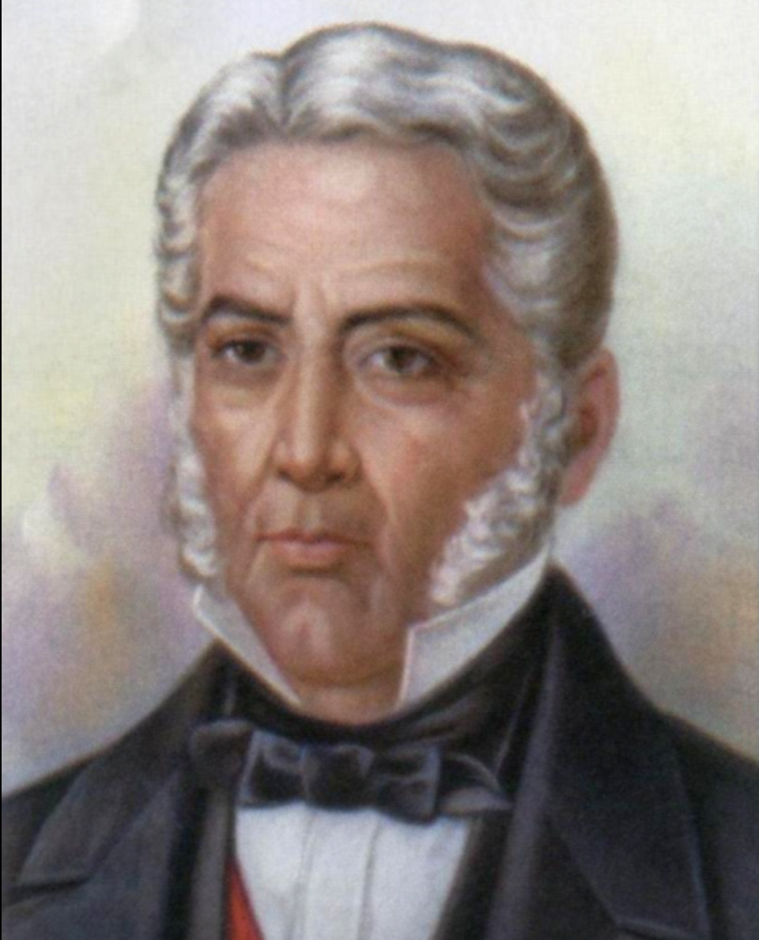
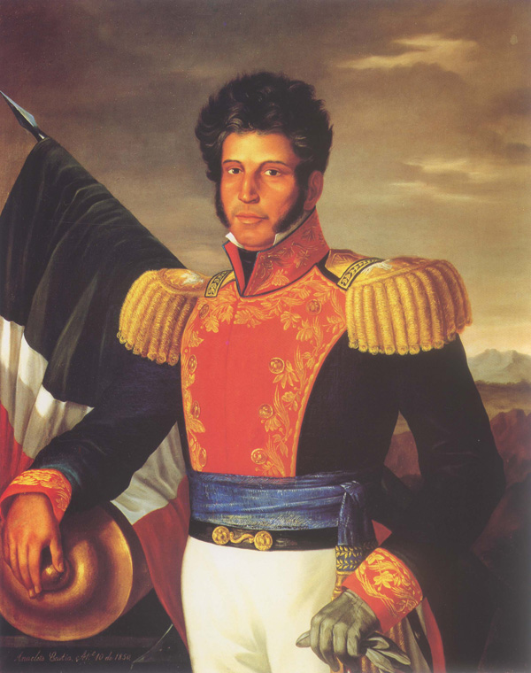
Federalists

Slide 6
These were broad political tendencies NOT political parties.
Most people held views somewhere on the spectrum between these two viewpoints.
Over the decades, ideologues on either side become more and more extreme.

Slide 7
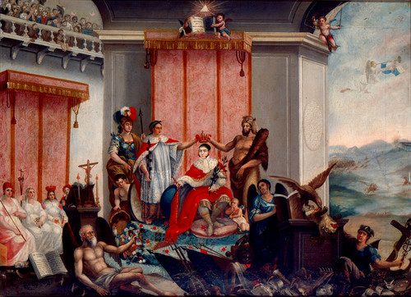
1821-1823 Empire
Agustín de Iturbide heads a governing junta and establishes a Congress to sort out form of government.
Feb. 1822. Congress votes to concentrate power in itself and lowers numbers of soldiers.
May 1822. Iturbide declares himself Emperor of Mexico. He dissolves Congress.
December 1822. Plan of Casa Mata launched by rebels. (Former Independence leaders like Vicente Guerrero but also moderates like Antonio de Santa Ana)
May 1823. Iturbide is forced into exile in Europe.
July 1824 Iturbide executed in Padilla (Tamaulipas) following return from exile.

Slide 8
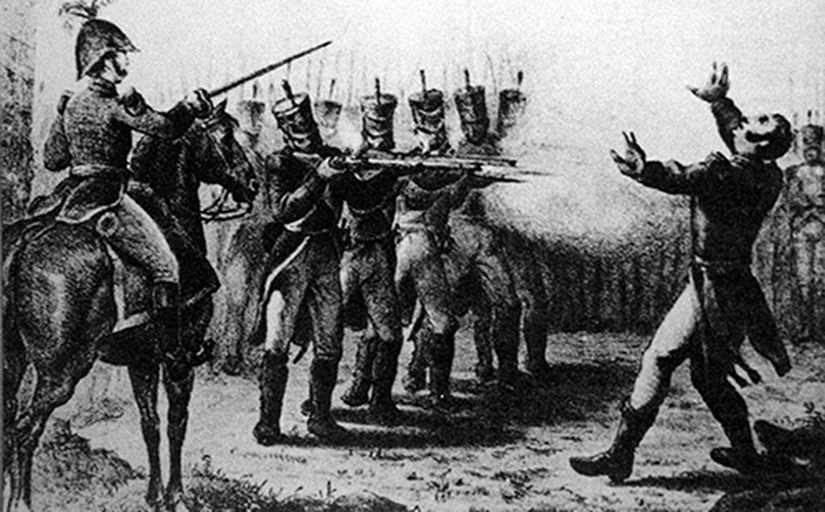

Slide 9
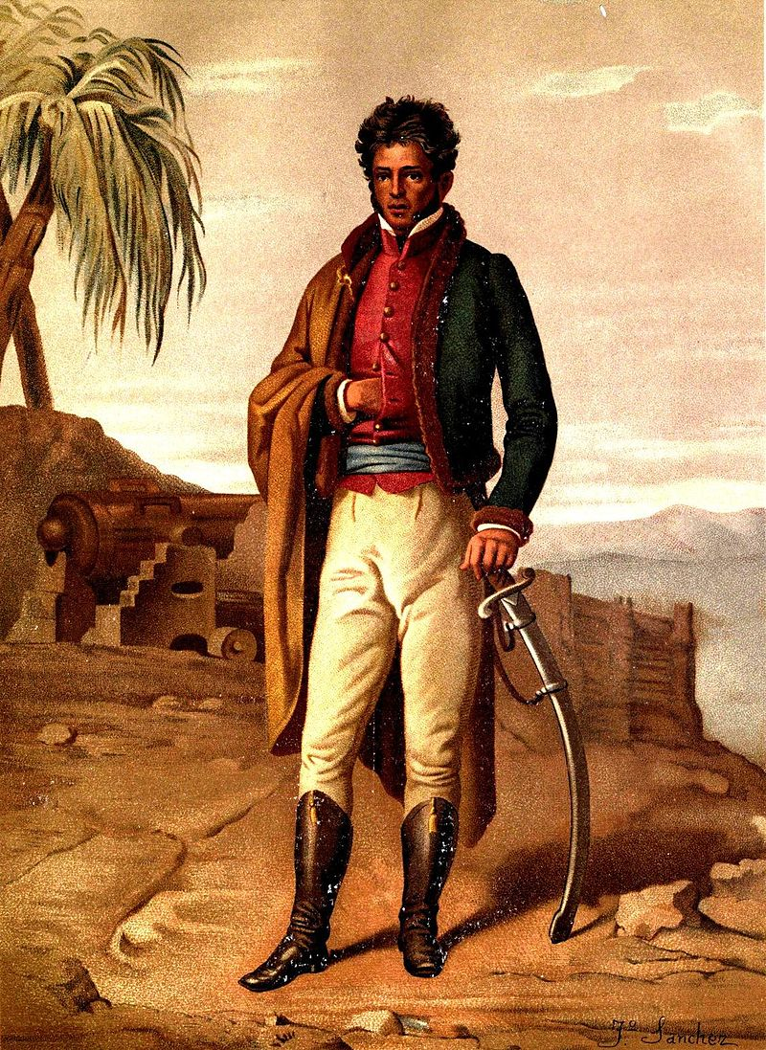
1824-1828
Federal Republic
1824 Mexican constitution modeled on that of the United States.
Federalist system – division into states.
Representative democracy at national, state level and municipal level.
1828 Fiercely contested election between conservative “centralists” and more radical “federalists” led by Vicente Guerrero.
1828-1831. Centralist rule Mexico City. Federalists rebel in the provinces.
1831 Vicente Guerrero is captured and executed.
J. Sánchez Vicente Riva Palacio, Julio Zárate (1880)México a través de los siglos Tomo III: "La guerra de independencia" (1808 - 1821)

Slide 10
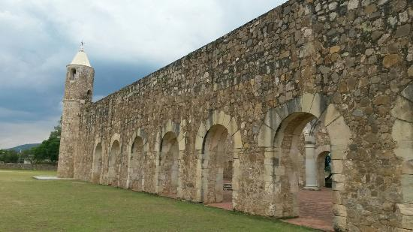
Cuilapam

Slide 11
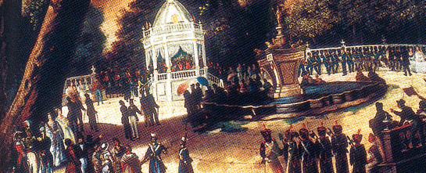
From Federal to Central Republic
1833. Federalist Rule under Valentín Gómez Farias.
1834. Centralist Rebellion
1835-1846. Centralist rule.
  Narrowing of franchise.
  Reduced state and municipal power
  Increased power of bishops and church

Slide 12
How to interpret this period
It is possible to view the period 1821-1846 as a conflict between the old royalist landowning and commercial elite and the old pro-Independence middle and lower classes.
There is much to this.
See in particular Peter Guardino, Peasants, Politics, and the Formation of Mexico's National State

Slide 13
BUT there are also problems with this interpretation
The role the caudillo
Politics in Mexico dominated by caudillos or “political strongmen”.
Classic caudillo was Antonio Lopez de Santa Ana who was president of Mexico on 11 occasions.
Where was Santa Ana on the spectrum? He moved from moderate federalism to extreme centralism, eventually declaring himself dictator.
Where was caudillo politics on the political spectrum?
  Some caudillos like Juan Alvarez and Vicente Guerrero were federalists.
  Was caudillo politics democratic (needed men to fill your army, needed popular acclaim, needed the power of the crowd) OR dictatorial?
  Similarity in some ways with modern populism.

Slide 14
Religion and the role of the church
Who protected the community religious practices that ensured the rain and the harvest?
Was it the centralists with their defense of the status of the bishops, priests, and church land?
Or was it the federalists, who weakened the institutional church and so gave you more freedom to do what you wanted to do?
What about fueros?

Slide 15
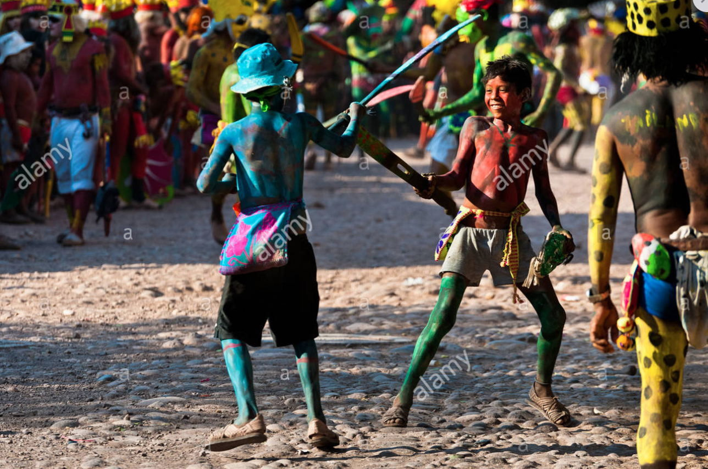

Slide 16
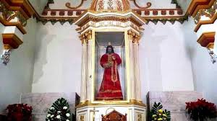

Slide 17
Race
It is tempting to see Mexico’s divisions as ones of race.
  Centralists – more Spanish.
  Federalists – more indigenous or Afro-Mexican.
There is much to this.
  Leaders
  Areas of influence.
But what of the guerras de castas?

Slide 18
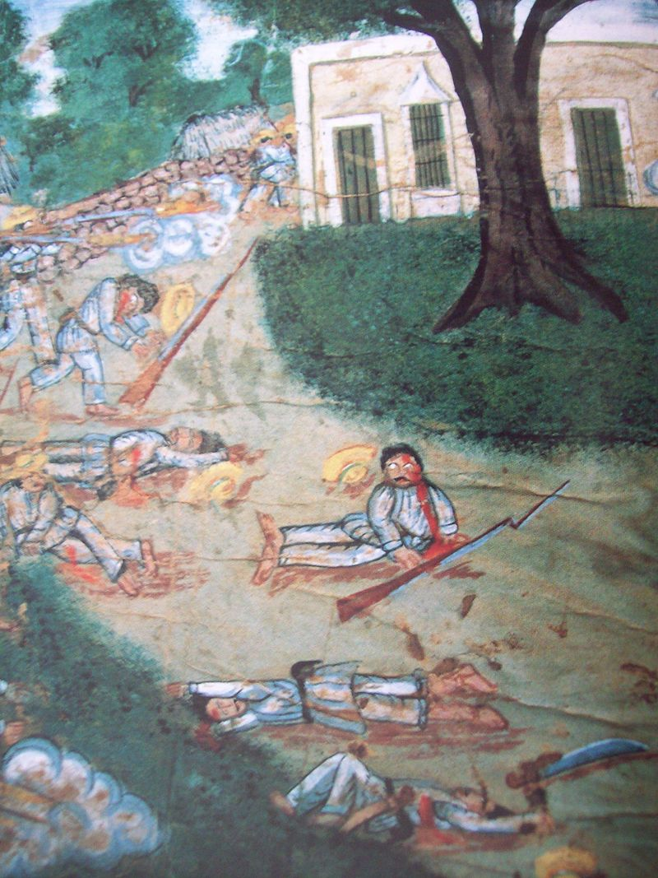
Indigenous uprisings
1847-1907 Caste War of Yucatán
1845-1849 Caste War of Huasteca
Yaquis – 1825, 1832, 1841
Seris – 1844
Triquis – 1834, 1846

Slide 19
Some were linked to federalist uprisings.
But others had an independent timing and dynamic.
  Made no reference to federalism.
  Led by monolingual indigenous men.
  Often centered on a particular religious symbol or apparition.
  E.g. Caste war of Yucatán and the Speaking Cross

Slide 20
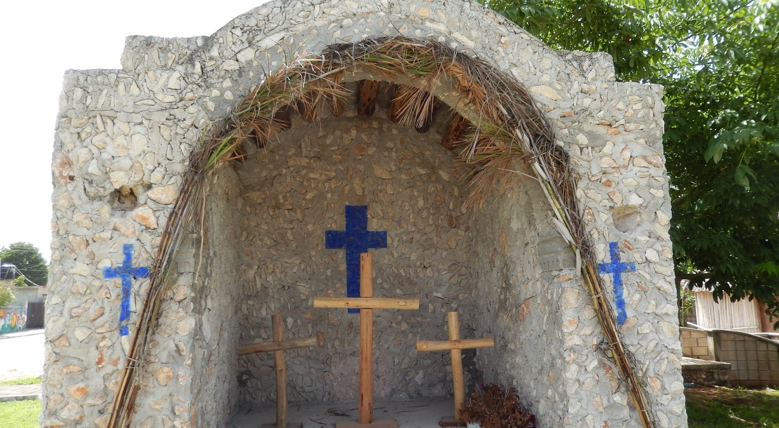

Slide 21


Slide 22
Questions
What factors made Mexicans support centralism or federalism?:Politics? Personal loyalties? Racial loyalties? Religion?
To what extent were Mexicans unconcerned with high politics?

