Slide 1
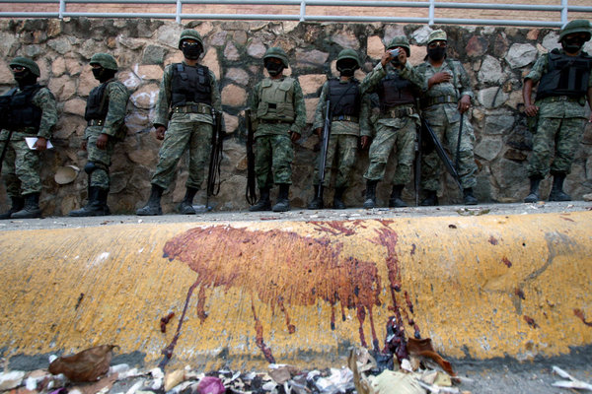
The Drug Trade in Mexico

Slide 2
Since 2006, 200-250,000 dead
100,000 disappeared presumed dead.
Other crimes (kidnapping, extortion, fuel theft etc) have skyrocketed.
Price of heroin and cocaine in US has gone DOWN.
Overdoses in US have gone up to 100,000 a year

Slide 3
How did Mexico get here? Two essential themes
1) Supply and demand. What does the US consumer want? And what do the Mexicans give them?
2) What is the relationship between the state and the cartels.

Slide 4
Mexican drug trade has gone through five stages
Stage 1 – 1910-1960
Mexican market
Use of marijuana by soldiers, prisoners and poor
Minimal use of heroin/cocaine
Minimal use of smoking opium by Chinese Mexican community
U.S. market
1914 Harrison Act prohibits smoking opium, heroin, and cocaine.
Increasing Mexican smuggling of smoking opium and heroin.

Slide 5
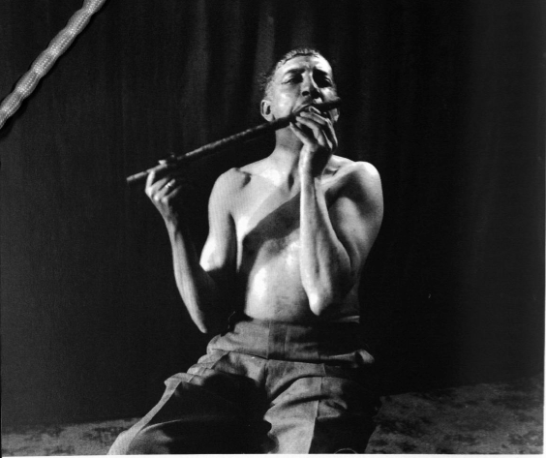

Slide 6
Opium poppies first grown by Mexico’s small Chinese-Mexican population
1920s/1930s Mexican nationalist movements expel many Chinese.
Mexicans take up the growing of opium poppies.
Principally in “Golden Triangle” – states of Sinaloa, Durango, Chihuahua
Grown by peasants
Bought up and trafficked by merchants/former revolutionaries
Protected by state governments

Slide 7
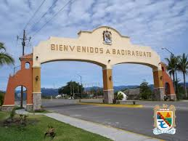

Slide 8
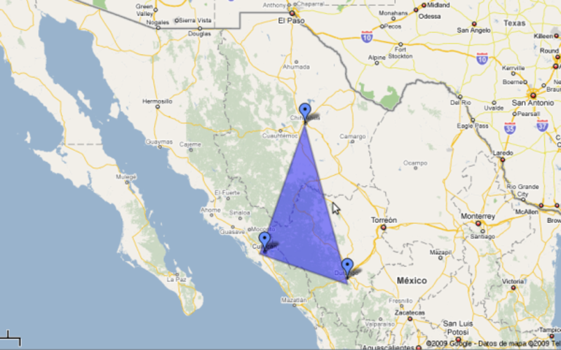
The Golden Triangle

Slide 9
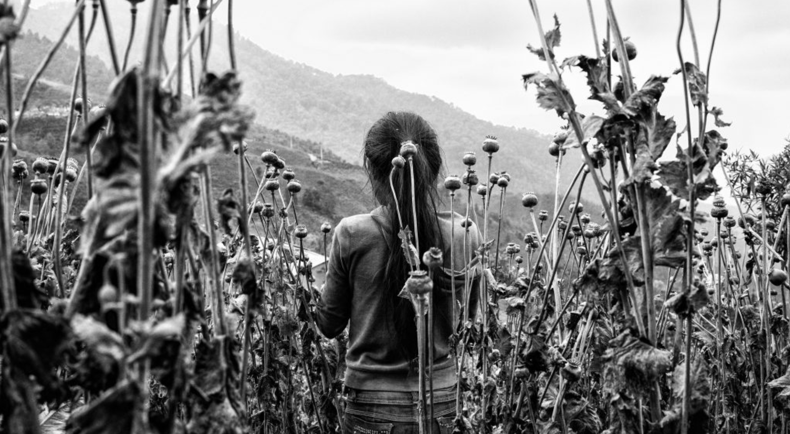
Poppy field, around harvest

Slide 10
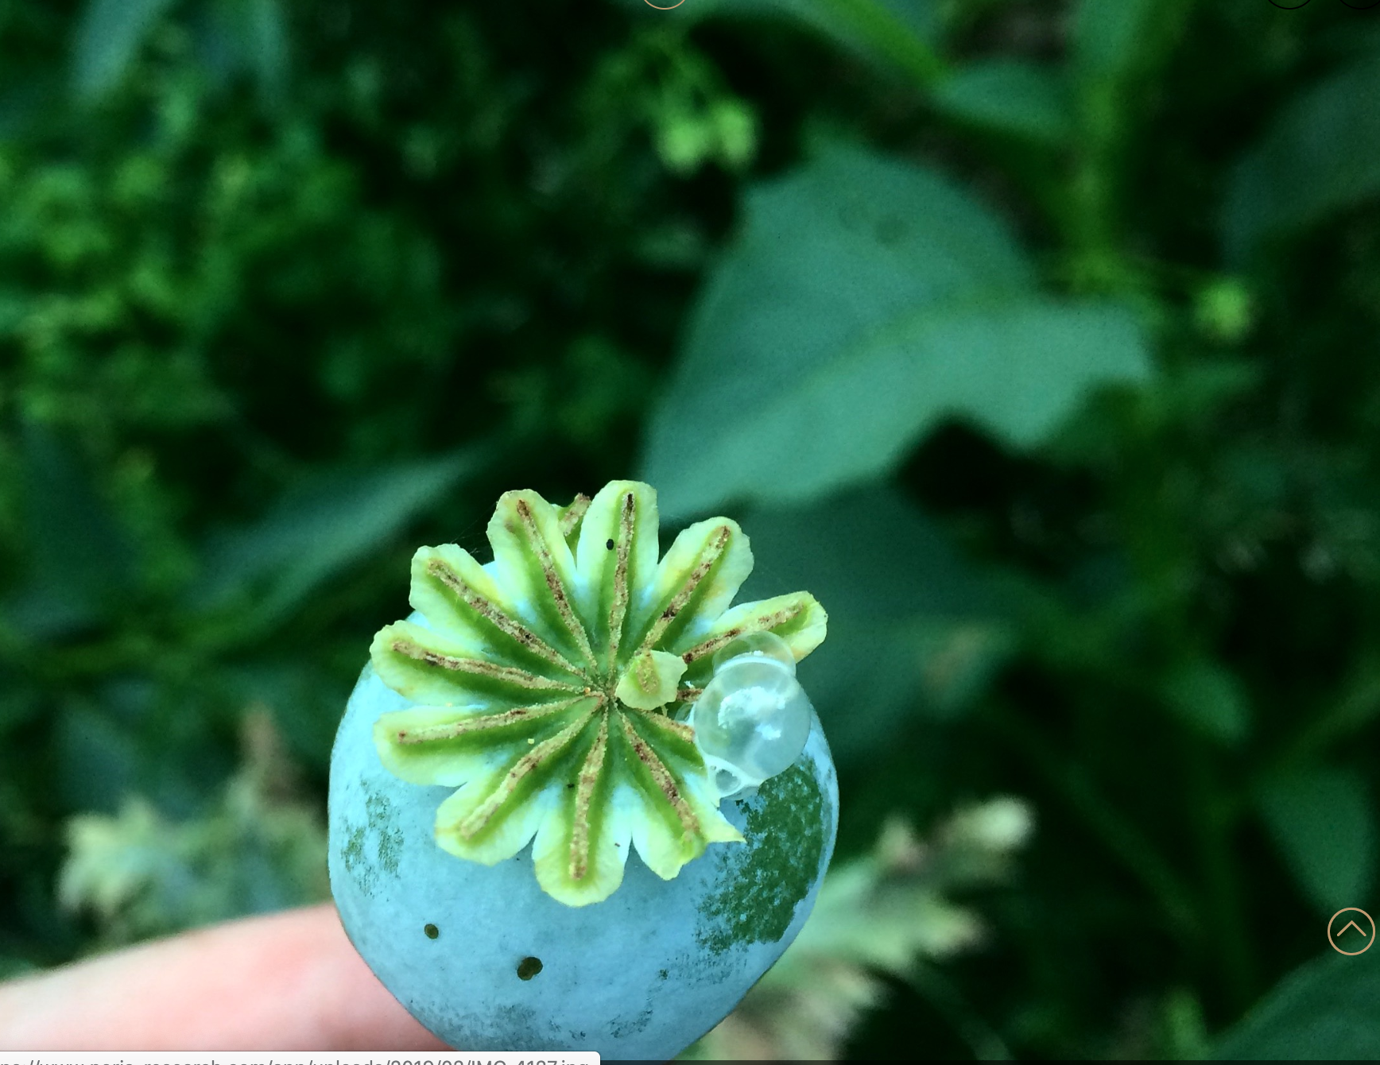

Slide 11
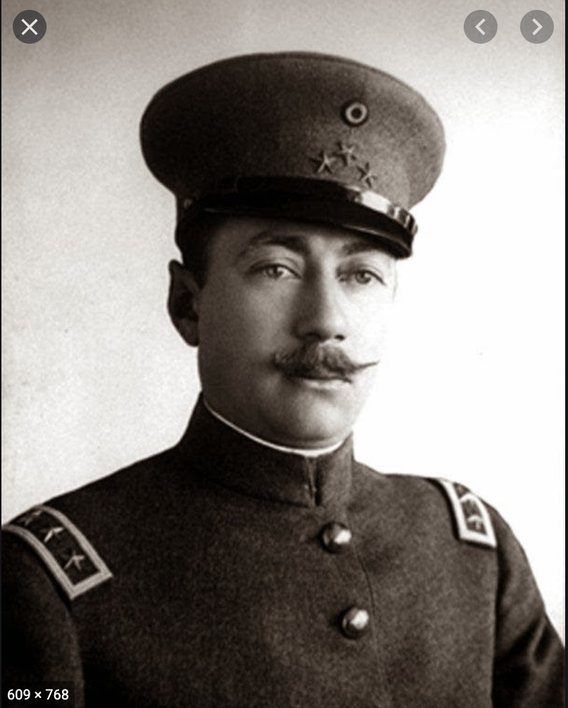
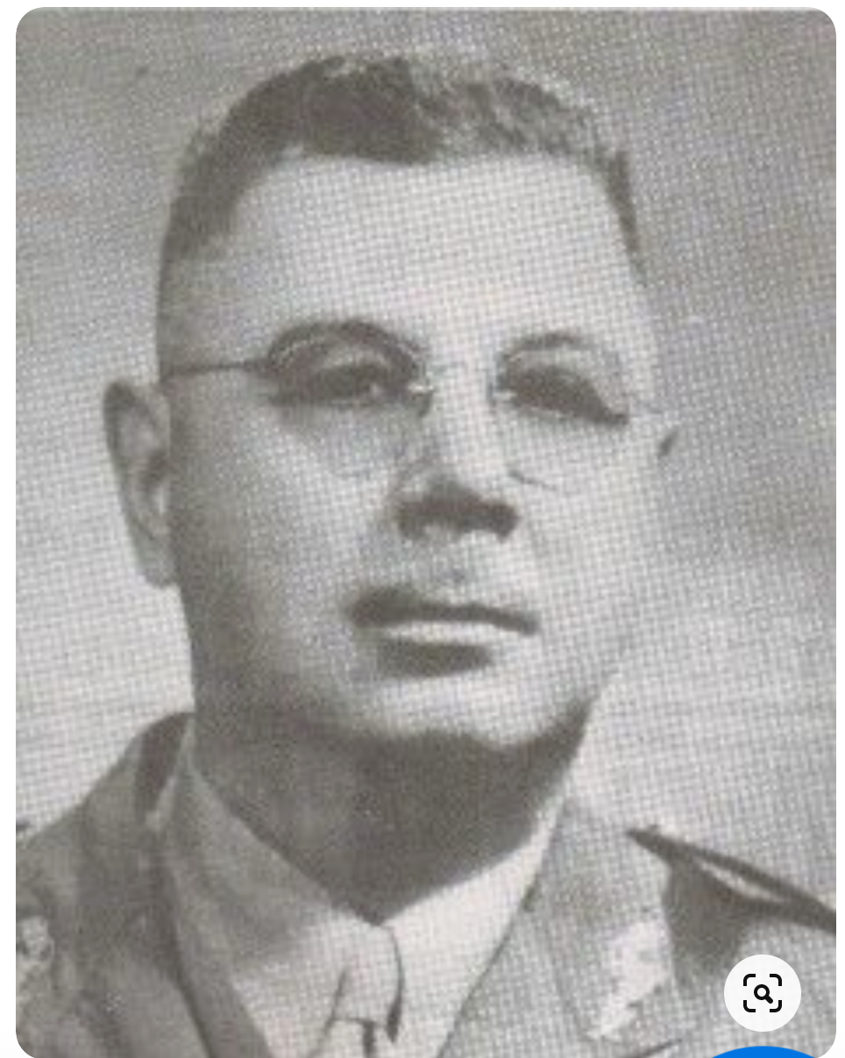
Local governors harness returns from opium industry. They offer protection in return for a percentage of profits. These are protection rackets.

Slide 12
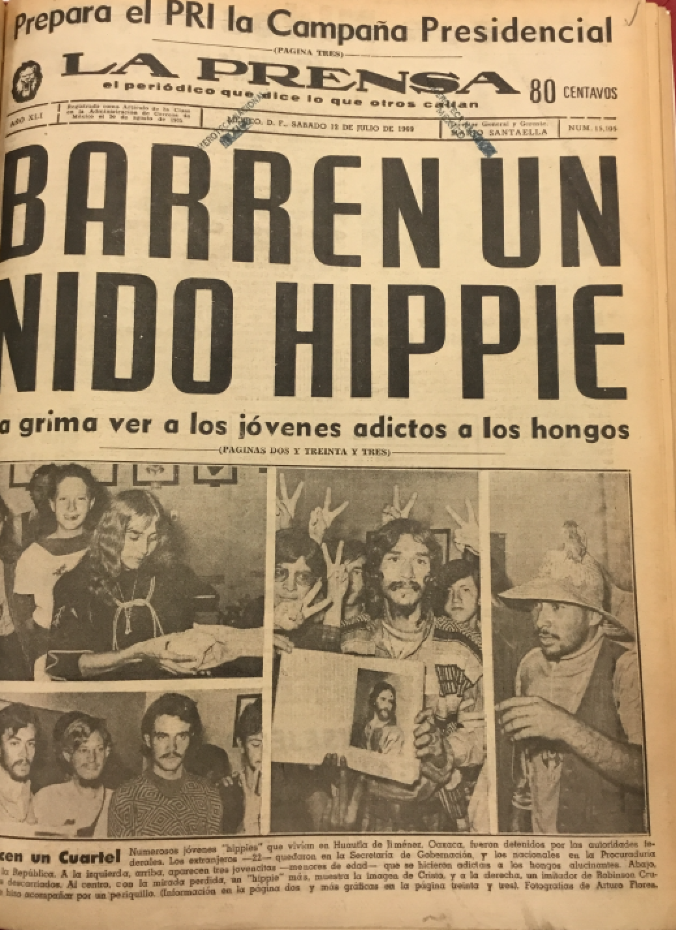
Stage 2: The Counterculture (1960-1975)

Slide 13
Hippy Marijuana Trade
Volume of drugs consumed by U.S. increases markedly.
Mexico provides much of the marijuana and heroin as well as hallucinogens including peyote and magic mushrooms.
At first hippies come down to Mexico, smoke weed, and smuggle small amounts back to U.S.
By by late 1960s using planes to ship back tonnes of weed.
Marijuana industry pushed from a few fields outside Mexico City to most Mexican states. Concentration in west coast states of Sinaloa, Guerrero, Oaxaca, Jalisco.
Increasing specialization – Acapulco Gold, Zacatecas Purple, sinsemilla.

Slide 14
Post-1972 Increase in heroin trade
“French Connection” folds.
Mexican brown heroin (Mexican mud) now dominates the U.S. market.
Increasing financial rewards from marijuana and heroin.
By end of Luis Echeverria’s (1970-1976) drugs thought to correspond to value of around 15% of Mexican exports.

Slide 15
Export of marijuana to the US (metric tonnes)

Slide 16
Value of Mexican heroin exports (millions of dollars)

Slide 17
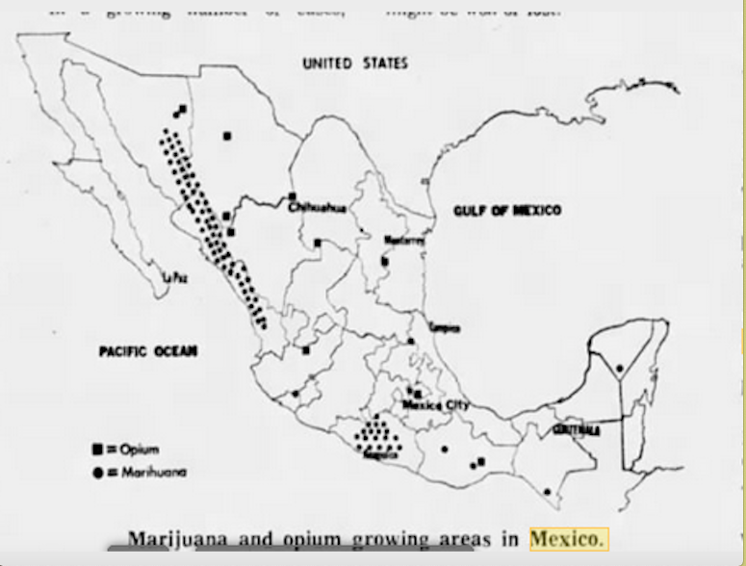
Growing areas 1970s

Slide 18
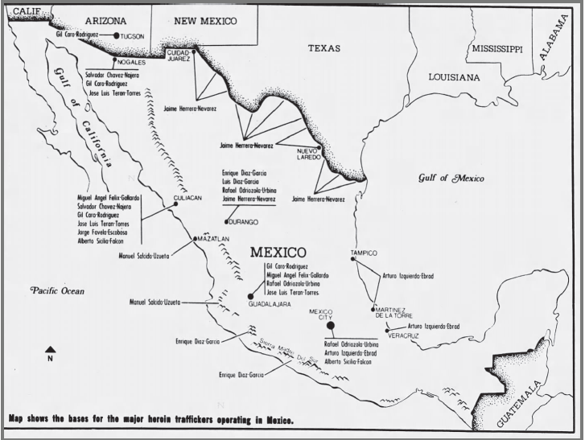
Major traffickers, 1979

Slide 19
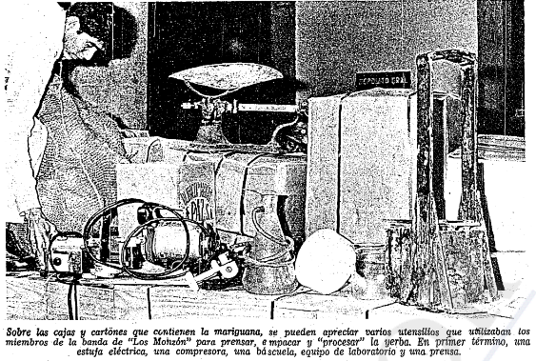
New tech

Slide 20
1975-1990s Stage 3: The First War on Drugs and Federal Control
Increasing U.S. Pressure on Mexico to tighten up drug policing. (1969 Operation Intercept, 1975 Alberto Sicilia Falcon case)
Mexico launches massive militarized anti-narcotics effort. Entitled “Operation Condor”
Military takeover of Golden Triangle and southern growing states of Guerrero and Oaxaca
Spraying of narcotics with herbicides
Increased policing by the Federal Judicial Police (PJF)

Slide 21
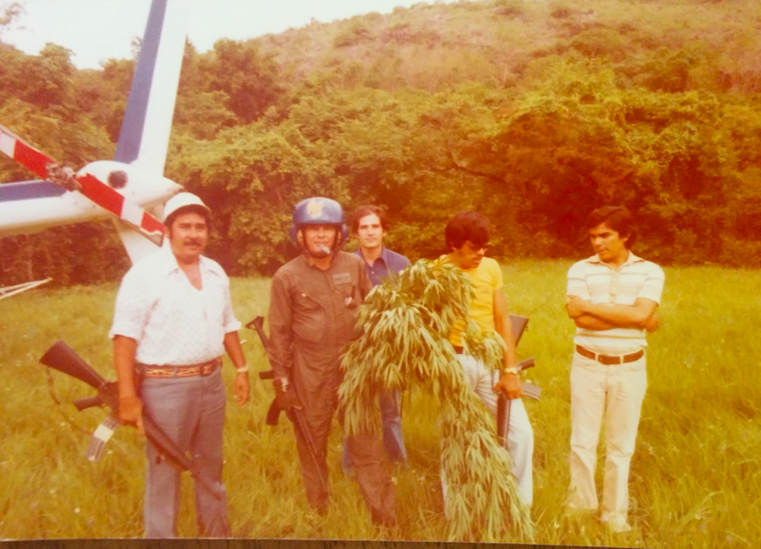

Slide 22
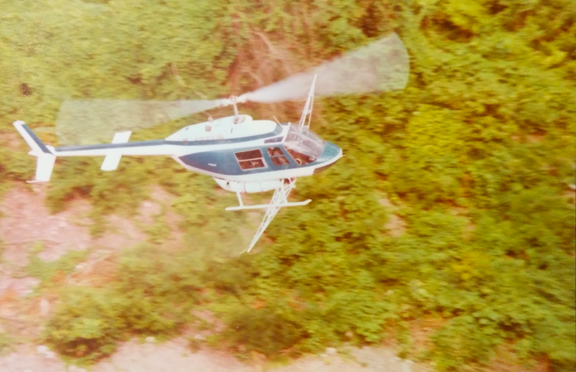

Slide 23
The cost
Marijuana and heroin trafficking did decrease. From around 90% of U.S. market in 1975 to 30-40% by early 1980s.
Human Rights
Murder of peasants
Mass migration of peasants from rural areas to cities
Torture of suspects
Broad distrust of state

Slide 24
Federal government doesn’t want to lose income from trade.
So federal police (PJF) take over the local protection rackets. They now charge traffickers for protection.
This involves:
Killing of state police (especially in Sinaloa).
Arrest/killing of certain major traffickers.
Extortion of other traffickers.
Then cooperation with these traffickers. (e.g. Guadalajara cartel)
Shift towards cocaine trafficking through Mexican airports (less obvious to Americans)

Slide 25
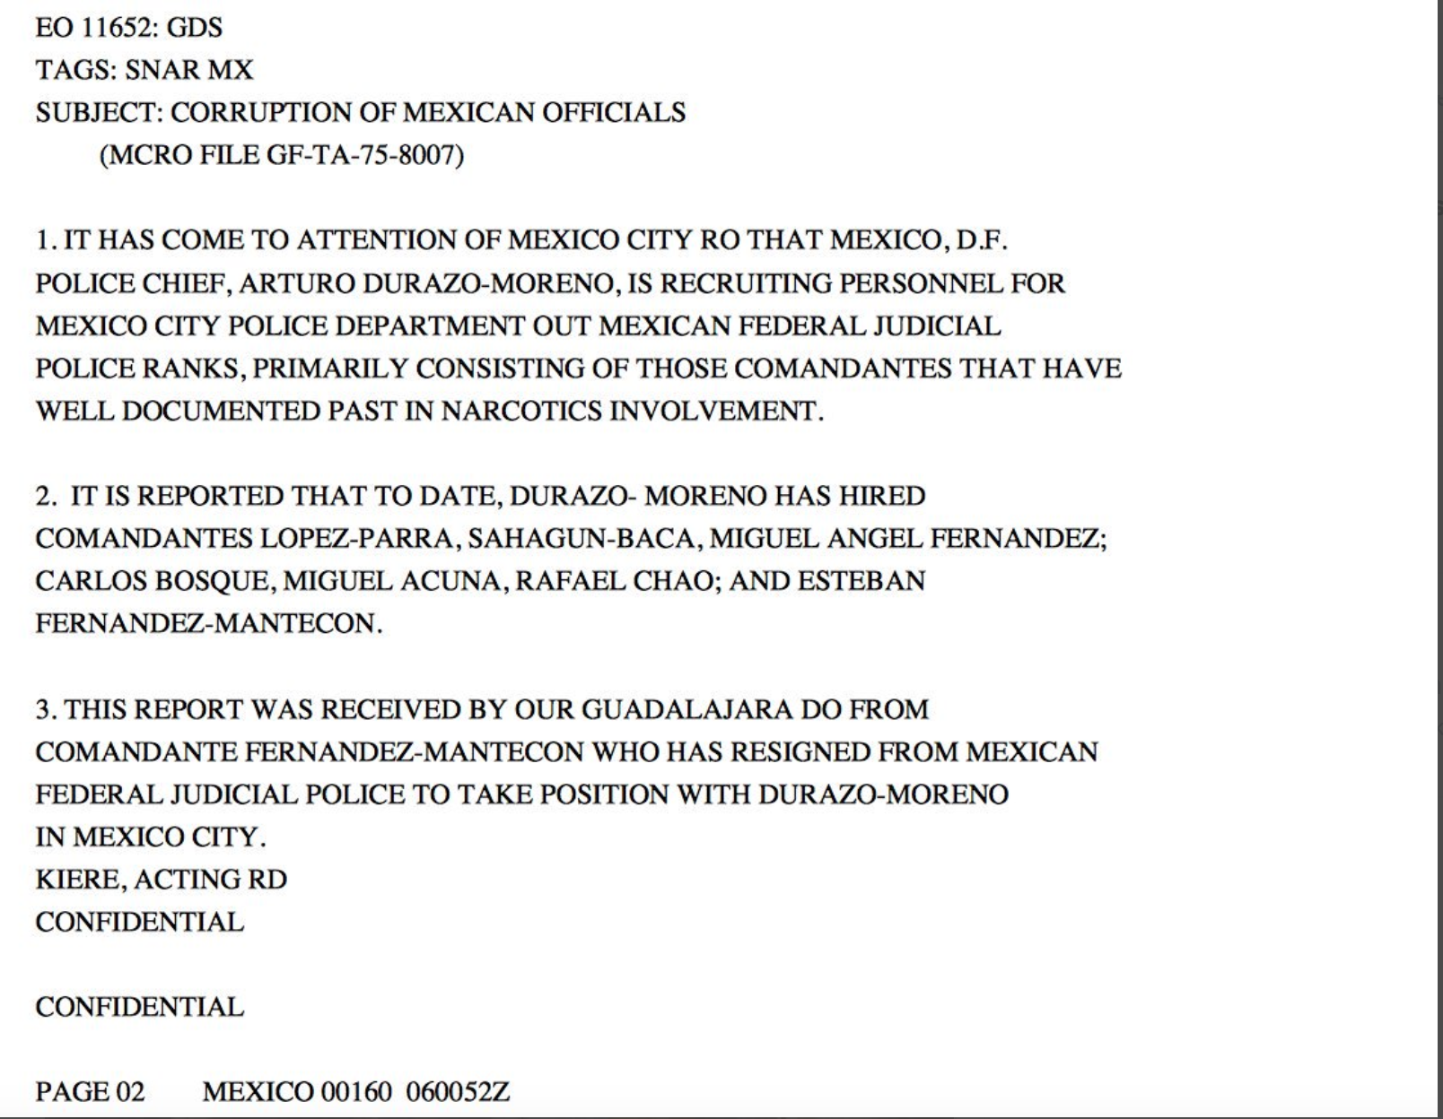

Slide 26
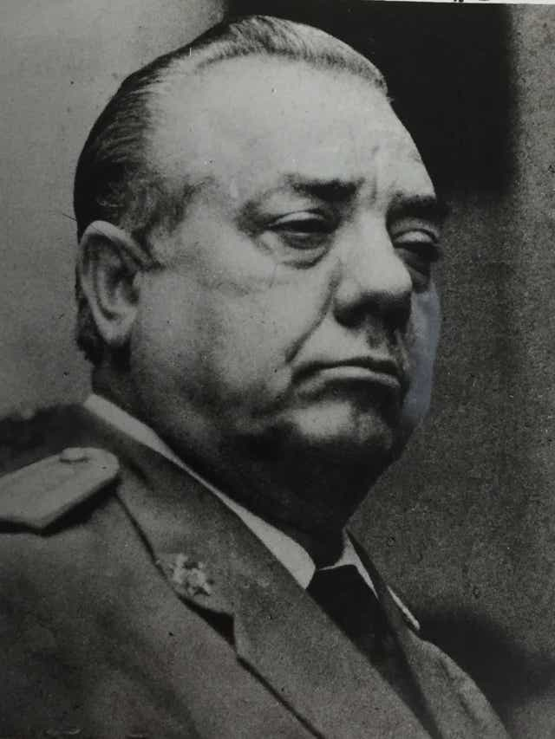
Arturo “el Negro” Durazo

Slide 27
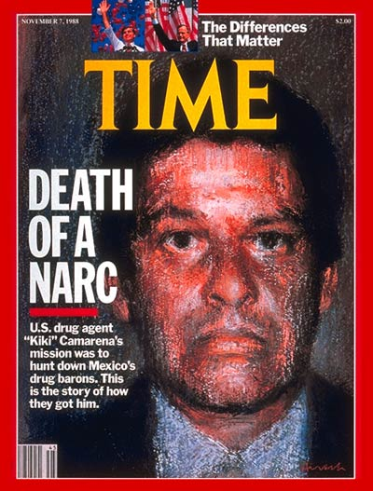
Developments: Camarena affair
1982 DFS (secret service) takes over or at least shares control with PJF.
1982 U.S. starts to close down Colombia-Florida cocaine route
1985 DEA agent Enrique Camarena killed.
DFS closed.
1985-early 1990s System of state control continues

Slide 28
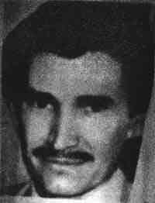
Miguel Angel Felix Gallardo

Slide 29
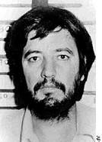
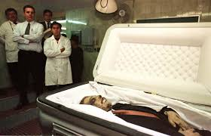
Amado Carrillo Fuentes

Slide 30
Stage 4: Cracks in the System, 1990s-2006
Two massive structural changes
Neoliberalism.
Increase in transborder trade. Mexico becomes THE only place to traffic drugs to U.S.
Crushes peasant farmers through removal of import tariffs. Peasants have 3 options - grow narcotics, migrate to cities (where they can’t find work), or migrate to U.S.
Crushes Mexican industry. Large unemployed, male urban, population
Democratization
As opposition parties win municipal, and then state elections, old control arrangements break down.
Opposition parties soon realize that narcotics as source of electoral funding and enrichment.

Slide 31
The Cartel takeover
The two developments flood cartels with money AND undermine the PRI’s ability to control the drug protection rackets.
Cartels now start to run protection rackets. They charge money in return for protection.
For the first time drug traffickers gets violent. Running protection rackets is completely different from drug trafficking.
They employ armies of young men (sicarios) to practice extortion.
They kill those who don’t pay.
They occasionally work with state governments and occasionally against them. E.g. in Ciudad Juárez the sicarios were state policemen.
They compete with one another over who charges protection in certain zones.

Slide 32
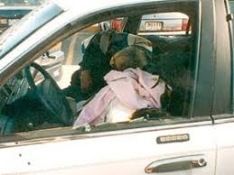
Divisions
1992-3: Sinaloa Cartel/Federation vs Tijuana Cartel

Slide 33
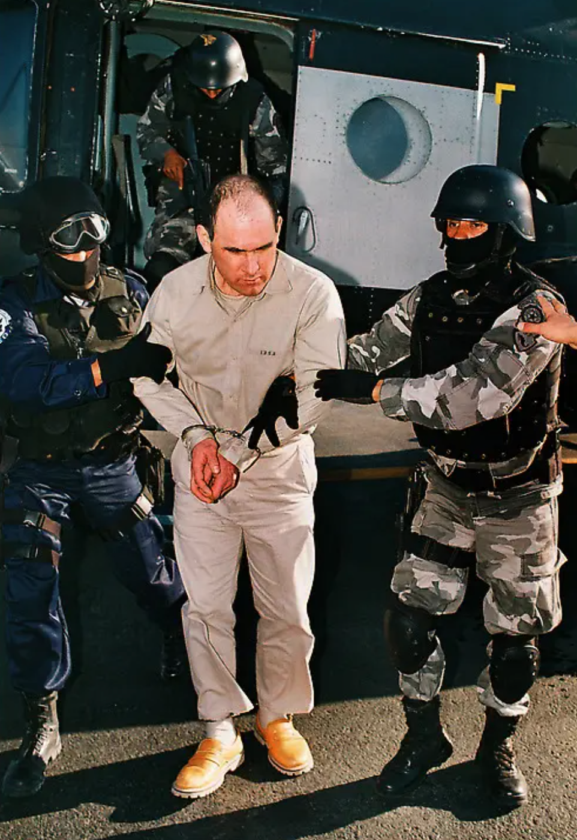
2004-5: Sinaloa Cartel/Federation vs Gulf Cartel

Slide 34
Stage 5: War and Total War, 2006-2022
2006 Felipe Calderon narrowly wins election. To boost legitimacy announces militarized war on drug cartels.
2006-2012 70-100,000 killed
Conflicts between military and heavily armed drug cartels (2004 end of U.S. automatic weapons ban)
Fragmentation of cartels into smaller units. Conflicts between these for trafficking routes:
Juarez cartel, Tijuana cartel, La Familia, Gulf Cartel, Zetas, Knights Templars, Cartel Jalisco Nueva Generación, Beltran Leyva Cartel
Increasing outsourcing of violence to military/paramilitary units e.g. Zetas, Kaibiles, Maras.
Heavy set-piece battles in Ciudad Juárez (2009-11) and Sinaloa (2008-11)
Increasingly public use of violence

Slide 35
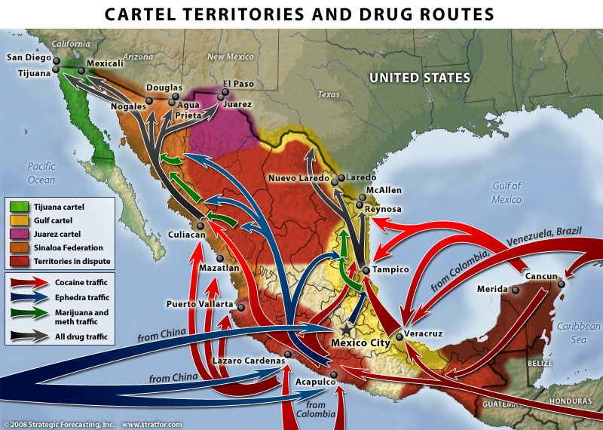

Slide 36
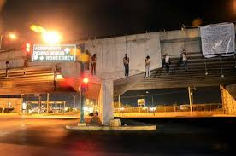
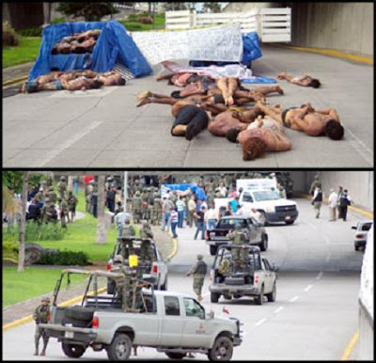
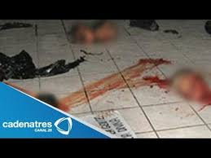

Slide 37
Developments, 2012-2022
Michoacán/Guerrero. Civil society takes matters into own hands and forms self-defense forces. These are funded/infiltrated/corrupted by rival drug gangs.
Legalization of marijuana in U.S./reduced access to borderpushes groups towards “polycrime” business – extortion, kidnapping, organ trafficking, human trafficking.
Crime/murder rates dip then soar to 2006-2012 levels.
Increasingly people blame federal government (El Chapo escape, Ayotzinapa)

Slide 38
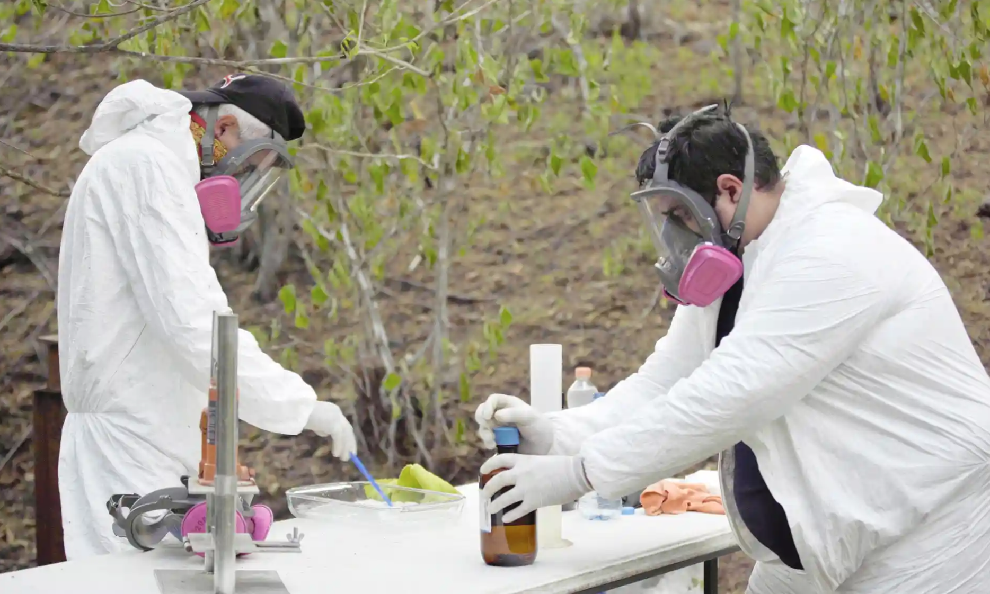
The Drug Trade in Mexico continues despite violence
Currently US drug trade estimated to account for $100 million. Mexico estimated to gain $30 million.
Until recently Mexican drug use was minimal.
Currently Mexican drug cartels grow
Opium poppies
Marijuana
They also make
Fentanyl
Methamphetamines
They also traffic
Cocaine

