Slide 1
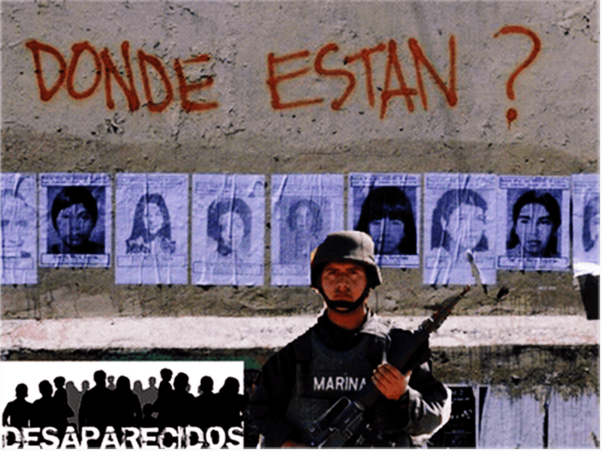
The Dirty War: Guerrillas and Counter-Insurgency

Slide 2
The Early Guerrilla Movements
What is the difference between a guerrilla movement and a land invasion or violent attempt to unseat an unpopular mayor?
Is it a matter of shifting ideologies and strategies OR official framing? Or is it a dynamic between these?
During the 1960s, popular mobilizations were recast as “guerilla insurgencies”. Governmental repression pushed them towards more radical tactics.
https://cmdpdh.bandcamp.com/album/concursos-corridos-rosendo-radilla

Slide 3
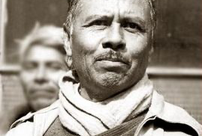
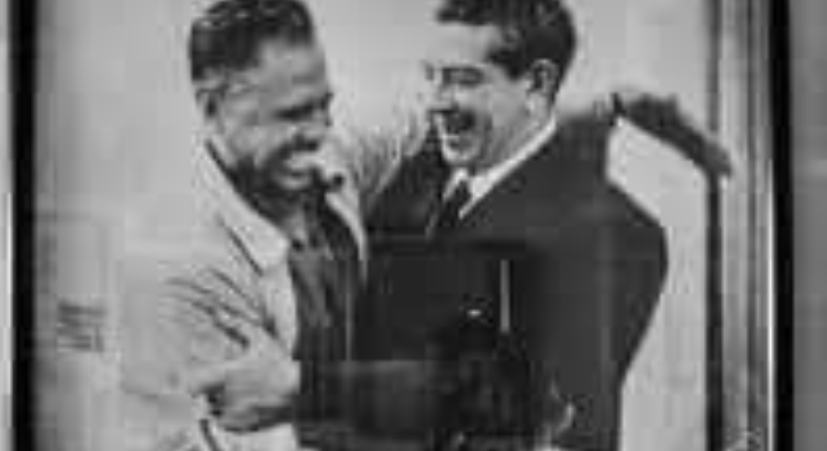
Ruben Jaramillo, Morelos
Former Zapatista from Tlaquitenango, Morelos.
1940s and 1950s, pushed for more political control for peasants and greater land distribution.
Worked WITHIN electoral system, attempting to become governor of Morelos in 1946 and 1952.
1953 led armed revolt against government. But President Adolfo López Mateos pardoned him in 1958.
1962 Helped peasants squat on ejido land that had been annexed by cattle farmers.
May 23 1962. Jaramillo, his wife and his pregnant daughter murdered by federal police.

Slide 4
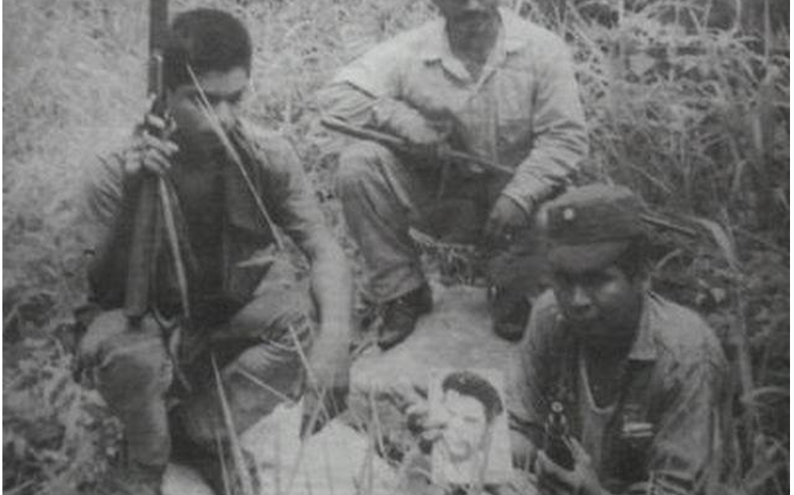
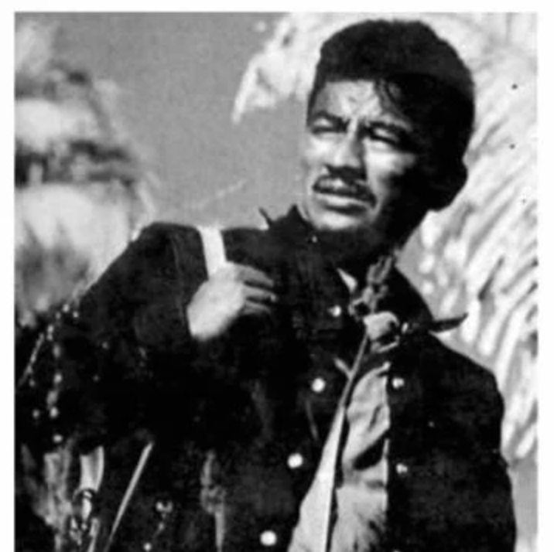
Genaro Vázquez Rojas in Guerrero
Genaro Vazquez was a rural teacher.
Cut teeth in 1958 Mexico City teachers’ movement.
1958-1960, Leader of Guerrero Civic Association. Organization aimed to:
  Impose land reform
  Gain control of municipalities
  Remove governor of Guerrero
December 1962 Massacre of Iguala. 28 demonstrators killed.
1962-1966 Vazquez in hiding. Arrested, then busted out of jail in 1968.

Slide 5
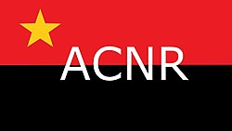
Genaro Vázquez’
Asociación Cívica Nacional Revolucionaria.
1968-1972 Vazquez forms the Asociación Cívica Nacional Revolucionaria.
  1969 Attacked Mexican Commercial Bank, stole 3 million pesos
  1971 Kidnapped head of Commercial Bank of the South.
  1971 Kidnapping of head of Coca Cola concession
  1972 Genaro Vázquez is captured by army and “dies from his wounds”

Slide 6
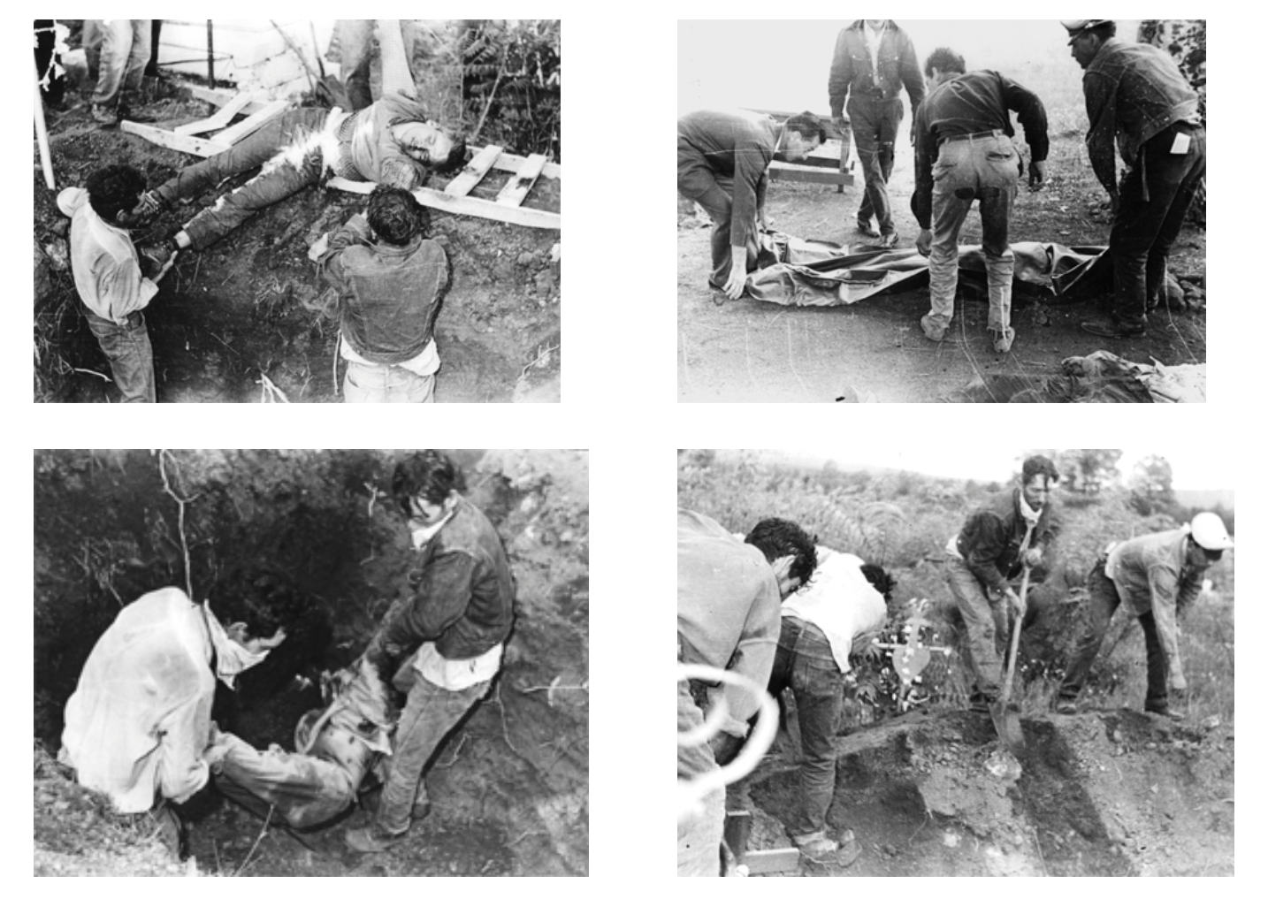
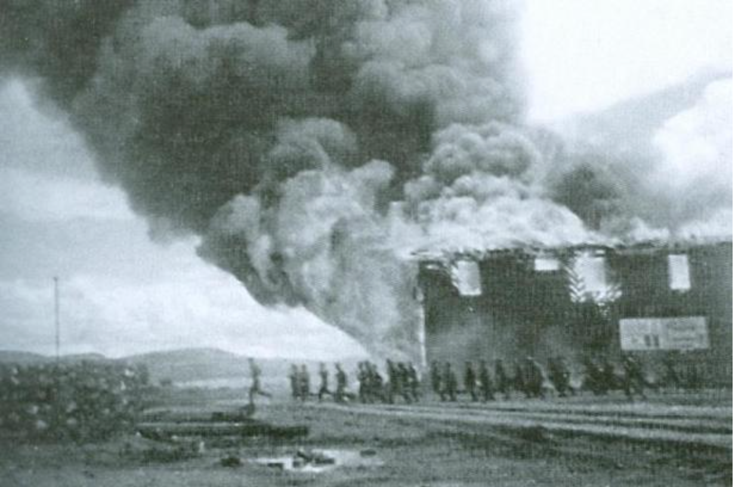
e.g. Ciudad Madera attack 1965
1962-1965. Peasant organizations in Chihuahua had complained that large landowners were robbing them of their lands.
1964. Peasants attempt to build broad coalition with students, teachers, and handful of sympathetic politicians.
1964. Riots at visit of presidential candidate, Gustavo Díaz Ordaz.
23 September 1965. Hardcore of peasants and teachers attack barracks at Ciudad Madera. They are captured and killed.

Slide 7
Post 1968 Guerrilla Movements
After student uprising of 1968 and subsequent repression, many students started their own guerrilla organizations.
Questions:
To what extent were they continuing a Mexican tradition of protest, or to what extent were they influenced by guerrilla movements in Cuba, Vietnam, Colombia etc.?
How influential or powerful were these movements? Were they small minorities? Or were they much larger networks and played down by the Mexican government?
To what extent were they pushed into violent acts? Or were some of these violent acts deliberate “false flags” stoked by a government wanting to discredit them?

Slide 8
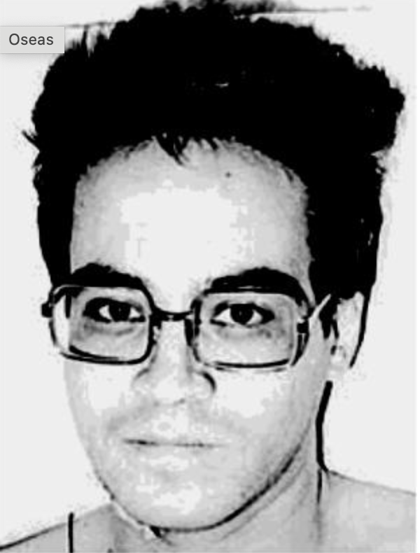
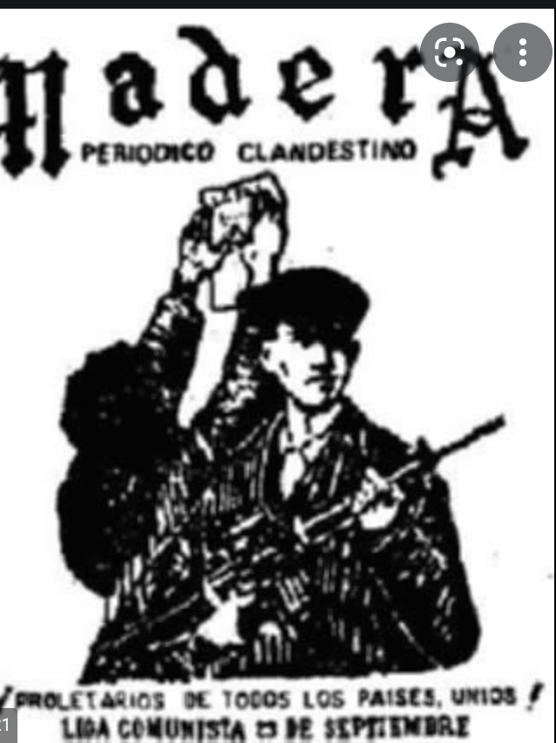
Liga 23 de Septiembre (Ciudad Madera)
Formed 1967 in Sonora by survivors of Ciudad Madera. Headed by Salvador Gaytán. Staffed predominantly by student radicals.
Concentrated in north around states of Nuevo León, Sinaloa, Sonora, and Jalisco.
A confederation of local organizations, with different local characteristics. In Monterrey, influence of relatively wealthy, upper middle-class followers of Liberation Theology. In Sinaloa, support from migrant agricultural workers.
But specialized in kidnapping and assaults:
  Murder of Eugenio Garza Sada, beer magnate of Monterrey, 1973
  Murder of Fernando Aranguren, Jalisco industrialist, 1973
  Kidnapping of US consul in Guadalajara, 1973

Slide 9
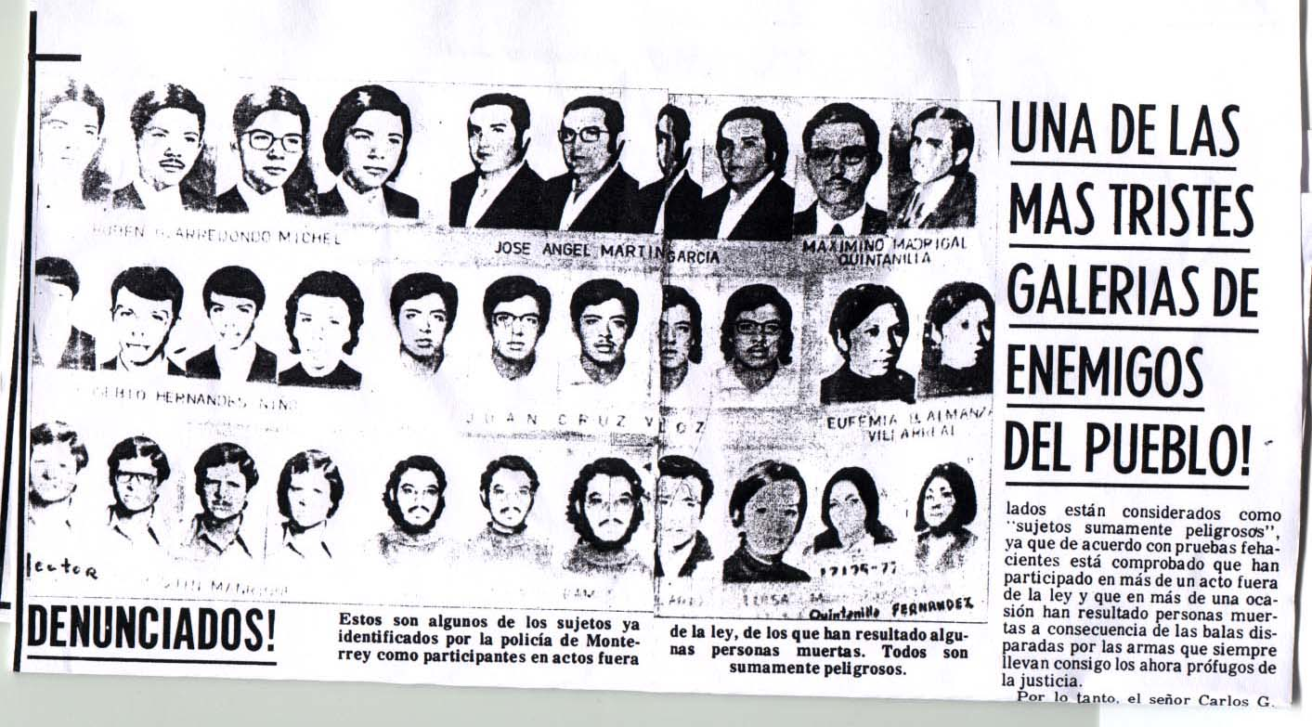
“ONE OF THE MOST SHAMEFUL GALLERIES OF ENEMIES OF THE PEOPLE”

Slide 10
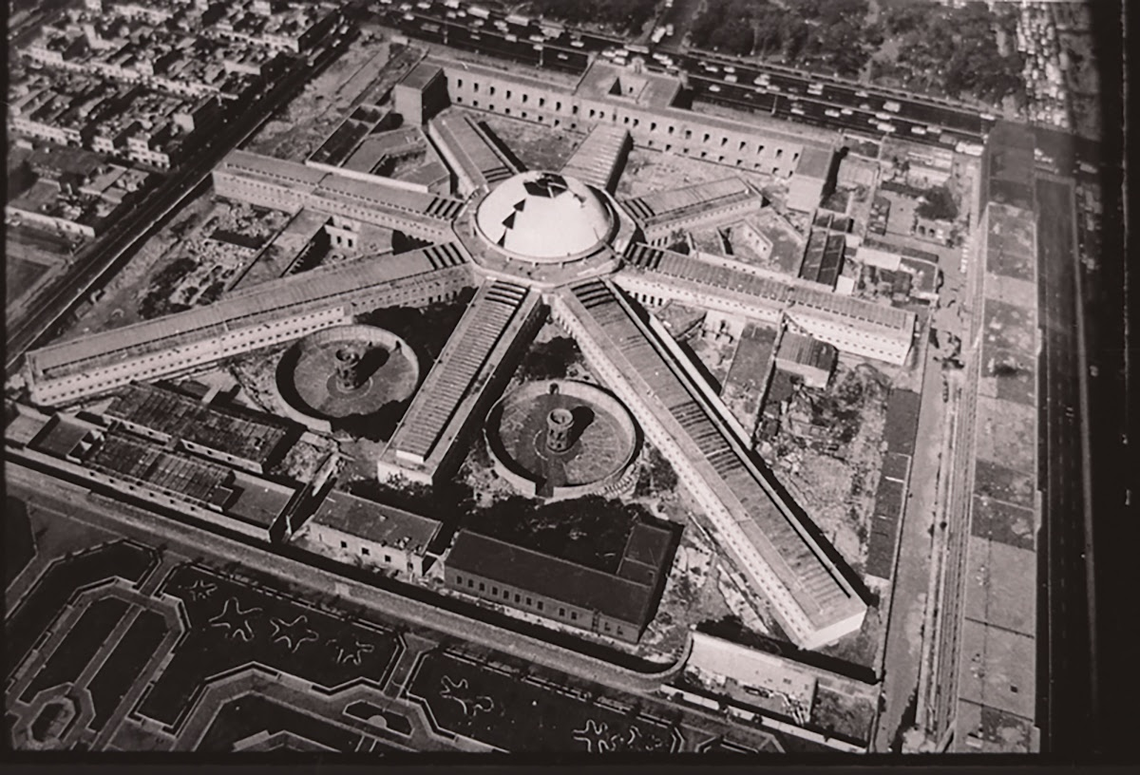

Slide 11
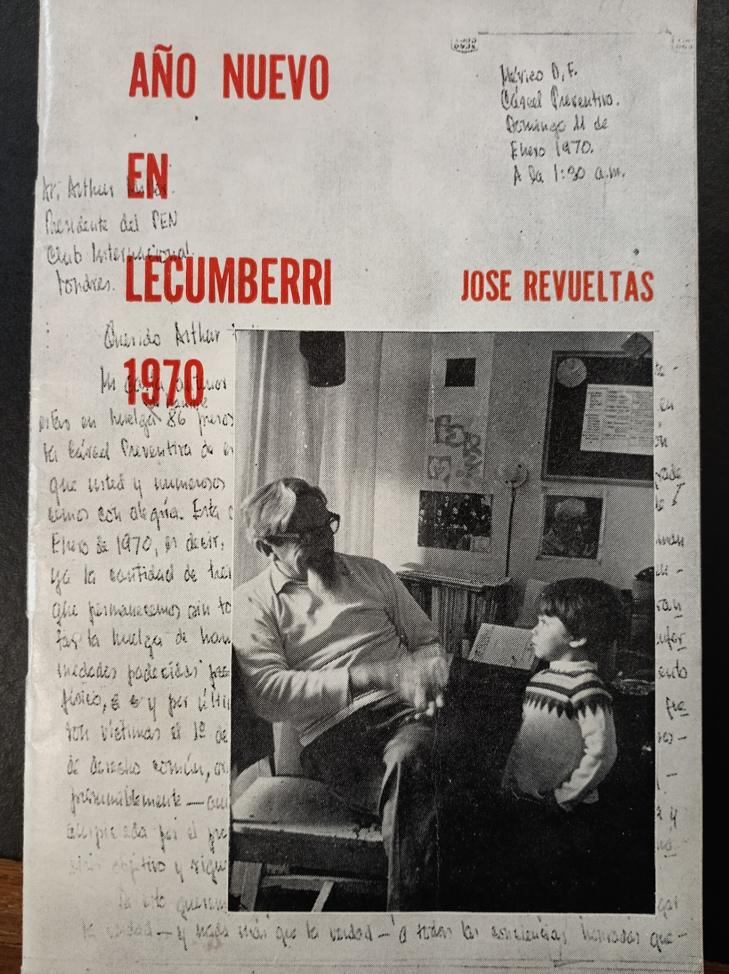
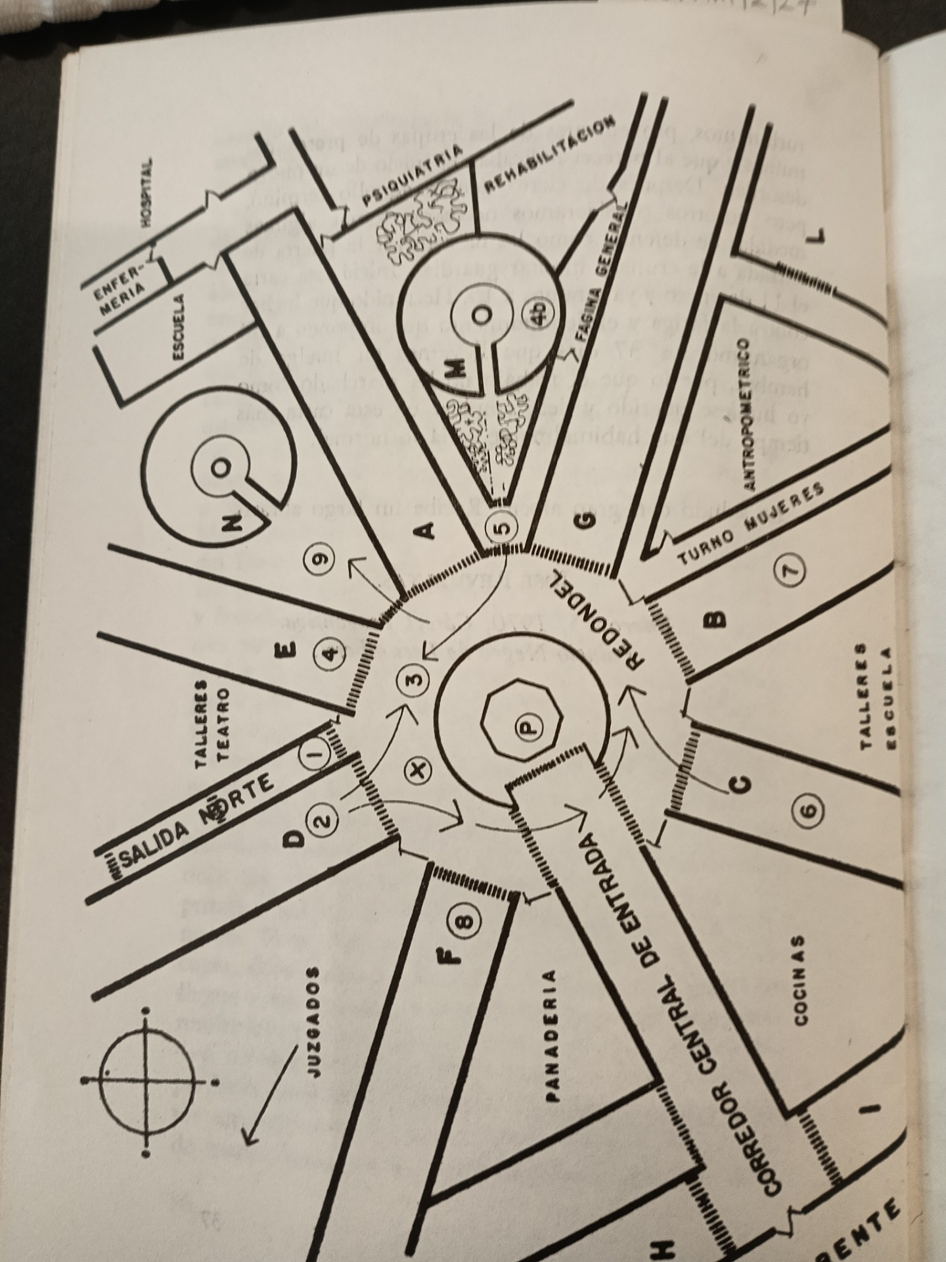

Slide 12
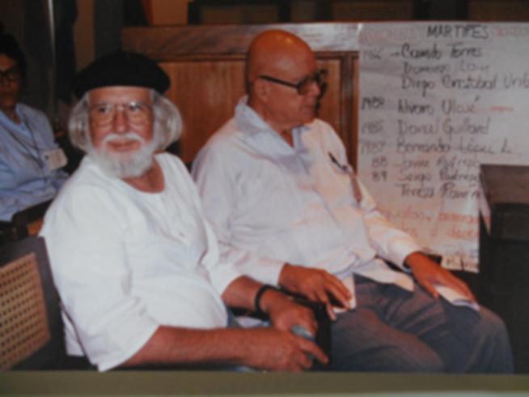
Liberation Theology
Eg. Sergio Méndez Arceo,
the “Red Bishop” of Cuernavaca
1968 Condemns the Tlatelolco Massacre
1971 Confronts Fidel Velázquez (CTM). Organises a priests’ strike in defence of local independent labour unions.
1972 attends Cristianos por el socialismo meeting in Chile
1972-74 Cristianos por el socialismo, Sacerdotes para el Pueblo.
1976 Arrested in Ecuador alongside 12 other Latin American Bishops
1978 visits Cuba with Ernesto Cardenal and Alfonso Carlos Comín. They co-author Reflexión Cristiana en Cuba
1979 Visits Nicaragua as a guest of the Sandinista Government
1979 Mexican Episcopal Conference try and fail to get him to stand down.

Slide 13
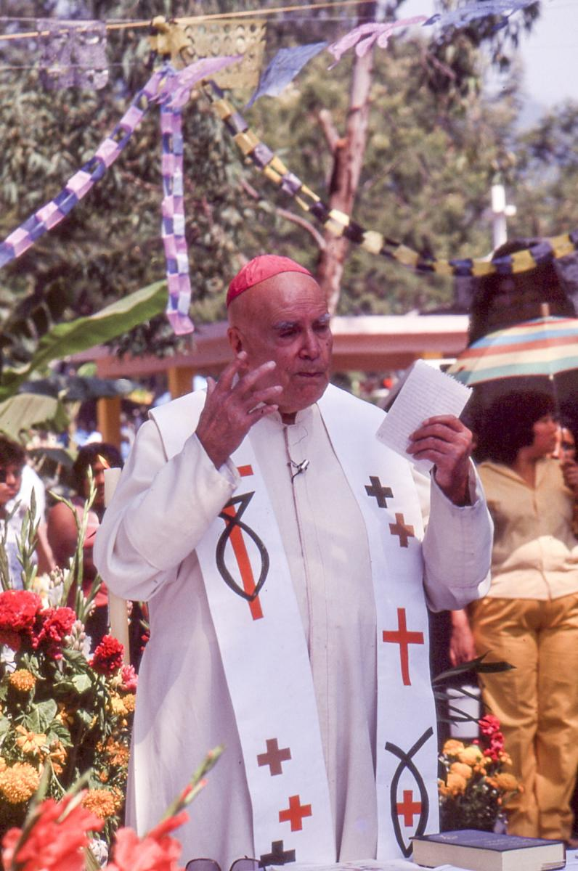
The Development Ministry
“More than half of the rural population and a considerable proportion of the urban population make up the marginal population who cannot meet their basic needs to food, housing, basic education etc. These are indigenous people, many ejidatarios,landless peasants, minifundistas with limited resources and settlers who live in misery in the deprived outskirts of our cities made up primarily of people with no stable or fixed occupation and with exceedingly low incomes.”
Pastoral Letter on the Development and Integration of the Country, Mexican Bishopric, 26 March 1968.
Ejidatarios = Those with access to communally held lands for farming. Ejidos or communally farmed plots were central to article 27 of the revolutionary constitution of 1917 relating to agrarian reform.

Slide 14
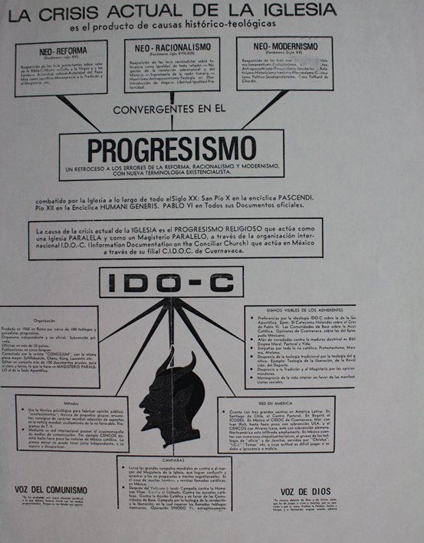

Slide 15
Reflexión Cristiana en Cuba, 1978
“A partir de ese hacerse revolucionario con los revolucionarios, el cristianismo podrá vivificarse, ser sal de la tierra, y por supuesto, cumplir sus responsabilidades; entre ellas, la denuncia profética contra toda injusticia, contra toda la violación de la persona en el complejo proceso de la lucha de clases que hoy vive la humanidad enfrentada al imperialismo.”
https://www.lajornadamorelos.mx/opinion/recordando-a-mendez-arceo-2/

Slide 16
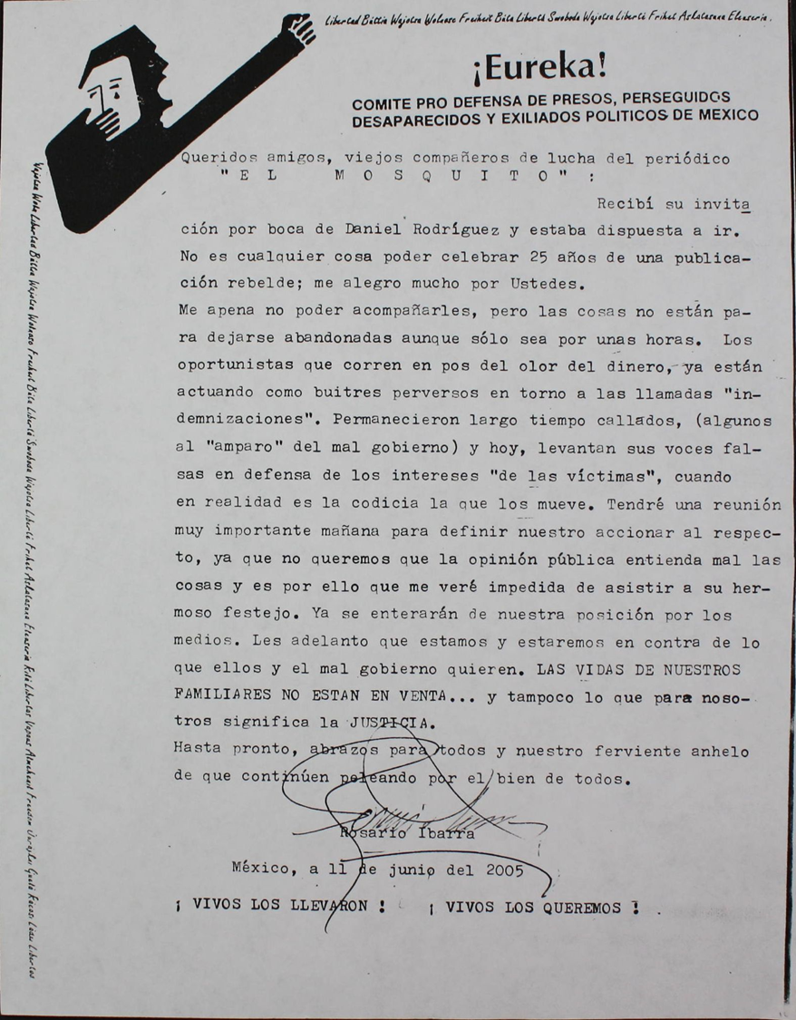
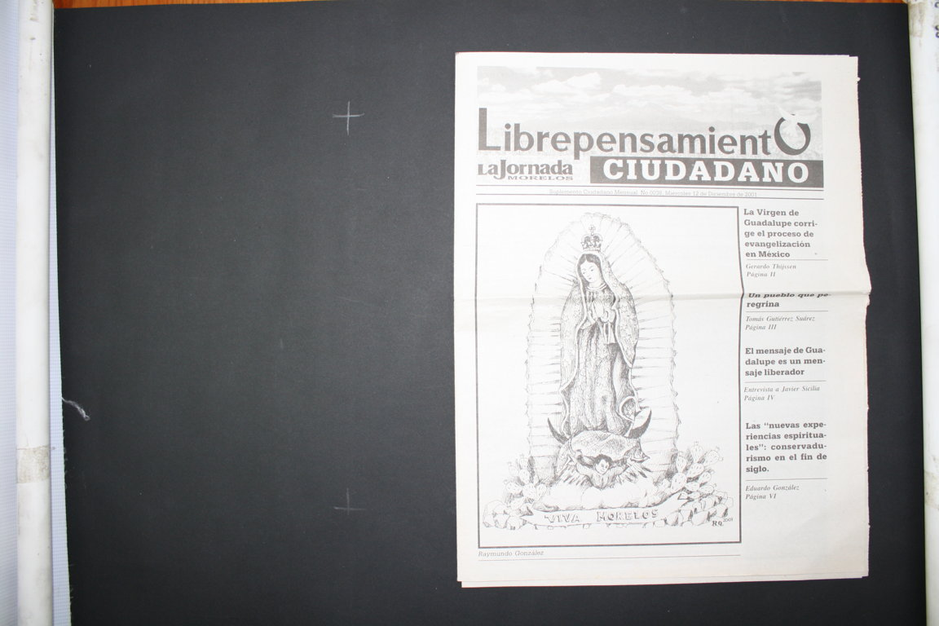

Slide 17
Counter-insurgency
Unlike other Latin American countries (Guatemala, Argentina, Chile), Mexican authorities have played down extent of dirty war.
Official numbers of dead and disappeared stand at around 500. Others quote numbers in the 1000s. Conservative estimate now around 1200.
However, between 1960 and 1982, Mexico like other Latin American countries used a mixture of security specialists and military and paramilitary forces to put down guerilla groups.

Slide 18
Growing push among historians and activists to challenge myth of Mexico’s limited dirty war
2002 Vicente Fox publishes report on Mexican Dirty War which claims that army and security forces “tortured, disappeared, and murdered hundreds”.
Special prosecutor’s office claimed that the report was “overly biased against the military”
Repeated attempts to discover what happened:
  Discoveries of mass graves on Guerrero army base http://www.reuters.com/article/2008/07/08/idUSN08316698

Slide 19
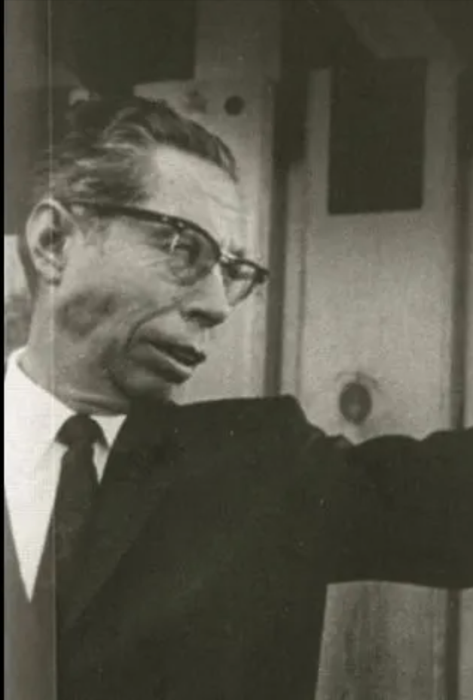
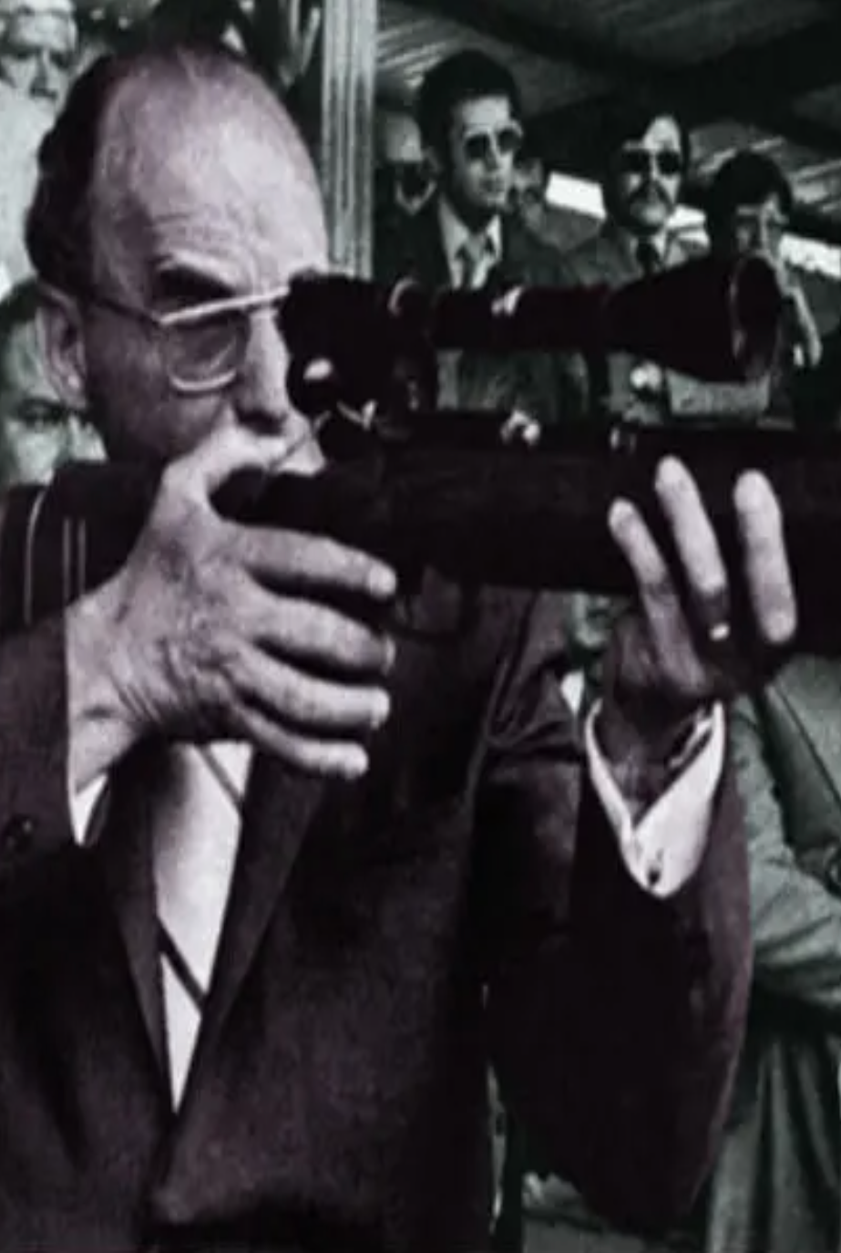
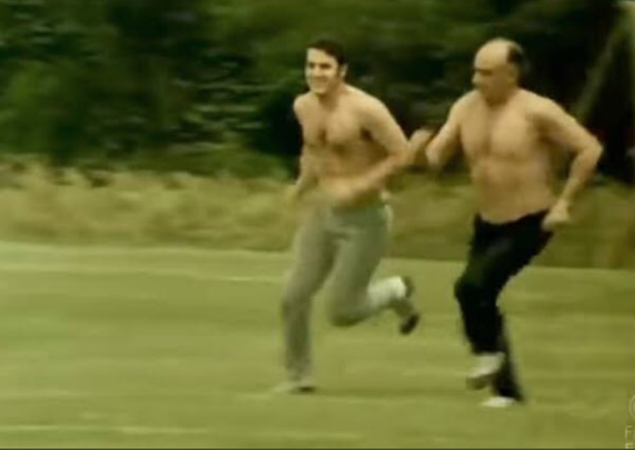
The Presidents
The three presidents involved in major counter-insurgency operations were:
Gustavo Díaz Ordaz (1964-1970)
Luis Echeverria (1970-1976)
Jose López Portillo (1976-1982)

Slide 20
The army
Compared to other Latin American countries, Mexico did not witness heavy militarization.
Military budget as percentage of spending barely increased.
But, 1960 20 percent of municipalities had garrisons
Army often sent in force to deal with specific problems.
E.g. Operation Condor (1976-1980) was anti-narcotics operation BUT focused on regions with guerilla insurgencies (Guerrero, Chihuahua, Sinaloa) AND often neglected anti-drugs focus and targeted guerilla groups.

Slide 21
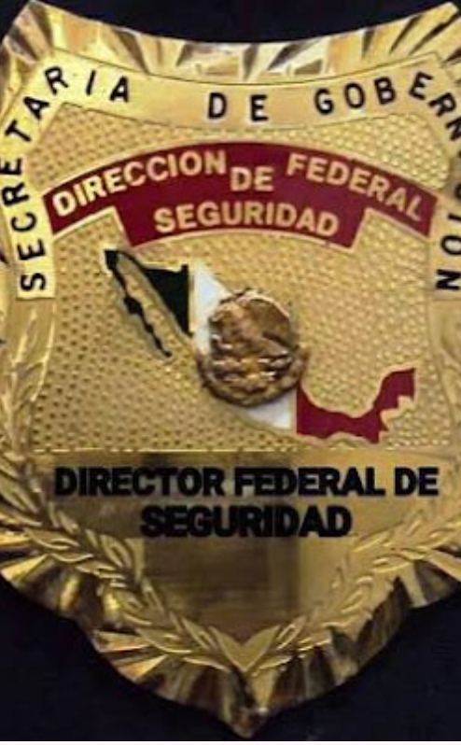
The Security Forces
Mexico had two security forces run by the Ministry of the Interior:
  Direccion General de Investigaciones Políticas y Sociales (DGIPS)
  Dirección Federal de Seguridad (DFS)
  DGIPS understaffed primarily an information-collecting agency. In 1964 only had 38 agents, 4 secretaries and a driver. Seven described as “incompetent”.
  DFS created in 1947 by President Alemán to counter communist threat. 1947- 1965, the DFS relatively weak. In 1965 120 members. (FBI 6000).
  1970s DFS became the President Echeverria’s key counter-insurgency force. Employees up from 120 to 3000.

Slide 22
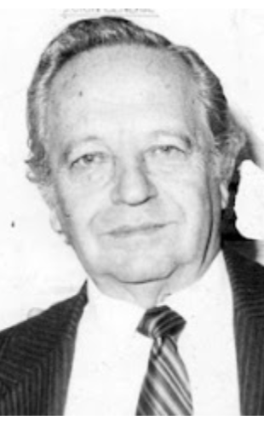
DFS was led by Miguel Nazar Haro.
Heavily involved in counter-insurgency measures in Guerrero, Sinaloa, Nuevo León and Jalisco especially against urban groups like Liga 23 de Septiembre.
By 1980s took control of drug trafficking in Mexico in league with the Guadalajara cartel led by Miguel Angel Felix Gallardo.
Disbanded in 1985 as linked to murder of DEA agent, Enrique Camarena.

Slide 23

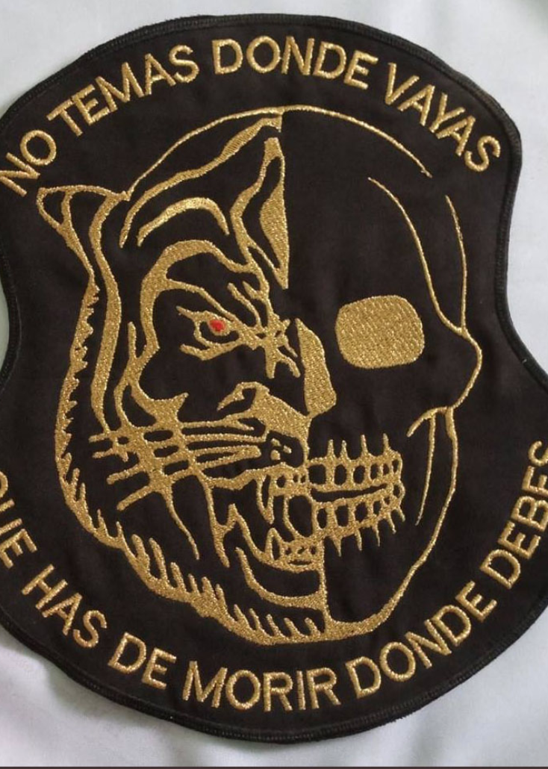
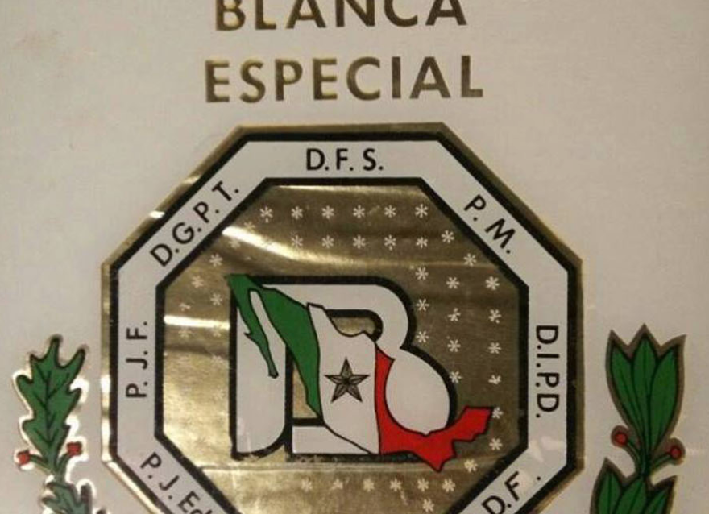
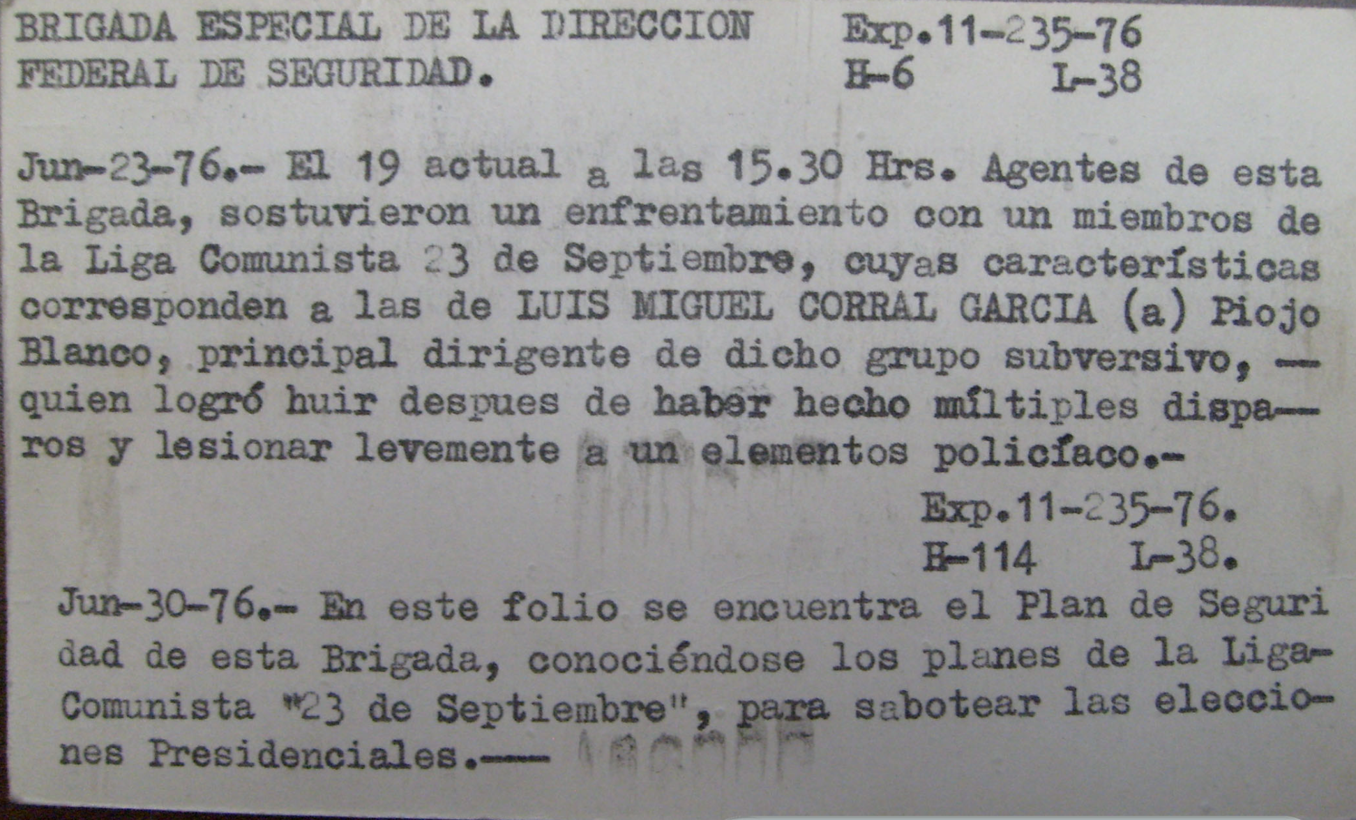
Brigada Blanca
Created in 1972 by 240 members of DFS and Judicial police to “aplastar” the Liga Comunista 23 de septiembre.
After DFS captured members of organization, Brigada Blanca was charged with “disappearing” the suspects.
Originally worked in Jalisco, Sinaloa, and Guerrero. 1976 President Echeverria moved focus to Mexico City to combat urban squatters.
https://sitiosdememoria.segob.gob.mx/es/SitiosDeMemoria/Multimedia

Slide 24
Paramilitaries
Local governments, local landowners, and DFS also employed both individual pistoleros and paramilitaries to take out suspected leftists.
In Sinaloa, Guerrero and Jalisco DFS employed drug traffickers to do their dirty work. (see work of Alex Aviña, Adela Cedillo and Sergio Aguayo)
In Hidalgo, large landowners employed ranchers to kill Nahua land invaders. (see Frans Schryer, Ethnicity and Class)

Slide 25
The problems with measuring the dirty war
The victims
  Many of the victims were card carrying members of left-wing organizations.
  But many were not. Many were simply local peasants.
  Many were killed by local caciques or as part of other operations (particularly anti-narcotics).
The murderers
  Although we can broadly estimate murders mentioned in CIA, DGIPS and DFS files, what about murders done by off-the-books organizations and pistoleros?
  What about hidden graves, tactic of dropping victims out of planes and helicopters?

Slide 26
The significance of the dirty war
According to CIA and DFS, there were over 40 guerilla organizations operating in Mexico during 1970s.
What denotes a guerilla organization?
How much popular support did these organizations possess?
How to explain relative stability of era compared to rest of Latin America? Was this a myth?

Slide 27
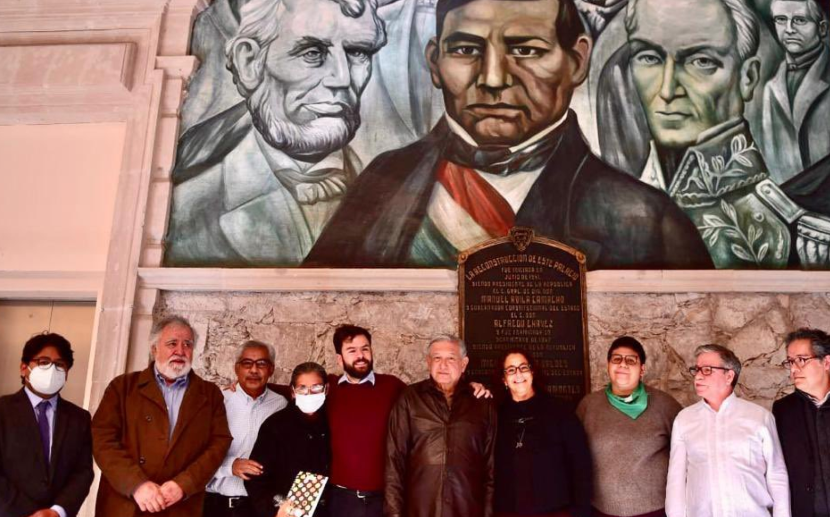
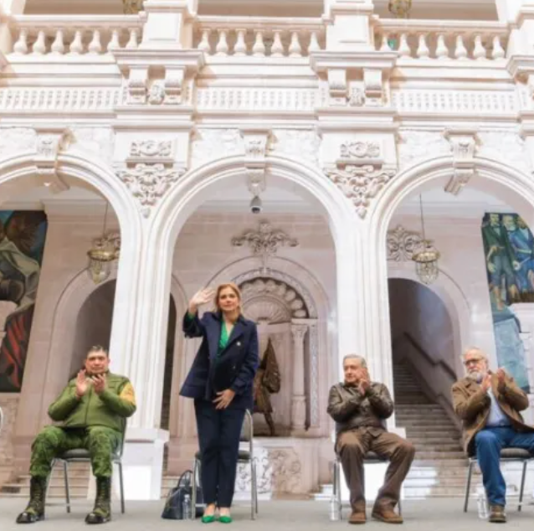
Truth and Reconciliation Commissions
Other Latin American countries have installed Truth and Reconciliation commissions in order to discover the truth behind the dirty war. In some cases (Argentina and Guatemala), they have brought authorities to trial.
2002 President Fox attempted to install similar commission in Mexico but failed.
2014 State-level truth and reconciliation of Guerrero publishes findings. Report buried under news of Ayotzinapa massacre.
2021 President López Obrador introduces new Truth and Reconciliation Commission
Memory and forgetting.
  How has lack of commission affected collective memory of PRI years?
  Did lack of commission play into PRI’s re-election in 2012?

