Slide 1
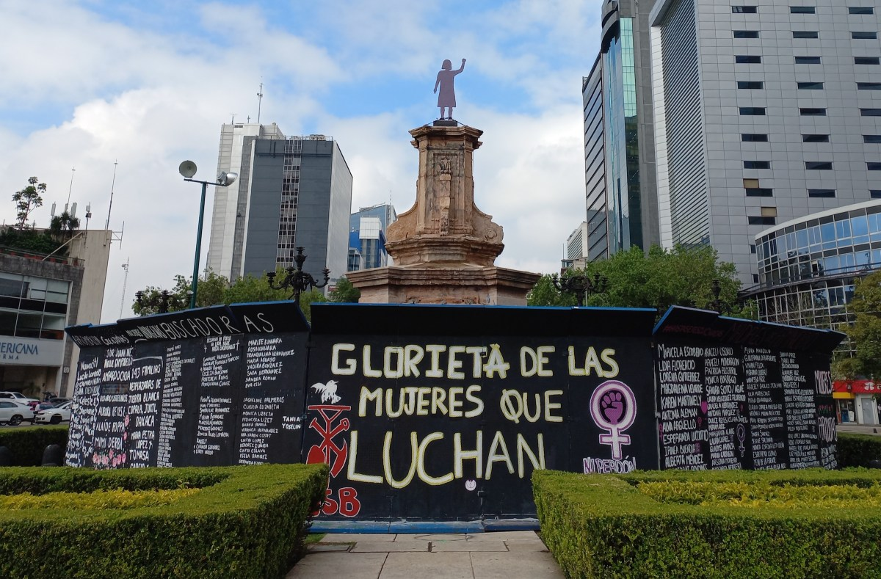

Human Rights and Transitional Justice in Mexico

Slide 2
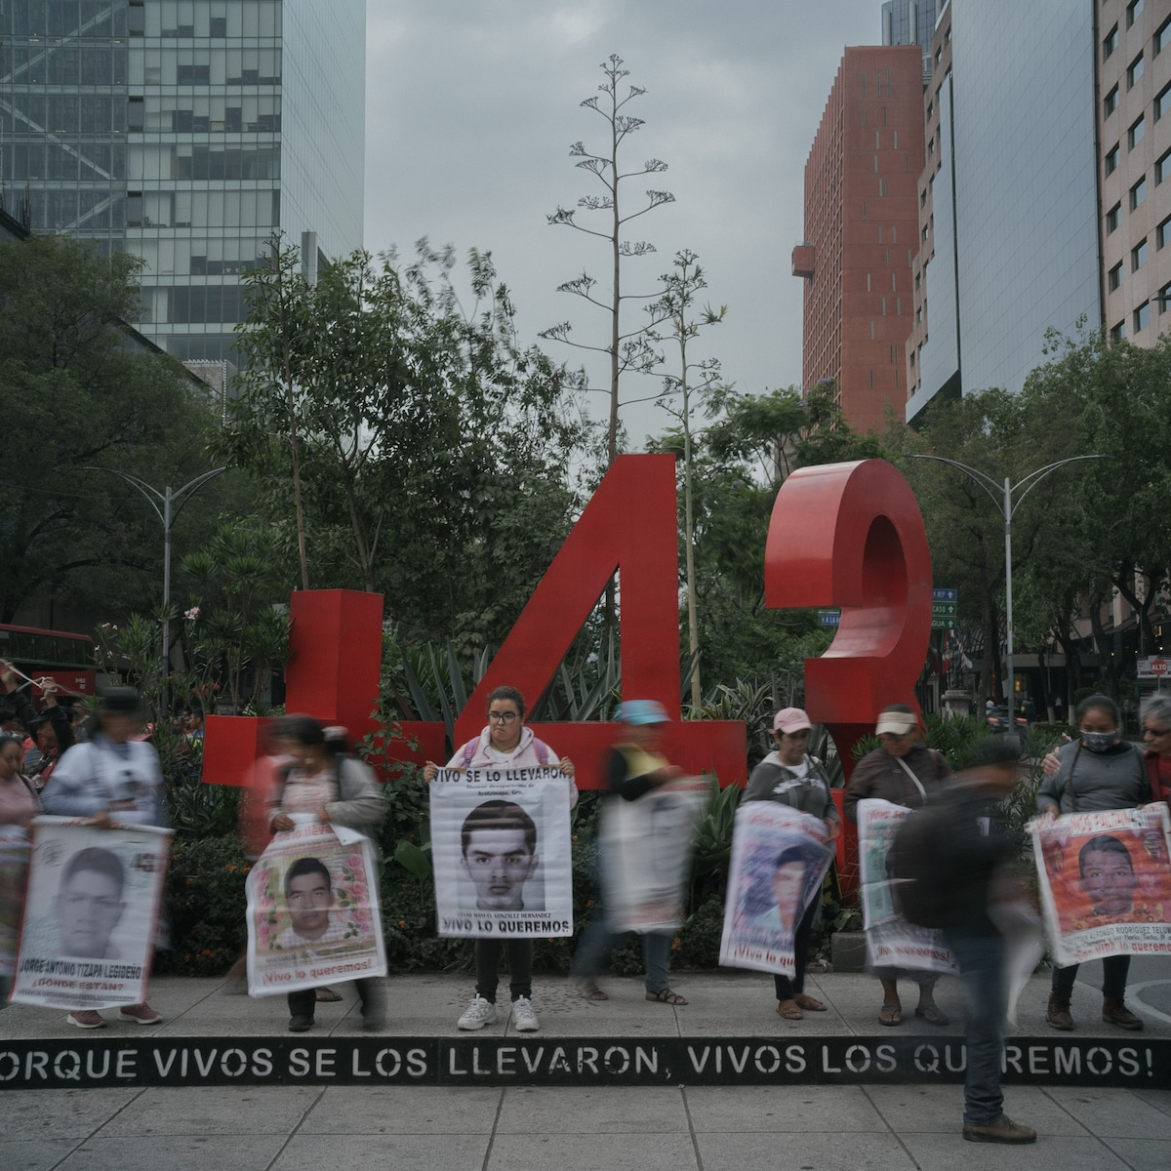
Human Rights Issues and Legislation: Human Rights, Violence and Justice
Race and indigeneity
Torture and forced disappearance
Violence against:
Women
Indigenous groups
Journalists
Human Rights Defenders
Migrants
Impunity is a major concern- Truth and Justice

Slide 3
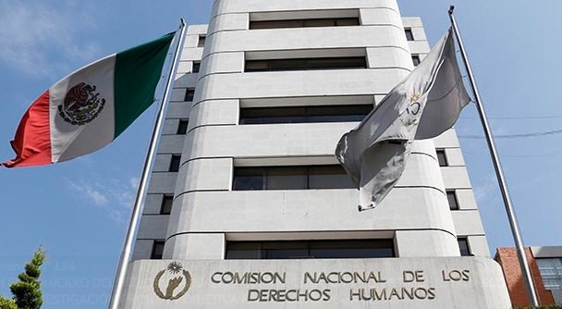
National, Inter-American and International Institutions
Since 1945-The United Nations
Since 1959- Inter-American Commission on Human Rights (IACHR) Organization of American States (OAS)
Since 1979- Inter-American Court of Human Rights (OAS)
Since 1990- Comisión Nacional de los Derechos Humanos (Mexico)
2011, the Mexican Constitution amended to state that international human rights treaties are part of Mexican law and are binding on all authorities at all levels, country-wide.

Slide 4
National Development Plan 2013-2018
Objetivo: 1.5 Garantizar el respeto y protección de los derechos humanos y la erradicación de la discriminación.​​​
Estrategia 1.5.1 Instrumentar una política de Estado en derechos humanos​​

Slide 5
Recent Developments
2024 Report: Informe del Mecanismo para la Verdad y el Esclarecimiento Histórico “Fue el estado.”
http://www.meh.org.mx/especial-informe-final/
https://nsarchive.gwu.edu/news/mexico/2024-08-19/truth-commission-documents-25-years-state-violence-during-mexican-dirty-war
2021 Commission for Access to Truth, Historical Clarification and the Promotion of Justice for serious human rights violations committed between 1965 – 1990
Transnational Mechanism for Access to Justice for Migrants
2020 Search Table for Disappeared Migrants (MBPMD) within the National Search System (SNBP).

Slide 6

Civil and Political Rights and Socioeconomic Rights
1981 Mexico signs and ratifies the International Covenant on Economic, Social and Cultural Rights (1966-in force 1976)
1981 Mexico signs and ratifies International Covenant on Civil and Political Rights (1966, in force 1976)

Slide 7
Human Rights and Indigenous Rights
1989- Organisation (ILO) Convention 169 on the Rights of Indigenous and Tribal Peoples which was ratified in 1989 and came into force in 1991. It provided the framework for self-determination of formerly colonised peoples in independent countries “who, irrespective of their legal status, retain some or all of their own social, economic, cultural and political institutions.” It included titles on land, employment, vocational training and rural industries, education and means of communication and contacts and cooperation across borders. The emphasis throughout was on consultation with communities regarding any governmental development, educational or cultural project impacting their lives.
1990 ILO Convention 169 ratified by the Mexican government. Convention, which was binding for signatory states. Followed by a period of reform known as the ‘politics of recognition’; judicial and legislative reform and grass roots mobilization aimed at recognising the identity and rights of indigenous people.
1992 a paragraph was added to Article 4 of the Mexican Constitution recognising the ’pluricultural composition’ of the Mexican nation ’founded in her indigenous peoples’. It included a commitment that ’The Law will protect and promote the development of their languages, cultures, customary law, customs, resources and specific forms of social organisation’. Legal pluralism. There was a federal legislature, 32 state legislatures and, at the time, 60 indigenous authorities recognised by the state as being governed by usos y costumbres (customary law and governance). It guaranteed recourse to the law and access to justice for indigenous communities, including the promise to respect their right to establish their own systems of justice.

Slide 8
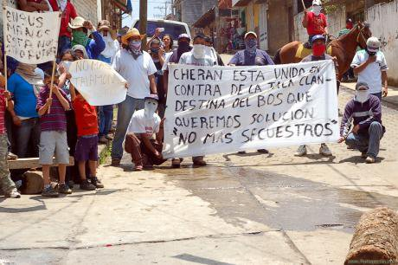
E.g. Cherán
In 2011 Comuneros of San Francisco Cherán, Michoacán start a movement against deforestation and criminal violence.
Judicial process-Mexican state recognises indigenous peoples’ claims to autonomy and self-determination and self-government as a judicial right.
Cherán becomes the first formally recognised indigenous municipality governed by a government structure chosen according to usos y costumbres (customary law).

Slide 9
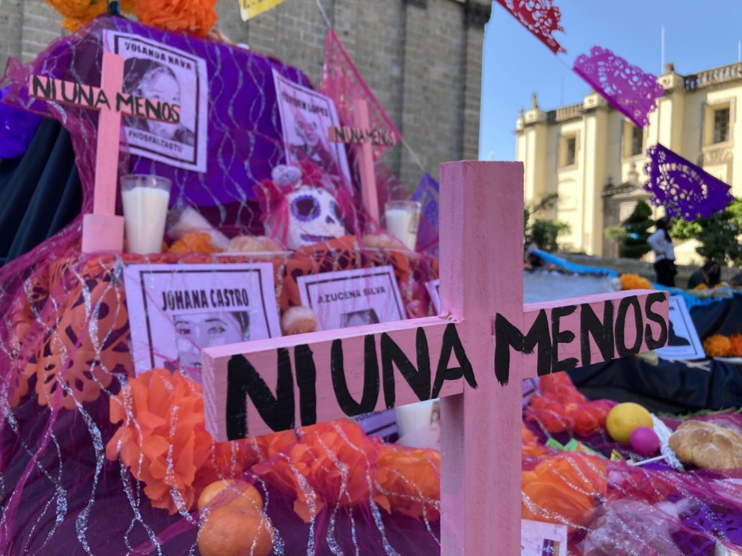
Women’s Rights
1980-1981- Mexico signs and ratifies the Convention on the Elimination of All forms of Discrimination Against Women (CEDAW) 1979 1999-2002- Optional Protocol to CEDAW
2013-2018 National Development Plan
2014-2015 Electoral Reform
2018 on The Green Wave- Reproductive Rights
2021, the Supreme Court of Mexico ruled reproductive freedom is a constitutional right of “persons that can become pregnant,” which includes women, transgender, and non-binary people. The decision was revolutionary in its scope and use of inclusive language use. The Court determined that the criminalization of abortion violated constitutional rights, including the principle of equality and non-discrimination, the right to health, the autonomy to choose whether to continue a pregnancy, and an individual’s liberty to develop their personhood and livelihood. Consequently, the Court concluded that abortion should not be criminalized. It was further argued that in a democratic, secular nation, criminal law should be the last reason for the state to intervene in personal decisions such as sexual and reproductive preferences.

Slide 10
Femicide/ Feminicide Ni una menos
Femicide as a criminal category-broader patterns of gender-based violence. 1990s exponential rise in Mexico. Feminicide- includes the wilful ignorance on the part of the state.
‘All women experience violation of their human rights stemming from the subaltern social status and political subordination of gender that affects them. It is in that framework that feminicide must be explained’ (Lagarde y de los Ríos 2010), xix The government is complicit in avoiding or colluding in the problem of gender-based violence.
2003 Marcela Lagarde wins a seat in the Chamber of Deputies and pushes for fully-funded research.
2007 Ley General de Acceso de las Mujeres a una Vida Libre de Violencia (General Law on Women’s Access to a Life Free of Violence), identifies violencia feminicida (feminicidal violence) as a violation of women’s human rights in the public and private sphere as linked to the state’s tolerance of cases of gender violence.
2012 reform to Article 325 of the Federal Criminal Code that codified feminicidio as a crime, defining it as the murder of a woman for “gender reasons,” and includes provisions to punish public servants when they hinder the administration of justice. Feminicidio carries a maximum 60-year prison sentence. Public servants may be punished with a three- to eight-year prison term and the removal from their post. In recognizing the state as a perpetrator of violence, these laws made the state itself a target of its own punitive power.

Slide 11
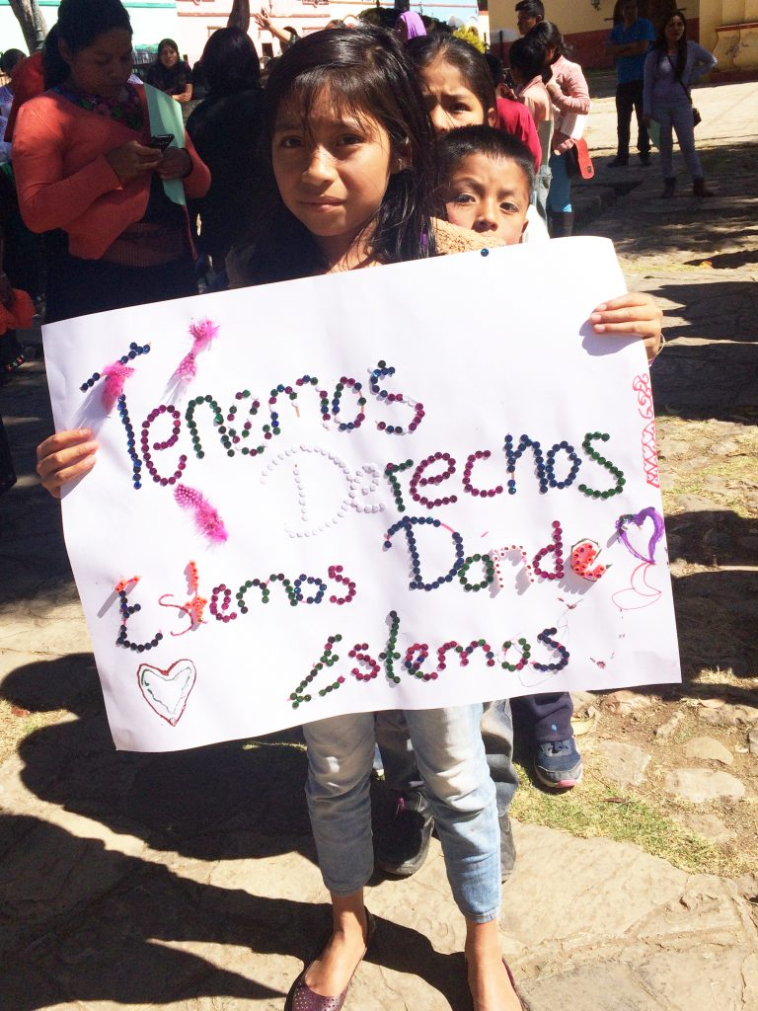
Children’s Rights
1990 Mexico signs and ratifies the United Nations Convention on the Rights of the Child (UNCRC) 1989
2000-2002- Mexico signs and ratifies the Optional Protocols to the UNCRC on both the involvement of children in armed conflict and the sale of children, child prostitution and pornography.

Slide 12
Torture and Forced Disappearance
1985-1986 Mexico signs and ratifies the Convention against Torture or Other Cruel, Inhuman or Degrading Treatment or Punishment (The Torture Convention) 1984
2003-2005 Mexico signs and ratifies The Torture Convention
2007-2008 Mexico signs and ratifies the International Convention for the Protection of All Persons from Forced Disappearance 2010
2015 Protocol on Forced Disappearance and Protocol on Torture
2013 Agreement on search for remains in Tamaulipas and Nuevo Leon Agreement with civil society organisations, Argentine forensic service and PGR (Attorney General)
2017 Laws on Disappearances and on Torture

Slide 13
Human Rights Defenders (HRDs) and Journalists
National Level
2012 Federal Protection Mechanism for Human Rights Defenders and Journalists. Ley para la protección de personas defensoras de derechos humanos y periodistas. (Weak independent review)
2022 Initiative of a general law to respect, protect, guarantee and promote the rights of human rights defenders and journalists (proposed bill) Que reforma los artículos 6o. y 73 de la Constitución Política de los Estados Unidos Mexicanos y expide la Ley General para respetar, proteger, garantizar y promover los Derechos de las Personas Defensoras de Derechos Humanos y Personas Periodistas, a cargo de integrantes de la Comisión de Gobernación y Población
State Level in the 32 states
4 states no protection: Yucatán, Tabasco, Nuevo León and Baja California Sur.
3 States protection only for journalists: Colima, Veracruz, Querétaro.
6 States no specific laws, only dedicated prosecutor agencies: Sonora, Campeche, Chihuahua, Chiapas, Oaxaca, and Zacatecas
8 States laws or policies to cooperate with the federal protection mechanism: Tlaxcala, Tamaulipas, Puebla, Morelos, Michoacán, Jalisco, Estado de México, Durango.
11 States “autonomous” protection laws: Aguascalientes, Baja California, Coahuila, Ciudad de México, Sinaloa, San Luis Potosí, Quintana Roo, Nayarit, Hidalgo, Guerrero, Guanajuato.

Slide 14
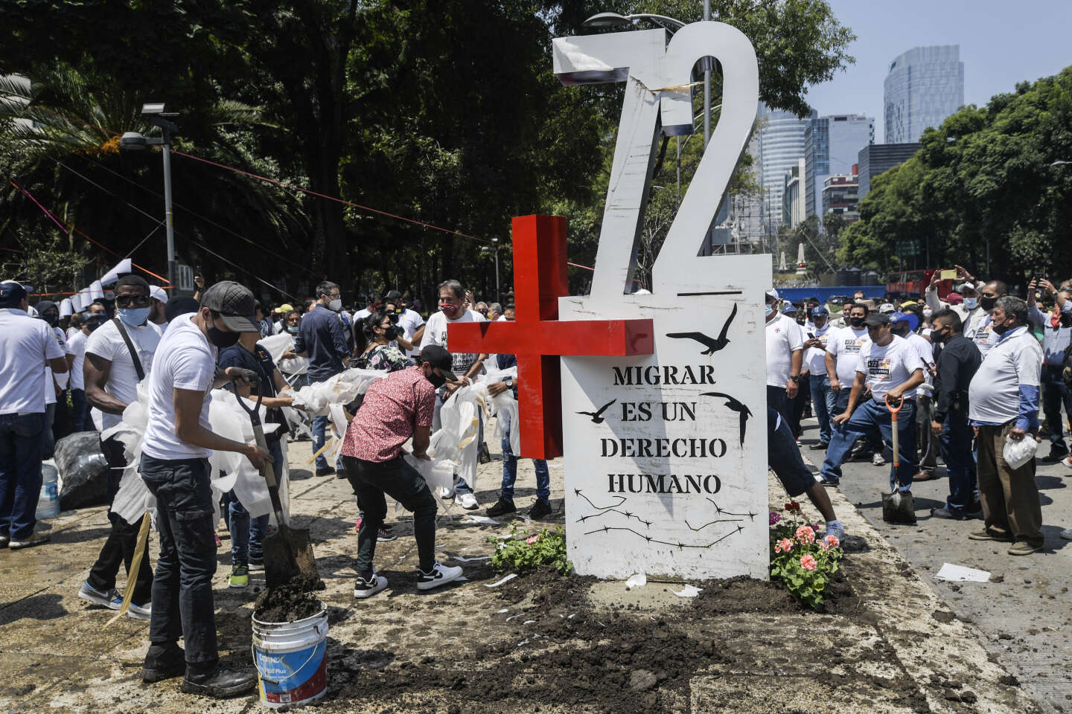
Migrant Rights
1991-1999 Mexico signs and ratifies the International Convention on the Protection of the Rights of All Migrant Workers and Members of their Families 1990
2018-2019 Migrant Caravan Honuras to Tijuana
2020 Search Table for Disappeared Migrants (MBPMD) within the National Search System (SNBP).

Slide 15
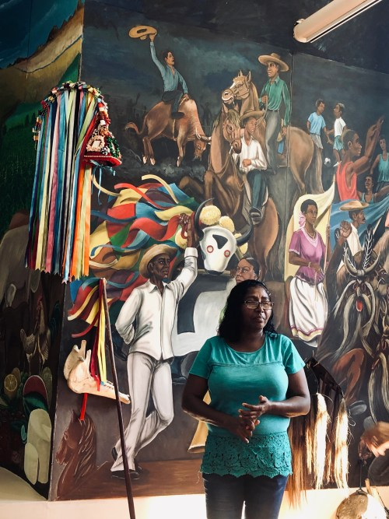
Afro-Mexicans
1946 anthropologist Gonzalo Aguirre Beltrán wrote: "Yes, yes, there are Blacks. They are in Oaxaca, they are in Guerrero, they are in Veracruz, they are in such places."
1997- México Negro A.C. founded. First Annual Meeting of Black Towns or Encuentro de pueblos negros, afromexicanxs y afrodescendientes.
2001 World Conference Against Racism, Racial Discrimination, Xenophobia and Related Intolerance at Durban defines “Afro-descendant”
2002- The Working Group of Experts on People of African Descent of the UNHCR established
2003, the federal government of Mexico initiated the Third Root Program. Educational television programs. Scholarship on the African heritage of Mexico.
2003-Ley federal para prevenir y eliminar la discriminación

Slide 16
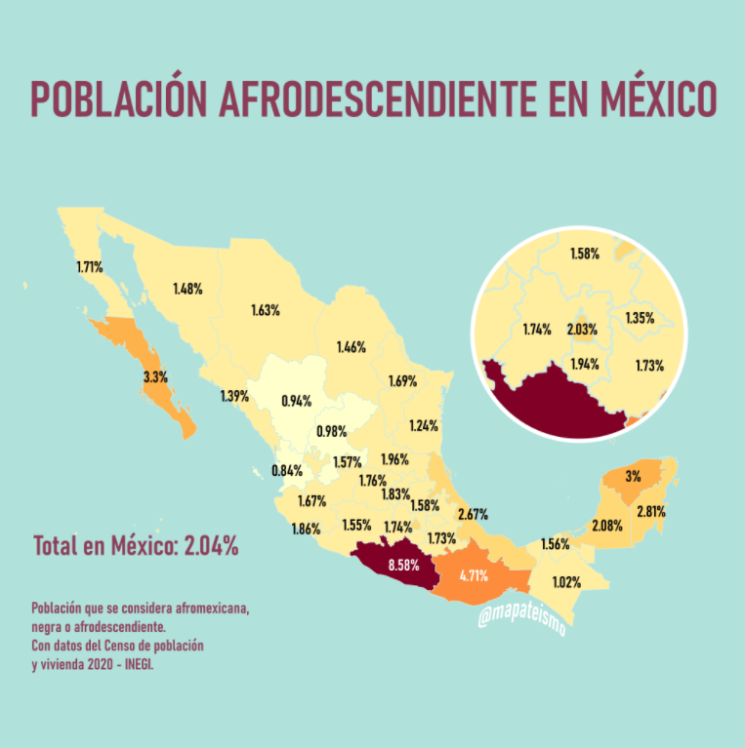
Afro-Mexicans
2015 Intercensal Survey includes Afro-Mexicans (first attempt to count since 1810-10%). In 2015 1.7% identify as Afro-Mexican or Partially Afro-Mexican 1.4% don’t know.
2019, the first Afromexican Women's House was inaugurated in the municipality of Santa María Cortijos, in La Llanada on the borders of La Costa Chica of Oaxaca and Guerrero. Legal and psychological counselling is provided to women victims of violence.
2019 Decree published in the Official Journal of the Federation by which section C added to Article 2° of the Political Constitution of the United Mexican States. It recognizes Afro-Mexican peoples and communities as part of the pluricultural composition of the nation in order to guarantee their self-determination, autonomy, development, and inclusion.
2020 Census (first to include Afro-Mexicans) Afro-Mexicans in 25 of the 32 states. Afro-Mexican population concentrated in Guerrero (6.5%,), Oaxaca (4.9%) and Veracruz (3.3%).

Slide 17
Afro-Mexicans
2021-UN Permanent Forum on People of African Descent
Only 5 states recognise Afro-descendent communities in their state constitutions.
2023 Reform to the 2003 discrimination law Las acciones afirmativas serán prioritariamente aplicables hacia personas pertenecientes a los pueblos indígenas, afro descendientes, mujeres, niñas, niños y adolescentes, personas jóvenes, personas con discapacidad y personas adultas mayores.

Slide 18

1970 Article 2, 5 and 56 of the Mexican Federal Labour Law prohibit employment discrimination based on gender or sexual orientation
2003 Federal Law to Prevent and Eliminate Discrimination).
2002 Criminal Code of Mexico City, hate crimes committed based on sexual orientation and/or gender identity considered an aggravating circumstance. Under the Federal Criminal Code, those who deny the provision of a service, deny or restrict labour and/ or educational rights due to reasons of sexual preference are punished with imprisonment or community work and a fine. The penalty is increased if the individual committing the crime is a public officer or if there is an existing labour relationship with the victim.
2005, the Supreme Court ruled Civil Codes of those States which say that marriage can only occur between a man and a woman, unconstitutional. Obliges every State to legally recognise marriage between same-sex couples. At a federal level, civil partnerships are not recognised. At the state level, six States recognise same-sex registered partnerships. Attached rights similar to marriages, but not the same. Adoption of children by same-sex couples regulated in three States.
2011 the Supreme Court of Justice declared constitutional the right of same-sex married couples to adopt. In 2017, jurisprudential criteria confirmed the right of same-sex married couples to adopt and includes the possibility of the use of scientific methods for procreation.
LGBTQ+ Rights
https://m68.mx/coleccion/36939

Slide 19
Gender Identitiy
On a federal level, no gender recognition exists. Article 135 Bis (2008) of the Civil Code of Mexico City (1928), Article 36 of the Civil Code of the State of Nayarit, and Article 117 of the Family Code of the State of Michoacán are the only legal provisions regulating gender recognition in Mexico. The person must be 18 years of age and present the change request before the Registry Office of Mexico City, Nayarit or Michoacán. No surgical intervention or medical diagnosis is needed. The legal gender can only be changed to female or male.

Slide 20
Transitional Justice
International Institutions:
Since 1979- Inter-American Court of Human Rights (OAS)
Since 2002 Office of the High Commissioner on Human Rights (OHCHR)
State-led initiatives
2001 Special Prosecutors Office in response for calls for a Truth Commission- arrest and indictment of the former head of the secret police and three other security officials Draft report on past abuses.
President Fox signed an agreement with the United Nations High Commissioner for Human Rights (UNHCHR) that committed Mexico to collaborating with the U.N.
2002 Transparency Law
2021 Commission for Access to Truth, Historical Clarification and the Promotion of Justice for serious human rights violations committed between 1965 – 1990
2020 Search Table for Disappeared Migrants (MBPMD) within the National Search System (SNBP).

Slide 21
Transitional Justice- Civil Society Organisations
Comisión Mexicana de Defensa y Promoción de los Derechos Humanos, (CMDPDH)
Founded 1989, consulting status with UN, International Federation of Human Rights member.
Member of the following networks:
Coalición por la Corte Penal Internacional
Observatorio Ciudadano Nacional del Feminicidio
Observatorio Ciudadano del Sistema de Justicia
Red Internacional para los Derechos Económicos, Sociales y Culturales
Coalición Internacional de Organizaciones por los Derechos Humanos en las Américas
Consejo Internacional para la Rehabilitación de las Víctimas de la Tortura.
https://cmdpdh.org/quienes-somos/

Slide 22
Violent Democracies/ Violent Pluralism
“The everyday presence of violence contrasts starkly with governmental efforts to extend civil, political, and legal rights to all citizens, and it is invoked as evidence of the failure of Latin American countries to achieve true democracy. ” Daniel M. Goldstein and Enrique Desmond Arias(eds) , Violent Democracies in Latin America, Duke, 2010.
“The spreading violence in the region represents not so much a failure of democratic institutions as, in many cases, the basis on which those institutions function…the phenomenon reflects not so much a deficit of citizenship rights as the proliferation of multiple sets of violent orders that impose different notions of political subjectivity on the population. These notions entail different sets of expectations for different parts of the population, which are often at odds but also sometimes in dialogue with the concept of democratic citizenship.” Enrique Desmond Arias, “Understanding Violent Pluralism” in Daniel M. Goldstein and Enrique Desmond Arias(eds) , Violent Democracies in Latin America, Duke, 2010.

