Slide 1
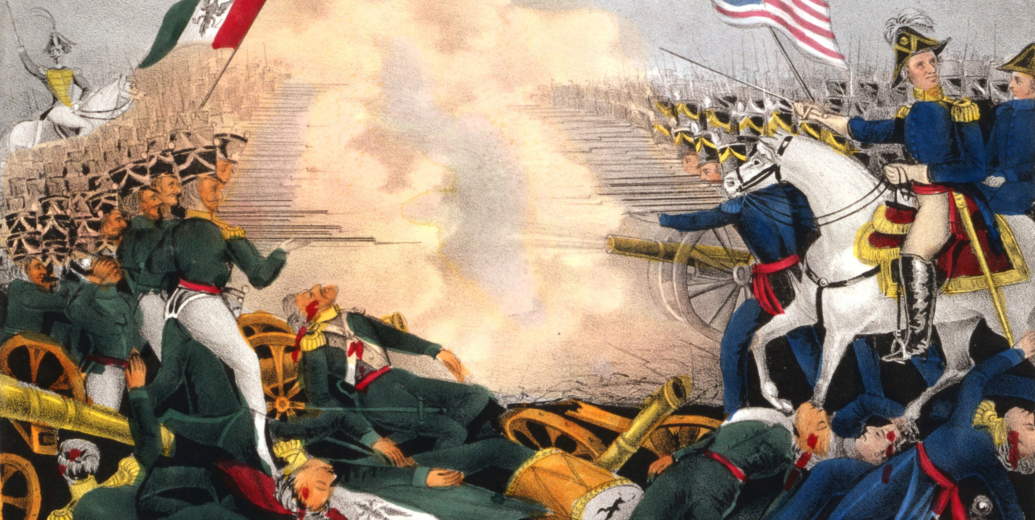
The Mexican American War, 1846-1848 https://www.youtube.com/watch?v=MkHCWoR5GoQ
(Lila Downs, La Iguana, from Ry Cooder Album, San Patricio, 2010

Slide 2
The Background
U.S. Imperialism
  Summed up by journalist, John O’Sullivan’s (or Jane McManus Storms’) idea of “Manifest Destiny” (1845).
  That it was their mission to expand and colonize all North America.
    Economic growth
    Desire to extend Protestant religion
    Desire to extend “civilization” and representative democracy
  Was embraced by many U.S. leaders including President James Polk.

Slide 3
The Background contd.
Underpinned by:
  Southern Democrats.
  American ideas of proper male behavior.
  American ideas of race, in particular, white supremacy.
    This had gained traction during 1830s as defense of annexation of Texas. Mexicans seen as inferior race, unable to defeat Texas Indian tribes.
  American distrust of Catholicism.
    Increasingly Catholic migrants in United States. Idea of fifth column.
    Instinctively anti-democratic.

Slide 4
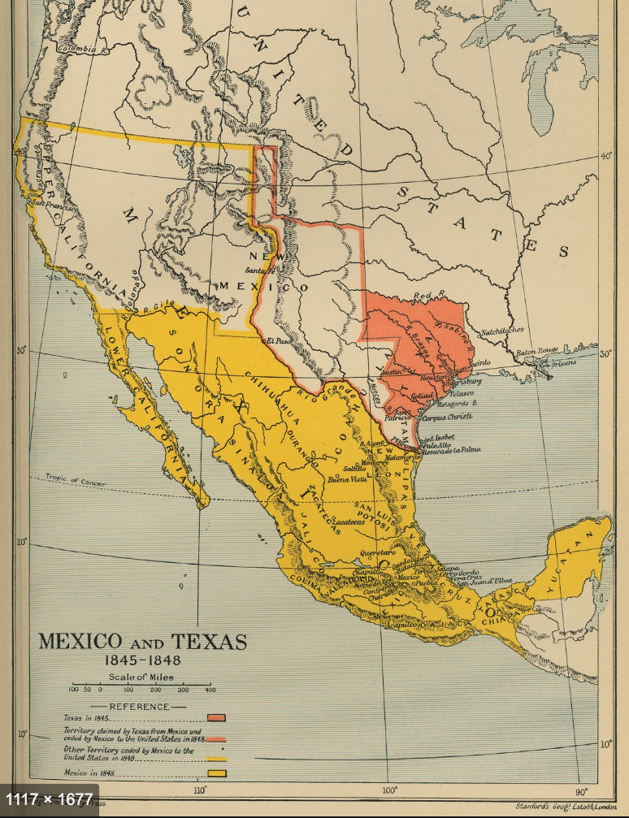
The Texas Problem
1834-1845

Slide 5
The Texas Problem
Distant, separated by vast desert.
Under populated by non-Indians.
Threatened by raiding Indians, particularly the Comanche.
Increasing Anglo settlers.
Possibility of cotton farming and slavery.

Slide 6
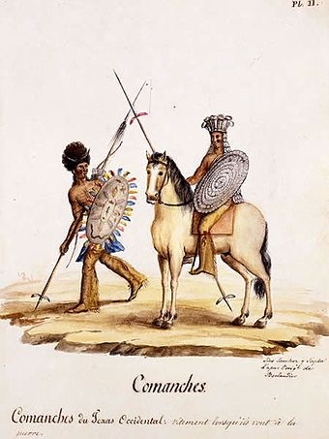
Comanches of west Texas

Slide 7
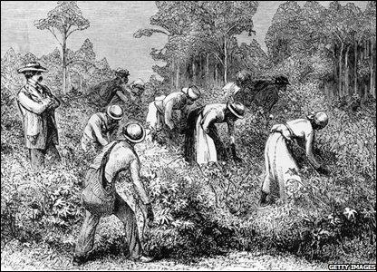
Cotton picking in Texas

Slide 8
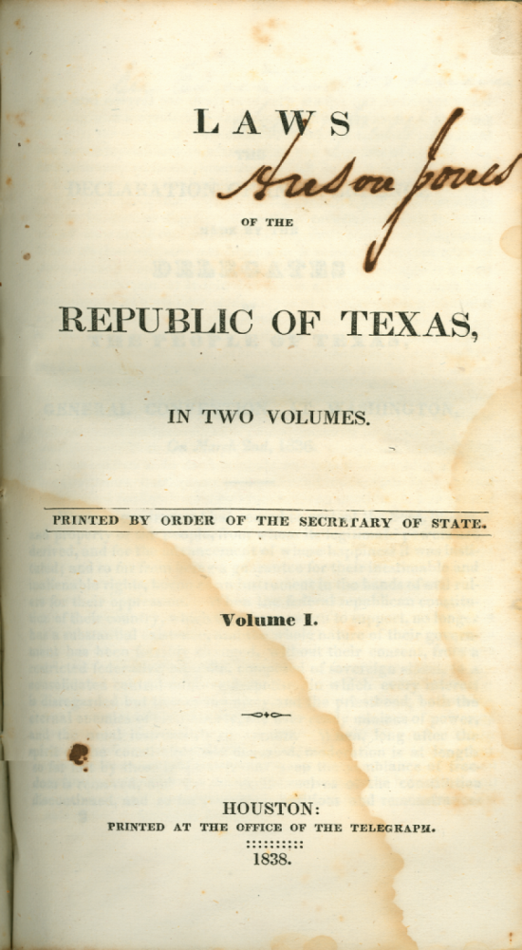
1838 Constitution allowed for continuation of slavery

Slide 9
The Texas Problem Contd.
1834 Mexicans introduce centralist constitution, which limits independence of Texas state government.
1834 Texas federalist rebellion.
1836 Battle of the Alamo.
1836 Battle of San Jacinto.
1836 Texas declared an independent republic.

Slide 10
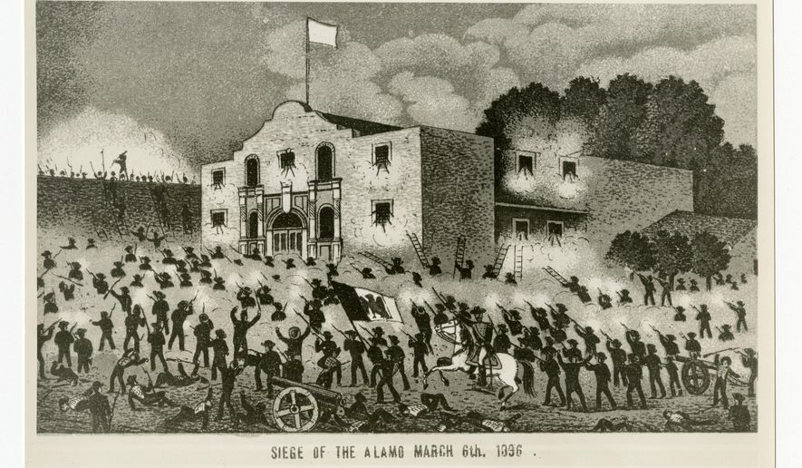
Battle of the Alamo
The Alamo, Dir. John Wayne, MGM, 1960

Slide 11
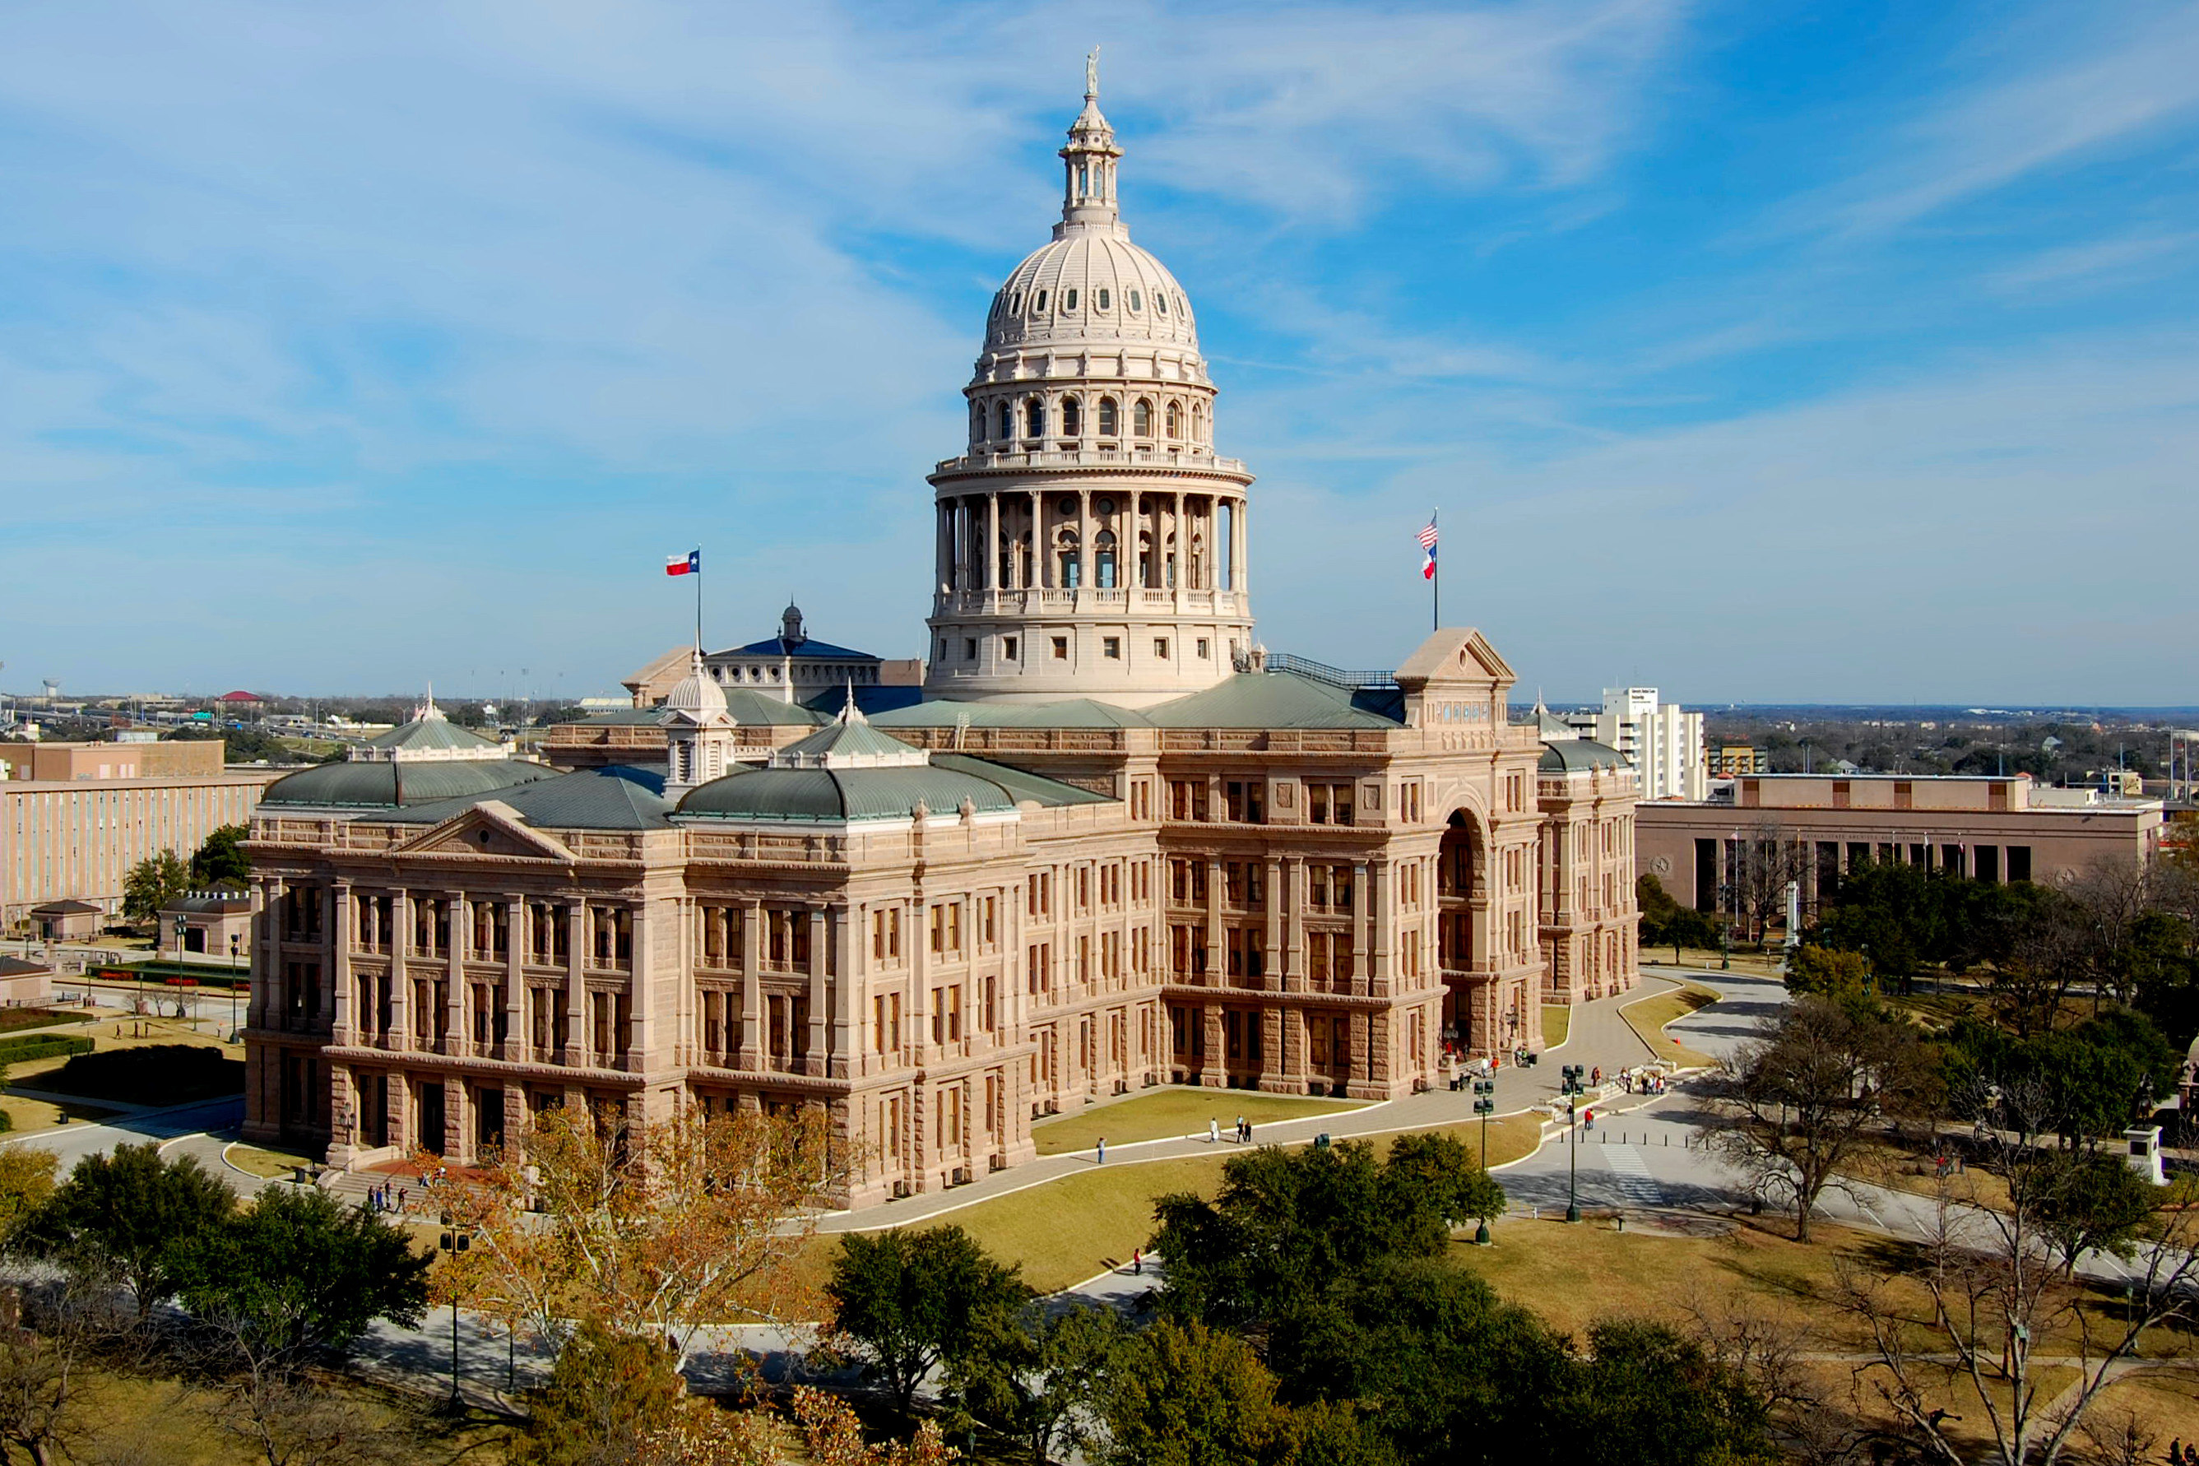
Texas State Capitol, Austin

Slide 12
Independence of Texas
Culturally changes attitude of Americans to Mexicans. They were now seen as on par with Native Americans.
Politically sets U.S. on collision course with Mexico.
  1836 Texas asks for annexation to U.S.
  1836-1845 U.S. Congress refuses
  1845 President Polk annexes Texas.

Slide 13
The War
1845 Polk sends troops to Rio Grande, de facto declaring that this was the new border between U.S. and Mexico.
Provokes Mexican forces to attack.
The war starts.

Slide 14
The Mexican forces
Politically divided.
Centralists vs Federalists.
May 1846 Centralist Mariano Paredes uses Mexican army to take power in coup d’etat.
July 1846 Paredes asks cousin of Spanish Queen to become monarch of Mexico. He refuses.
August 1846 Paredes is deposed and federalism is reinstituted.
February 1847 Polkos Rebellion
8 September 1847 Battle of Molino del Rey

Slide 15
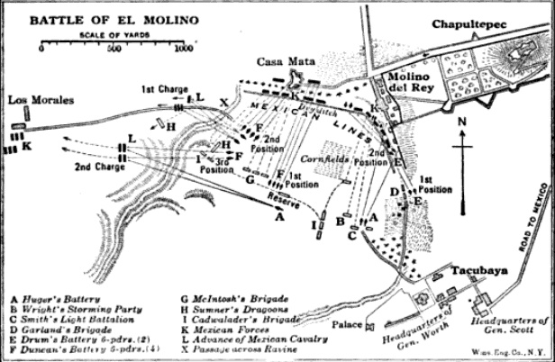

Slide 16
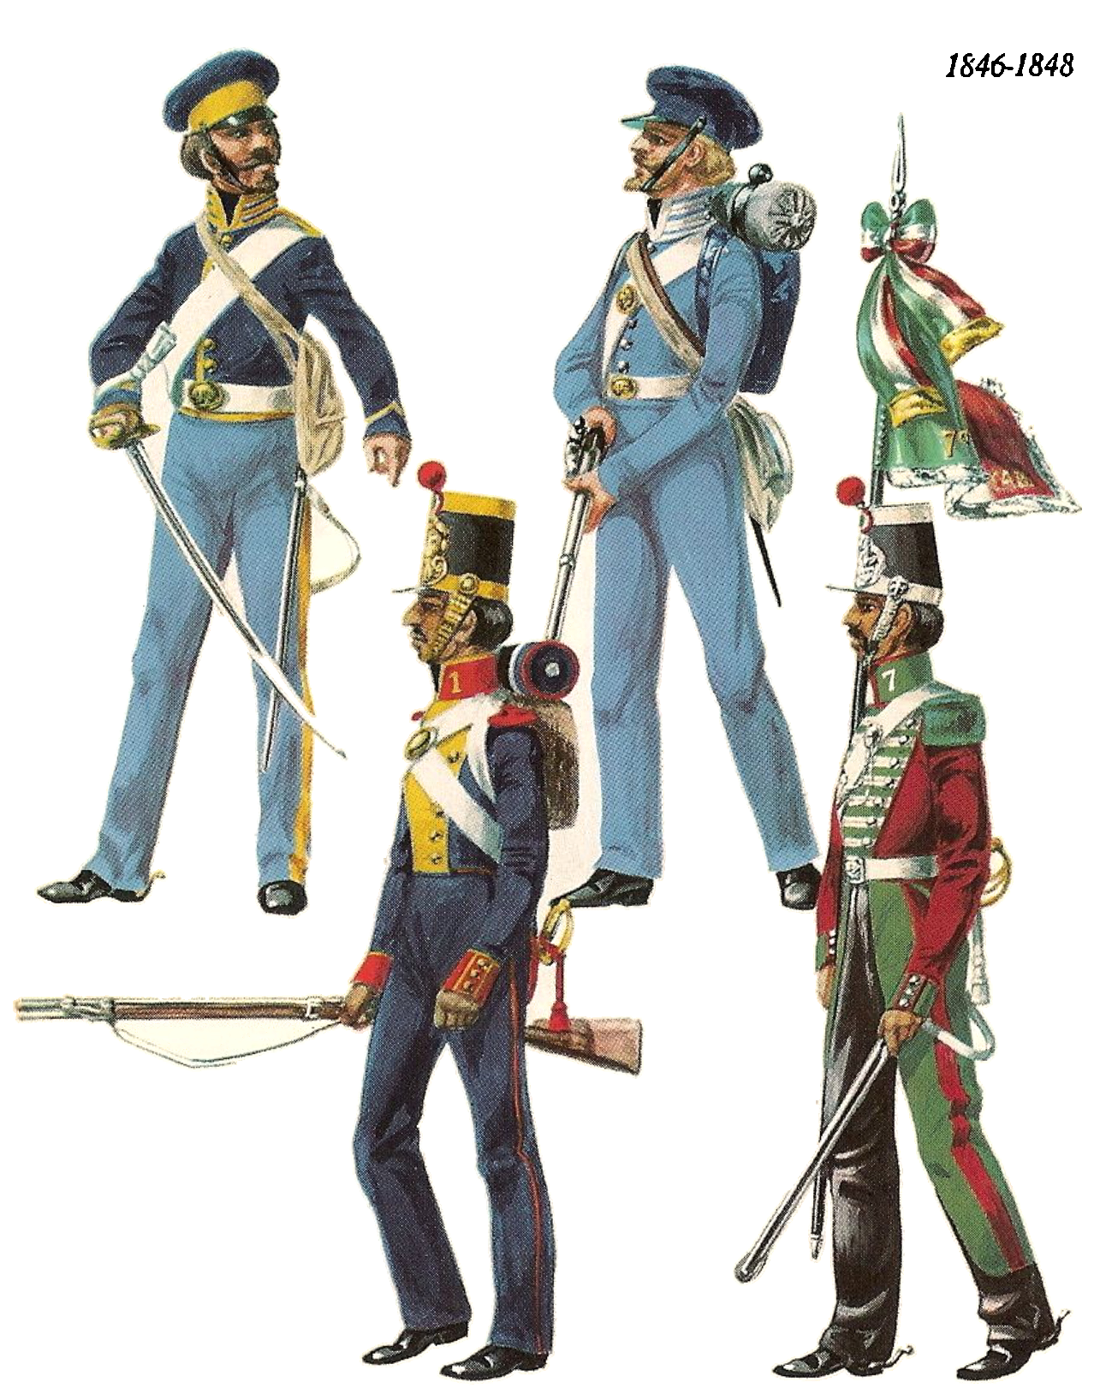
Poverty of Mexican army.
  Often barely had money to feed soldiers. Relied on living off Mexican locals.
  Poorly equipped. Relied on British muskets, some of which were 50 years old.
  Desertion was endemic.

Slide 17
But, not as one sided as previously believed.
Strong Mexican nationalism.
United by desire to defend Catholic religion.
United by patriarchal ideas of masculinity. Desire to defend families and personal honor.
Effective guerrilla campaign.
Losses predominantly due to inferior weaponry.

Slide 18
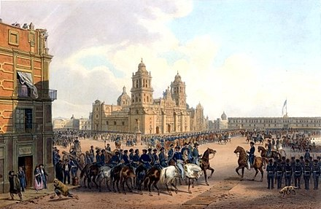
U.S. occupation of Mexico City, 1847

Slide 19
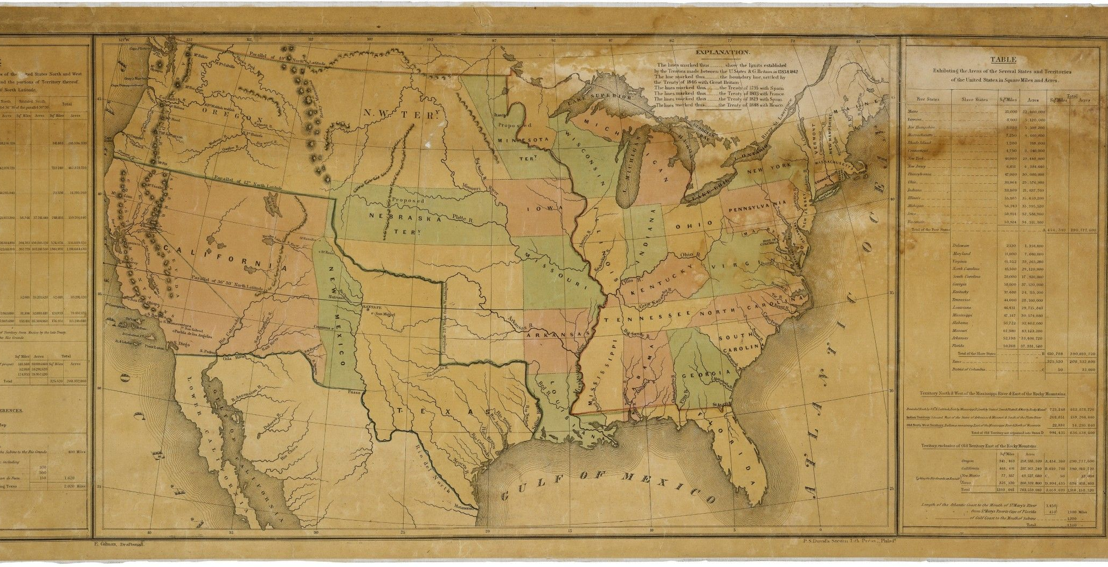
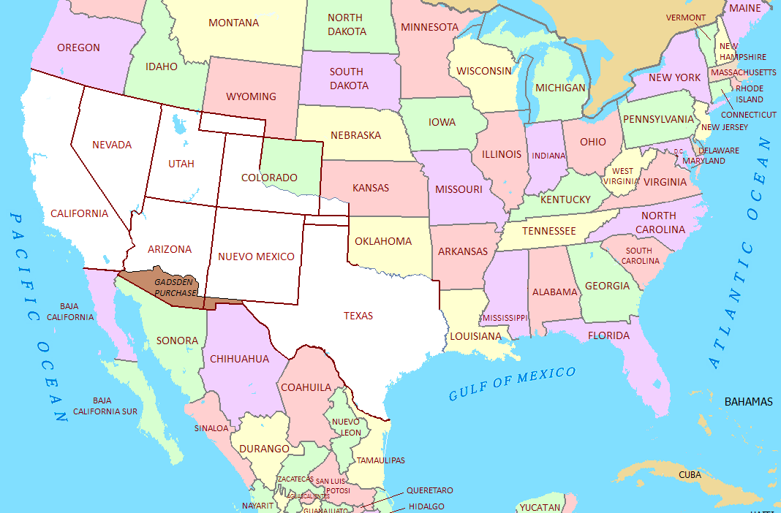
Treaty of Guadalupe Hidalgo
Recognized Río Bravo as division between Mexico and United States.

Slide 20
Insights from the Mexican American War
First development of U.S. imperialism into a flexible, less ambiguous doctrine.
Move beyond Native Americans.
Elision with white supremacy and Manifest Destiny.
Would underpin further conquests in Caribbean, Philippines, Central America.

Slide 21
Importance of Anti-Catholicism
Developed in Lyman Beecher’s Plea for the West (1835) which argued that both Catholic immigrants and Catholic Mexicans were a threat to American republicanism.
Popularized by Maria Monk’s The Hidden Secrets of a Nun's Life in a Convent Exposed (1836)
Pope vs. democracy; celibate priest vs. ideal of masculinity; elision with white supremacy.
U.S. soldiers seen as “missionaries of republicanism”.
U.S. soldiers engaging in idolatry – stabling of horses in churches, destruction of altars, saints, robbery of church goods.
San Patricios battalion.

Slide 22
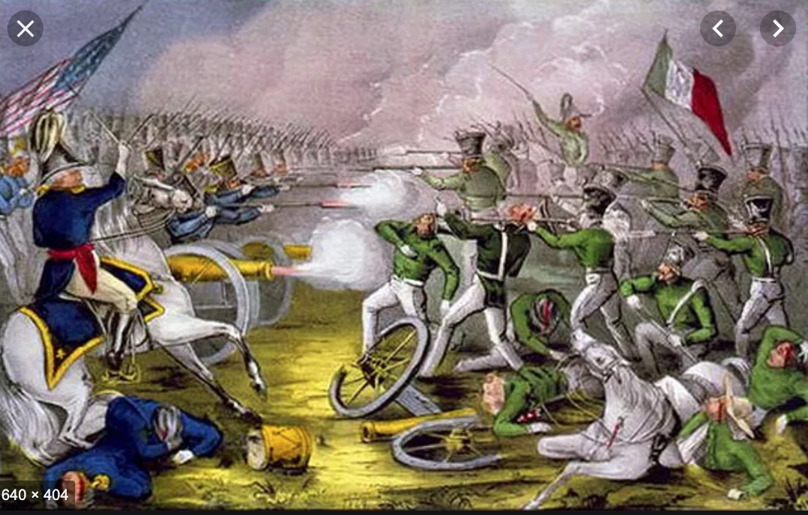
San Patricios Batallion

Slide 23
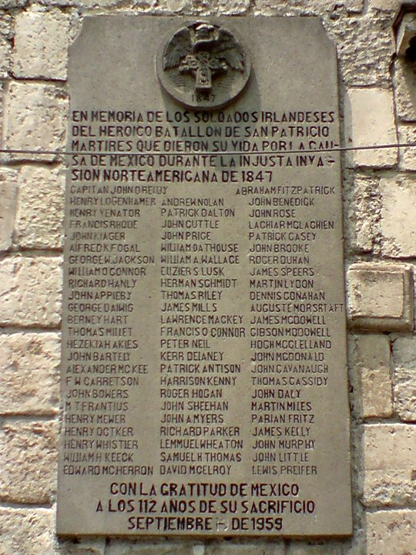

Slide 24
In Mexico
Development of citizen soldiers.
Importance of militia units, often drawn from poorer, indigenous areas.
Link between defense of realm and federalism, egalitarianism, and democracy.
Would mark politics of fifty years – Liberal-Conservative war, French Intervention, basis of Porfirio Díaz power, basis for revolutionary units.

Slide 25
Polarization of political opinions
Disaster polarized federalists and centralists.
Some saw the answer in a return to Spanish/monarchic rule. Centralists became conservatives.
Some saw the answer in democracy, free trade, federalism (basically the U.S. system). Federalists became Liberals.

Slide 26
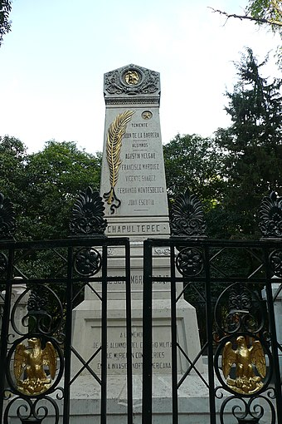
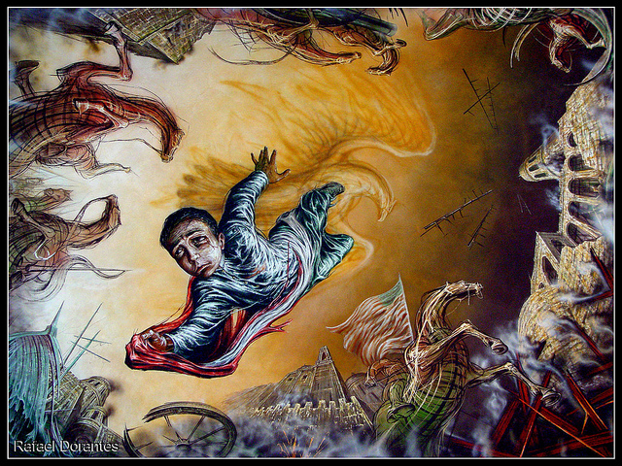
Emergence of new national myths
Niños Heroes. Celebrated on 13 September.

Slide 27
New ambiguous relationship with United States
Acknowledgement of U.S. military and economic power.
Emergence of gringophobia?
Development of “weapons of the weak” foreign policy.

Slide 28
Creation of Mexican Americans
Around 50-60,000 Mexicans remained in new U.S. land.
Creation of three tier society – whites, Mexicans, African Americans.
Lynching of Mexican Americans – at rate of 27.1 per 100,000 during C19.
Attempt by some Mexican landowners to redefine as Spanish.

