Slide 1
Mexican Independence
1765-1821

Slide 2
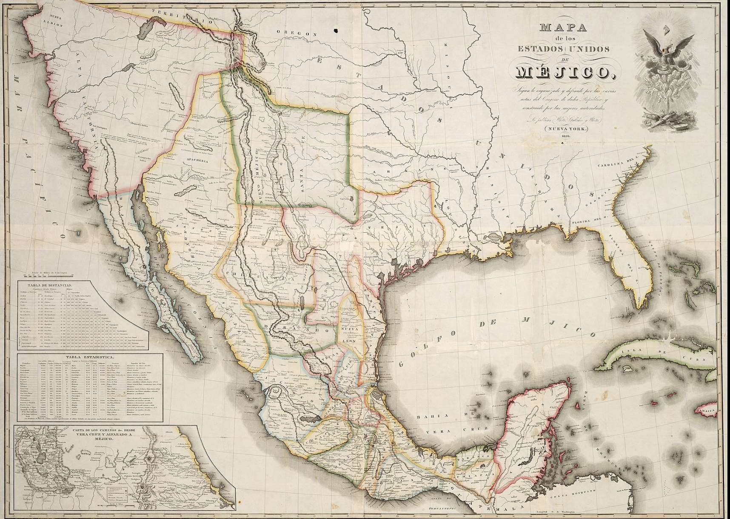

Slide 3
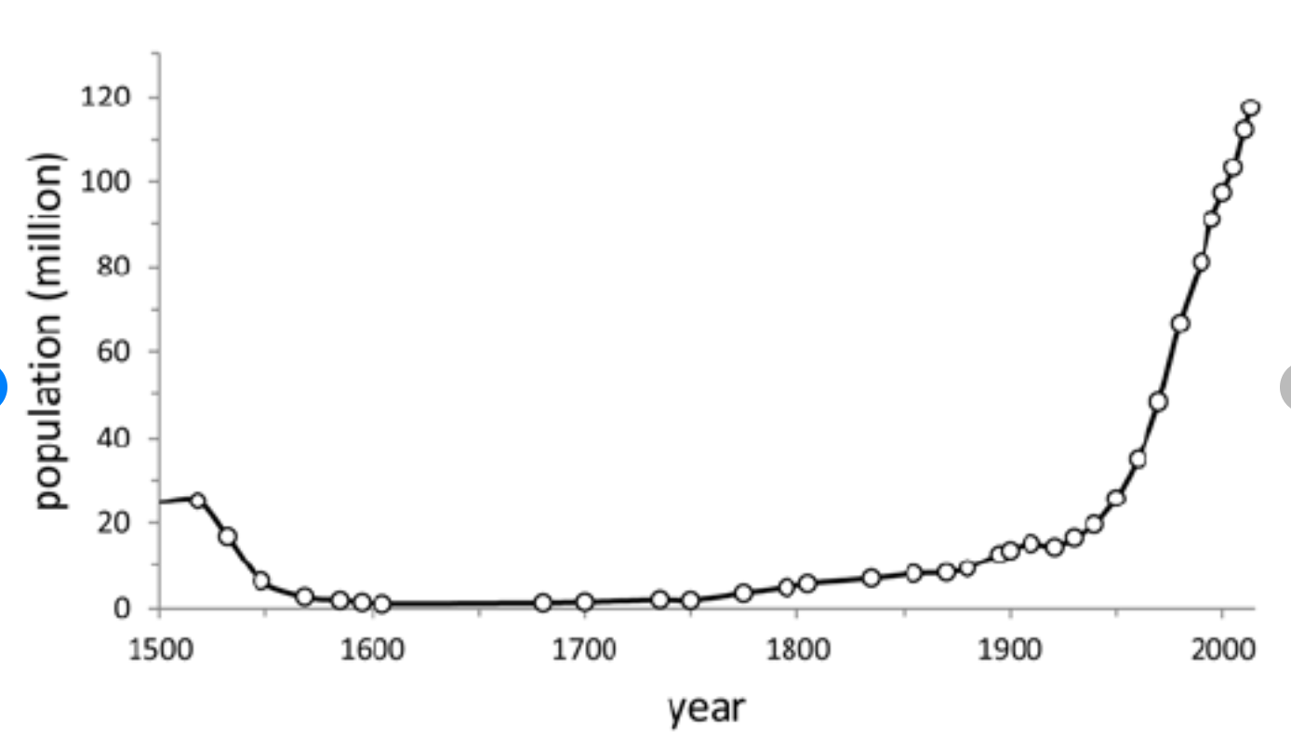
Underlying Socio-economic problems
Demographic surge – (2 million in 1700 to 8 million in 1800)

Slide 4
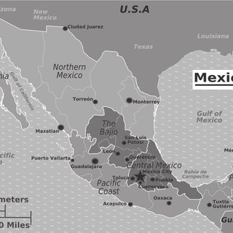
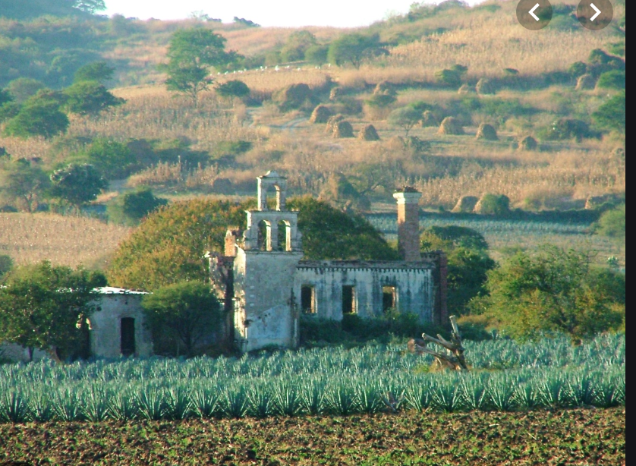
Drought and repeated crop failures - 1713-4, 1749-50, 1785-6, 1808-9
Expansion of big haciendas at the expense of indigenous villages, especially in the Bajío.

Slide 5
A note on landowning
What is a hacienda? Who owns the land? What does it produce? What form of labor does it use?
What is a Mexican village? How is it legally defined? Who lives in it? Who owns the land? What does it produce? What form of labor does it use?

Slide 6
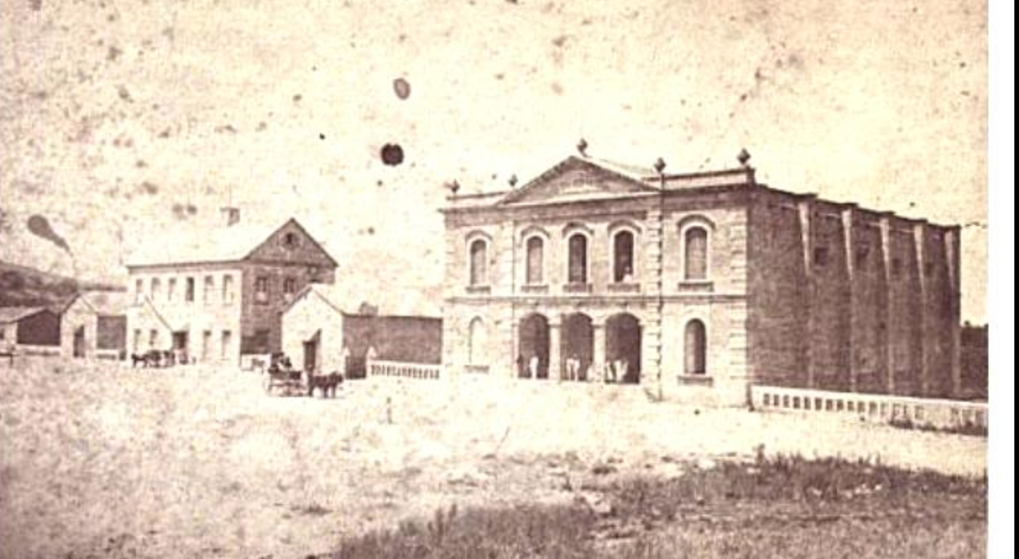
Hacienda Atequiza, Jalisco

Slide 7
Racial Divisions
Peninsulares – Spanish-born Spaniards
Creoles – American-born Spaniards
Indigenous Mexicans
Afro-Mexicans
Mestizos and castas

Slide 8
Cultural Divisions
Traditional Mexican Catholicism stressed:
Link between Catholic calendar and crops e.g. 3 May, day of Holy Cross
Link between Catholic processions and indigenous lands
Power of local saints to intercede on behalf of the village and the individual.
Pilgrimages
Visions, miracles, lay preachers
Cofradías or Confraternities
Enlightenment Catholicism – banning of processions and confraternities, persecution of lay preachers

Slide 9
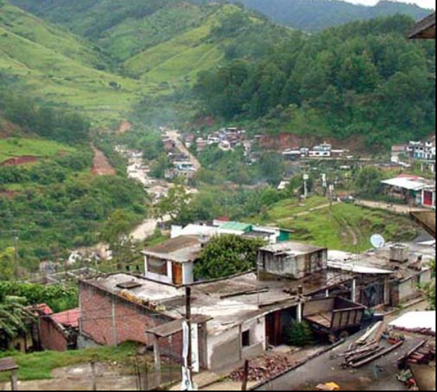
The Virgin of Juquila – classic indigenous saint

Slide 10
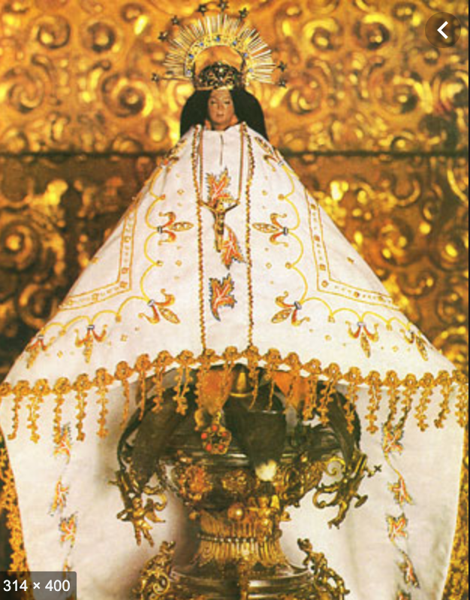
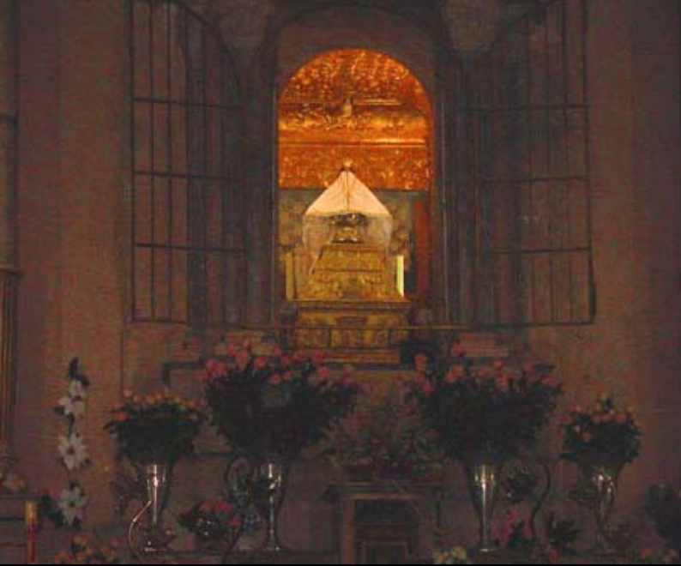

Slide 11
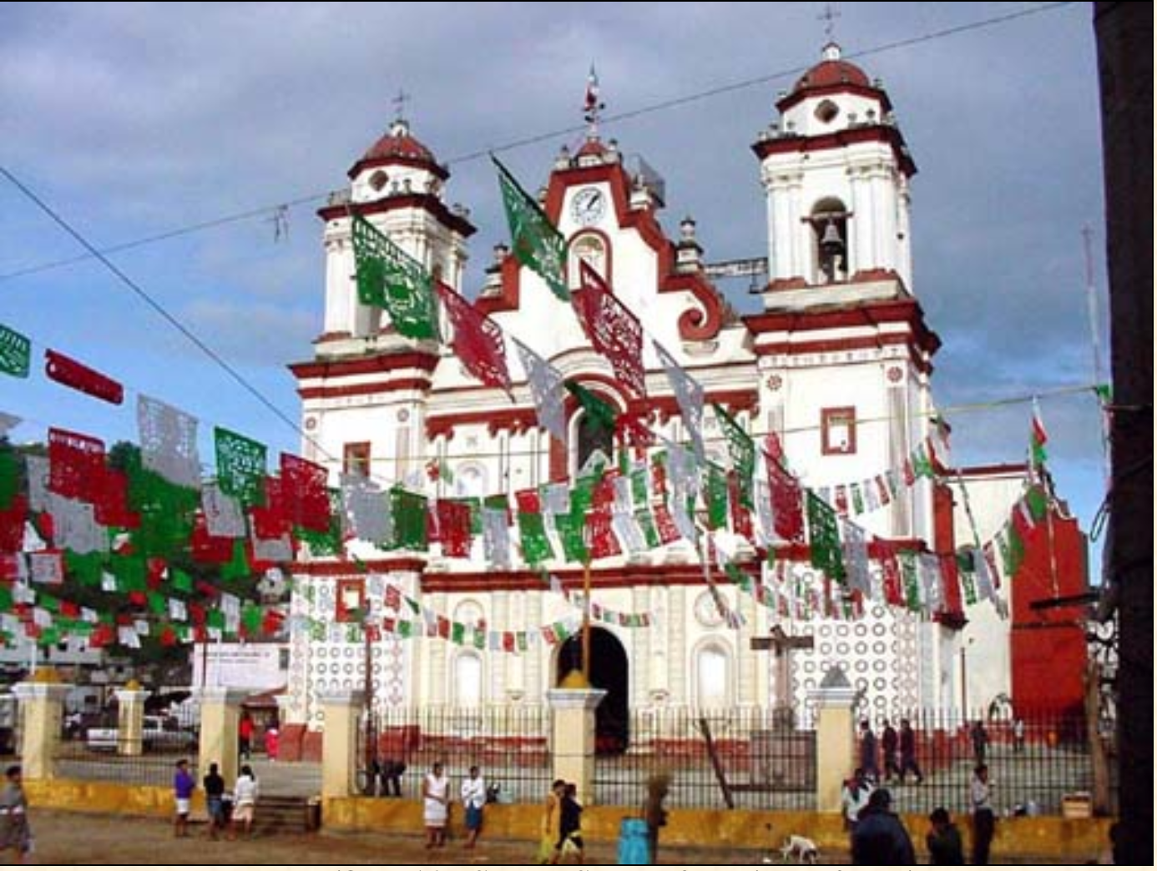

Slide 12
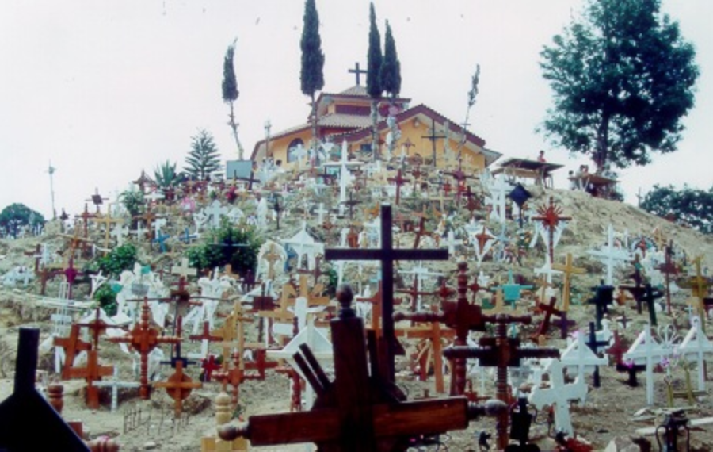

Slide 13
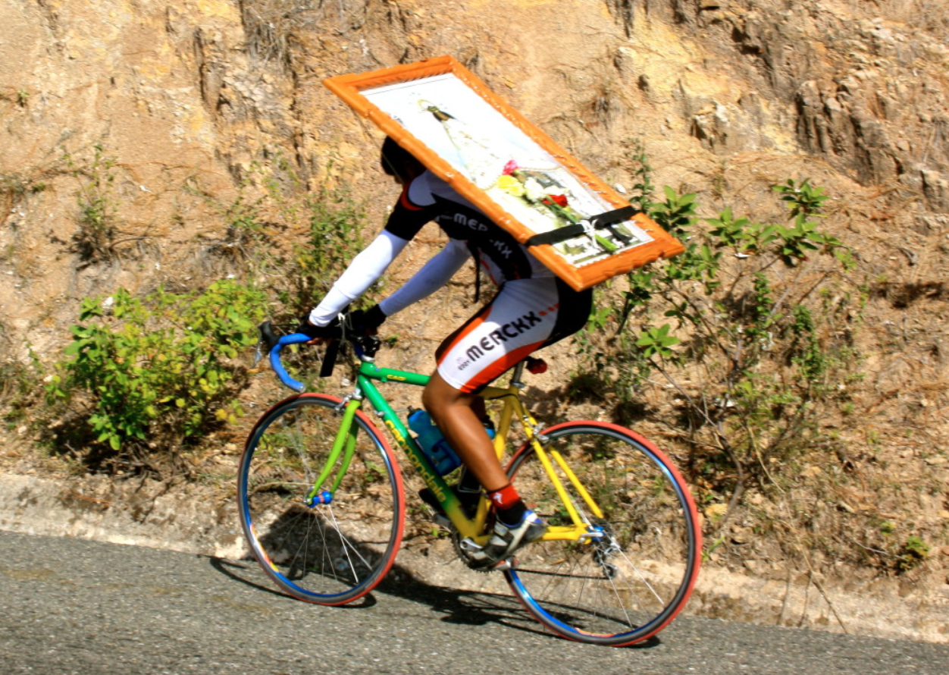

Slide 14
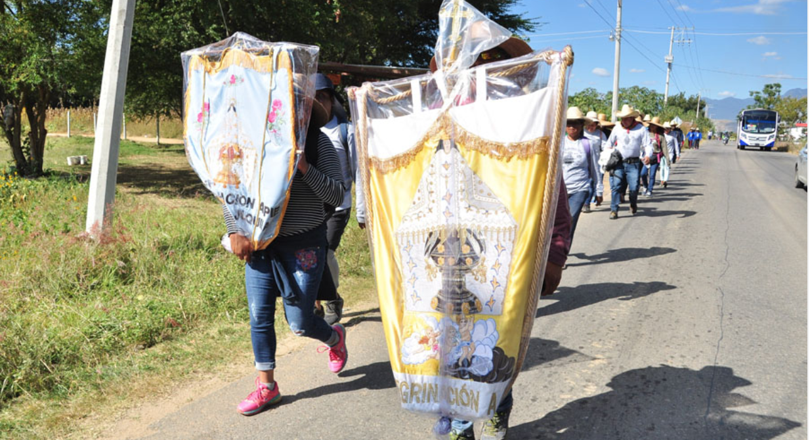

Slide 15
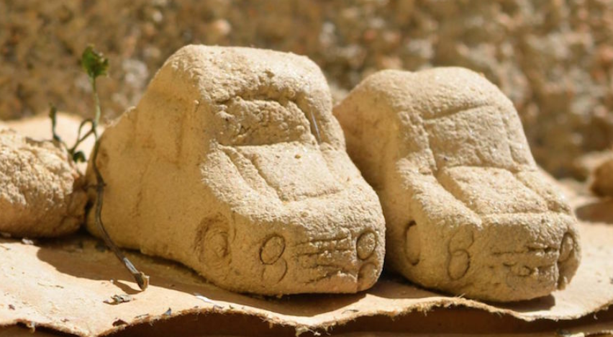

Slide 16
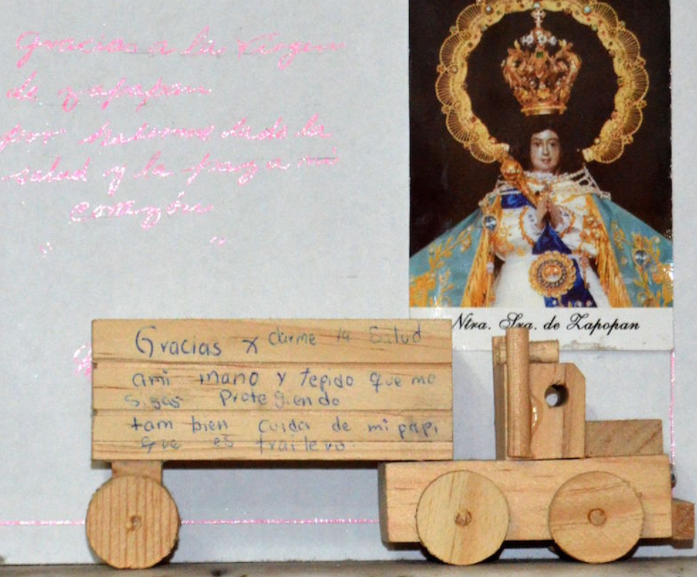

Slide 17
Political Change
The Bourbon Reforms – “A Revolution in Government”
Followed the visita general of José de Gálvez (1765-1771).
Designed to a) increase administrative efficiency and b) collect more tax
Involved:
Appointment of more Spanish born Peninsulares rather than Creoles to bureaucratic positions
Creation of Intendant system directly responsible to crown
Increased tax collection
Reduced role of regular clergy (i.e. monastic orders like Jesuits)
Heavy taxation of cofradías
Creation of militia

Slide 18
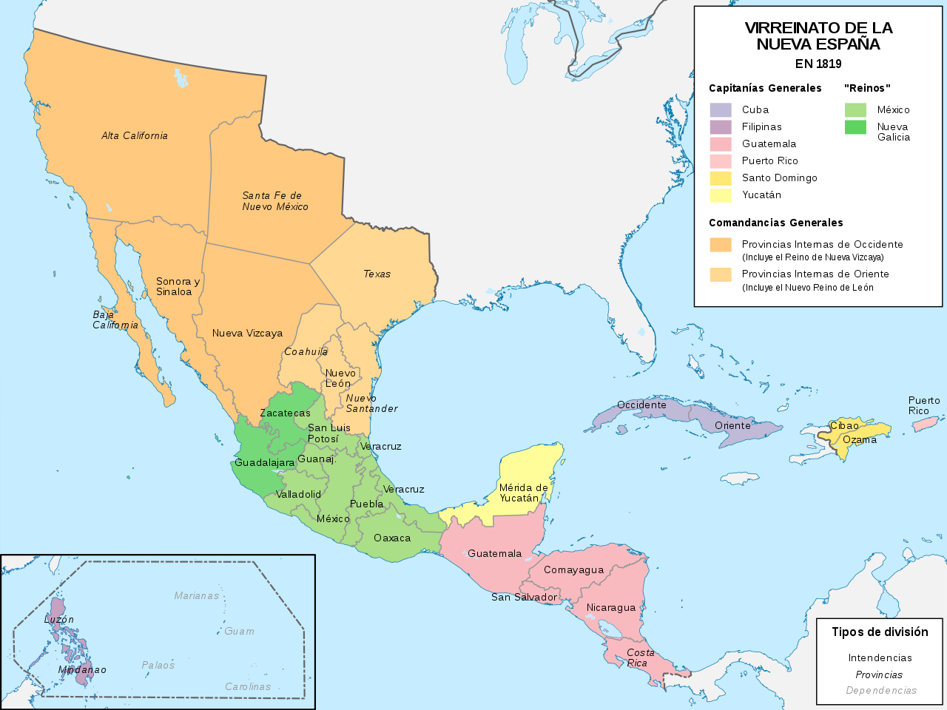
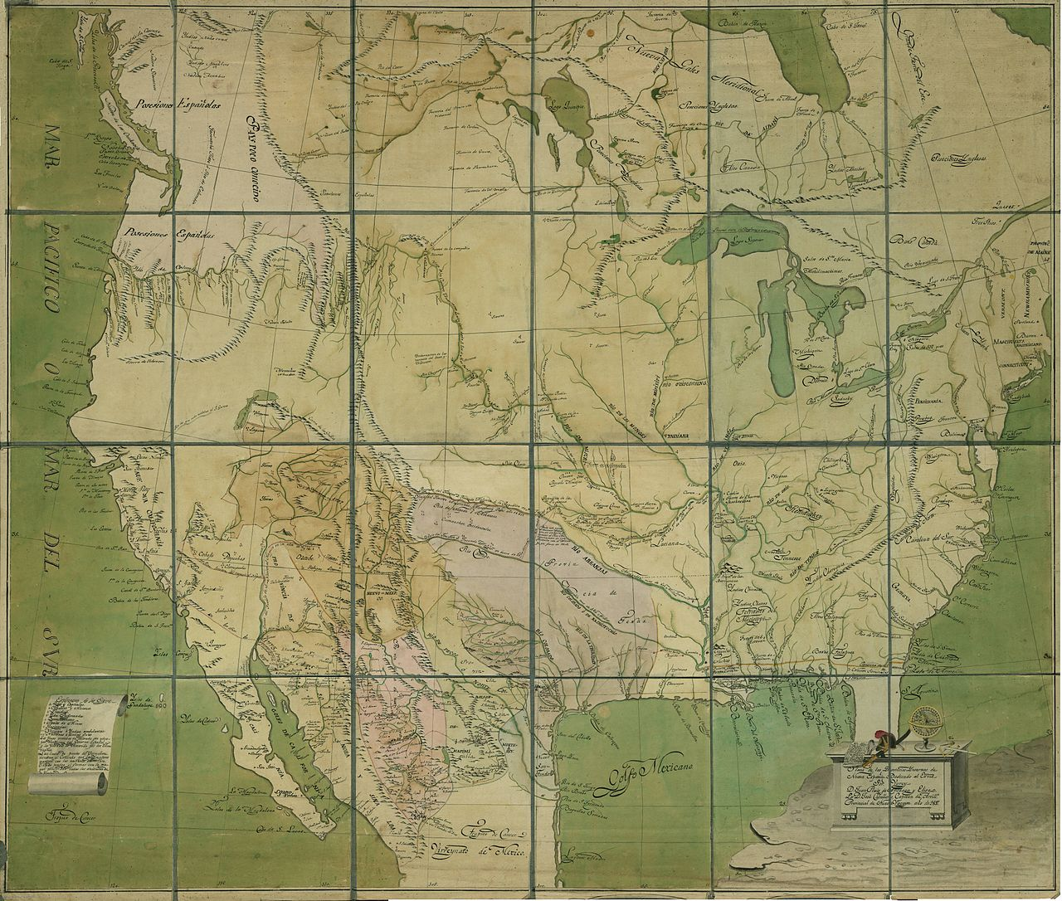
The Northern Borders
Northern areas of Mexico populated by
Catholic missions (Franciscans, Jesuits, Dominicans)
Settlers from southern New Spain
Multiple indigenous groups – Apache, Seri, Yaqui, Tarahumara
Introduction of separate military command (1776 and 1787)
Continued conflicts between settlers and indigenous groups

Slide 19
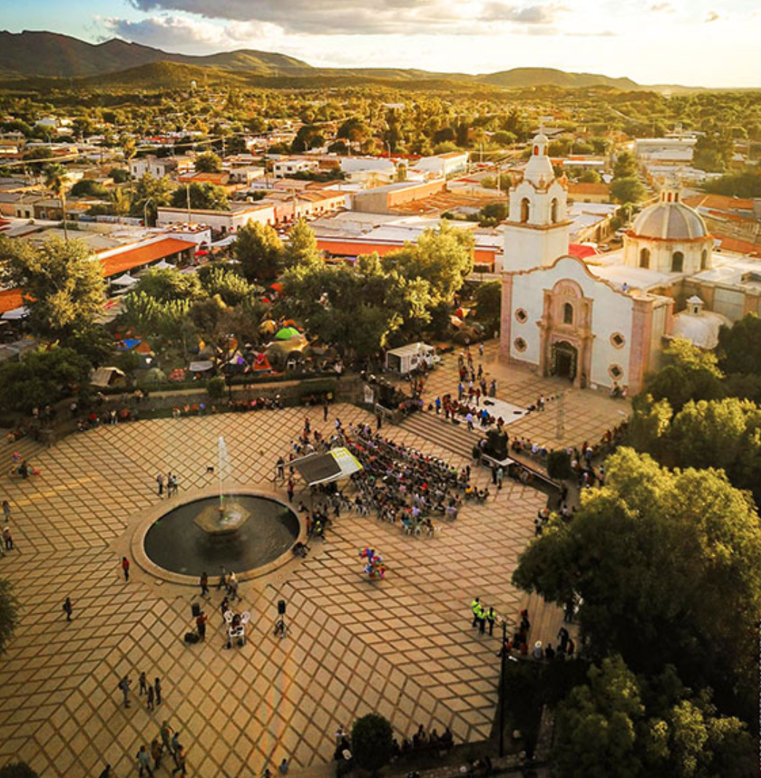

Slide 20
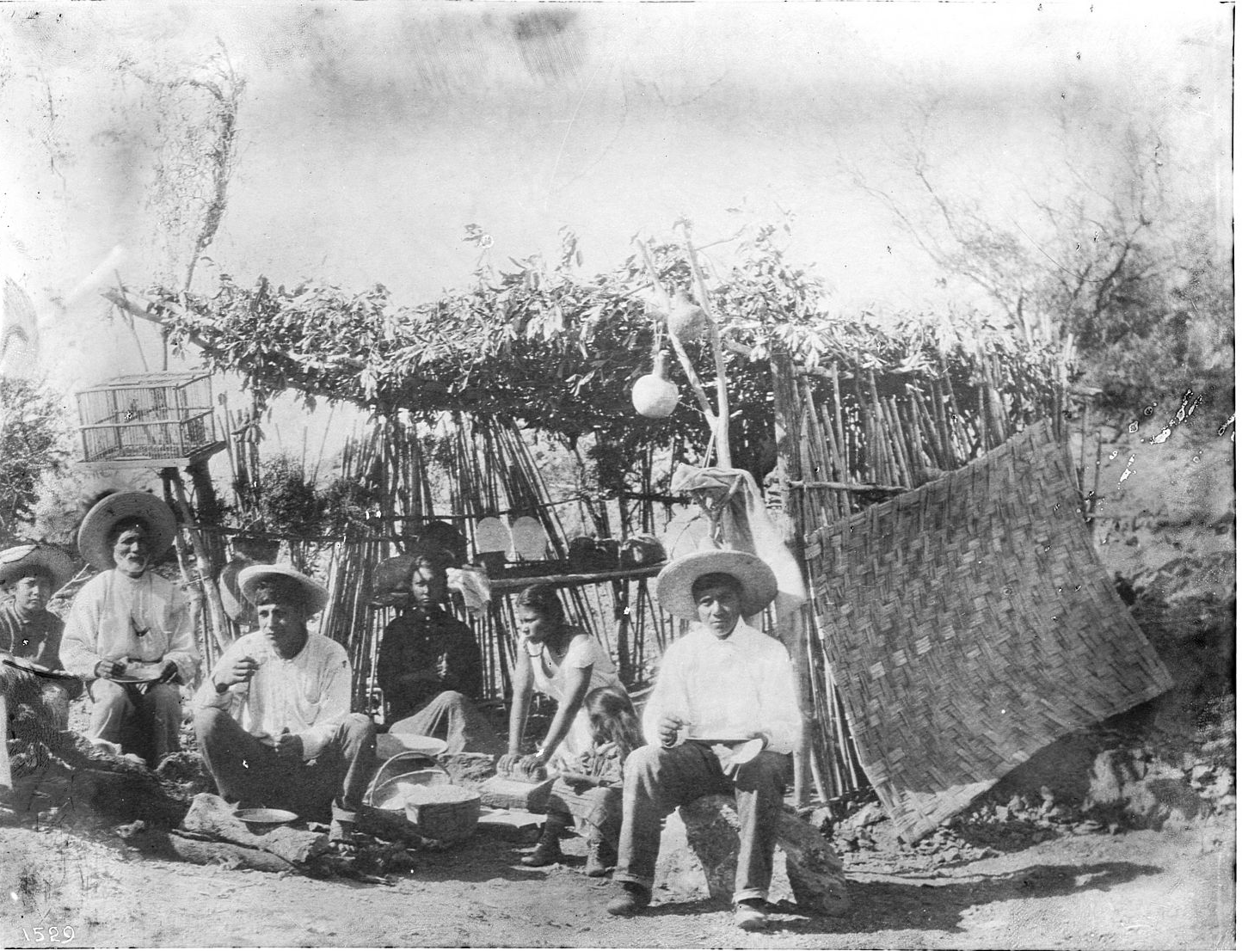

Slide 21
Immediate Political Problems
1808 Napoleon forces Spanish king to abdicate and places French puppet on throne.
Spain loses credibility.
September 1808 Mexico City council and Viceroy, José de Iturrigaray claim sovereignty in absence of true king.
September 1808 Spanish peninsulares lead coup against Iturrigaray and imprison pro-independence elites.
As a result, Mexican Independence is not only an elite-led movement.

Slide 22
The popular revolt
16 September 1810 provincial Creole priest, Miguel Hidalgo, Grito de Dolores and leads an insurgency of thousands against Spanish forces.
United under the banner of Virgin of Guadalupe.
“Death to bad government”
Limited political aims?
Massacre of the Granary of Guanajuato
Millenarian?

Slide 23
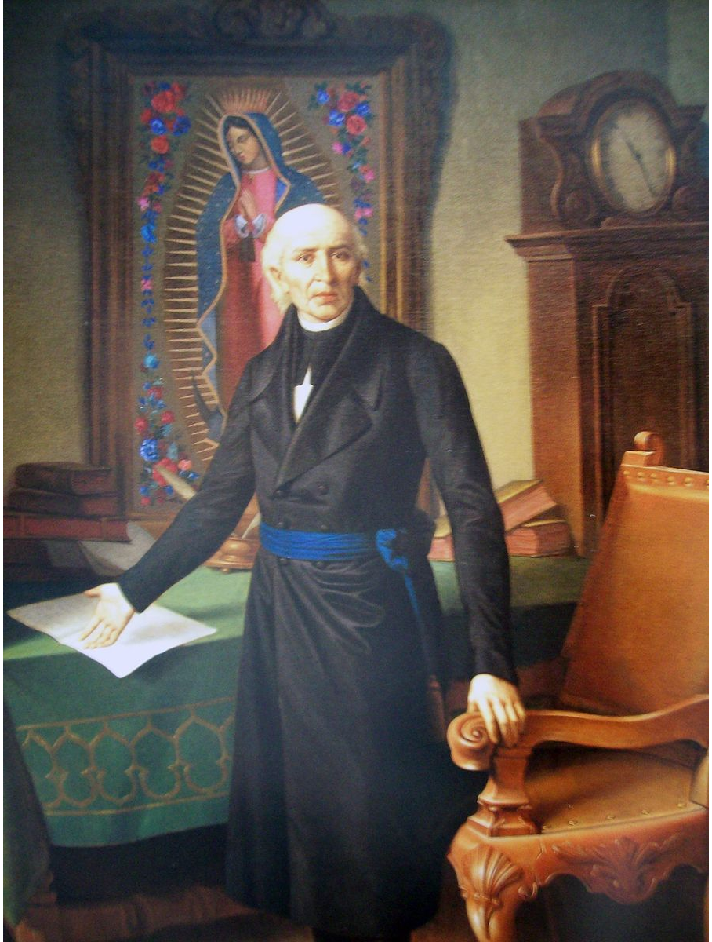
Miguel Hidago y Costilla

Slide 24
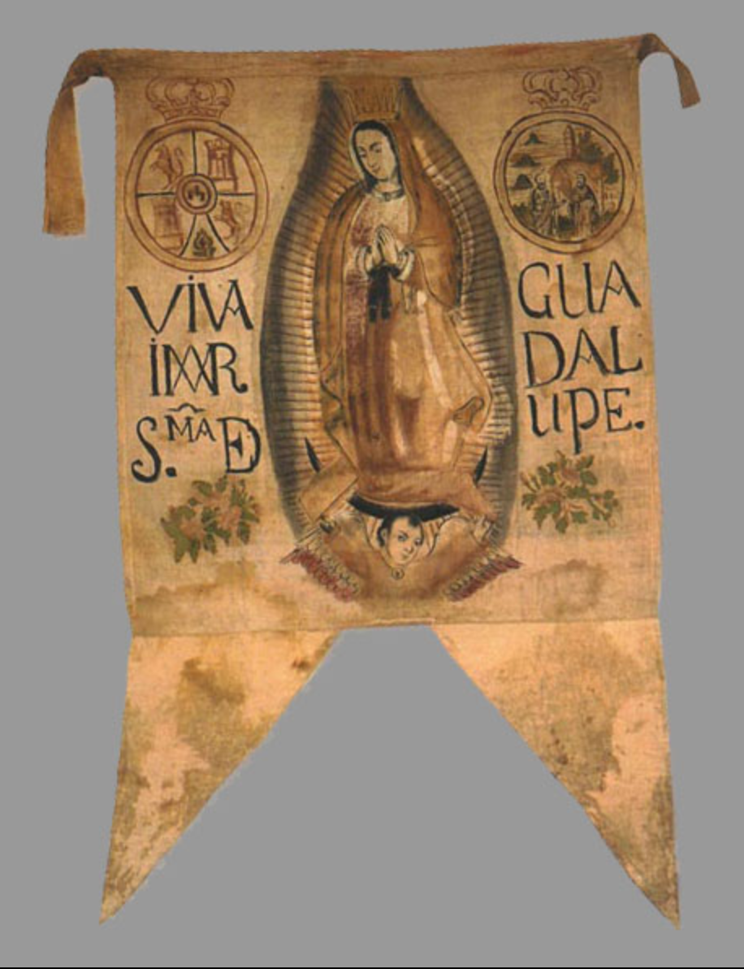

Slide 25
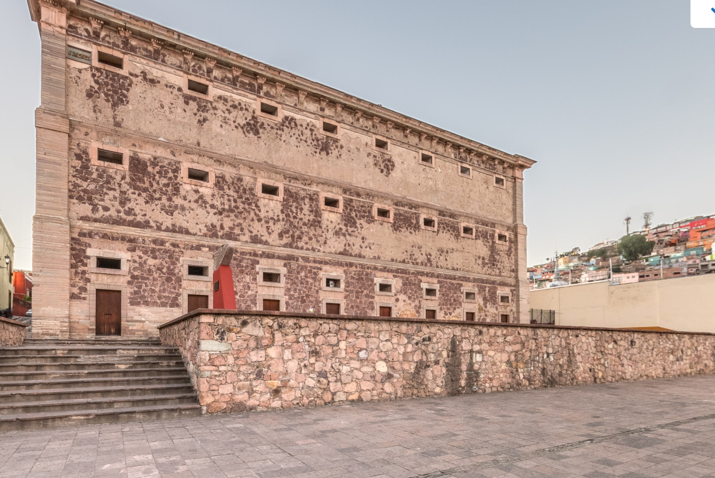

Slide 26
The republican turn
After death of Miguel Hidalgo in 1811, another priest, José María Morelos, leads the pro-independence forces. After his death (1815), forces are led by Vicente Guerrero. Centered around Tierra Caliente on Pacific coast.
Pro-Independence forces start to link political independence with:
Getting rid of caste system.
Abolition of slavery
Equality before the law (abolition of fueros)
At the Congress of Chilpancingo (1813), it was declared “That slavery is proscribed forever, , as well as the distinctions of caste [race], so that all shall be equal; and that the only distinction between one American and another shall be that between vice and virtue."

Slide 27
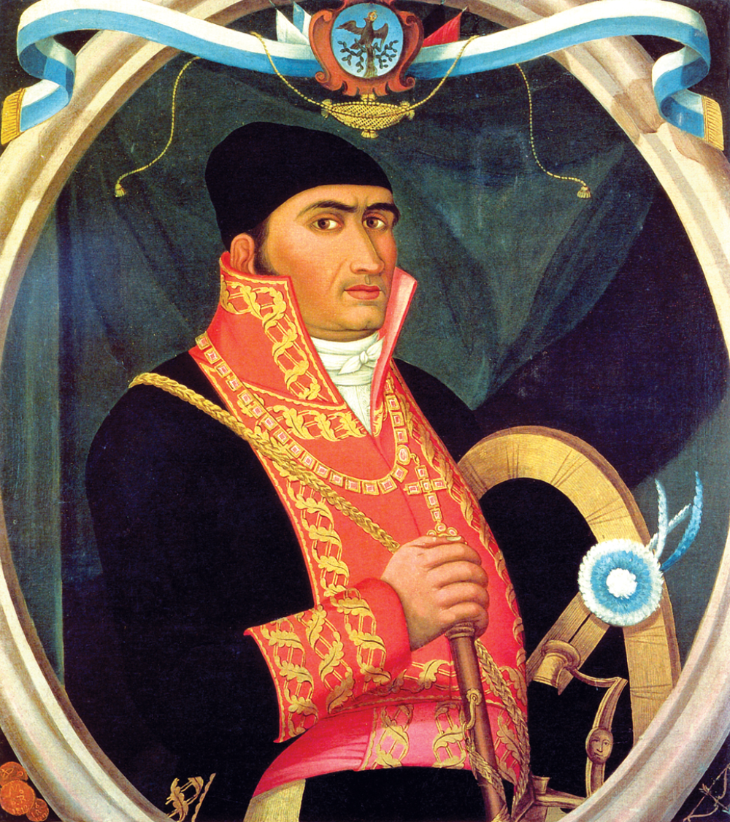
José María Morelos

Slide 28
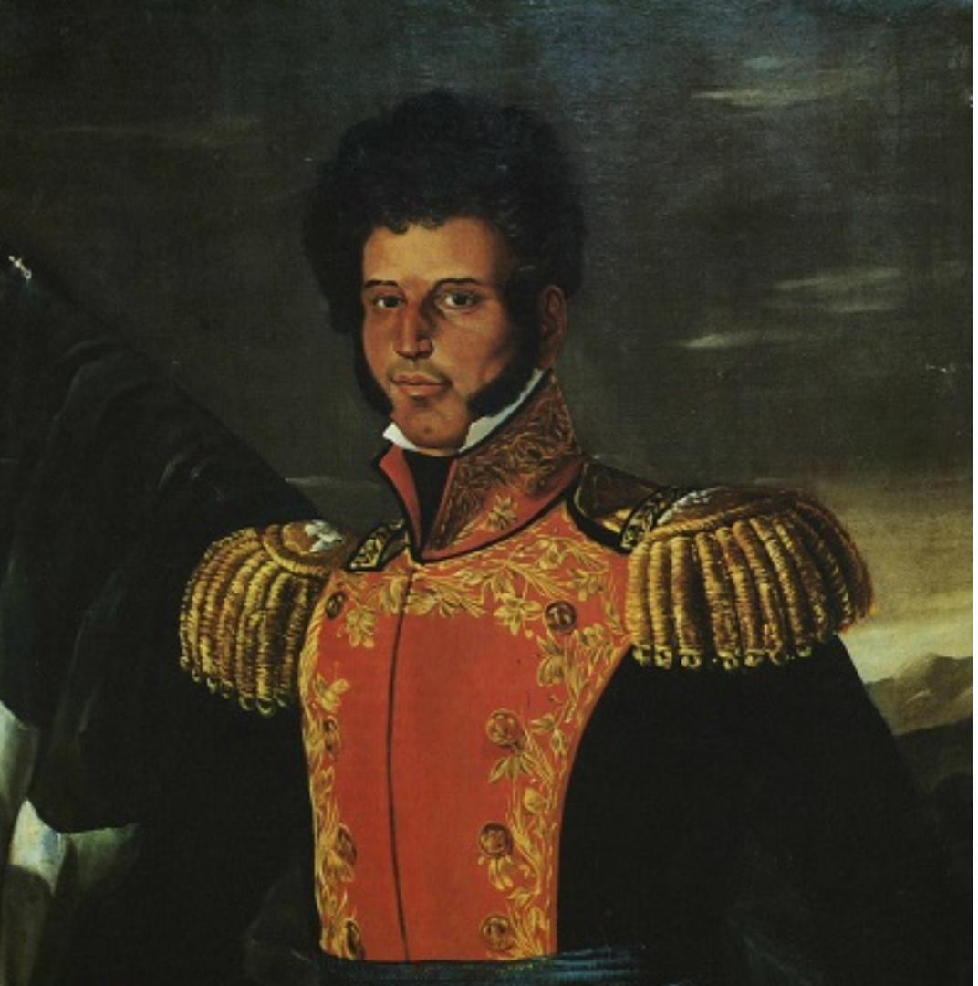
Vicente Guerrero

Slide 29
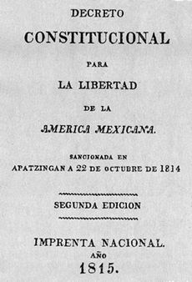
Meanwhile in Spain
1812 Liberal Constitution of Cadiz. Maintains New Spain as colony. But gets rid of república de indios and institutes town councils throughout New Spain.
Creation of town councils (municipios) is crucial for Mexican political system. They are the basis for bottom up democracy to this day.
1814 Monarchist coup gets rid of Liberal Constitution of Cádiz
1820 Return of liberals and Constitution of Cádiz.

Slide 30
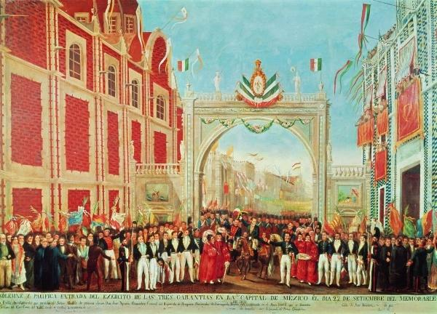
1820-1821 Mexican Independence
Royalists under Agustín de Iturbide see Cádiz Constitution as a threat to status quo. Therefore, move towards Independence.
Rebels under Guerrero see opportunity for independence through alliance with former enemies.
27 Sept 1821 Iturbide rides in Mexico City and next day declares Independence. The Plan de Iguala. The Three Guarantees.

Slide 31
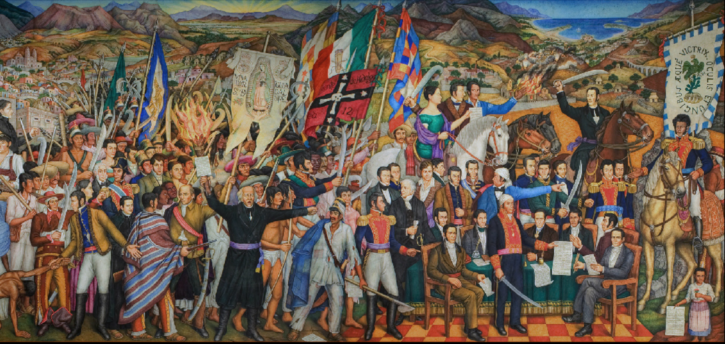
Mexican Independence, Diego Rivera, Palacio Nacional, 1935

Slide 32
Independence Version 1
Buildup of anti-Spanish feeling (late 18th century) . . .
leads to anti-Spanish independence movements in 1810
the significance of the Enlightenment:
--circulation of ideas and discourses across the Atlantic (republicanism, natural laws, citizenship)
--emergence of new identities (creole patriotism)
Bourbon reforms eroded the ‘colonial pact’ and led to widespread cross-class dissatisfaction with Spanish rule
proto-nationalism
leading to a breakdown in colonial hegemony and the start of the wars of independence

Slide 33
Independence Version 2
Napoleonic wars, and especially Napoleon’s invasion of the Iberian Peninsula in 1807 . . .
led to breakdown in political consensus in the Hispanic world
One version stresses the antecedents/ the build up to the actual outbreak of independence.

Slide 34
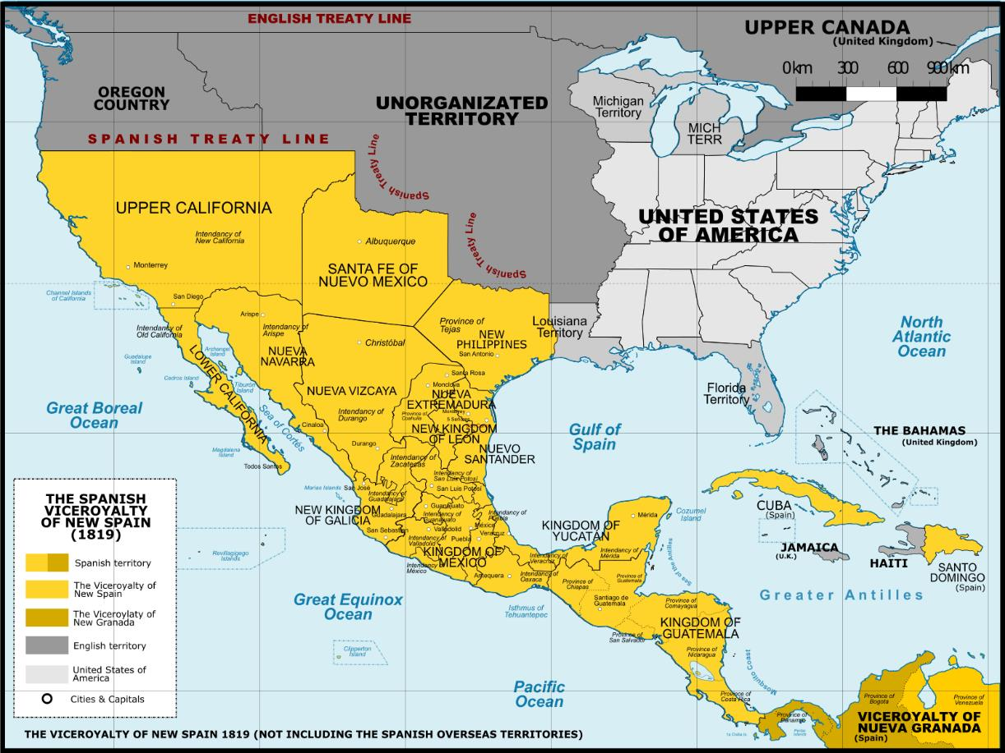
New Spain, 1819

