Slide 1
Mexico: An Introduction

Slide 2
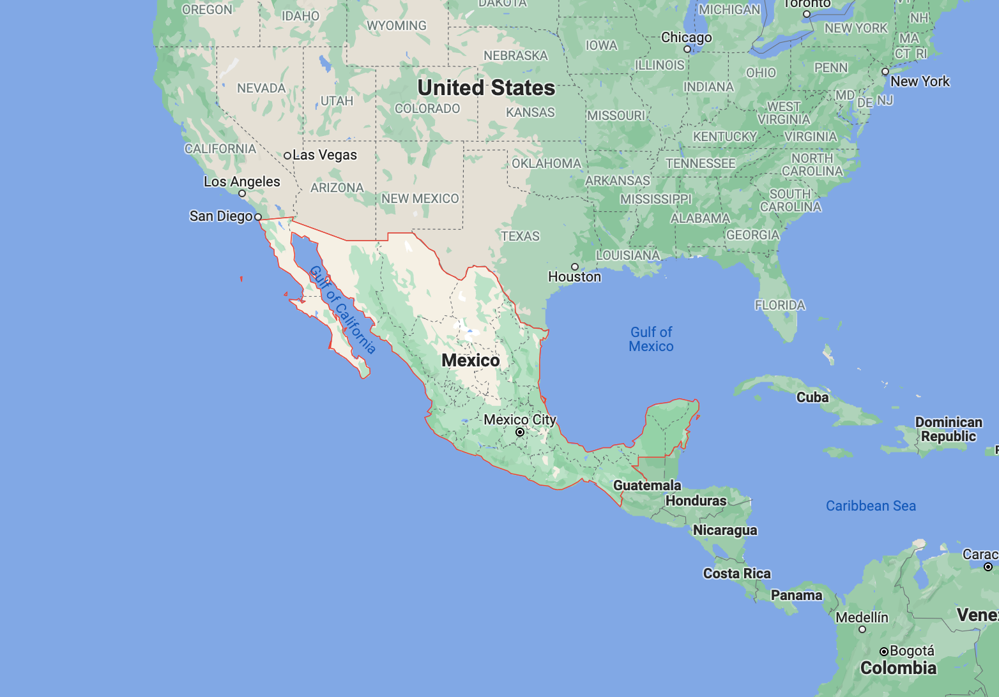
Mexico Today
1.9 million sq km
(10 times the size of UK/3 times the size of France)
128 million people (twice size of UK)
GDP: 1 trillion USD (12th in world)

Slide 3
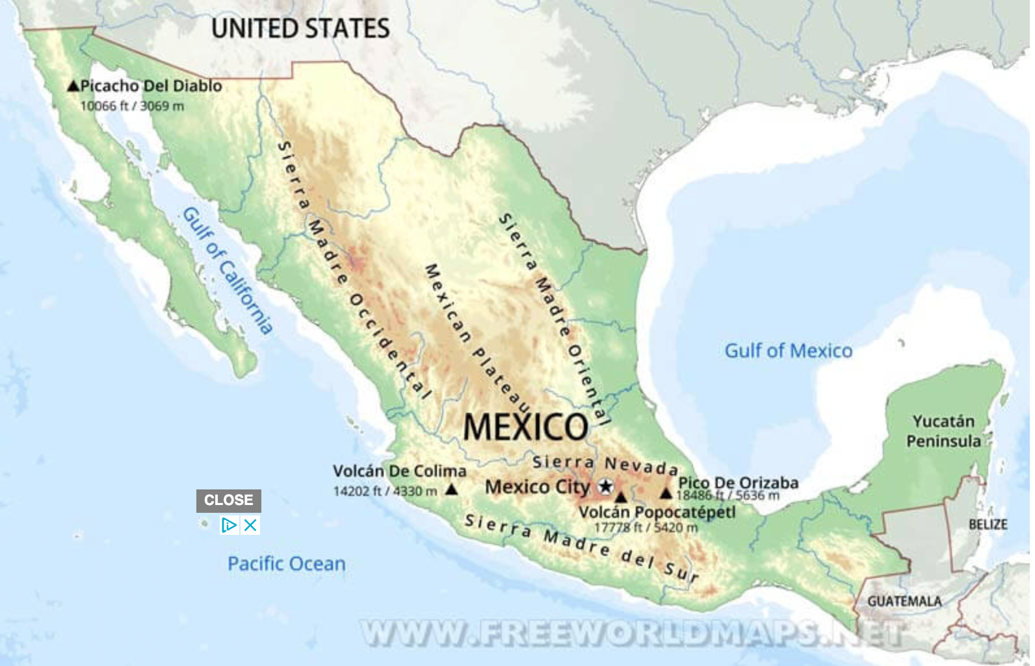
Geography of Mexico
Mountain ranges: Sierra Madre Occidental, Sierra Madre Oriental, Sierra Madre del Sur

Slide 4
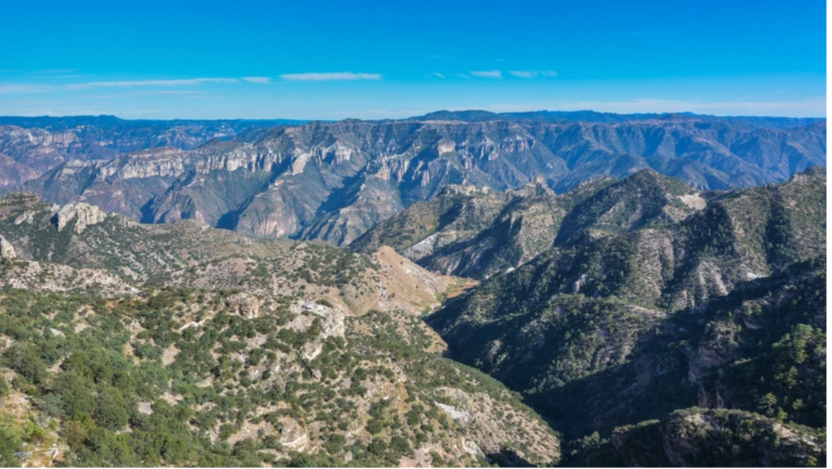
Sierra Madre Occidental, Chihuahua

Slide 5
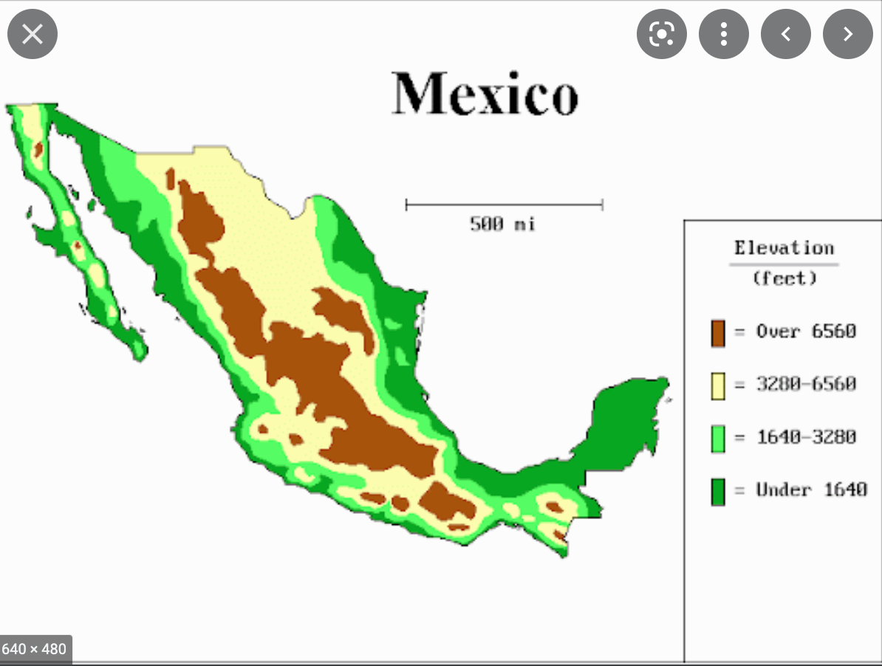
The Mexican Lowlands
Yucatán peninsula, Pacific and Caribbean coasts, Isthmus

Slide 6
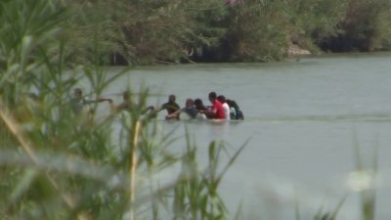
Rio Bravo

Slide 7
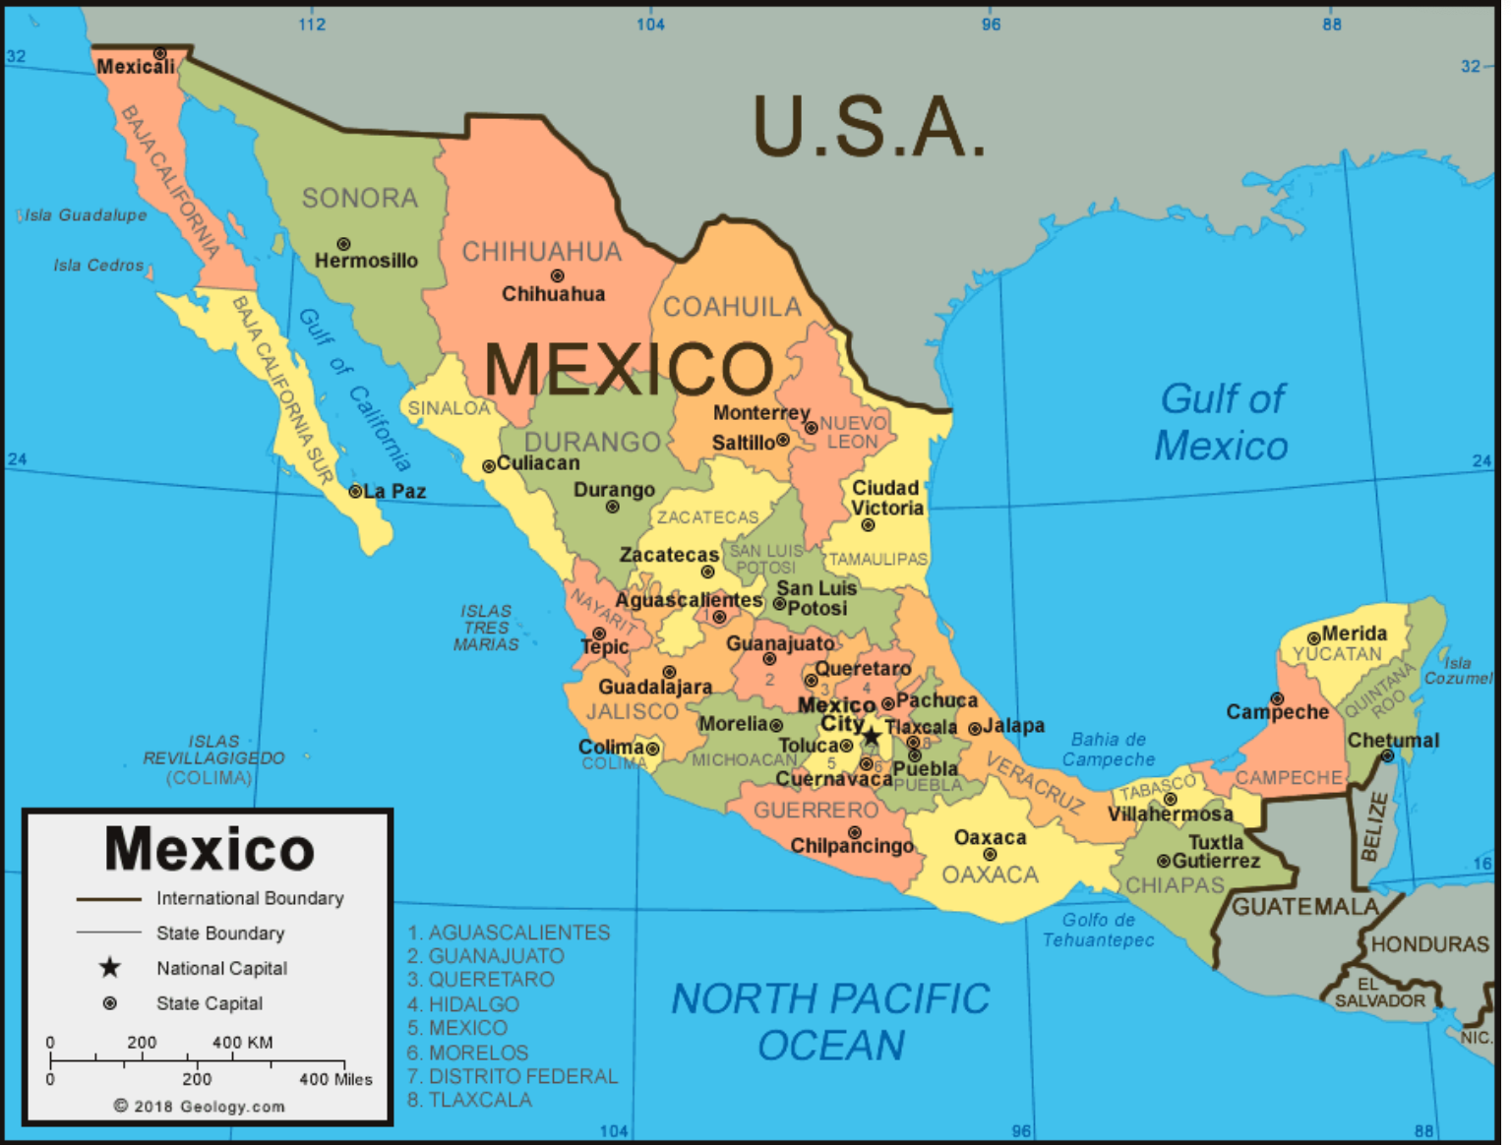
Politics in Mexico
Mexico was a colony of Spain from 1521-1821
Since then, with a few changes, it has been federation and a democracy.
It has been – and is – divided into states and municipalities . Each has their own governing body and their own regional cultures.

Slide 8
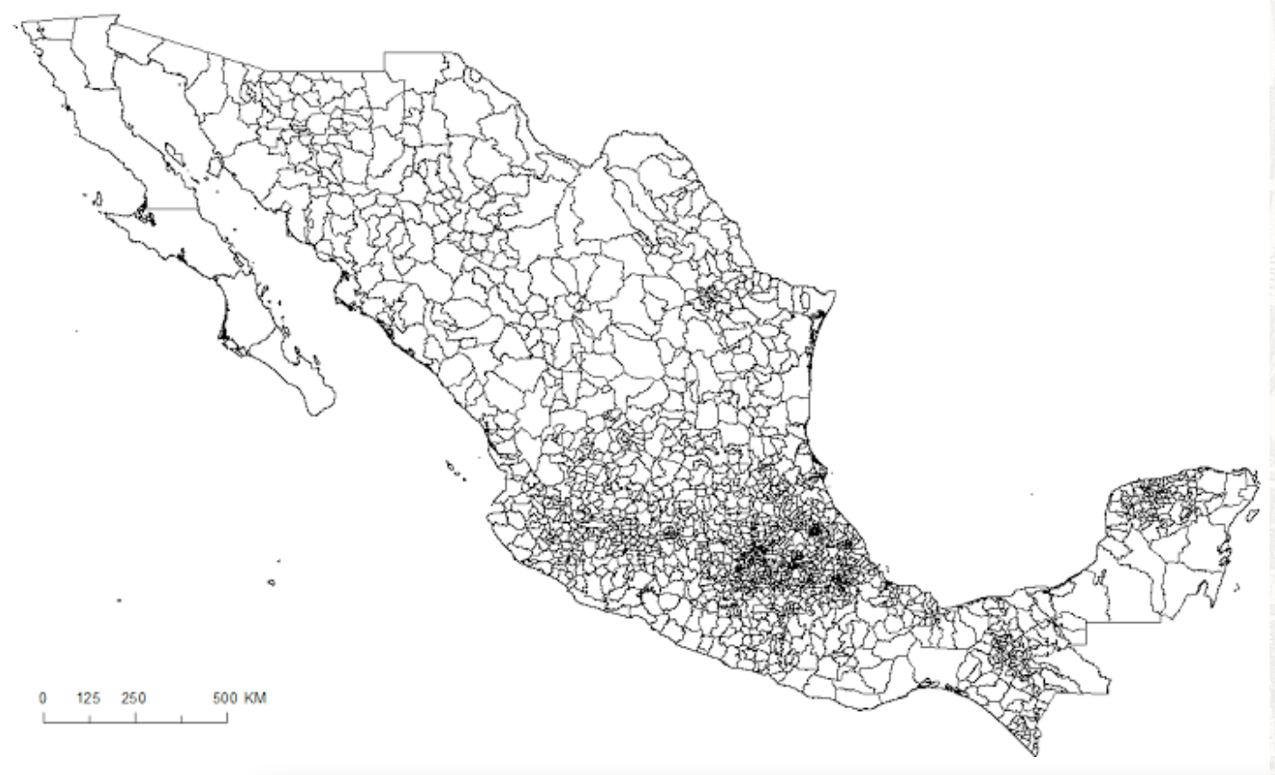
Mexico
More than 2500 municipalities. Each municipality has a mayor and a council.

Slide 9
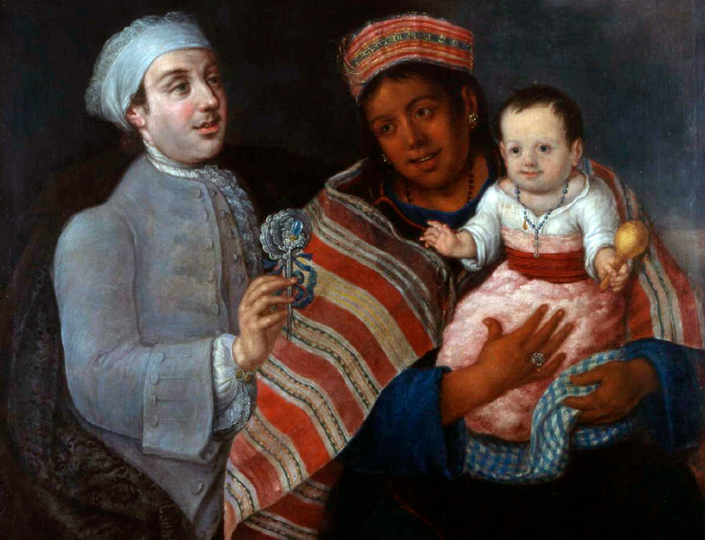
Race in Mexico
Mexico presents itself as a mestizo or mixed-race nation.
Still around 50-60 per cent of Mexicans identify as mestizo
They identify as a mixture of Spanish and indigenous descent

Slide 10
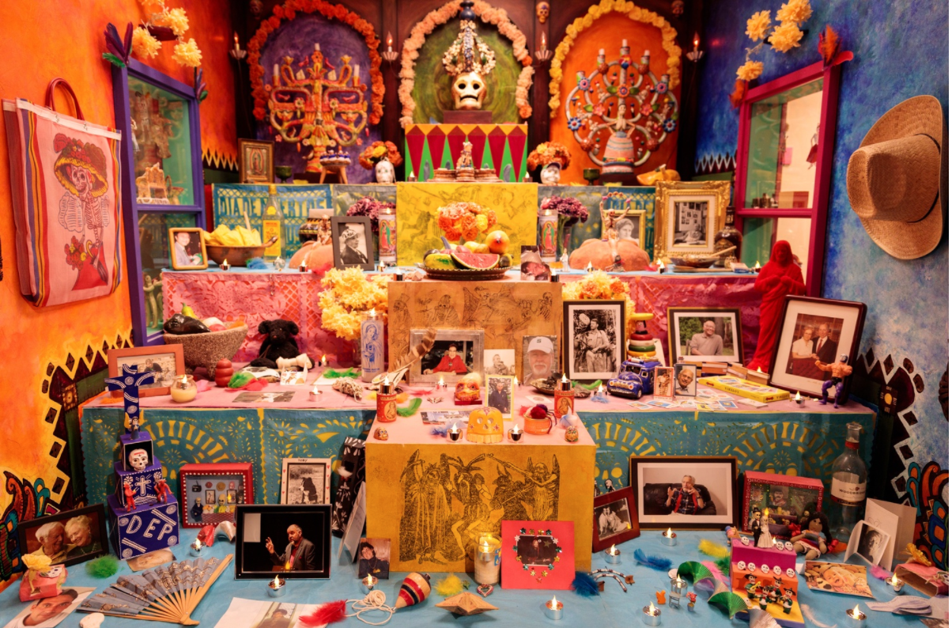
What is mestizaje?
What is mestizaje?
Mestizaje describes the process of ‘biological’ mixing.
But it also describes the process of cultural mixing.
Thus, theoretically you can be indigenous ‘biologically’ but also mestizo in terms of culture.

Slide 11
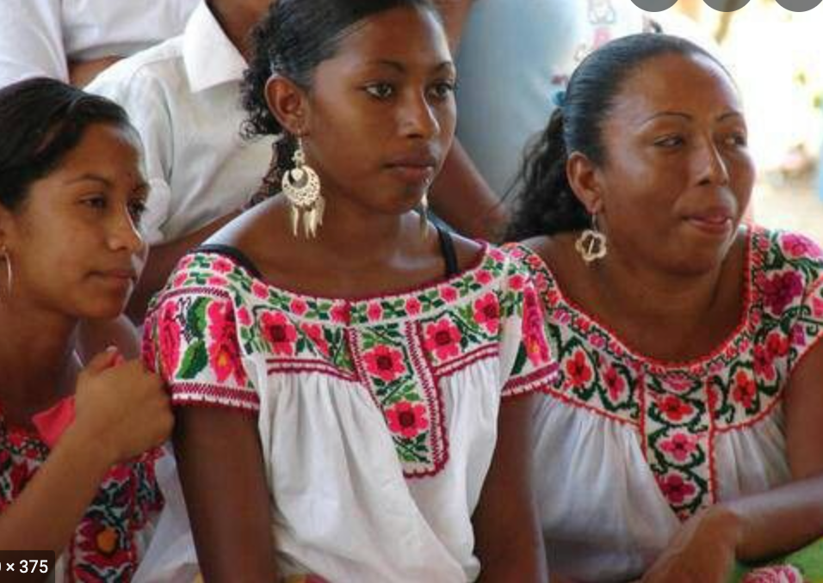
Though Mexico has often prided itself on its racial blindness (especially in comparison to the USA), it is no racial utopia.
1) Where are the people of African descent? Left out of idea of mestizaje, left out of the idea of the nation.

Slide 12
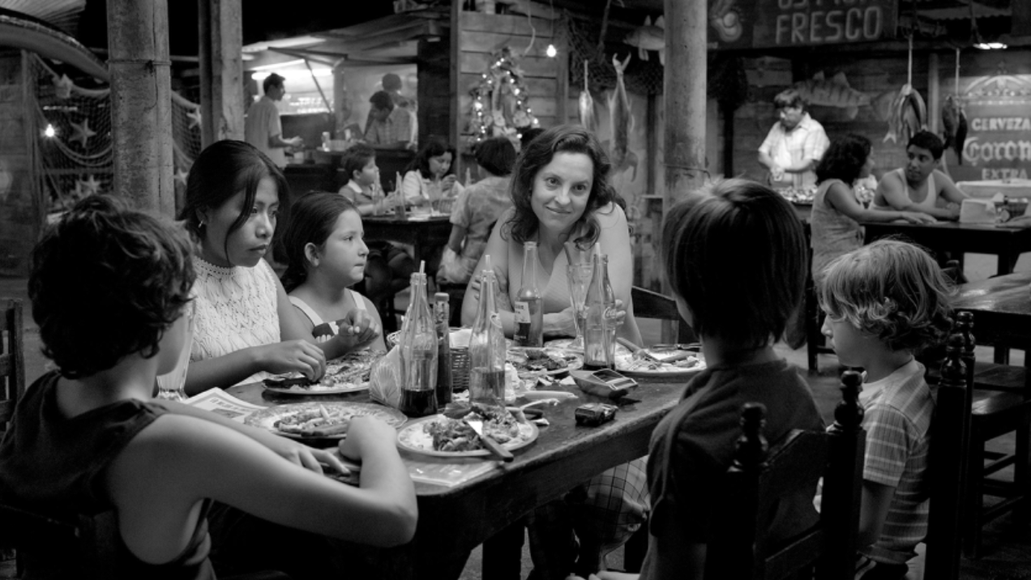
2) There is still a persistent racial hierarchy. This overlaps with the socio-economic hierarchy. If you are indigenous, you are more likely to be poor.

Slide 13
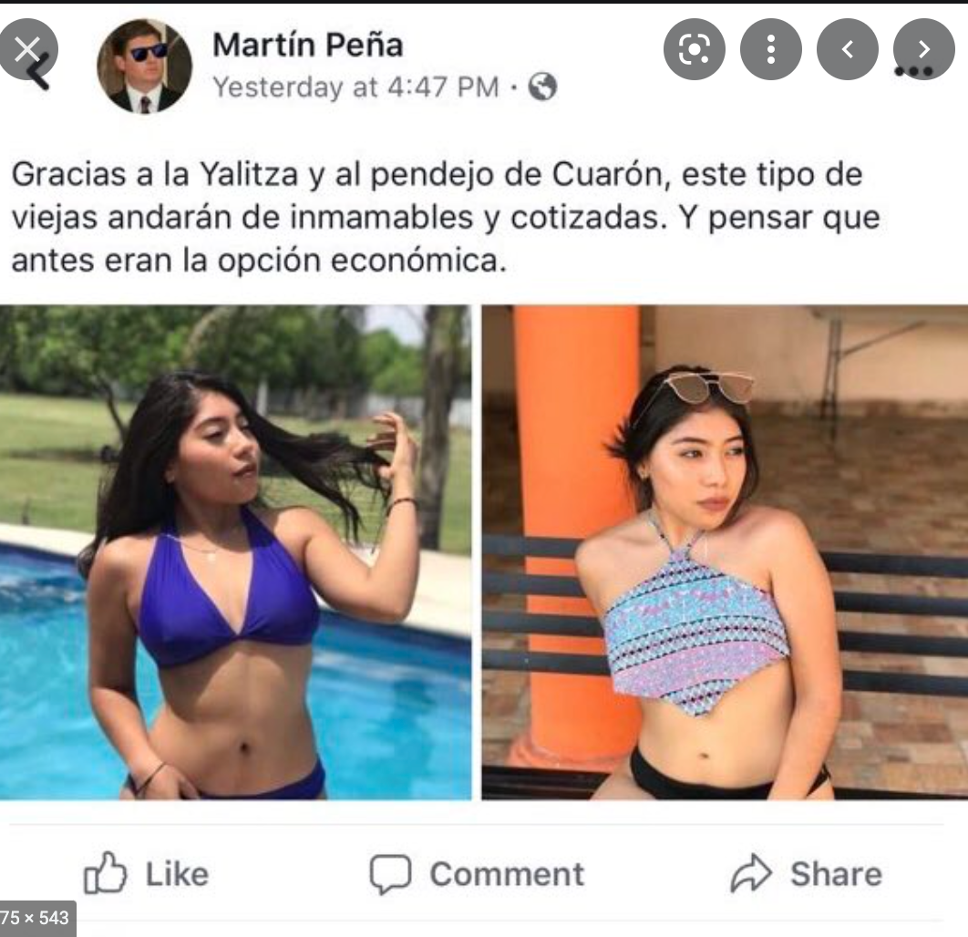
Roma itself generated an enormous backlash in social and mainstream media

Slide 14
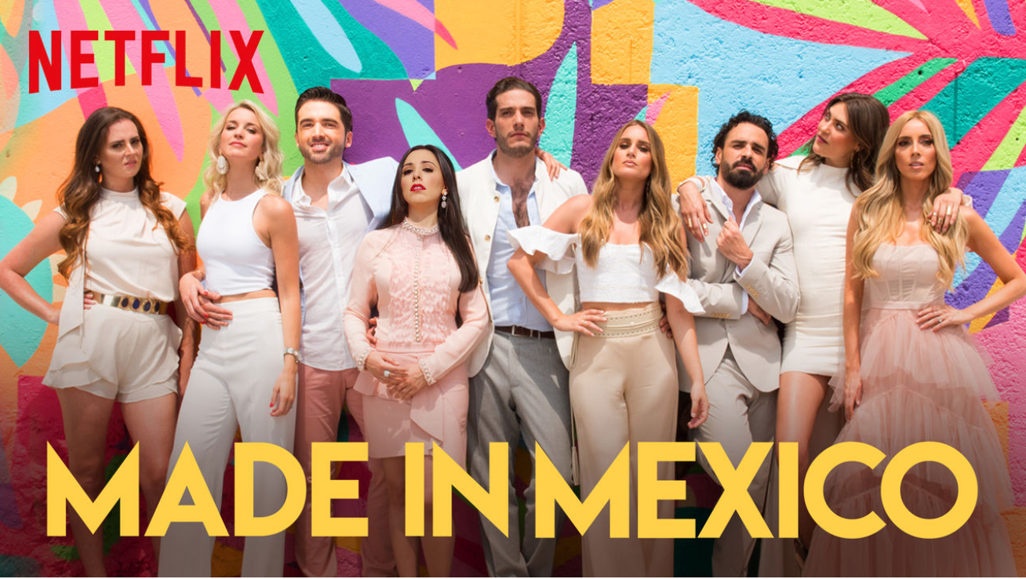
This is also evident in the mainstream media – check out the various Whitexican memes

Slide 15
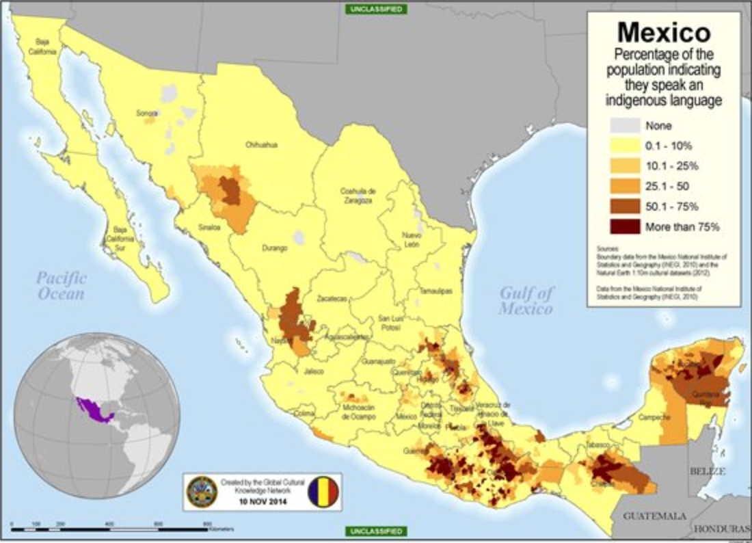
But it can also be seen in the endurance of indigenous cultures.
There are 61 different indigenous groups in Mexico.
The include speaks of Nahuatl (Aztec), Mixtec, Zapotec, Totonac.
In just the state of Oaxaca there are 16 and over 100 diffuse indigenous dialects.

Slide 16
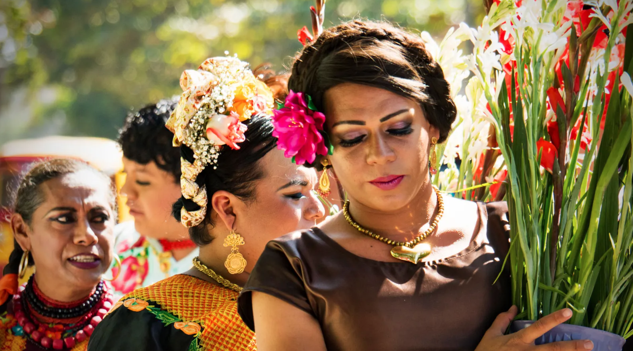
Juchitán: Zapotec City

Slide 17
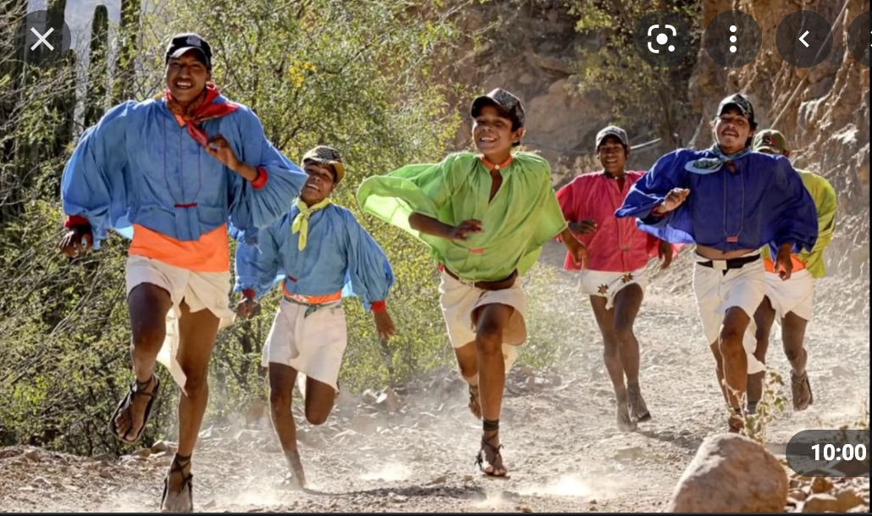
Raramuri of Chihuahua

Slide 18
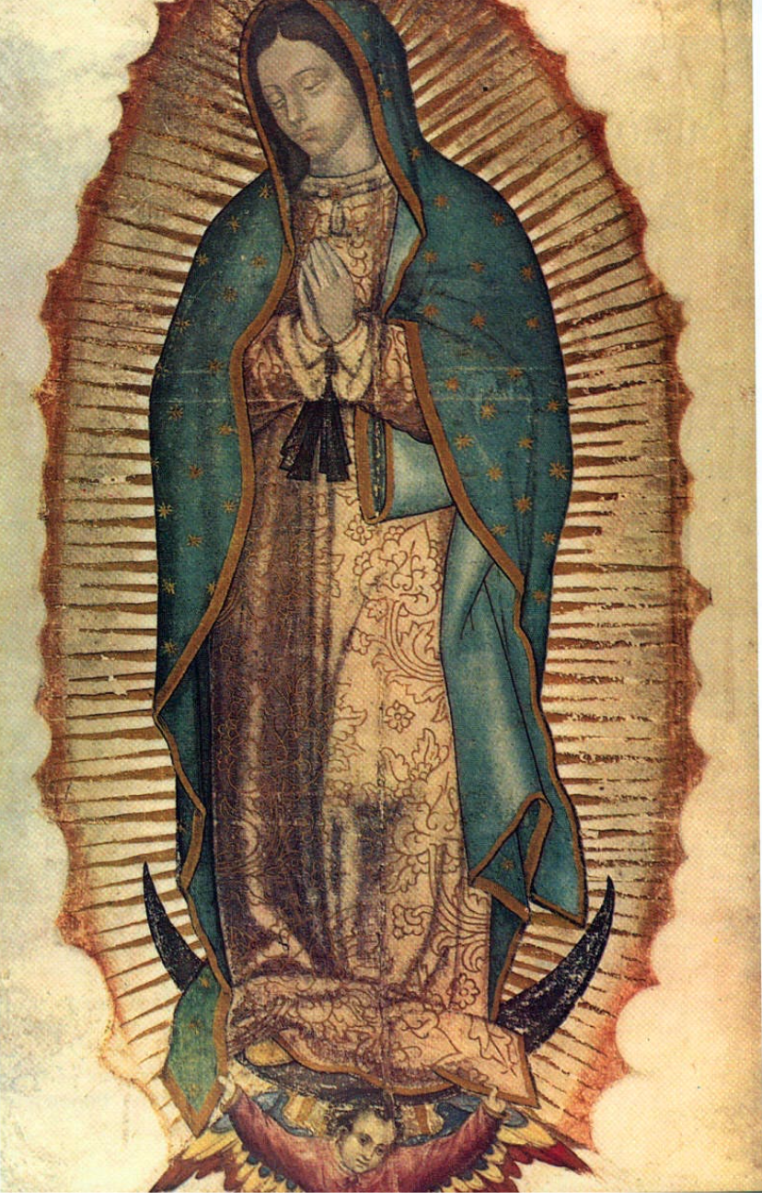
Religion in Mexico
Religion in Mexico
Religion, like race and culture, is a mixture.
Most Mexicans are Catholic.
But this Catholicism is a mixture of indigenous, Spanish, and African traditions.

Slide 19
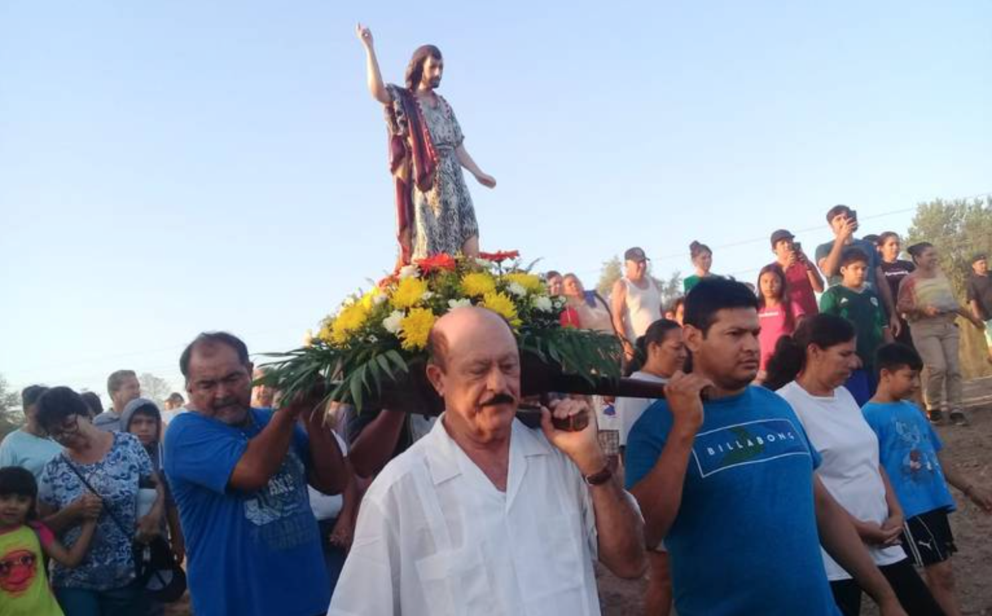
The saints are key to Mexican everyday life.
They protect the village and the individual.

Slide 20
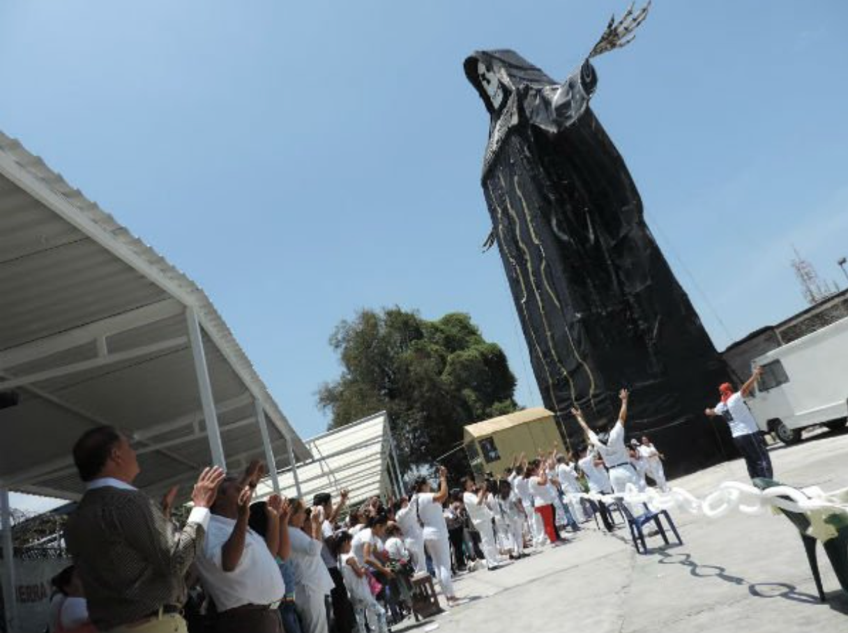
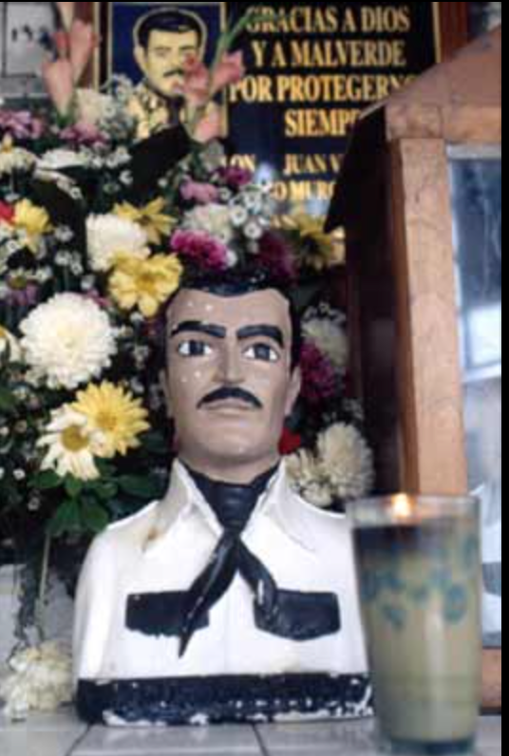
Mexico’s new saints have embraced this cultural mixing

