Slide 1
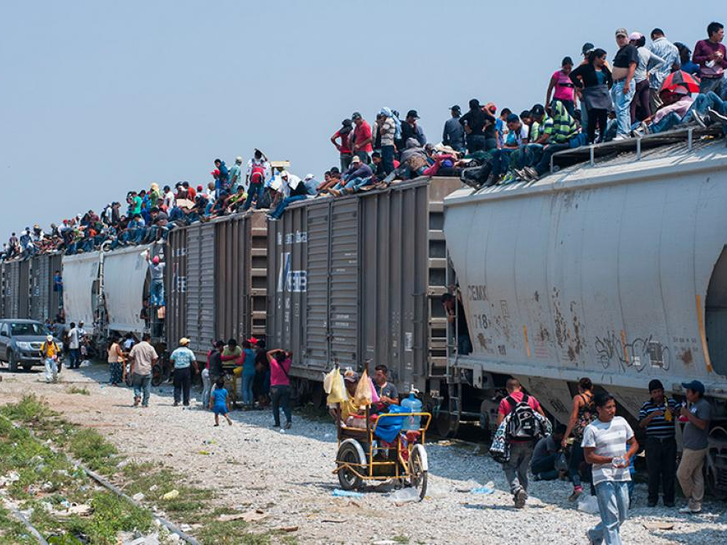
A History of Mexico-U.S. Migration

Slide 2
Some Representations
Clandestino
https://www.youtube.com/watch?v=7AzimrAgWbA
Immigrants
https://www.youtube.com/watch?v=6_35a7sn6ds
La Bestia
https://www.youtube.com/watch?v=JMfUdb9QUpM
The Beast
https://www.youtube.com/watch?v=JOw5YEIg-t4

Slide 3
Successive waves of migration
California Gold Rush (1848-1855)
Liberal-Conservative Civil wars (1854-1867)
Mexican Revolution (1910-1920)
Cristiada (1926-1929)

Slide 4
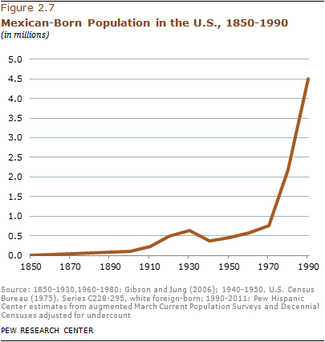

Slide 5
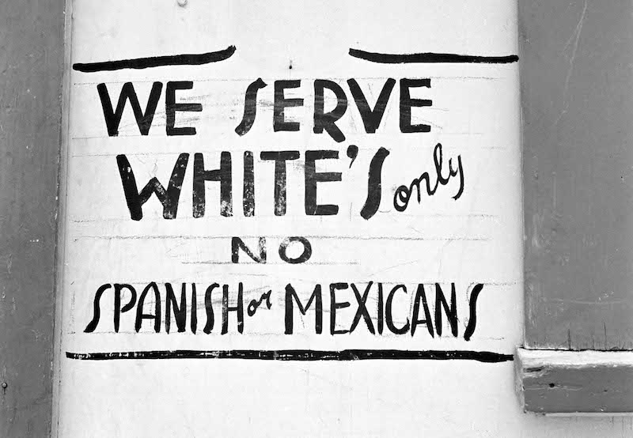
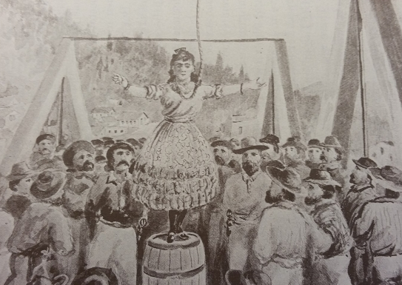
Anti-Mexican Discrimination
Illegal deportations. (Bisbee deportation 1917)
School segregations (in 1940, as many as 80% of Orange County Latinos attended separate schools)
Lynching
Illegal Shootings

Slide 6
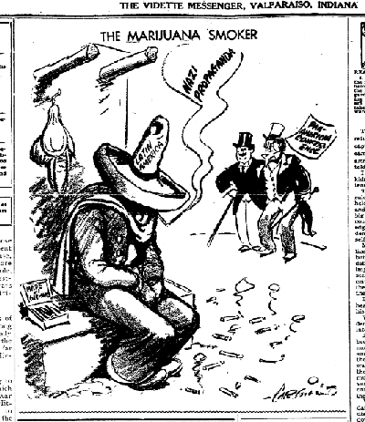
The Great Depression
High unemployment and agricultural stagnation.
Many U.S. government ministers, civil society spokesmen and citizens focus anger on Mexicans.

Slide 7
1929-1936 Repatriation i.e. Deportation of between 500,000 and 2 million Mexicans.
Some repatriations were voluntary.
Some conducted by private companies.
However, especially in California, immigration raids, quick court hearings, and deportation was forced.

Slide 8
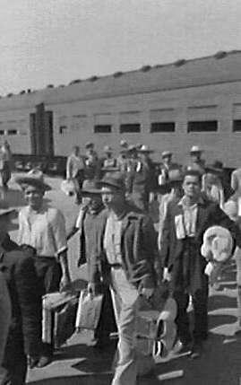
Bracero Program, 1942-1964
1942 Need for workers in U.S. agriculture because of WWII. Arrange large scale organized labor migration.
Around 200,000 per year
Immigration within limits – allowed certain jobs, wages deducted, kept to certain areas.

Slide 9
Deportations continue
E.g. After 1945, 400,000 Mexicans deported at the end of WWII.
Operation Wetback, 1954. First major tactical operation designed by the INS (Immigration and Naturalization Service) to block “illegal” Mexican immigration

Slide 10
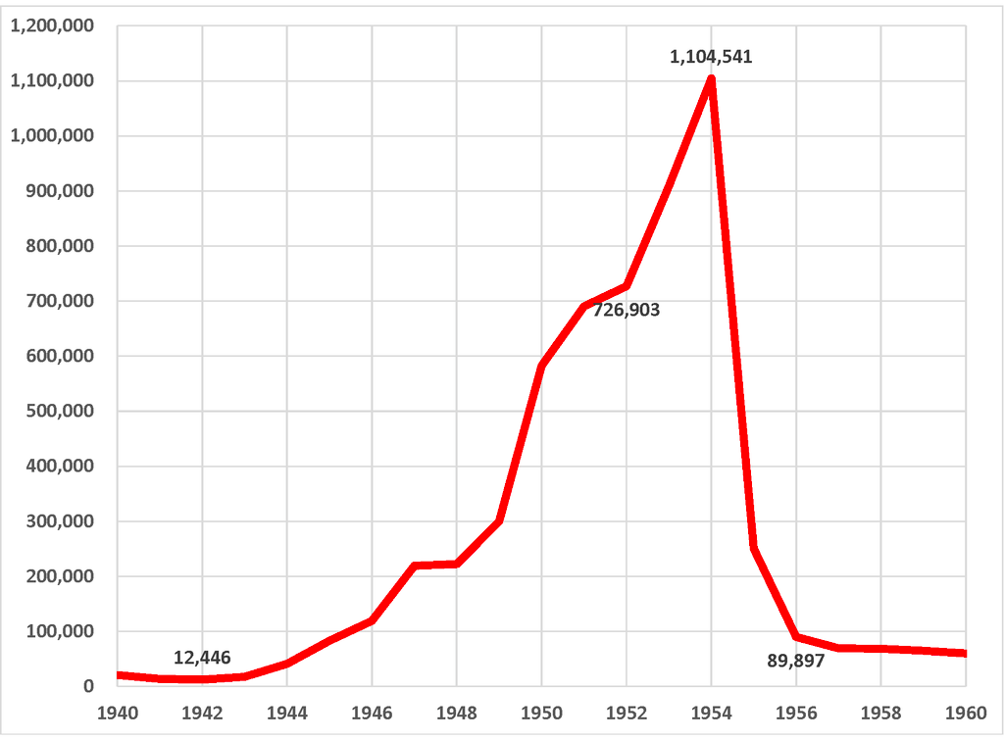
Mexican deportations

Slide 11
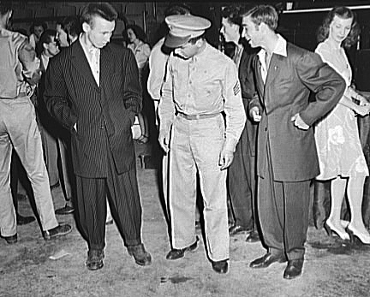
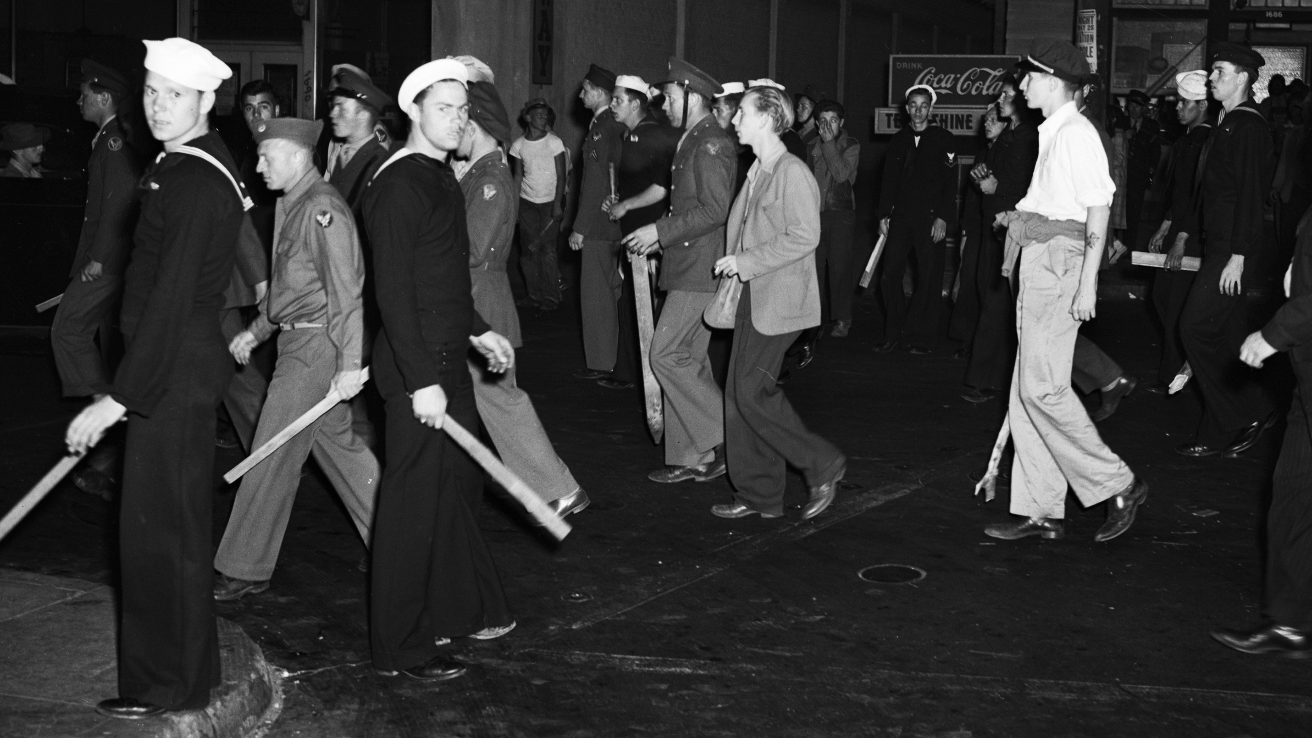
Tensions continue
E.g. Zoot suit riots (1943)

Slide 12
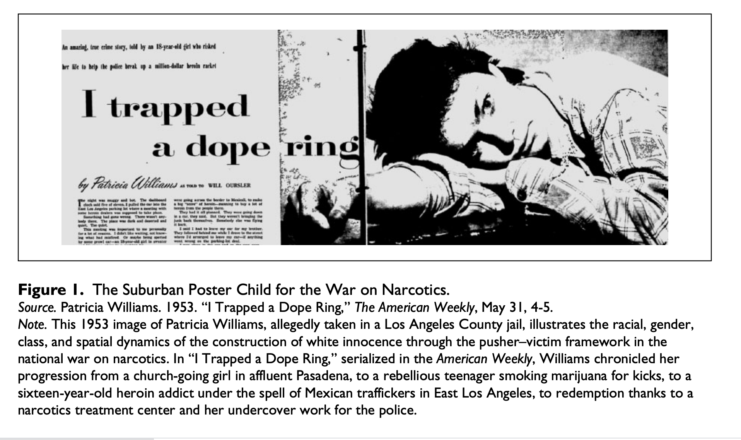
Or Increasingly Aggressive Anti-Narcotics Legislation in California

Slide 13
New Waves of Migration
1965 Border Industrialization Program. Designed to establish tariff-free border region. In fact, causes major influx of migrants to northern cities and then over the border.
Economic crises
Decline of peasant agriculture from 1950s onwards.
“Closed shop” nature of Mexican labor.
Increasing informal labor in Mexican cities.
Distinct economic crises – 1976, 1982, 1994 spur migration.

Slide 14
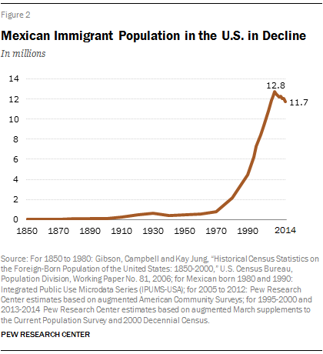

Slide 15
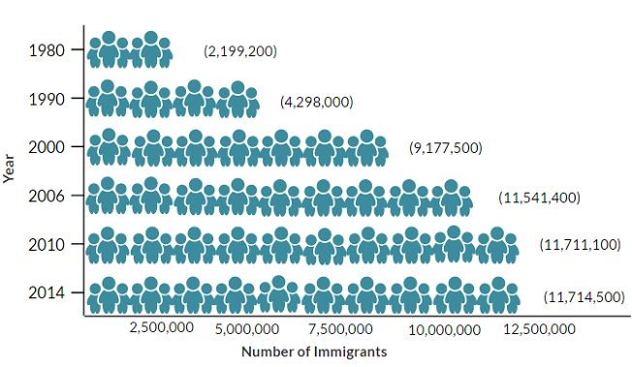
Mexican immigrant population in U.S.

Slide 16
Questions?
Push/pull factors
U.S. - Higher wages, more stable jobs, stable currency, by the 1990s large Mexican communities in the U.S.
Mexico – to what extent was migration a “pressure relief mechanism” (Snodgrass), embraced by some Mexican politicians to control a) agrarian unrest b) stifle industrial costs c) possible urban unrest d) increase remittances.
Mexicans increasingly “pushed” by non-economic factors e.g. Cold War violence, drug war, state-wide strikes.

Slide 17
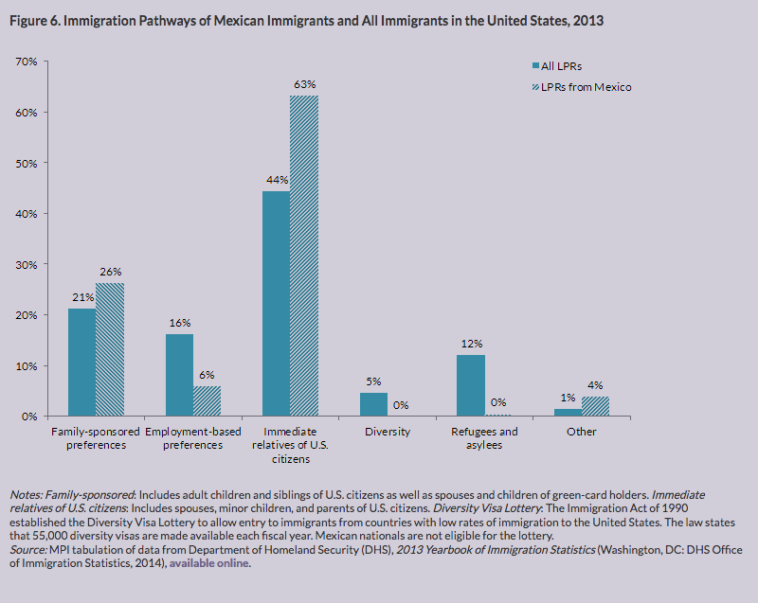
Family relations as key factor

Slide 18
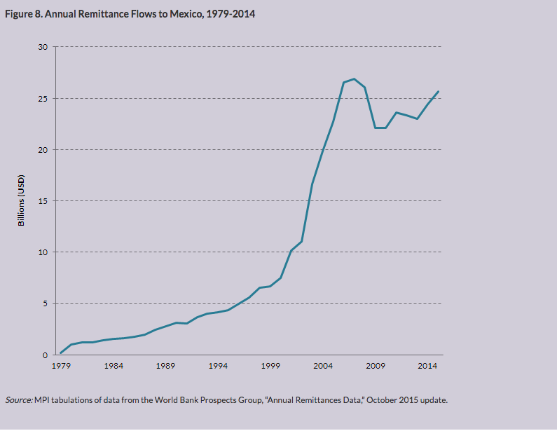
Remittance flow

Slide 19
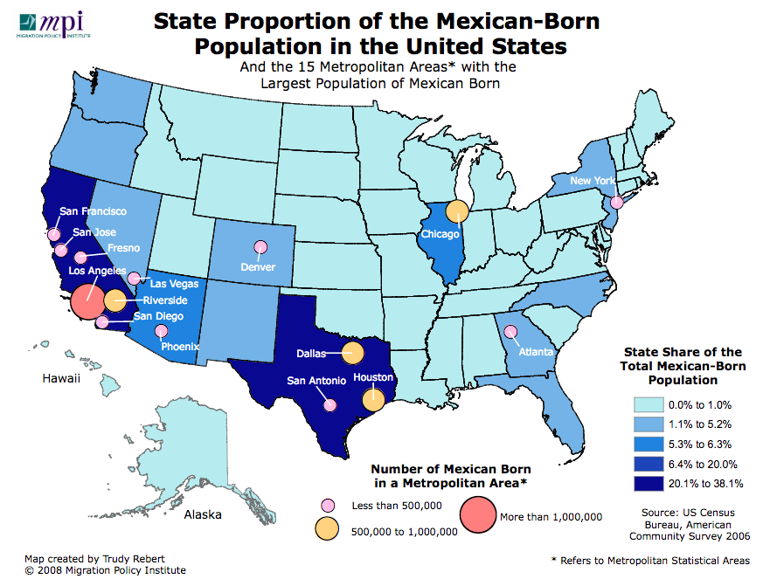
Where?

Slide 20
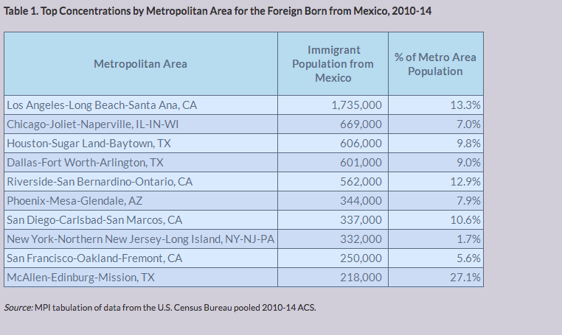
New geographies of migration, 2000-2014

Slide 21
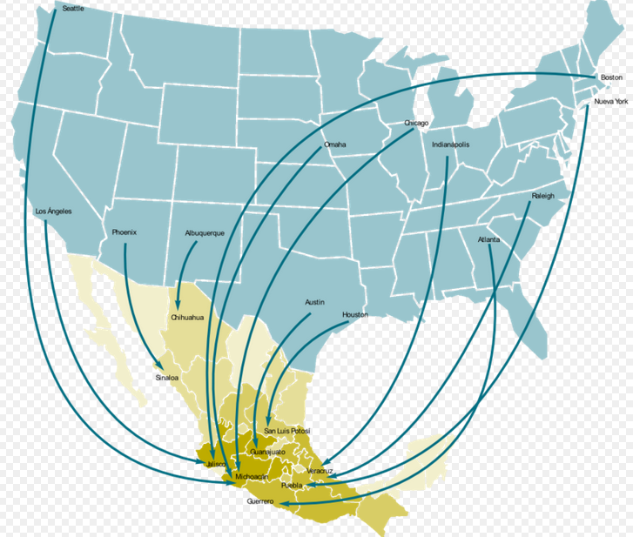
Where from? Flow of remittances 2006-7

Slide 22
A New United States
Increasing economic role of Mexicans/Mexican Americans.
Increasing political influence (28-30 per cent of voters now “Hispanic”). Predominantly Democrat.
Increasing cultural impact of Mexican-Americans: music, film, religion, food, sport etc.

Slide 23
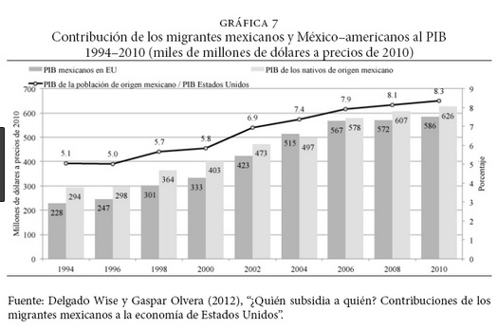

Slide 24
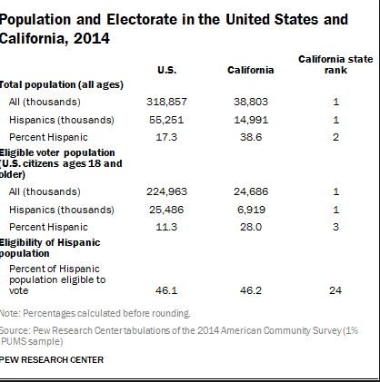

Slide 25

Cuauhtémoc Blanco Bravo

Slide 26

Mexican Filmmakers

Slide 27
The new border
Increasingly militarised border patrol
Increasing paramilitary organization (e.g. Minute Men)
Fences, walls, and patrols push migrants towards desertified “dead zones”.

Slide 28
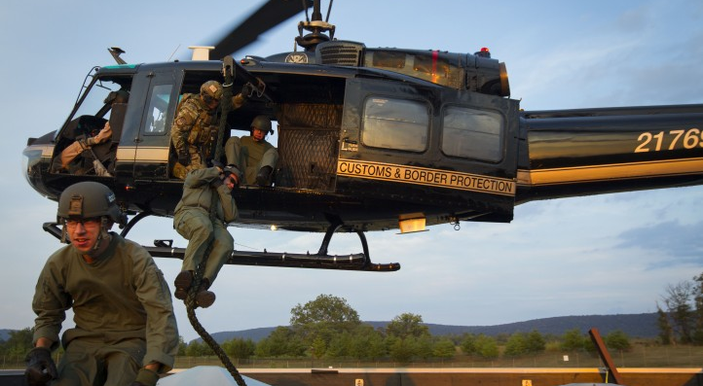

Slide 29
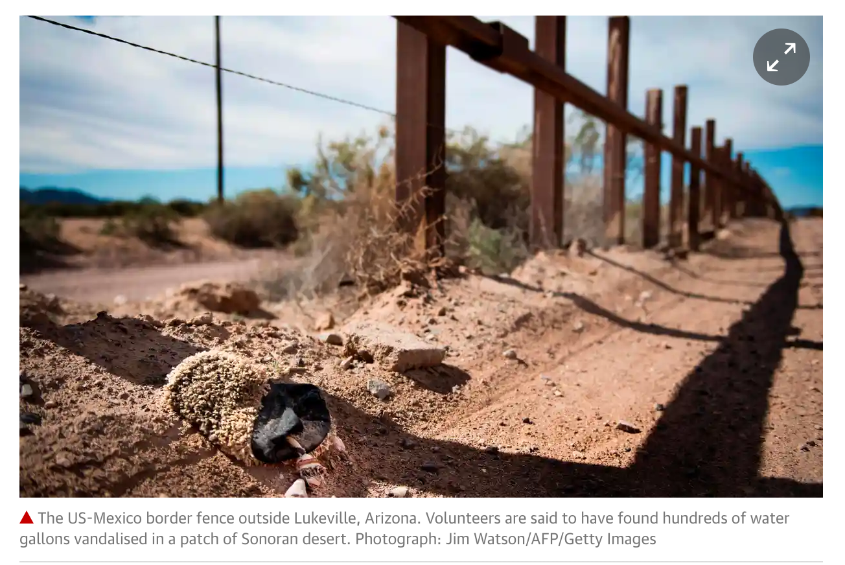
https://www.theguardian.com/us-news/2018/jan/17/us-border-patrol-sabotage-aid-migrants-mexico-arizona

Slide 30

The Minute Men

Slide 31
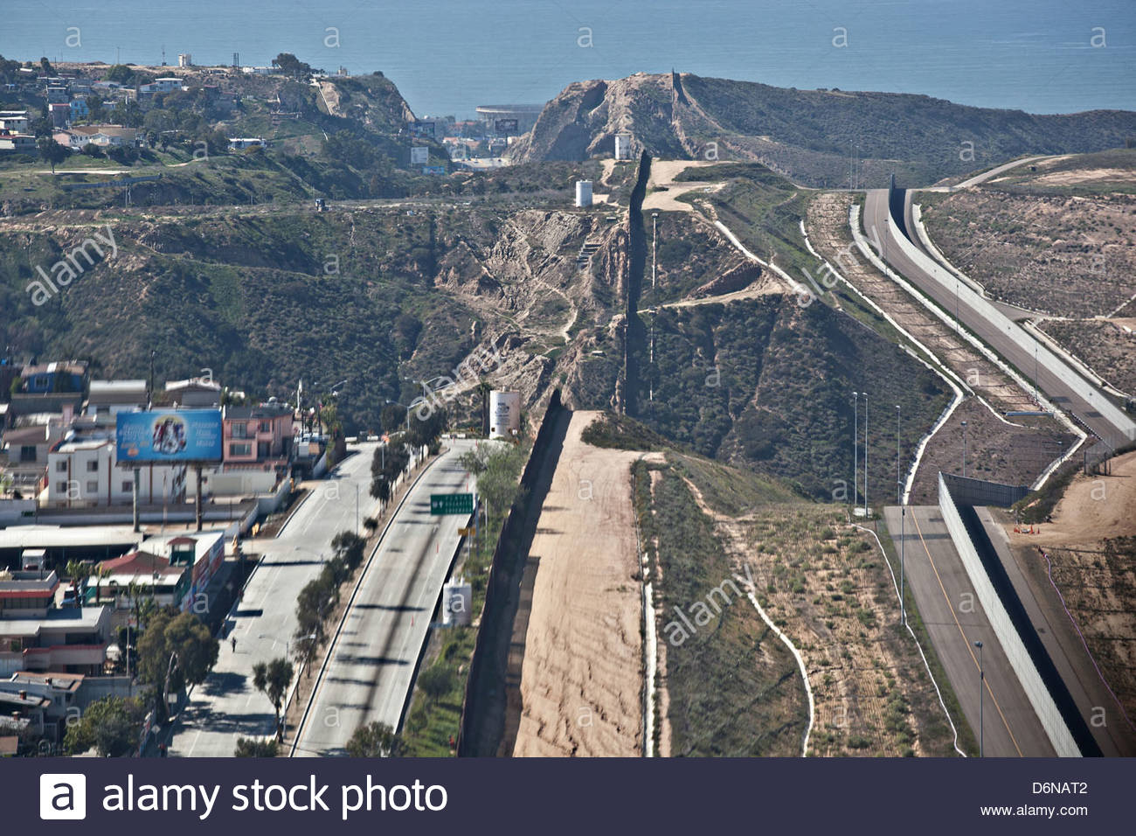
The Border fence, San Diego-Tijuana

Slide 32
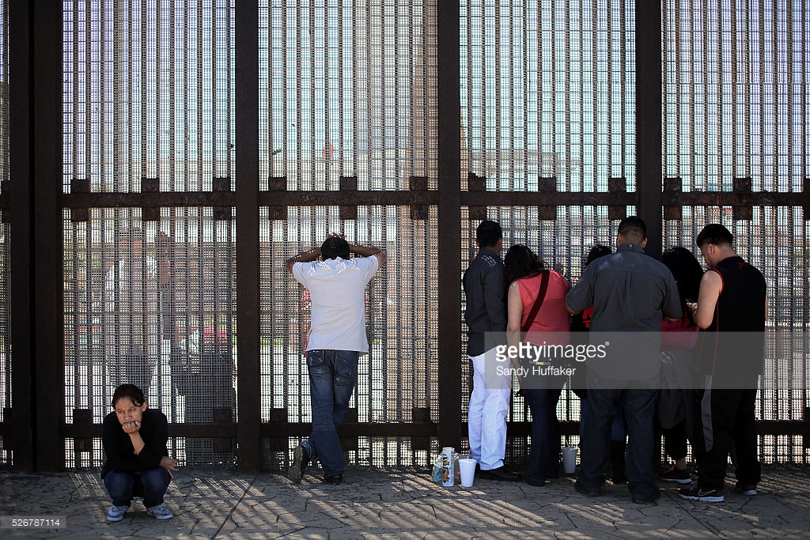
The Border Fence

Slide 33
