Slide 1
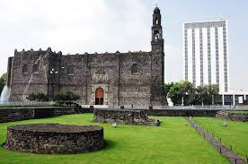
A History of Modern Mexico
Revision

Slide 2
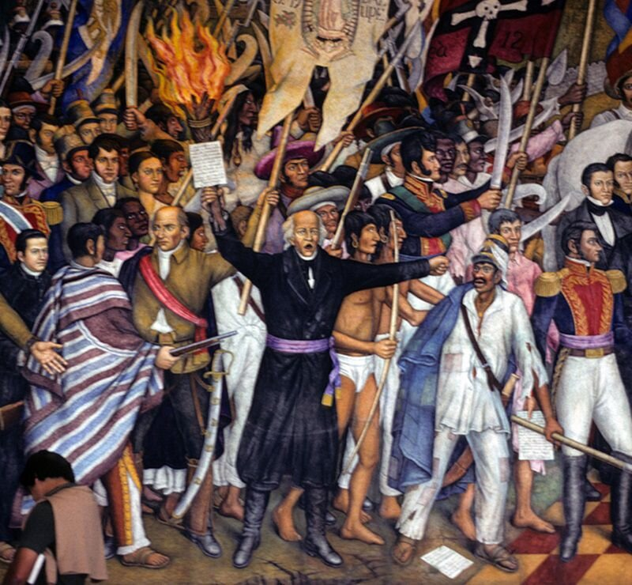
Mexican Independence (1810-1821)
Drought and recession
The popular revolt
Creole discontent
Bourbon Reforms
Napoleonic invasion of the peninsula
The Plan de Iguala- Independence
Age of Revolution?

Slide 3
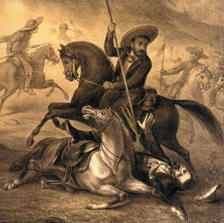
Democracy and Dictatorship (1821-1846)
Instability
Caudillos
Civil conflict
Foreign debt
Political divisions: federalism and centralism
Political culture-popular federalism
Age of Revolution?
Caste wars

Slide 4
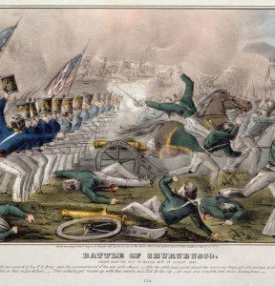
The Mexican American War (1846-1848)
US Revivalism and expansionism
Mexican ongoing concerns about territorial integrity
Instability in Mexico
Ideas of democracy: manifest destiny
Religion
Race
Borderlands
Treaty of Guadalupe Hidalgo
Civil wars

Slide 5
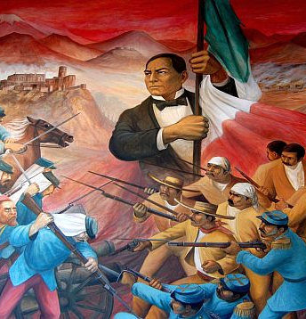
Civil War and Benito Juarez (1848-1876)
Reform War
French Intervention
New generation of politicians: liberals and conservatives
Secularisation
Benito Juarez legacy- first indigenous president, anti-imperialist, revolutionary?

Slide 6
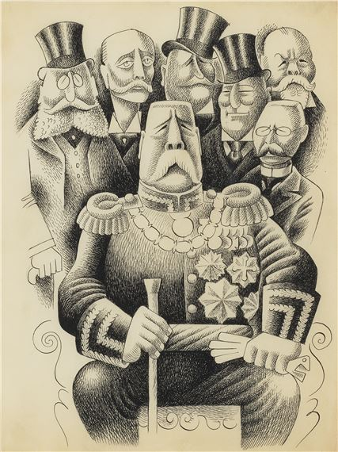
Porfirio Diaz: The Liberal Dictator
(1876-1910)
Conservative liberalism
Clientelism
Globalisation and industrialisation
Banking system
Oligarchy
Race, social Darwinism and mestizaje
Understanding the regime with the hindsight of the revolution

Slide 7
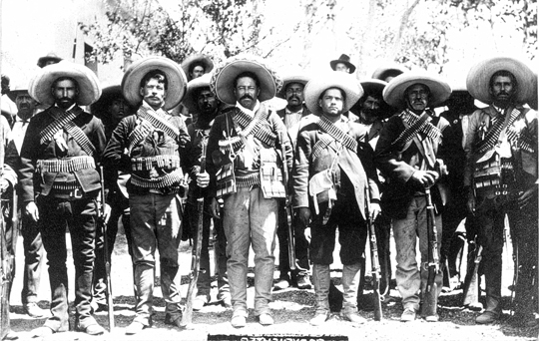
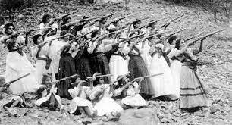
The Mexican Revolution (1910-1920)
Who participated? Middle class anti-re-electionists, the agrarian revolt and the Zapatistas, Villistas, Orozquistas, Carrancistas and Constitucionalistas.
Agrarian, Social, Cultural?
Was it a revolution or did the Carrancista state co-opt?
What about urban labour? How do we interpret article 123 of the constitution?
The consummation of liberalism?
What about the issue of reading from the legacy of the one-party state?

Slide 8
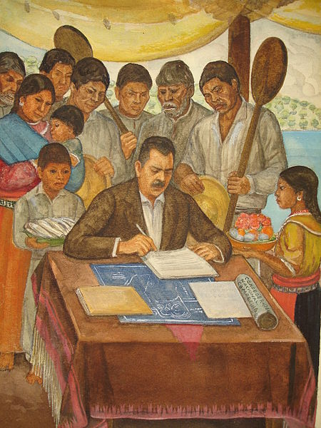
Land and Labour (1920-1940)
Land reform-ejidos
State Corporatism CNC
Labour CGT

Slide 9
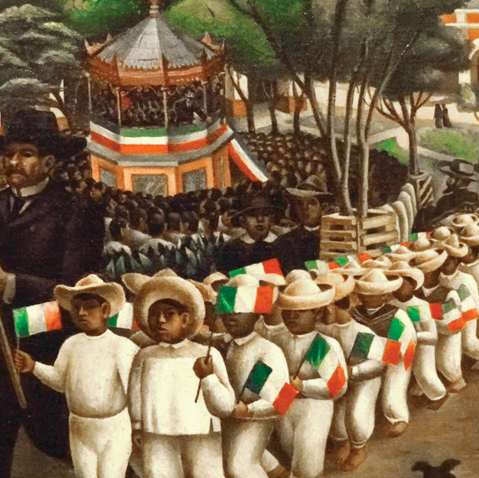
Cultural Reforms (1920-1940)
Indigenismo
Secularisation
Education
Gender

Slide 10
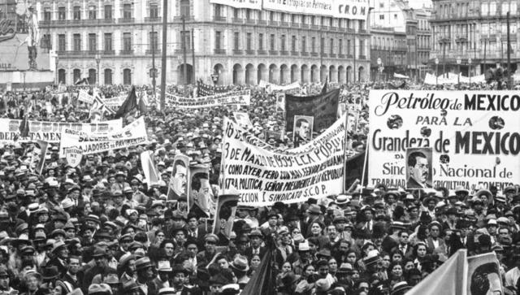
Counter-Revolution and the PRI state (1940-68)
The Golden Age of the PRI
The economic miracle
The one-party state: labour, popular sectors etc.
Import Substitution Industrialisation
‘Labour aristocracy’
Agrarian economy in decline
Hegemony/ ‘consensus’
Soft Authoritarianism-Democracy

Slide 11
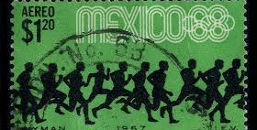
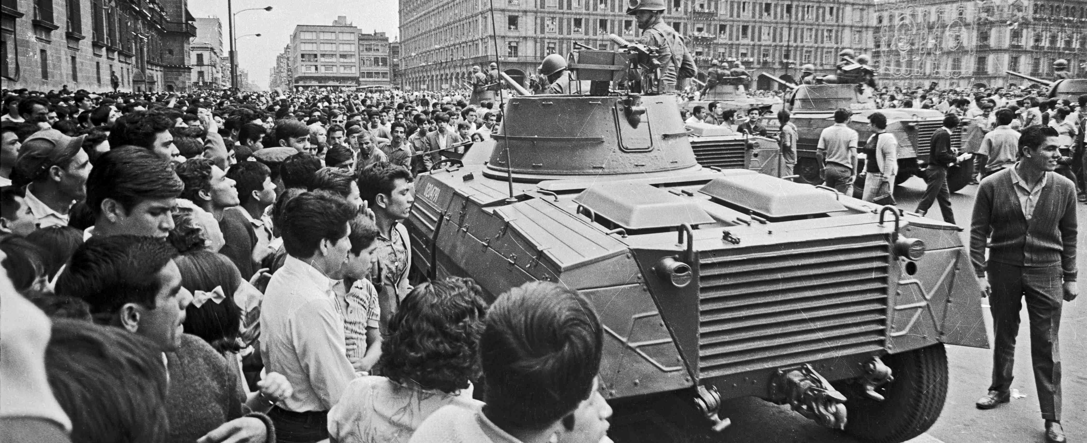
The 1960s in Mexico
The end of the PRI consensus?
Olympics
Tlatelolco

Slide 12
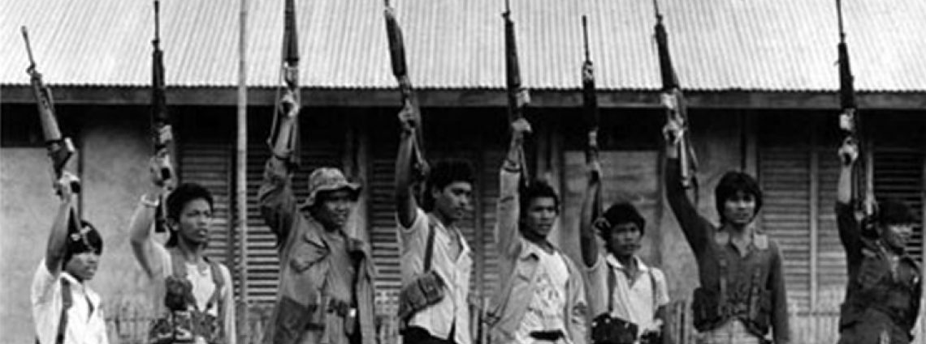
The Dirty War (1965-1982)
The influence of the Cuban Revolution
Echeverria and Cold War Politics
Guerrilla in Guerrero: The Party of the Poor
Memory and commemoration: Truth commission

Slide 13
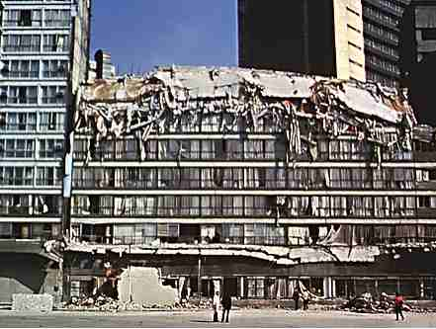
Modern Mexico: Neoliberalism and Democratization
The earthquake and civil society
Economic crisis
New parties
Opposition press
Mega corruption

Slide 14
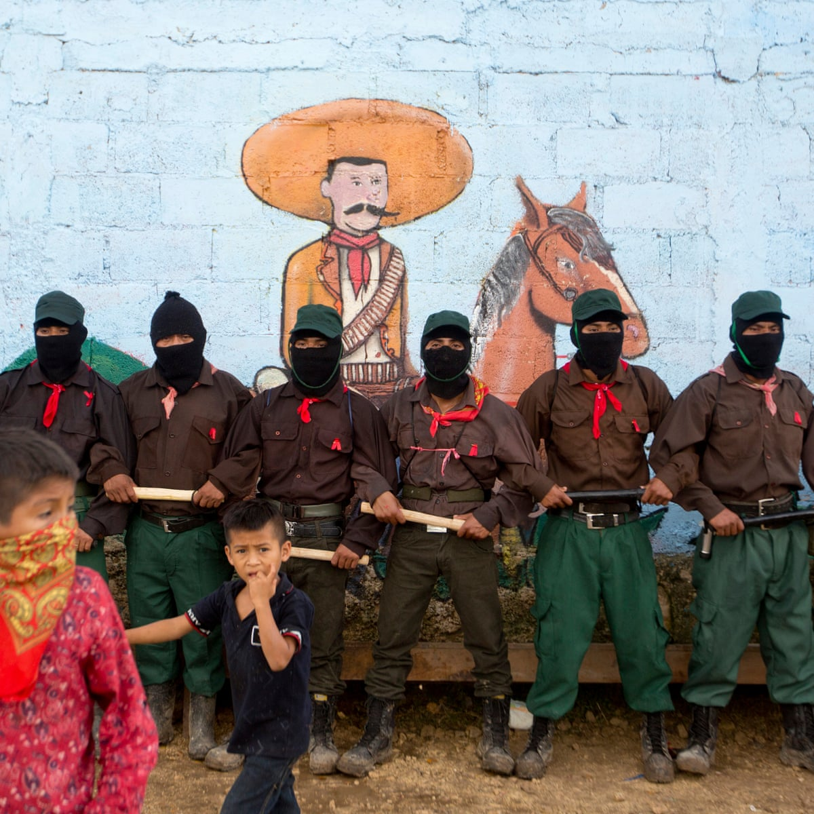
Modern Mexico: Zapatistas and Indigenous Rights
ILO 169 and multicultural constitutionalism
Globalization and NAFTA
Electoral fraud and the one party state
Guerrilla, student movement and some sectors of the church (e.g. Liberation Theology) have reached out to indigenous communities.
Demands: autonomy within the state not overturning the state, infrastructure, recognition of usos y costumbres.
Negotiations with the government, San Andres Agreements
A guerrilla, an NGO, a post-modern movement?

Slide 15
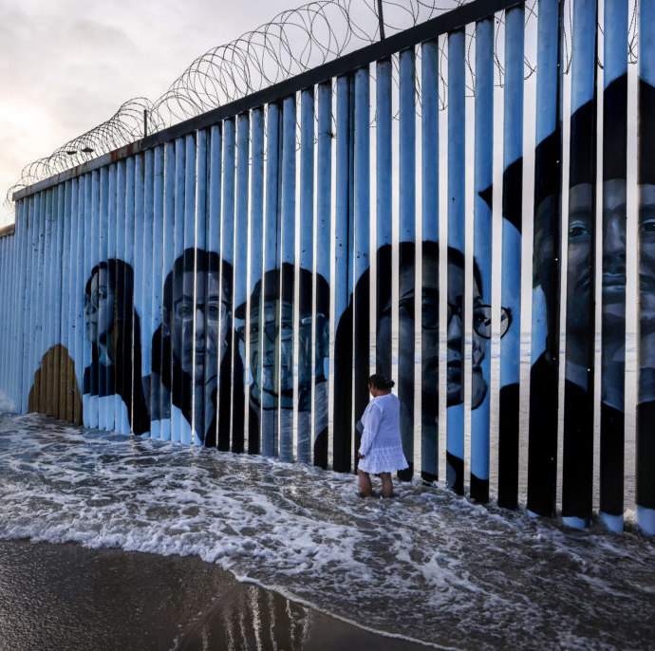
Migration and the Border
Bracero programme
Established networks
Push factors: Impact of ISI on the countryside, modernization and migration, 1980s economic crises, violence
Pull factors: employment, family networks
Central American migration
NGOs and organisations
Migrant caravans
US border policy
Policing and vigilantism

Slide 16
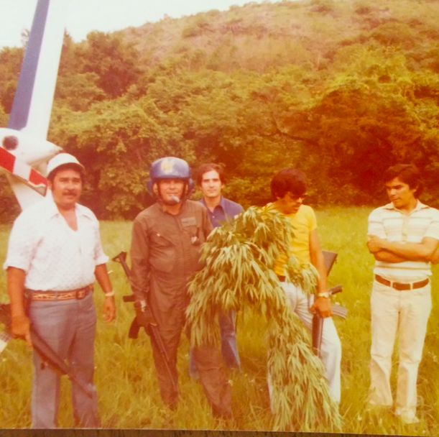
The Drug Trade
Stage 1 – 1910-1960
  1914 Harrison Act prohibits smoking opium, heroin, and cocaine.
  Marijuana, opium, protection rackets
  Stage 2: The Counterculture (1960-1975)
  Hippy tourists
  Post-1972 Increase in heroin trade
  Stage 3 1975-1990s : The First War on Drugs and Federal Control
  Militarisation of control
  Human rights, migration, distrust of the state
  Stage 4: Cracks in the System, 1990s-2006
  Neoliberalism and democratization
  Cartel takeover
  Stage 5: War and Total War, 2006-2022
  Fragmentation of cartels
  Diversification

Slide 17
Researching for Essays
Start with the suggested reading list.
Secondary Sources: Textbooks/ General histories (eg. Mexico’s Once and Future Revolution), Monographs (like Knight‘s The Mexican Revolution), Journal Articles, Edited Volumes (Like, Dictablanda), Other Writings e.g Online (.ac websites, also LANIC, National Security Archives.)
Review articles and articles on histroiogrphy.
Primary Sources: Edited collections of primary sources (like The Mexico Reader). They have useful introductions to the sources. MRC relatively untapped resources.
Start broad, dig deep, remember historiography. In essays, cite less from general textbooks. Identify the main arguments from the other secondary sources. Use primary sources to support your arguments.

Slide 18
What makes a good essay?
Set up a historical problem: what remains unresolved, highly debated, or unknown about the topic you intend to discuss?
If ‘an argument is something someone could reasonably disagree with,’ what will your argument be?
State your argument as clearly as possible at the beginning of your essay. This is your ‘thesis statement’.
Consider the length of the essay, the kind of evidence you need to support your argument and the time you have.

Slide 19
What evidence will you use to support your argument?
From secondary sources:
Start with recent research and suggested readings. How will you identify the key arguments? How will you find sources beyond the reading list?
From primary sources: Summarise the source. Consider the type of source. (See the source review form) What are its limitations? What can it tell us and what can’t it tell us? How will you use it in relation to your argument?
What is it? (Examples: Letter, report, scrapbook, photograph, poem, poster, book)
When was it made/ written/ created? (Is there a date? Can you tell by the style or format of the piece?)
Do you know who made / wrote / created it? (Maybe a person or organisation; named or anonymous, official or unofficial
What is it telling you? What can you find out from it? (Does it have a value social; cultural, historical?)
Why do we have it? Where is it archived? Is it translated?
How do you feel about it? Do you need more information for it to make sense? (Is it intimate, old fashioned, difficult to read? What other questions does it make you ask?)

Slide 20
Structure
Introductions and Conclusions:
Your introduction should say what you will argue (thesis statement) and how a map of the essay or overview of the argument. Your conclusion should review the points you have made during the essay and place the argument in the broader context.
In the main body:
Start each paragraph with a sentence that introduces and defines the content of that paragraph a ‘topic sentence‘. Topic sentences should reflect how your argument proceeds, step by step.
So a paragraph structure might be: topic sentence – evidence to support it – analysis of the evidence – transition to the next point.

Slide 21
Writing Style/ Clarity of Writing
Be concise and to the point.
The functions of sentences should be:
topic sentences,
engaging with the historiography sentences,
advancing your argument sentences,
supporting evidence sentences,
or conclusions.
Avoid:
Long, complicated sentences.
Generalisations like ‘historians argue’.
Structuring language like, ‘in this essay I will argue’, ‘It is vitally important to consider’ Get on with your argument rather than writing ‘it could be argued’.
Repetitions of words and ideas.
Long, direct quotes and pseudo-paraphrasing.

Slide 22
Think about the themes of the module.

