Slide 1
Land, Labor and Modernity during the Porfiriato, 1876-1910

Slide 2
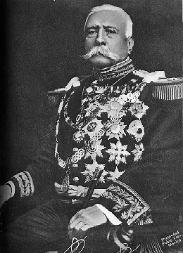
The Dictator, Porfirio Diaz, 1907

Slide 3
Porfirio Diaz, the early years (1830-1876)
“There is no figure in the world who is more romantic or heroic than that soldier-statesman whose adventurous youth outshines the pages of Dumas and whose iron hand has transformed the warlike, ignorant, superstitious and impoverished Mexican masses, after centuries of cruel oppression by the greedy Spaniards, into a strong, pacifist and prosperous nation that honours its debts”
Born to Spanish father and Mixtec mother
Studied at Institute of Arts and Sciences in Oaxaca City
Started his career organizing militia in Zapotec regions of Ixtlan and Tehuantepec. Cemented relationship with Mixe and Zapotec indigenous groups.
During the War of French Intervention was appointed commander of the Army of the East. He won a succession of guerilla skirmishes and then major victors such as the capture of Puebla on 2 April 1867.

Slide 4
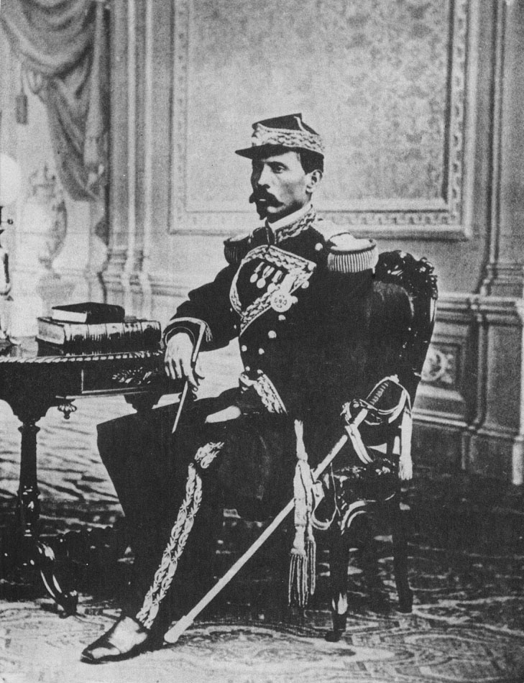
The young Diaz as commander of Tehuantepec

Slide 5
Porfirio Díaz versus Benito Juárez
Porfirio Díaz, the military hero of the War of French Intervention, attempted to take on Juárez, the civilian hero, in elections of 1867 and 1871.
1871, Porfirio Diaz, having lost the election, announces Plan of La Noria against Juarez. He is forced to retire.
1876, Porfirio Diaz, having lost another election, against Juarez’s successor, Sebastian Lerdo de Tejeda, announces the Plan of Tuxtepec against Lerdo. This time he succeeds.
He becomes president of Mexico and rules it from 1876-1880 and 1884-1911.

Slide 6
Porfirio and the Church
“With peace assured in the Republic and independence established between
church and state, there is no longer any motive for precautions or hostility
against the Catholic church, as long as it limits itself to the legitimate objects
of its ministry, without trying to meddle in political matters”
Crucial to this policy was the establishment of relationships with bishops like
Eulogio Gillow (bishop of Oaxaca) and Antonio de Labastida y Davalos
(archbishop of Mexico).
As a result, the Church was free to start a program of “social Catholicism” in
order to draw back the poor and middle class towards the church –
establishment of schools, charity centres, charity groups, publication of
newspaper, educational books. In particular, the church started to rely on urban
and rural women’s organizations.

Slide 7
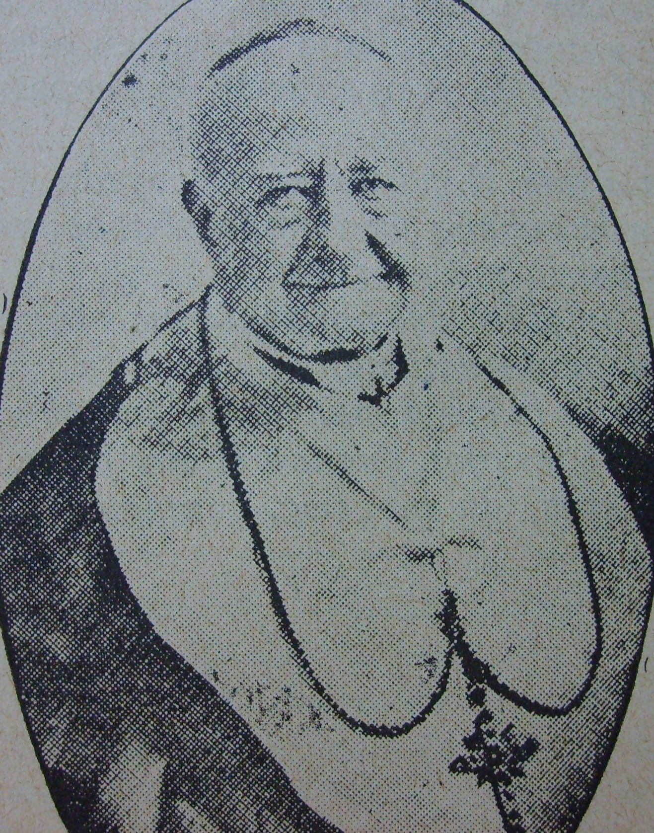
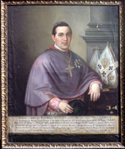

Slide 8
Porfirian Macro-economics
During the Porfirian period, the Porfiriato, industrial production rose by 6.5 per cent per year, mining by 7 per cent, exports by 6 per cent. How?
Restoration of banking system
Resolving of debt problems
Encouragement of foreign investment e.g. at world fairs
Jose Yves Limantour and the regulation of public finances

Slide 9
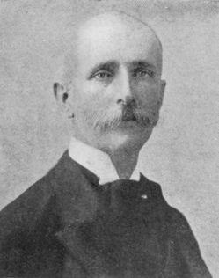
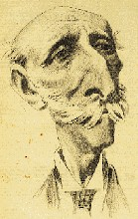
Jose Yves Limantour

Slide 10
The Results of the Economic Programme
Increased infrastructure (especially railways). 19,280 km of railways by 1910.
Mining – in northern states of Chihuahua, Durango, Sonora and Coahuila.
Oil – Tampico, Tamaulipas
Commercial agriculture – sugar (Morelos), Henequen (Yucatan), cotton (La Laguna), Tobacco (Valle Nacional)

Slide 11
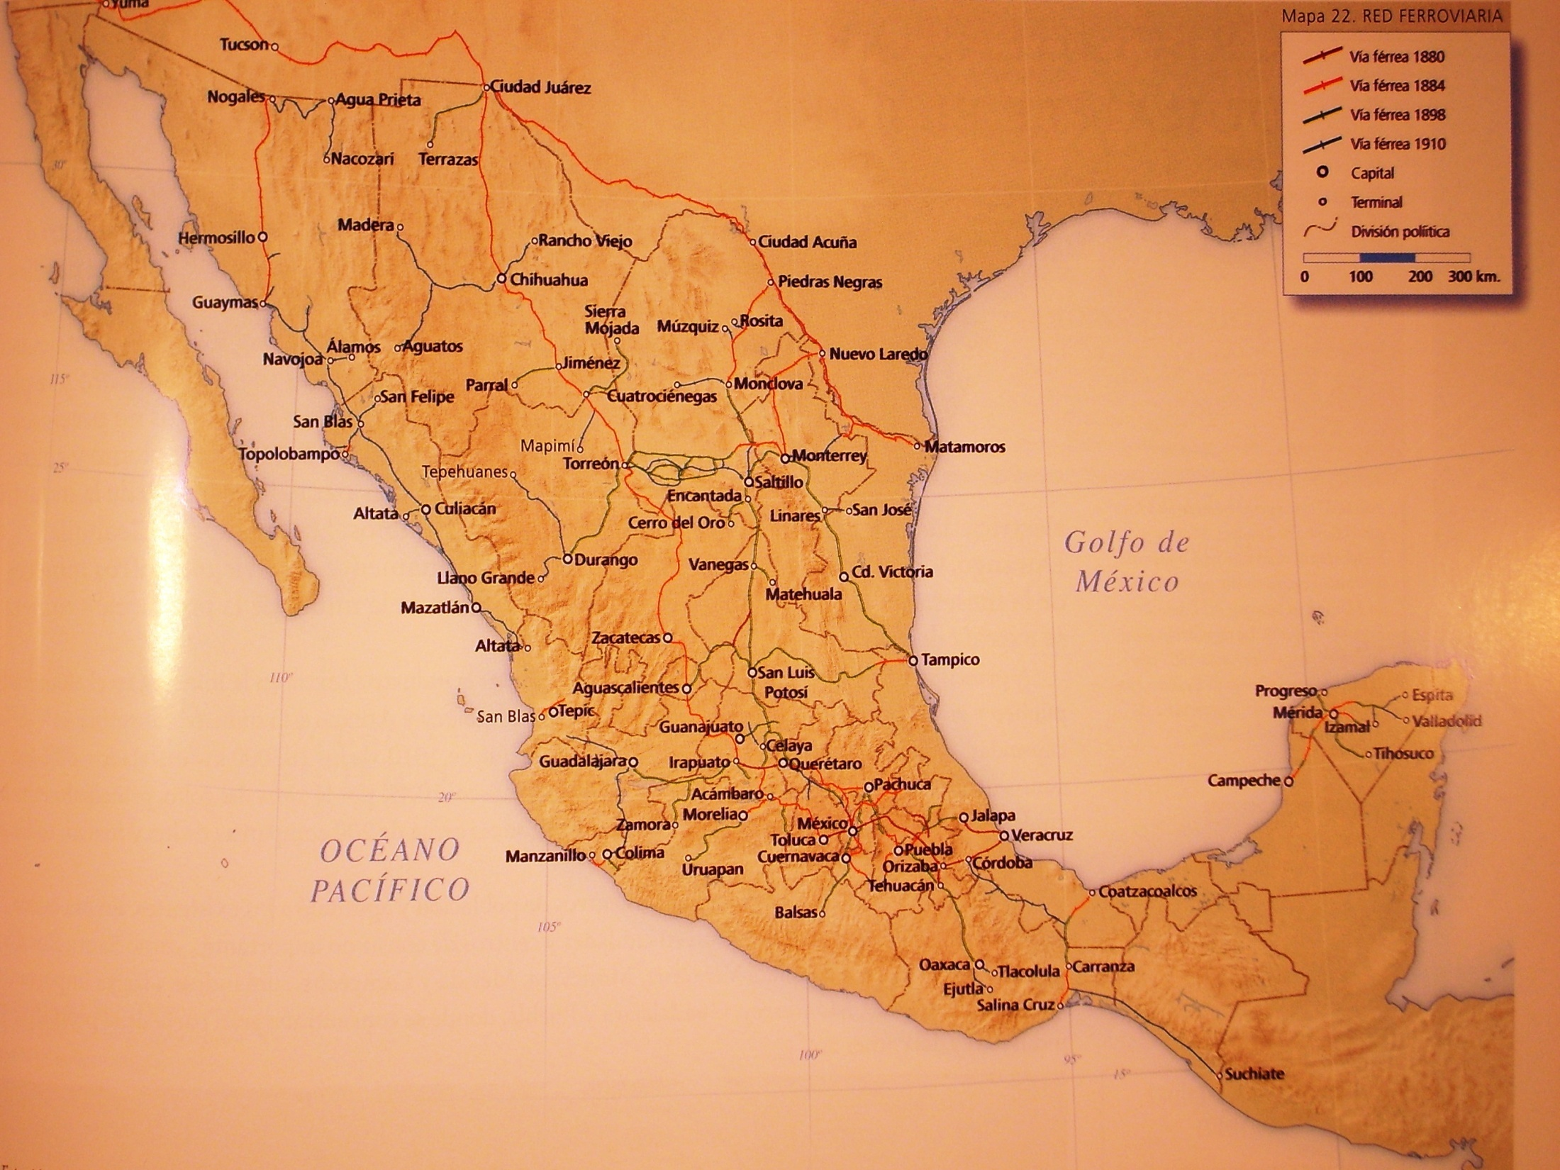
The Railways of Mexico, 1910

Slide 12
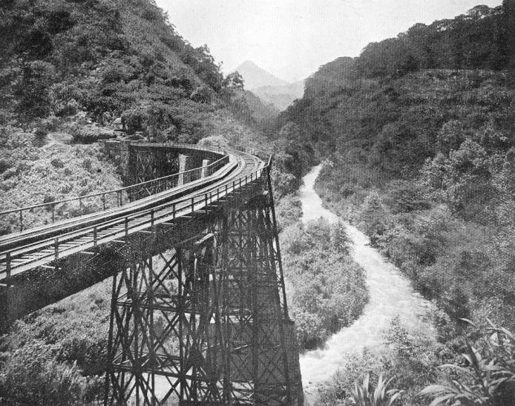

Slide 13
The dark side of the economic project - Land
Although there was growing private land ownership in Mexico
Haciendas: huge farms, Spanish or mestizo-owned, often geared to commercial agriculture (sugar, cotton, wheat), employing debt peons
Ranchos: small Spanish or mestizo-owned farms
Much land was still in the power of corporate bodies
Church lands: urban property (schools, convents, houses) and rural property (haciendas, ranchos)
Communal village lands: Owned communally by villages, given out by Spanish king during colonial period, agricultural land given to particular family each year, pastoral land used communally

Slide 14
1856 Lerdo law prohibits all corporate properties.
This means that all communal and cofradia lands must be divided into individual plots.
1884 Law of Unused Lands – this allows Survey companies to survey “unused” lands, keep 1/3 of these lands and sell the other 2/3 to private investors.
By 1890 this precipitates a “land grab of massive proportions”
Private speculators use the Lerdo law to buy up communal lands
Survey companies start to survey indigenous lands and claim that they are unused.
Landless peasants are forced to work as peones (debt laborers) on haciendas
By 1910 some historians claim that from 84 to 95 percent of the rural families had no land at all, while wealthy families often had estates running into millions of acres. The Terrazas family had 13.5 million acres in Chihuahua, while the Escandón estate in Hidalgo stretched for 90 miles.

Slide 15
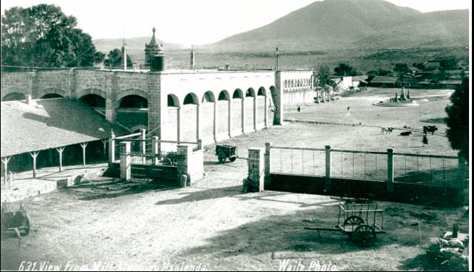
The Hacienda

Slide 16
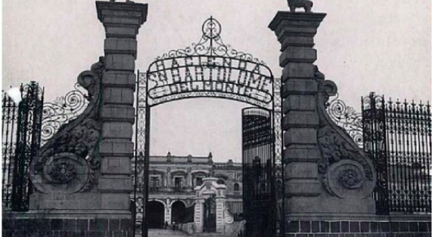

Slide 17
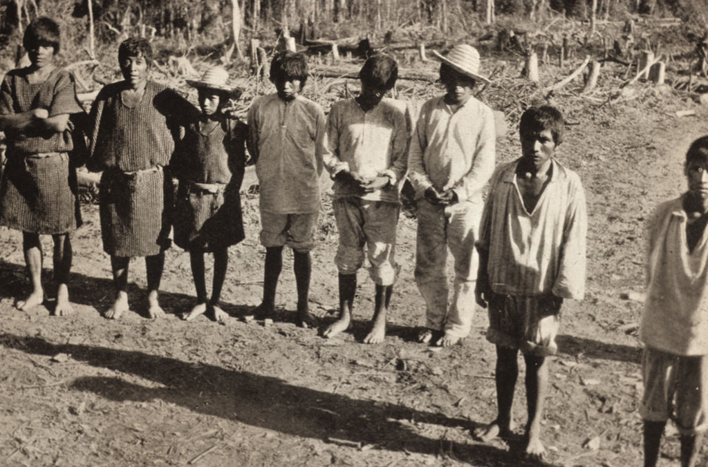
Meanwhile, the vast majority of Mexicans were forced to become peons or debt slaves

Slide 18
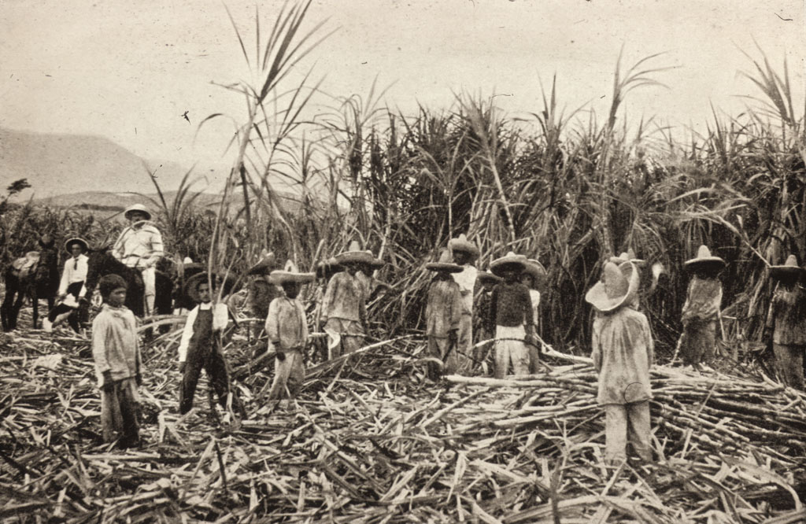
Workers in Valle Nacional

Slide 19
Porfirian Politics
Standardisation of electoral process: Municipal elections upwards were decided by Porfirio Diaz.
Removal of the restrictions on Re-election: Diaz was first re-elected in 1888, and then subsequently another five times. Congressmen were also allowed to be re-elected.
Carpet-bagging: Elections to regions where one had no independent political base. (especially trusted allies from his home state of Oaxaca)
Implementation of jefe politico system. These were personally appointed by Porfirio Diaz to control elections, rural violence in the districts.
Disbandment of the militia and establishment of professional, loyal army.

Slide 20
This increasingly dictatorial and unequal system was enforced by Diaz’s rural police – the rurales
During the 1880s President Porfirio Díaz expanded the rurales from a few hundred to nearly 2,000 by 1889. By early 1900s there were well over 10,000
Initially he did this by recruiting captured bandits
Officers were usually seconded from the federal army.
The Rurales were heavily armed, carrying sabres, carbines and pistols.
These were the enforcers of the Diaz regime and maintained political and economic repression.

Slide 21
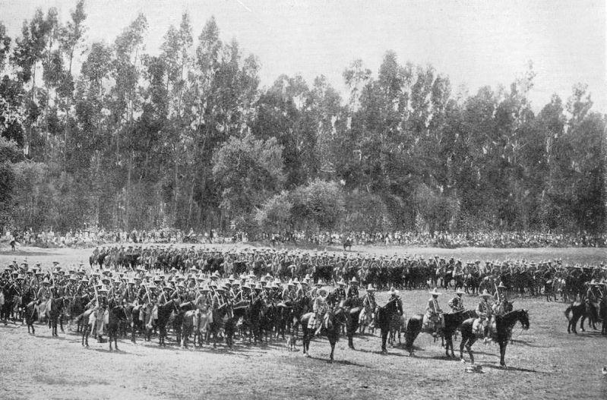

Slide 22
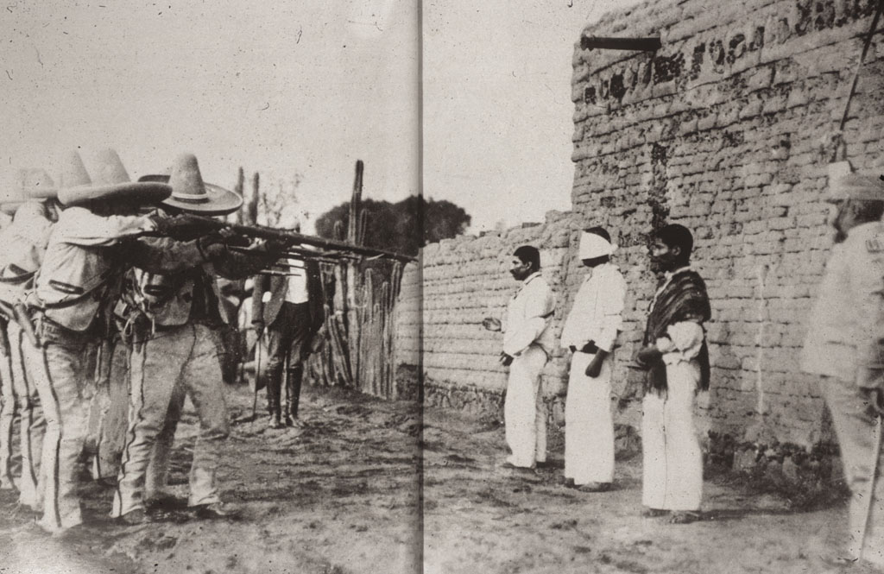
Rurales kill rural criminals, c. 1900

Slide 23
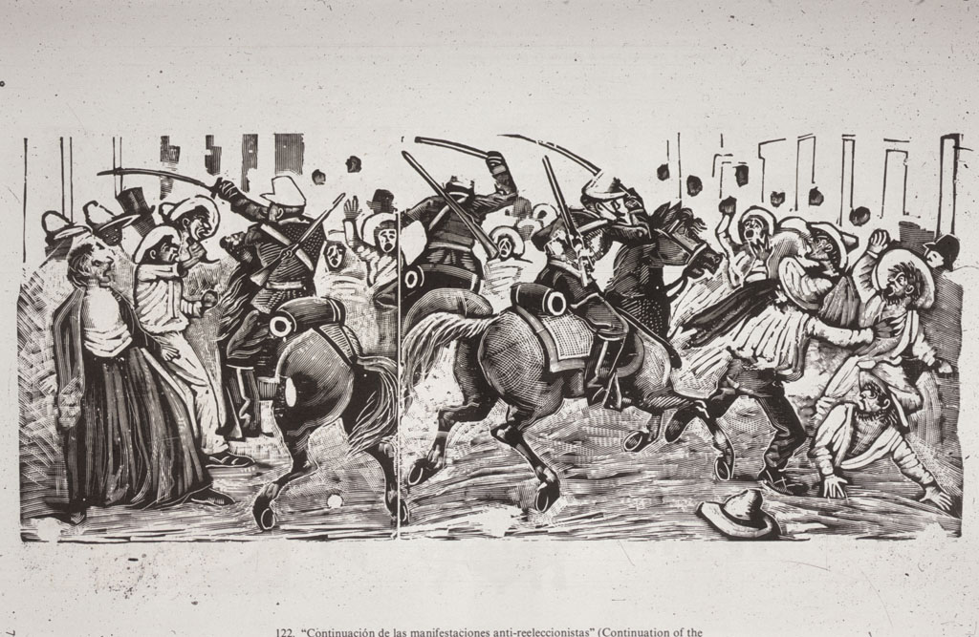
Posada’s Policing of Elections

Slide 24
However, Porfiriato was not simply about political repression
The system worked because Porfirio Díaz, in his years as a military leader, had made contacts throughout the country. He knew local powerbrokers
These powerbrokers or caciques often started as quite popular military leaders. But, by the early 1900s they had become old, unresponsive and elitist. E.g. Juan Francisco Lucas in the Sierra de Puebla

Slide 25
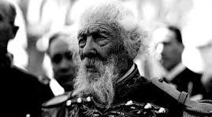
Juan Francisco Lucas, cacique of the Sierra Norte de Puebla

Slide 26
Modernity and the Porfiriato: 1) Social Darwinism and Race
Social Darwinism emerged in the US and Europe during the 1870s.
Attempt to apply biological concepts to society and politics.
Fundamental idea is that conflict between groups is both natural and beneficial as superior groups will emerge victorious over inferior ones.
Used by European powers to defend imperialism and national expansion.

Slide 27
However, also applied to different races
In Mexico, various “thinkers” or “cientificos” applied social Darwinist ideas to race.
They argued that as Mexico progressed, the country would become gradually whiter.
A mix of European immigration and superior breeding would lead to increasing European presence
High indigenous mortality rates and poor breeding would lead to their eventual extinction.

Slide 28
Porfirian Policy-makers attempted to help along this march to progress
Encouraged European and US immigration
This was a common trend throughout Latin America
1884-1933 Brazil received 4 million migrants from Portugal, Italy and Spain
1850s-1930 6.5 million Europeans arrived in Argentina
In comparison, Mexico’s campaign was a relative failure.
Between 1876 and 1910 Mexico managed to attract a maximum of 200,000 foreign nationals
Many were not “European” but Chinese and Lebanese

Slide 29
2) Persecuted the poor and the racially “suspect”
Class, race, and crime
During the Porfiriato intellectuals latched onto the new “science” of criminology, attempting to define “born criminals”
Some used race, arguing that indigenous groups were more prone to violence. They claimed that indigenous people “thought of bloody extermination” and were in danger of returning to the ways of the Aztecs.
Others used class, arguing that the class hierarchy reflected an innate capability for crime (e.g. Julio Guerrero)

Slide 30
Pelvicology and Sterilization
Phrenology – the science of measuring skulls to discern position of the Darwinian scale of evolution had a flip-side – pelvicology.
Pelvicology – the science of studying pelvis size to discern the probably skull size of the baby.
Most Porfirian doctors practiced pelvicology and believed that indigenous or poor women had “misshapen” pelvises. As a result, they gave birth to “degenerate” babies.
During the early 1900s, many Mexican doctors practiced sterilization of indigenous women.

