Slide 1
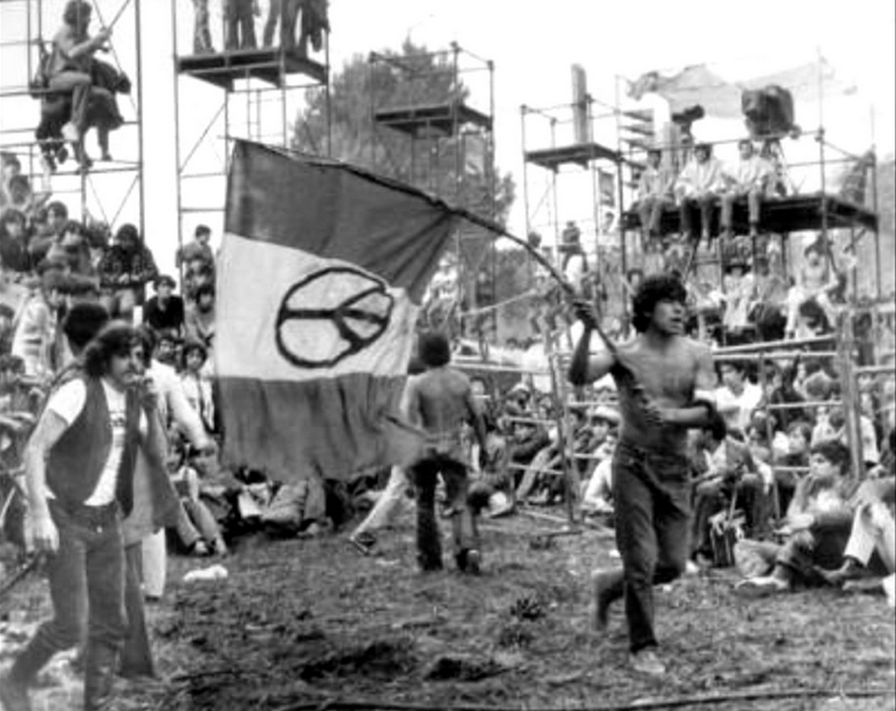
The 1960s in Mexico – The Student Movement

Slide 2
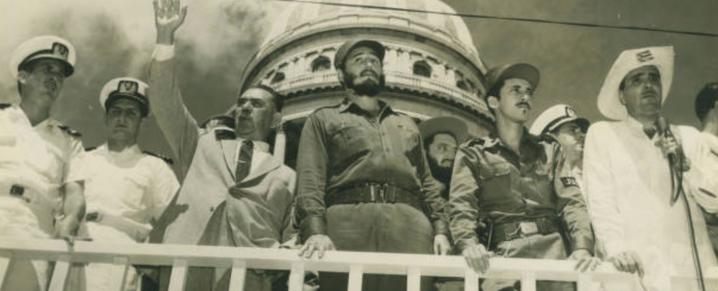
The Background
1) The Cuban Revolution
1959 Cuban Revolution has enormous effect on Mexico’s young people.
They now possess an alternative example of a successful anti-US revolution.
Although Mexican government ably balances US and Cuban interests, Fidel and Che become heroes to rebellious youth. e.g. 1961 Students destroy the Morelia US-Mexican institute in protest at Bay of Pigs.

Slide 3
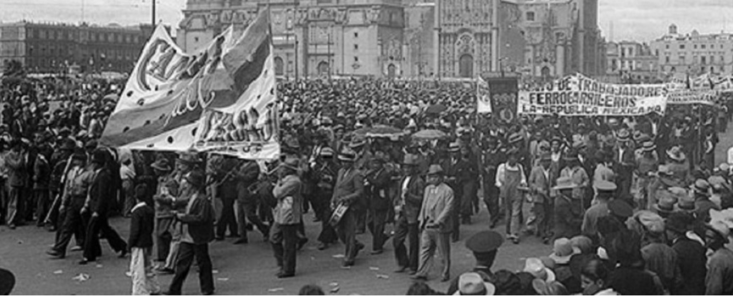
The Background 2) Benefits of PRI start to dry up
Agrarian problems – land invasions, independent peasant unions.
Labor problems – 1959 railway strike, 1958 teachers strike
PRI political system seen as increasingly elitist, revolutionary caciques like Heliodoro Charis dying out

Slide 4
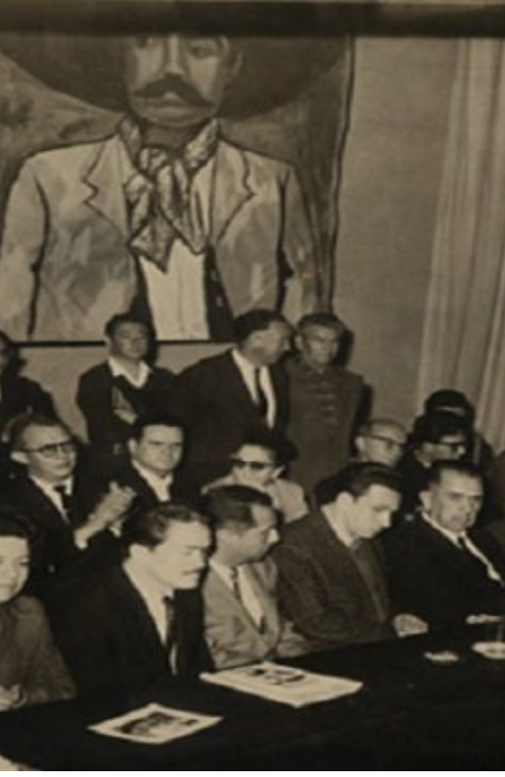
The Background 3) The PRI goes rogue
1961 Former President Lázaro Cárdenas starts the Movimiento de Liberación Nacional (MLN) catchall group of PRI leftists inspired by Cuban Revolution to push for move to left.
1965 Head of the PRI, Carlos Madrazo, initiates campaign to bring young people into the PRI.
Hold new local PRI committee elections.
Holds primaries to choose local town councilors
September 1965, Madrazo challenges control of governor of Sinaloa, Leopoldo Sánchez Celis, and is deposed. He spends next four years travelling around the universities of Mexico, encouraging young to get involved in politics, to overturn old, sclerotic PRI, and start a new party. Killed in a very dodgy aircrash in 1969

Slide 5
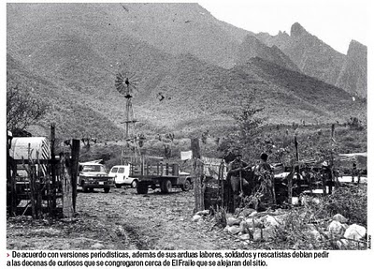
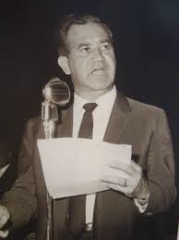
Carlos Madrazo is killed in a very dodgy air crash in 1969

Slide 6
The Background 4) The change in the Public sphere
Increasing criticism of the party and even the president in the public sphere.
Publication of critical political magazines, Política in 1960-1967 and Por Qué? in 1968-1974.
In provinces, publication of critical newspapers e.g. Acción in Chihuahua, 1962-1965
Increasingly critical cartoons e.g. Rius

Slide 7
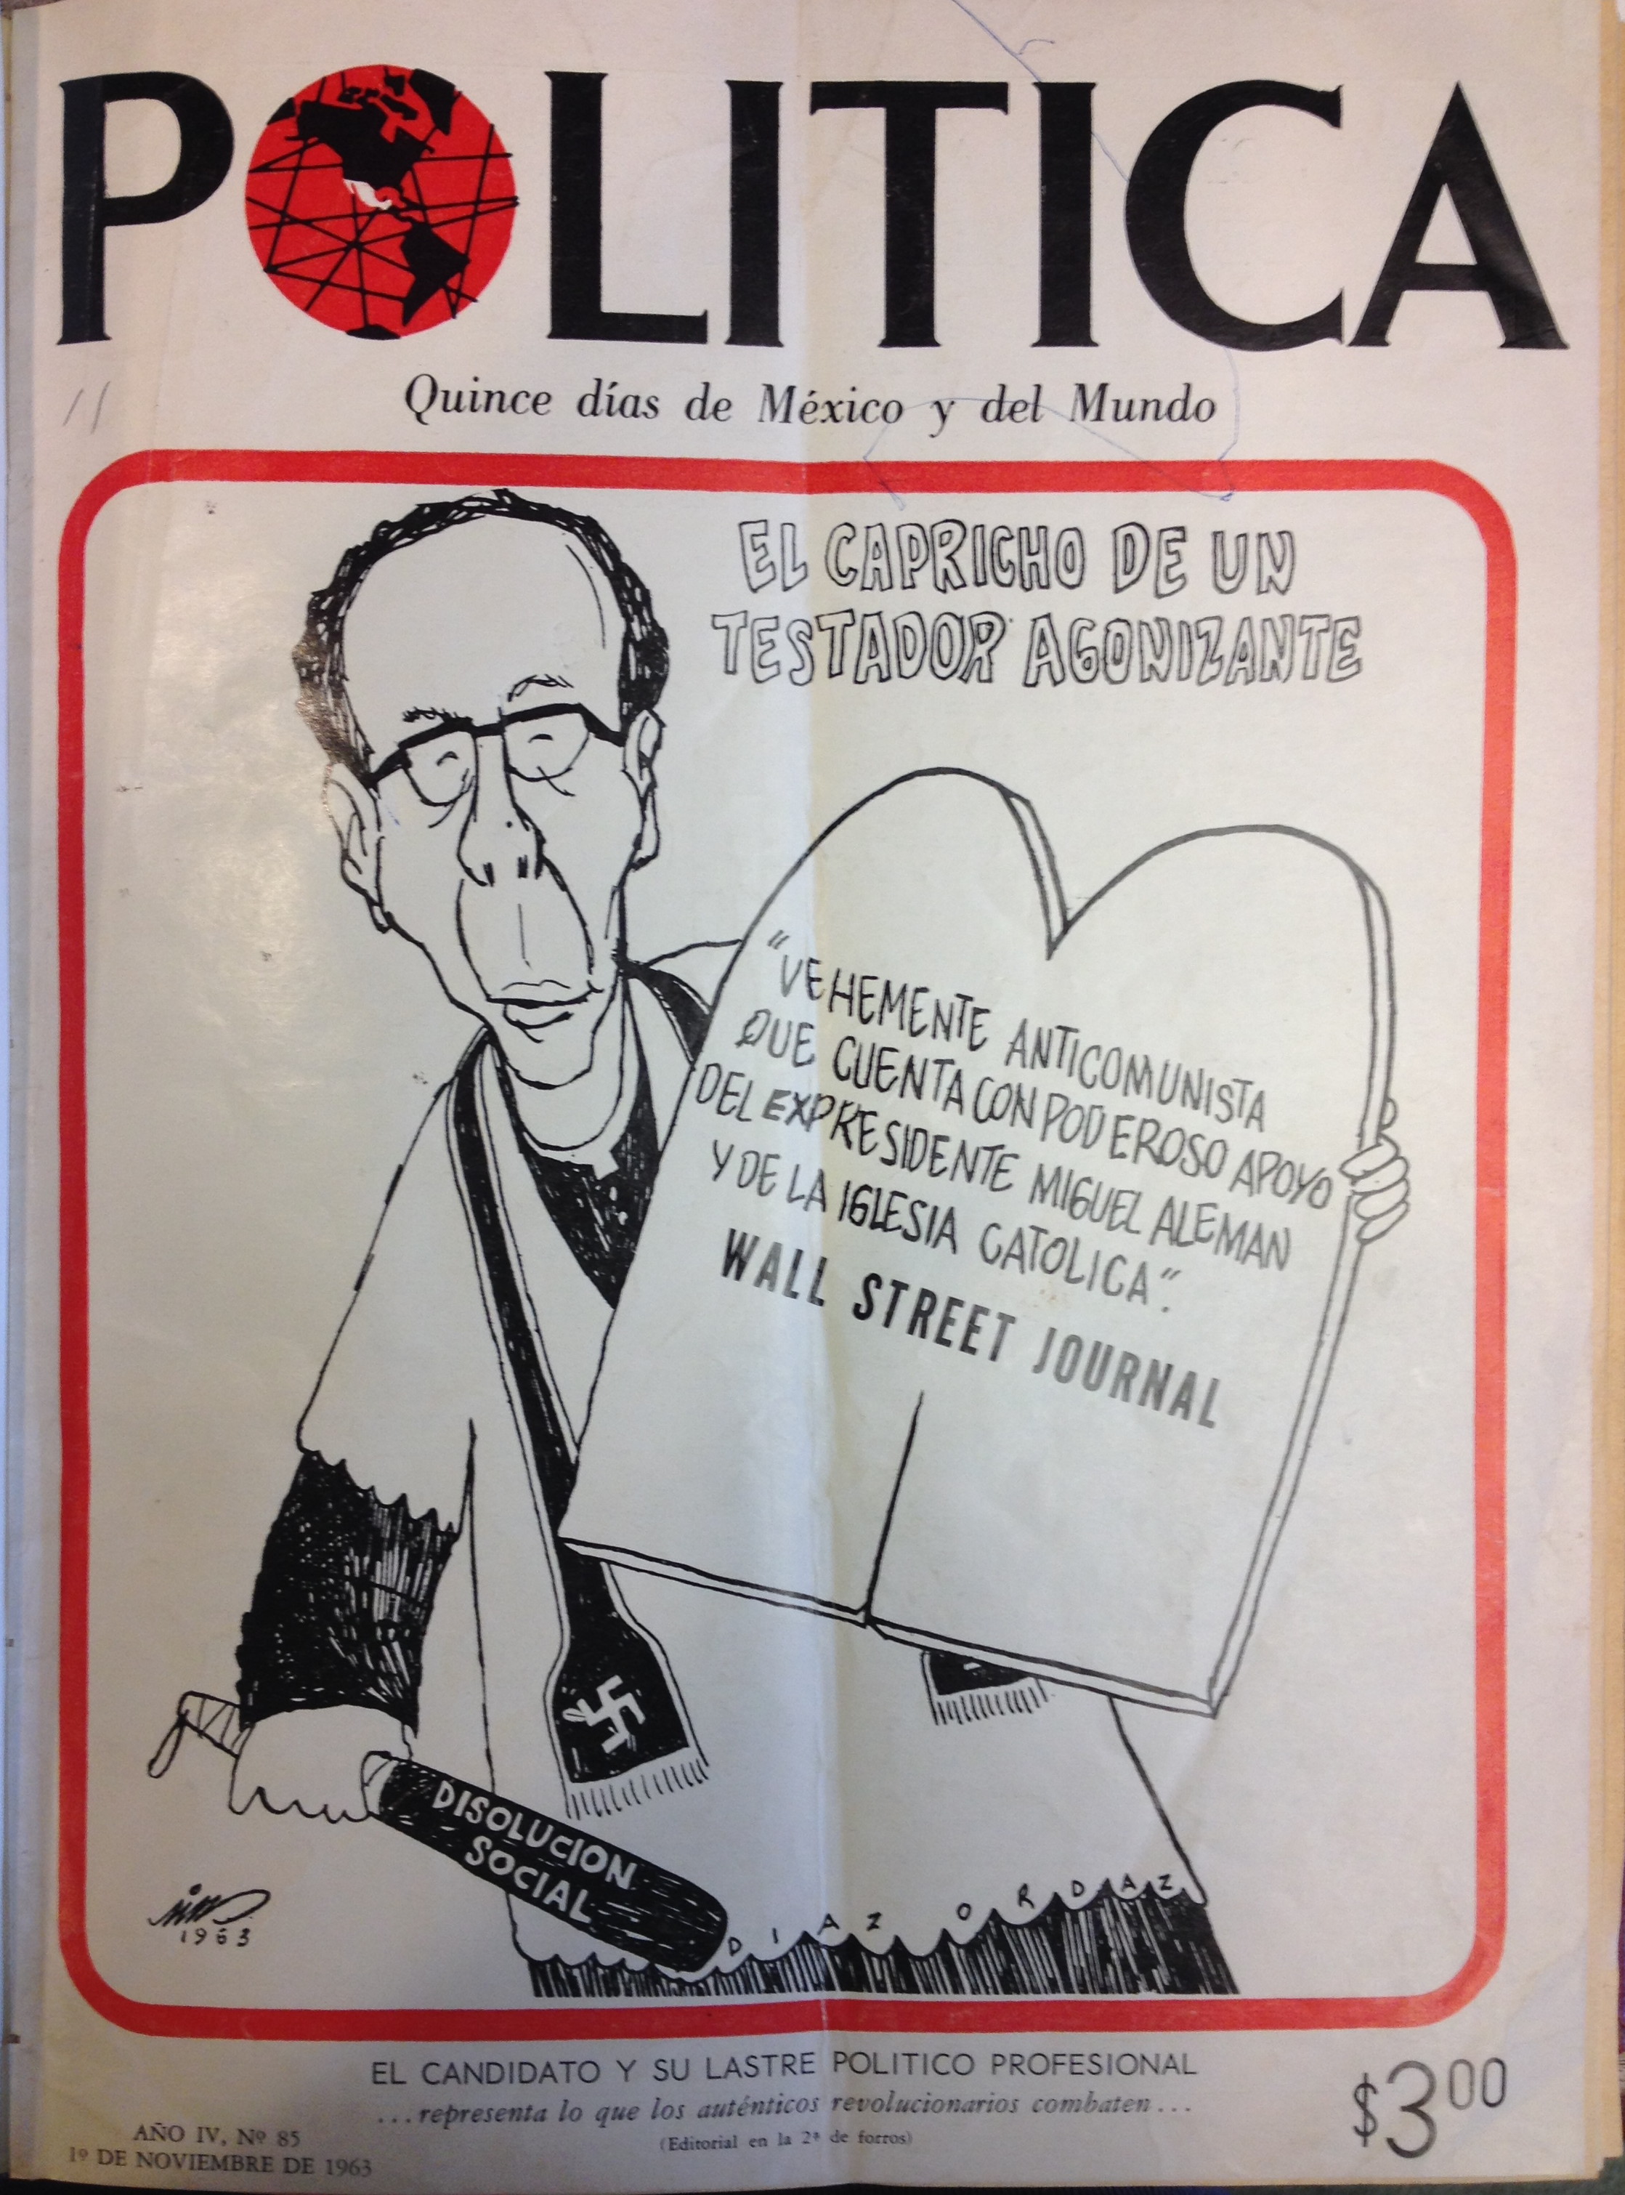
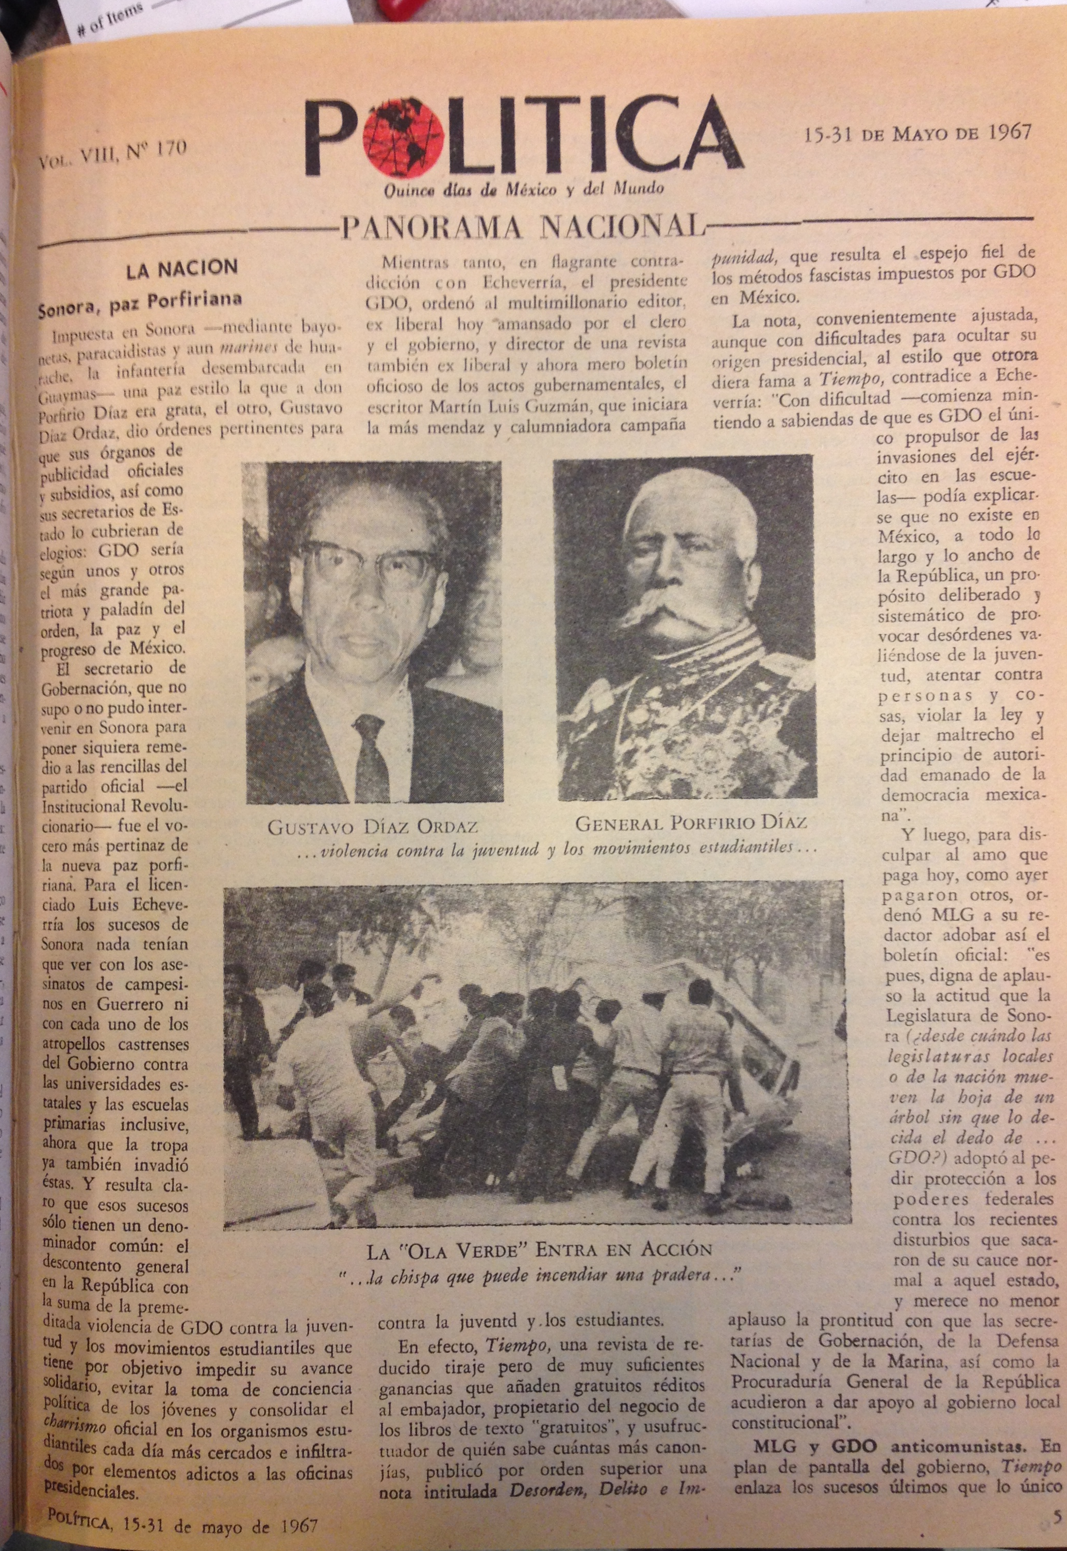

Slide 8
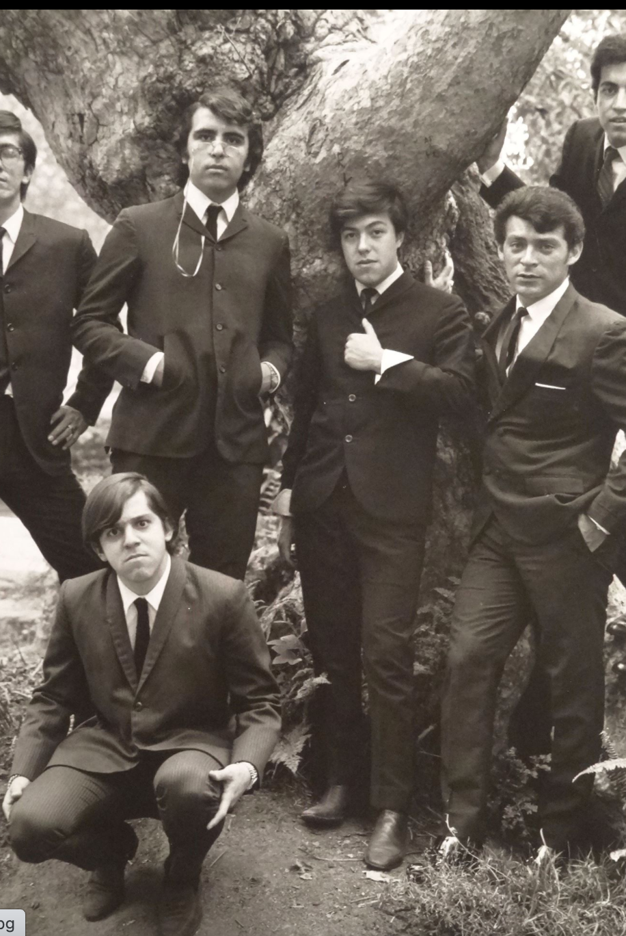
The Background 5) Cultural Change in Mexico
Mexican middle-class youth adopt US rock and roll e.g. Los Rebeldes de Rock, Los Locos del Ritmo, Los Crazy Boys
http://www.youtube.com/watch?v=zJuX3DYtKV0
By mid-1960s, Mexican youths have also adopted hippy culture.
Increasing confluence between US and Mexican interest in indigenous use of hallucinogenic drugs. E.g. mushrooms among Mazatecs of Huautla, peyote among Huichol.

Slide 9
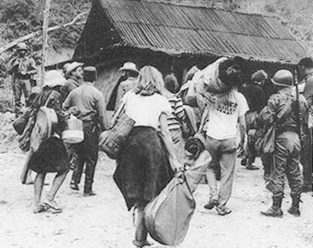
US hippies in Huautla de Jimenez face prospect of arrest

Slide 10
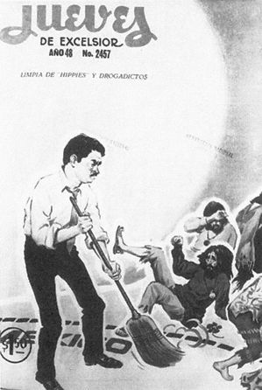

Slide 11
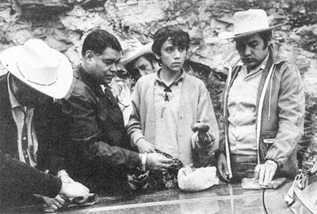
Mexican “jipi” arrested with magic mushrooms

Slide 12
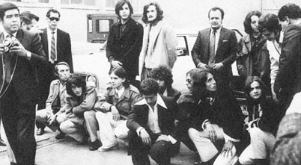
Mexican “jipis” rounded up in Mexico City in 1971

Slide 13
1) STUDENTS
In 1929 Mexico’s major university, the Universidad Nacional Autonóma de México (UNAM) had 8000 students.
By 1966, it had 78,094
In 1929, the Instituto Politécnico Nacional (IPN) had 1388 students. By 1966, it had over 20,000.
In the provinces, creation of new universities (e.g. Universidad de Nuevo León) and similar increase in student numbers.
In Oaxaca, student numbers increased from less than 1000 in 1940 to 20,000 in 1965.

Slide 14
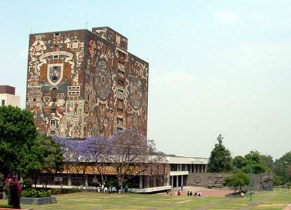
1950s Building of Ciudad Universitaria to house UNAM

Slide 15
Early Student Protest
Social, political, and cultural change generates series of clashes between students and university authorities from mid-1950s onwards. E.g. IPN 1956, 1961 San Luis Potosí, 1961 Guadalajara, Hermosillo 1958.
In the provinces, these were often linked to movements to rid states of PRI “dinosaurios” e.g. San Luis Potosi vs Gonzalo Santos, Hermosillo vs Calles clan.

Slide 16
1966-1968
Between 1966 and 1968 student protests reach high levels.
There are strikes and confrontations in Mexico City, Aguascalientes, Durango, Campeche, Chihuahua, Guerrero, Jalisco, Michoacán, Puebla and Sinaloa.
Issues include curriculum, personnel, and bus fares.

Slide 17
1968 Student Movement in Mexico City
1968 Mexico is first “third world” country to hold the Olympic Games. (Invests $150 million)
http://www.youtube.com/watch?v=KrOXf0TmSzU&list=PL4B232F8C5BE46180

Slide 18
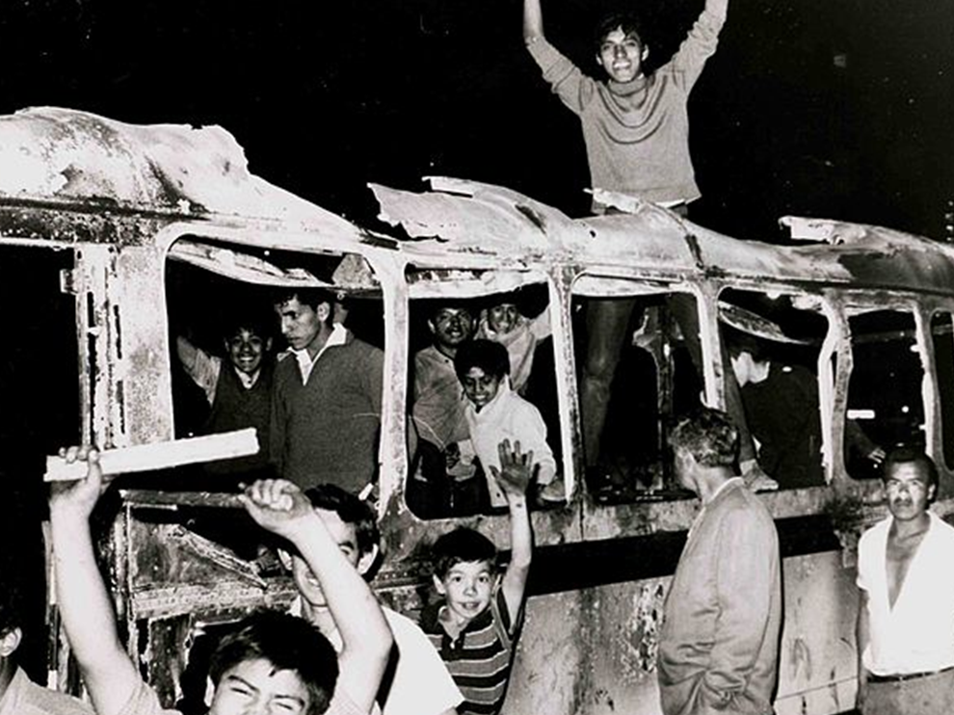
June 1968: Students in Mexico City start to protest
June 1968: Initial student protests were over government repression of student street gangs.
July 1968 Students at UNAM and 70 other universities form Consejo Nacional de Huelga (CNH). They demand:
Repeal of crime of social dissolution (Art. 145)
Abolition of granaderos (military police)
Freedom for political prisoners
Dismissal of police chief of Mexico City

Slide 19
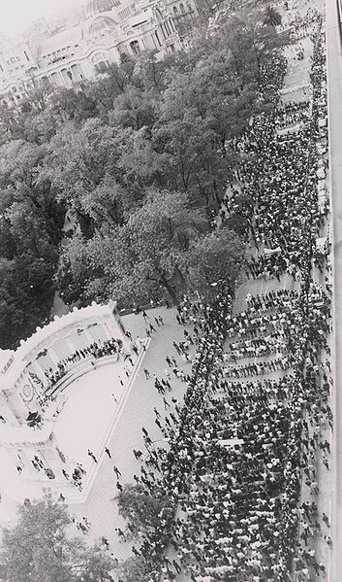
1968 Student protests in central Mexico City
Escalation of hostilities
23 July Assault on Vocational School No. 5
1 August Peaceful protest in UNAM
9 Sept CHN announces strike over
13 Sept CNH announce Silent march
15 Sept Soldiers occupy UNAM
23 Sept Soldiers occupy IPN.

Slide 20
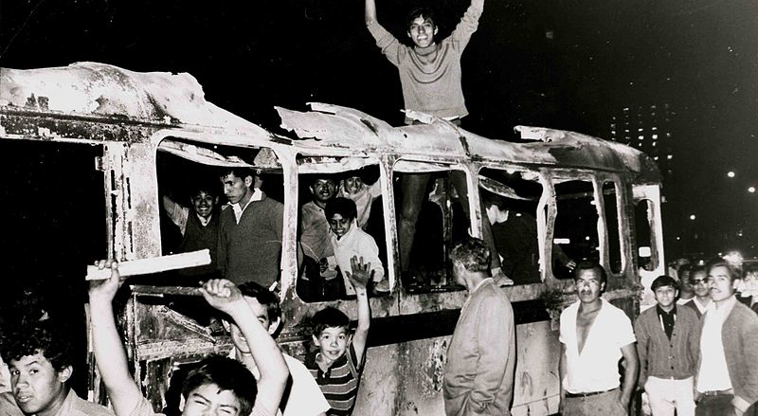
Student protestors

Slide 21
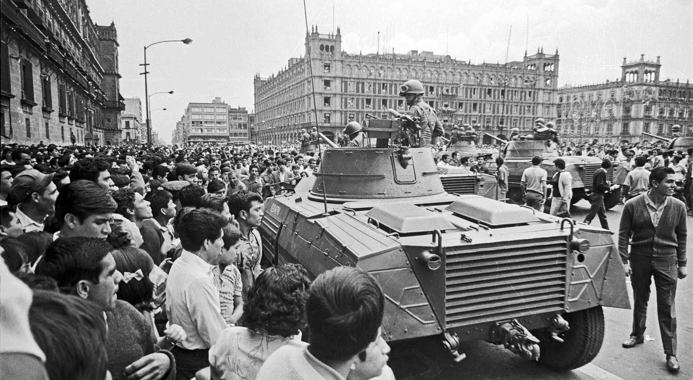
Increasing government repression

Slide 22
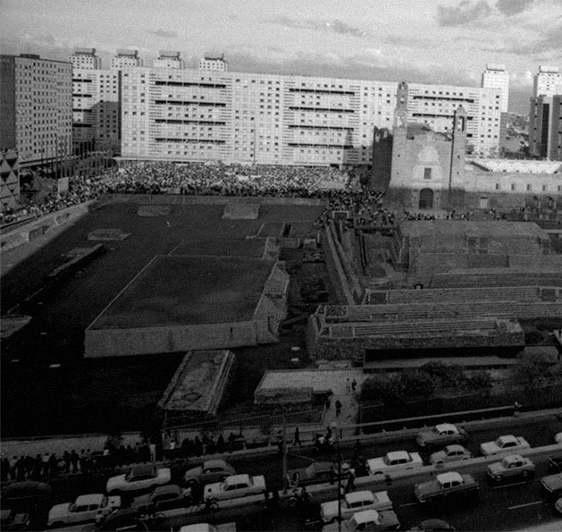
2 October 1968
10,000 students occupy Plaza de las Tres Culturas in Mexico City
Flares released from helicopters. Square closed off.
Soldiers in surrounding flats open fire on protestors.
Olympia squad arrest over 1000 protestors.

Slide 23
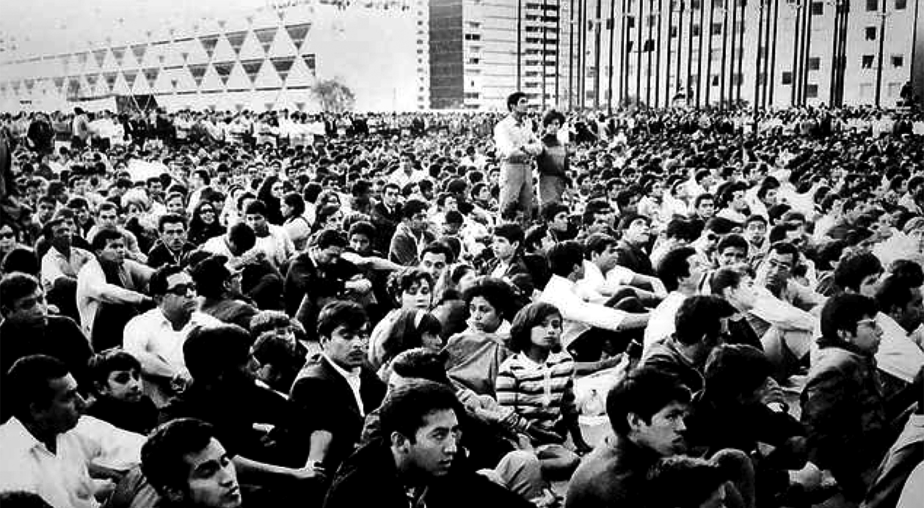
Demonstrators in Plaza de las Tres Culturas

Slide 24
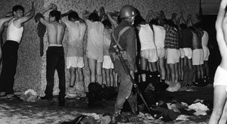
Tlatelolco 1968

Slide 25
The controversy
Until 1990s Mexican government maintained that students had fired on soldiers first and that student deaths were minimal.
2000 Election of PAN president, Vicente Fox and investigation into massacre discovers that Government had sent in Olympia squad to murder or arrest protestors.
They conclude that:
Murders were premeditated
Murders committed in cold blood
Murders probably planned by Minister of the Interior and future president, Luis Echeverria.

Slide 26
The Death Toll
Original government estimates – 7 dead
Recent estimates range from 30-300
Although 300 is popularly stated number, Kate Doyle from National Security Archives claims evidence for 44 dead on actual day.
http://www2.gwu.edu/~nsarchiv/NSAEBB/NSAEBB201/index.htm

Slide 27
The significance of 1968
For many on the Mexican left, the massacre became representative of general government repression.
Many argued that 68 students were demanding “democracy”. Sergio Zermeño, México, una democracia utópica: El movimiento estudiantil del 68
Many believe that Mexican move towards democracy began in 1968.
Many of 68ers that survived e.g. Elena Poniatowska became staunch critics of the regime. Many criticized the idea of the Mexican Revolution.

Slide 28
1968 revised
1968 a sacred cow in Mexico among both the left and the right. For the left it represents continuing state repression. For the right, it represents the beginning of democratization.
But questions over its significance remain
Was it really a turning point?
If so, why did democratization take over 30 years.
Why did so many 68ers take government employ under Echeverria?
Was it really about democracy or fairly standard student demands?
Who cared outside a self-selecting Mexico City elite?
How popular was it (Poll taken found 80 per cent of Mexicans against students in 1968)
Did the 68 movement really demonstrate the left’s (continuing) inability to mobilize non-middle-class support.
Does the perception of the importance of 68 indicate the priority urban, elite Mexicans put on their lives rather than those of the rural poor. After all, rural massacres of peasants relative common pre-1968.

