Slide 1
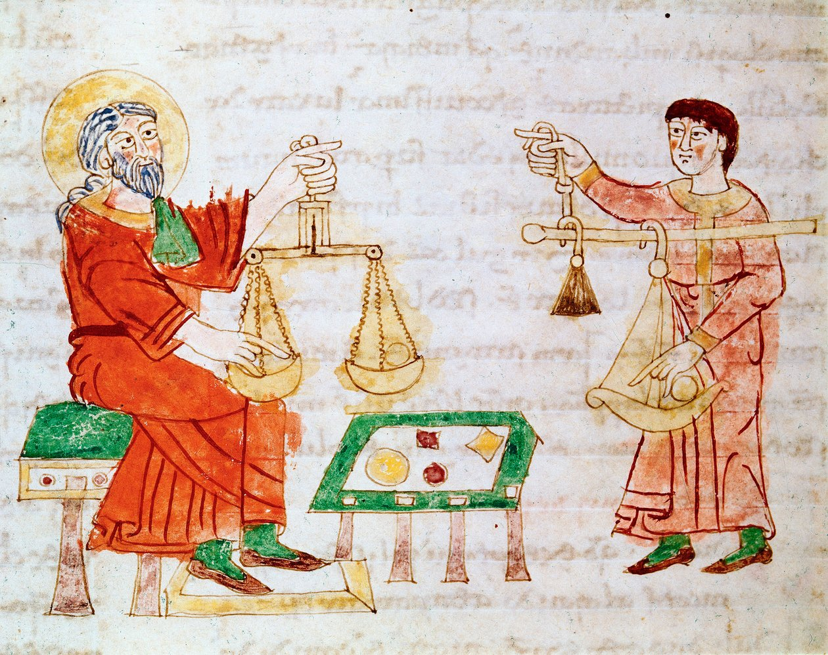
Towns and Trade
800 to 1500
Joe Chick
Notes:
Historic merchants using scales, Monte Cassino MS Casin 132, circa 1022 to 1035. From https://www.meisterdrucke.uk/

Slide 2
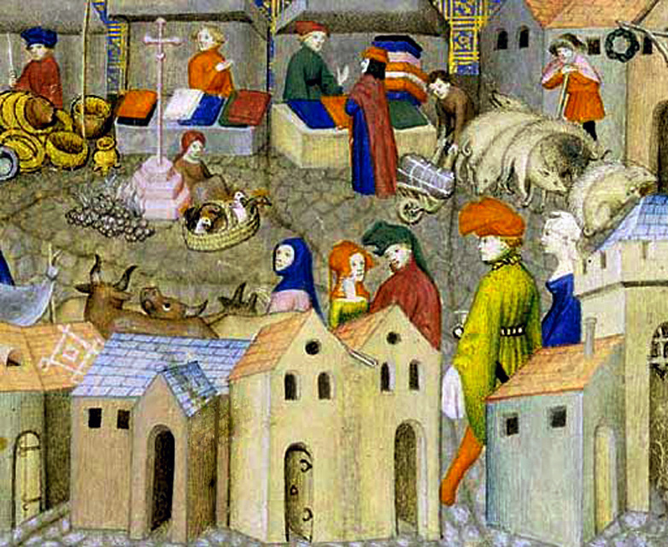
What is a town?
Population?
Problem of moving goalposts and urban character not guaranteed by size.
Borough status?
Charters don’t always reflect the nature of a settlement.
Mixed criteria
Population concentration, diversity of occupations, commercial activity, local centre.
A market scene from ‘Le Chevalier errant’, c. 1400–1405.
Notes:
Image from Le Chevalier errant, c. 1400–1405. Bibliothèque nationale de France, MS Français 12559, fol. 167. From Wikimedia Commons.

Slide 3
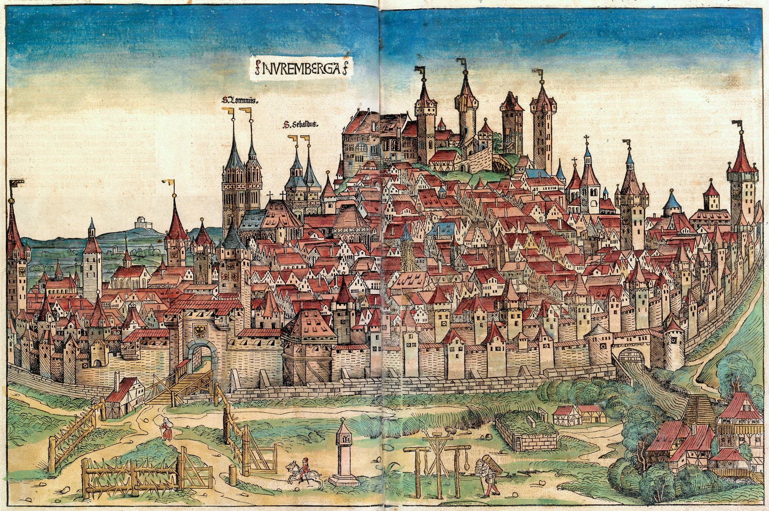
What did a medieval town look like?
A depiction of Nuremberg from 1493, showing city walls, dense buildings, churches, gateways, and surrounding landscape.
Notes:
Image from Hartmann Schedel's Nuremberg Chronicle, 1493. Woodcut attributed to Michael Wolgemut and Wilhelm Pleydenwurff. From Wikimedia Commons.

Slide 4
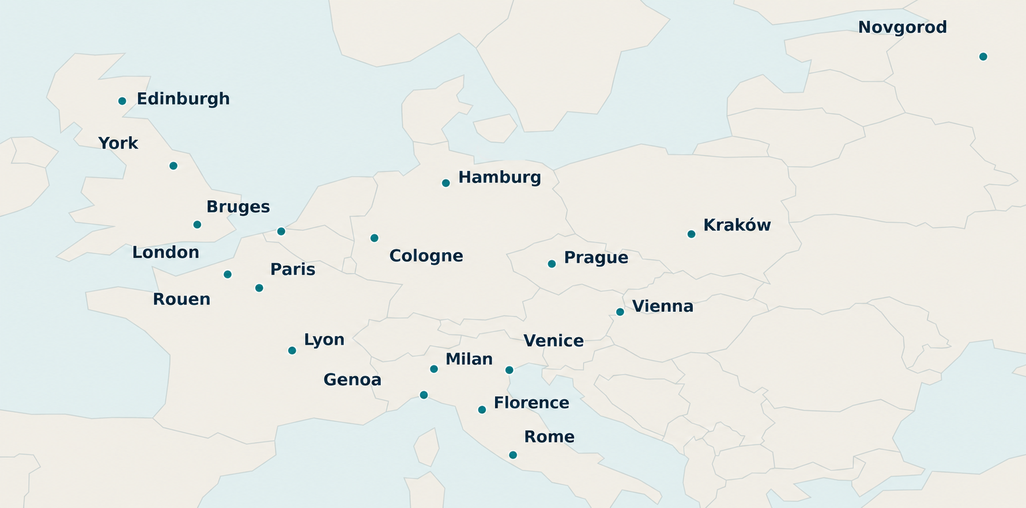
The origins of medieval towns
Roman inheritance
Some surviving cities.
Viking era
Raiding and trading.
Saxon era
Building of fortified ‘burhs’.
Major centres established by 1000.
Notes:
Map uses Natural Earth country boundaries base map, public domain.

Slide 5
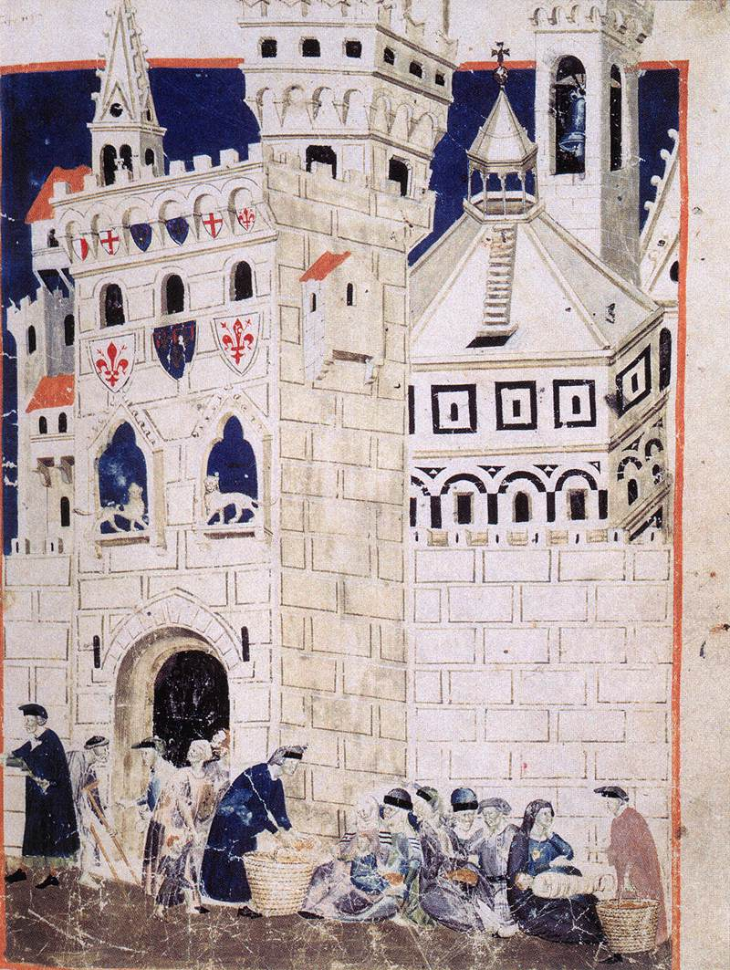
Growth and migration
Expansion c.1000–1300
Population growth and commercial opportunities encouraged new towns.
A Florentine manuscript miniature representing impoverished people driven out of Siena and their arrival in Florence.
Migrants vital
High mortality made newcomers essential, often from nearby villages.
Opportunity
Work and apprenticeships attracted migrants.
Insecurity
Security and civic privileges weren’t guaranteed.
Notes:
Image from Domenico Lenzi's Libro del Biadaiolo, c. 1344–1347. Biblioteca Medicea Laurenziana, Florence, MS Tempi 3, fol. 58. From https://www.wga.hu/

Slide 6
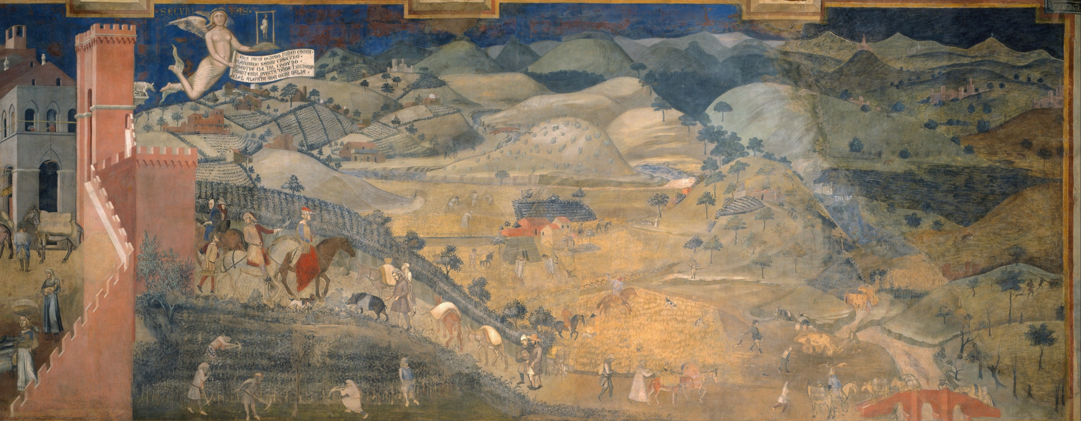
The town–country relationship
TOWN
COUNTRY
Provided markets for produce, specialised goods, and services.
Provided food, fuel, raw materials, and migrants.
Mutual dependence, unequal power
Notes:
Ambrogio Lorenzetti, Effects of Good Government in the Countryside, 1338–1339. Palazzo Pubblico, Siena. From Wikimedia Commons.

Slide 7
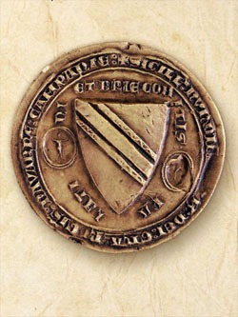
Markets and fairs
Weekly markets
Regular local trade, often within a day's return journey.
Fairs
Less frequent gatherings that attracted merchants from much further away.
The Champagne fairs
Major centres of European trade, credit and debt settlement.
Seal of the Champagne fairs, 1267.

Slide 8
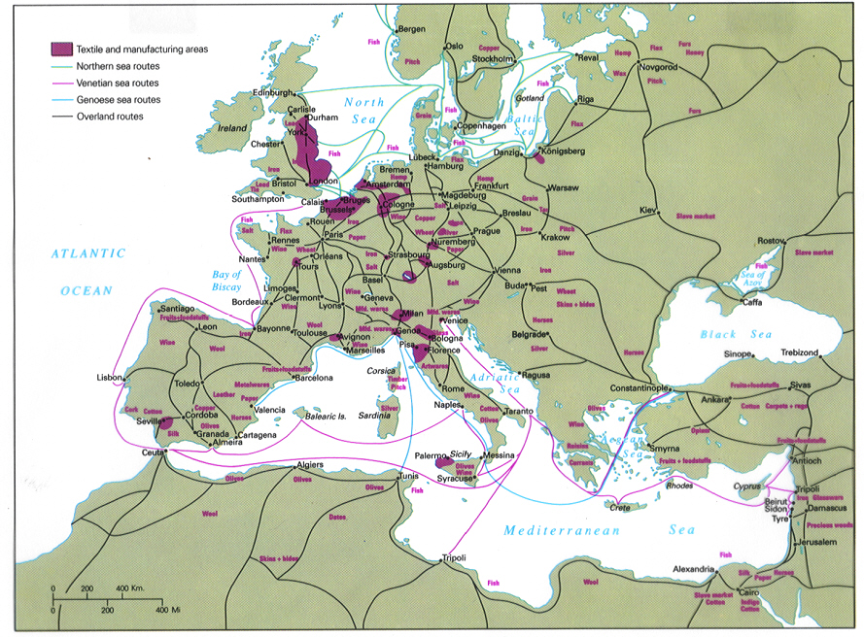
International trading networks
Mediterranean and Black Sea
Italian merchants connected Europe with the Islamic world and wider Asian trading networks.
North Sea and Baltic
Hanseatic merchants linked northern European ports through trade and commercial privileges.
Overlapping networks
Goods passed through many hands across long distances, although risks from piracy, shipwreck, and war.

Slide 9
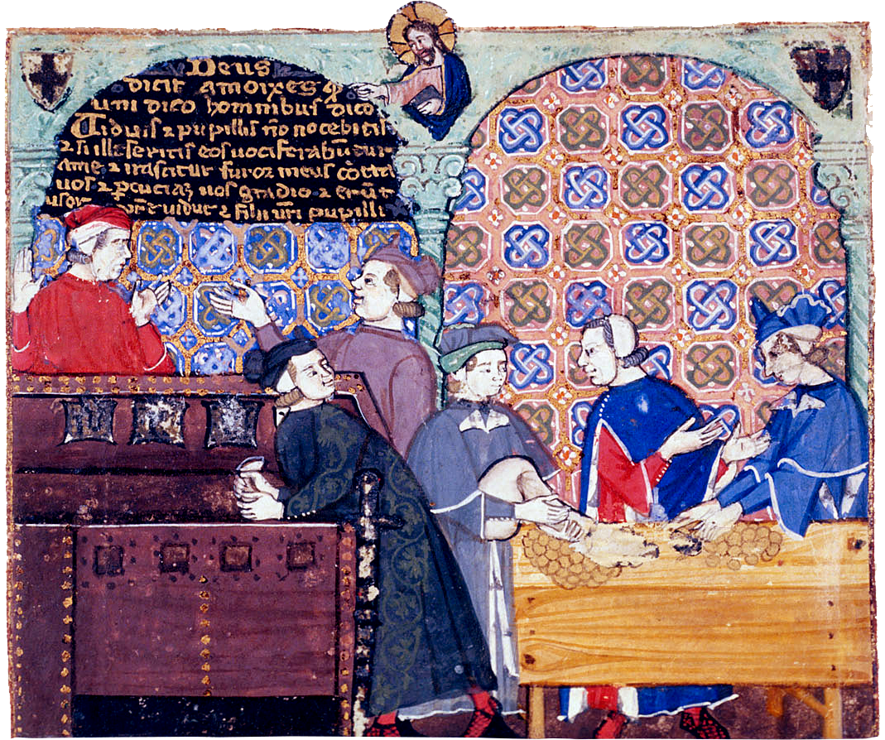
Credit and banking
Credit essential
Merchants often bought goods long before receiving payment.
Usury
Church law prohibited interest: alternative forms of profiting developed.
Trust and enforcement
Family networks, guilds, overseas agents, and courts helped merchants.
Not just for the rich
Craftspeople and farmers borrowed too.
Miniature showing people handling money at a table from a manuscript discussing the sin of avarice.
Notes:
Image from the Cocharelli Codex, c. 1340. British Library, Add MS 27695, fol. 8r. From Wikimedia Commons.

Slide 10
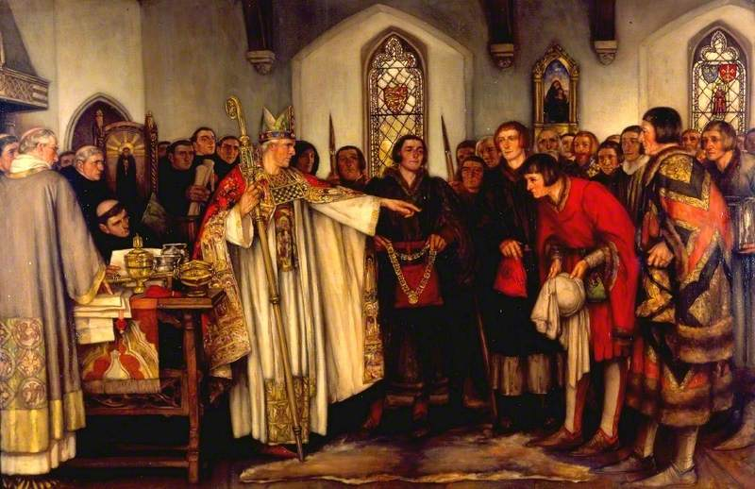
Lordship and urban government
Lordship
Towns might be owned by the Crown, bishops, monasteries, lords, or knights.
Independence
General trend towards greater autonomy across medieval era.
Varied situation
Charters granting liberties were negotiated locally, not universal.
Painting of the abbot of Reading selects a mayor from the shortlist chosen by the town inhabitants.
Notes:
Image from https://artuk.org/

Slide 11
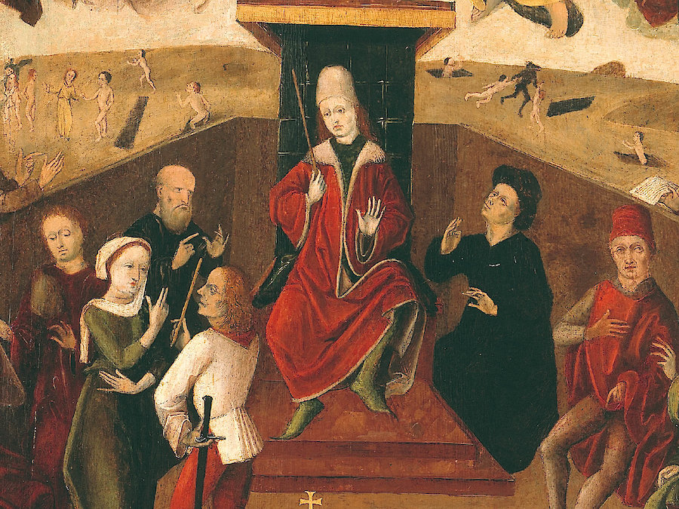
The urban political elite
Government by a minority
The highest offices were dominated by wealthy merchants and property holders.
Many excluded
Civic autonomy didn’t lead to inclusive government.
Factional politics
Guild rivalries and competing interests divided the urban elite.
Panel painting showing Niclas Strobel (wealthy master butcher, judge, and mayor of Graz in Austria) presiding over a city court, 1478.
Notes:
Image from Graz Museum, Austria, https://360.grazmuseum.at

Slide 12
Guilds and apprenticeship
Merchant guilds
Gave trading privileges for elite merchants.
Apprentice
Training in master’s household
Craft guilds
Ensured standards of goods and sometimes oversaw apprenticeships.
Journeyman
Work for daily wages
Religious guilds
Master
Not a guaranteed destination
Organised the veneration of saints, commemoration, and charitable work.
Blurred categories
Functions often overlapped.

Slide 13
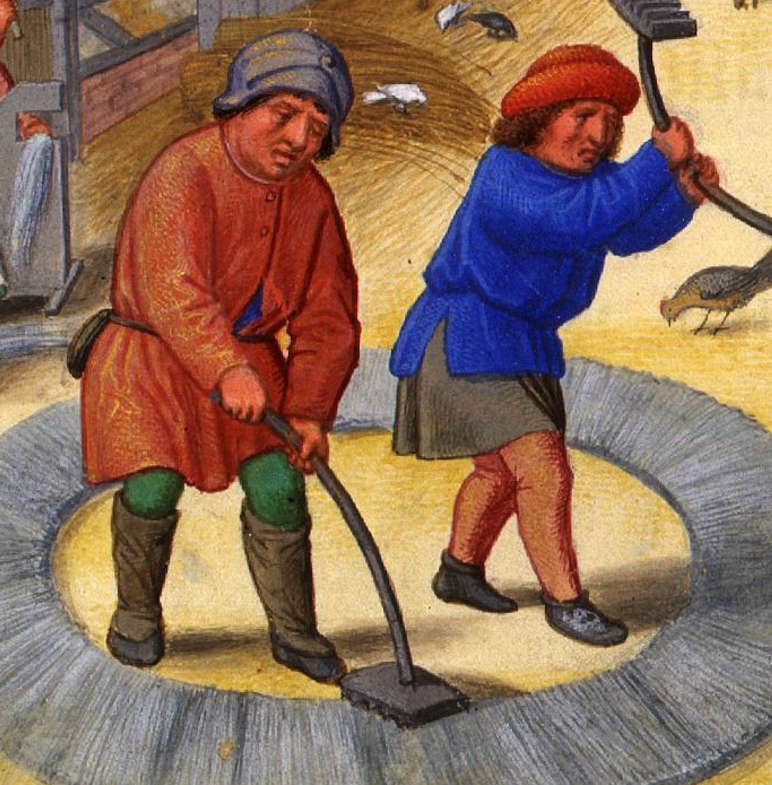
Households and livelihoods
Blurred domestic and work space
Houses often combined domestic rooms with shops and workshops.
Multiple livelihoods
Households practised several different crafts and trades, rather than relying on a single occupation.
Urban agriculture
Many townspeople kept animals or cultivated fields around the town.
Men carding wool, c.1515.
Notes:
Men carding wool, c.1515. Da Costa Hours, Pierpont Morgan, MS M.399, fol. 12v. Courtesy of Wikimedia Commons.

Slide 14
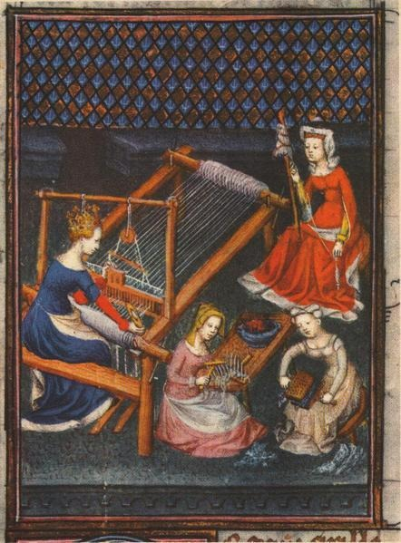
The lives of urban women
Activity often invisible
Records focusing on men often obscure women's contribution.
Wide range of work
Participation in textiles, brewing, retail, household production, and credit.
Independence with limits
Widows and unmarried women running businesses.
Exclusion
Fifteenth-century image of women working on various stages of cloth production.
Rare to have access to guilds or political office.
Notes:
Fifteenth-century image of women working on various stages of cloth production. Des cleres et nobles femmes, BnF MS Français 12420, fol. 71r. Courtesy of Wikimedia Commons.

Slide 15
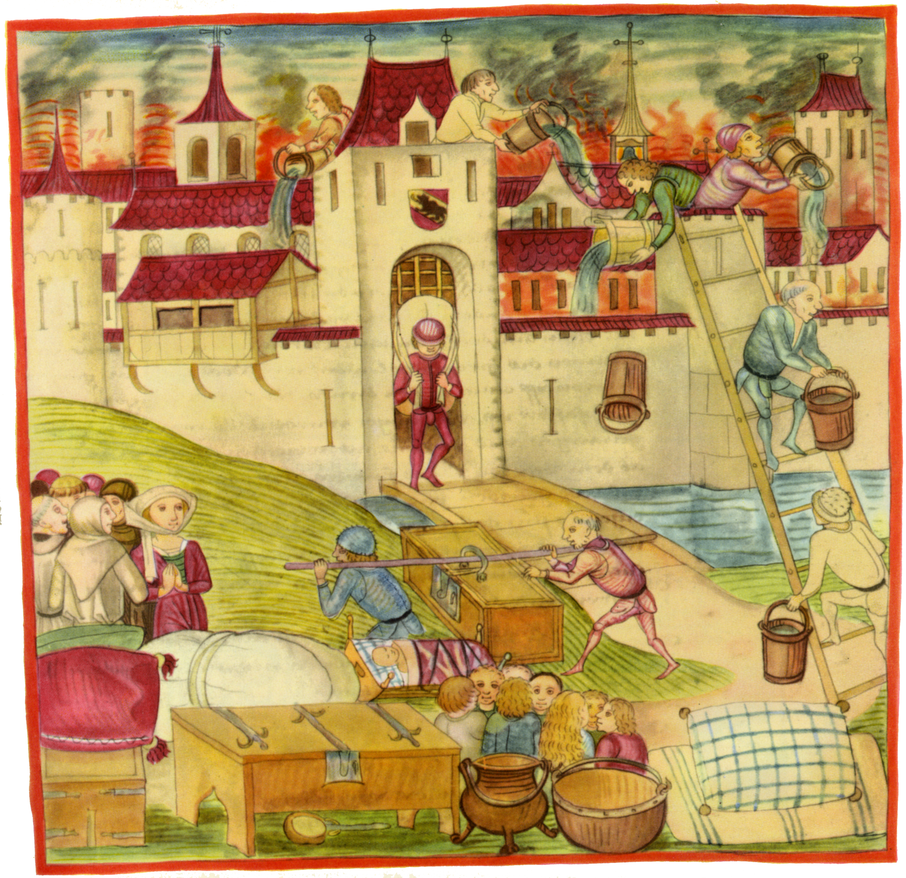
What was it like to live in a medieval town?
Fire risk
Waste disposal
Animals and crowded streets
The great fire of Bern in 1405, with inhabitants escaping, moving belongings, and carrying buckets to fight the flames.
Notes:
Image from Diebold Schilling's Bern Chronicle, 1478. From Wikimedia Commons.

Slide 16
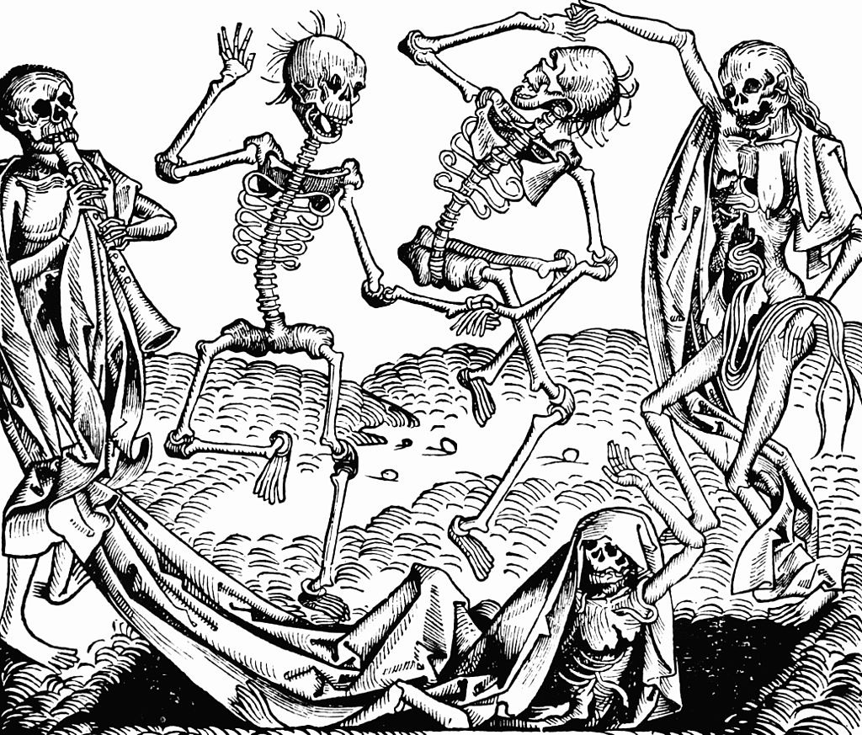
The fifteenth-century urban decline debate
1315-17
Great Famine
1347-51
First wave of Black Death
15th C
Smaller waves but population stagnates
15th century decline wasn’t a ‘rule’ everywhere
Ipswich
Early 15th C prosperity from Suffolk cloth.
Reading
Mid to late 15th C prosperity from cloth trade.
A ‘Dance of Death’ woodcut.

Slide 17
Towns and trade
Population shift to towns, but still rural life dominated
Blurred distinction between urban and rural life
Guilds and parishes provided some security
Town hierarchies left many excluded

