Slide 1

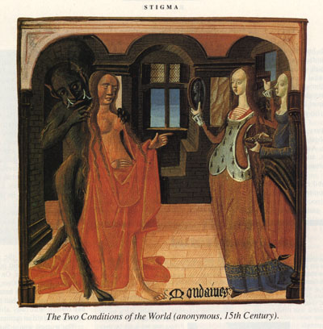
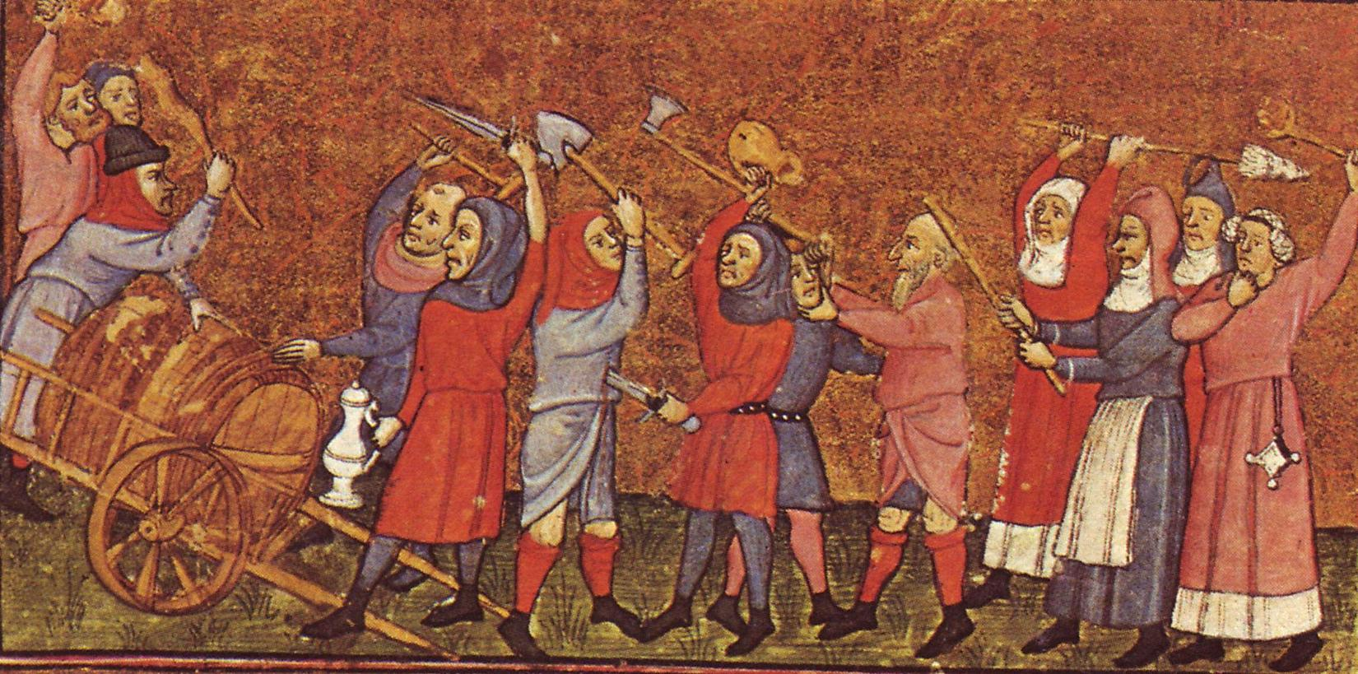
Crossing Boundaries and Breaking Norms in the Medieval World
Lecture 1

Slide 2
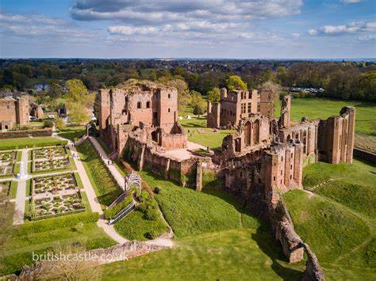
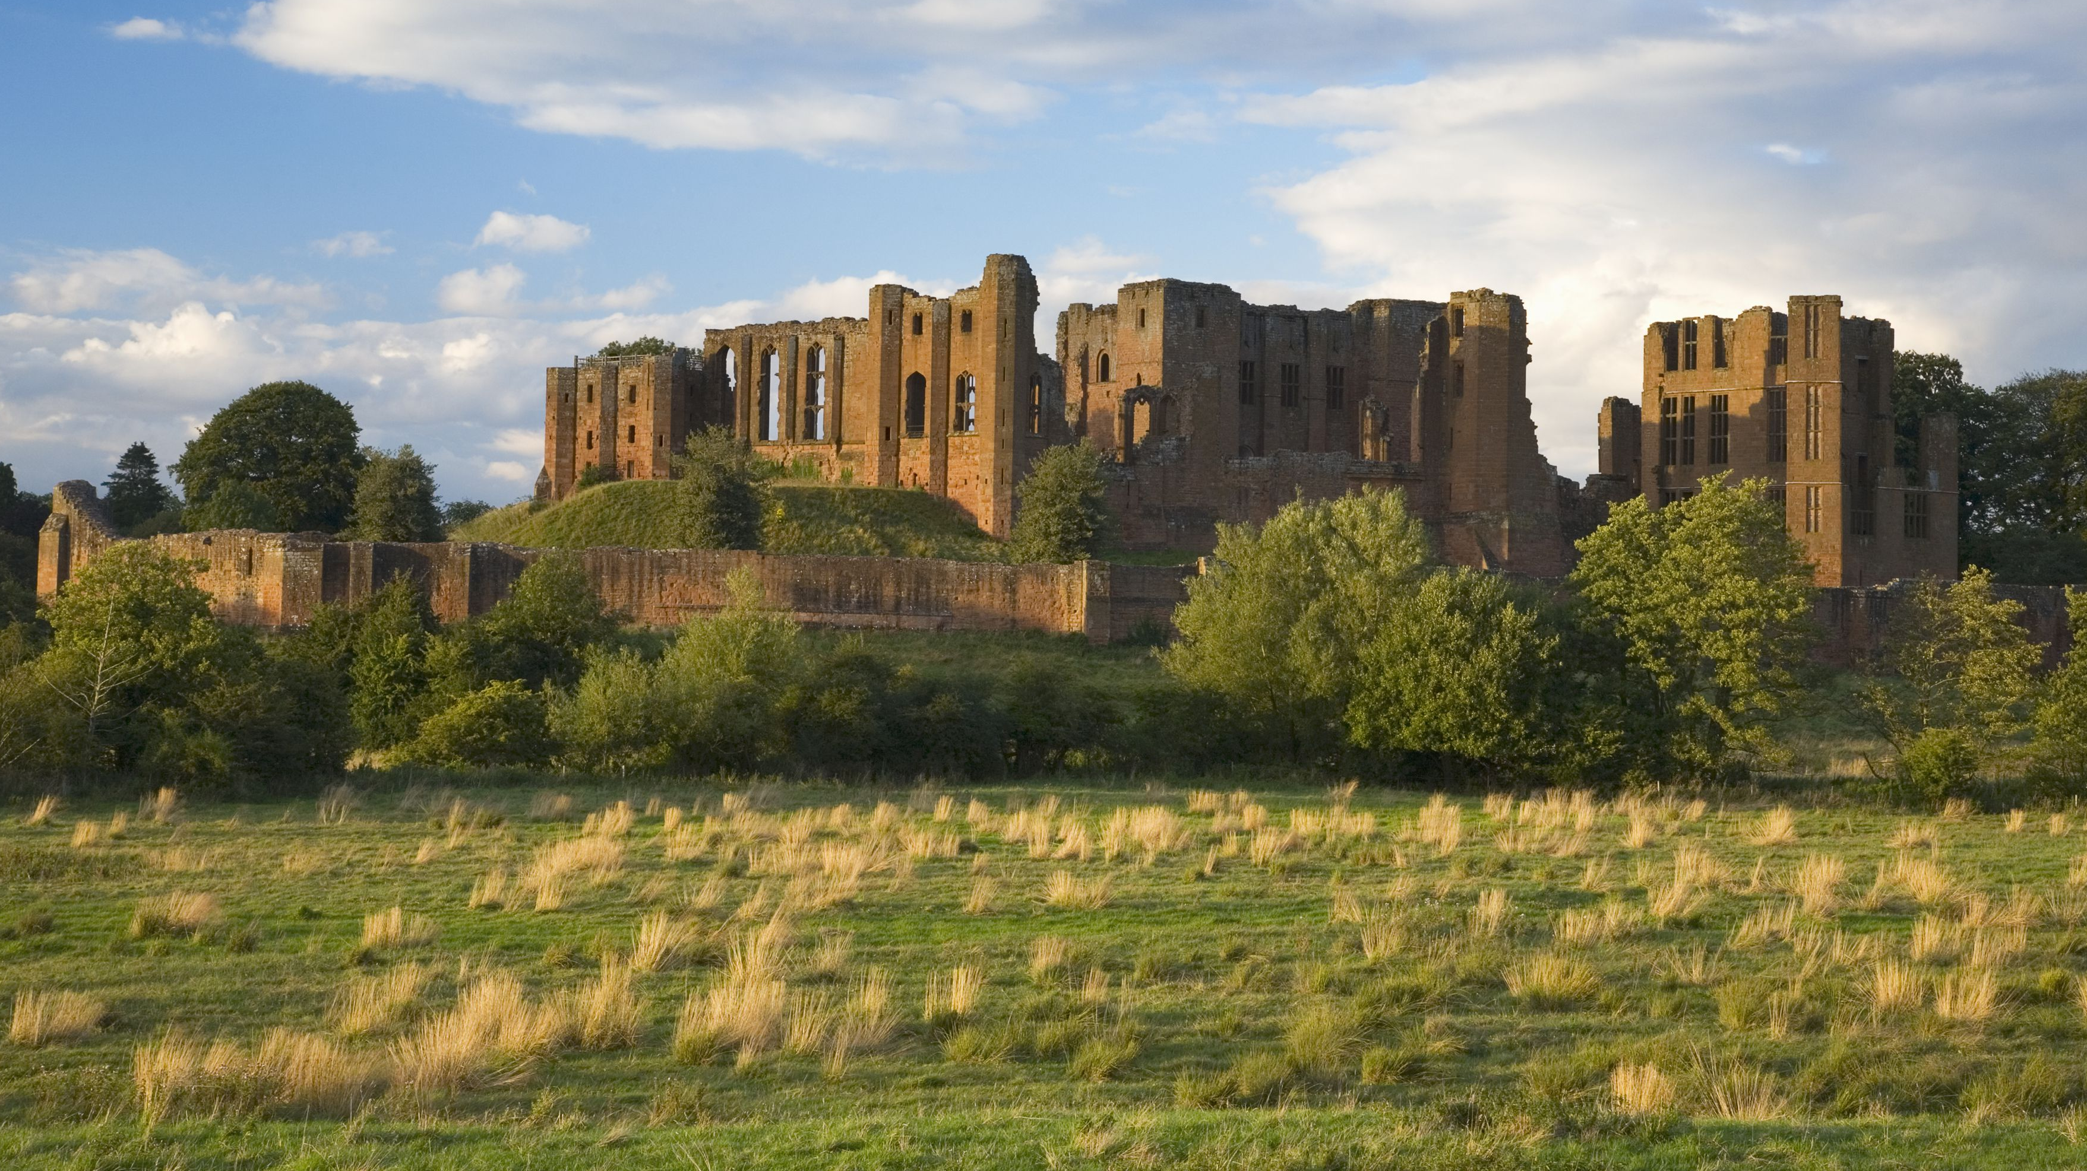
Kenilworth castle, c. 1120-1570

Slide 3
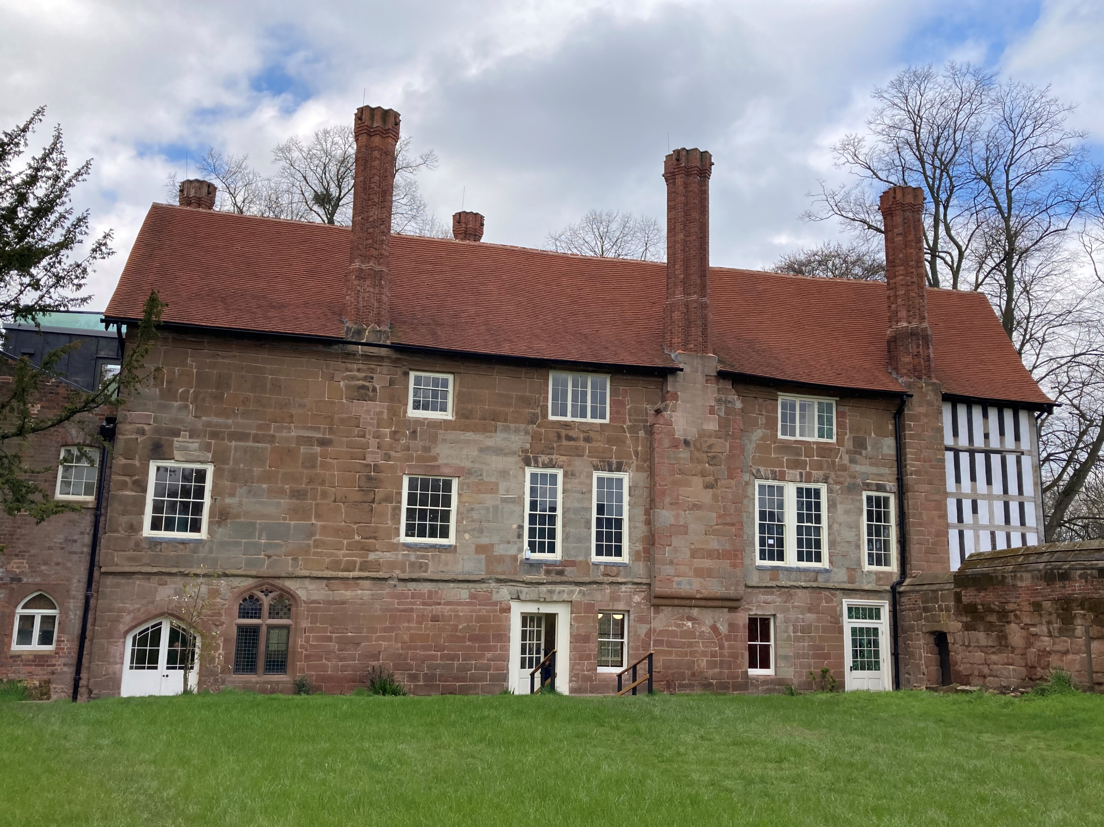
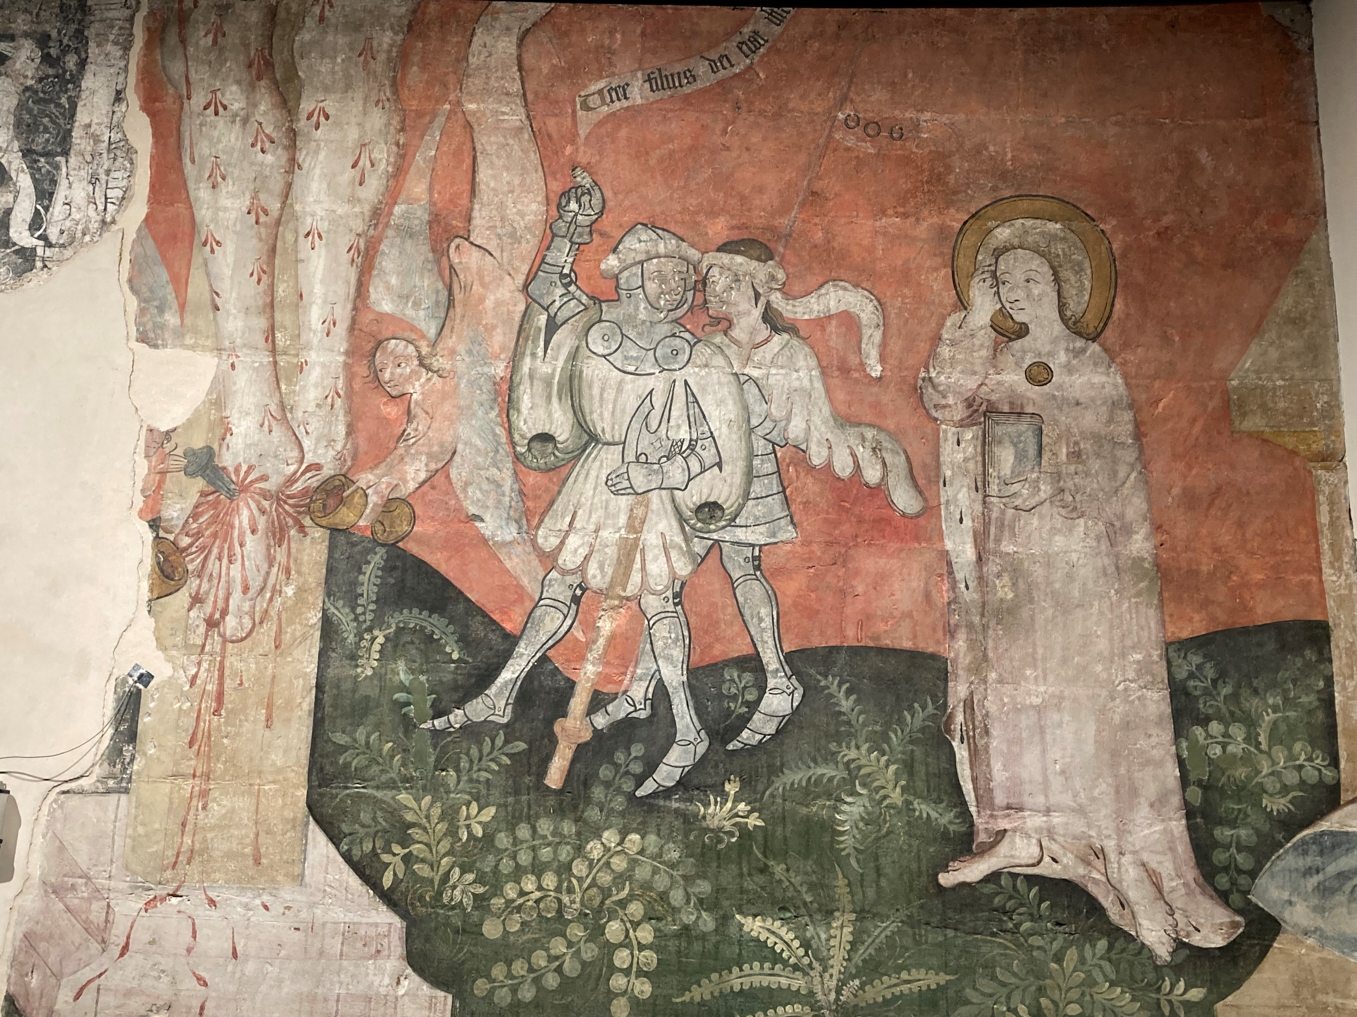
CHARTERHOUSE, COVENTRY c. 1380

Slide 4
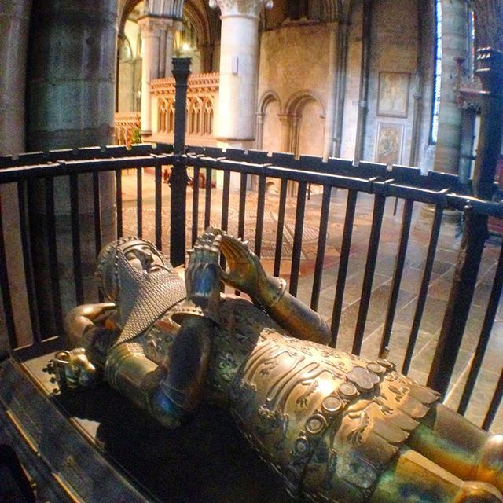
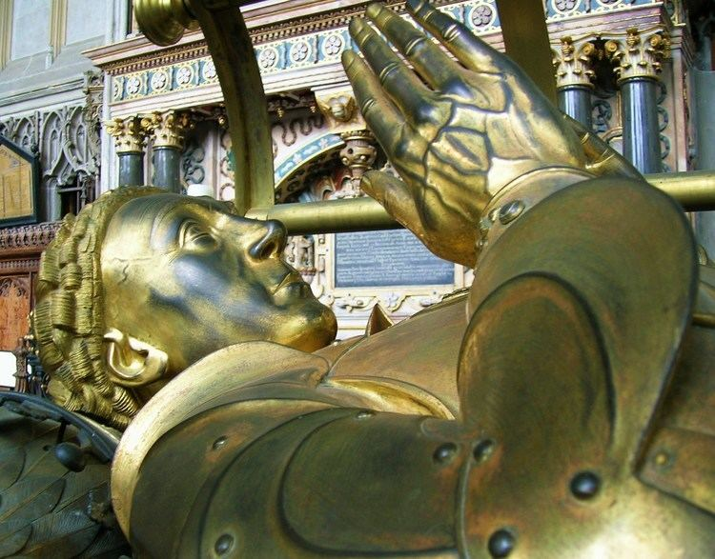
tomb of Richard Beauchamp (1382-1439) in St Mary's Church, warwick cf black prince (1330-1376) in canterbury cathedral

Slide 5
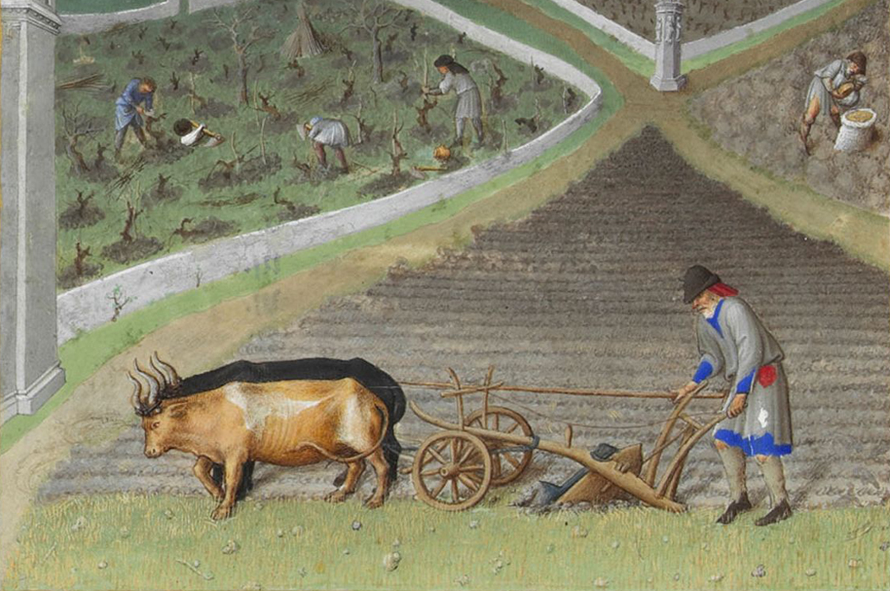
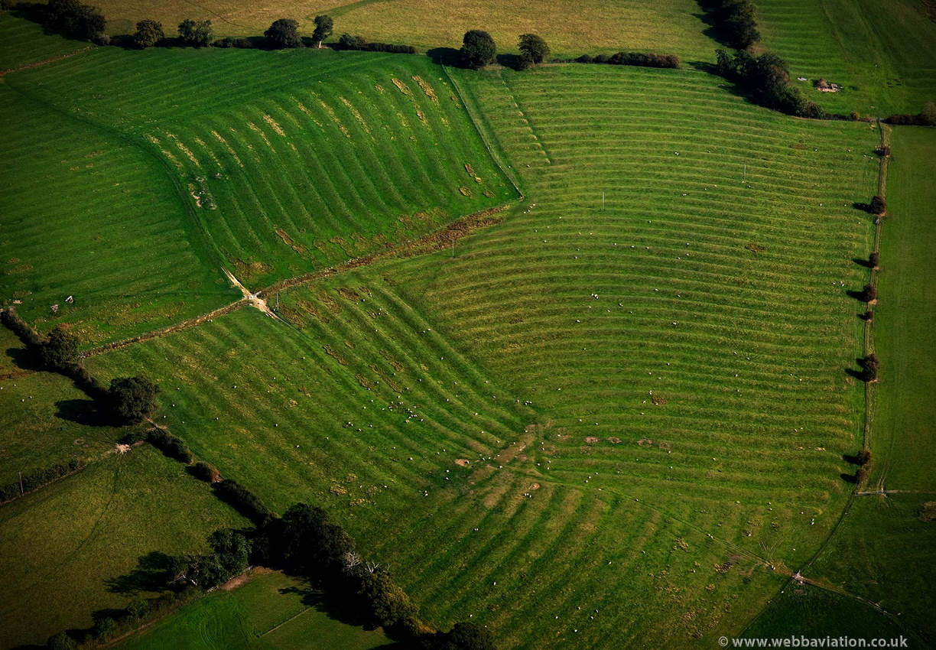
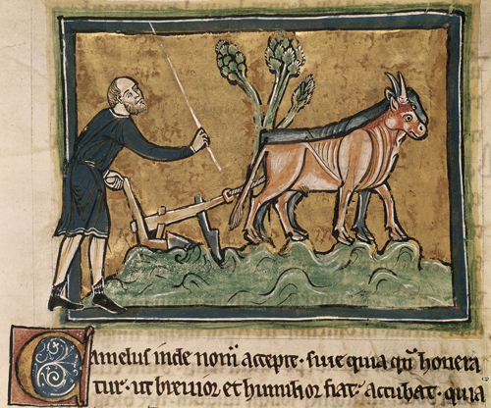
MEDIEVAL LANDSCAPE: RIDGE AND FURROW

Slide 6
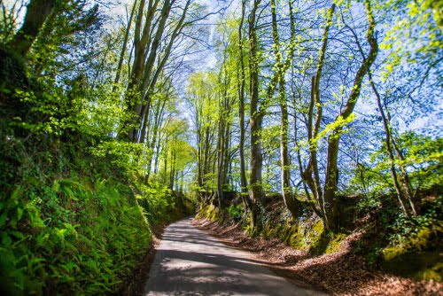
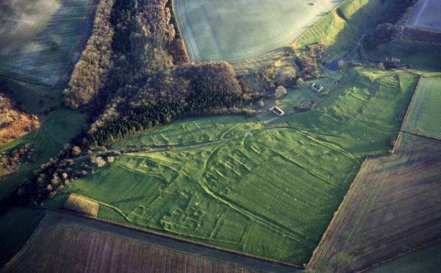
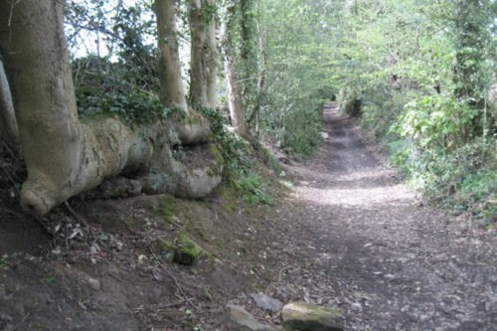
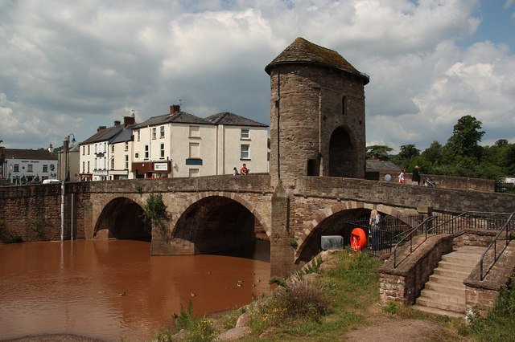
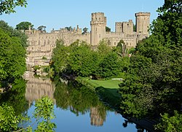
HOLLOWAYS & Deserted villages & urban remnants

Slide 7
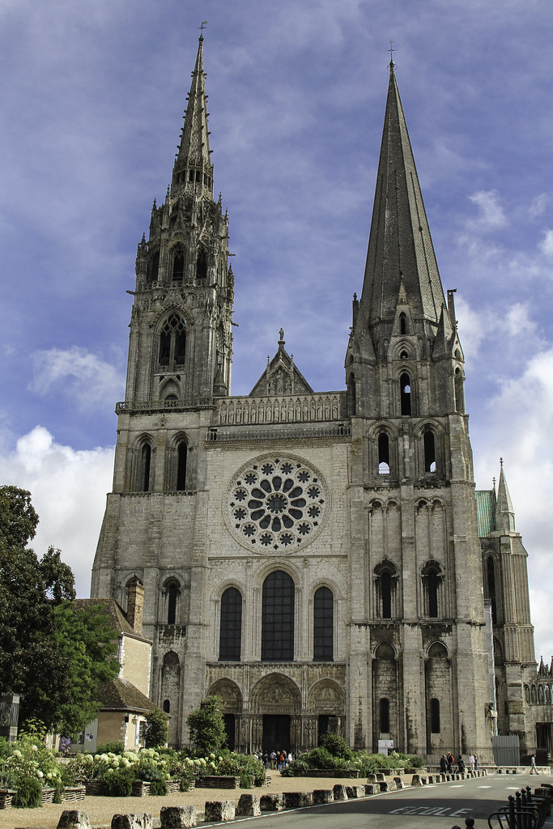
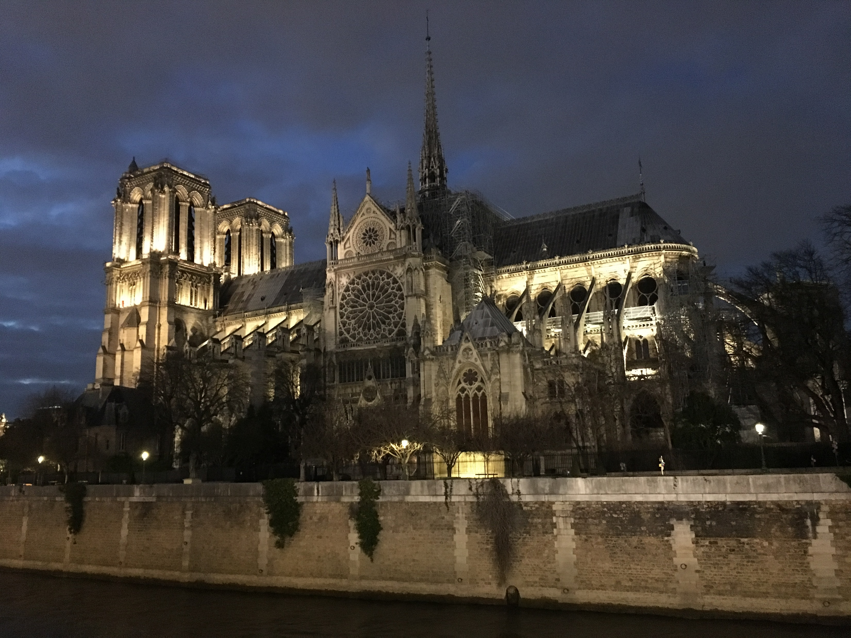
CHARTRES CATHEDRAL c. 1190-1220
NOTRE DAME, PARIS c. 1160-1260

Slide 8
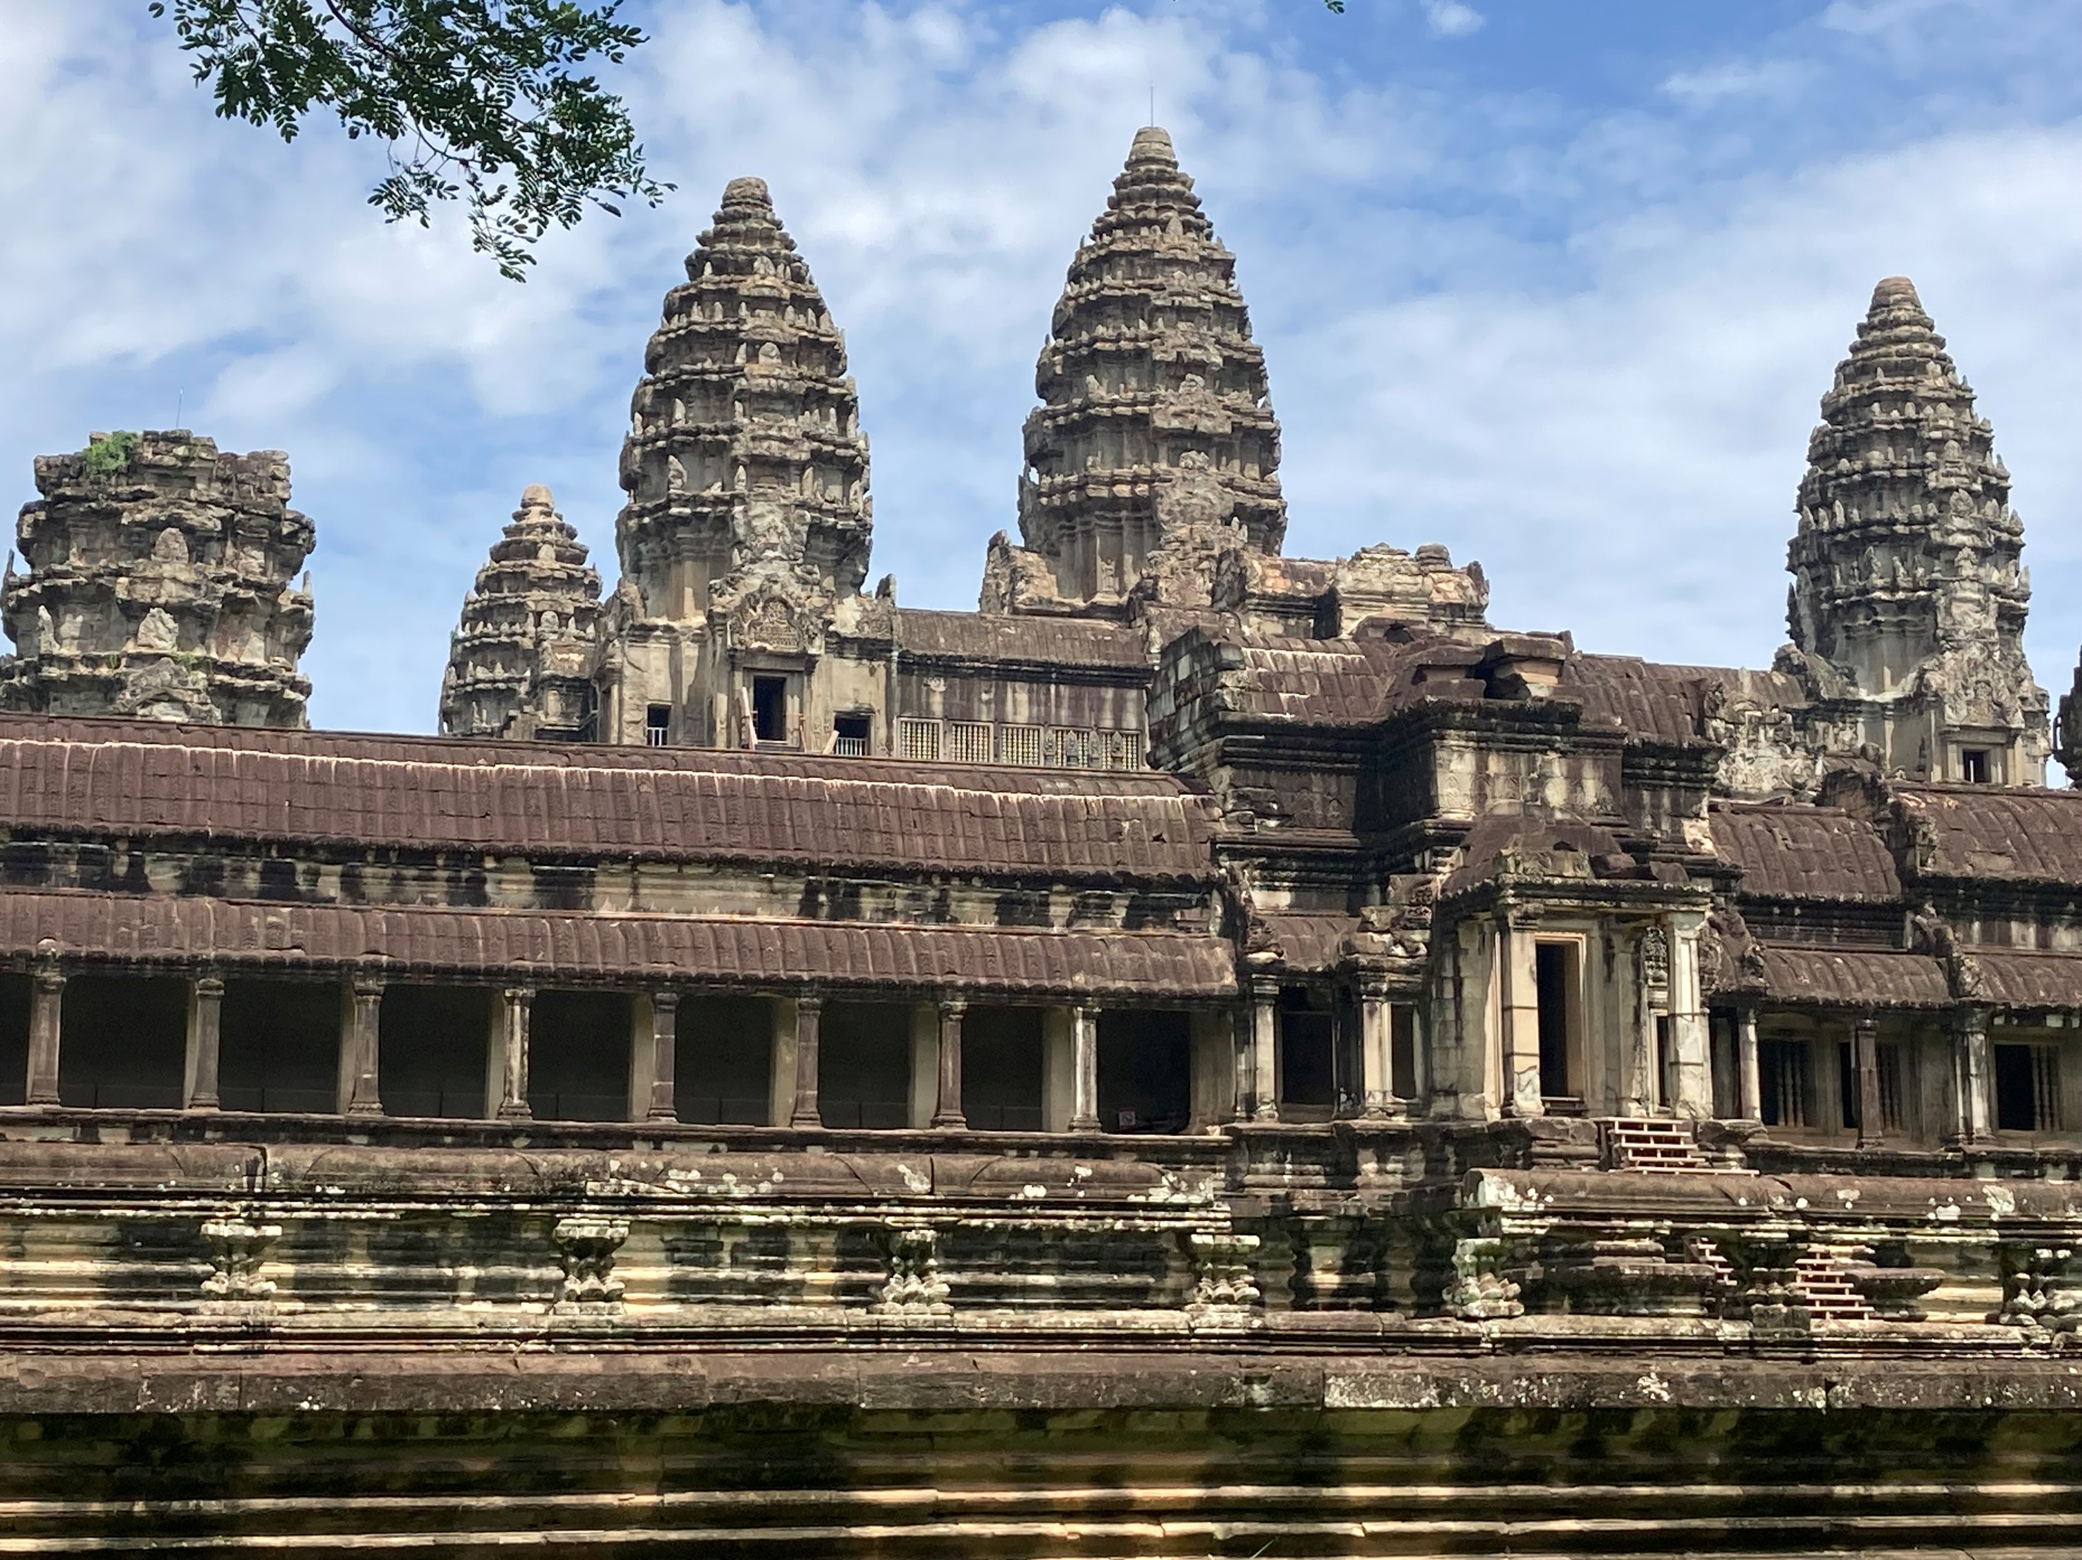
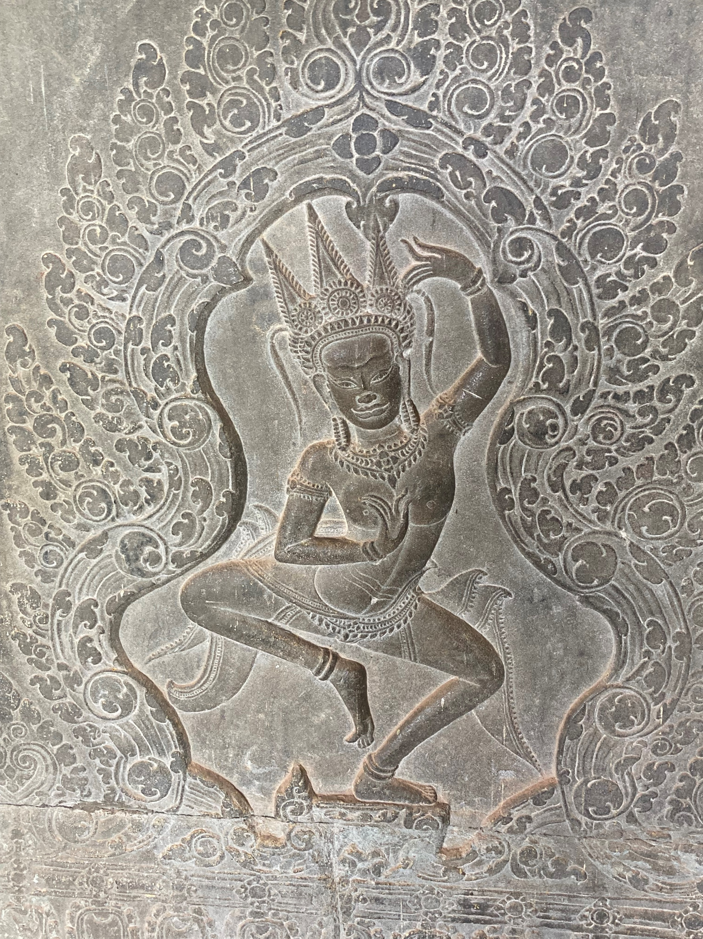
Angkor Wat, Cambodia c. 1150

Slide 9
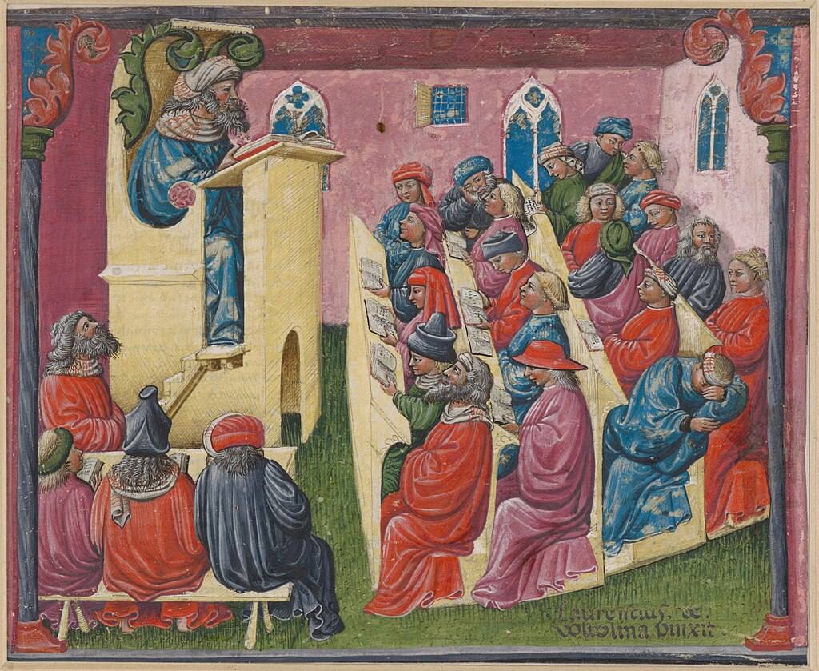
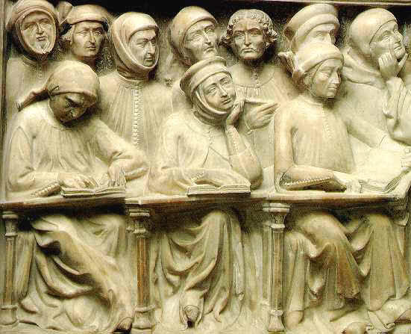
FIRST UNIVERSITIES C. 1150: PARIS, BOLOGNA, OXFORD

Slide 10
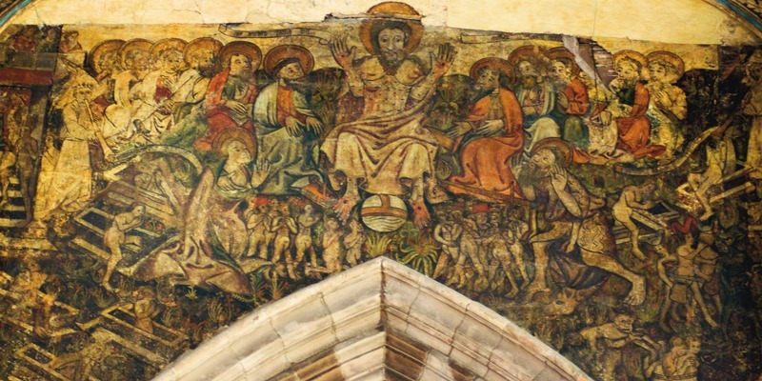
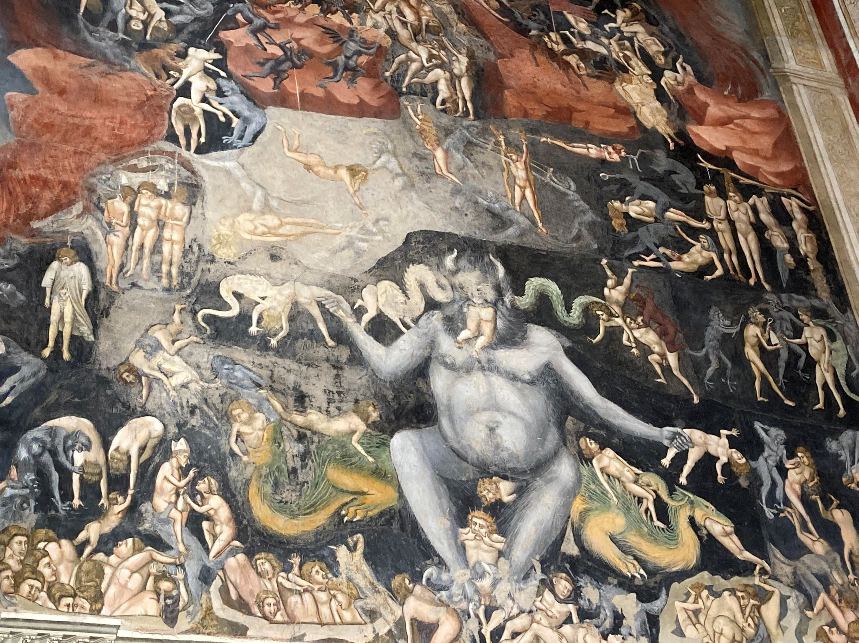
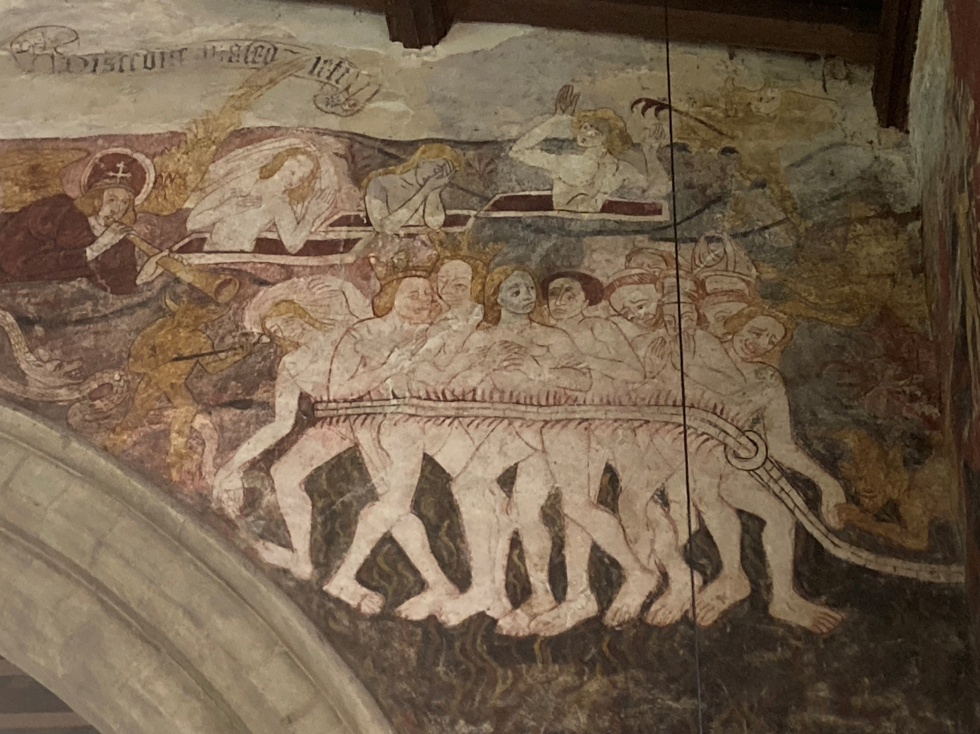
Hell, Last Judgement & Doom Frescoes

Slide 11
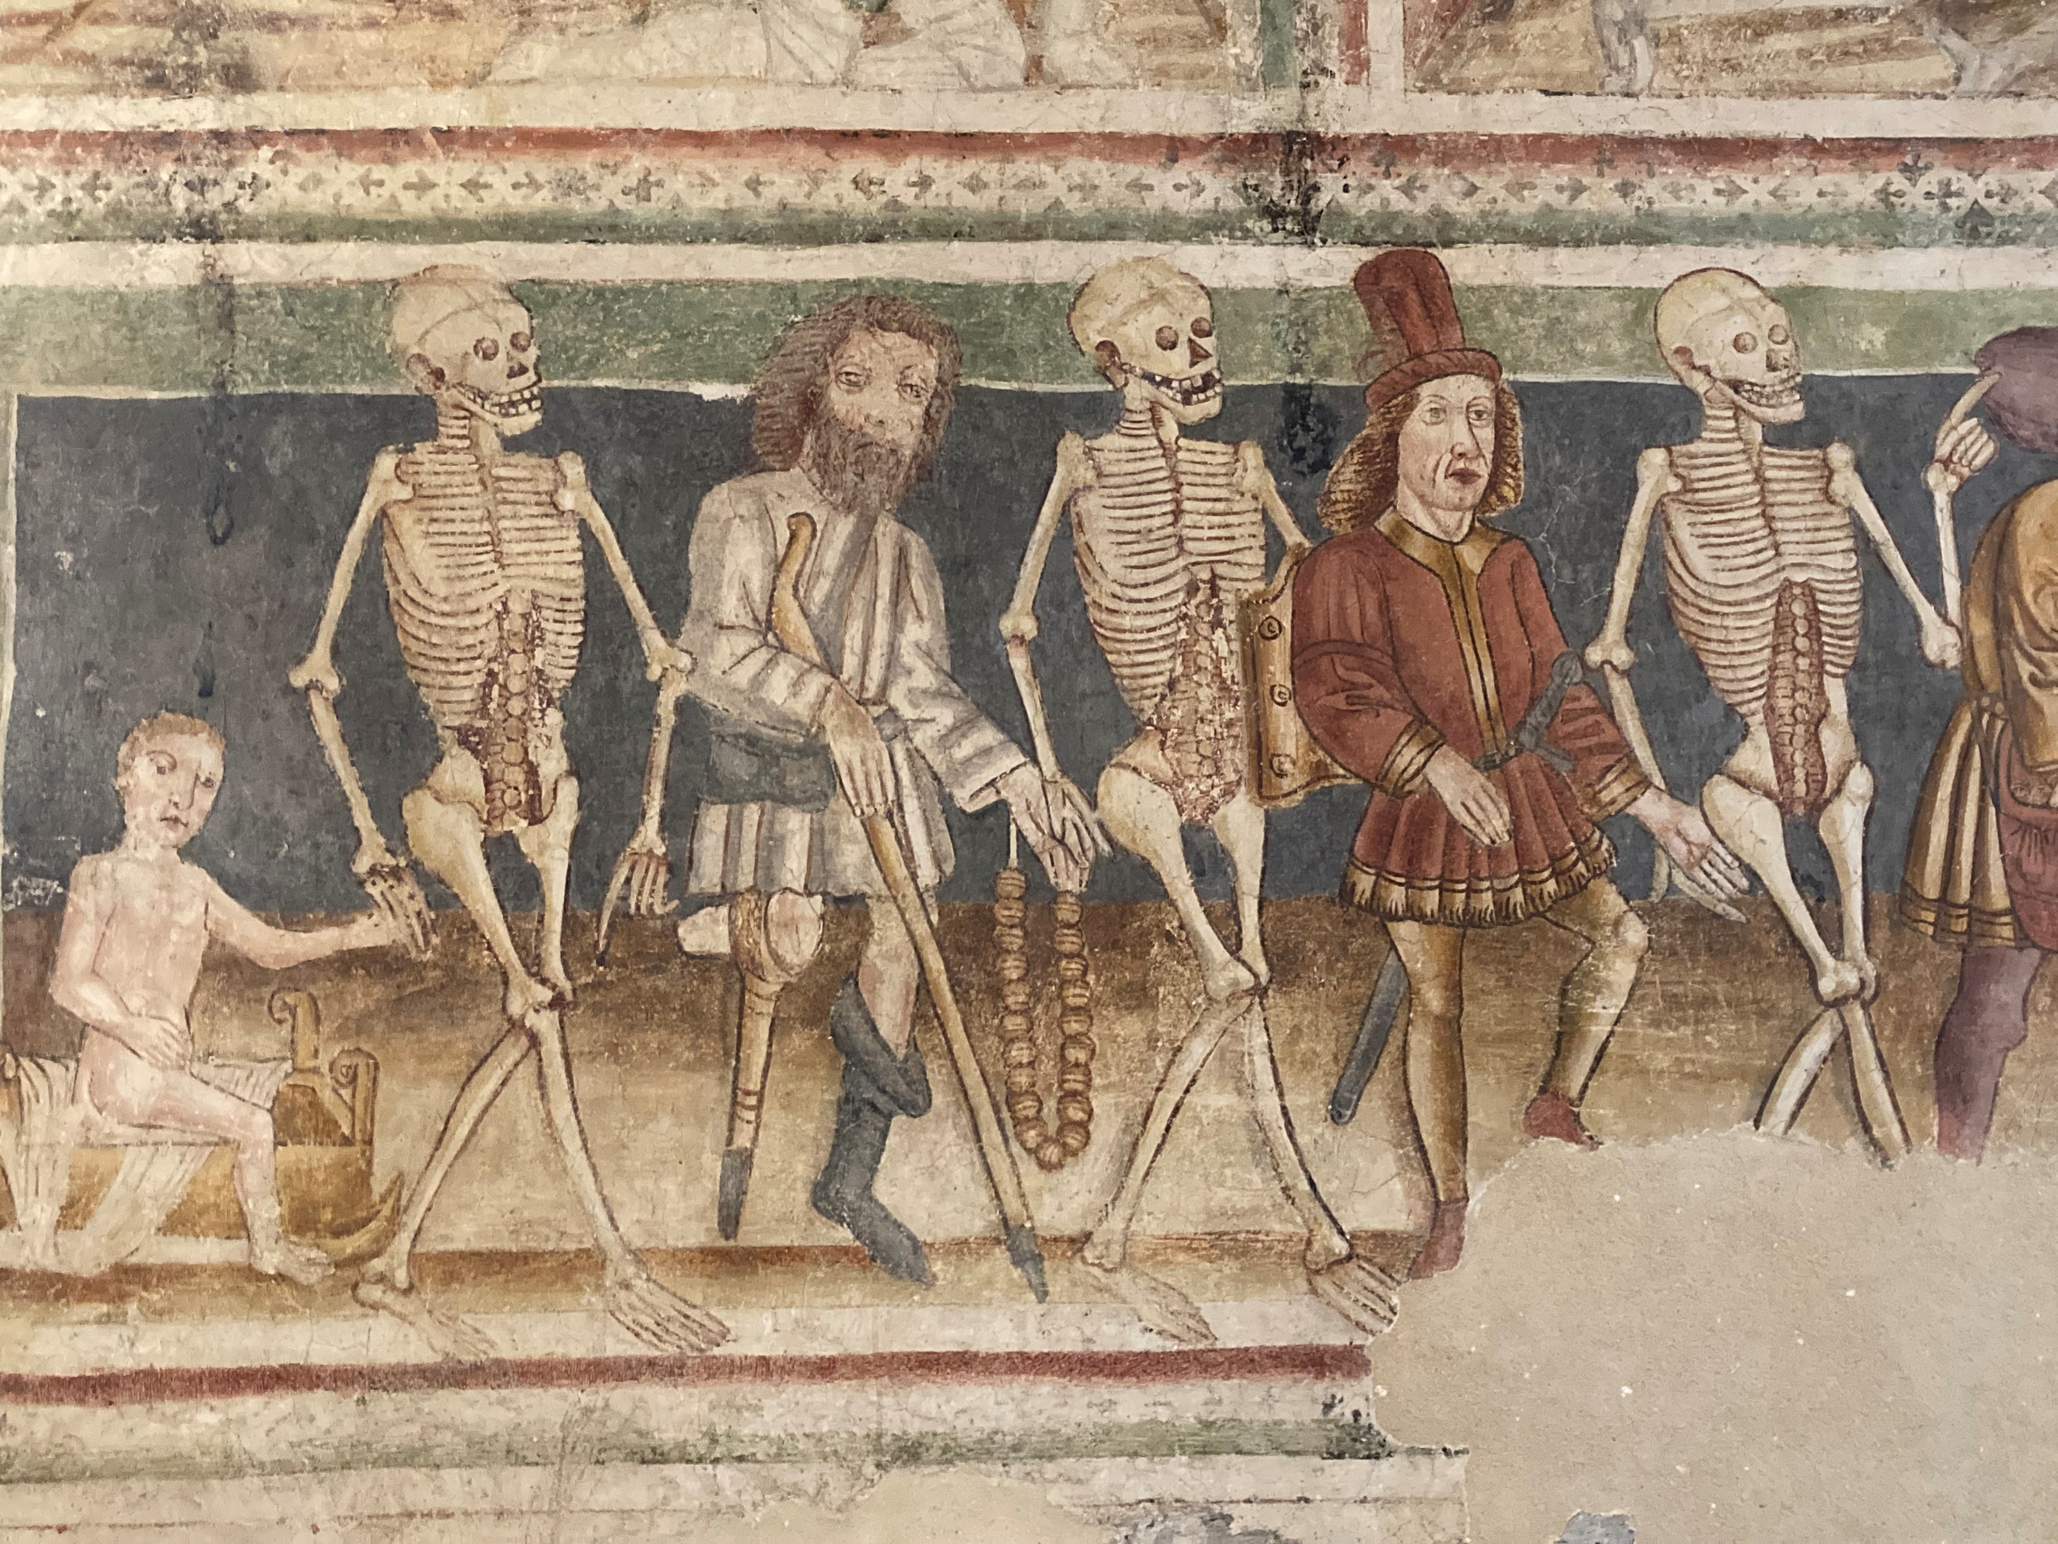
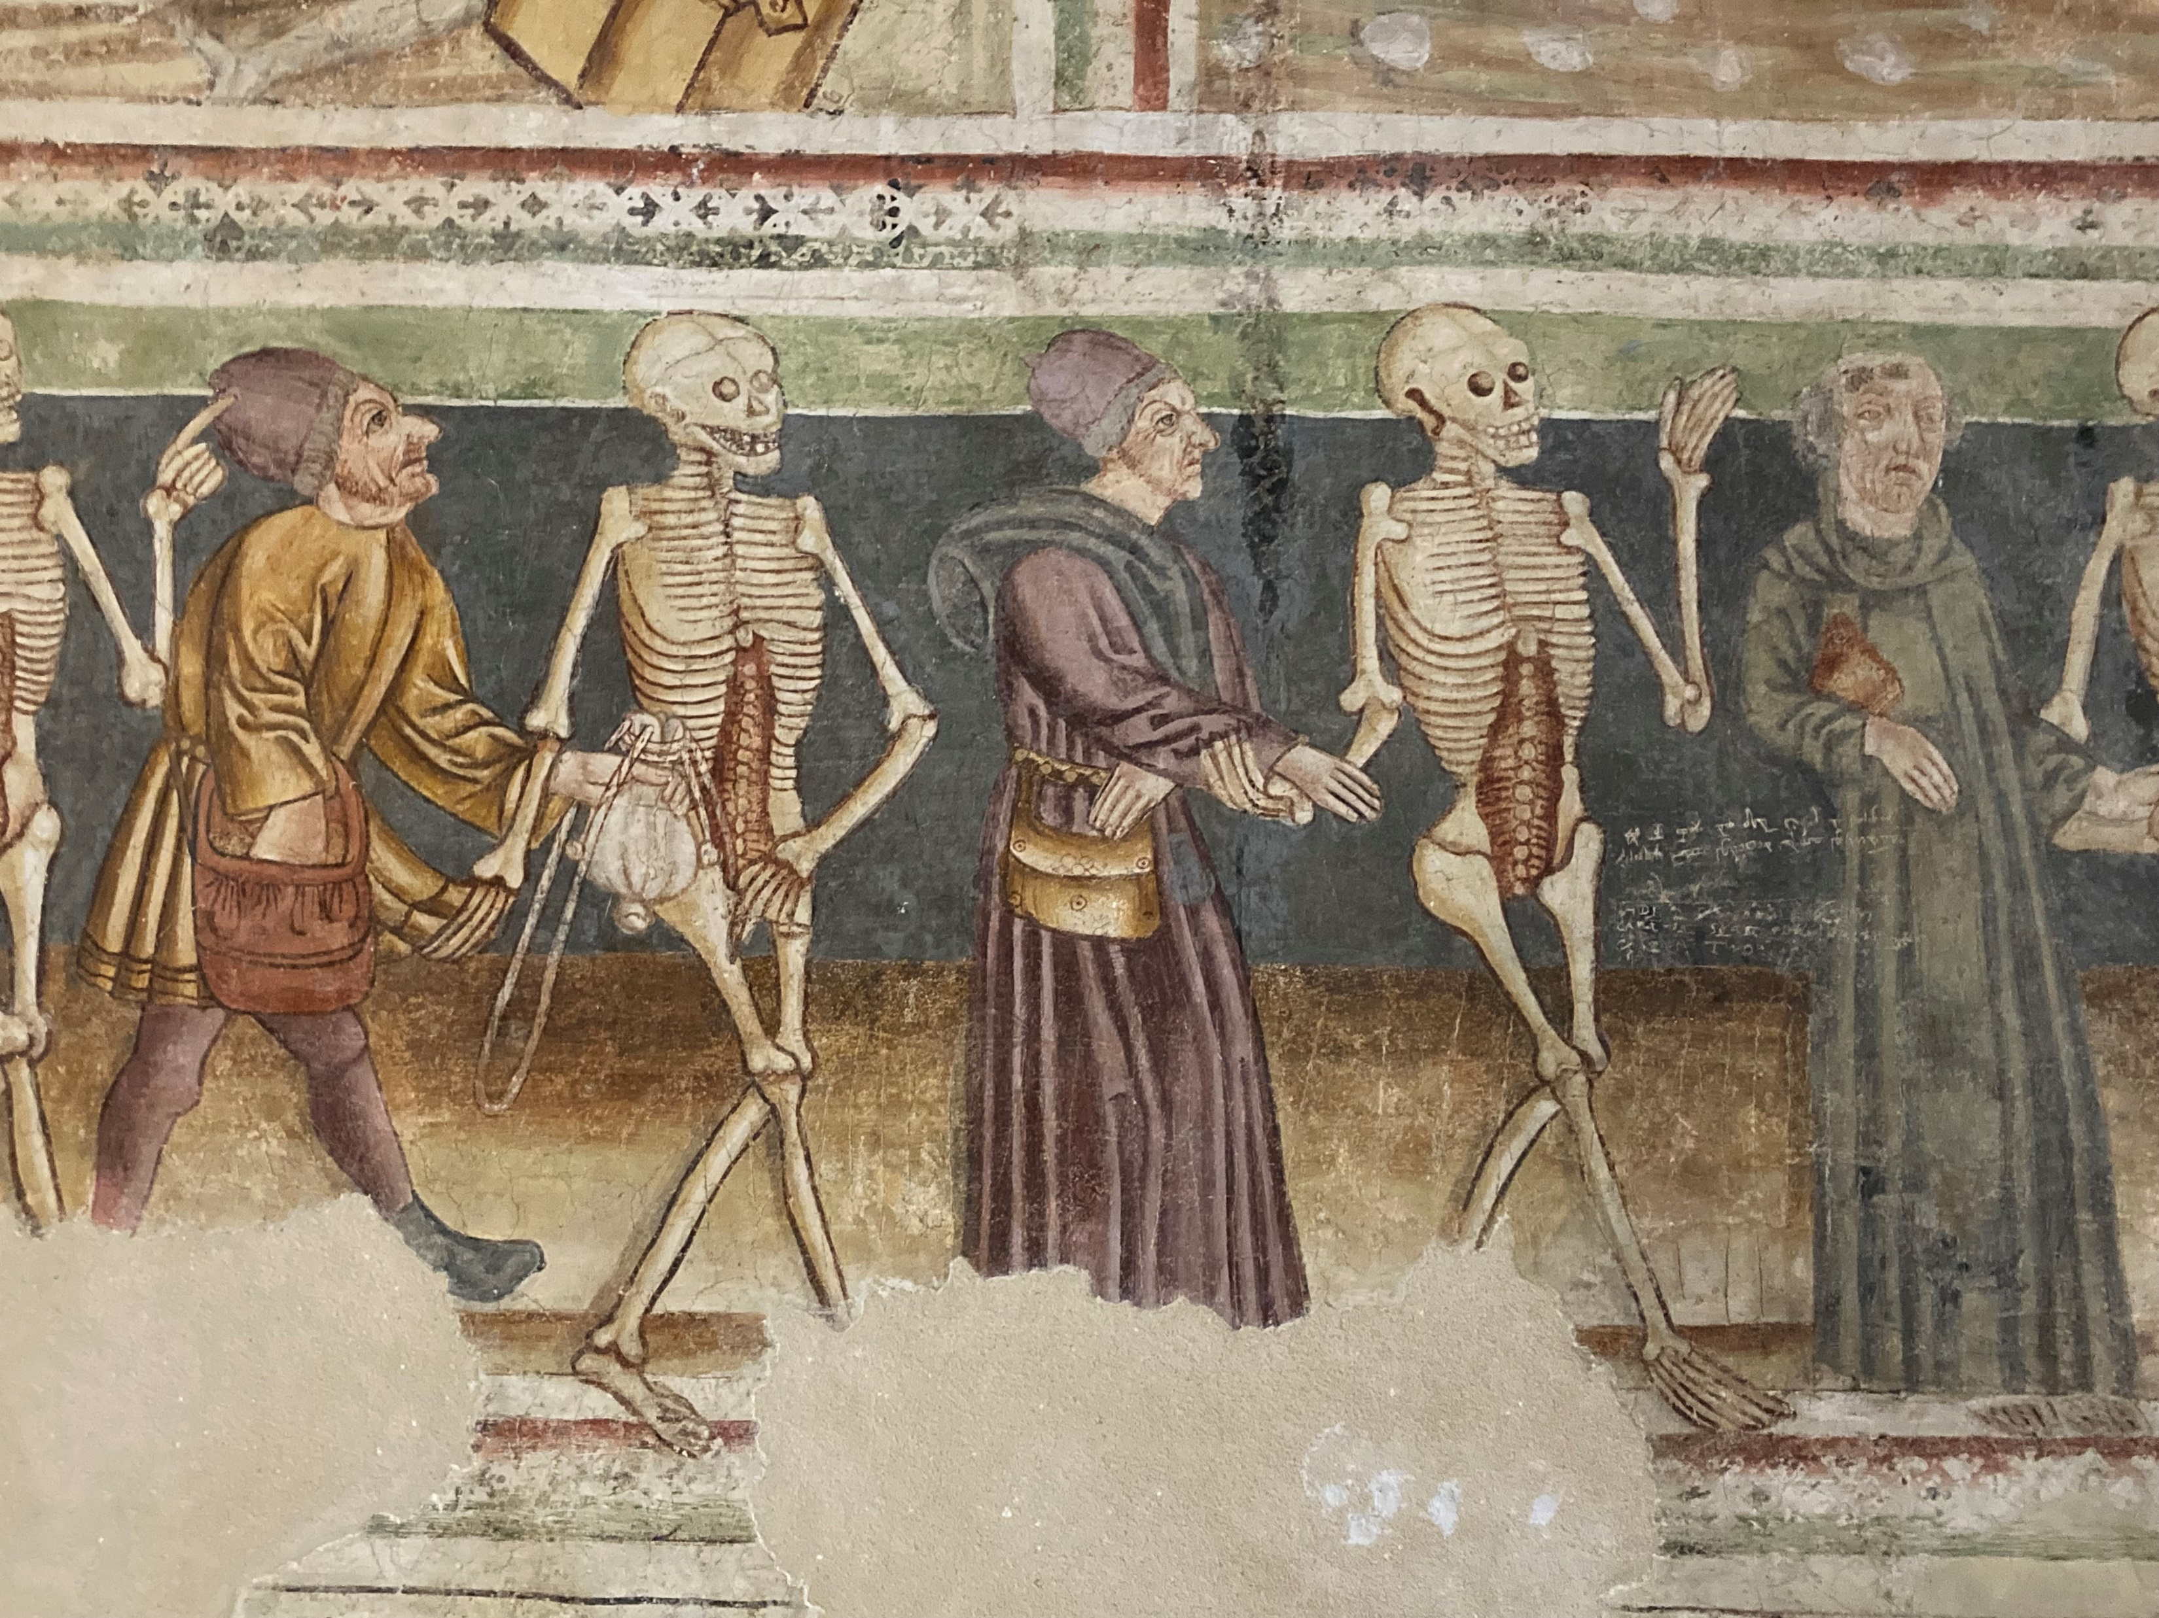
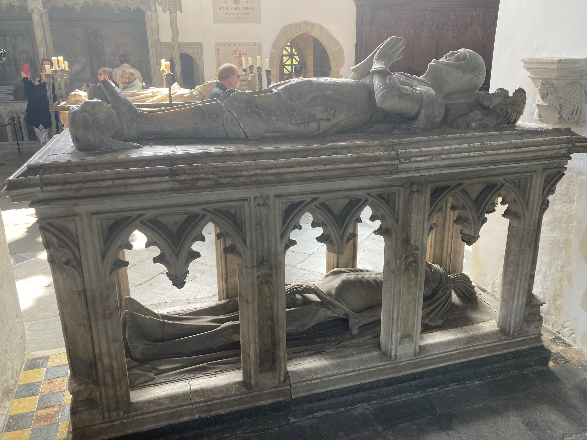
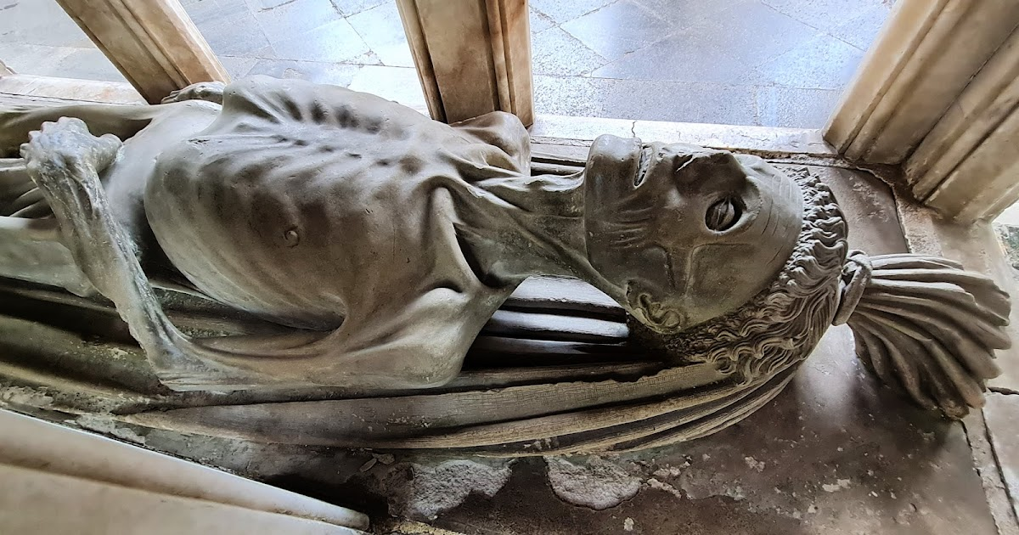
Dance of death & transi(or cadaver) tombs

Slide 12
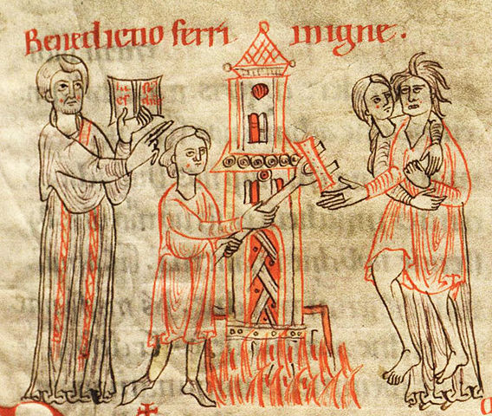
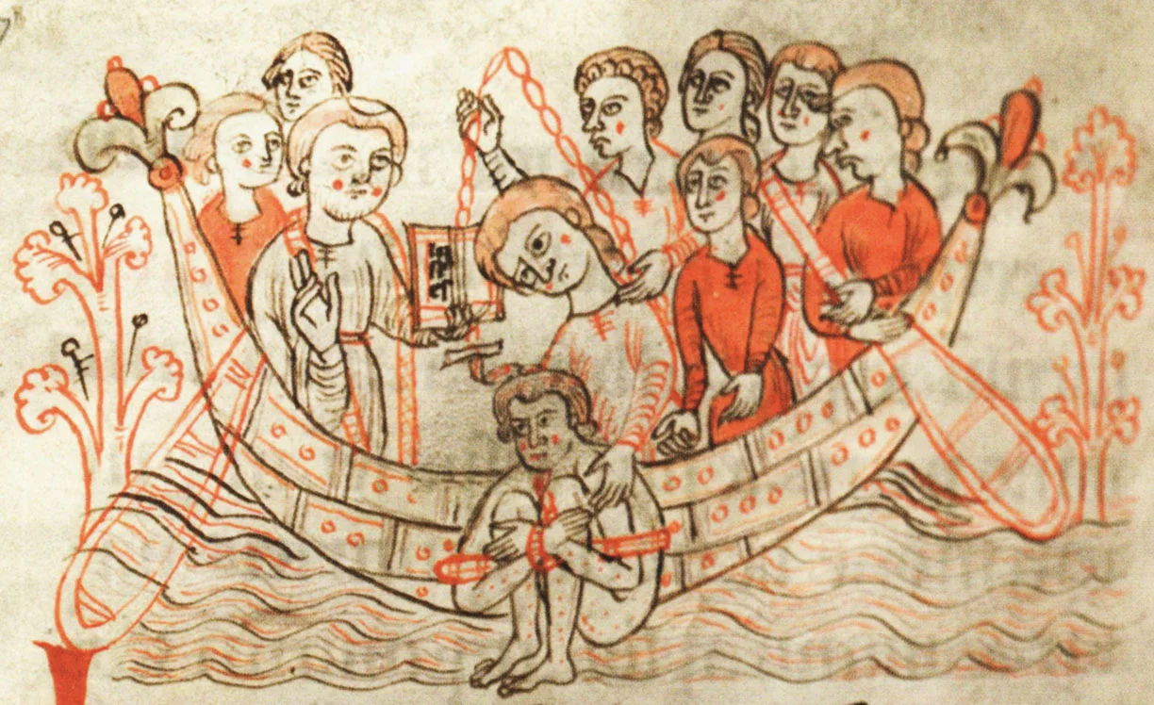
Social norms, rules and transgressions sin vs crime & PUNISHMENTS

Slide 13
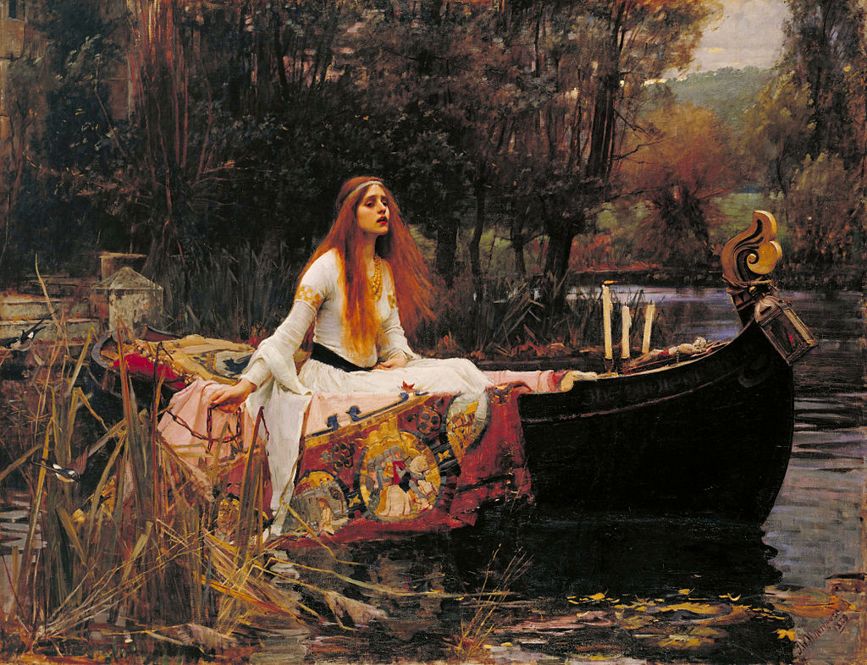
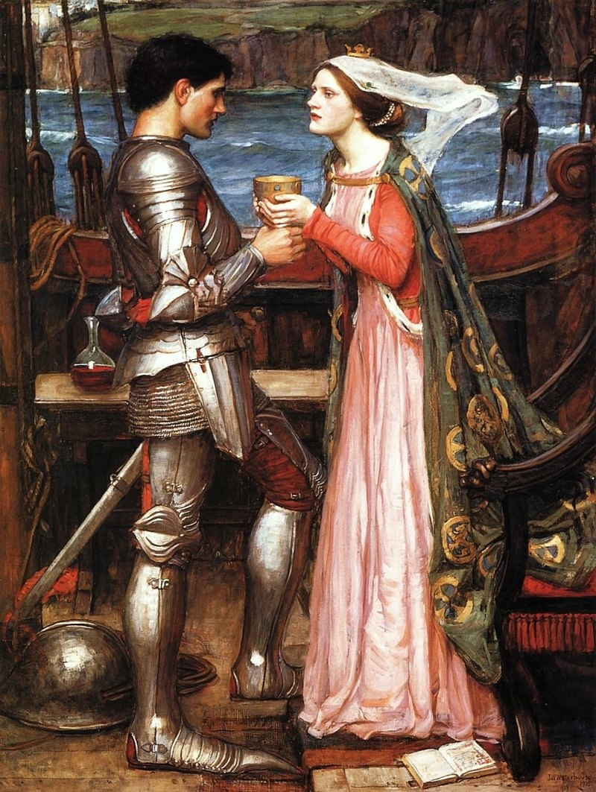
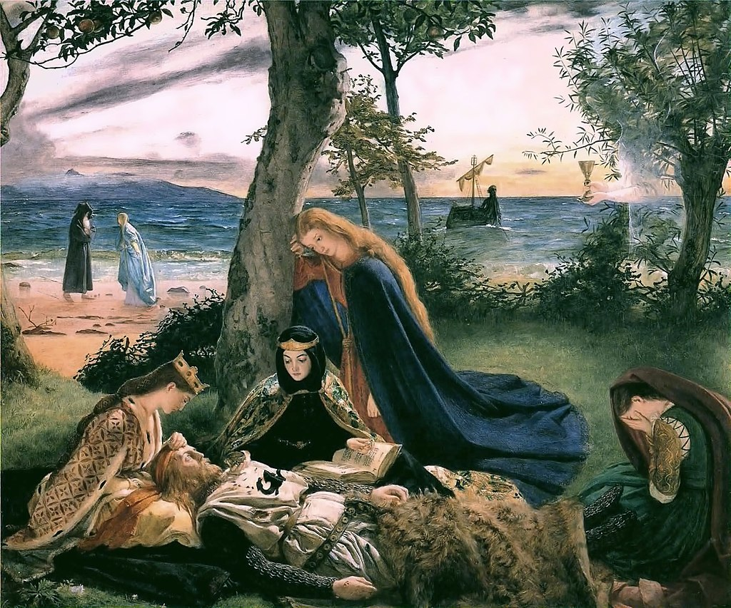
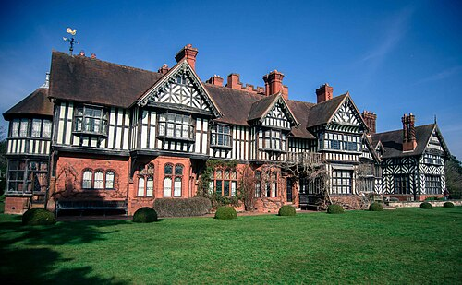
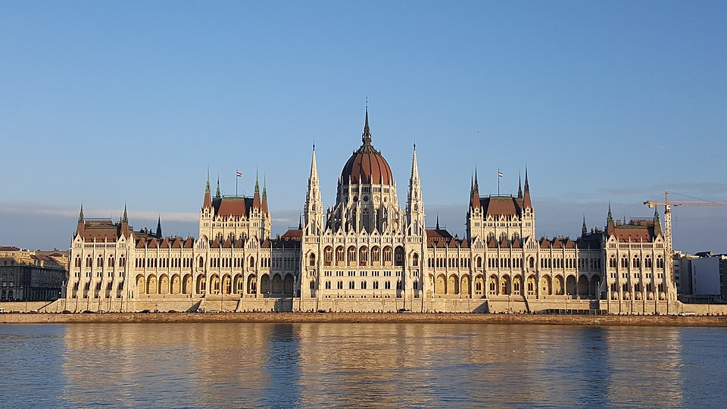
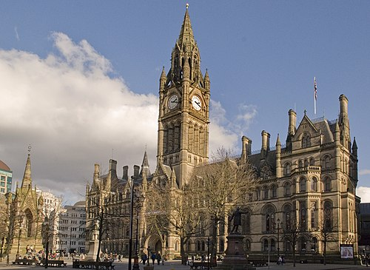
Revival of medieval influences in modern culture: romantic literature, Preraphaelite Art, neogothic architecture [art nouveau design]

Slide 14
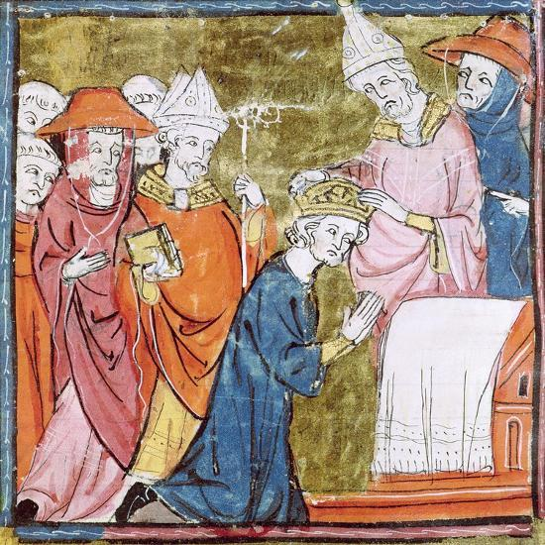
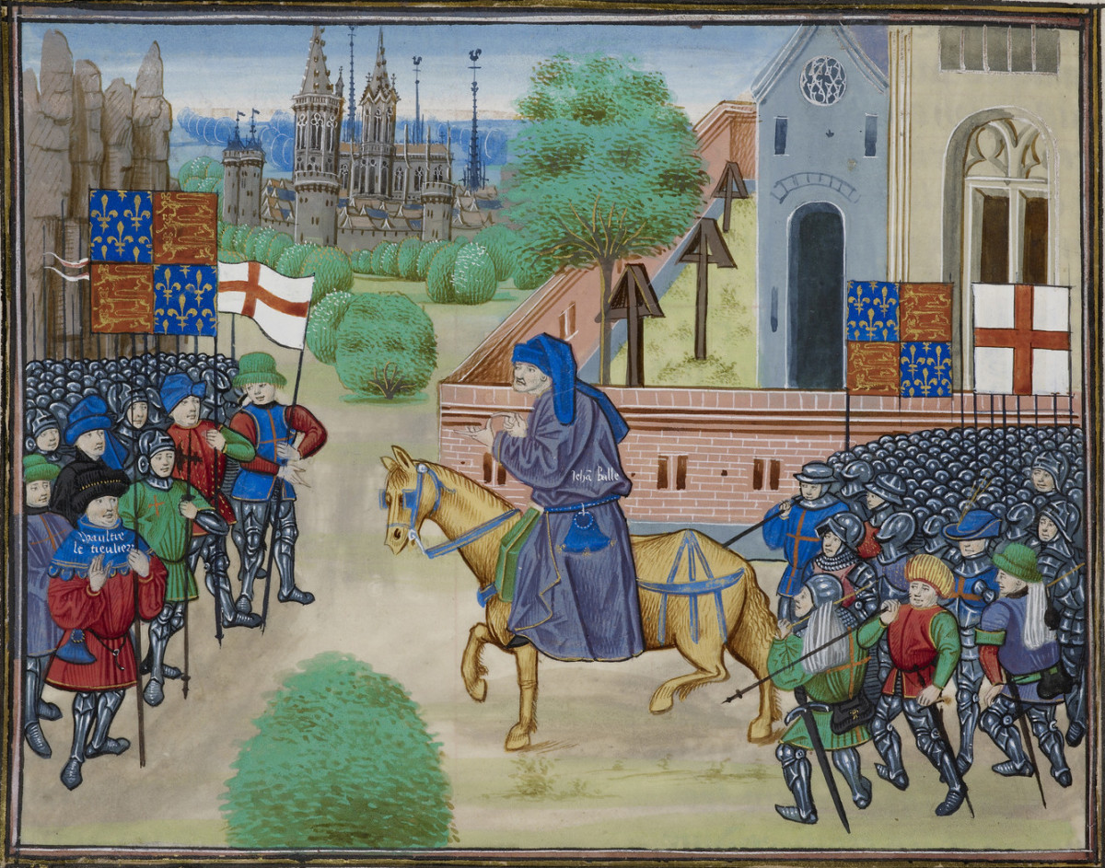
DEFINING THE MIDDLE AGES: CHRONOLOGIES/PERIODISATION
The Medieval Period or Middle Ages
Between the Fall of the (Western) Roman Empire and the Renaissance (literally rebirth) [Eurocentric, elite]
Early Middle Ages c. 500-900: Barbarians, Dark Ages & feudalism, but also Charlemagne (crowned by pope 800), revival of trade, learning etc
High Middle Ages c. 900-1250: rise of learning/universities, legal systems, urban growth, building of great cathedrals, monastic movements, friars v heresy, crusades [dominance of Catholic Church]
Thirteenth century: commercial revolution, ‘capitalism’, increasing trade & manufacture, peak of population growth
Late Middle Ages c. 1300-1500: crisis of Black Death, climate change, economic stagnation and decline, but also social change, Renaissance, Hundred Years War, Chaucer, rise of ‘nation states’, exploration

Slide 15
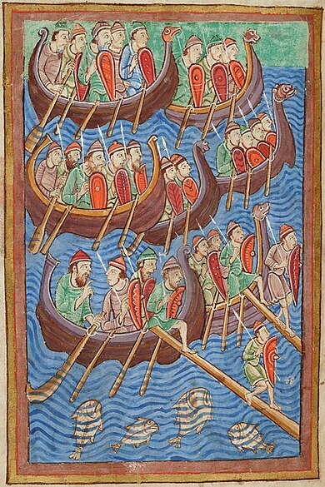
Challenge stereotypes & understand context
Medieval/feudal = shorthand for ignorant, brutal, oppressive & uncivilised, backward, ignorant, superstitious & lawless
Problem of shortage of sources especially re people vs elite (nobility & clergy; peasantry make up 90%), men vs women
Different questions & sources, understand beliefs and justice
Use literature e.g. Arthurian legends product of C12th-C13th
Archaeology: e.g. Vikings = traders vs raiders, migration
Role of violence & feud in regulating society
Development of bureaucracy, law & learning led by Church
Tensions with secular rulers re abuse of power & violence
But also persecution of minorities and crusades
Opportunity for agency & mobility as well as limitations

Slide 16
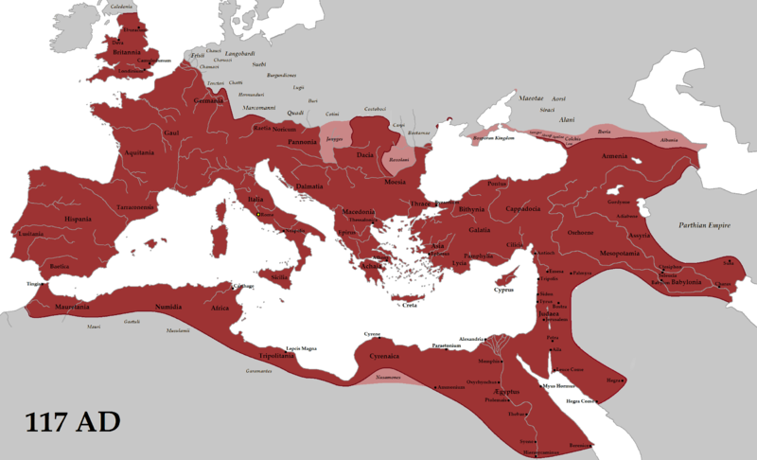
ROMAN EMPIRE 117 A.D.

Slide 17
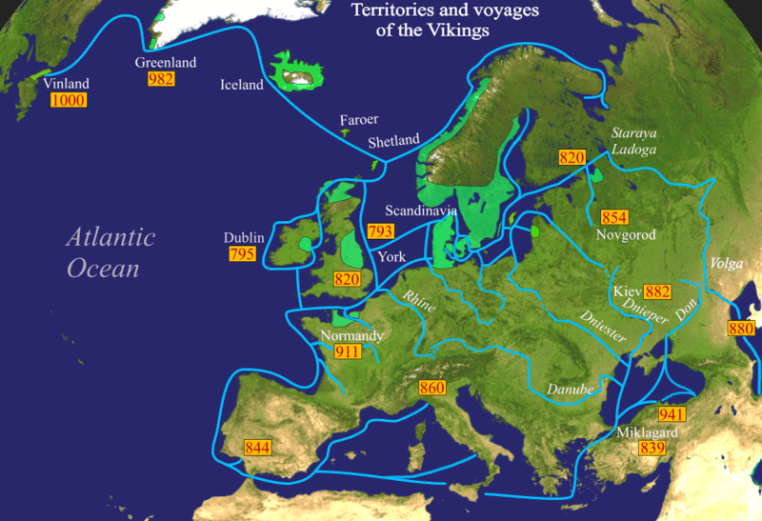
Viking voyages

Slide 18
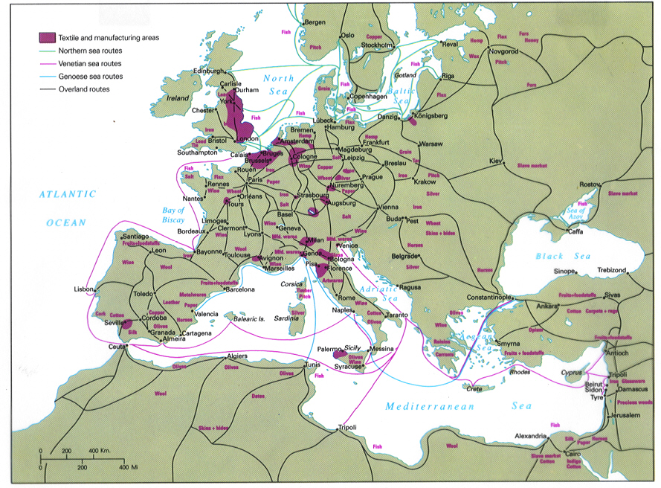
MEDIEVAL TRADE ROUTES

Slide 19
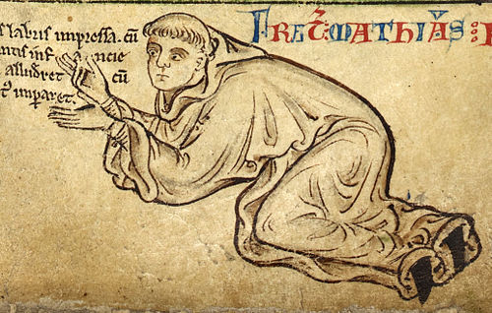
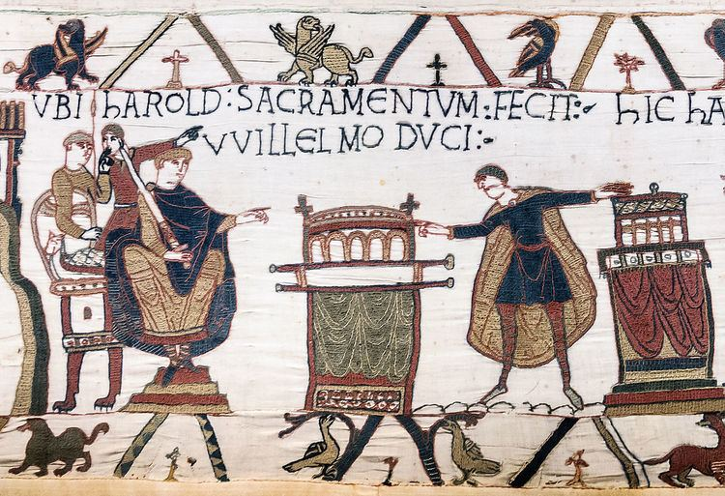
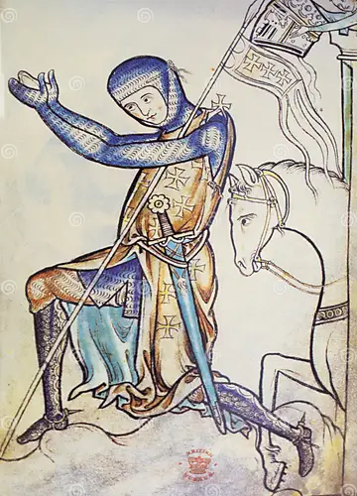
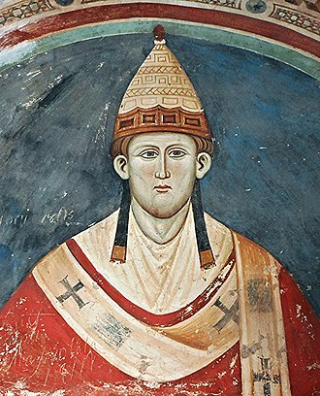
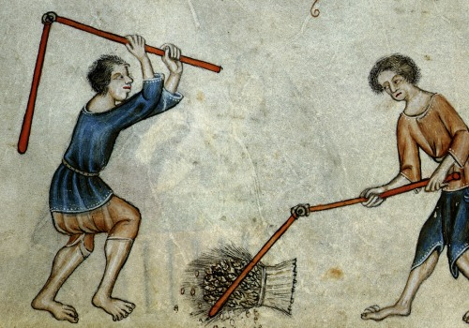
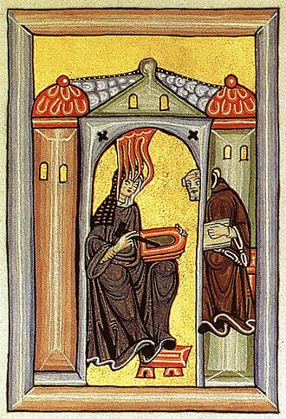
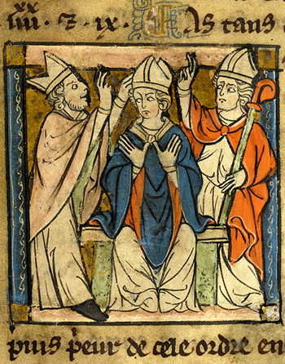

BOUNDARIES AND NORMS
TERM 1
DEFINING THE MIDDLE AGES
How medieval society was organised and governed (three estates model): feudal relations; rural and urban life
CROSSING RELIGIOUS BOUNDARIES
The Medieval Church: the papacy and those who supported and opposed it, including heretics, orthodox and unorthodox supernatural beliefs

Slide 20








BOUNDARIES AND NORMS
TERMS 2 & 3
DESTABILISING THE SOCIAL ORDER
The Black Death and its impact; popular protest; gender roles and their transgression; defining the ‘other’ in medieval society
CROSSING GEOGRAPHICAL, POLITICAL AND CULTURAL BORDERS
Encounters between East and West: the Crusades; the Mongols; the Ottomans; Spanish Reconquest
BOUNDARIES OF WARFARE AND GOVERNANCE
The Hundred Years War; kingship and queenship

Slide 21


GLOBAL TIMELINES
Asia korea europe

