Slide 1
kinGship and Queenship
Crossing boundaries in Medieval Monarchies
Lecture 19

Slide 2
Lecture plan
Discuss the ideals of medieval kingship
Examine some case studies from the 15th century
Define queenship
Examine the roles that queens played
Explore some case studies (Margaret of Anjou, Elizabeth Woodville)

Slide 3
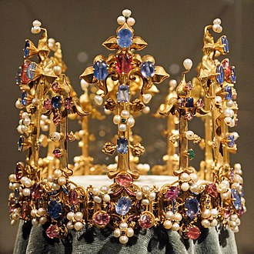
Ideals of Medieval Kingship (in no specific order…)
Justice (fairness; obeying the rule of law)
Legitimacy (ordained by God)
Strong military leadership
Protection of the realm (safety, security, peace, diplomacy)
Wisdom (self-control; mercy)
Piety (defence of the Church, patronage)
Control over taxation and finances
Good counsel
As opposed to…tyranny, self-interest, favouritism, poor counsel, profligacy, lack of control and disorder, military defeat…

Slide 4
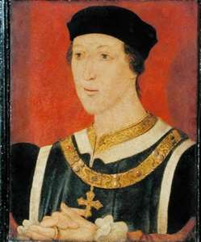
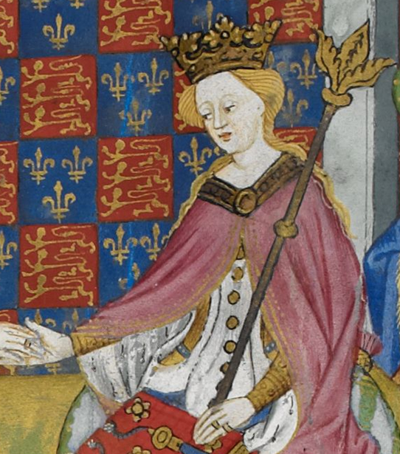
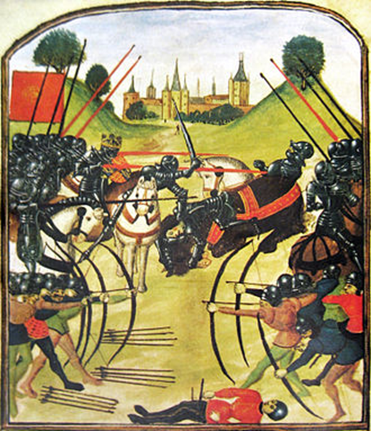
Henry VI 1422-61, 1470-1(married to Margaret of Anjou)
Lack of control (over the nobility, political affairs, the economy…)
Hundred Years’ War was lost during his reign
Miserable finances
Cade's rebellion 1450
Suffers dynastic challenges: Wars of the Roses (three phases: 1455, the first battle of St. Albans to the victory of Edward IV in March 1461; the second phase from 1469 to 1470-1; the third phase 1483 – 1487)
Very pious; founded Eton College; King's College, Cambridge; and All Souls College, Oxford
Deposed and killed

Slide 5
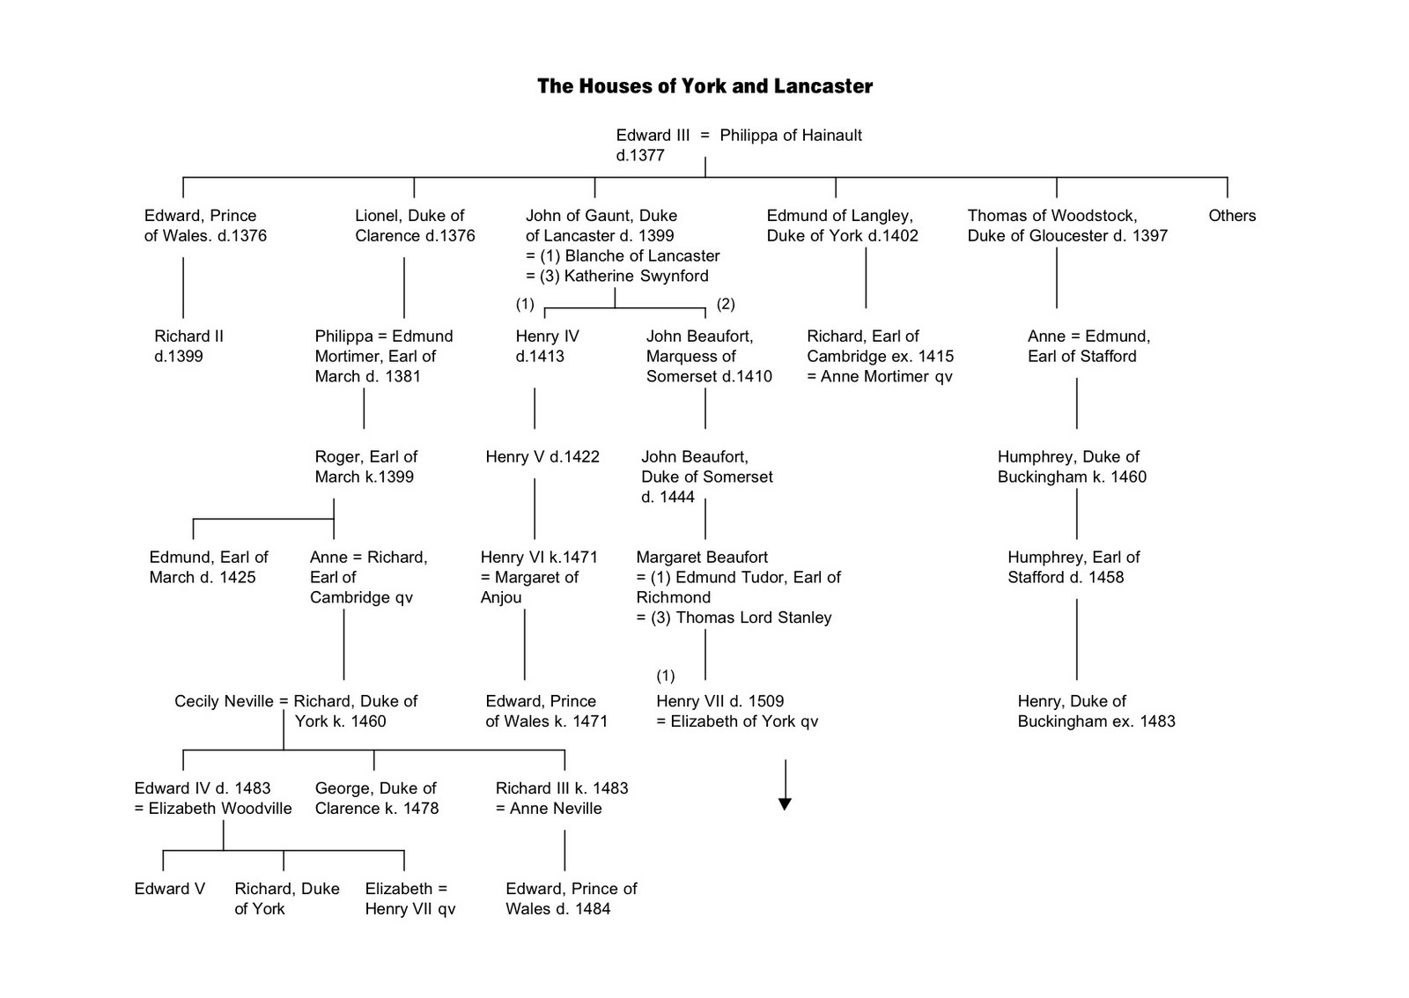

Slide 6
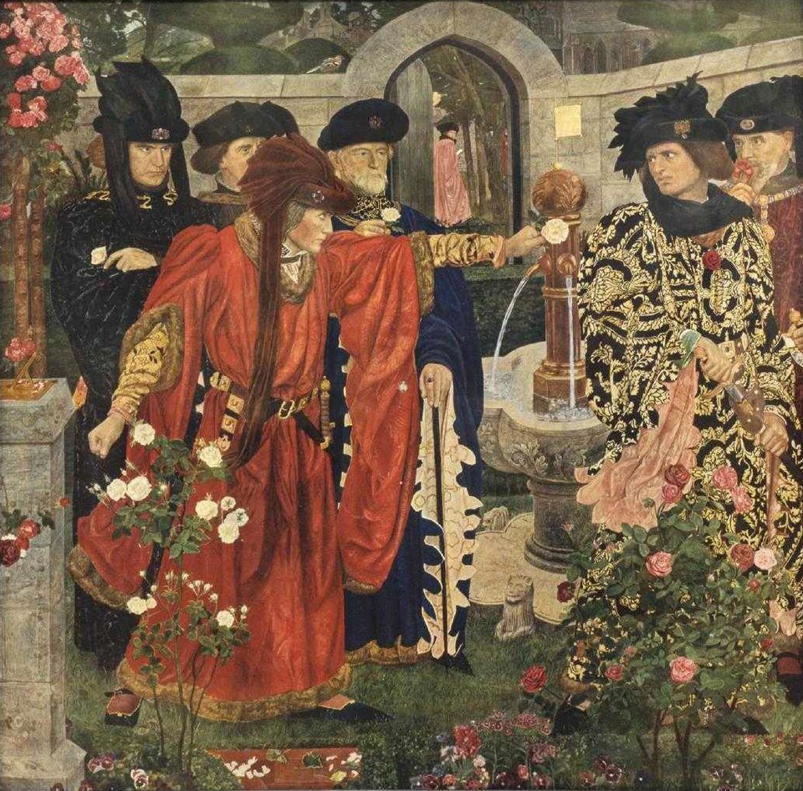
Wars of the Roses
Essentially a dynastic war (but not always)
Fighting very sporadic (20 weeks in total in
30 years)
Pitched battles: Towton, Tewkesbury
Struggles for power within the landed elite

Slide 7
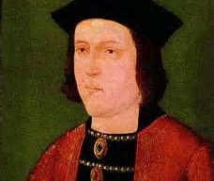
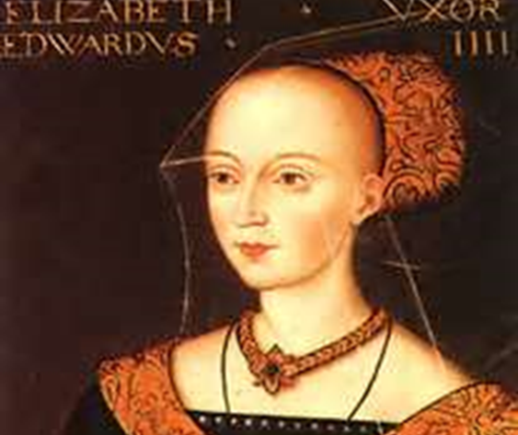
Edward IV 1461-70, 1471-83 (married to Elizabeth Woodville)
Reconciliation
Better finances
Better image
Decisive action
Good links with local communities
Died in his bed
But…wrong marriage?; military action in France and Scotland; failed to secure his son’s place in succession…

Slide 8
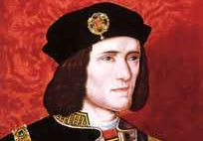
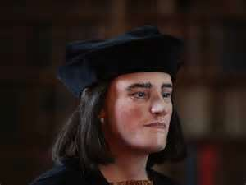
Richard III 1483-5 (married Anne Neville)
Claimed Edward IV’s sons were illegitimate
An opportunist?
Battle of Bosworth

Slide 9
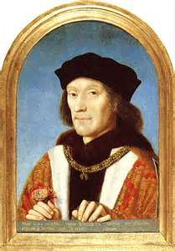
Henry VII (married Elizabeth of York)
Pretenders to the throne: Lambert Simnel and Perkin Warbeck
Consolidation
Excellent finances
Faced serious challenges, but achieved stability
Improved image of kingship

Slide 10

Queenship
‘a cluster of customs, practices and political theory that focuses on who queens were and what they did; how were they perceived by their peers; and how they were vital to family culture religion, and economics in the European Middle Ages’.
Theresa Earenfight, ‘Medieval Queenship’, History Compass 15:3 (2017).
‘Queen regnant’ (Melisende of Jerusalem (ruled 1131-1153), Joanna I and Joanna II of Naples, Isabella of Castile)
‘Queen regent’ (Louis IX’s mother Blanche of Castile
‘Queen consort’

Slide 11
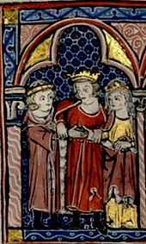
Dynastic roles
Production of male heirs
Arranging marriages for daughters
While fertility is important, the pious chastity of a queen could be praised

Slide 12
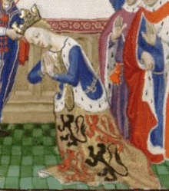
Political Roles
Acting as intercessors
steering the king’s actions away from war towards peace
‘The proper role of a good, wise queen or princess is to maintain peace and concord and to avoid wars and their resulting disasters. Women particularly should concern themselves with peace because men by nature are more foolhardy and headstrong, and their overwhelming desire to avenge themselves prevents them from foreseeing the resulting dangers and terrors of war. But woman by nature is more gentle and circumspect’. Christine de Pizan, ‘The Book of the City of Ladies’

Slide 13
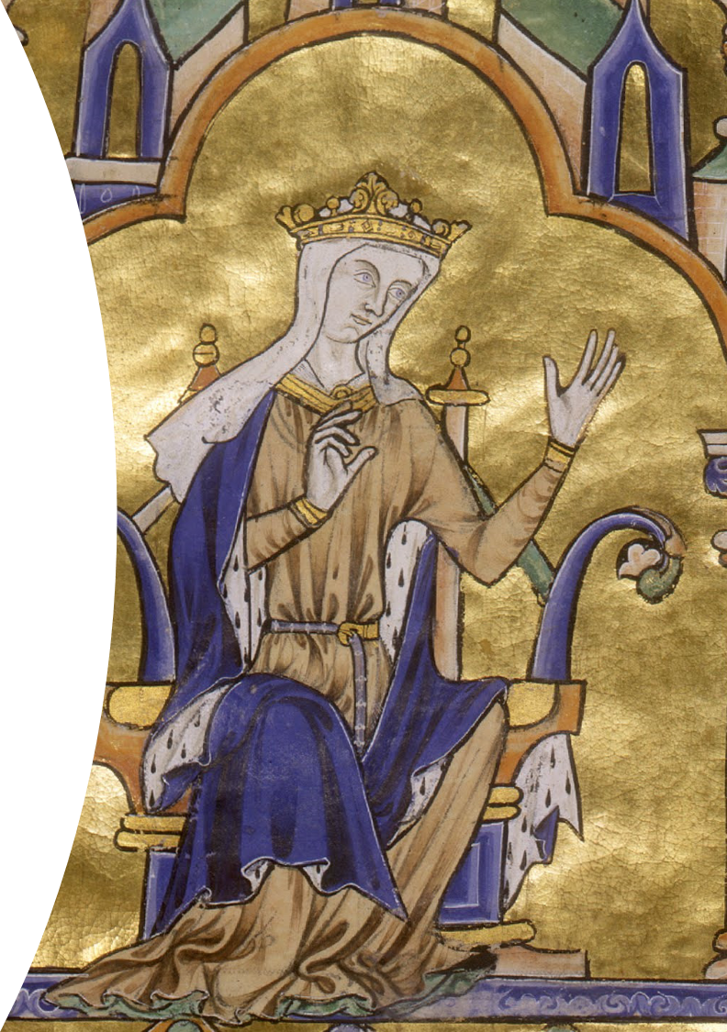
Economic roles
Dowries
Mobile assets
Queen’s Wardrobe Accounts
Gifts

Slide 14
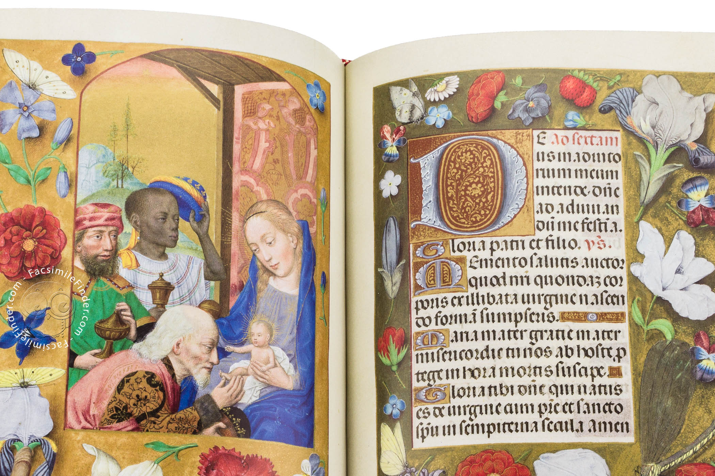
Religious and Cultural Roles
Piety
Offering patronage and support to churches, monastic institutions, and nunneries; paying for building repairs, altar cloths, ceremonial robes, sculptures and religious artworks
Commissioning texts (such as Isabella of Castile’s Book of Hours)
Offering patronage of chroniclers, artists and poets

Slide 15
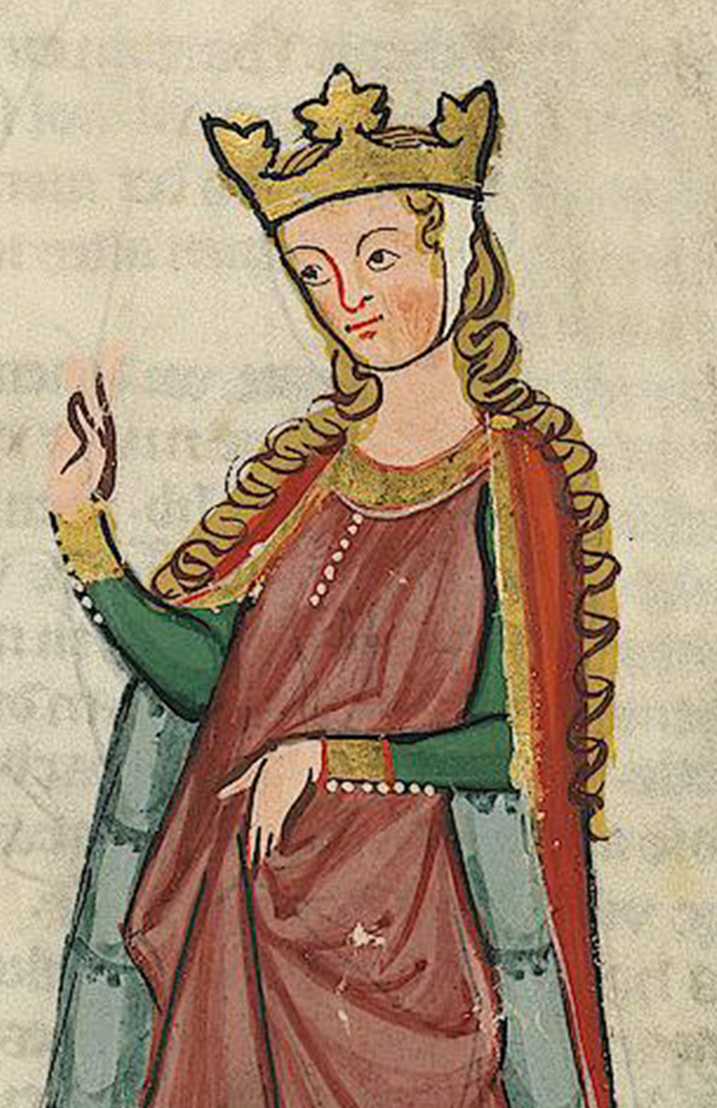
Accusations and Criticisms
They could be accused of:
giving bad counsel
meddling
favouritism
prioritising their bonds with their natal families
adultery (Eleanor of Aquitaine, Isabeau of Bavaria and Isabella of France)
lack of piety
being bad mothers
witchcraft (Elizabeth Woodville, Joan of Navarre)

Slide 16

Margaret of Anjou
Period of childlessness
Questions over Edward’s parentage
(‘[the prince] was not the naturall sone of kynge Henrye, but chaungyd in the cradell’, Robert Fabyan (1504))
Denied regency
Shakespeare’s ‘She-Wolf of France’.

Slide 17

Elizabeth Woodville
Came from a relatively minor noble family (not the daughter of a duke)
Had a lot of siblings and relatives, who received lands and offices
An effective queen consort (patronage and intercession)
Ricardian and Tudor narratives paint her as ‘scheming, ambitious and manipulative’; fostering the interests of her family rather than the common good

Slide 18
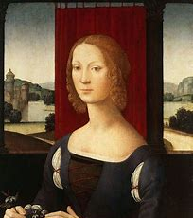
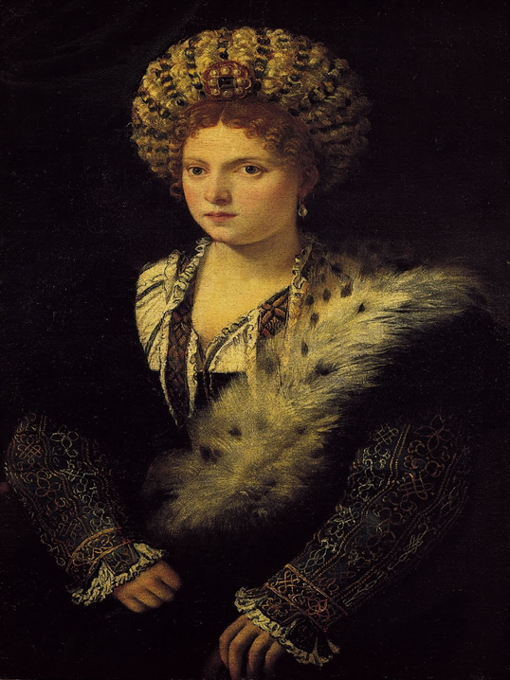
Elite women in Renaissance Italy
Dynastic roles
Regents
patrons of artists, painters, sculptors and poets

Slide 19
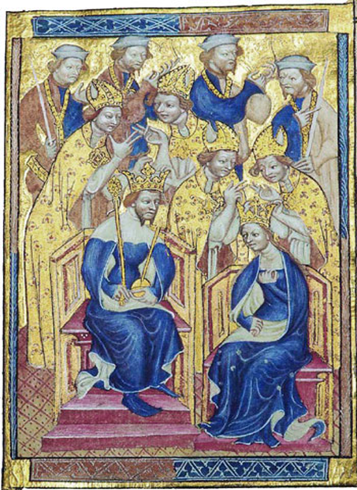
Conclusion
‘Powerful women, no matter how they exercise or express their power, will only be fully understood within their wider political frame-work, and that frame-work will only be fully understood when women are taken into account’. (Theresa Earenfight, Queenship in Medieval Europe, p.6
Liber Regalis: Coronation of Richard II and Anne of Bohemia in the 14th century

