Slide 1

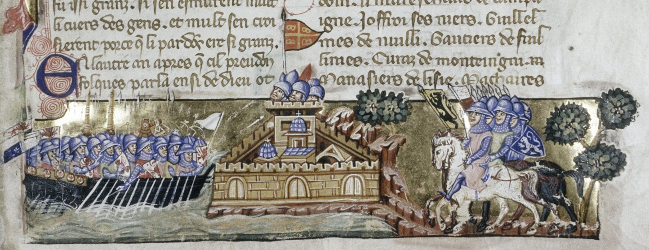
The Crusades
European Contact with ‘Others’

Slide 2
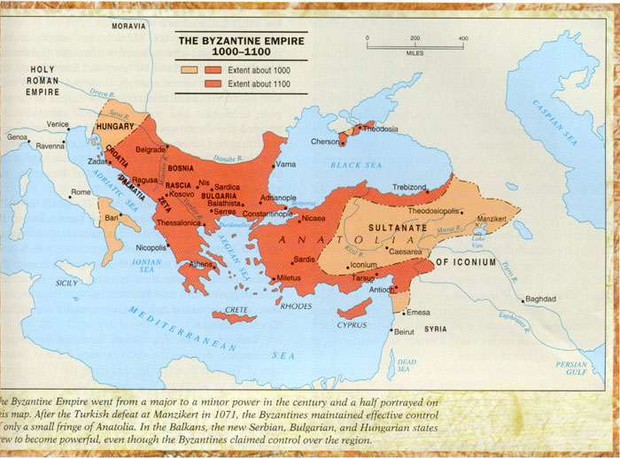
Byzantine Empire 1000-1100

Slide 3
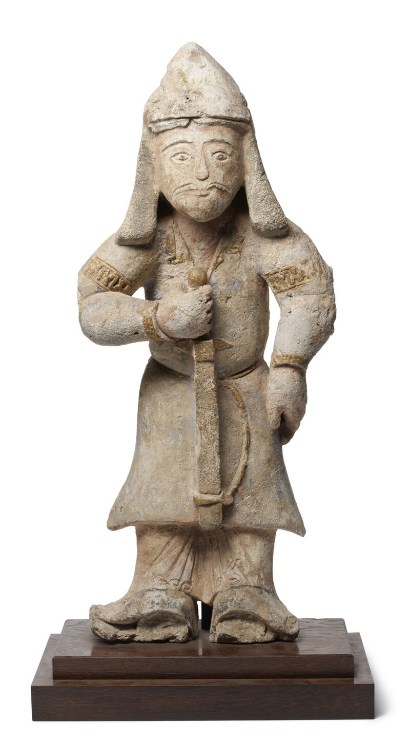
Byzantine Empire vs neighbours
1054: split from Rome
Emperor Alexius I Komnenos (1081-1118)
By 1080, most of Anatolia fallen to Turks
1055: Seljuks > Abbasid Baghdad > Great Seljuk Empire
1071: in Anatolia, major victory @ Battle of Manzikert; then Palestine & Jerusalem
1092, Sultan Malik Shah died & empire split (Anatolia, Aleppo, Damascus, Mosul)
Islam also split: Shiite (Egypt) & Sunni (Baghdad), Seljuk Turks allied with Sunnis
1095: Byzantium asked for help (again)
Seljuk Warrior

Slide 4
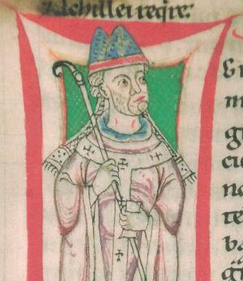
European Background
Peace of God (989) and Truce of God (1063)
Pope Gregory VII (1073-85): ‘fighting in the name of religion’
1073: urges campaign vs Muslims in Spain
1074: urges knights to help Byzantium (also 1080)

Slide 5
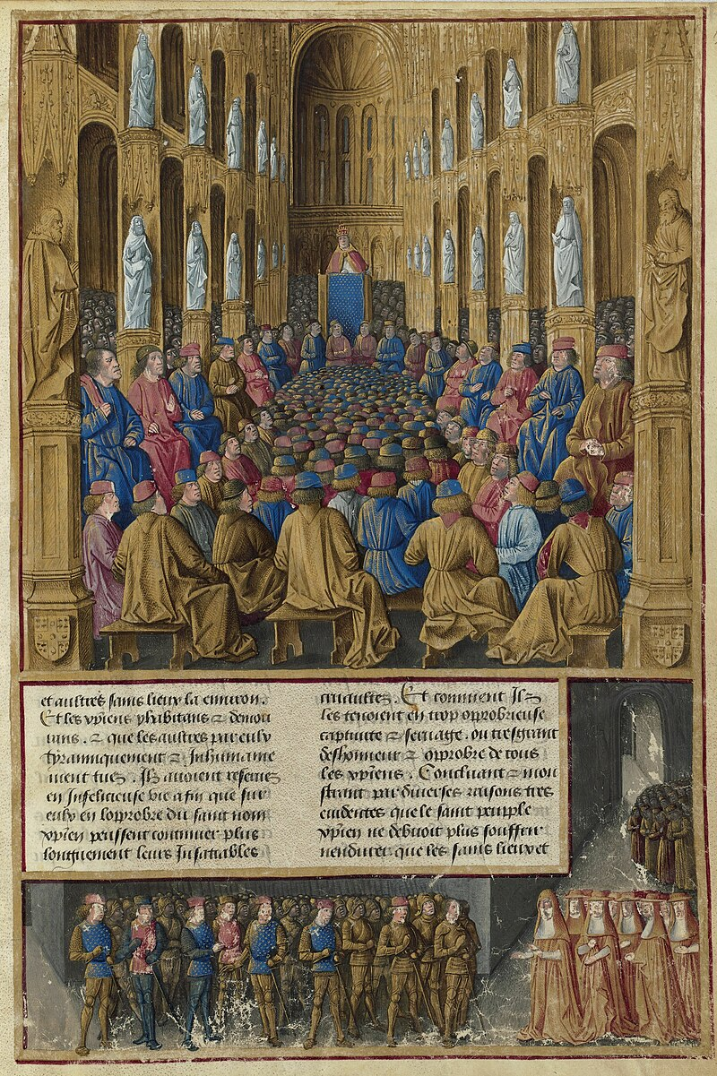
Council of Clermont 1095
Urban II’s message:
1) To save Jerusalem & Christians
2) Just war
3) Penance
(other attractions: economic; honour; tradition; adventure)
Taking of cross involved solemn vow & symbolic act
How to define a ‘crusade’?
‘An expedition authorised by the Pope on Christ’s behalf, the leading participants in which took vows and consequently enjoyed the privileges of protection at home and the Indulgence, which, when the campaign was not destined for the East, was usually equated with that granted to crusaders to the Holy Land’: Jonathan Riley-Smith

Slide 6
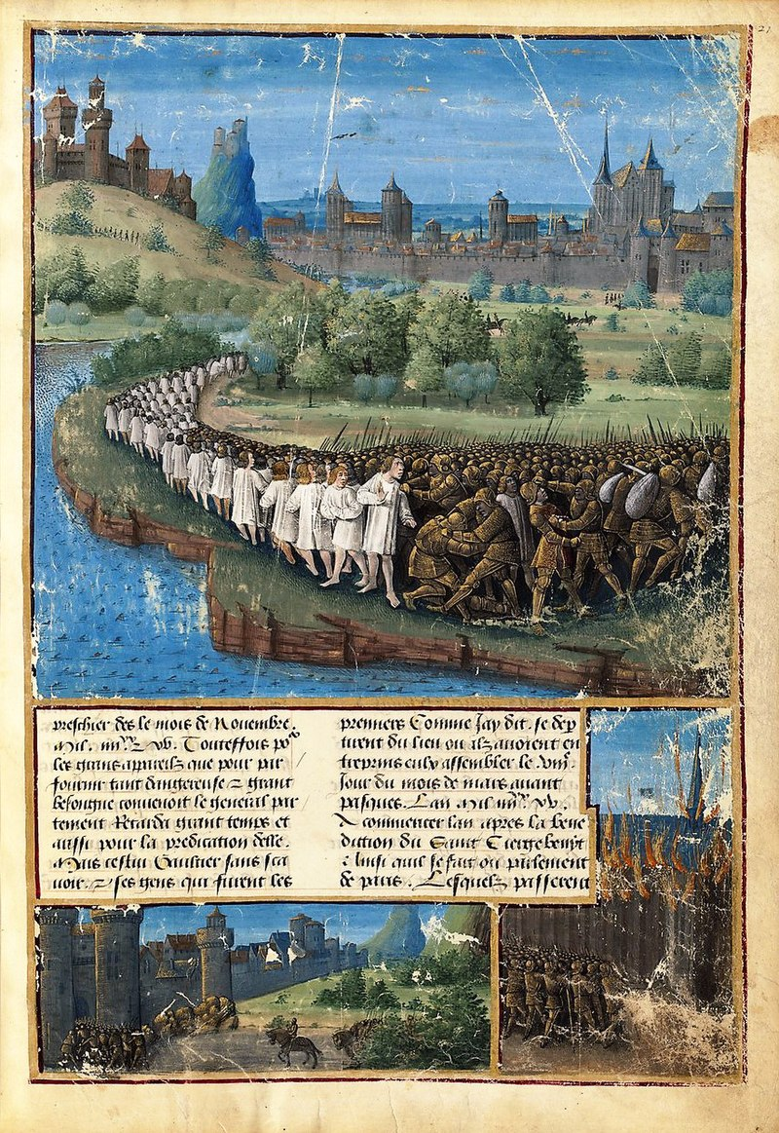
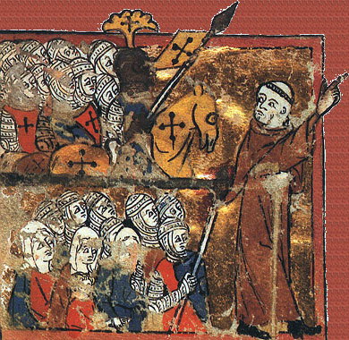
1st wave: Spring 1096, ‘People’s Crusade’
Peter the Hermit & Walter Sans-Avoir
Pogroms against Jews in Rhineland
Wreaked havoc en route
At Constantinople shipped over Bosporus
Many killed or enslaved by Turks

Slide 7
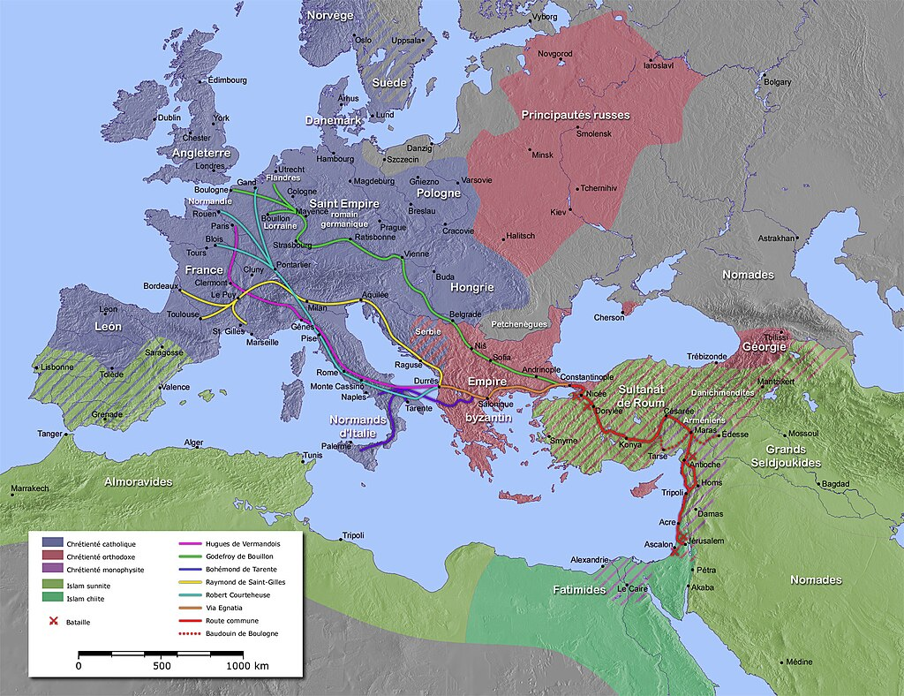
Overland routes of crusaders

Slide 8
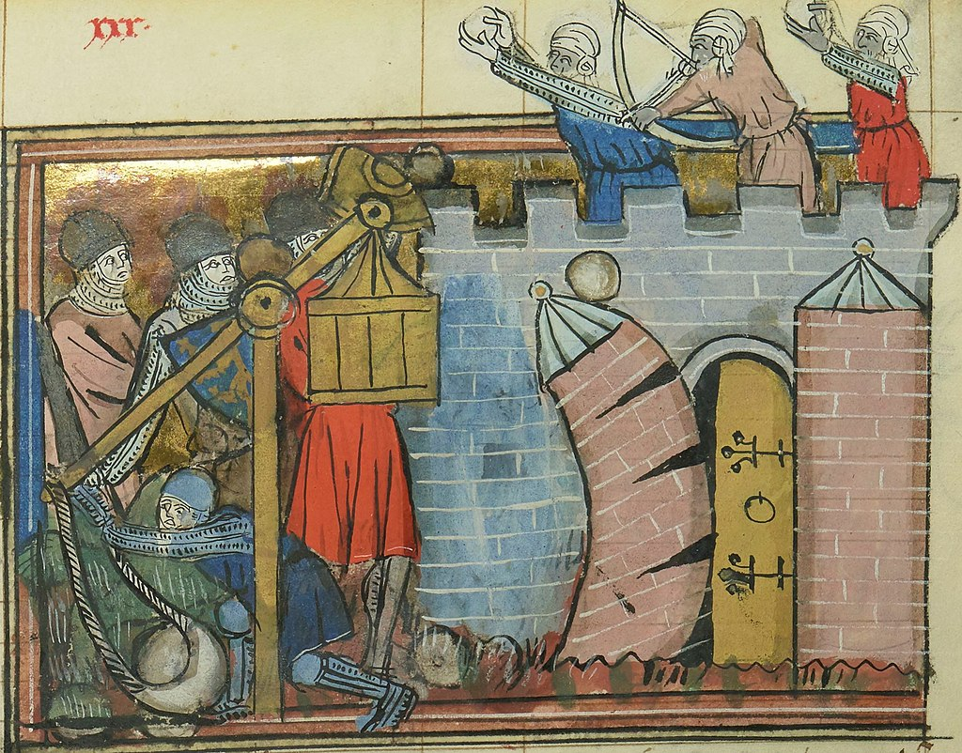
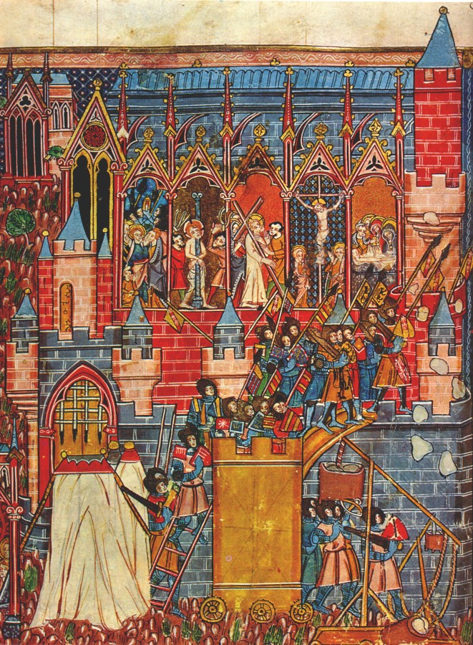
Crusader Armies
2nd Wave: August 1096
Count Hugh of Vermandois: brother of Philip I
Godfrey de Bouillon: duke of Lower Lorraine & brother Baldwin
Bohemond of Taranto & Tancred: Normans of Sicily
Raymond of Saint-Gilles
Duke Robert of Normandy (Curthose)
Count Robert of Flanders
Count Stephen of Blois
Bishop Adhémar of Le Puy: papal legate
April 1097: crossed Bosporus & besieged Nicaea (see pic 1)
To Armenia: Baldwin > rule Edessa
Siege of Antioch (Oct 1097-June 1098) > Bohemond
Siege & Fall of Jerusalem (June 1099) (see pic 2)

Slide 9
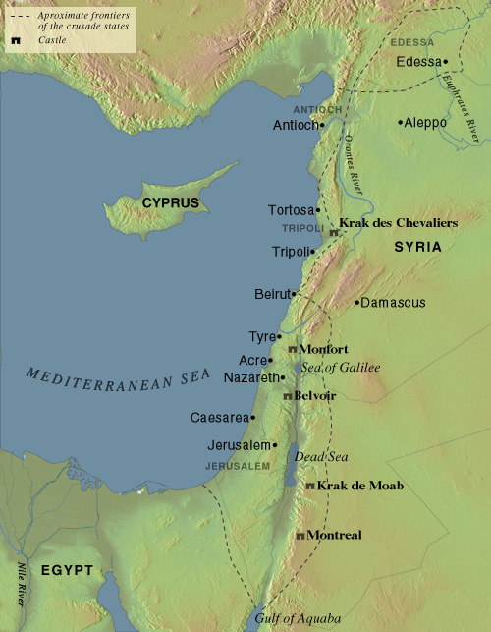
Crusader States
Godfrey of Bouillon > ‘Advocate of Holy Sepulchre’
Baldwin de Boulogne first King of Jerusalem (1100-18)
Religion: Christian sects under Catholic bishops & Patriarch
Muslims and Jews initially expelled
Templars (military order) founded
Trade: role of Italian towns
Tensions with Byzantines but kingdom & three principalities with Tripoli (1109)
Diplomatic ties with Muslims until 1140s
1144: Zengi (ruler of Aleppo & Mosul) conquered Edessa > Second Crusade

Slide 10
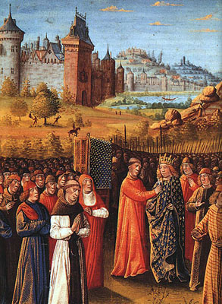
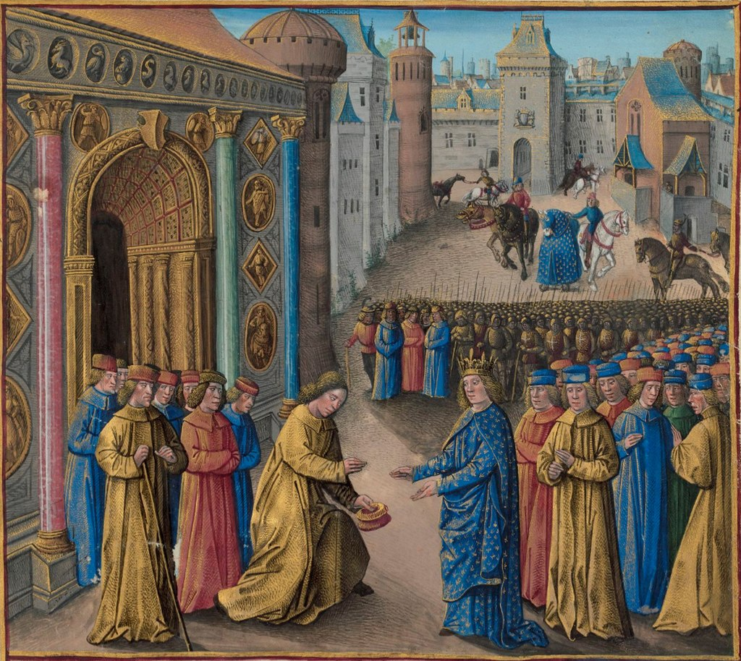
Second Crusade (1147-1149)
Louis VII, King of France takes the cross & arrives in Antioch (see pics below)
Conrad King of the Germans with large army

Slide 11
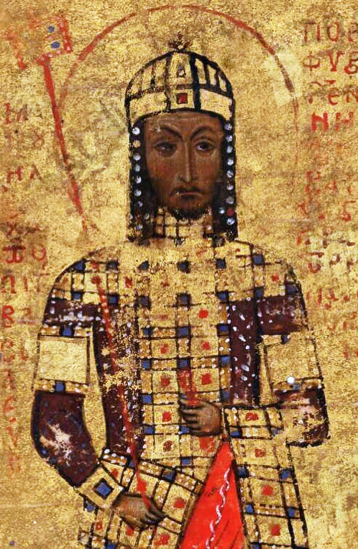
Byzantine Emperor Manuel I Komnenos (1143-1180)
Not requested crusade
Demanded good behaviour
Made swear allegiance
Germans across Bosporus
Fortified walls against French
Conrad defeated by Turks
Templars helped crusaders next to Antioch
Failed siege of Damascus vs Nureddin
Second crusade a failure

Slide 12
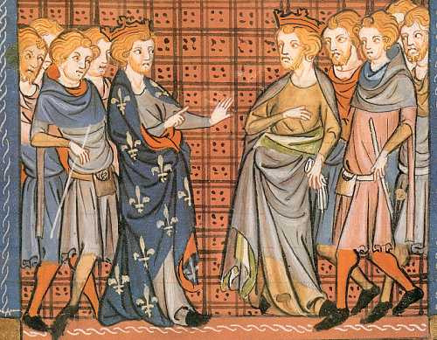
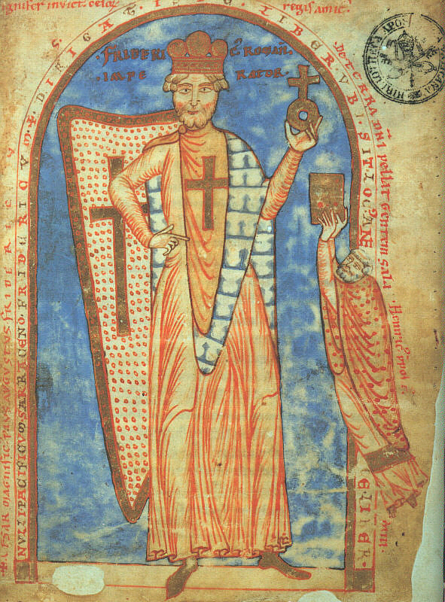
Third Crusade (1189-92) vs Saladin
Philip Augustus & Richard the Lionheart
Frederick I Barbarossa

Slide 13
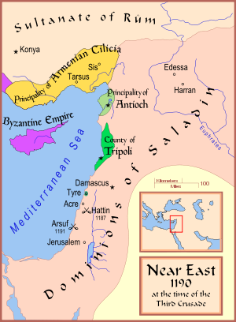
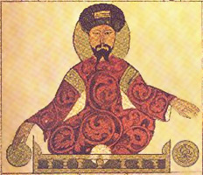
The Near East c. 1190
Kingdom of Jerusalem weakened under ‘leper king’ Baldwin IV (1174-1185)
Sunnis in Syria and Shiites in Egypt > united under Saladin
Jihad > unify & inspire
1187: took Jerusalem after Battle of Hattin
Saladin Ayyubi (c.1137-93)

Slide 14
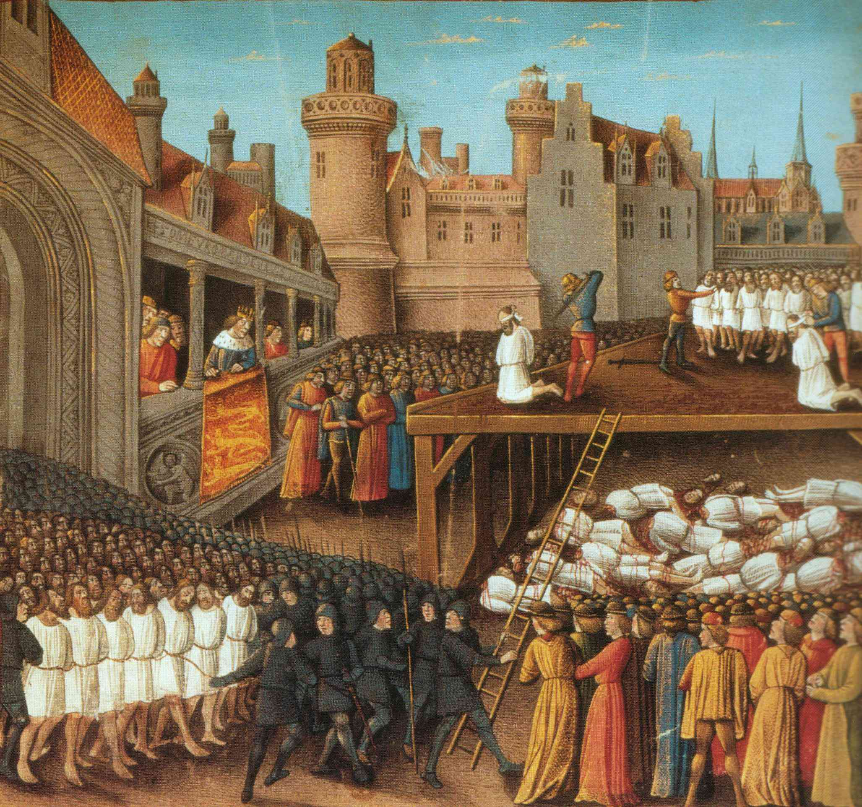
Richard I orders massacre at Acre 1191
1191: to Jaffa & beats Saladin in battle but fails to attack Jerusalem
1192: signs treaty with Saladin & sets off home (via 2-year captivity in Empire)
Coastal strip & important towns of Acre, Tyre & Jaffa in Latin hands
Kingdom of Jerusalem survives for another 100 years

Slide 15
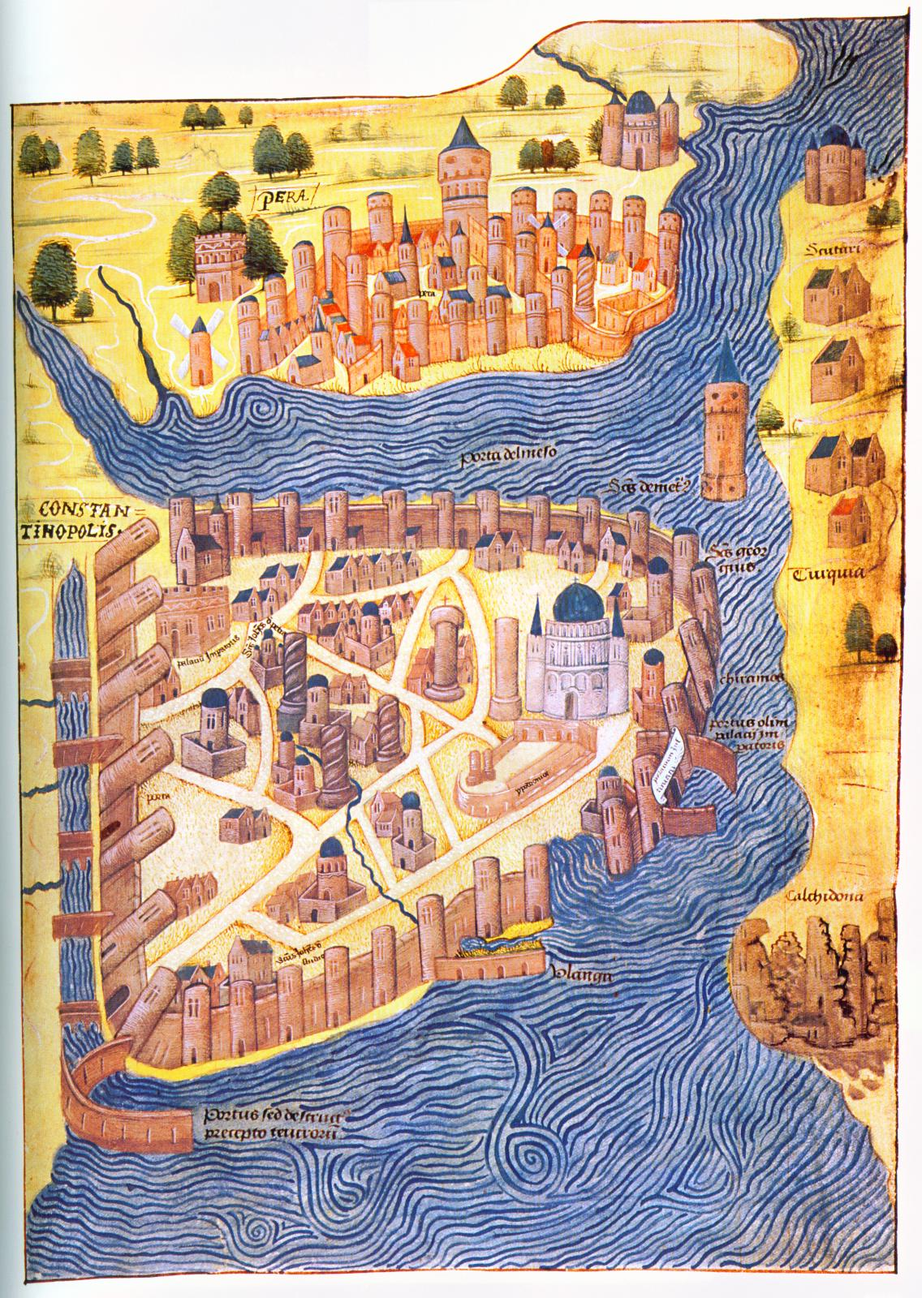
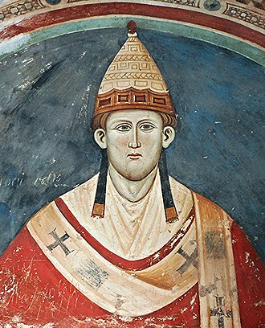
The Fourth Crusade: takes Constantinople
Ordered by Innocent III
Hope to reunite churches
Attacked Zara & Constantinople
Two theories:
intrigue/conspiracy
or chance/accidents?
Venetian tensions & resentment > violence

Slide 16
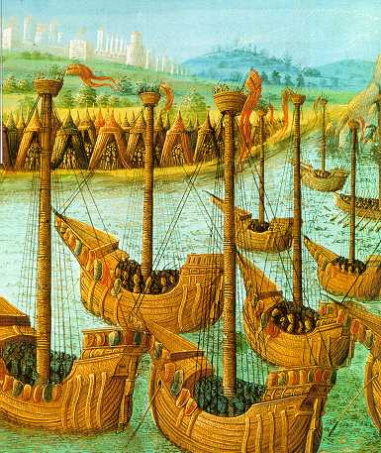
The Crusaders (1202-1204)
Enrico Dandolo, doge of Venice
Baldwin, count of Flanders
Henry, count of St. Pol
Louis, count of Blois
Theobald, count of Champagne
Boniface, Marquis of Montferrat
Geoffrey of Villehardouin, marshal of Champagne & chronicler
Robert of Clari, ordinary knight & chronicler

Slide 17
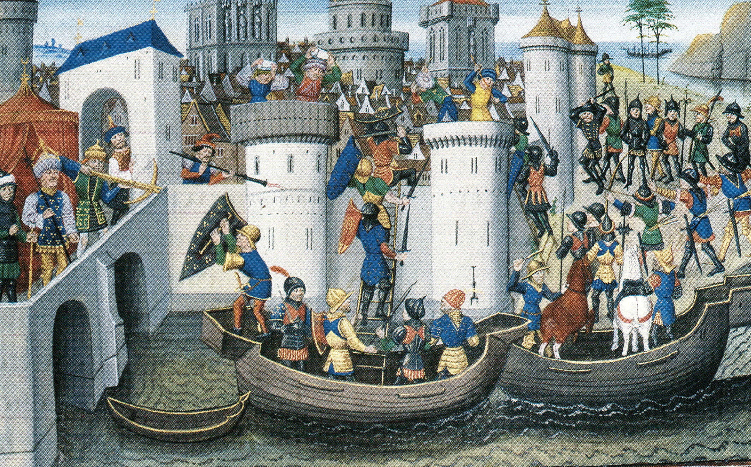
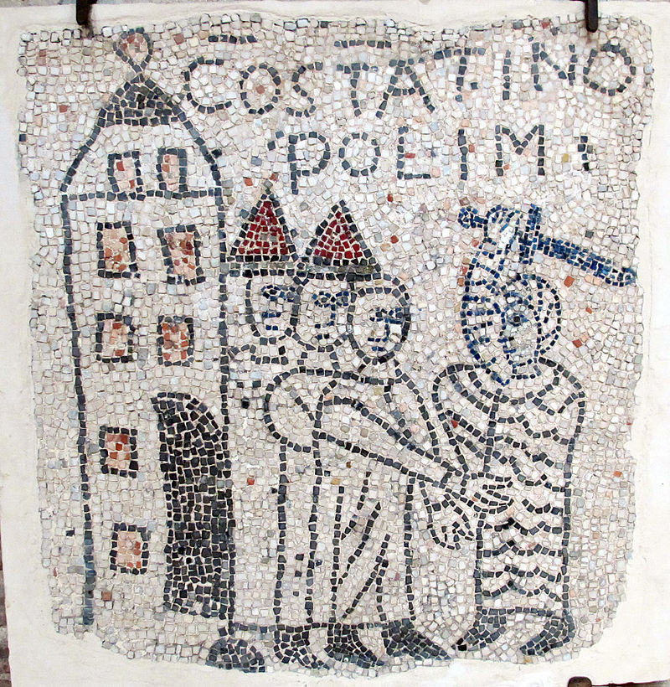
Crusader attack on Constantinople
Motivations:
monetary rewards to be gained after putting rightful heir, Alexius Angelos, back on Byzantine throne
bring Greek church back into fold
bring Byzantium and West closer together politically, using new unity to launch attack against Muslims
help Venetians get trading privileges back
hope Alexius might give military support > Jerusalem
Plan failed: sack of Constantinople
Accident or design?
Long history of tensions

Slide 18
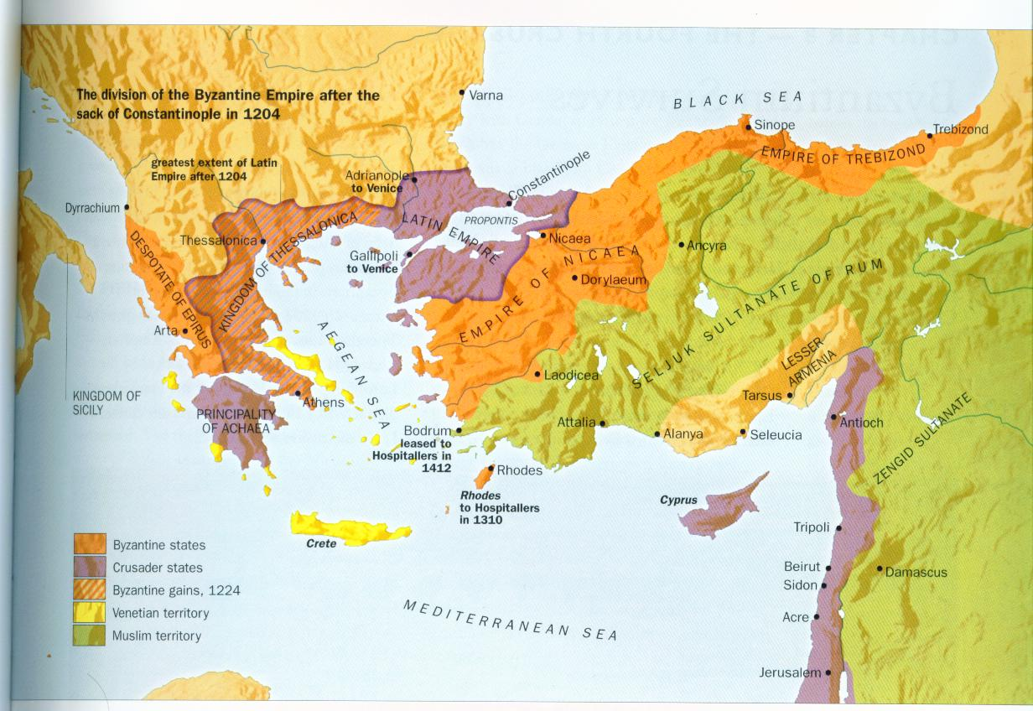
After 1204
Crusades against Muslims continue
Crusades within Europe against enemies of Catholicism: heretics, pagans, schismatics
Against enemies of papacy (e.g. Gregory IX vs Frederick II)

Slide 19
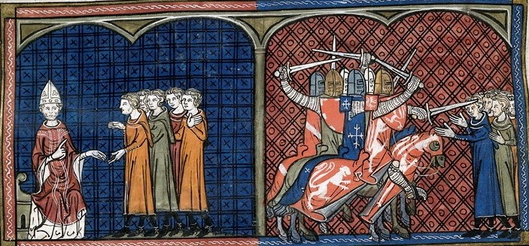
Albigensian Crusade

Slide 20
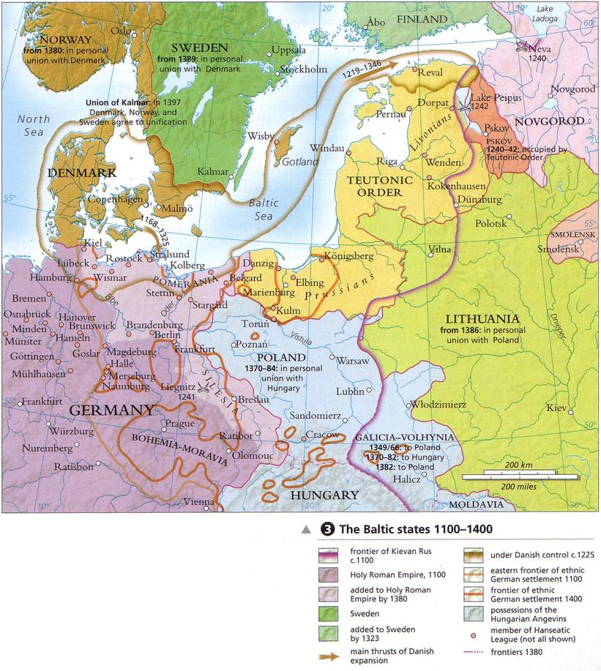
The Northern or Baltic Crusades

Slide 21
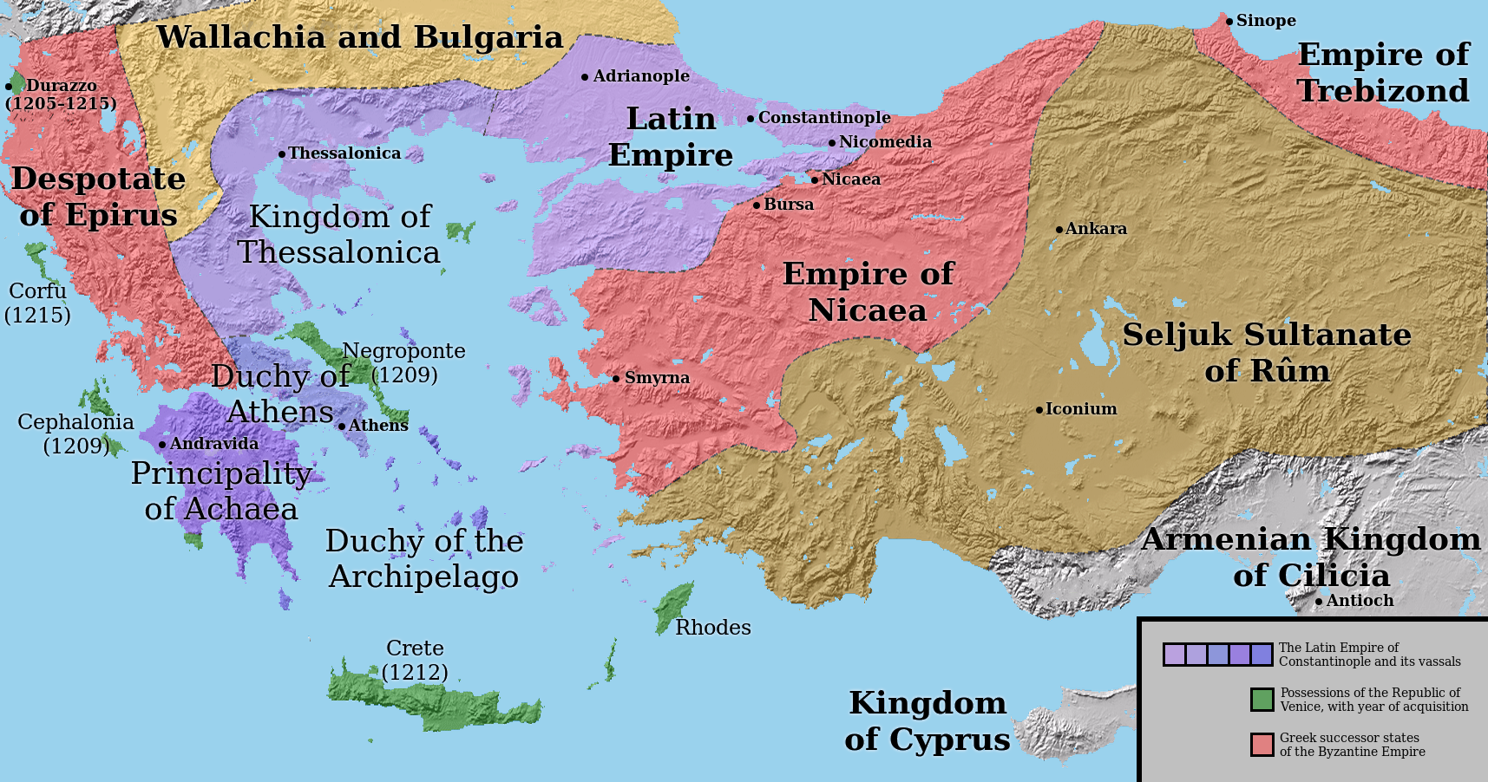
What did the crusades mean to Europe?
Opened western Europe to wider world (culturally, economically & politically)
Weakened Byzantium irretrievably
Papacy gained new political & military tool to employ within European political arena

