Slide 1

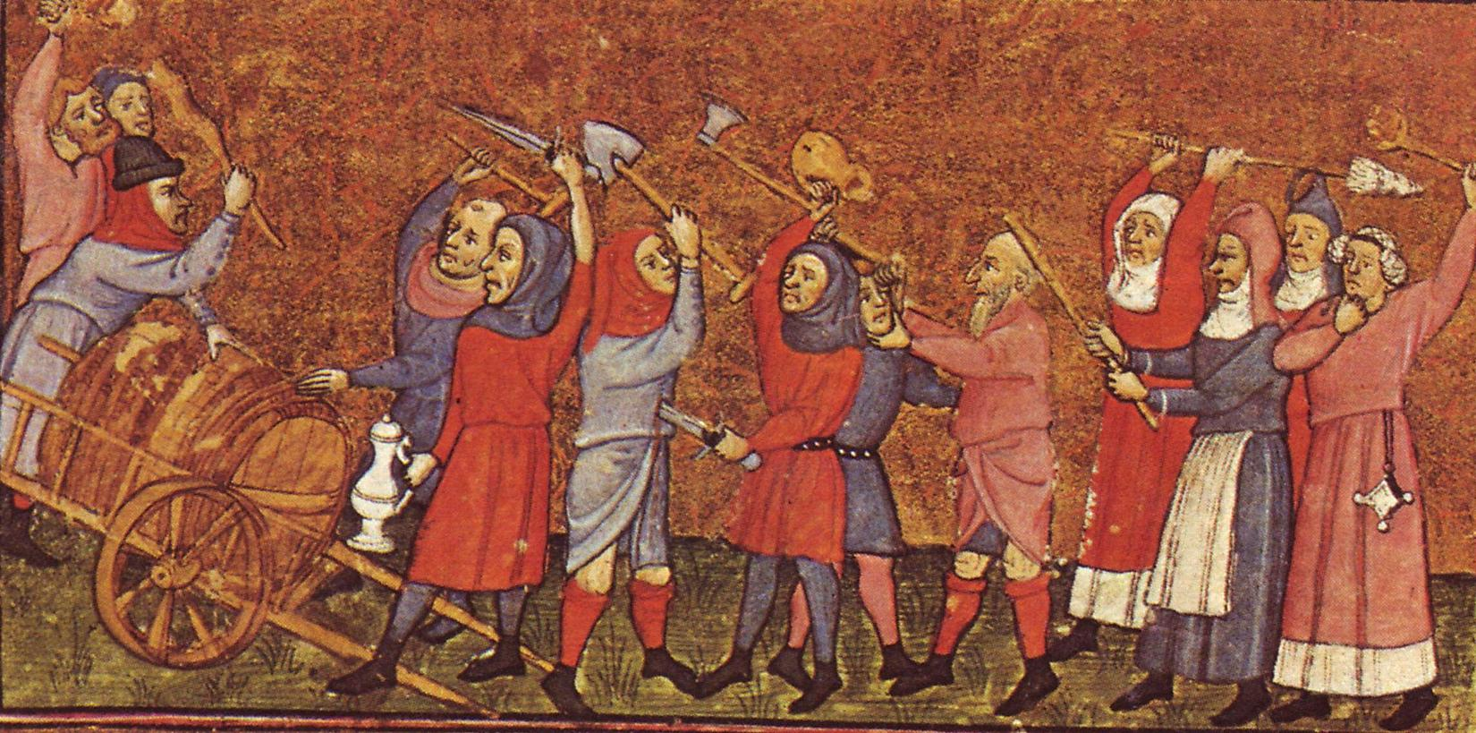
Popular Protest
Expectations of improvement thwarted & perceived injustice & inequality led to resentment & protest

Slide 2
Frequency of revolt (Samuel Cohn):
1200 to 1425: 1,112 revolts in the Low Countries, France, Italy and England
1200-1348: 470 revolts (3+ per year inc. Flanders in 1320s)
1348-1425: 642 (8+ a year)
In the post-Black Death period, revolt became a common occurrence especially 1378-1382

Slide 3
Why rebel (and why not more)?
Denied access to opportunities & rights restricted
Sense of unfairness & thwarted expectations of improvement
Rarely most poor or desperate, but those with something to lose
BUT
Rebellions rarely succeeded, often violent suppression
Life hard enough & difficult to organise on large scale
Required good leadership, organisation & communication: provided when demands and targets coalesced

Slide 4
Motives & Leadership
Motives varied & sometimes difficult to judge
Propaganda of the victors
But sources do reveal attitudes, opinions & concerns
Mixture of peasants (elite & poor), townspeople, lesser nobility
Leadership also varied:
Dependent on context (rural or urban or mixed)
Philip Wolff on peasant revolts: leaders emerge from 1) land-owning middle peasantry 2) peasants at periphery of manorial relations
Reflected social structures (legitimacy)
Conservative vs radical?
Short-term or long-term change

Slide 5
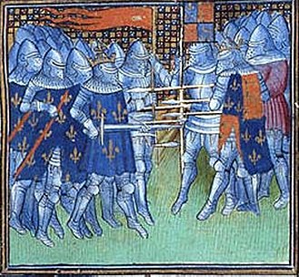
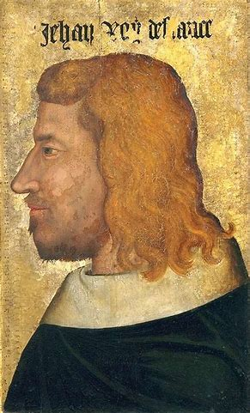
Background to the Jacquerie (1356-58)
Aftermath of the Black Death
Defeats and cost of the Hundred Years War
Absent (imprisoned) King John II of France
Taxes increased
Mercenaries on the loose > pillage
economic stresses caused by the above
popular discontent (both urban and rural)

Slide 6
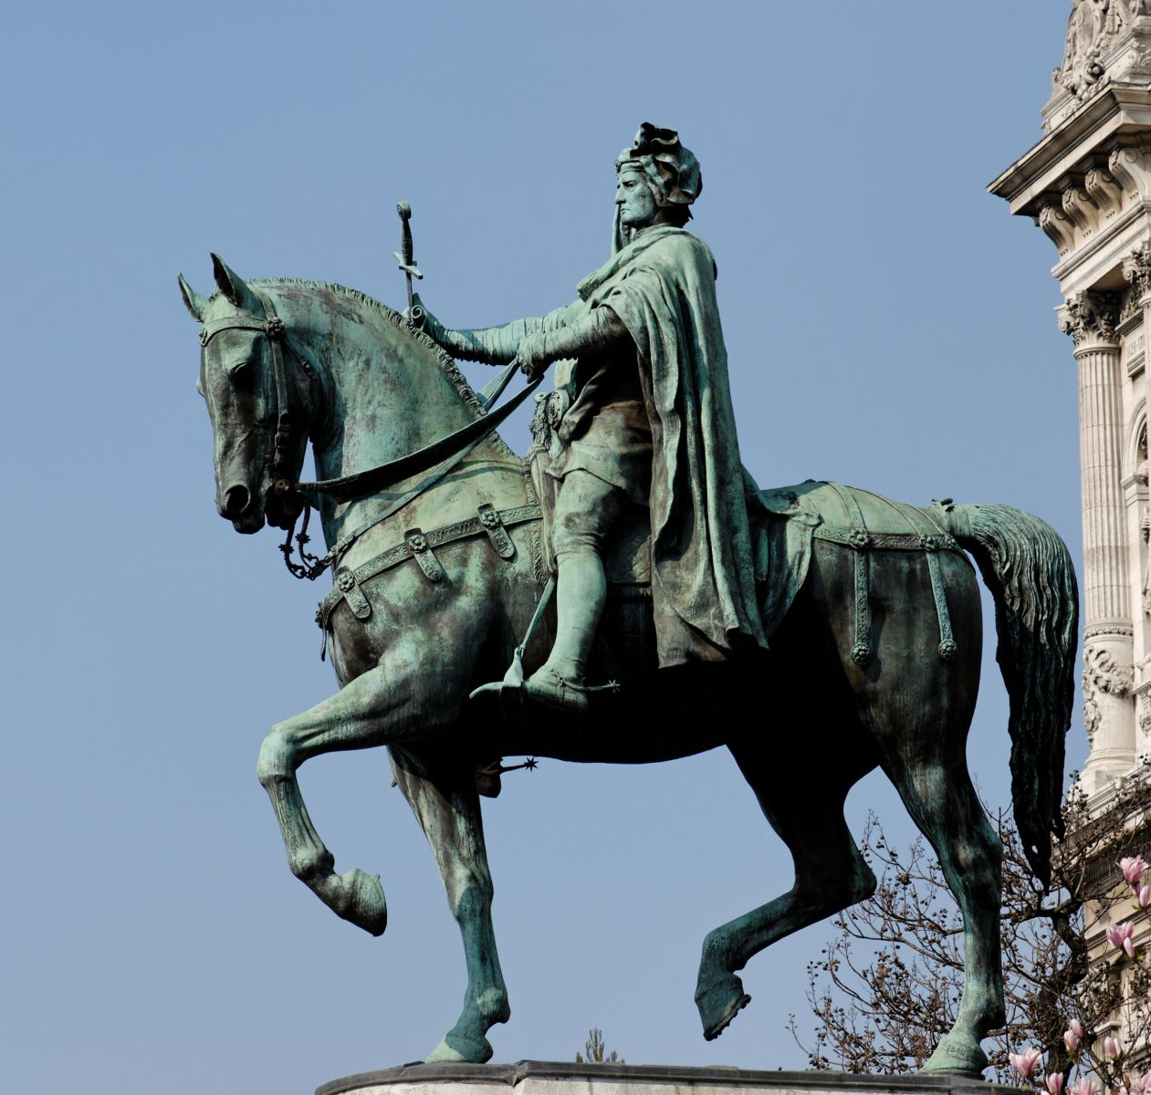
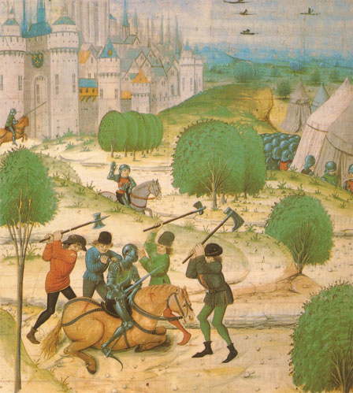
The Jacquerie: rural vs urban
Rural revolt
Discontent with nobles & taxes
Led by rural elite
Violent attacks on chateaux
Urban revolt
Led by Etienne Marcel – provost of Paris
Sought self-governing commune vs regent
Manipulated peasantry to attack opponents

Slide 7
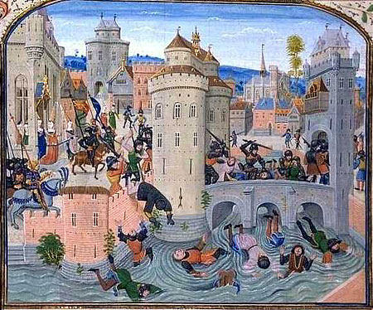
Froissart’s Chronicles: Peasants beaten at Meaux

Slide 8
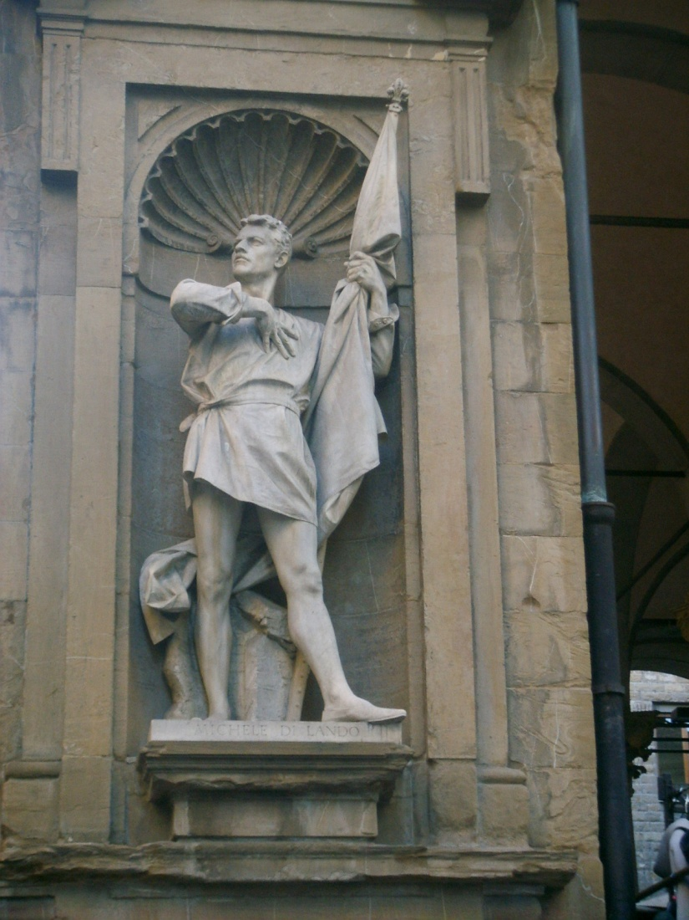
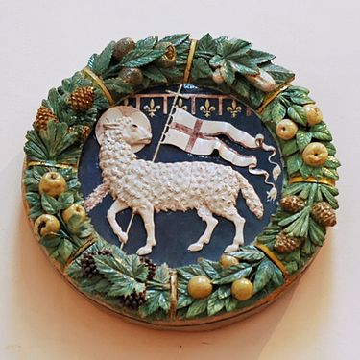
Ciompi in Florence (1378)
Urban revolt by clothworkers
cf Flanders, 1378-85
Wool-carders but also small-scale entrepreneurs, artisans and patricians
Fight with pope over territorial borders
Trade interrupted
Unemployment and fiscal troubles
Demanded guilds & political representation in government
Radical potential not realised
Michele di Lando - leader

Slide 9
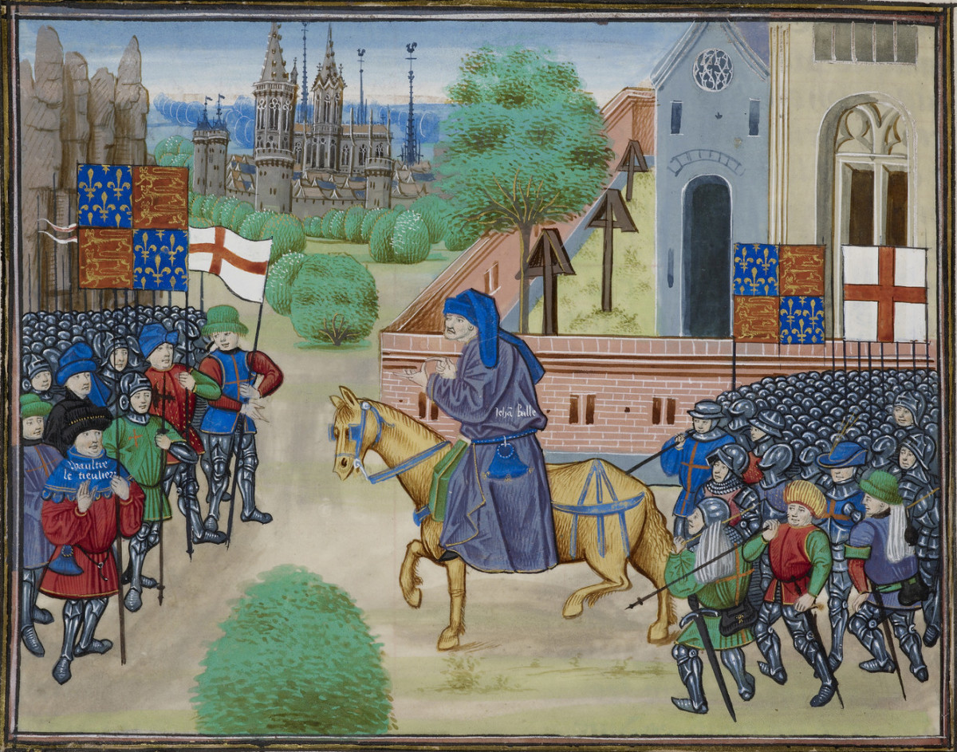
Most well-documented = English Rising of 1381
Other revolts: urban and rural
Tuchins - cf Jacquerie but in South West France (1360s-‘80s)
Social banditry vs authorities. Regional conditions favoured (cf Cathars)
Remensas – Catalan unfree peasants (c. 1388-1486); allied w crown of Aragon vs lords & towns
Spanish pogroms vs Jews in 1391 (scapegoats)

Slide 10
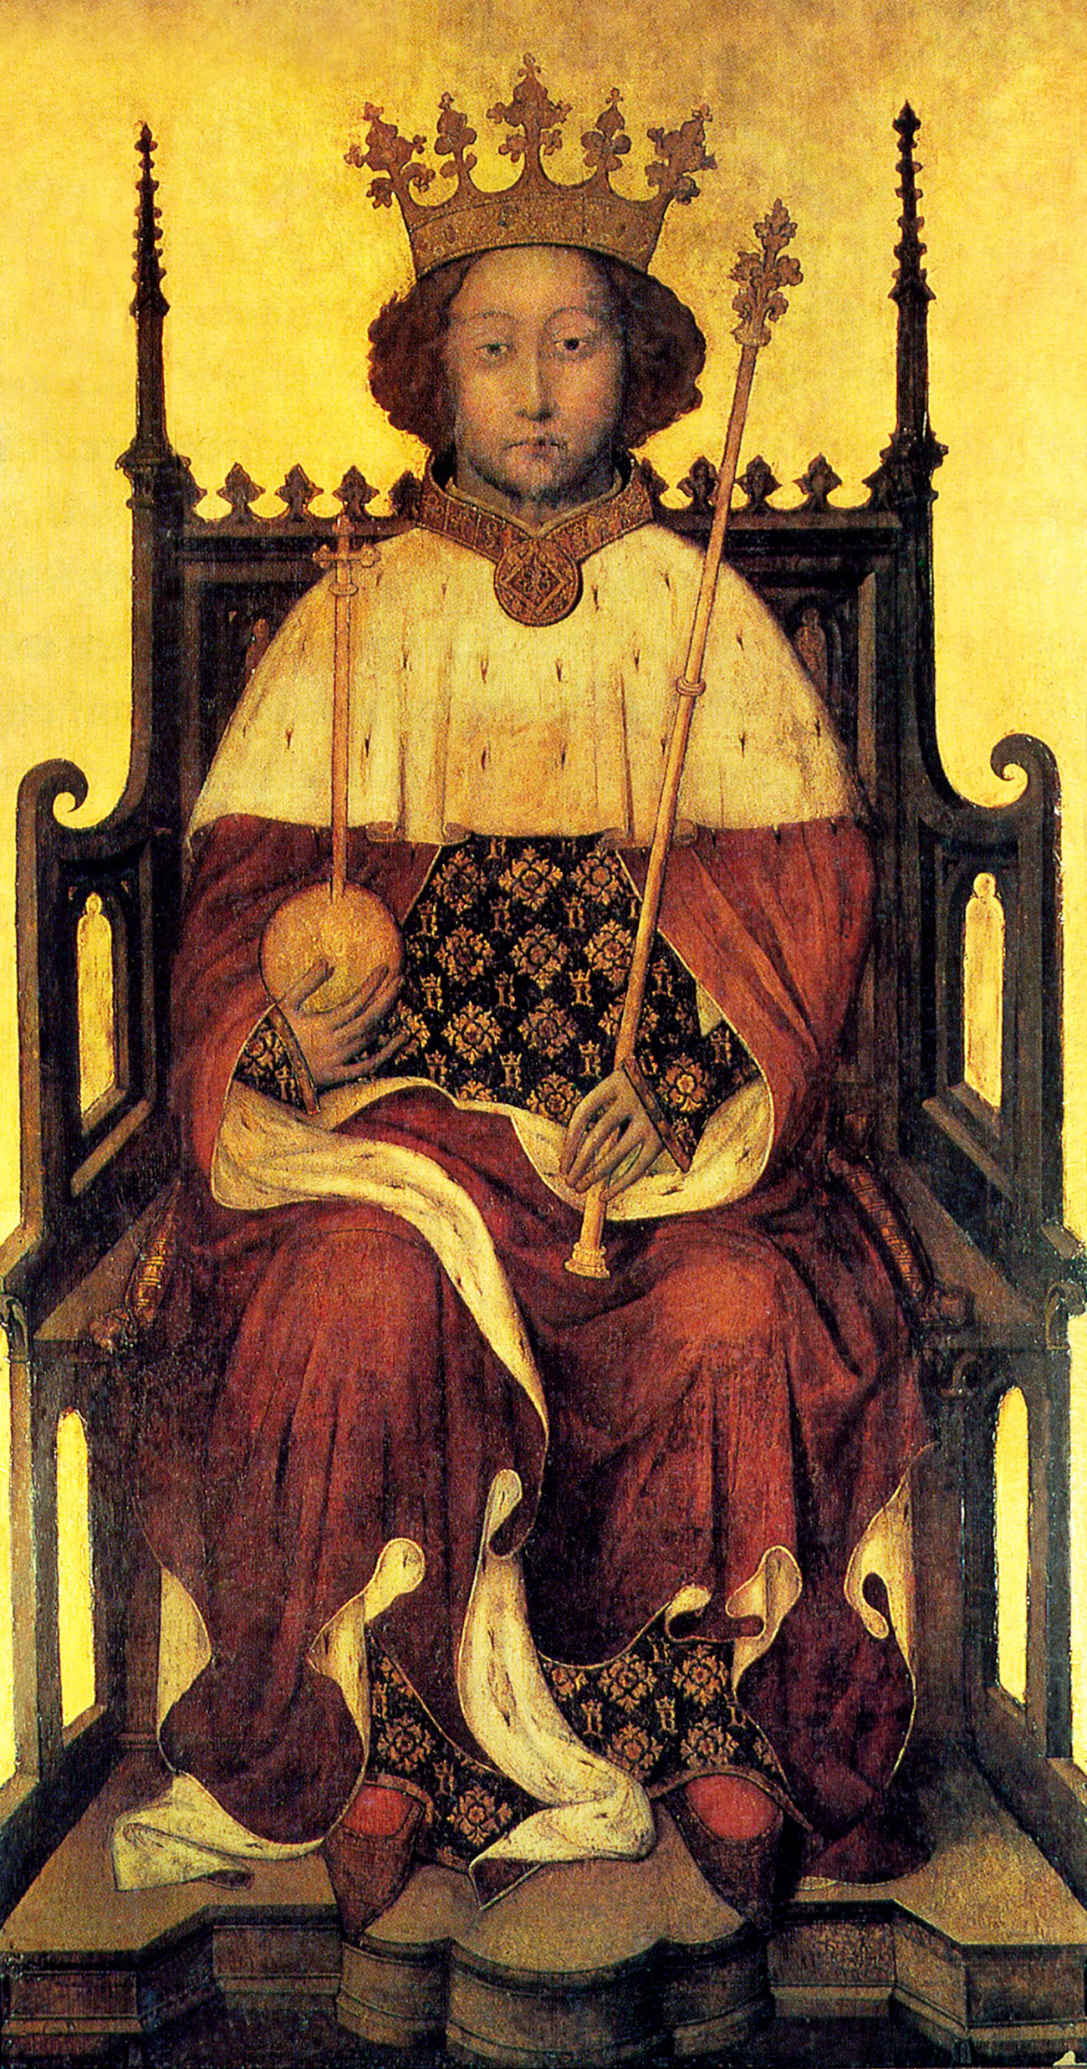
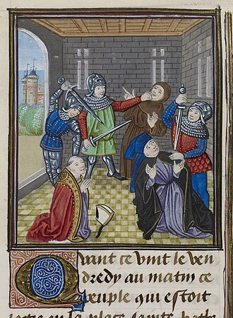
The Background
Ordinance (1349) and Statute of Labourers (1351)
Sumptuary Law 1363
Dissatisfaction of ‘Good’ Parliament 1376
Taxation: third poll tax granted 1380
Young king Richard II and ‘evil’ counsellors
John of Gaunt (Savoy palace burned down)
Simon Sudbury, archbishop of Canterbury, chancellor of England, & Robert Hales, head of Hospitaller Order & treasurer of kingdom, seized & killed

Slide 11
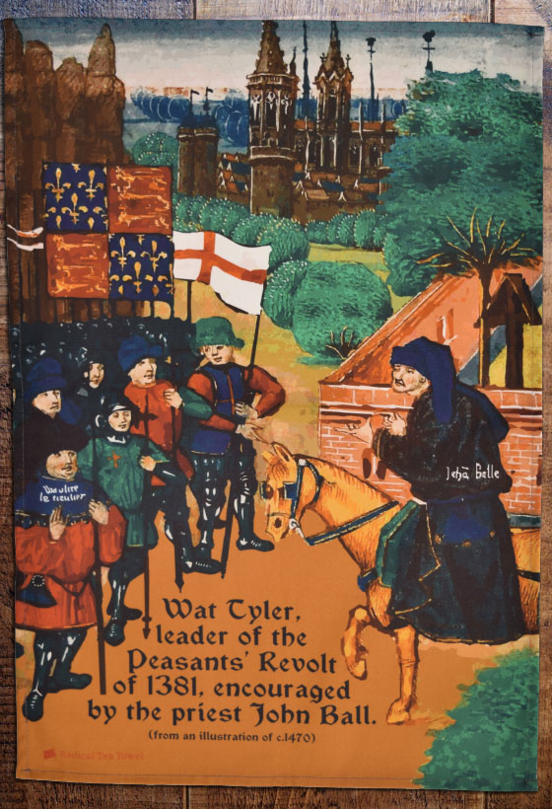
Who were the Rebels?
Mostly free peasants & townspeople from south & east
Large ecclesiastical estates at Canterbury, St Albans, Bury St Edmunds, Ely
Leaders = John Ball & Wat Tyler (‘Jack Straw’?)
Coercion of lower aristocracy?
Urban & rural: vs lords, lawyers, ministers & tax-collectors
Hostile sources: ‘Confession of Jack Straw’ > kill nobility, hold all in common
Ideas of equality: radical preacher John Ball
‘When Adam delved and Eve span, who was then the gentleman?’

Slide 12
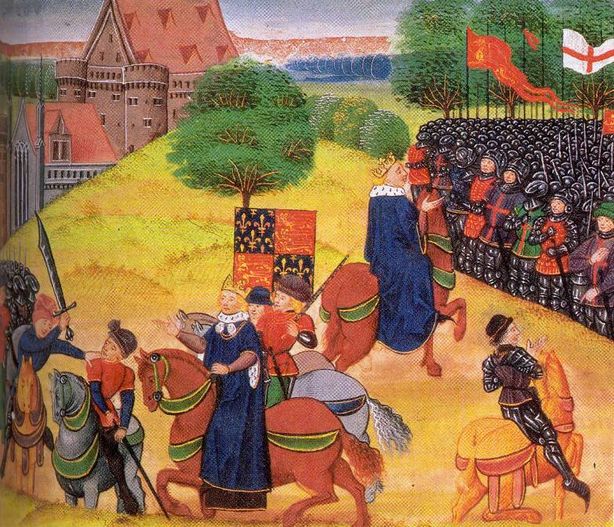
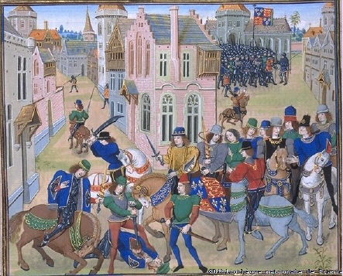
Aims:
‘fair’ rents (4d an acre) & higher wages; protection of rights; abolition of poll tax vs manorial records & sought tax accounts
Influence of Lollardy?
Urban support: e.g. Canterbury, Cambridge, Rochester
Londoners directed vs Temple Bar, Lambeth Palace, Flemish
End of Revolt: Mile End & Smithfield
Meetings with king on 14 & 15 June
Given promises & royal charters of pardon > disperse
Wat Tyler killed
Others identified & fined; few ringleaders executed
Class Antagonism (Hilton)? Failure re demands?
Local dissent continued & trends eroded burdens

Slide 13
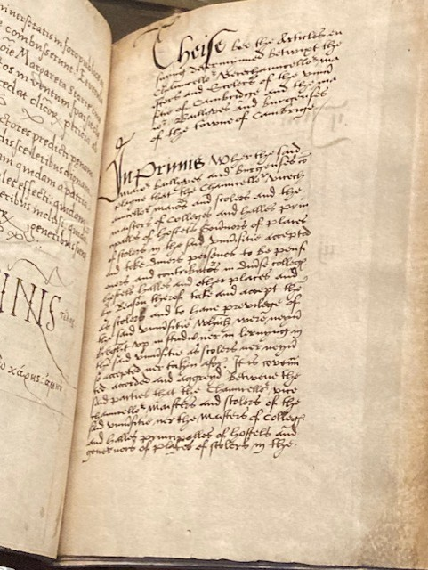
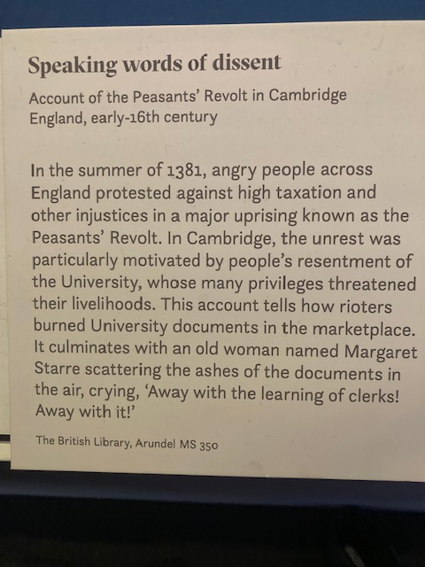
Urban Revolt in Cambridge 1381 vs University

Slide 14
End of Serfdom?
Cf 1450 Jack Cade’s Rebellion
based in Kent; dissatisfaction with how war going > War of Roses; socio-econ & political grievances; violence vs lords & suppression
Never formally abolished
Landlords often let go of services and dues gradually
Rise of long-term farms & copyhold tenure
Serfs manumitted throughout 15th century
But fugitives still hunted down
Heriots still there
Some feudal rights (including labour services) still included in some leases
Still a few serfs found in 16th-century sources

