Slide 1
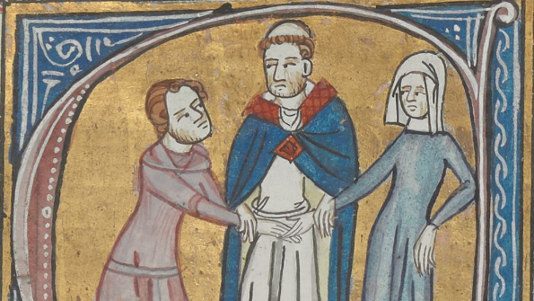
Marriage and the Family
Natalie Hanley-Smith

Slide 2

Lecture Outline
Marriage under the Roman Catholic Church
Customs and Rituals
Gender norms
Marital Sex
Crossing Boundaries? Separation, Adultery, Divorce, Illegitimate Children

Slide 3
Doctrinal Developments
Marriage – precedents and frameworks adapted from Ancient Rome/Judaism
Attempts to ‘Christianize’ and regulate from c.9th century but regional variances.
The Fourth Lateran Council (1215)
  Prohibited degrees
  Processes
  Consent – of both parties – was essential for a union to be valid
  Ages of consent: 12 for girls, 14 for boys
  Preferable, but not essential: witnesses, blessing from a priest, on church ground.

Slide 4
Ideological Frameworks
Sara McDougall – Catholic marriage offered husbands and wives ‘a complicated equality’.
Husbands and Wives shared 4 rights:
  The right to consent
  The right to conjugal duty/surrender of the body
  The right to leave an ‘invalid’ marriage
  The right to choose own place of burial
Adam and Eve ‘one flesh’ – interdependence and indissolubility
The Holy Family
St Augustine: the bond between husband and wife was as strong as the bond between Christ and the Church

Slide 5
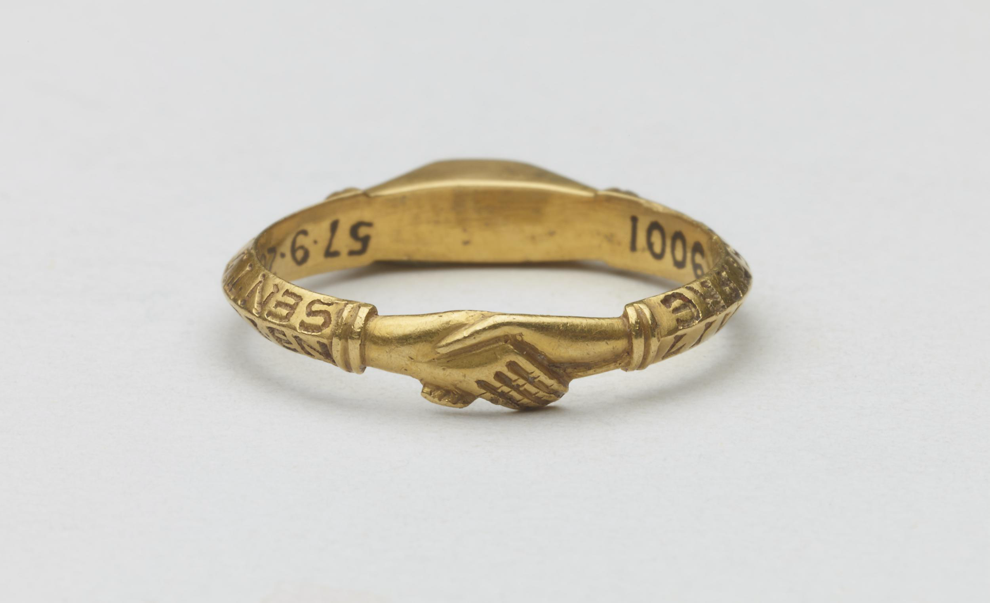
Customs and Rituals - Religious
Reading of the Marriage Banns in Church (three consecutive Sundays)
  Community awareness, to limit bigamous or clandestine unions
The Church porch or churchyard
Exchange of rings and vows
A blessing from the priest – bedding rituals
https://www.britishmuseum.org/collection/object/H_1857-0928-1

Slide 6
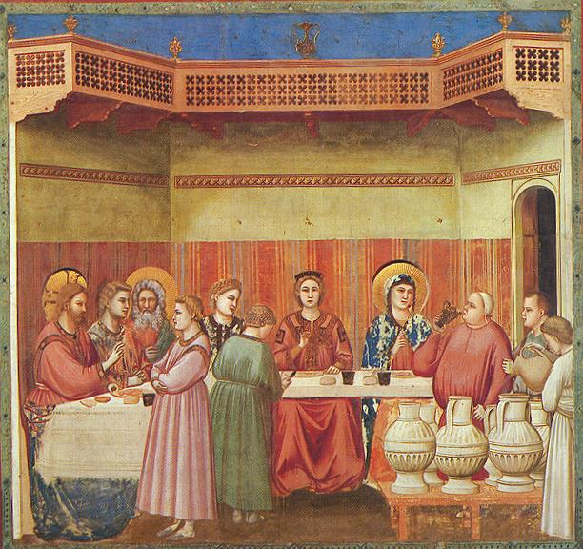
Customs and Rituals continued
Public celebrations
Gathering of family, kin, community
Food and drink

Slide 7
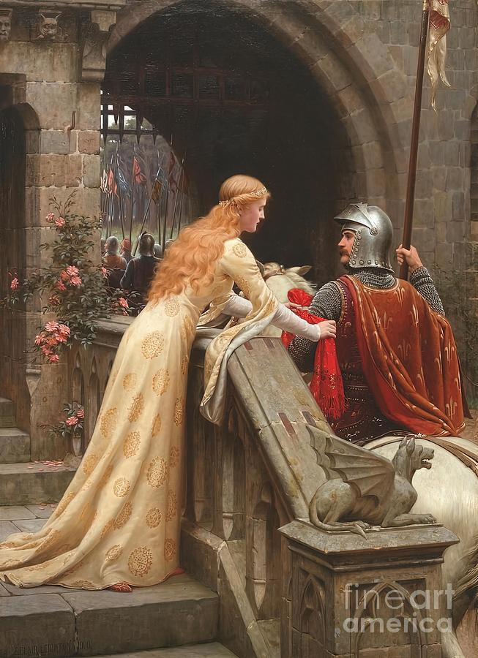
The Medieval Family
The ‘household family’ – included not only the ‘nuclear’ family but wider kin, domestic servants, and apprentices.
Demographic uncertainties: large families?
  High rates of infant mortality
  Birth control
The mini kingdom – male head and female auxiliary
A domestic partnership
Love in marriage?
  Courtly love – extramarital

Slide 8
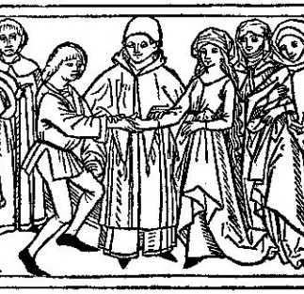
Peasant Marriage
An economic unit
The English Poll Tax returns of 1377 show us that 70% of women aged 15 and over were married
Average ages – harder to gage accurately but around 15-20 for women and mid-late 20s for men.
Younger in Southern Europe than in Northern Europe.
Marriage often put off during times of war, plague and famine.
Supposed to be able to support household
Social Status
Some evidence of tolerance for premarital sex with marriage taking place after the bride fell pregnant.
Dowries and the Merchet tax to the lord.
Distinction between serfdom and slavery in the way serf marriages were recognized and protected.

Slide 9
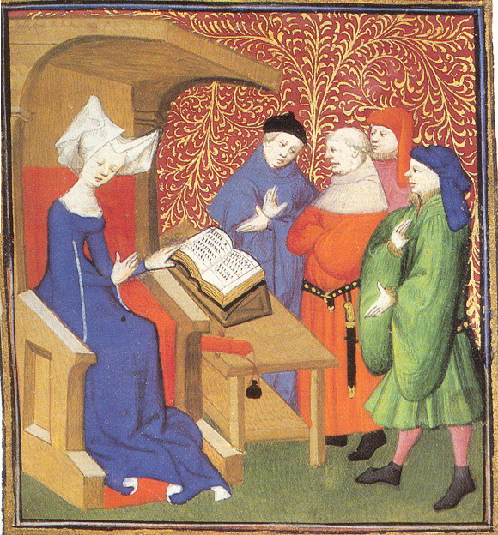
Urban, artisanal/craftsmen marriages
Similar emphasis on man’s ability to support a family before he marries.
Dowry provided capital to set up new business or trade.
Economic and working units
Many married from within their family’s professional networks
Wife to be a helpmeet and to understand husband’s trade well enough to supervise staff and apprentices in his absence.

Slide 10
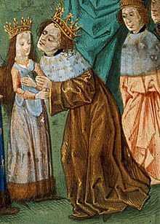
Aristocratic and Royal Marriages
Politically motivated – dynastical connections and alliances.
Cemented international relationships between kingdoms
Usually arranged when at least one party was a child – but not to be consummated until ages of 12(f) and 14(m) – ages of consent.
Betrothal ceremonies
On average women married in early-mid teens and men in their 20s.

Slide 11
An Economic Institution - Dowries
The Dowry: goods, land, and/or money paid by the bride’s family to the groom.
c.11th century revival of a custom from Ancient Rome
Changing forms – increasingly monetary
Practice heavily regulated in Italian cities
Rachel Stone: Clash of two main functions
  To support wife in widowhood/abandonment
  Resource to help the couple ‘set up’ domestic life.
  Legally belonged to the wife – but the husband managed it!
No dowry = no marriage? Option to ‘earn’ dowry through period of domestic service.

Slide 12
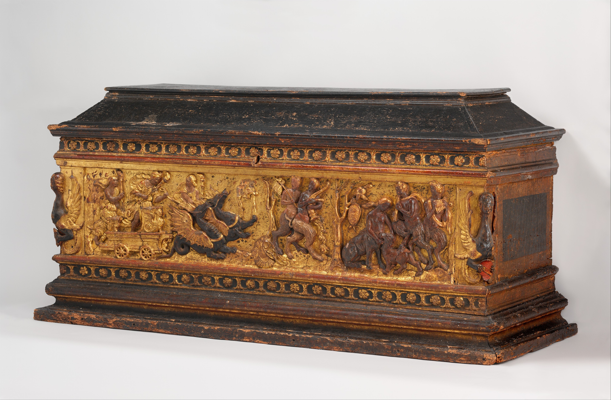
An Economic Institution – Gifts
Regional Variances: the Morgengabe
Material culture of the household
The marriage chest – Cassone
https://www.metmuseum.org/art/collection/search/193335

Slide 13
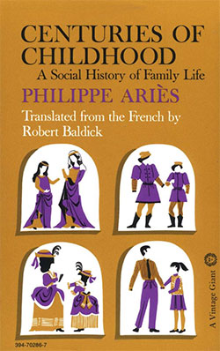
Parenting and Children
Philip Ariès, Centuries of Childhood: A Social History of Family Life (1960).
  No such concept of ‘childhood’ and parents did not emotionally invest in children because of high mortality rates
Widely criticized by revisionists:
  Evidence of grief after child loss
  Care from religious and secular authorities

Slide 14
Marital Sex
1 Corinthians 7: verses 1-3:
‘Now concerning the things whereof ye wrote unto me: It is good for a man not to touch a woman. Nevertheless to avoid fornication, let every man have his own wife, and let every woman have her own husband. Let the husband render unto the wife due benevolence: and likewise also the wife unto the husband’.

Slide 15
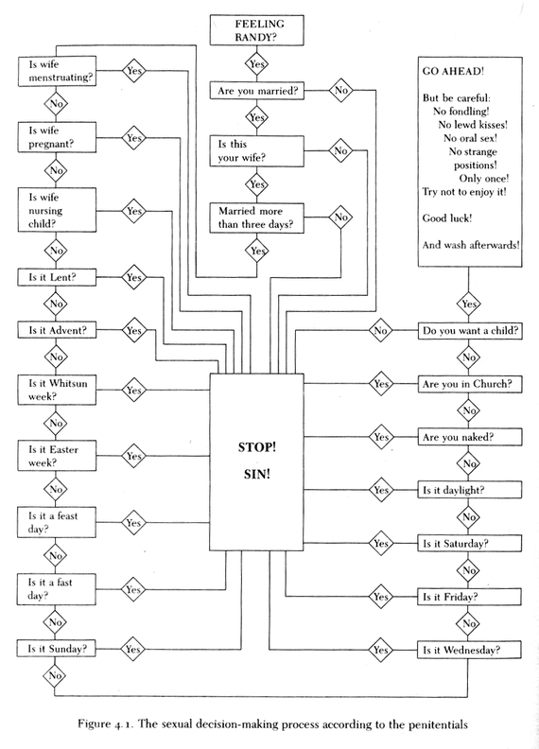
Marital Sex
A source of anxiety
Conjugal rights
Strict limitations on legitimate sexual activities
James Brundage, Law, Sex, and Christian Society in Medieval Europe (1987).
The Family was a moral unit

Slide 16
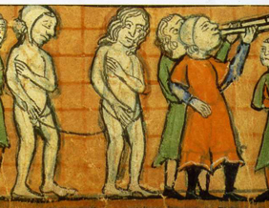
Sexual Transgressions
Fornication – public punishment and fines
Illegitimacy – importance of social status
Sara McDougall – less of a stigma than in the early modern period
Illegitimate children of the king usually from extramarital relationships - ‘Fitzroy’ privileges
Illegitimate children of serfs and peasants – breach of marriage contracts

Slide 17
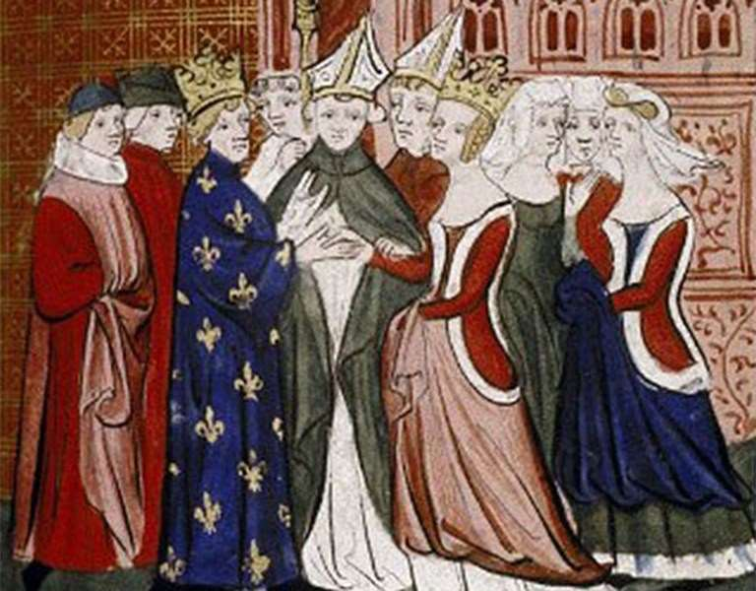
Divorce and Annulments
Much more flexibility in the classical world
By 1100, Roman Catholic Church had limited permissible grounds for annulments (with freedom to remarry):
A marriage could only be dissolved if it could be argued that the union had not been ‘valid’ in the first place.
Incest – prohibited degrees; forced or coerced marriages; insanity and leprosy; impotence – not just infertility – but the inability to consummate the union.

Slide 18
Legal Separation
Allowed both parties:
  To live apart
  To separate material goods
  To be exempt from conjugal duty
  BUT NOT TO REMARRY
Granted in cases where one party had a religious calling, or in cases of adultery or cruelty.
Not uncommon – records suggest large numbers of separation cases in Northern France, Italy and Belgium.
Cases often brought by women seeking assistance and intervention.

Slide 19
Remarriage
High mortality rates meant lots of people married more than once in their lifetime.
‘Blended’ families common
Under doctrinal law needed proof of death of first spouse to remarry but in practice not always demanded.
Byzantine Law had different restrictions: had to do penance and abstain from the sacraments for a period after remarriage.

Slide 20
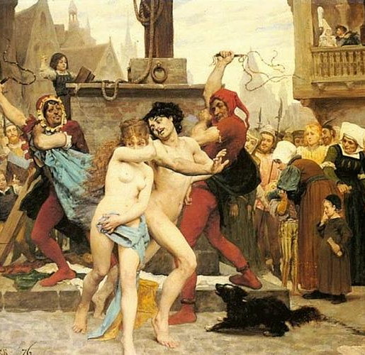
Adultery
Byzantine Law – even ‘suspicion’ of a wife’s adultery could be grounds for divorce (allowed her husband to remarry).
Double standards for male and female adultery.
Fears of illegitimacy and inheritance
Declining tolerance for male adultery?

Slide 21
Conclusions
Roman Catholic Marriage inspired by frameworks from Ancient Rome and Judaism
Attempts to legislate and regulate throughout medieval period
Rituals and Customs
An Economic Institution
Gender roles in the family – prescriptive but complementary
Sex – a source of anxiety
Became harder to legally end a marriage – but not impossible to leave one.

