Slide 1
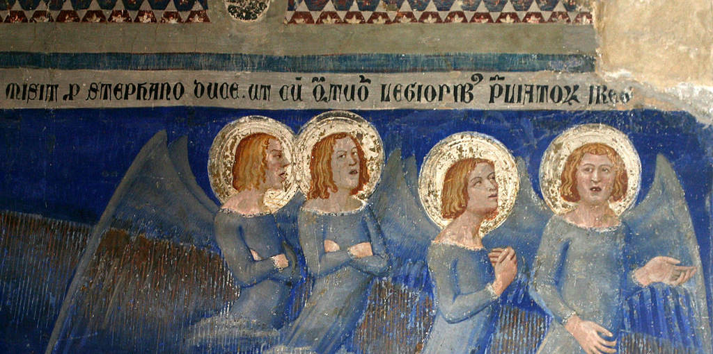
THE LATE MEDIEVAL CHURCH AVIGNON PAPACY, GREAT SCHISM AND COUNCILS
LOLLARDS AND HUSSITES

Slide 2
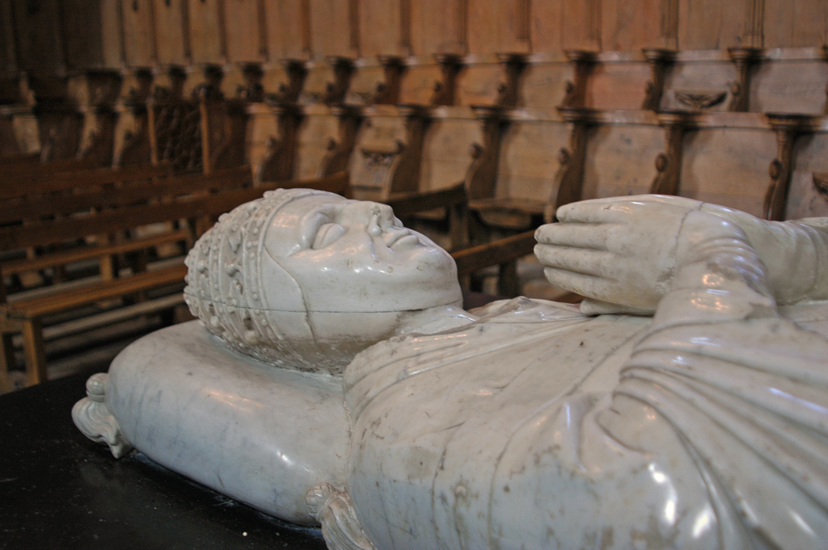
‘The Avignonese period produced major changes both in the functioning of the papacy and in the way the rest of the church perceived it. Never had the papacy done so much or with such effectiveness. Never had the papacy possessed a greater income or a greater impact on the farthest reaches of Christendom. But simultaneous with this growth in power was a decline in reputation. In the mid-eleventh century, the papacy had emerged as the leader of the reform movement in the western church. For more than two centuries the popes gave direction and inspiration to zealous reformers and pious believers ... In the fourteenth century, the conviction grew that the papacy itself needed reform.’ Joseph H. Lynch, The Medieval Church: A Brief History
THE 7 AVIGNON POPES
1305-1314 Clement V (Betrand de Got) 1316-1334 John XXII (Jacques Duèse) 1334-1342 Benedict XII (Jacques Fournier) 1342-1352 Clement VI (Pierre Roger) 1352-1362 Innocent VI (Étienne Aubert) 1362-1370 Urban V (Guillaume de Grimoard) 1370-1378 Gregory XI (Pierre Roger, nephew of Charles VI)

Slide 3
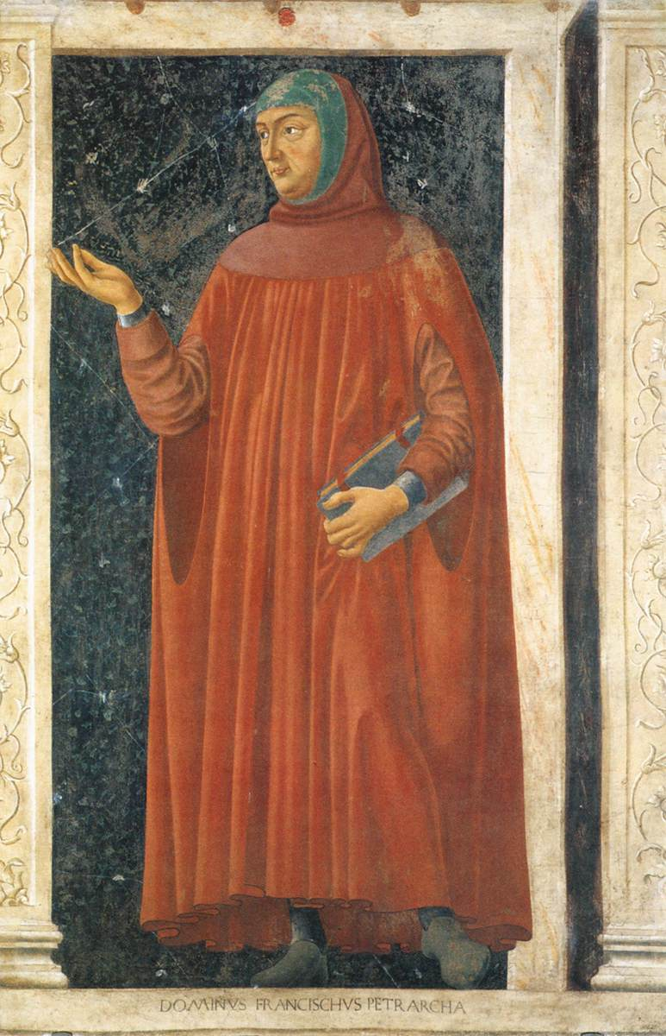
Contemporary critics
Petrarch (1304-1374) Avignon = ‘unholy Babylon, Hell on earth, a sink of iniquity, the cess-pool of the world. There is neither faith, nor charity, nor religion, nor fear of God, nor shame, nor truth, nor holiness, albeit the residence within its walls of the supreme pontiff should have made of it a shrine and the very stronghold of religion ... Of all the cities I know, its stench is the worst ... What dishonour to see it suddenly become the capital of the world when it should be but the least of all cities.’ G. Mollat, The Popes at Avignon
Also Catherine of Siena (1347-1380)
Bridget of Sweden (1302-1373)
Chronicles
Most historians up to early C20th
Traditional base in Italy > prolonged residence outside
Strong ties to France > temporary move
Took 30 years to settle! And military & other challenges to move back

Slide 4
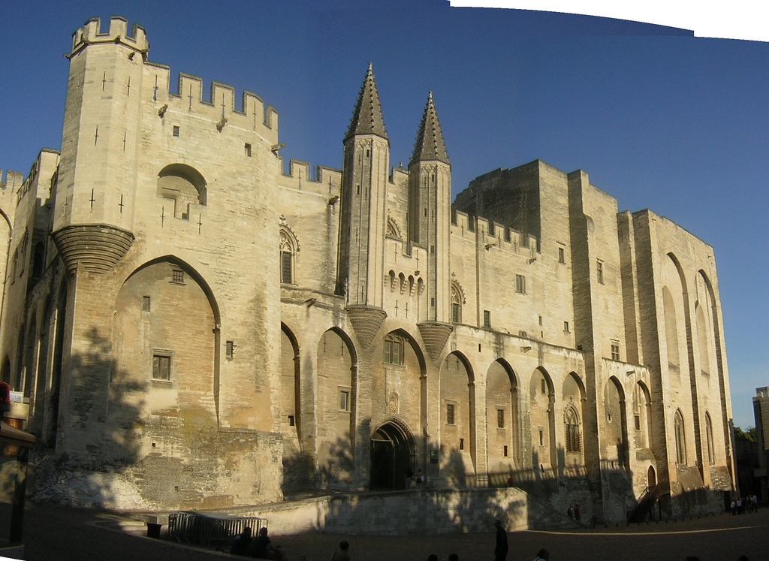
Criticism of Avignon papacy, three main issues:
French connection: domination (esp. Languedoc: all 7 popes, 96 of 112 French cardinals & almost half papal curia)
Moral character of popes: nepotism, luxury & profligacy
Growing centralisation and absolutism
John XXII vs Lewis of Bavaria
William of Ockham & Marsilius
of Padua critical
Expansion of papal curia
Growth of papal revenues
Clashes with college of
cardinals
Palais des papes, Avignon, built in two stages 1330s> = largest Gothic palace in Europe

Slide 5
THE PAPACY DURING THE GREAT SCHISM
Reign | Roman | Avignon | Pisan
1378(?)-1389 | Urban VI
1378-1394 |  | Clement VII
1389-1404 | Boniface IX
1394-1423 |  | Benedict XIII (deposed 1417)
1404-1406 | Innocent VII
1406-1415 | Gregory XII (resigned)
1409-1410 |  |  | Alexander V
1410-1415 |  |  | John XXIII (deposed)
1417-1431 | Martin V

Slide 6
RESOLUTION THROUGH THE CONCILIAR MOVEMENT, 1409-1449
Dates | Location(s)
March-June 1409 | Pisa
November 1414-April 1418 | Constance
April 1423-February 1424 | Pavia and Siena
July 1431-April 1449 | Basle, Ferrara, and Florence

Slide 7
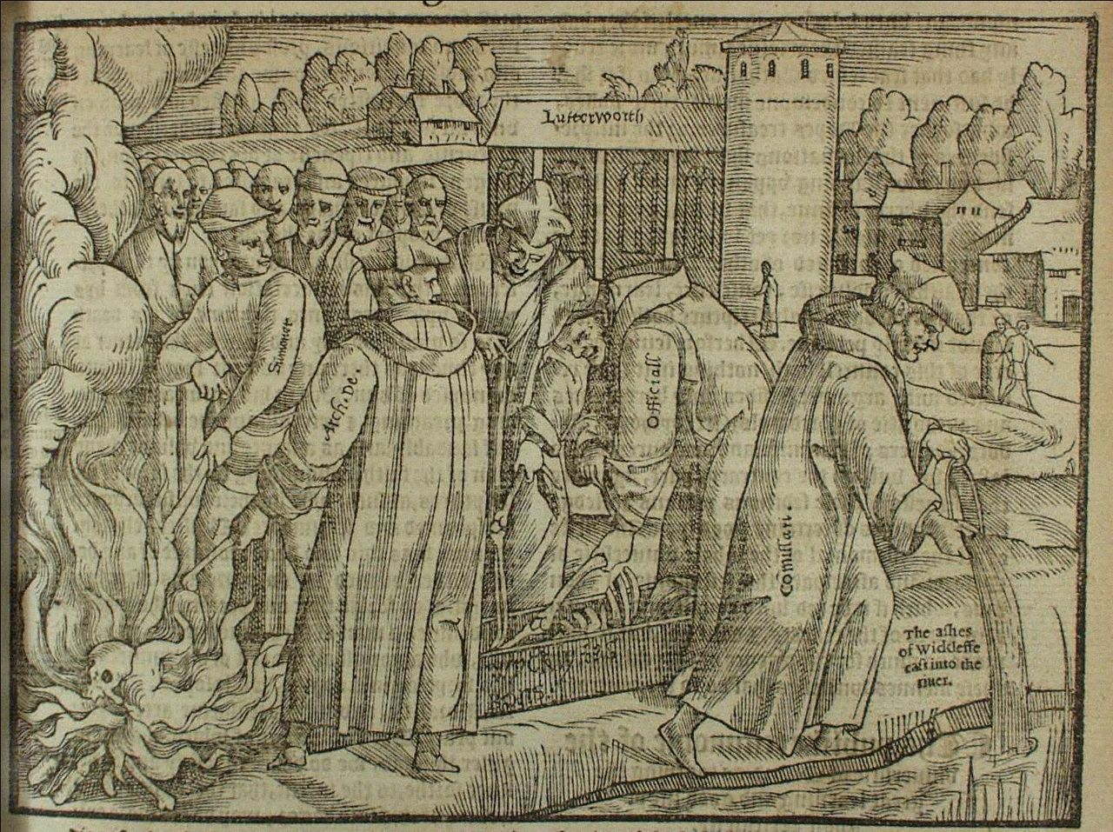
Lollards and Hussites
LATE MEDIEVAL HERESIES

Slide 8
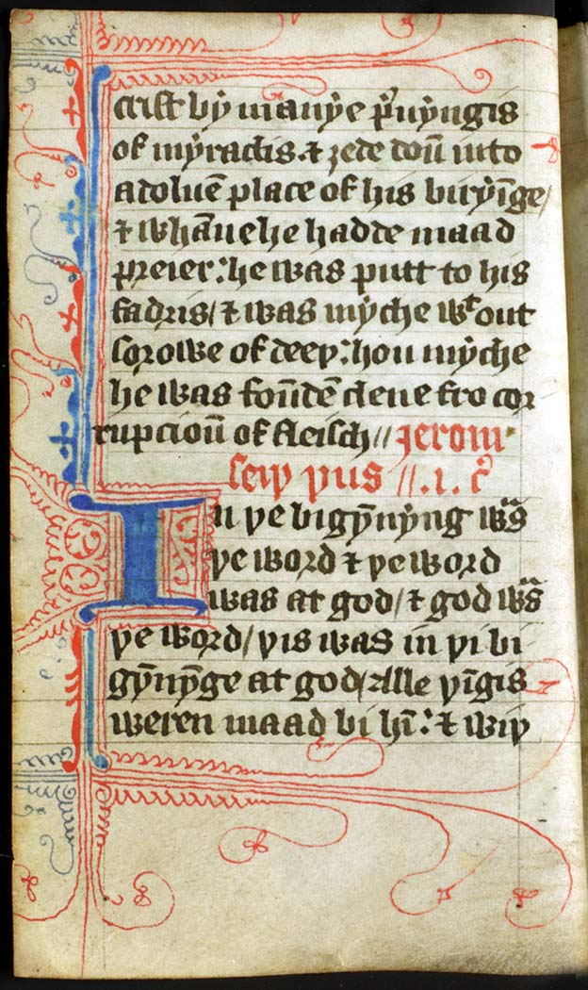
Lollard Bible, late 14th century
Lollards
Followers of John Wyclif/Wycliffe (1324-1384), England late C14th & C15th
From lollium = ‘hypocrite’ First used for Wycliffites in 1382 in Oxford
‘One of the most developed criticisms of the medieval church came from the English Lollards’
Steven Ozment, The Age of Reform 1250-1550

Slide 9
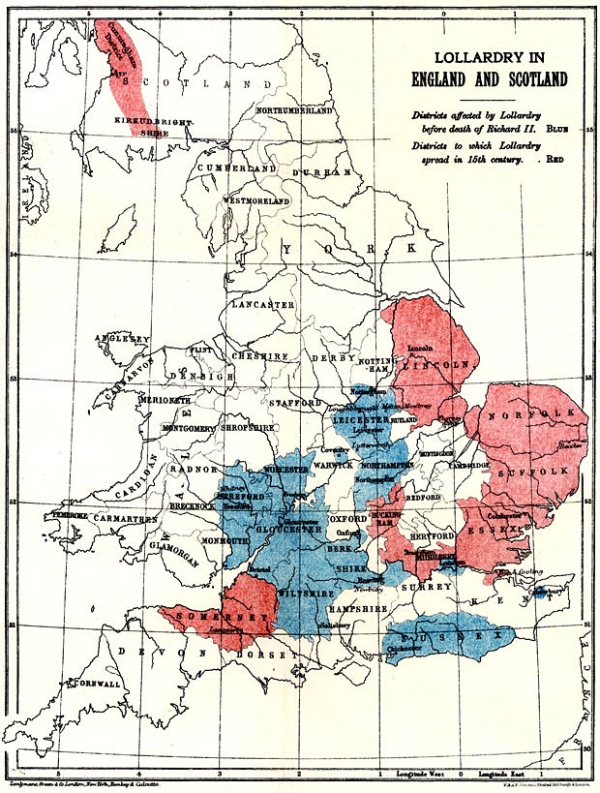
Background of discontent
Popular protests
Plague
Anti-clericalism
Higher literacy rates
Wyclif influential with people, intellectuals & nobility e.g. John of Gaunt
c.1380 attacked pope & friars & sent out ‘poor priests’ to spread ideas
vs transubstantiation
1382, 24 ‘Conclusions’ condemned

Slide 10
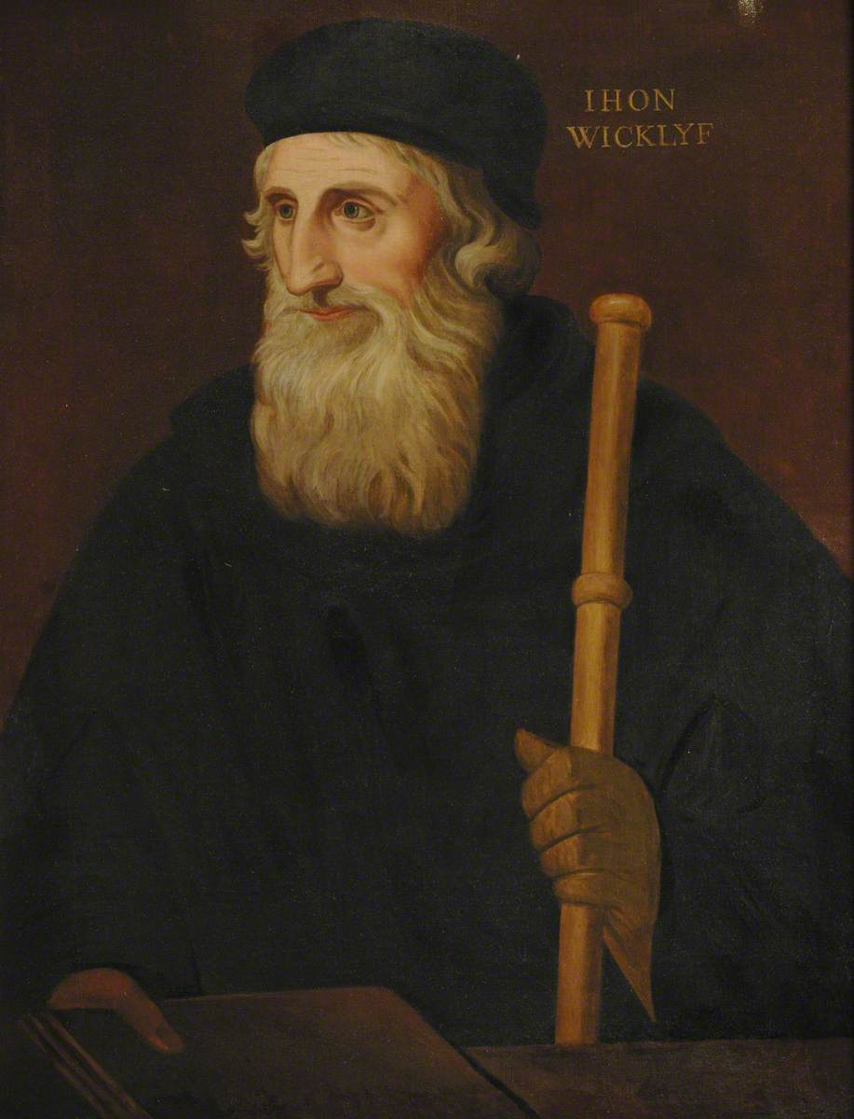
Lollard Beliefs: 12 ‘Conclusions’ 1395
celibacy of clergy and religious orders
‘feigned miracle of the sacrament’
‘feigned power of absolution’
‘feigned indulgences’
sacraments are ‘jugglery’
rejected power of saints
pilgrimages ‘not far removed from idolatry’
criticised friars for preaching for money and ‘preaching to the people falsehoods and fables to please them’
Prayers for the dead not a reason for almsgiving.

Slide 11
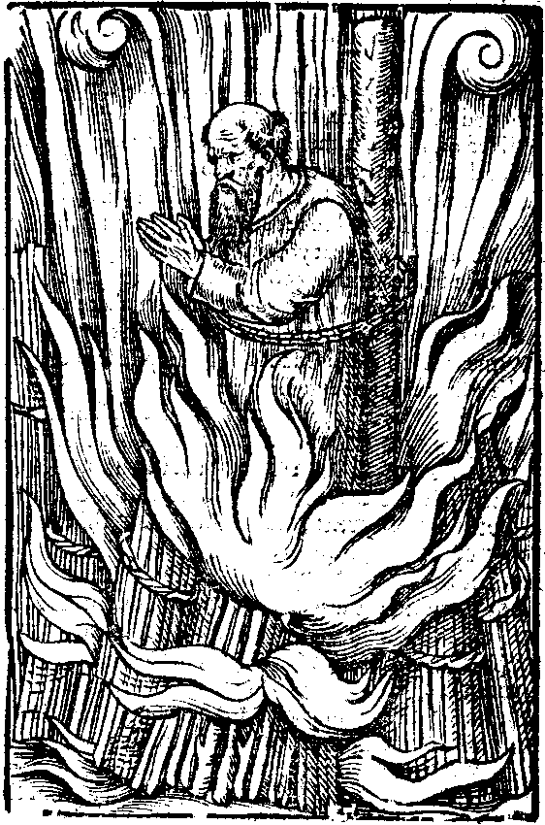
How did Lollard beliefs develop?
Accession of House of Lancaster in 1399
1401, Act on burning of heretics
Only eleven heretics burned at stake 1401-1485
1407, Archbishop Arundel banned Wycliffite translations of bible
1410, 267 propositions collected from Wyclif’s writings condemned
1415, Council of Constance declared him to have been a heretic.

Slide 12
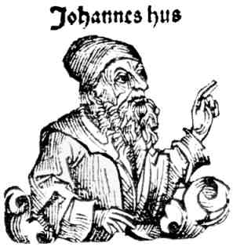
Hussites and Hussitism
Followers of Jan/John Hus (1369-1415)
Stronghold Bohemia/Czech Republic
Called ‘Wycliffites’
‘Hussites’ first used c.1420, beginning of Hussite Wars.
‘Prior to the Protestant Reformation, no religious movement had advanced more successfully against the late medieval church than the Hussites of Bohemia’. Ozment, The Age of Reform

Slide 13
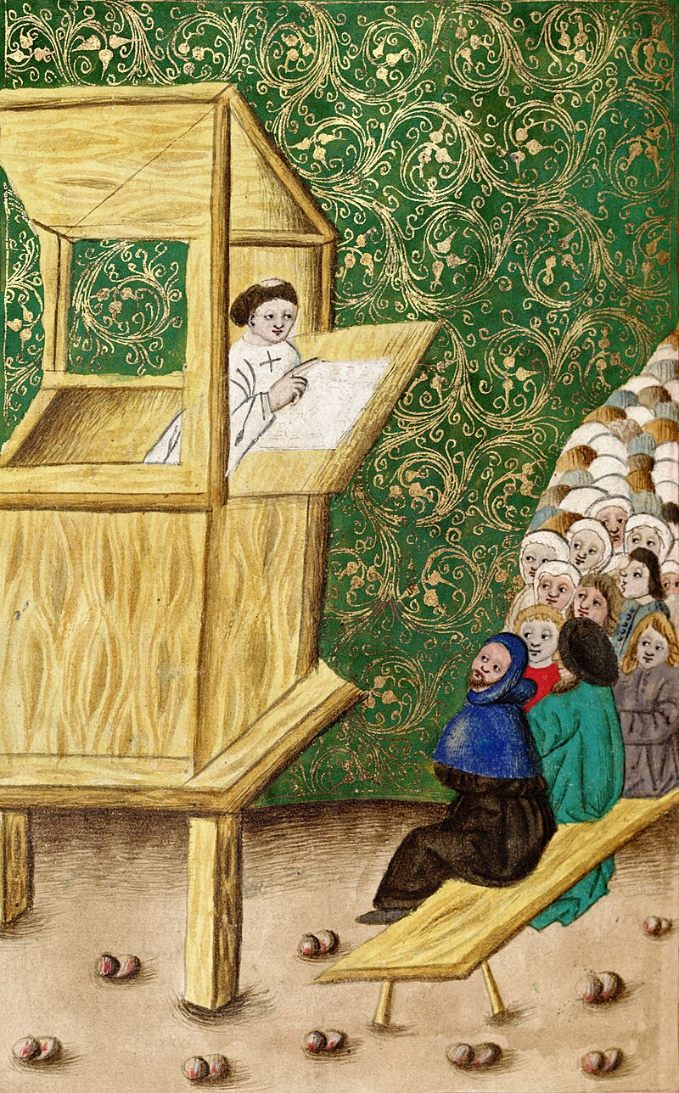
Origins of the Hussite movement
Hus studied and taught at University of Prague
Strong links with England & University of Oxford
Influenced by Wyclif
1403, ideas banned
1409, Hus became rector & promoted ideas

Slide 14
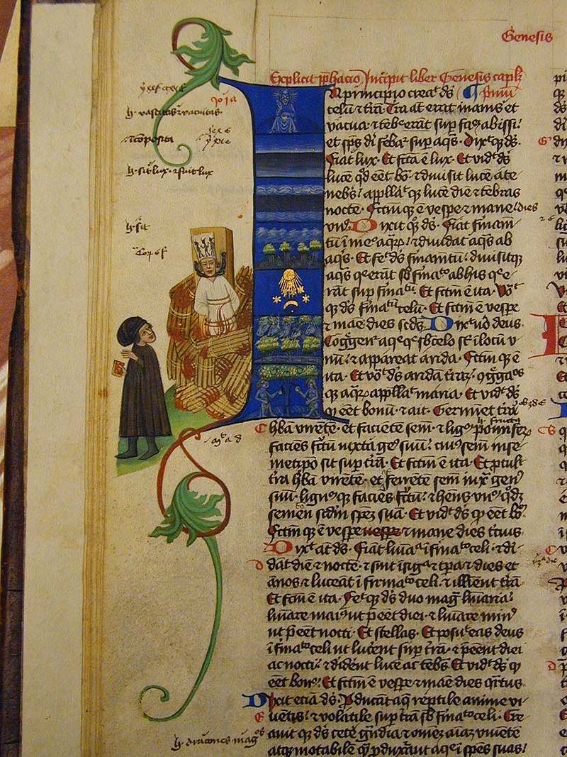
How did the Hussite movement develop?
1408, archbishop of Prague suspended Hus from position
1409, accused Hus of heresy and excommunicated him
1410, church authorities publicly burned 17 of Wyclif’s writings & Hus excommunicated by John XXIII
1411, preached against sale of indulgences.
1412, publicly defended several condemned beliefs of Wyclif
1413, wrote major work On the Church
1414, tricked into attending Council of Constance
1415, burned at the stake

Slide 15
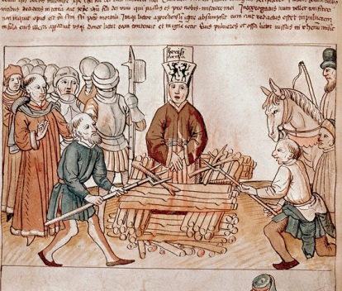
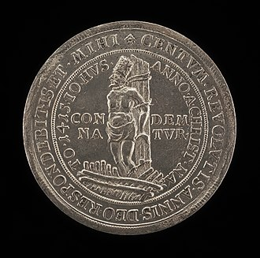
Execution of Jan Hus and his legacy
Utraquism: ‘Amen amen I say unto you: Except you eat the flesh of the Son of man, and drink his blood, you shall not have life in you.’ (John 6:54)
Churchmen should not have possessions, so temporal lords could take away Church goods
Emphasis on poverty: Taborites
1420 Articles of Prague

Slide 16
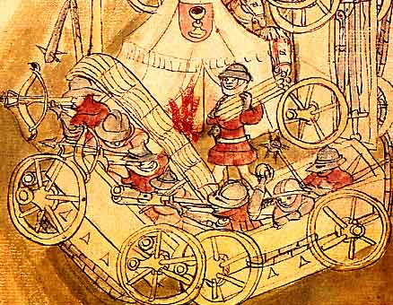
Radical Taborite manifesto, 1420
‘Henceforth at Hradiste and Tabor there is nothing which is mine or thine. Rather, all things in the community shall be held in common for all time and no one is permitted to hold private property... No longer shall there be a reigning king or ruling lord; for there shall be servitude no longer. All taxes and exactions shall cease and no one shall compel another to subjection. All shall be equal as brothers and sisters.’
(Arnold, Belief and Unbelief in Medieval Europe)
Hussite vozová hradba (wagon fort)

Slide 17
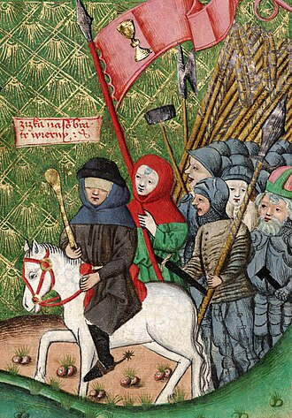
OUTCOMES
1434, Utraquists defeated Taborites
1435, Hussite elected archbishop of Prague
Conservative & aristocratic wing of movement proved most durable
1436, fighting ended & compromise reached
Ideas developed in 2 contexts
Great Schism
Czech nationalism

Slide 18
DIFFERENCE FROM EARLIER HERESIES
Know more about because sources from/by ‘heretics’ not just inquisitors/opponents, but still condemned
Both coherent and more eclectic sets of beliefs
No single message also encompassed socio-political elements
INFLUENCE ON THE REFORMATION?
No direct lineage
Catholic Church still going strong
Few Lollards, Hussites (unlike Waldensians) not embraced
Some geographical continuities?
Ideas & criticisms of Church pre-existed but required mass international movement to be effective

