Slide 1
Crossing Boundaries and Breaking Norms in the Medieval World
Lecture 2: ‘Feudalism’
Aysu Dincer

Slide 2
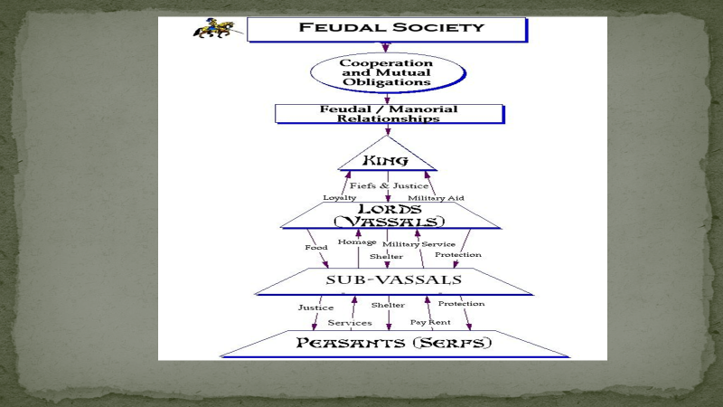

Slide 3
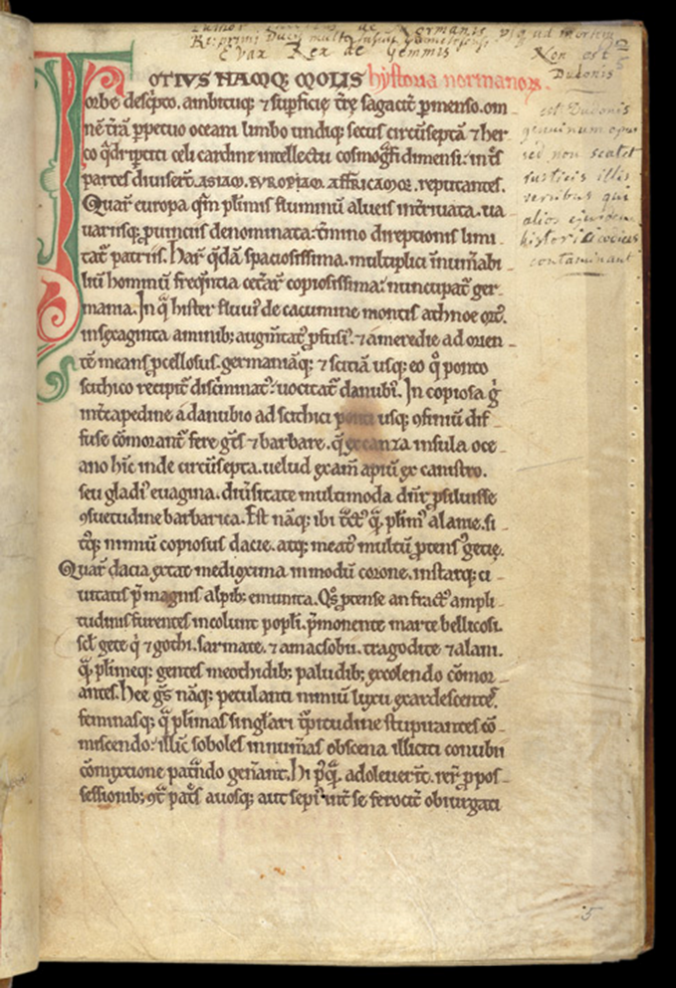
Dudo of St Quentin tells us that during the Norman invasion the French household knights begged the French king:
‘O lord king, we have served you unceasingly and have never received enough, except food and drink. We beg you, drive out and destroy these alien Normans and give us their fiefs and grant us wives’.
Dudo of St Quentin, Historia Normannorum

Slide 4
Debates
Elizabeth Brown: ‘Tyranny of a Construct’
Susan Reynolds (Fiefs and Vassals; Kingdoms and Communities)
Year 1000 debate

Slide 5
Other factors
Role played by the church
Towns and monetary relations
Soldiers paid in cash (mercenaries)
Property rights
Networks of relationships, rather than just vertical or horizontal ties

Slide 6
Feudal characteristics
A subject peasantry
Widespread use of the service tenement (the fief)
A class of specialised warriors
Ties of obedience and protection which bind man to man (called vassalage within the warrior class)
Fragmentation of authority (with an idea of ‘state’)

Slide 7
Should medieval society be analysed in terms of class divisions, or in terms of orders/estates?
Marxist historians (such as Rodney Hilton)
Their critics (such as Mark Bailey)
‘It is social function that mattered most’?

