Slide 1

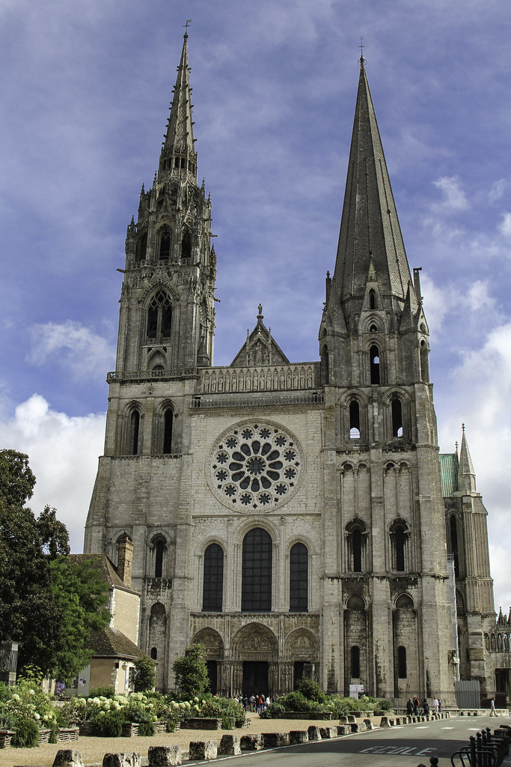
The Medieval Church
Dominant institution
Physical presence
Social & spiritual life
Provided for needy
Cradle to grave
Supernatural power
Intermediary with divine
Major landowner
Latin learning
Determined morality
Presided over by papacy
Chartres cathedral c. 1190-1220

Slide 2
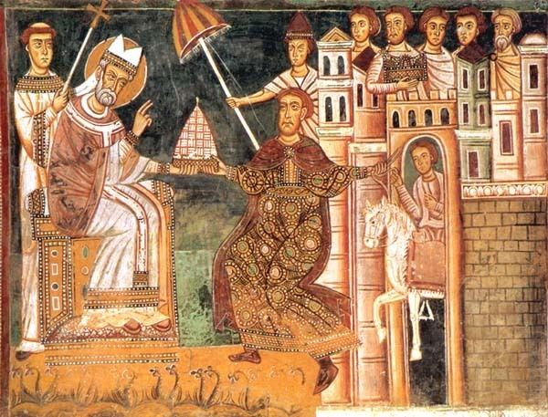
Papal Power & Reform
Pre 950 dominated by Roman nobility
Rome important: heirs of St Peter; pilgrimage site; pallium; Donation of Constantine
990s power over canonisation of saints
C11th Gregorian Reform + monasticism (Cluny)
Crusades
Reassessment of church/state relations
1040s: Emperor Henry III
> depositions & councils
Leo IX (1049-1054) led
reform group > 1049 Council
1059 election by cardinals

Slide 3
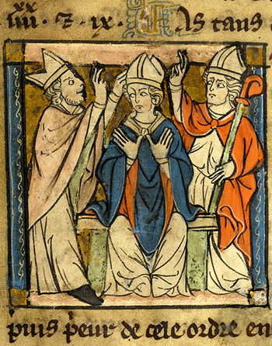
Reform and the ‘Investiture Crisis’ (1046-1123)
Targets of reform
Clerical marriage > celibacy
Simony = purchase of clerical office
Investiture of bishops by secular rulers
‘Libertas ecclesiae’
How to enforce reforms?
Papal representatives (legates) at synods
Papal appointment of bishops
Uniformity on liturgy & practice
Canon law

Slide 4
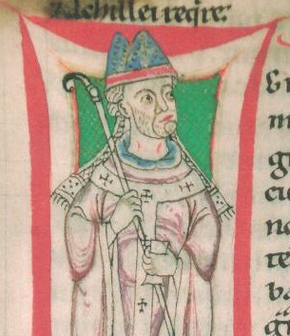
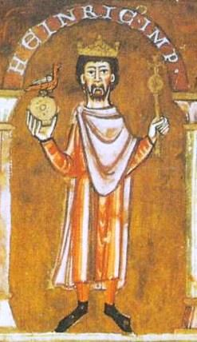
Pope Gregory VII vs Emperor Henry IV
Pope Gregory VII, the Dictatus Papae c. 1075
Supreme control within the church
Only pope can appoint and remove senior clergy
Only pope can issue new laws
Only pope can control Christian warfare
Only those who follow teachings of Roman church = Catholic
Only pope can appoint and depose secular rulers

Slide 5
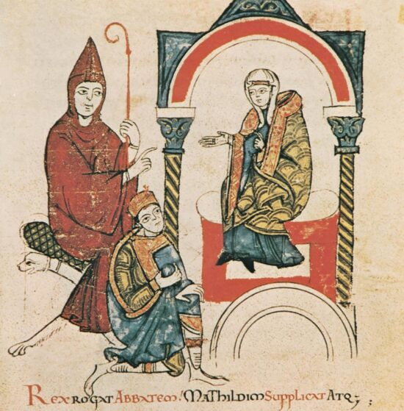
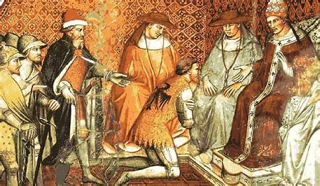
Emperor Henry IV claimed Pope Gregory illegitimate 1075 Excommunicated 1076 Forced to seek papal absolution at Canossa, 1077 Excommunicated again 1080 Not resolved until Concordat of Worms in 1122
Henry IV with Countess Matilda & abbot of Cluny

Slide 6
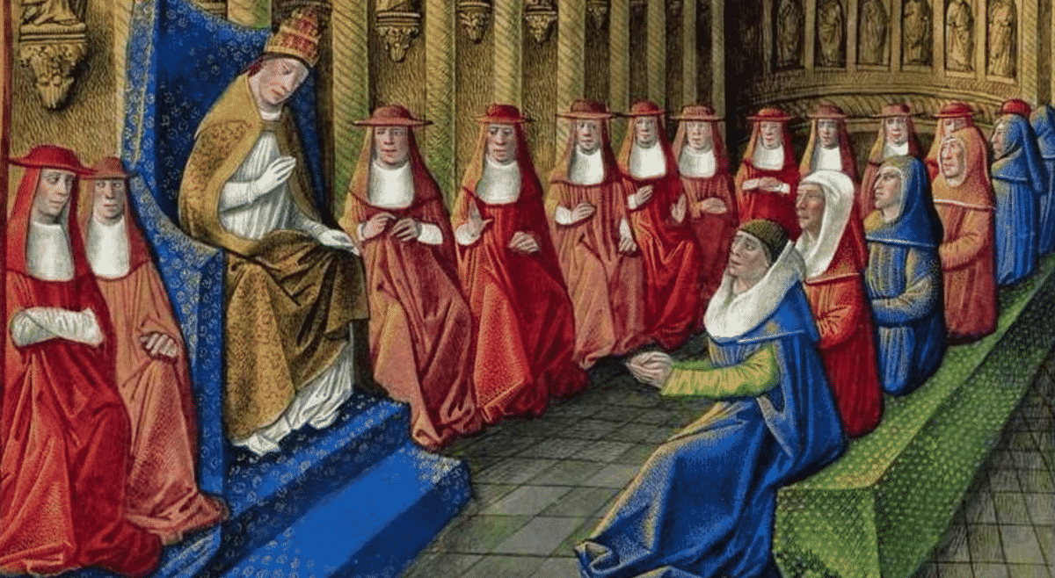
Expansion of Papal Authority (1124-1198)
Sovereign state + law, legates, councils
Cardinals powerful: as legates; ⅔ elect pope from 1179
Papal Curia: conducted business
Canon Law: Gratian of Bologna c. 1140
Crusade Tax: from 1190s
Revenue
Cistercians

Slide 7
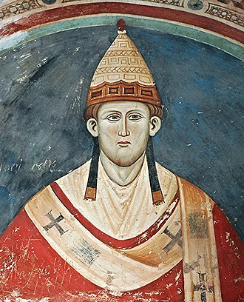
The Papacy at the Peak of its Power (1198-1303)
Innocent III (1198-1216)
4 crusades (inc. Albigensian)
4th Lateran Council 1215:
regulated sacraments
The Friars:
Franciscans & Dominicans
Universities: papal charters
Papal Curia & Canon Law
continued to expand
Papal states
Increasing power over + taxes

Slide 8
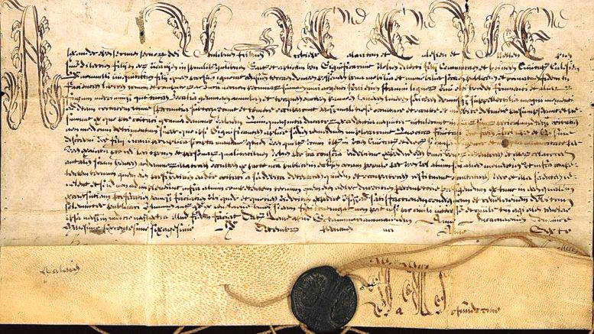
Rise and Fall: Boniface VIII (1294-1303)
1302 Boniface VIII issued the bull Unam sanctam which declared that, ‘...it is necessary for the salvation of every human soul to be subject to the pope.’
1303, Philip the Fair of France charged Boniface VIII as unfit pope & sent army into Italy to seize him. > Avignon papacy (1305)
Culmination of tensions between papacy & lay rulers

Slide 9
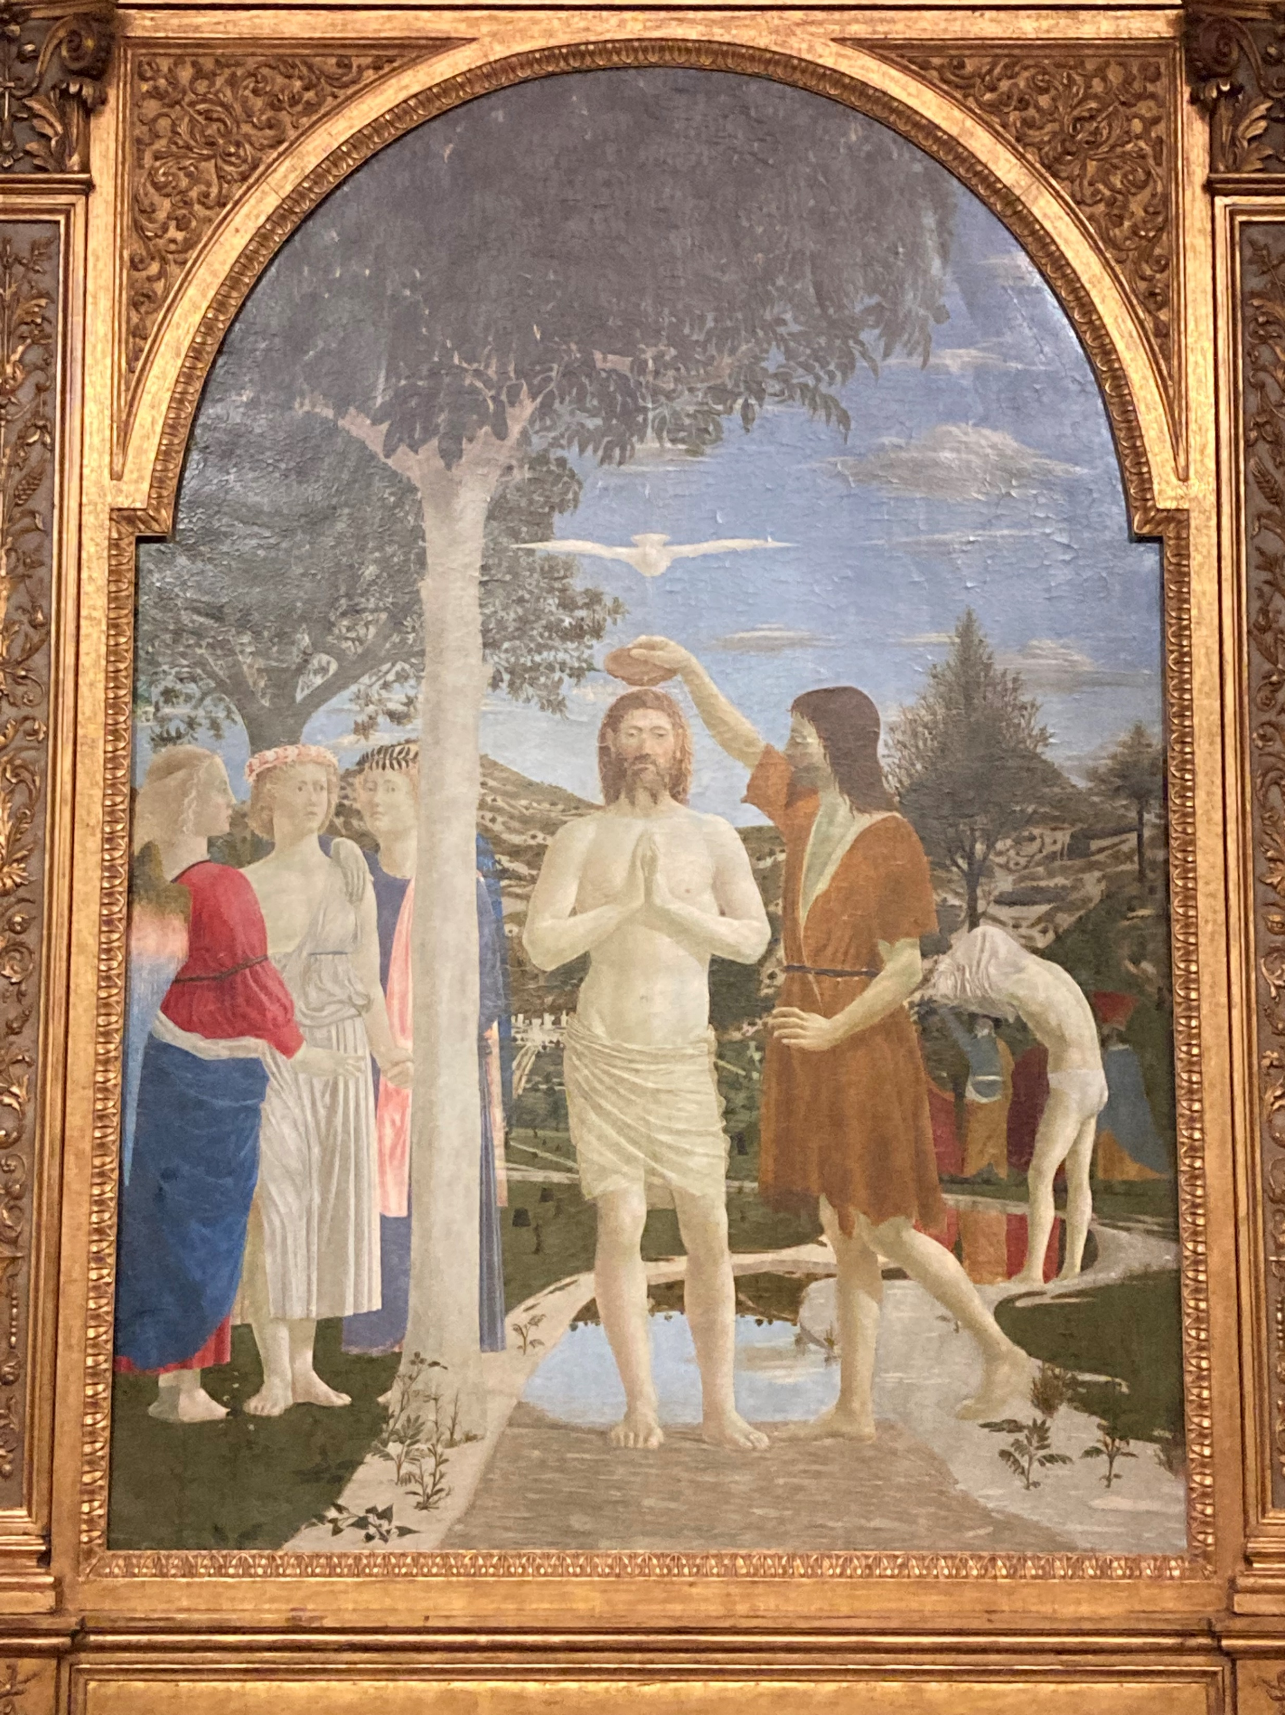
The Seven Sacraments
Peter Lombard (c.1096-1160):
baptism: salvation vs sin
confirmation: Holy Spirit
Eucharist: transubstantiation
(1215: confession & communion once a year at Easter)
penance e.g. Henry II
ordination: for clergy
marriage: increasing control
extreme unction (last rites)
Piero della Francesca

Slide 10
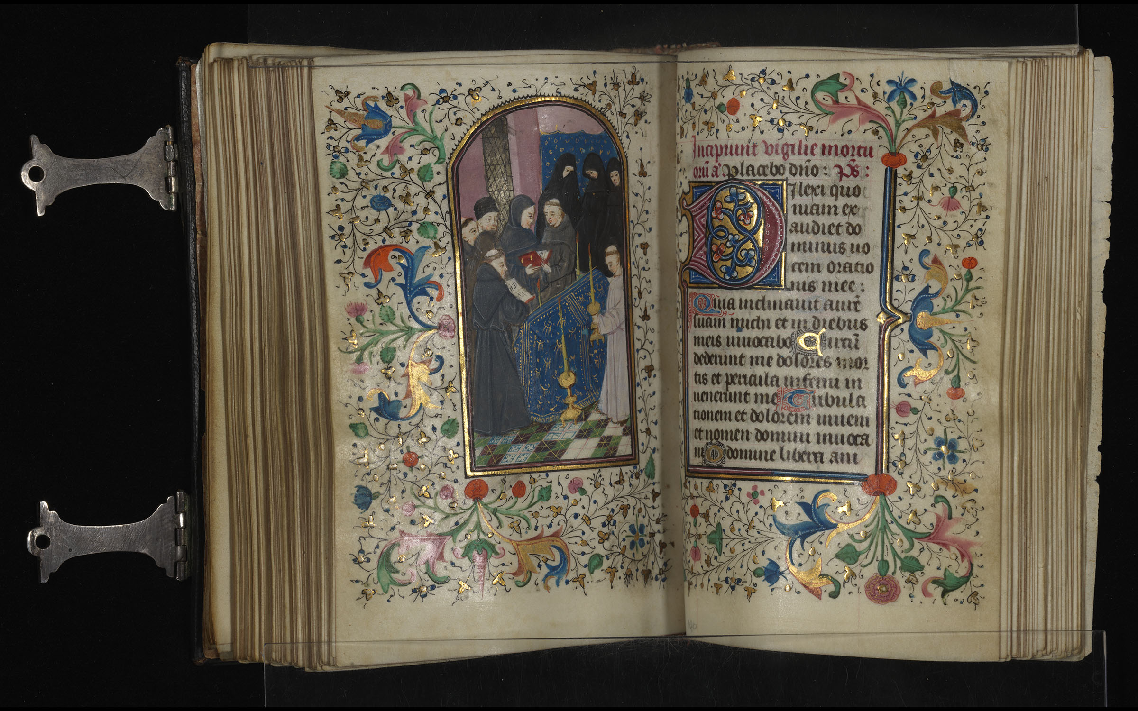
Reading the Medieval Bible
Accessible only to minority: low literacy
Few complete texts
Expensive to produce
Reliance on lectionaries & on clergy
Limited translation from Latin: concerns re heresy i.e. C12th Cathars;
C13th, 1st complete in French; C14th in other languages; Wycliffe & Lollards

Slide 11
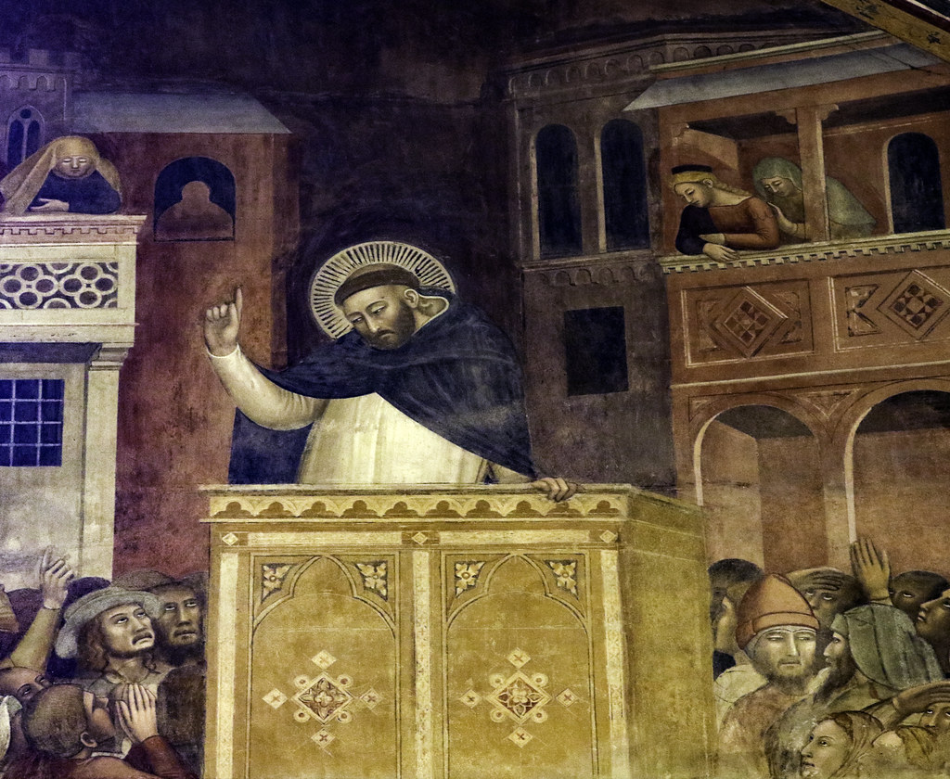
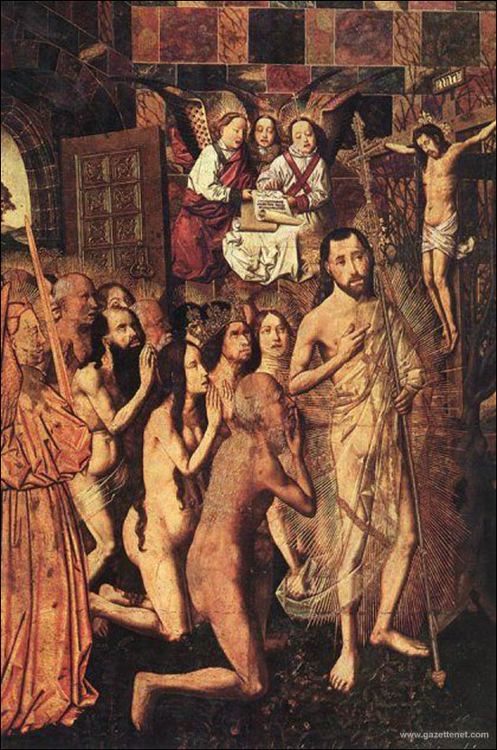
Combatting unorthodox opinions
Preaching
1095 & First Crusade
C12th: reforms, crusades, heresy
C13th: Franciscans & Dominicans
Improve lay religious instruction
Catechisms = manuals
Liturgy: St Thomas Aquinas
Ceremonies e.g. crib
Art: crucifixion; Virgin & child (incarnation);
Doom paintings
Drama e.g. mystery plays

Slide 12
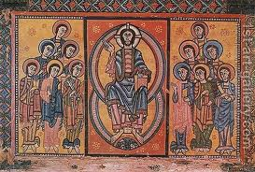
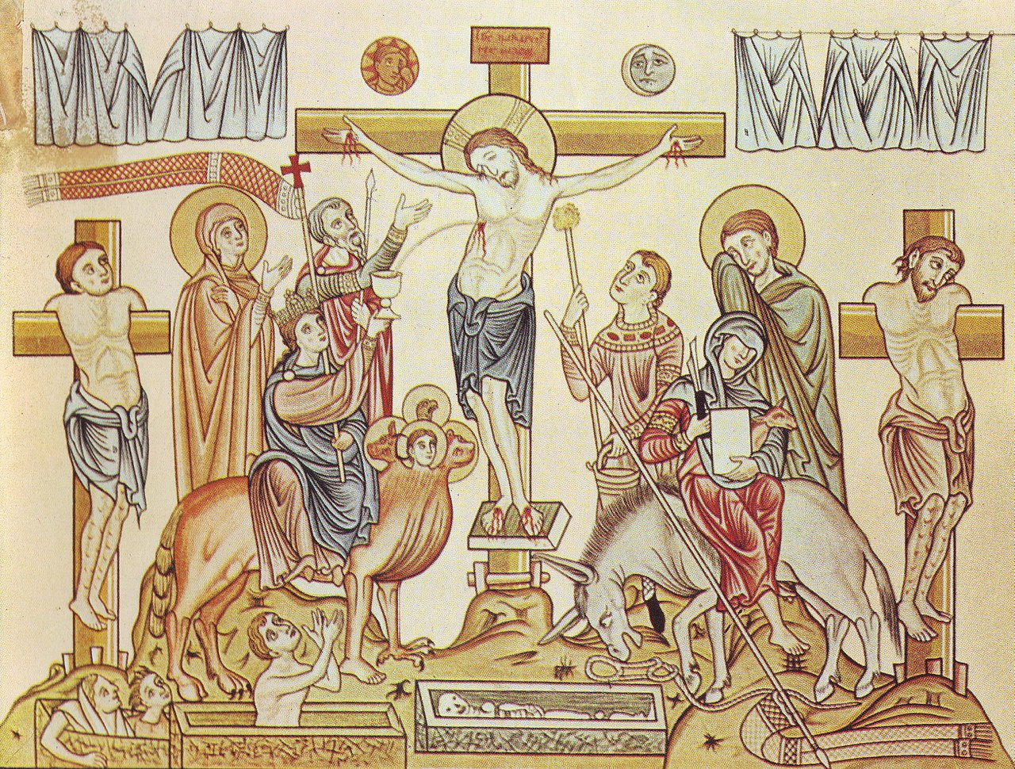
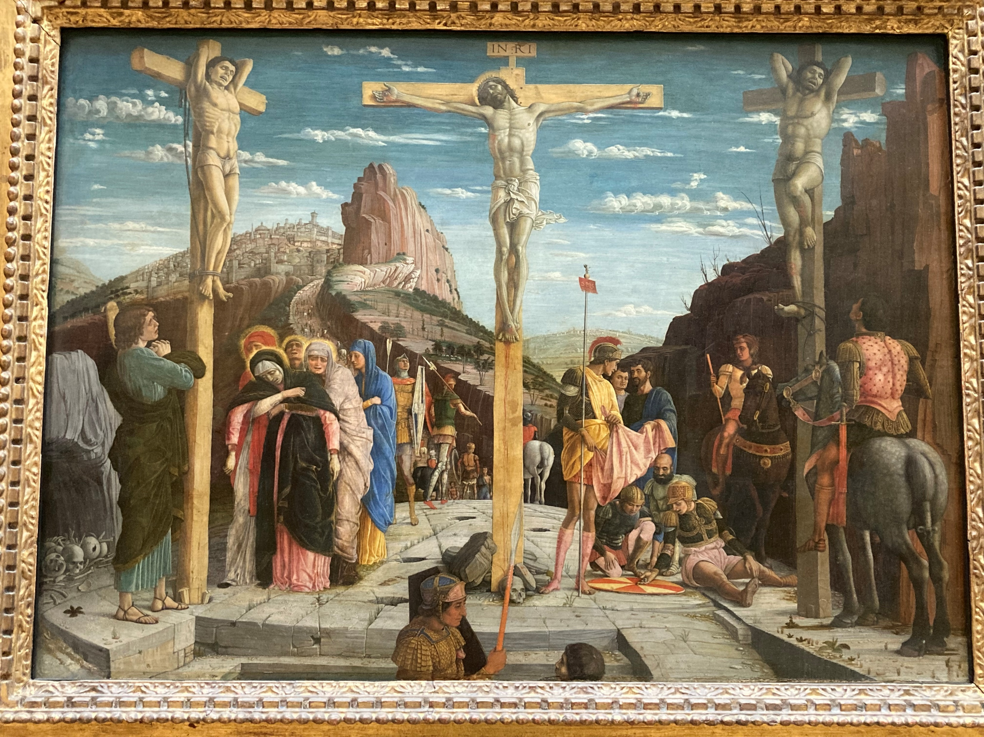
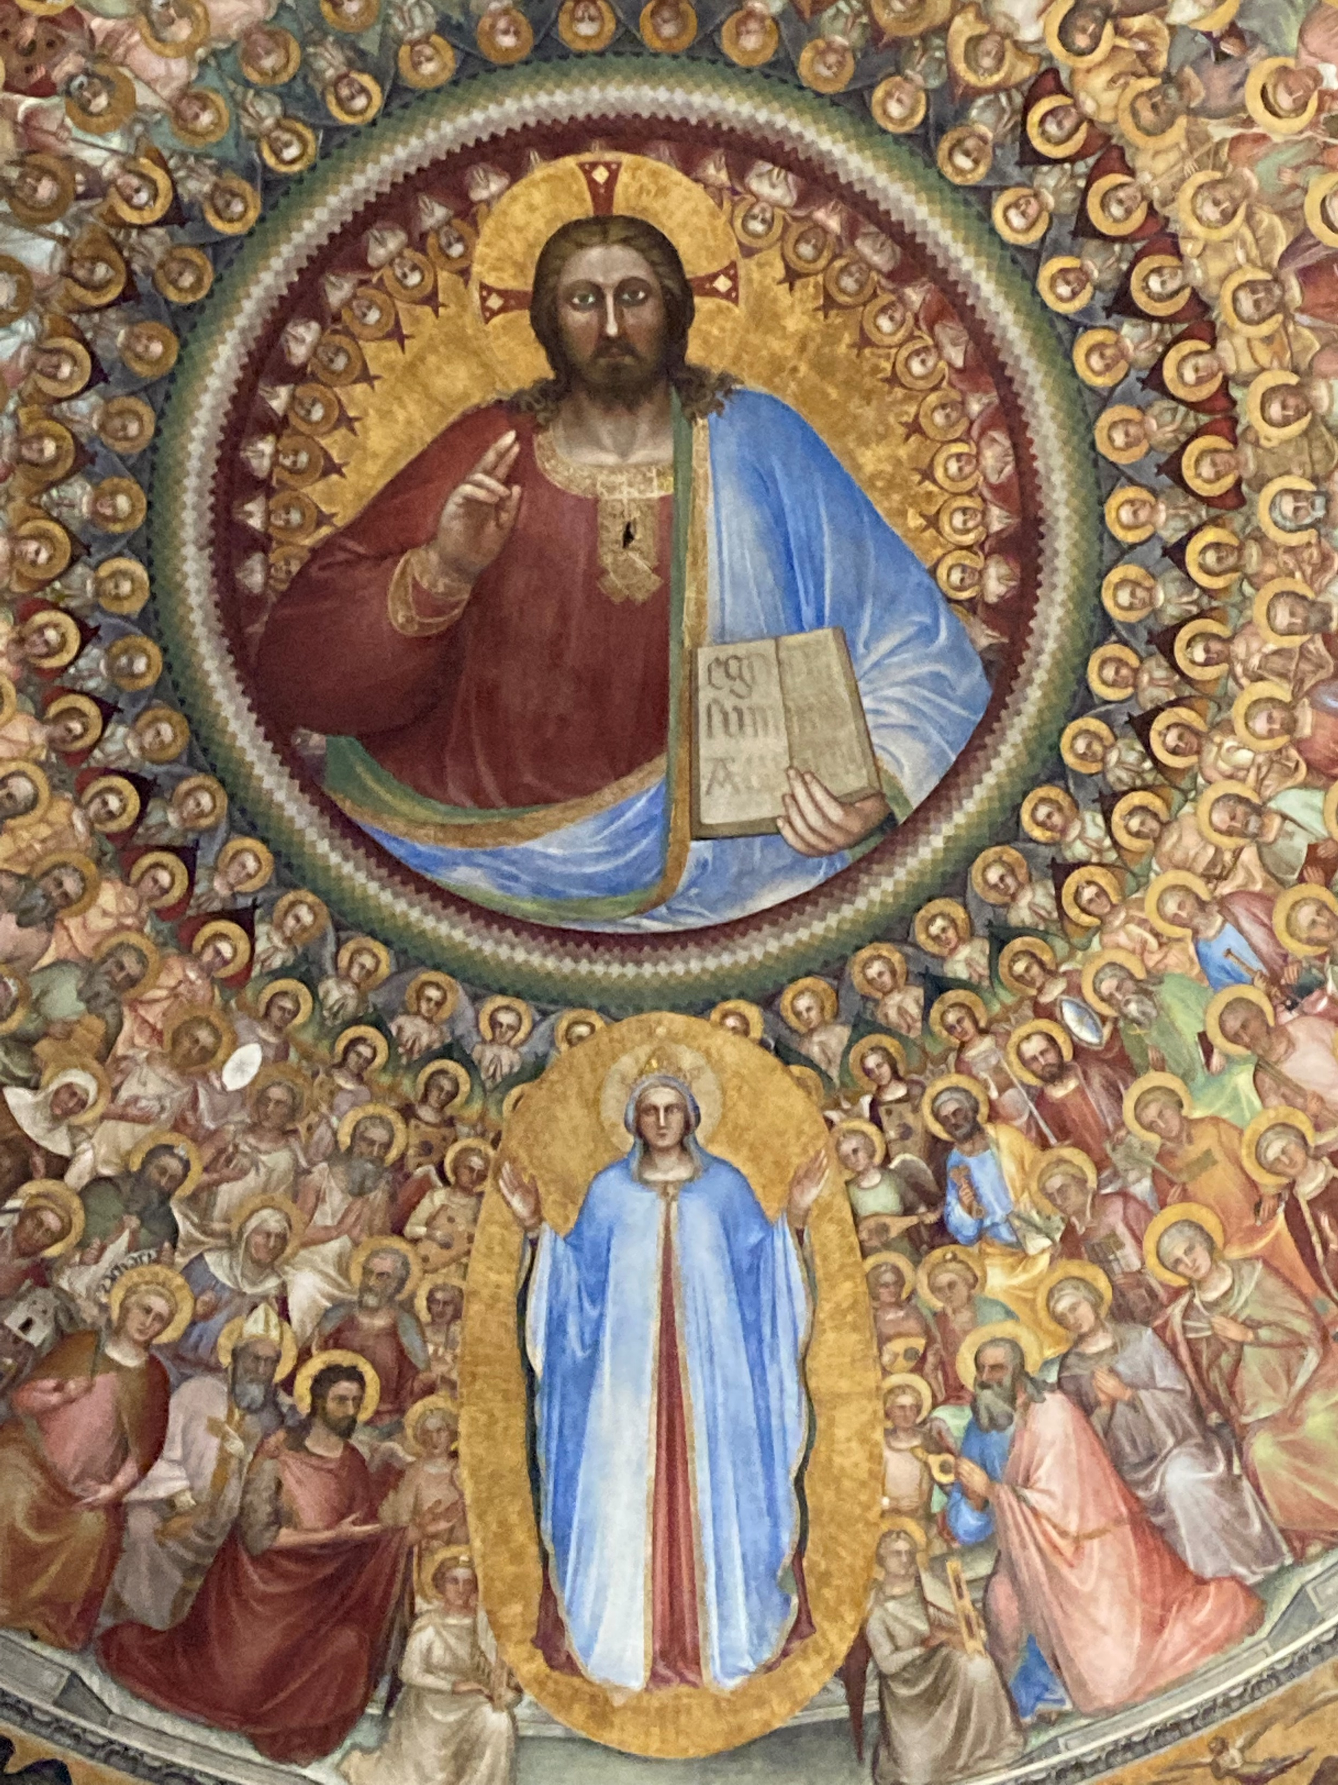
Changing images of Christ & crucifixion

Slide 13
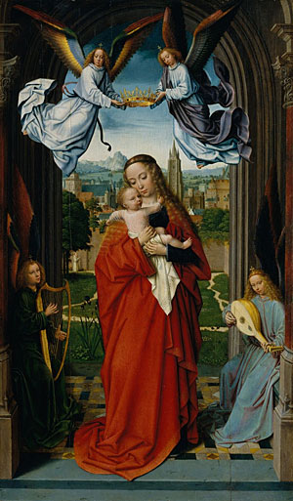
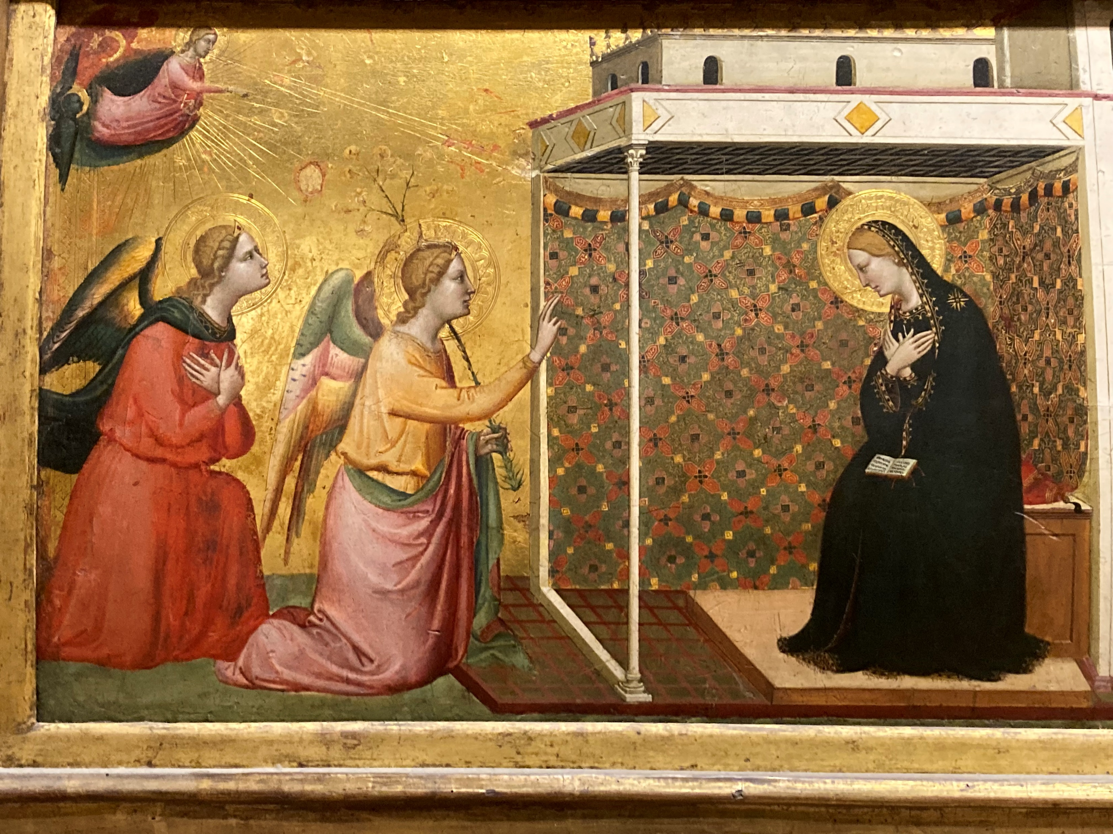
Annunciation and Virgin & child

Slide 14
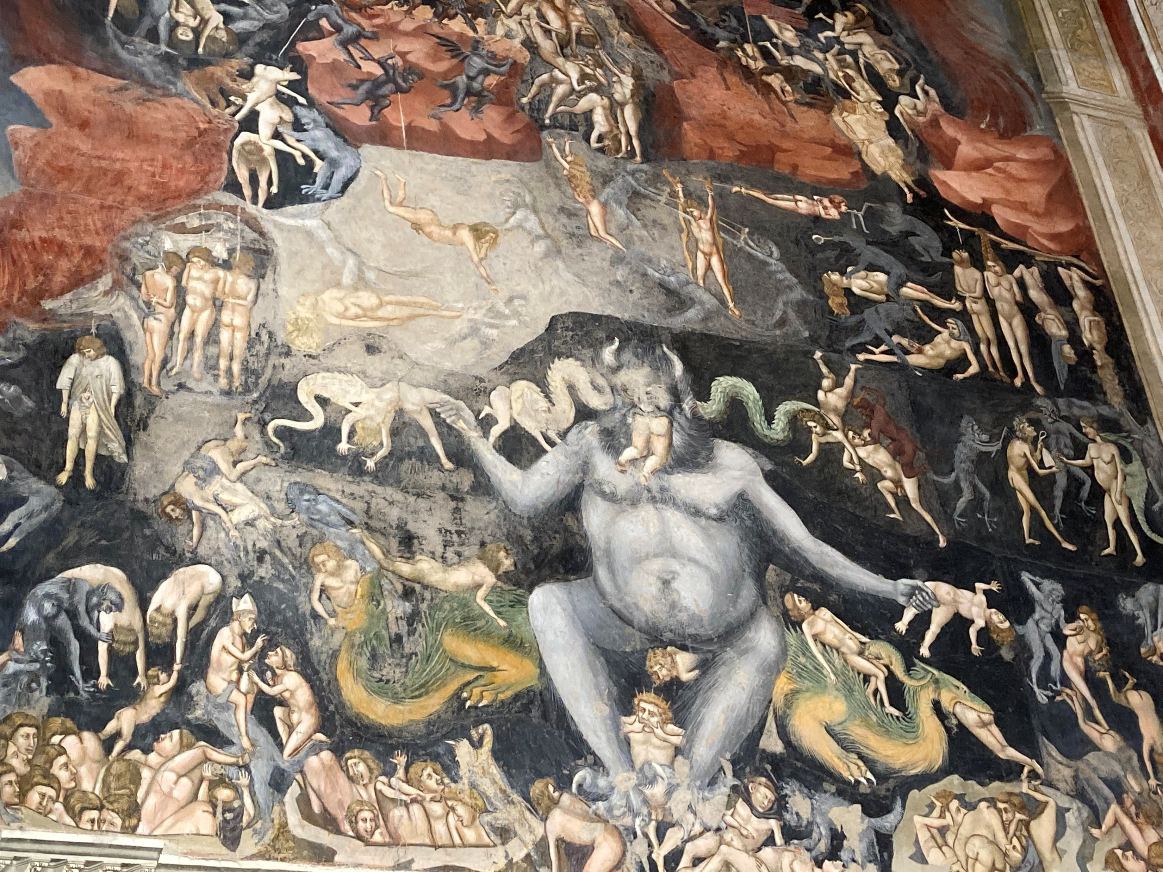
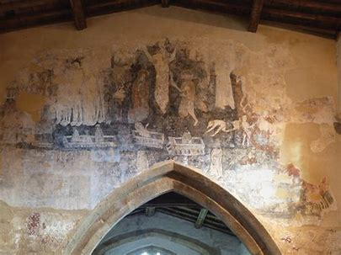
Hell, Last Judgement & Doom Frescoes

Slide 15
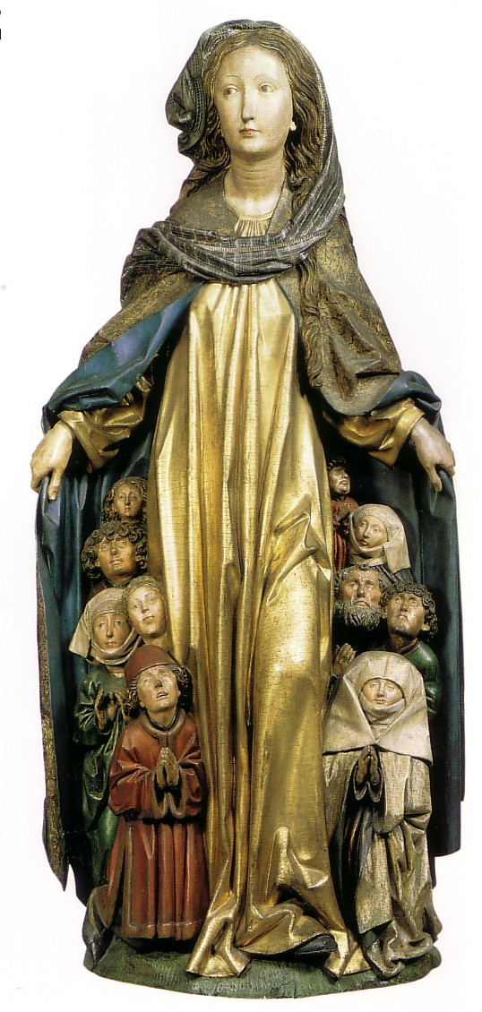
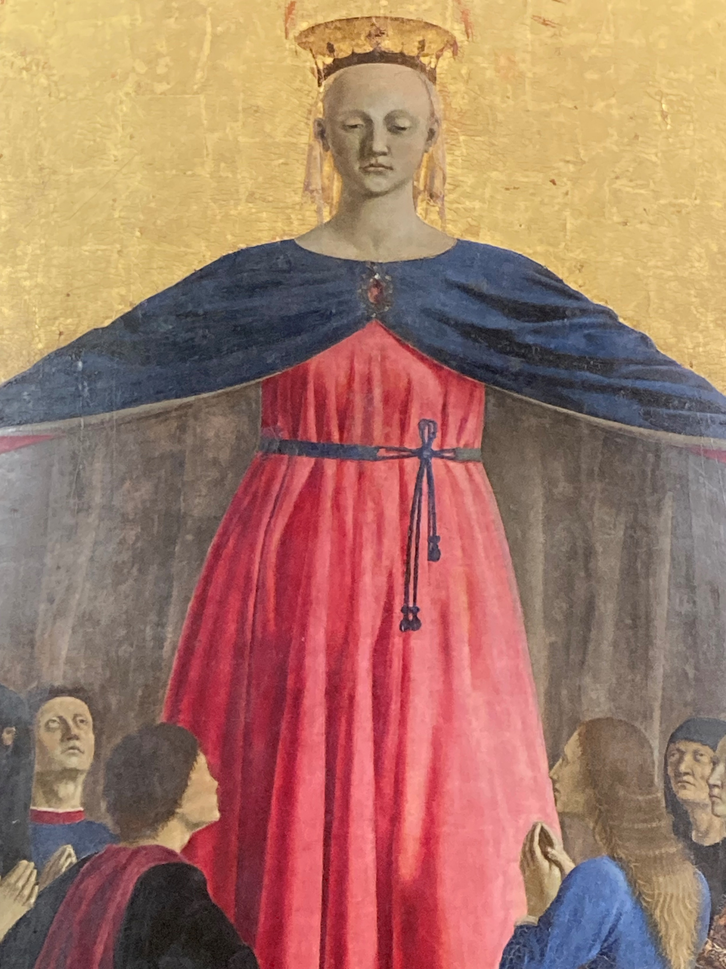
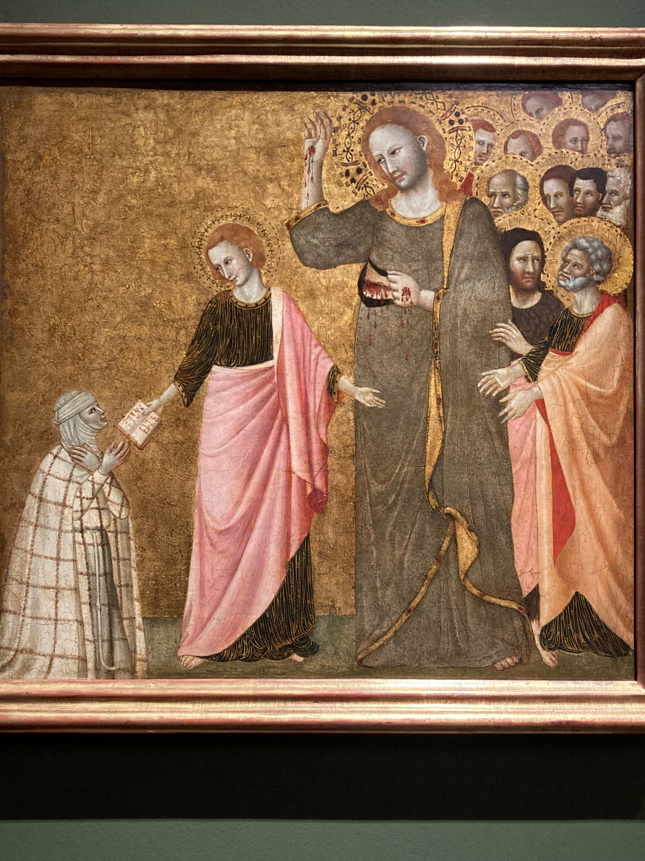
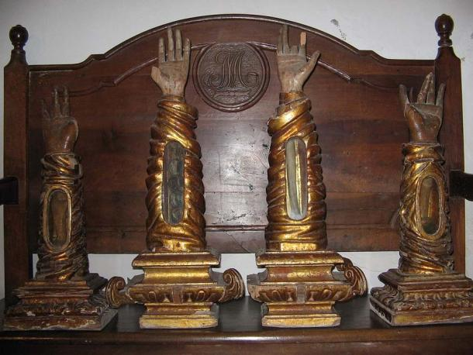
Forms of popular devotion
Votive masses
Blessing rituals
Cult of the saints
Cult of relics
Pilgrimages

Slide 16
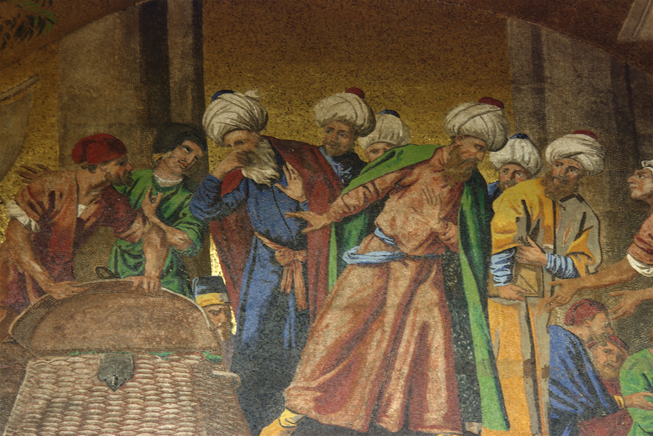
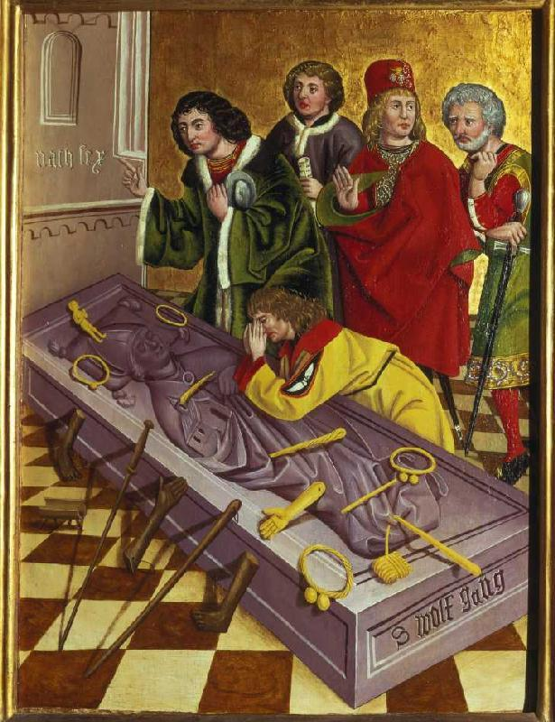
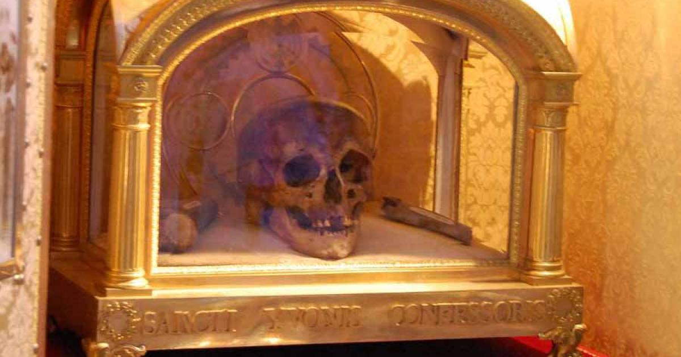
Cult of Relics
Translation of St Mark’s Relics to Venice 828

Slide 17
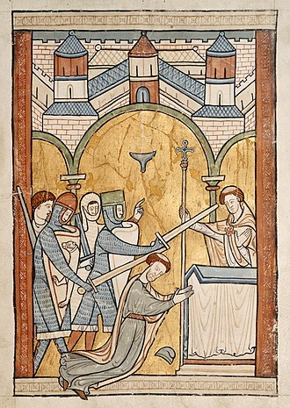
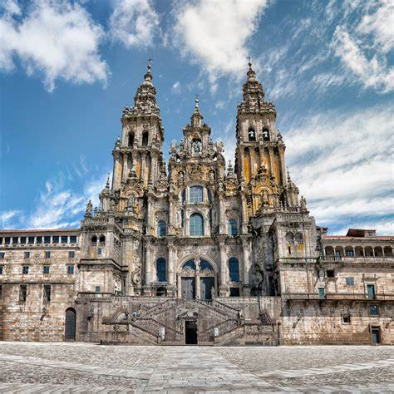
Pilgrimage
Jerusalem & Holy Land
Rome: 1300 Jubilee
Santiago de Compostela: St James
Canterbury: Thomas Becket
Cologne: Three Kings
Thomas Becket, murdered 1170;
canonised 1173

