Slide 1

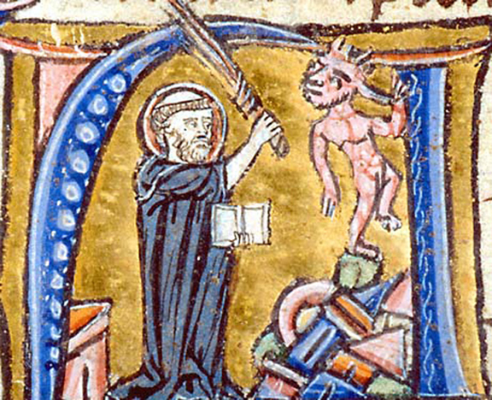
Saints and Heretics:
Friars and Cathars
Lecture 5

Slide 2
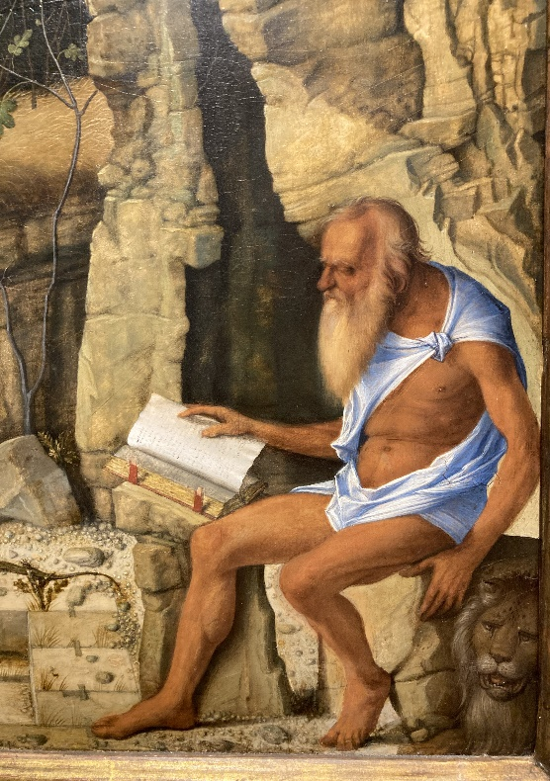
Medieval Monasticism
Monk from ‘monos’ = ‘one’ or ‘alone’
C3rd-C5th hermits e.g. Stylites, saints
Anthony & Jerome in deserts of east
Rule of Saint Benedict (480-547)
at Montecassino in Italy > monopoly C9th-C11th
e.g. Cluny in northern France
‘New’ monastic orders, C11th-C13th:
Cistercians (Benedictine rule), Bernard of Clairvaux (1115-1153); Carthusians; Premonstratensian and Augustinian canons (in towns); Templars & Hospitallers (military orders)
Friars/mendicant orders, C13th: Franciscans (grey, 1209) and Dominicans (black, 1215); also Beguines (lay women):
characterised by calls to a return to apostolic simplicity (emphasis on piety and poverty)
opposition to institutional powers of lay authorities and bishops

Slide 3
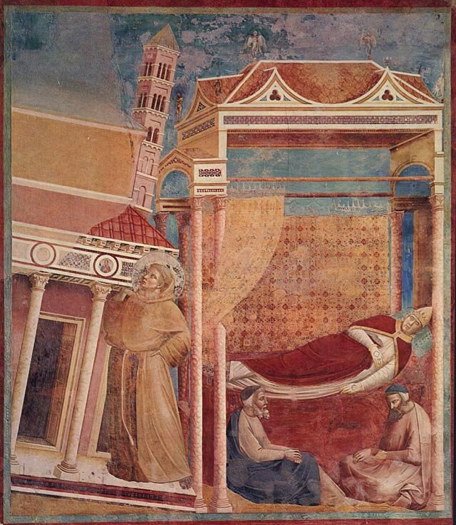
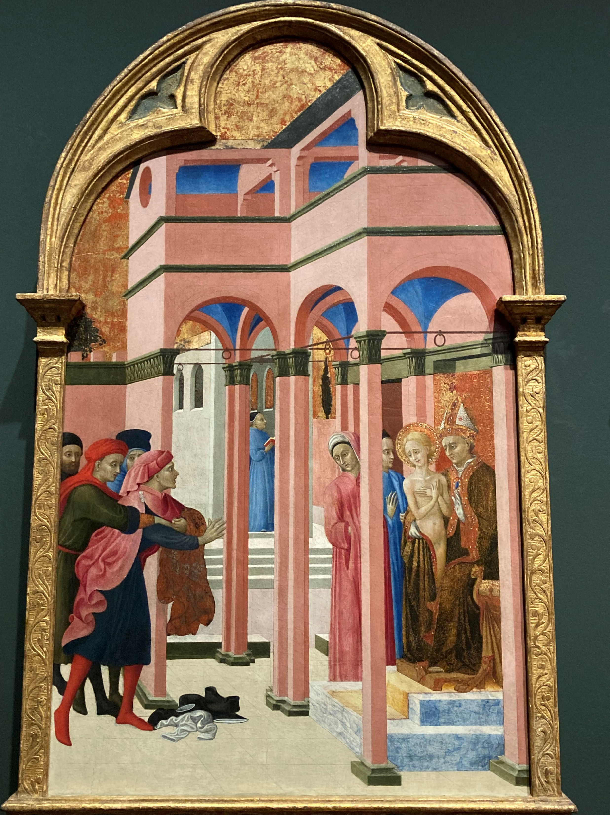
Papal Protection crucial
Innocent III’s dream > support for Francis & followers

Slide 4
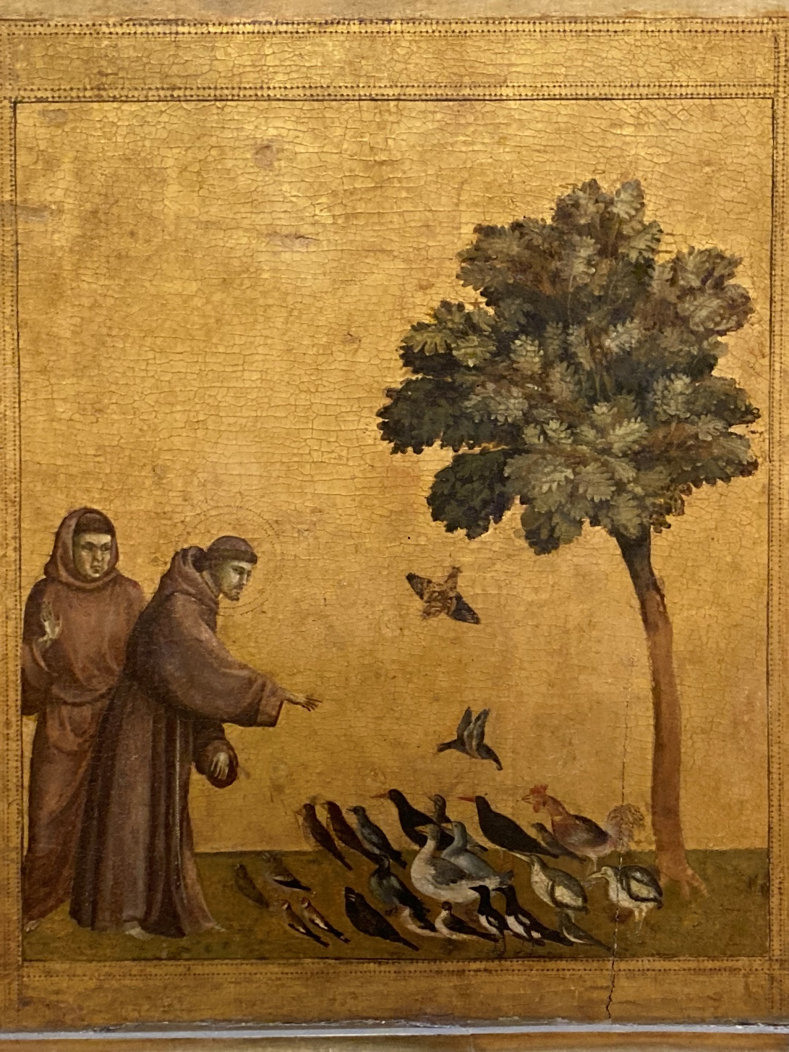
St Francis of Assisi (1181-1226)
protected and nurtured by the papacy from 1209
primitive rule 1210
emphasis on poverty,
humility & obedience = wandering friars
‘Poor Clares’ (1212)
cf Waldensians & Humiliati of 1170s/80s
Spain (1213-14)
Holy Land (1218-19)
provincial structure 1217, focus in Italy

Slide 5
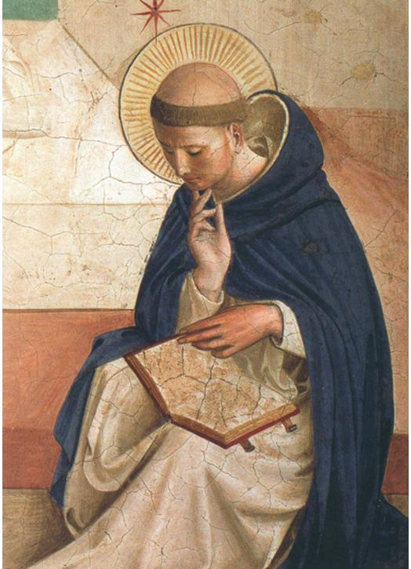
St Dominic (1170-1221)
Spanish Augustinian > active in southern France 1205
Formal sanction only 1215
emphasis on preaching to combat heresy > inquisitors
Education: learned order based in university towns of Paris & Bologna (1218)
Thomas Aquinas (1226-74)
Organisation: annual General chapter (1220), complete by 1228 cf Franciscan (1260)
Only 600 houses cf 1400 Franciscan by C14th

Slide 6
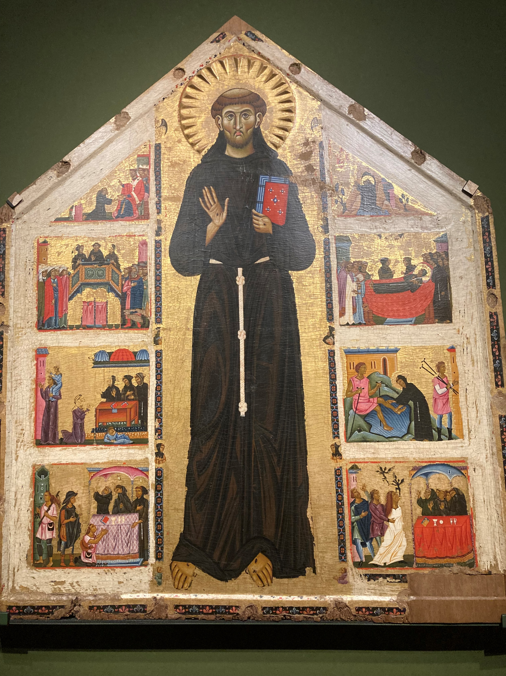
Franciscan problems & tensions
Relationship between minister general & general chapter
Resolved only by St Bonaventure (1257-73)
Emphasis on poverty > split between Observants & Conventuals (Spirituals or Fraticelli = condemned as heretics)

Slide 7
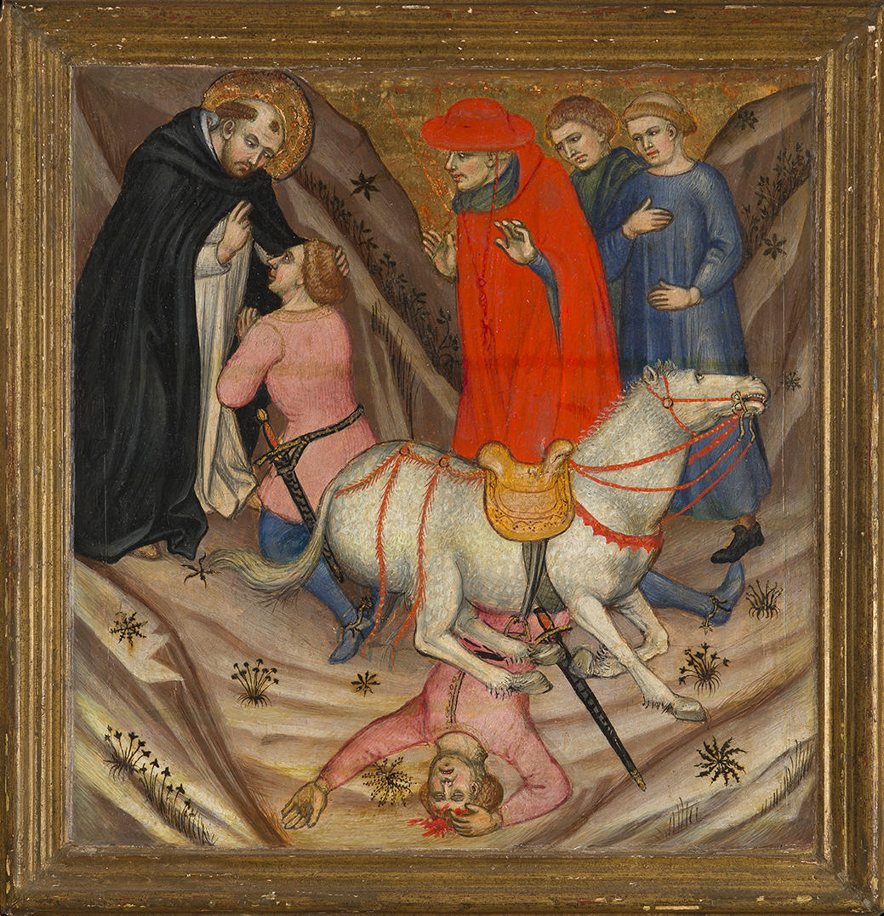
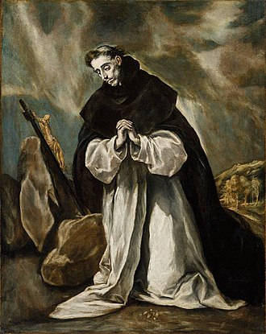
Success of Friars
Urban movement e.g. Franciscans in Umbria & Tuscany
Spiritual enthusiasm vs wealth
Filled religious gap at time of growing dissatisfaction
Chief role in combatting heresy
Product of same factors that encouraged heresy

Slide 8
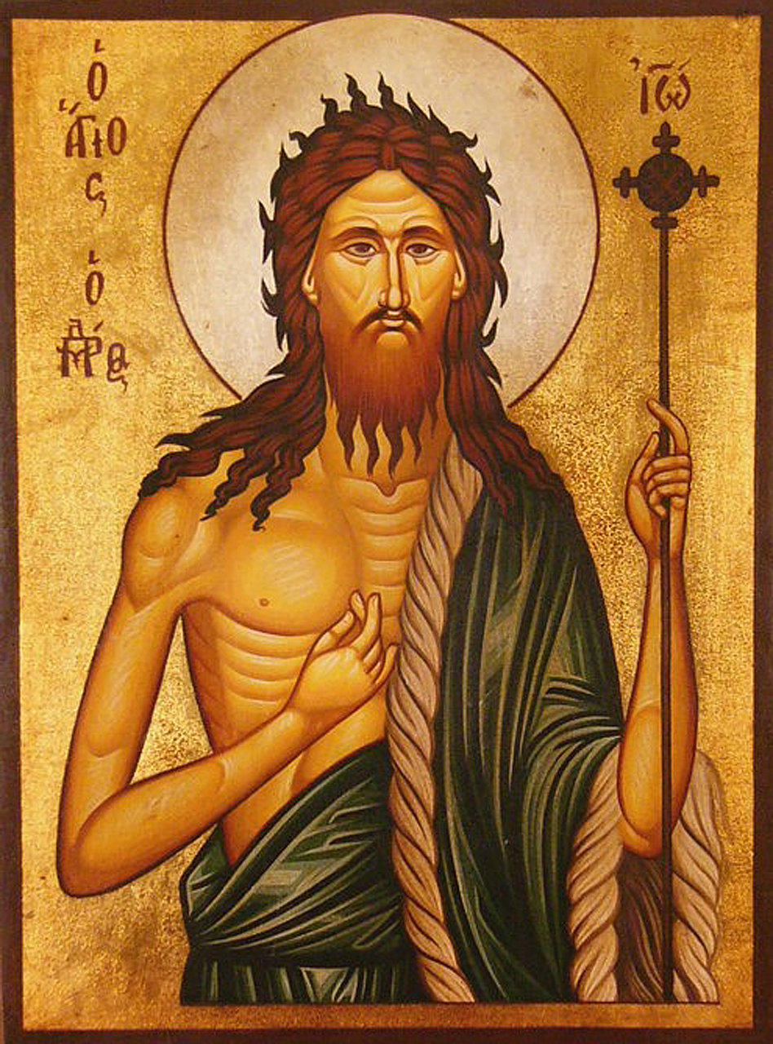
Heresy: early period c.600-1050
Individual preachers or small groups cf friars
Moore: ‘wandering preachers, men of wild aspect, conspicuous poverty and ferocious language’
1090s: Robert of Arbrissel, ‘clad in skins, barefoot, with staring eyes and unkempt hair’ > found abbey
of Fontevraud = double monastery
cf John the Baptist
No coherent theological challenge,
but ‘puritanical enthusiasm’
Anticlerical (anti-sacerdotalism)
Failure of church to communicate

Slide 9
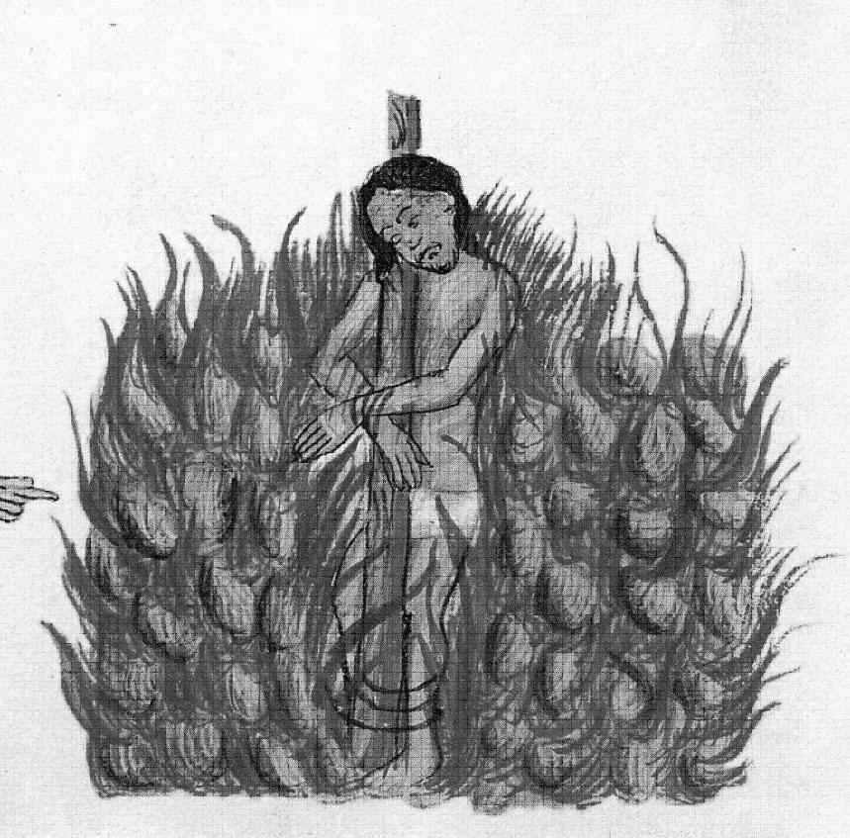
1050 to 12th century: Semi-heretical groups
Gregorian & monastic reform > combat for a time
Tanchelm of Antwerp (c.1110-1115): highly anti-clerical preacher in Netherlands
Role in marriage criticised: Henry of Lausanne (Le Mans, 1116)
Inadequate clergy:
distanced from laity
Latin services
little preaching
friars (& heretics) filled void

Slide 10
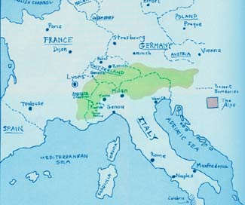
Waldensianism:
Peter Waldo or Waldes (c.1140-c.1205)
Emphasis on poverty: followers 'Poor
of Lyon/Lombardy’ or ‘Poor of God’
Vernacular translation of Gospels
Emphasis on preaching
Strict adherence to Bible
rejected swearing of oaths, denied existence of purgatory, immoral priests vs sacramental miracles, against violence, against worship of saints
Condemned by 4th Lateran Council 1215 but survived
Influence on Protestant Reformation?

Slide 11
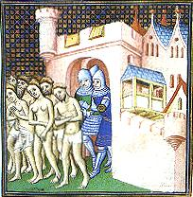
Cathar heresy
Cathar= pure in Greek
Northern Italy & southern France: 1160s
a dualist heresy: good & evil
Christ exists only in the spirit world
vs incarnation
devil behind all creation: sex & reproduction bad
vs prayers, the church, saints, relics, sacraments, trinity
Perfecti cf priests: administered consolamentum; celibate & vegan
Success in Languedoc due to social & political context
Historians dispute degree of coherence (shaped by inquisition) vs scattered beliefs

Slide 12
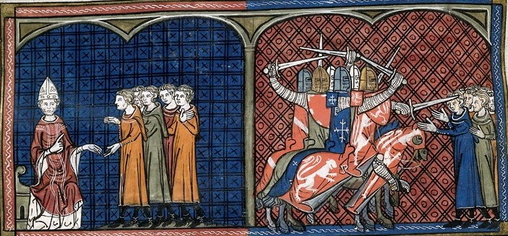
Pope Innocent III (1198-1216) launched the Albigensian Crusade (1208-09)
Armies led by Simon de Monfort entered the Languedoc in June 1209
Beziers fell; Narbonne and Carcassonne surrendered
Northerners took over lands of local aristocracy
Peace of Paris (1229)

Slide 13
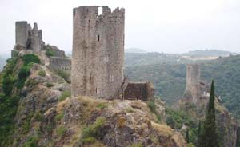
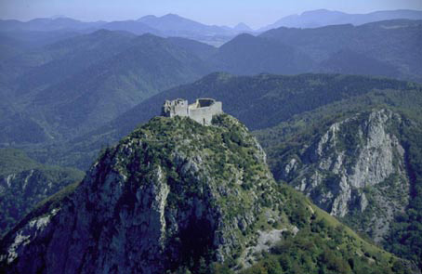
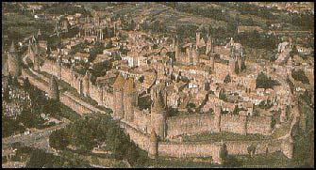
Cathar territories in Languedoc: heavily militarised & fortified

Slide 14
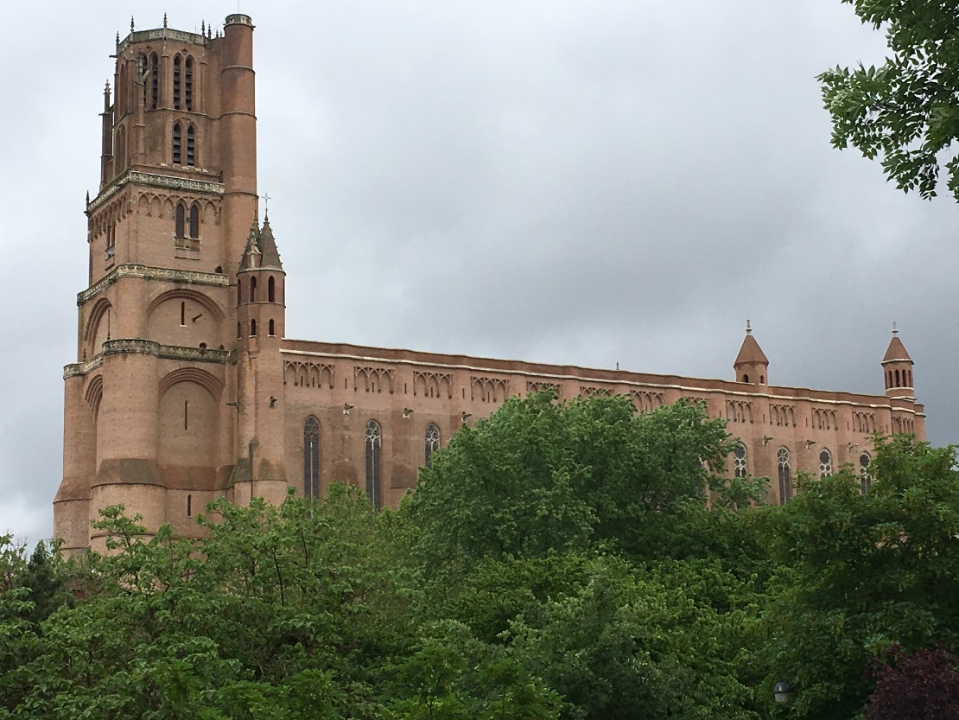
Consequences of Albigensian Crusade
French crown achieved political control over Languedoc
Heresy far from eliminated
Foundation of inquisition (1230s): check vs destroy
University of Toulouse (1229)
Cathedral at Albi (1282)
Friars decline too
Institutionalised
Criticised by Chaucer
New heresies emerge

Slide 15
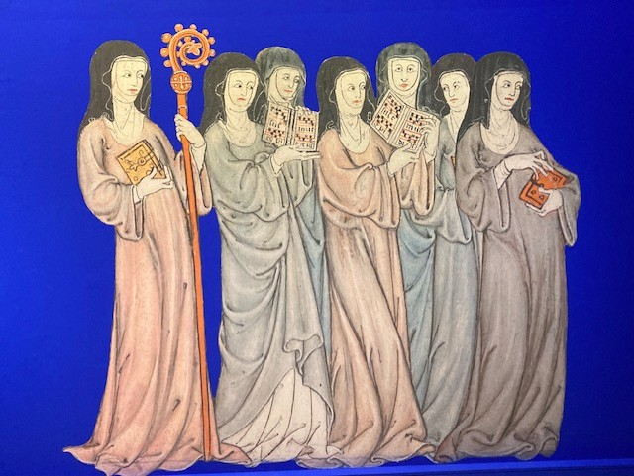
Female saints and heretics
Church even more nervous about women
Some saints: Clare of Assisi & Catherine of Siena (1347-80)
Anchoresses e.g. Julian of Norwich (c.1343-c.1416)
Others more problematic e.g. Joan of Arc (d.1431), Margery Kempe (c.1373-c.1438), Marguerite Porete (d.1310)
Some heresies allowed women to preach
Medieval Women in their Own Words exhibition at the British Library

