Slide 1
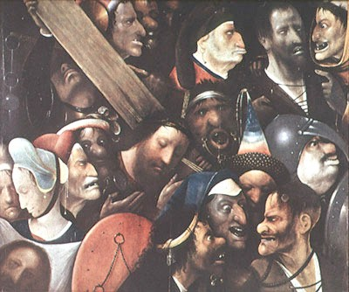
The (Religious, Social & Political) ‘Other’
Prejudice, persecution and prosecution common to all societies
vs those identify as suspect & threatening as differ from established norms
> marginalisation, ostracization or active persecution & prosecution
Common stereotypes: sexual depravity, criminality and other anti-social behaviour
Plus metaphors of sin, pollution and disease
E.g. from early Christians through heretical groups and other religious minorities accused of orgies, ritual violence and abuse of mainstream faith
Jews and witches faced similar accusations
= direct threat to respectable, law-abiding Christian society, even actively plotting against
Treatment of marginal groups as reflection of values and attitudes of societies
Hieronymus Bosch, Christ carrying the Cross c. 1500

Slide 2
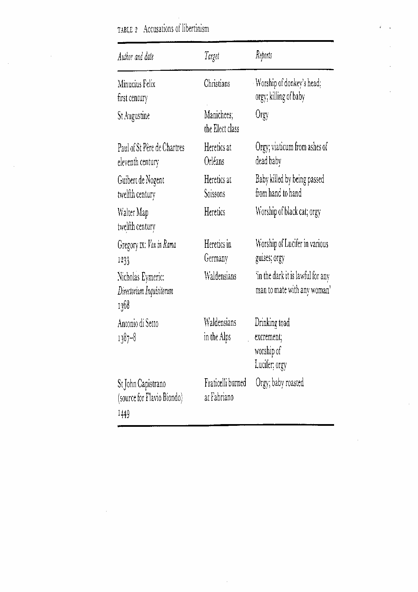
Standard Accusations vs Deviant Groups (from Malcolm Lambert, Medieval Heresy (1992), p. 166)

Slide 3
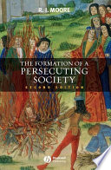
Moore: Persecuting Societies
C11th and C12th: (re)emergence (& persistence thereafter) of persecuting society primarily vs heretics, Jews & lepers
Significant undergoing major social, economic & political transformation generating anxiety (cf C14th or C16th?)
Durkheim: exclusion of those who violated norms, ‘otherness’ reinforced unity
Role of agents, authorities, law enforcers, inquisition & courts
Weberian: legal and bureaucratic regimes of period initiating persecution to consolidate own authority & power
Strengthening of Church & authority of papacy with Reform of C11th, + canon law & papal court, launch of crusades etc
Cf growth in embryonic nation states like England & France in C12th & C13th
Urbanisation: groups more visible in towns e.g. Jews, > regulation
Critics e.g. Nirenberg, Communities of Violence (1996): more specifics of time and place. Violence everyday low-key social norm interdependent with toleration. Integrated minorities at centre not margins, coexistence & agency
Cf C14th Aragon & southern France = demonstrating differences of approach: Aragon more restrained & tolerant, same stereotypes but different response

Slide 4
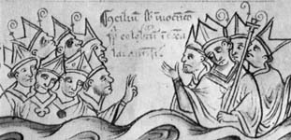
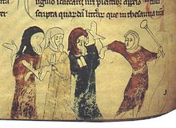
Fourth Lateran Council 1215 & 1321 Conspiracy
Council regulated Christian relations with & treatment of Jews, Muslims etc, sanctioned friars & established Inquisition vs heresy (later in Spain (1478) = instrument of state, focused on lapsed converts from Judaism and Islam)
Increasing violence against & expulsion of Jews: England (1290), France (1306 & 1394); cf Spanish monarchy in C15th as consolidated power by eliminating Muslim threat in Reconquest
Legislation to deal with unacceptable groups & behaviour to be tried in variety of ecclesiastical and secular courts
1321: supposed conspiracy by lepers to poison wells in French communities, aided and abetted by Jews & Muslims
Jews as reps of encroaching royal power & justice, expelled then readmitted & reclaim unpaid debts; defiance vs crown
Aragon vs ‘foreigners’ esp Genoese, as well as leper houses and Muslims rather than native Jews
Areas of tension = conversion, money-lending, processions & sexual liaisons between groups (miscegenation); ‘measured’ violence of Holy Week riots

Slide 5
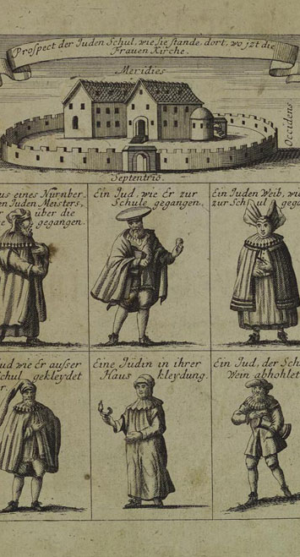
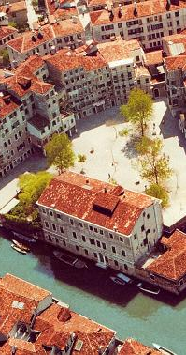
Toleration of Jews
Spread throughout Europe: relatively well integrated socially and culturally, despite expulsions, especially in Italy & Iberia, Germany & Poland-Lithuania (extensive privileges)
Official policy: practice religion but restricted dress/badged & kept separate
Allowed own courts & councils
Expectation conversion necessary prerequisite to 2nd coming (but few conversions until forced)
Valued by authorities not just as money-lenders, but doctors, traders, scholars…
BUT
Increasing exclusion & confinement (eventually > ghetto of C16th Venice)
Events such as Crusades & Black Death exacerbated role as scapegoats > violence
Other episodes linked to economic resentments e.g. 1321 in southern France & 1390s pogroms in Spain

Slide 6
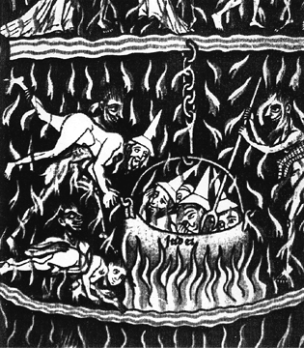
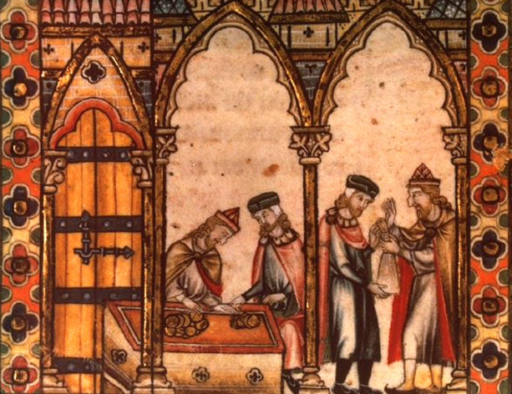
Reinforcement of Stereotypes: Jews burning in Hell and acting as money-lenders (note distinctive hats & noses)

Slide 7
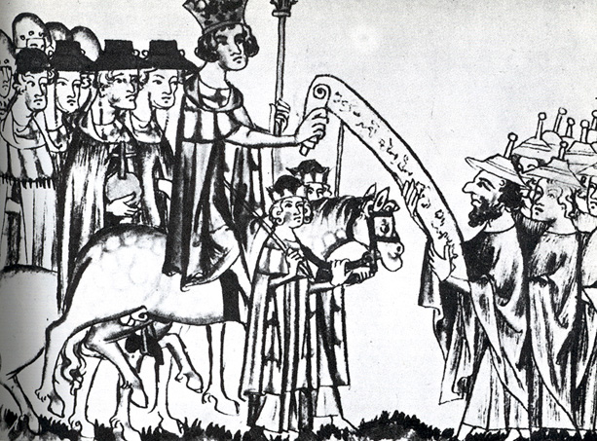
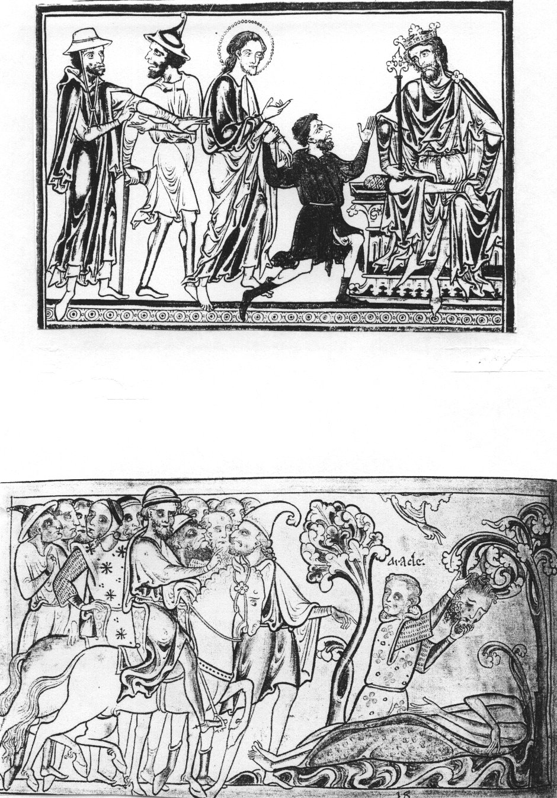
Official protection of Jews (& lepers): double-edged
Resentment: linked with opposition to authorities because privileges & role as tax-collectors & money-lenders
Vulnerable to removal of that protection e.g. in France > expulsion & readmission (removal of debts)

Slide 8
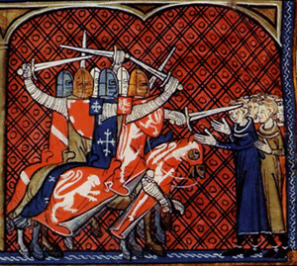
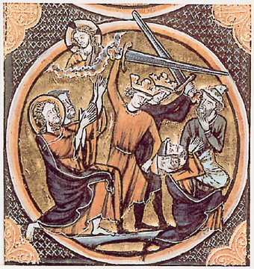
Increased use of Violence against Religious Minorities
Sporadic outbursts of violence against Jews e.g. notorious mass suicide in Lincoln’s Tower, York in 1190; Albigensian crusades (1209-29) & Spanish pogroms of 1390s

Slide 9
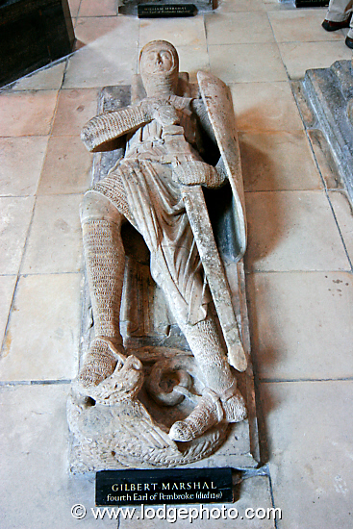
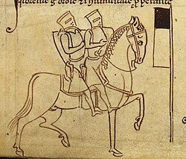
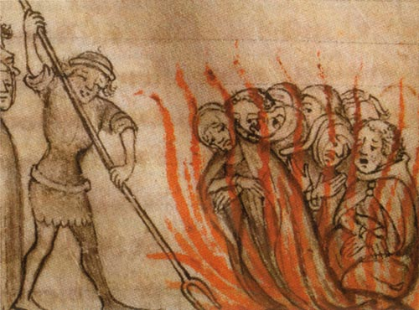
Trial of the Templars in Paris, 1307-1312: heretics & money-lenders (to French crown)

Slide 10
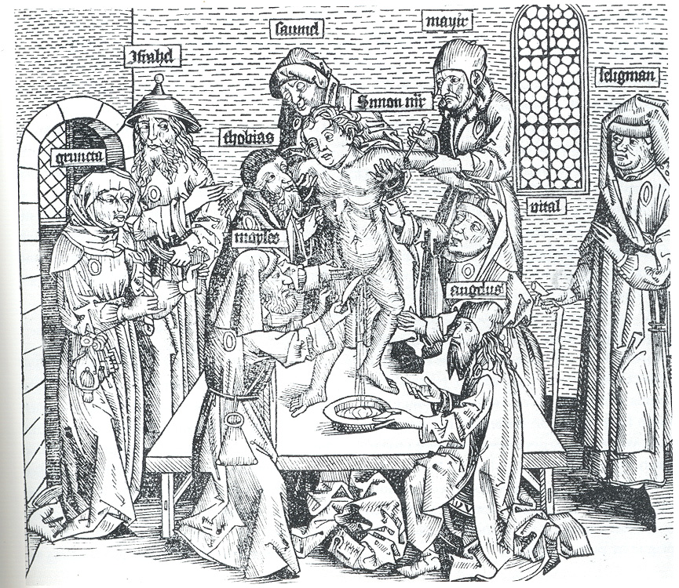
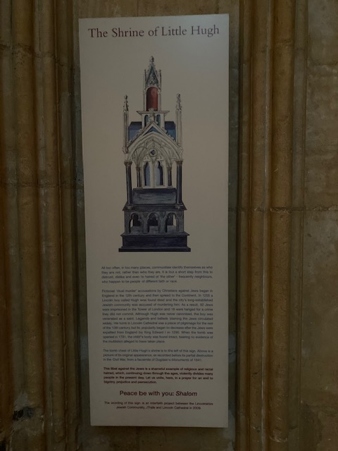
More Sinister = accusations of blood libel/ritual murder
Desecration of host associated with Christ-killers
Murder of Christian children: e.g. William of Norwich (1144), Hugh of Lincoln (1255), Simon of Trent (Germany, 1475), reflecting moments of tension

Slide 11
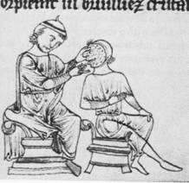
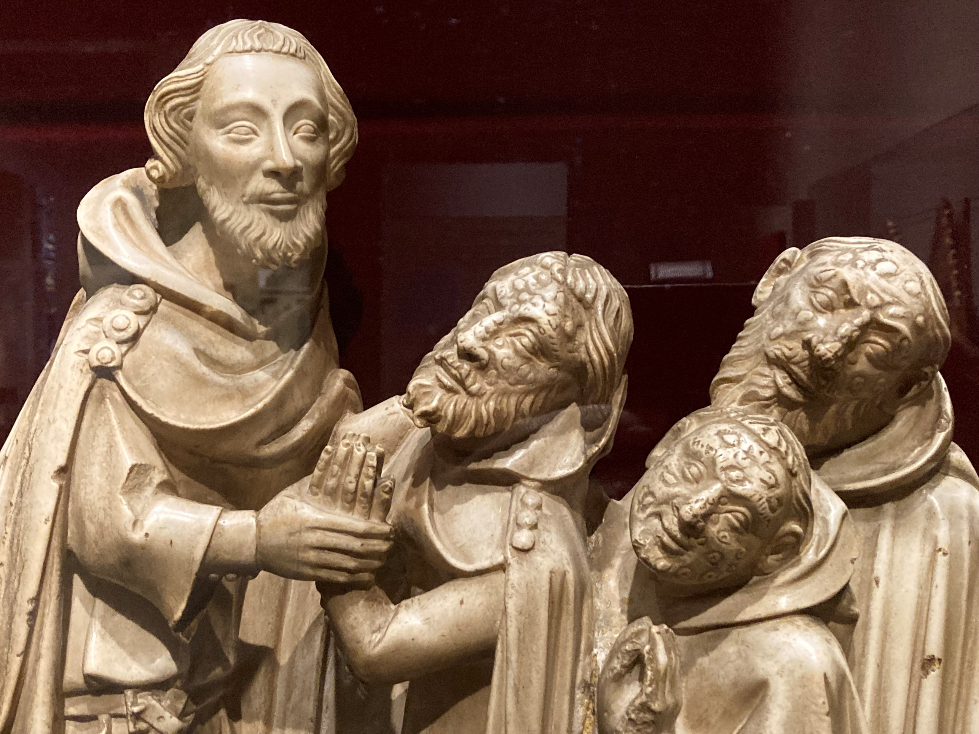
Treatment of Diseased
Fear of contamination:
Leprosy: leper(or lazar)-houses outside towns & own cemeteries; restricted social interaction; ambiguous legal & spiritual status as ‘dead’ (ritual of seclusion), vs property rights, occupations etc; largely disappeared in Europe by 1500
Plague: from 1340s of increasing concern
Mental illness: many conditions viewed as result of possession
And strong metaphorical use of disease re deviant groups in general
But also sympathy for the condition:
Reflection of individual vs collective sin?
Responsibility of Christian society to look after, doctors treat, others give alms to
Cf beggars – more tolerated in medieval society than subsequently
Central vs local approach

Slide 12
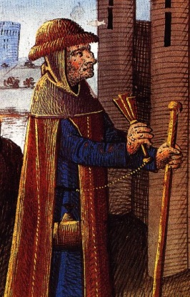
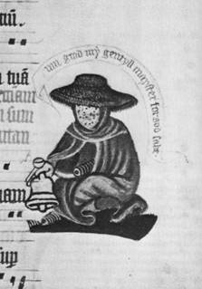
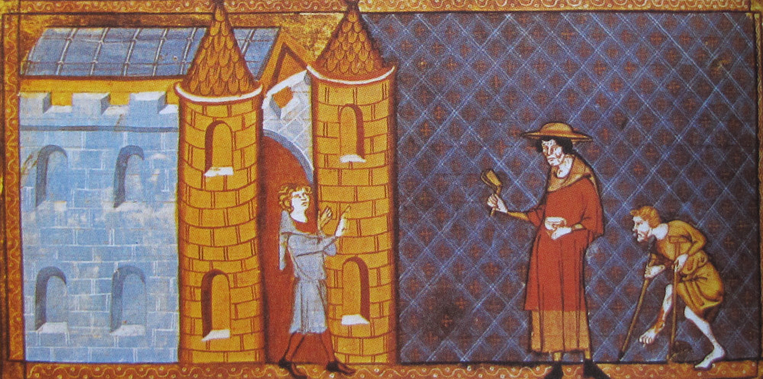
Lepers with clapper or bell: to warn or inform? Lazar houses to support or contain?

Slide 13
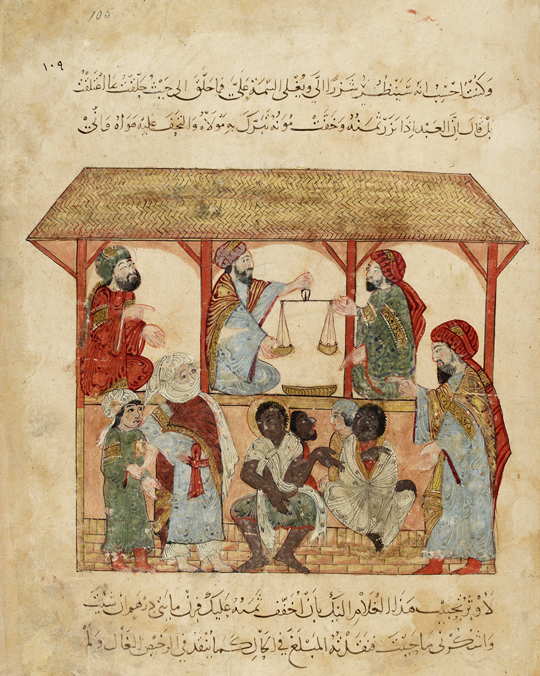
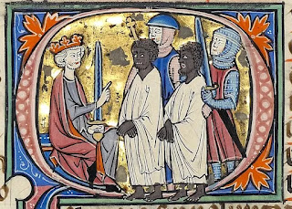
Race, Blacks, Slavery & Slaves
Flourishing Mediterranean Trade in slaves including White Christians as well as Blacks, Moors/Muslims often > domestic service
Common to see Black servants in Iberia & Italy
Diplomatic & commercial exchange with Muslim/African powers

Slide 14
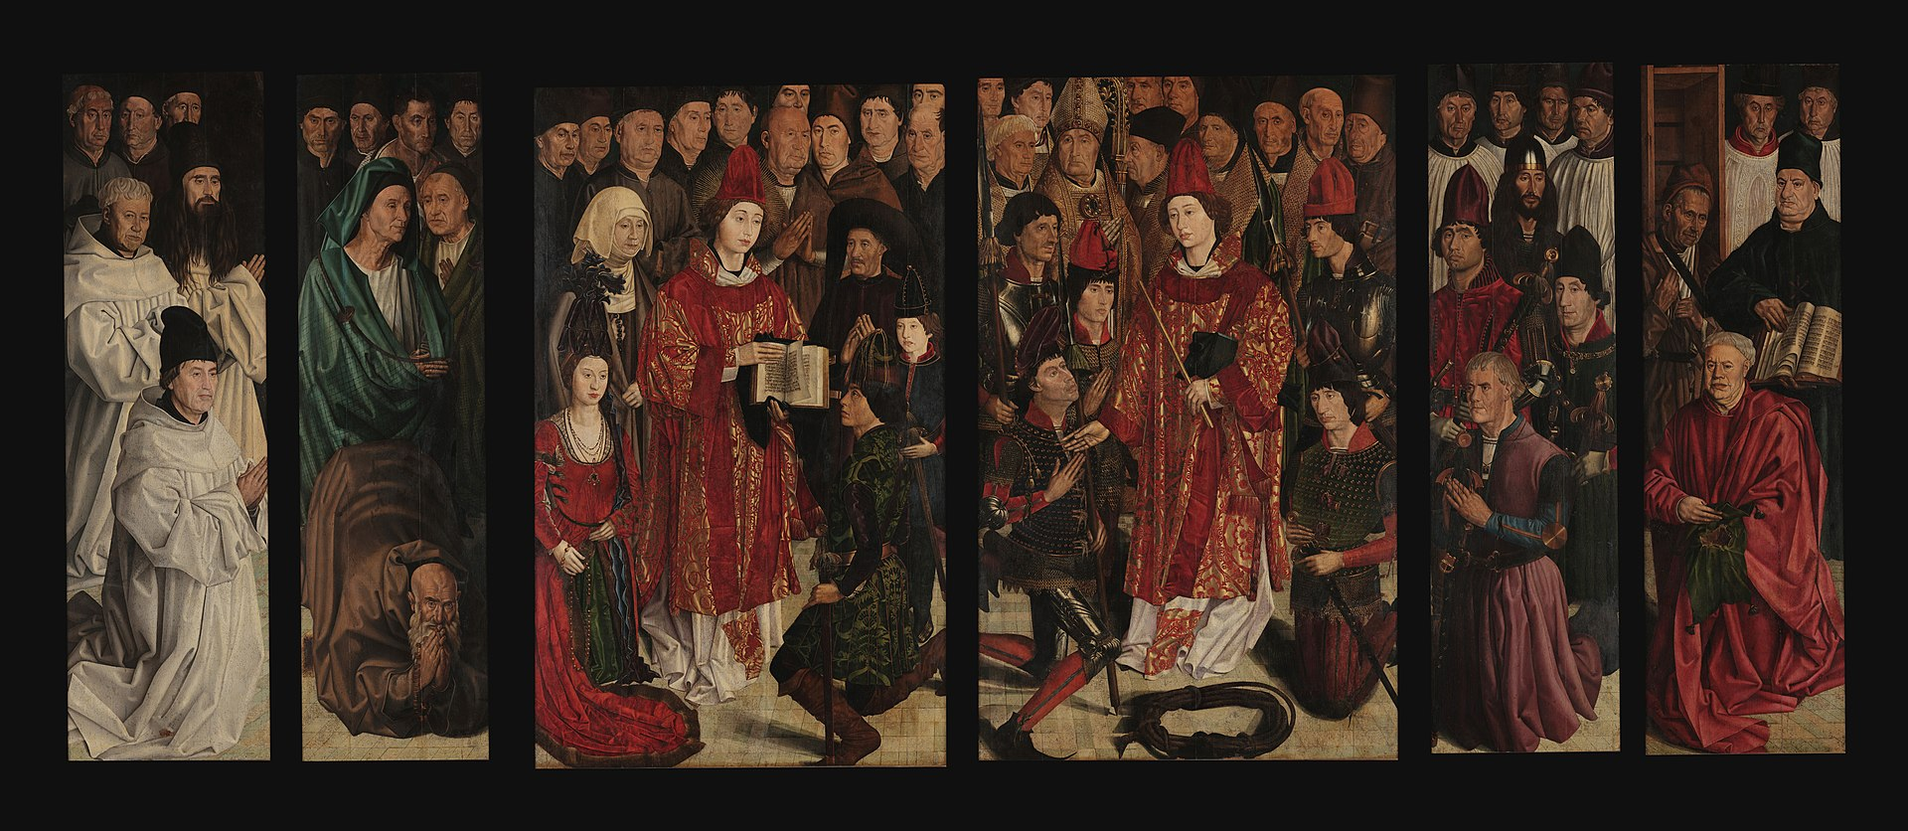
Portuguese Court: snapshot of coexistence at end of Middle Ages? > Early Modern clampdown & intolerance
Nuno Gonçalves, ‘Altarpiece of St Vincent’, Portugal c. 1470

