Slide 1
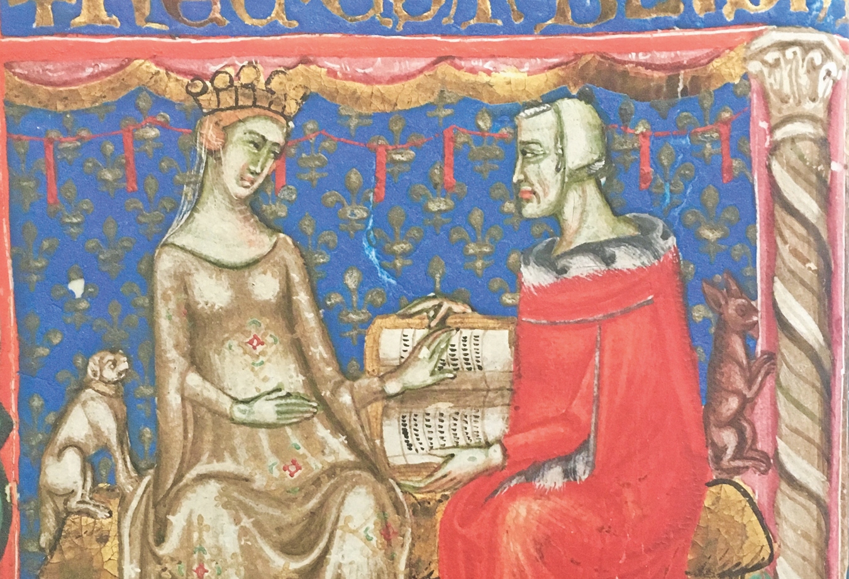
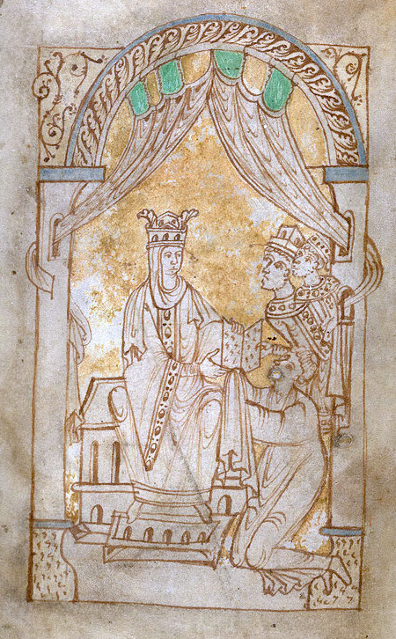
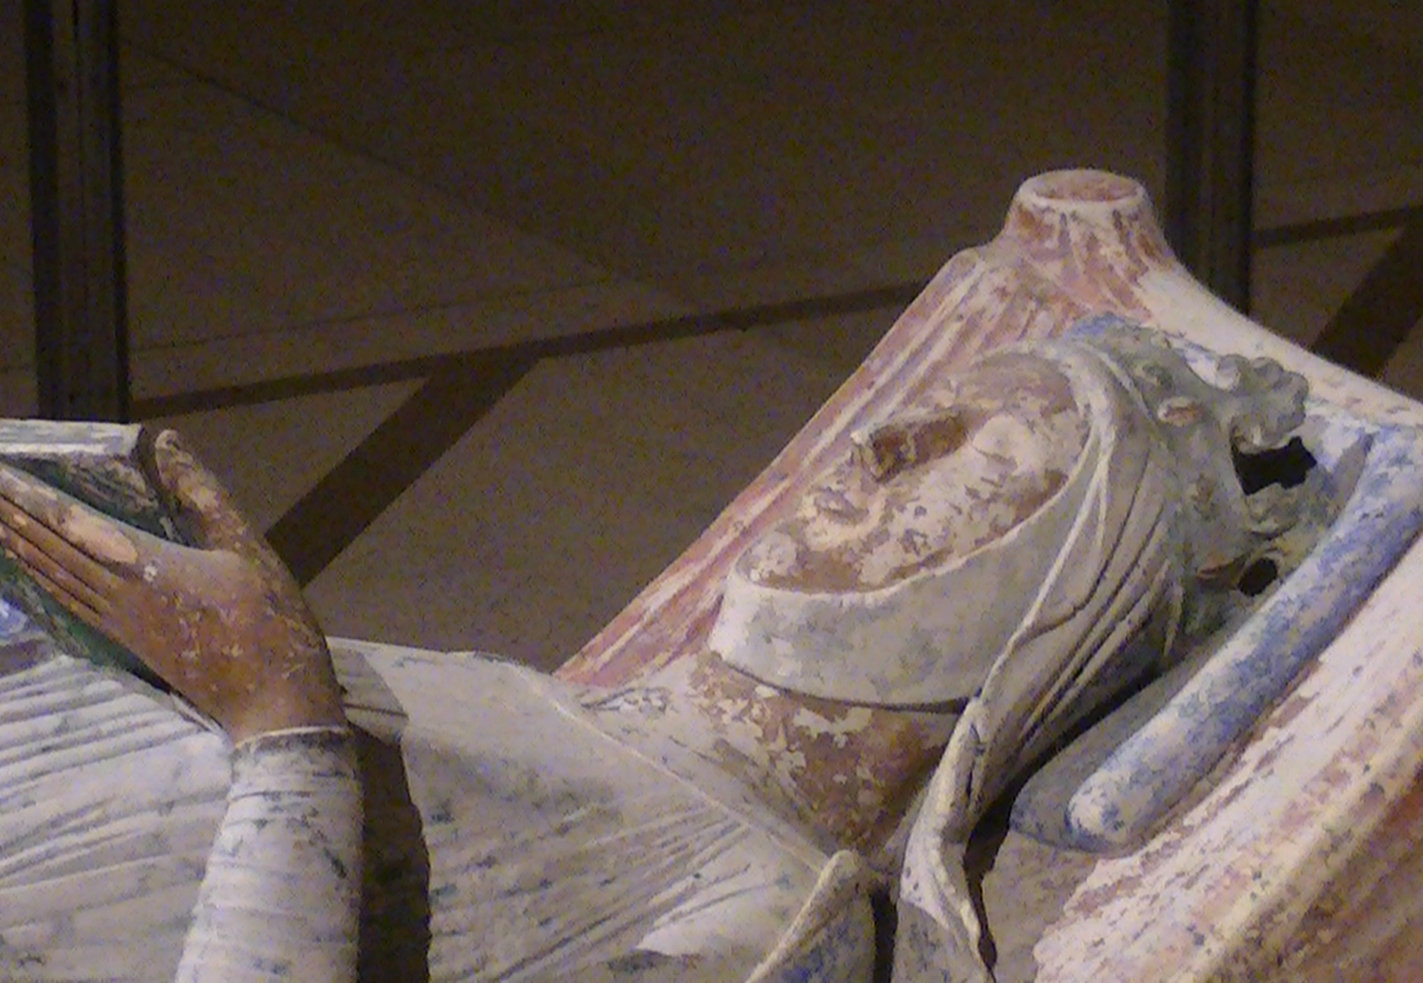
Queenship and Elite Female Power
HI2E9 Crossing Boundaries and Breaking Norms
Natalie Hanley-Smith
Natalie.Hanley-Smith@warwick.ac.uk

Slide 2
Queenship
‘a cluster of customs, practices and political theory that focuses on who queens were and what they did; how were they perceived by their peers; and how they were vital to family culture religion, and economics in the European Middle Ages’.
Theresa Earenfight, ‘Medieval Queenship’, History Compass 15:3 (2017).

Slide 3
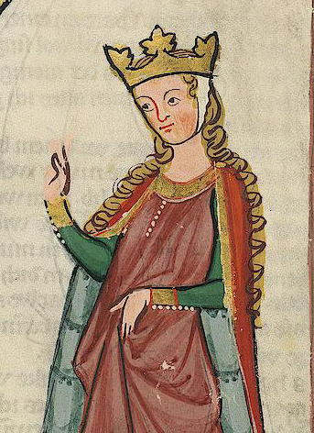
Lecture Outline
1) Types of Queen
2) Roles
3) Crossing Boundaries
4) Queens during the Wars of the Roses
5) Historiography

Slide 4
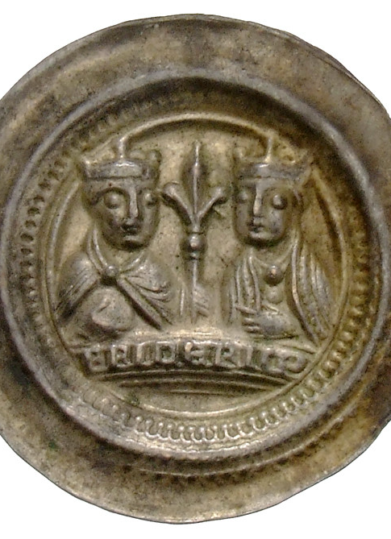
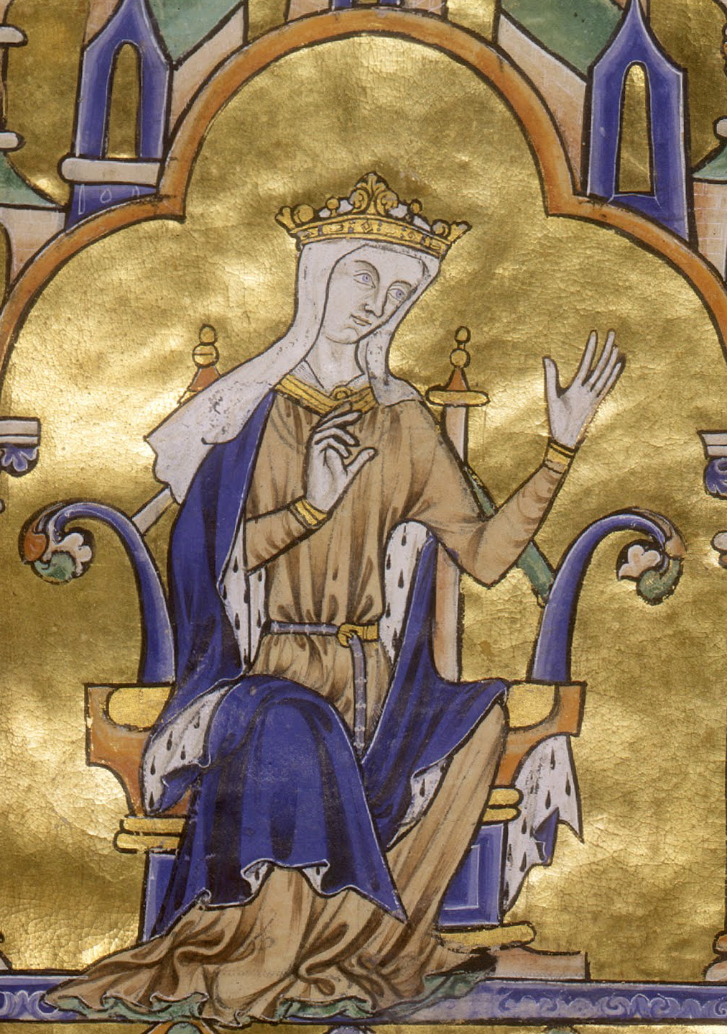
Types of Queen
Queen Consort
Wife of the reigning king
No constitutional powers
Queen Regent
Rules temporarily in place of a king who is absent, a minor, or incapacitated.
Queen Regnant
Rules in her own right, with the same powers as a king.

Slide 5
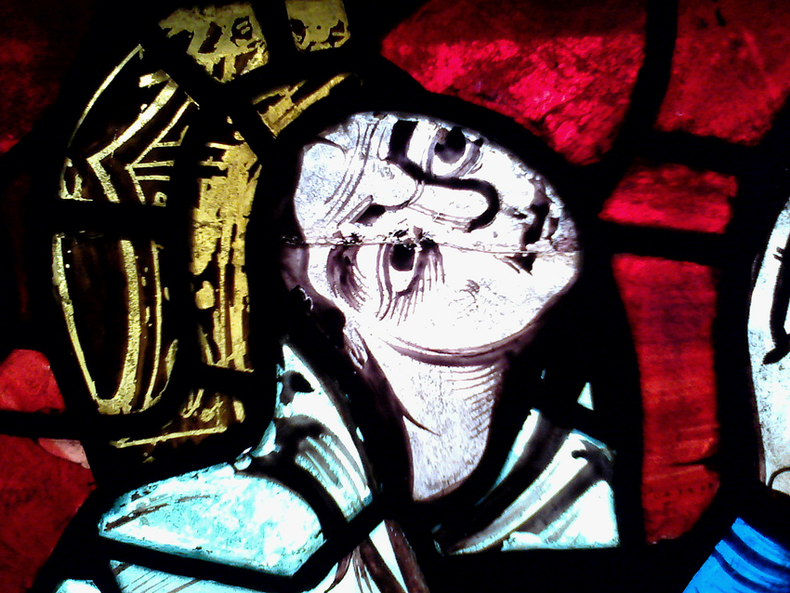
Roles – Religious and Economic
The most pious woman in the kingdom
Patron of religious institutions
Dowries
Lands
money
‘Mobile’ wealth
The Queen’s Wardrobe

Slide 6
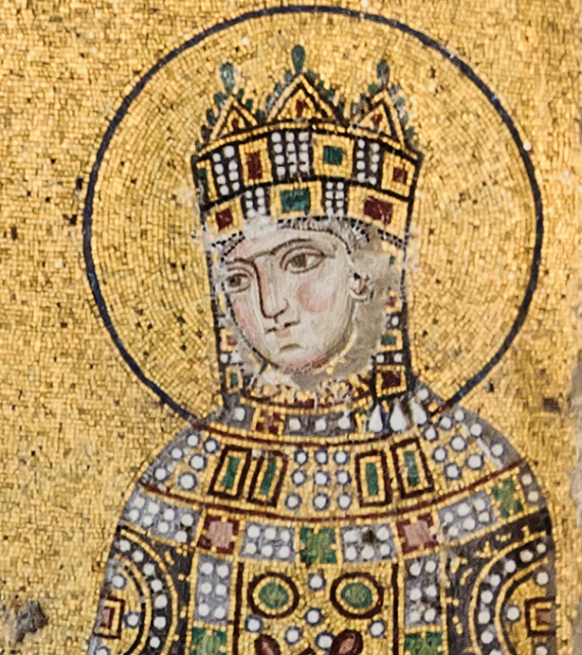
Roles – Cultural: Patrons of the Arts
Buyers and commissioners of art
Portraits and control of image
Youth and beauty

Slide 7
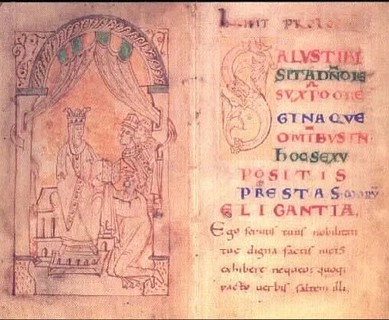
Roles – Cultural: Patrons of Literature
Commissioning literature as propaganda:
Encomium Emmae Reginae (1041/42)
Vita Aedwardi Regis (c.1067)
Employment at Court – the Queen’s household

Slide 8
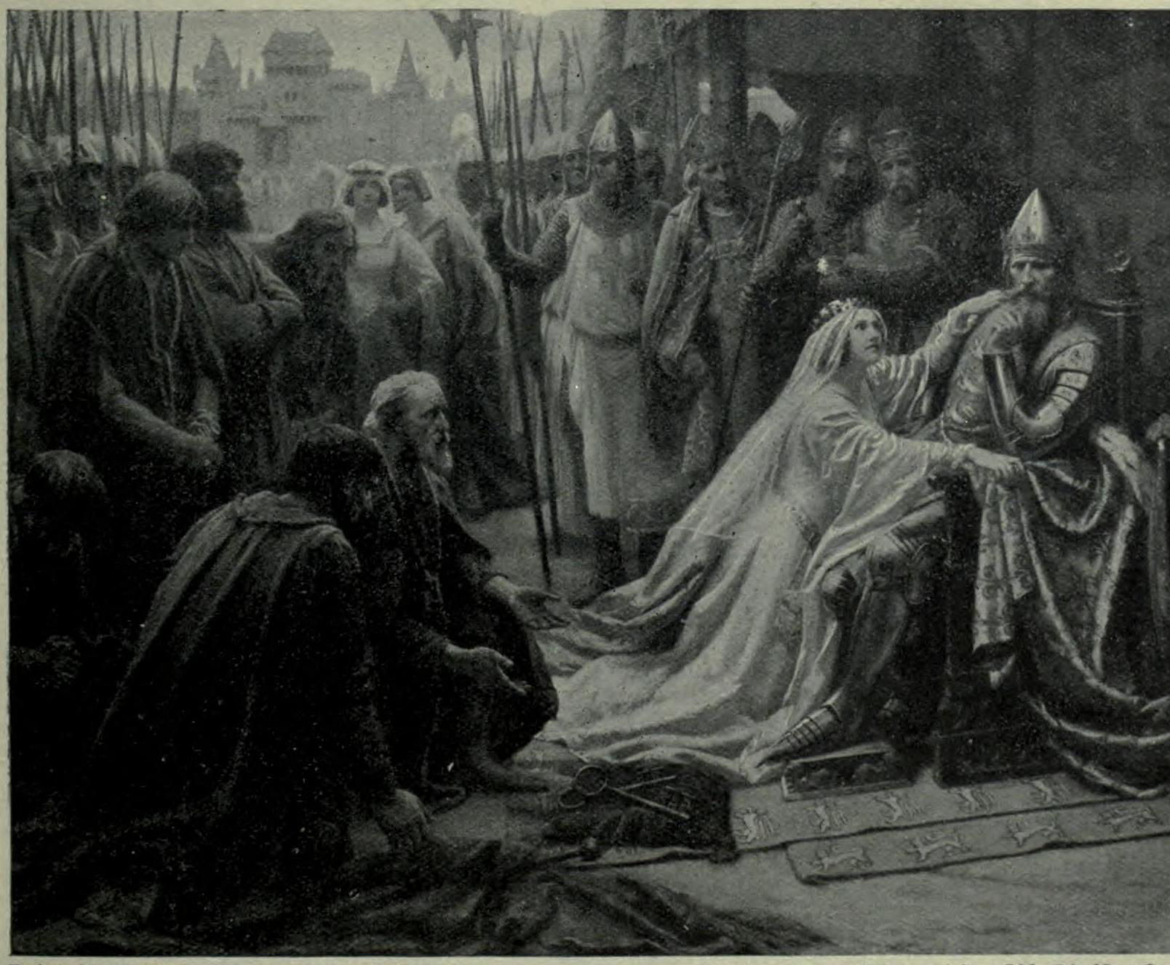
Roles – Political
Symbols of international alliances
Reproduction
Educating the next generation
War
Intercessors
‘The proper duty of the wise queen and princess [is] to be the means of peace and concord, to work for the avoidance of war because of the trouble that can come from it.’ Christine de Pisan, The Treasure of the City of Ladies (1405)

Slide 9
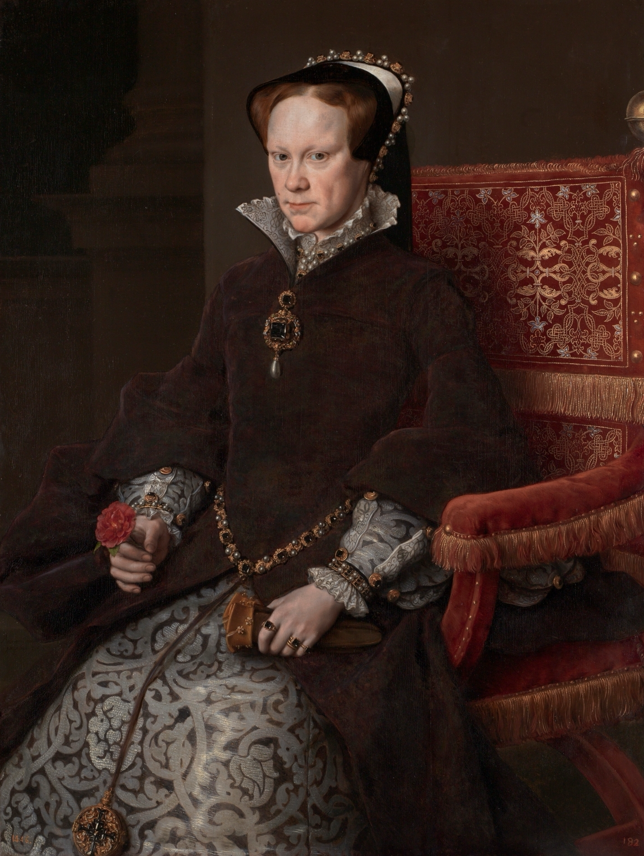
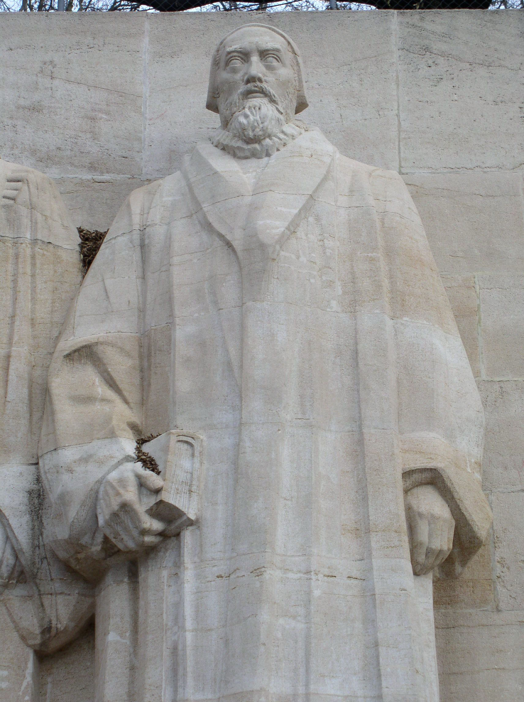
Crossing Boundaries
Misogynistic attitudes towards women problematised female rule.
John Knox, The First Blast of the Trumpet Against the Monstrous Regiment of Women (1558)
Threatened the ‘natural order’ as designed by God.

Slide 10
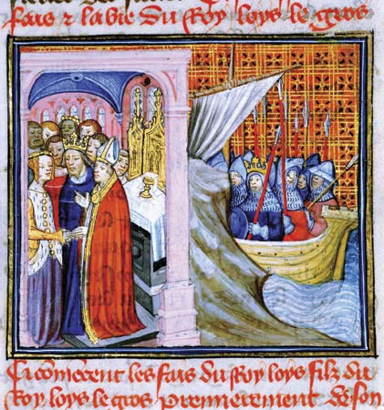
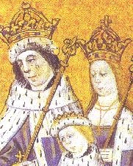
Accusations and Criticisms
Giving bad counsel
Meddling in politics
Favoritism
Prioritising their bonds with natal families
Adultery
Lack of piety
Being bad mothers
Witchcraft

Slide 11
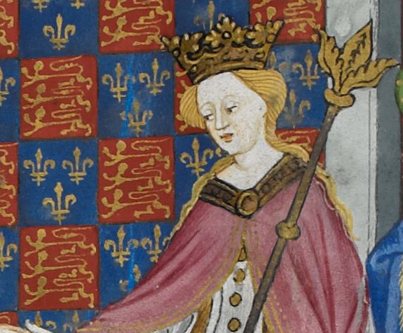
Queens during the Wars of the Roses (1)
Margaret of Anjou, Queen consort of Henry VI and mother of Edward of Lancaster.
Seized command of the Lancastrians when her husband was in a catatonic state.
Shakespeare’s ‘She-Wolf of France’.

Slide 12
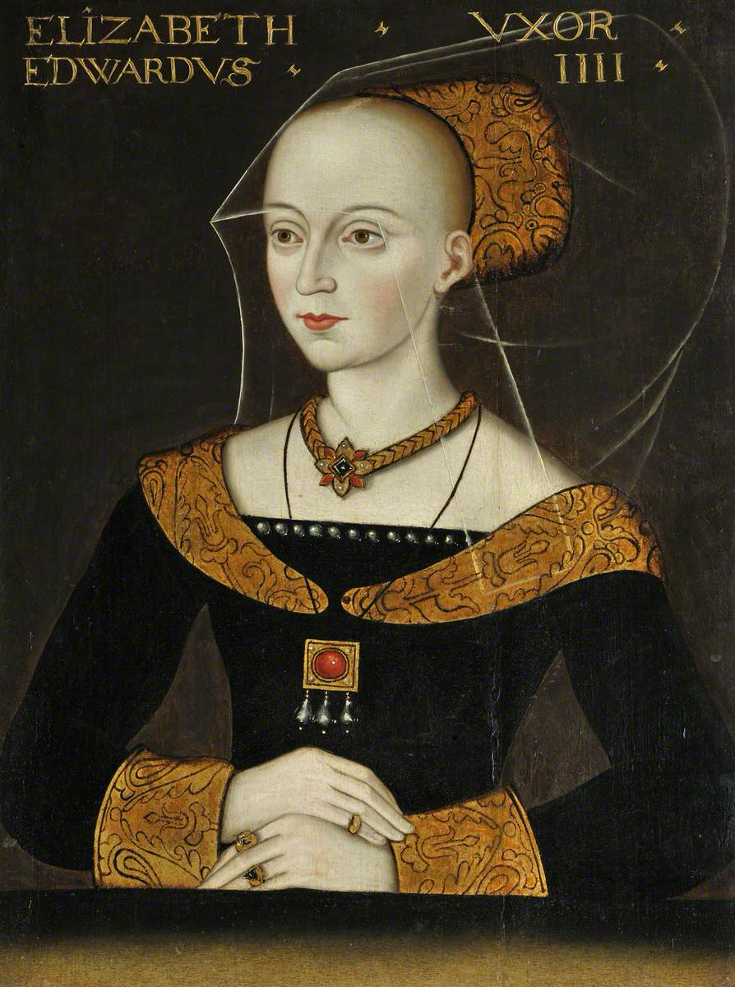
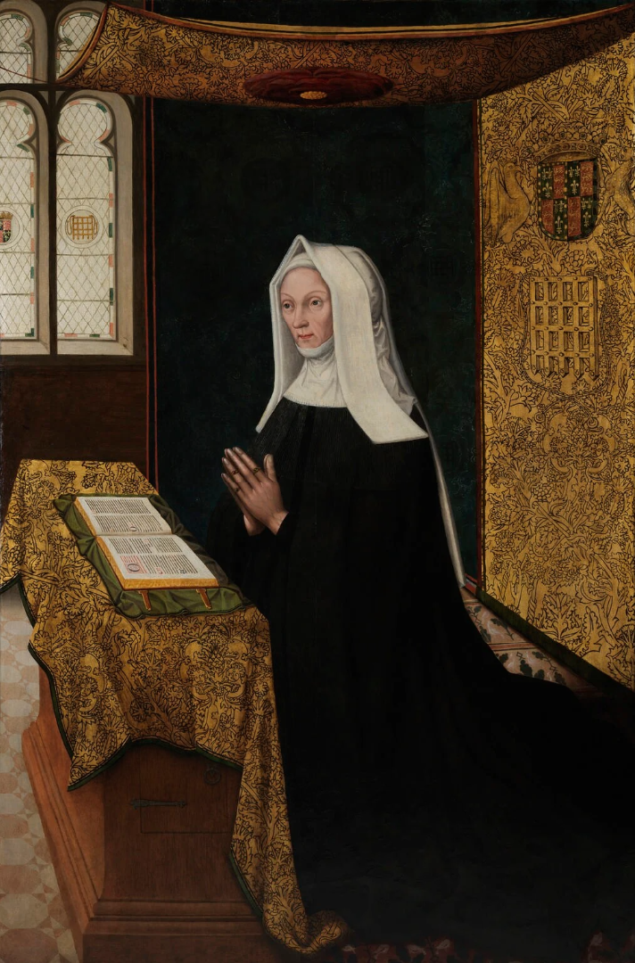
Queens during the Wars of the Roses (2)
Elizabeth Woodville, Queen of Edward IV – a bad choice of bride.
A prolific family.
Margaret Beaufort, mother of Henry VII.
Pious and determined.

Slide 13
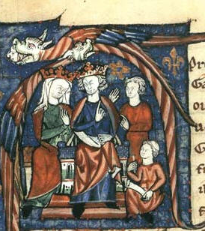
Historiography
Victorian interpretations
Biographies
1970s and 1980s feminists
1990s, early 2000s – comparative queenship
A better understanding of elite power and medieval monarchy

Slide 14
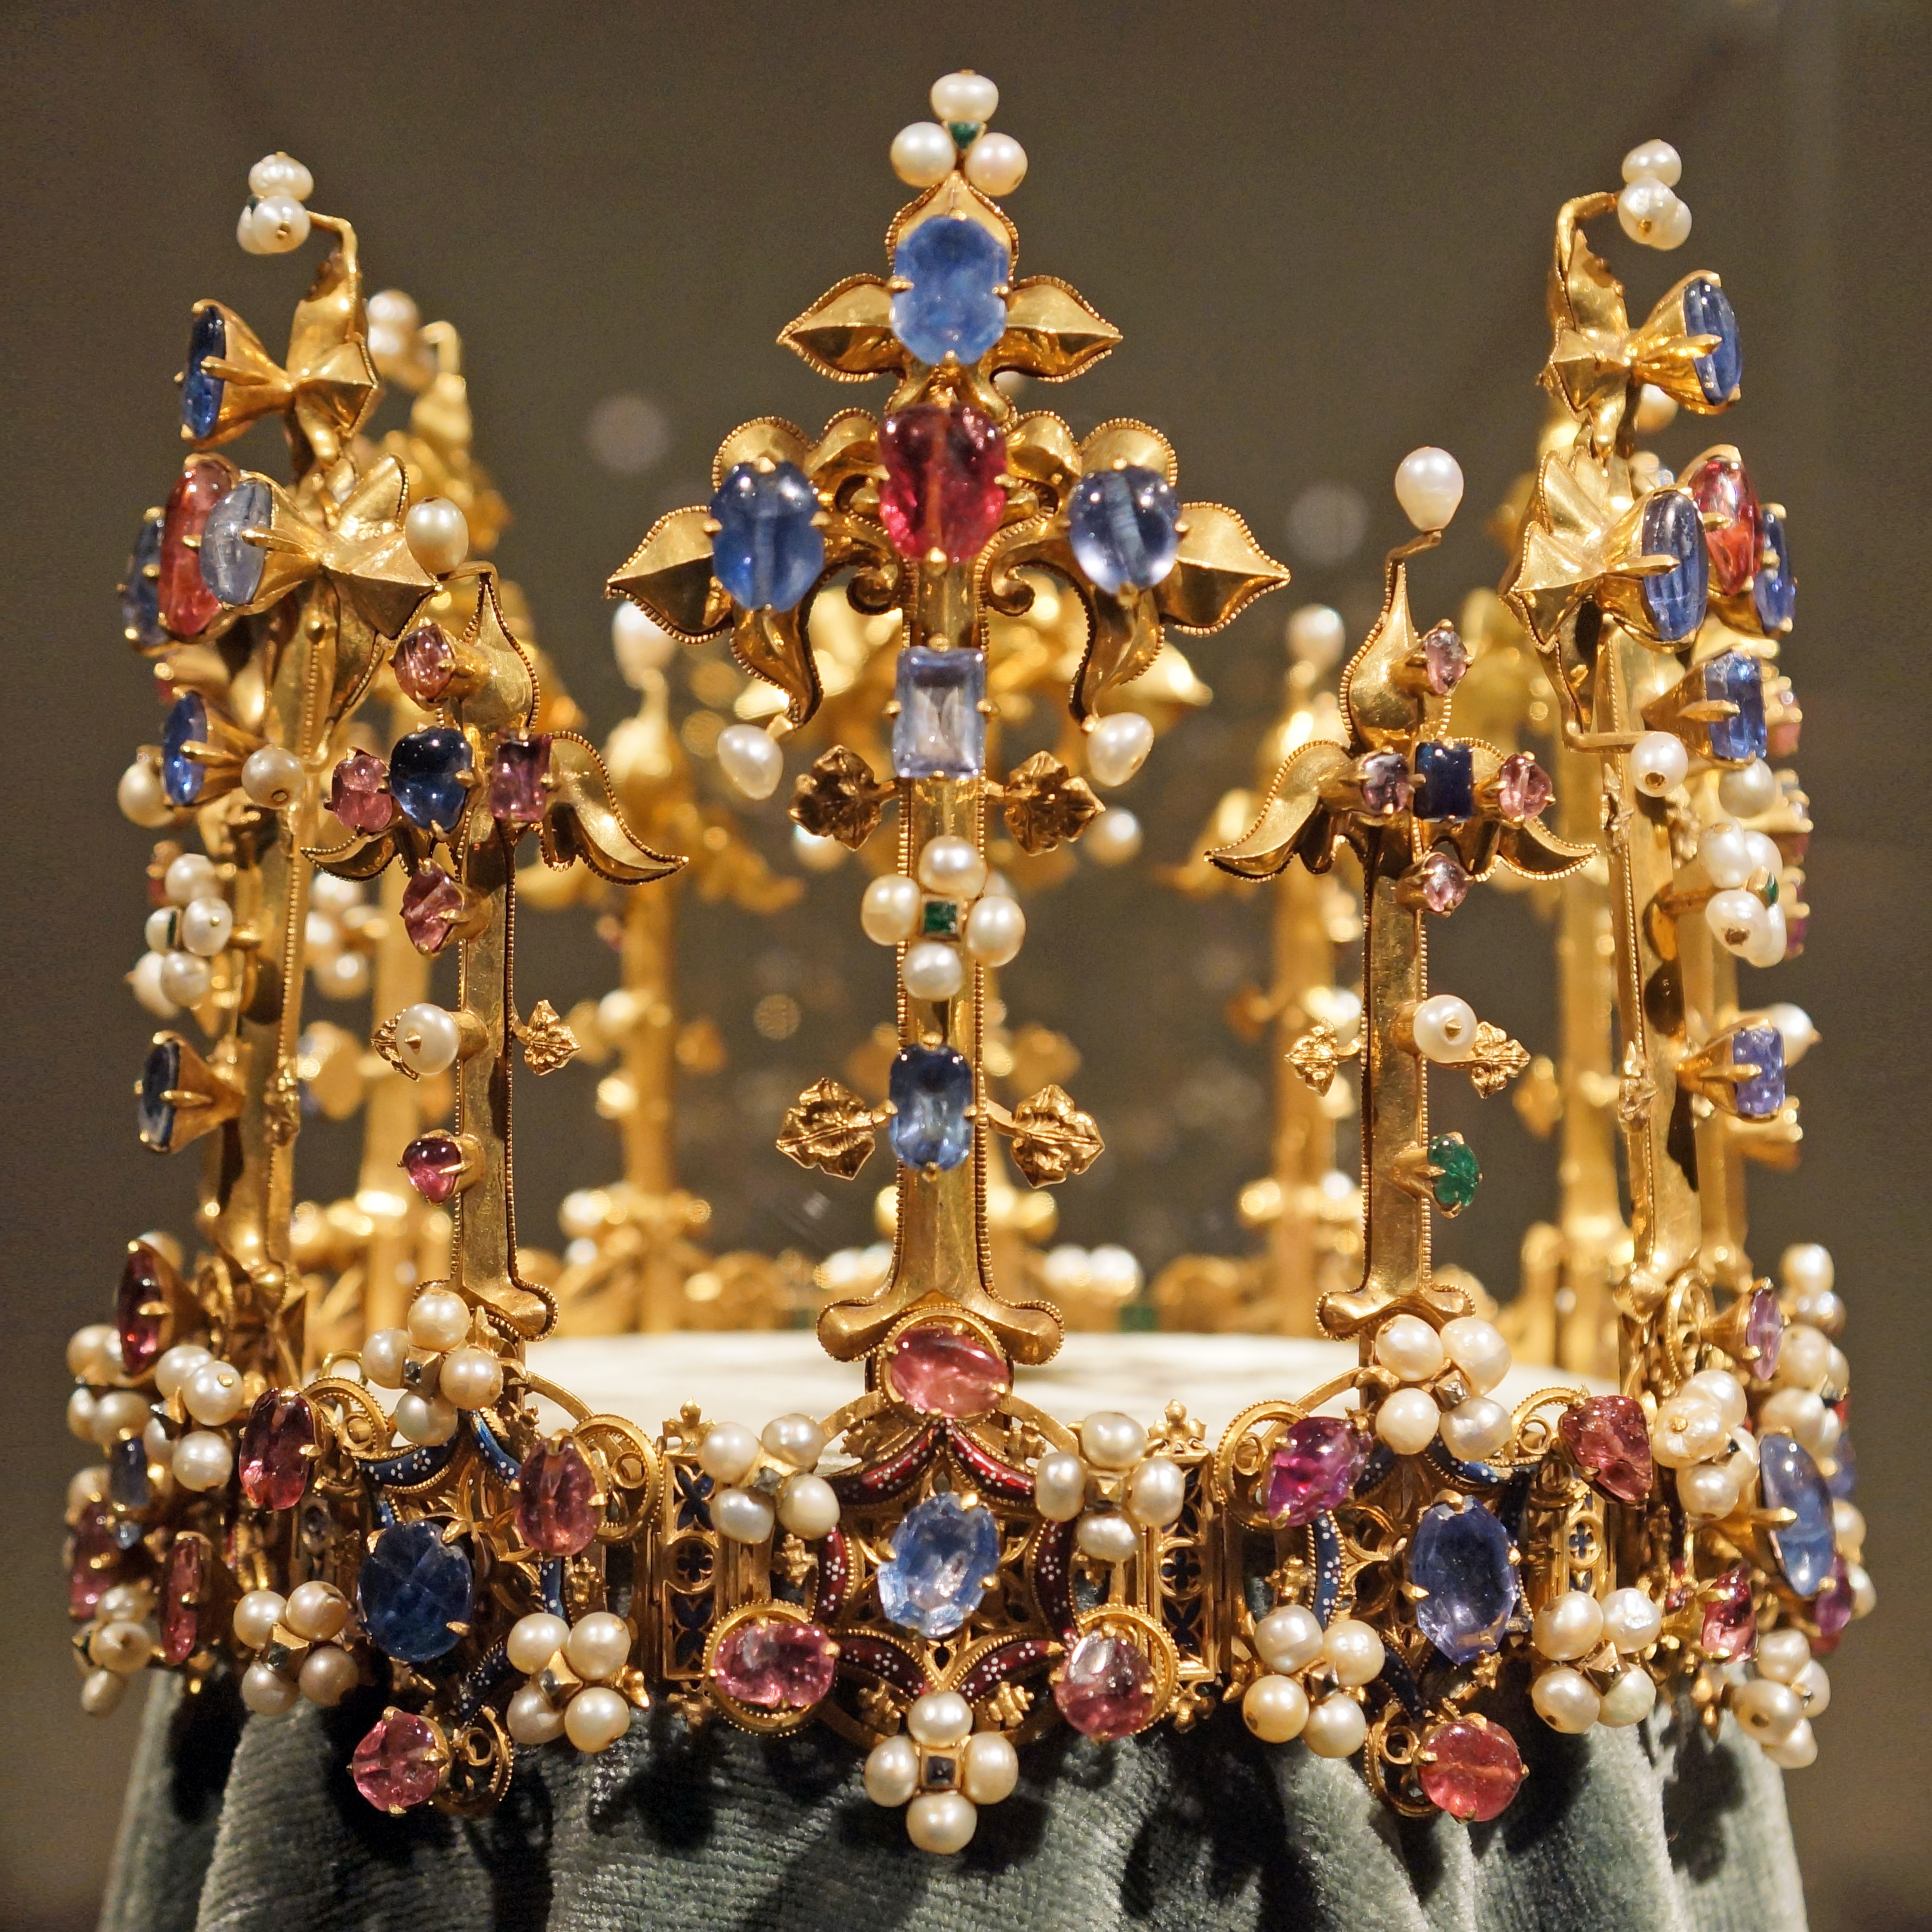
Conclusions
Queens – important players in medieval political structures
Could exercise considerable power and agency
Helen Maurer – Power versus Authority
Vulnerable to attacks and criticism

