Slide 1

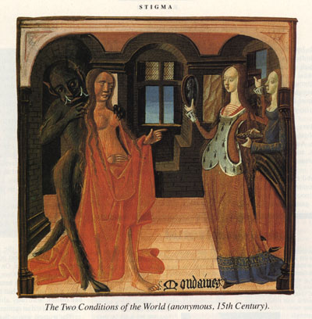
Transgressing Gender Roles

Slide 2
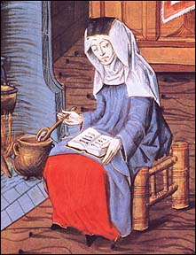
Celibacy vs Marriage
Celibacy as ideal
‘Great Celibacy movement’ of C11th and C12th
Increased entry to holy orders
St Paul, ‘better to marry than to burn with vain desire’
But restraint to be exercised
Only refrain by mutual consent e.g. Margery Kempe & husband
Procreation the primary aim
Did not exclude pleasure
Fantasy (literature) vs fact (courts)?
Margery Kempe (c.1373-1438)

Slide 3
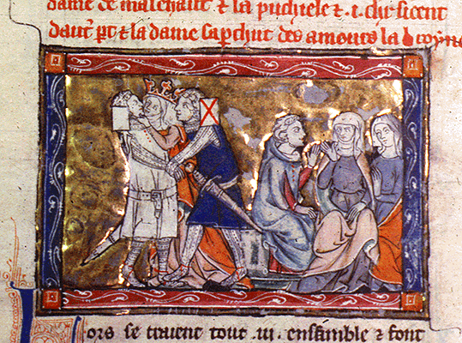
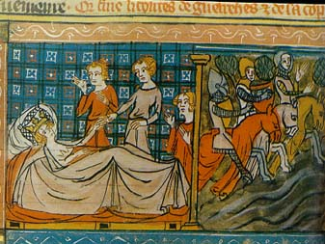
Adultery & betrayal: Lancelot & Guinevere

Slide 4
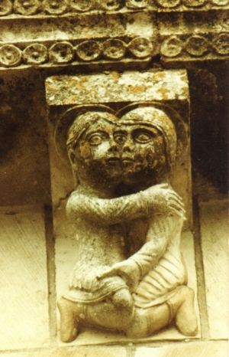
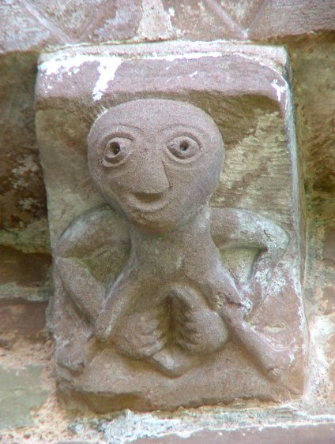
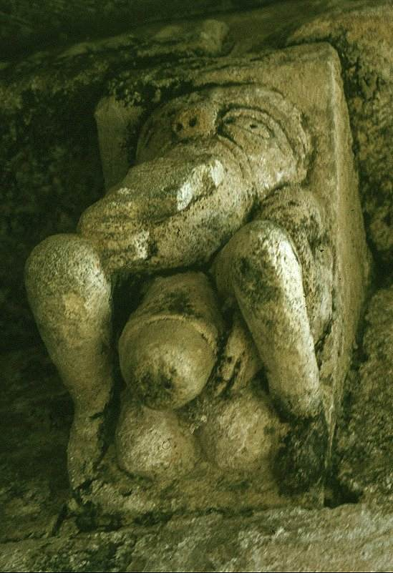
Lewd Church Carvings

Slide 5
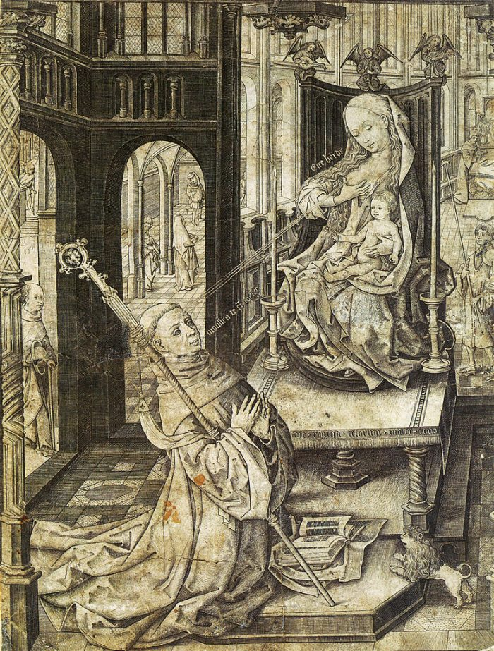
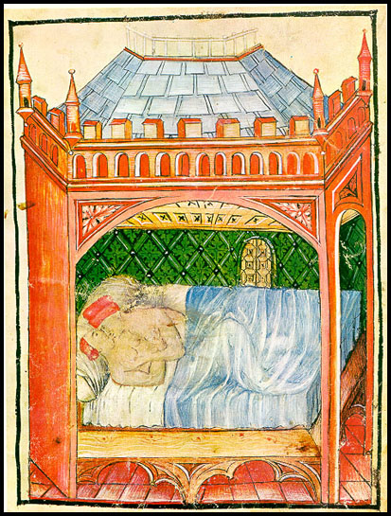
Erotic Aspects of Spiritual Ecstasy
Bible: Song of Songs (erotic vs spiritual love)
Adultery of David & Bathsheba
Saint Bernard of Clairvaux: intense focus on love of Christ and Virgin

Slide 6
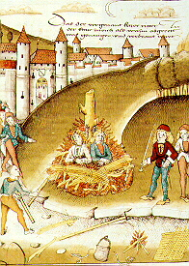
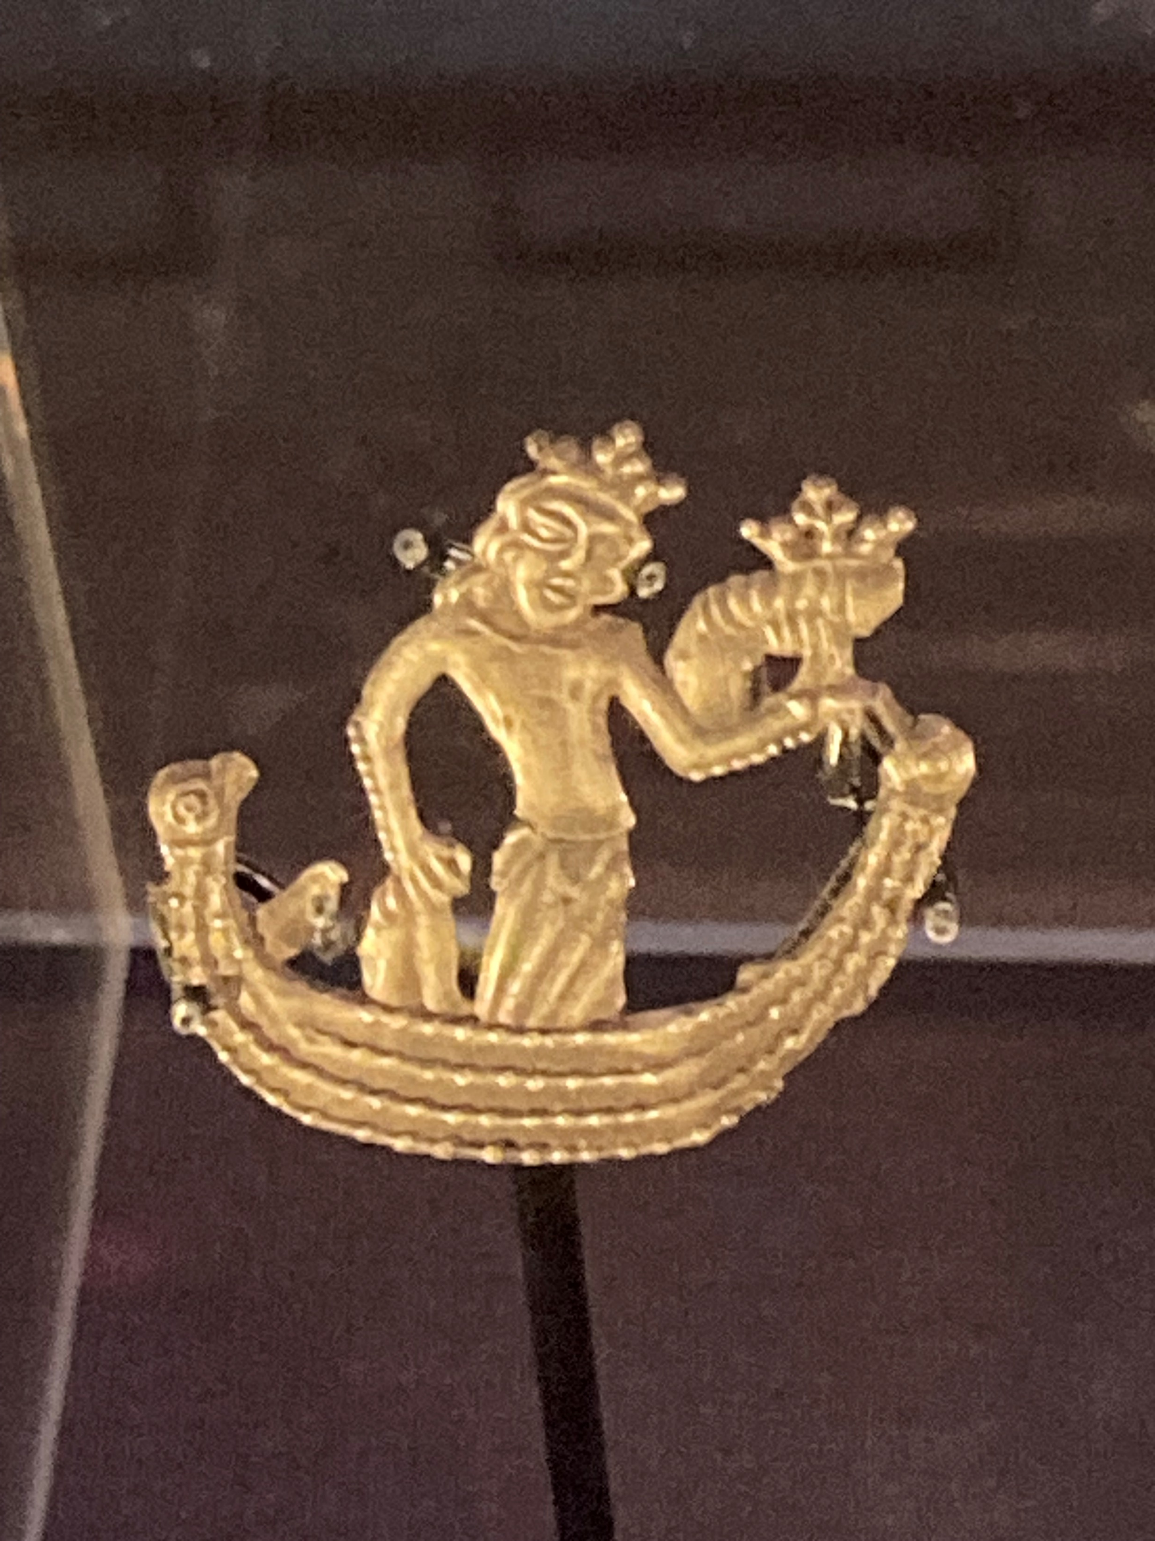
‘Natural’ vs ‘Unnatural’ Sex
‘Natural’ = procreative
Vast range of ‘unnatural’ acts designated as sodomy
Thomas Aquinas analysed hierarchy of vice
Accusations of sexual deviance levelled at non-conformist groups e.g. heretics, lepers, Jews, Muslims; & political opponents
Relative tolerance of male same-sex relationships e.g. Venice & Florence
Seen as youthful phase pre-marriage
Importance of upholding gender norms
Public humiliation vs execution
Burning for sodomy
Satirical badge depicting Isabella of France holding phalluses c. 1327

Slide 7
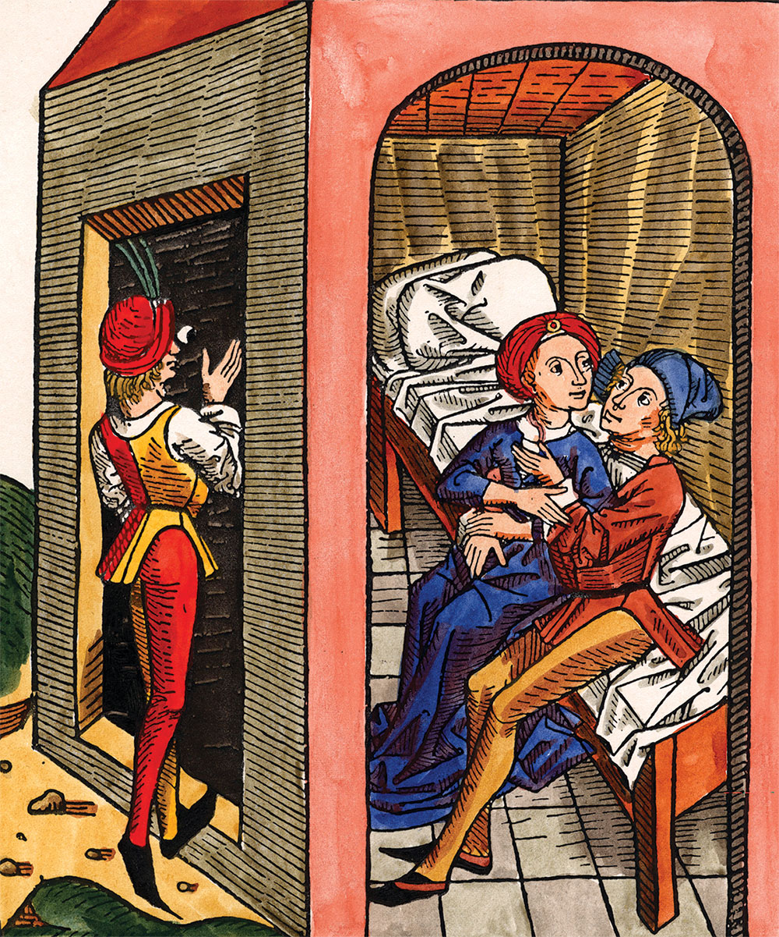
Prostitution
‘…prostitution deeply affected gender relations because its existence fostered the connection of feminine sexuality with venality and sin, and thereby justified the control of all women’ (Karras, Common Women)
Thomas of Chobham (C13th theologian) ‘meretrix’ =
1) a woman who has sex outside of marriage
2) a woman who has sex with many men
3) a woman who denies herself to no-one
4) a woman whose sin is public
5) a woman who sells herself
Accepted as trade
Accusations if too independent or disliked

Slide 8
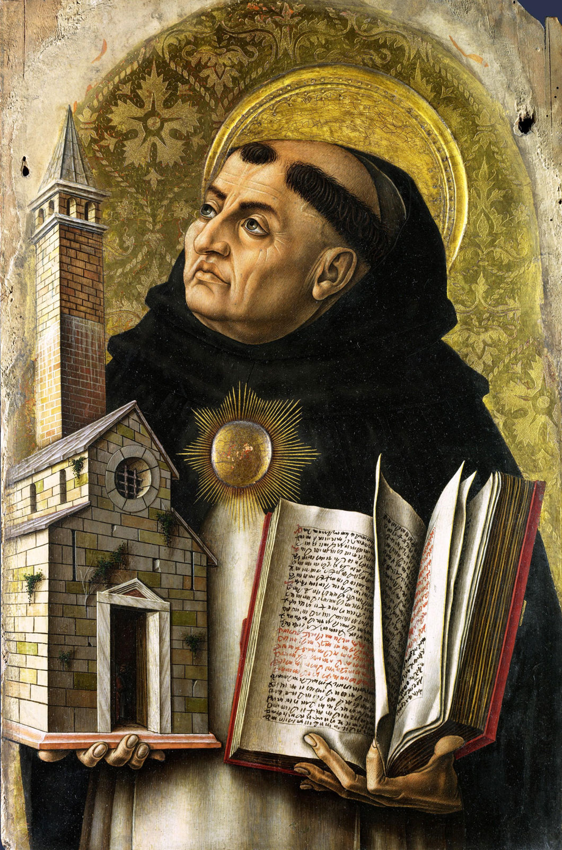
Perspectives: the Church
Sex outside marriage was a sin
But prostitution ‘necessary evil’ (St Augustine)
‘Remove the sewer and you will fill the palace with ordure; similarly with the bilge from a ship; remove whores from the world and you will fill it with sodomy’, attributed to Thomas Aquinas
Acceptance of prostitution, but with criticism of those who benefited and encouraging those involved to repent

Slide 9
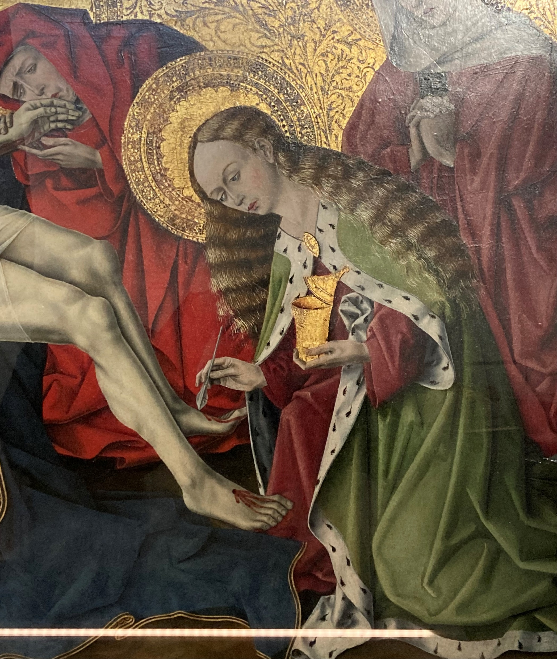
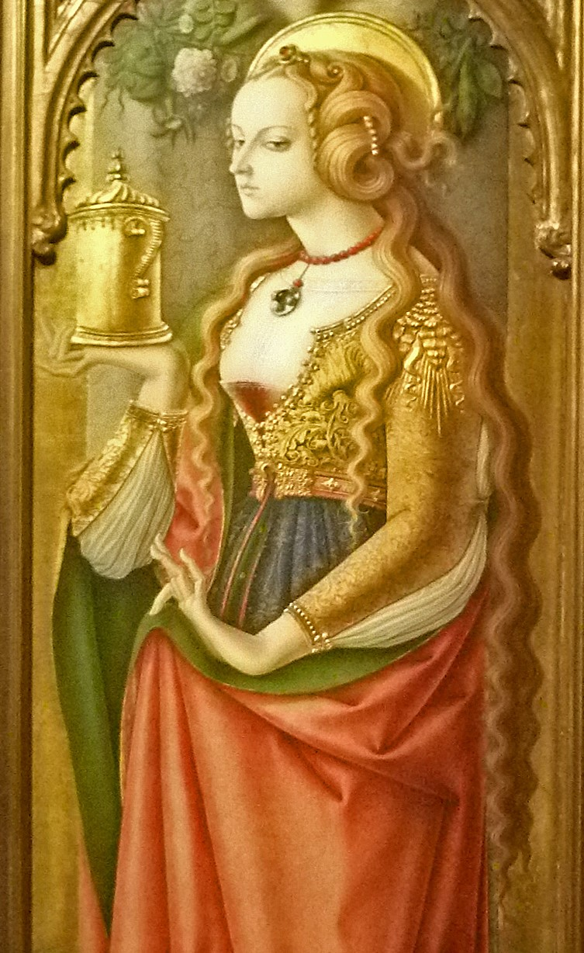
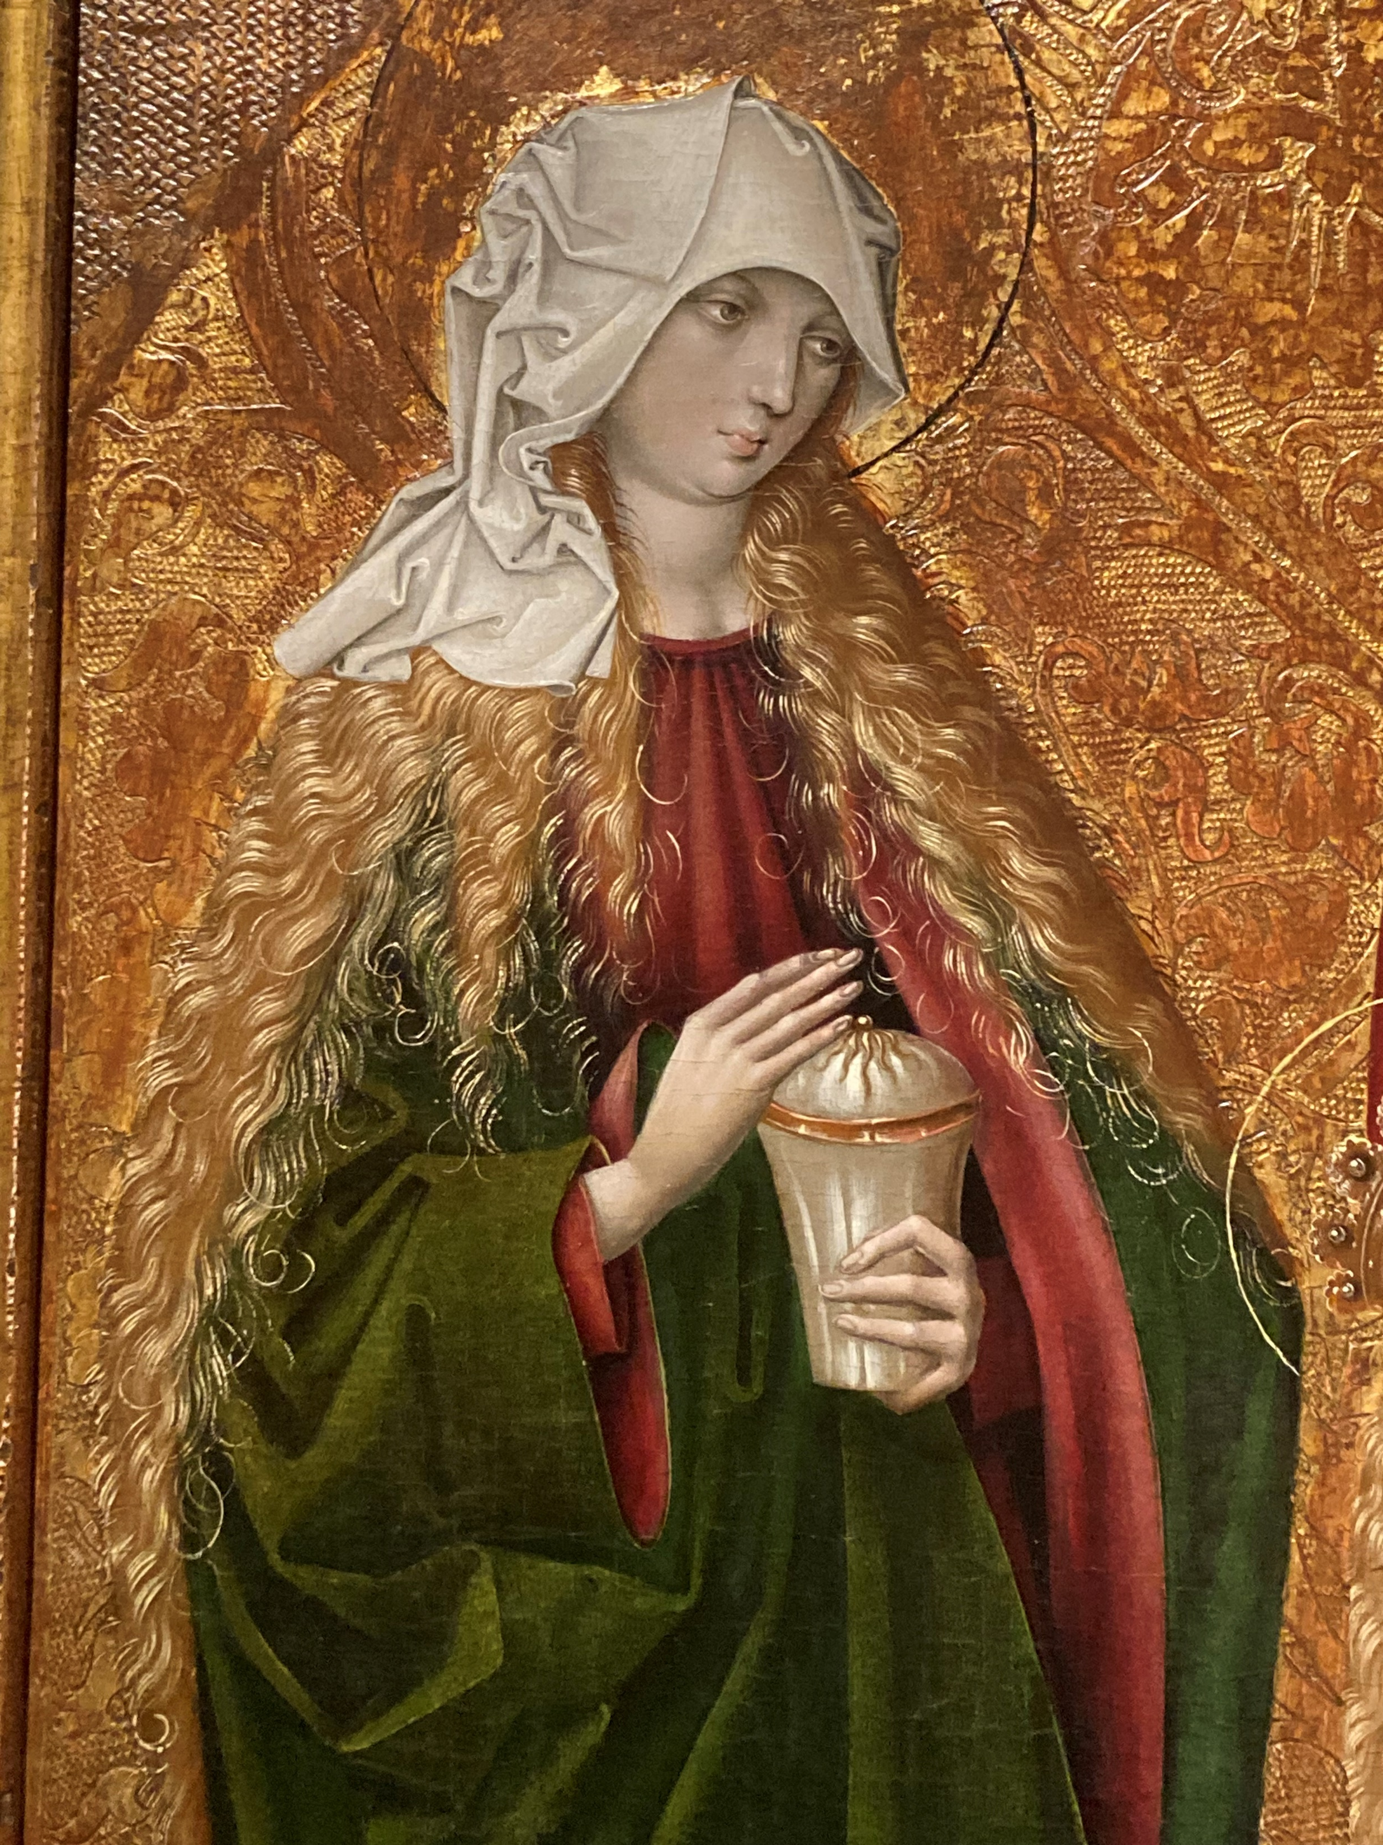
Mary Magdalene as the exemplary redeemed fallen woman

Slide 10
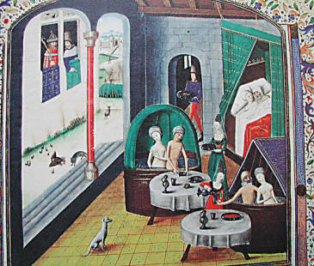
Control over legalised prostitution
Medieval brothels: urban and cash-based
Often immigrants worked there e.g. rural women but also local women (Goldberg)
Authorities mainly tried to control and regulate rather than eradicate
Aim to identify and segregate
Fear of ‘contagion’
Brothels heavily taxed
Some, perhaps most sex workers, freelance
Prostitutes mentioned in sumptuary laws
Victim vs agency?
Medieval bath house/brothel

Slide 11
Cross-dressing and gender boundaries
One sex-model: woman = inverted or inside-out man
= Incomplete males, also eunuchs & hermaphrodites
Sin against nature to pretend to be or act like other sex
Gender essential & fixed
Dress also linked to social status, occupation & marital status
Cross-dressing treated differently according to context
Religious context or performance accepted
Intent important: to deceive or to escape danger
Whether to do so permanently or for temporary necessity
Men as women much worse & ‘unnatural’
Very few cases on which to judge

Slide 12
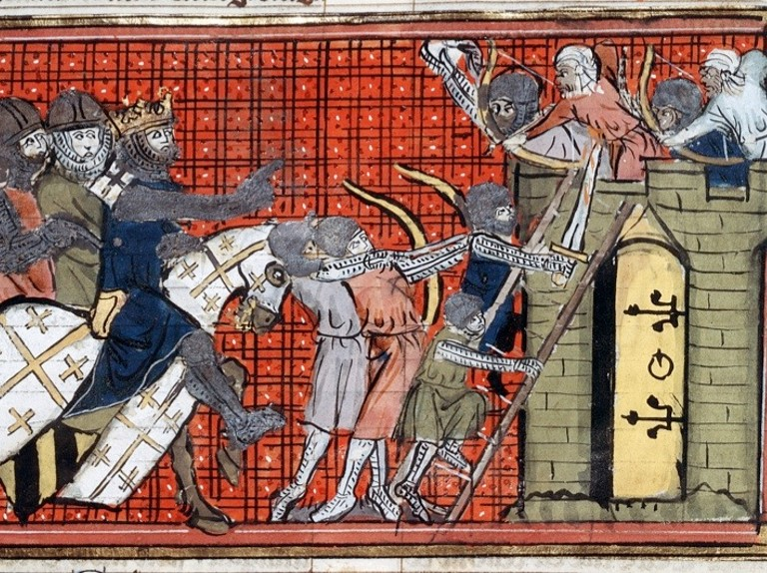
Cross-dressing women
Religious context: early desert saints
Military context e.g. Margaret of Beverley at siege of Jerusalem, 1187:
‘During this siege, which lasted fifteen days, I carried out all of the functions of a soldier that I could. I wore a breastplate like a man; I came and went on the ramparts, with a cauldron on my head for a helmet. Though a woman, I seemed a warrior, I threw the weapon; though filled with fear, I learned to conceal my weakness.’

Slide 13
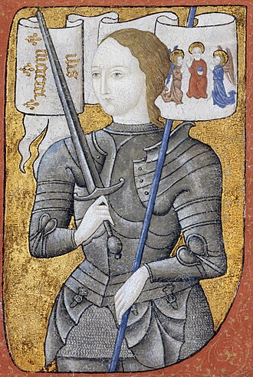
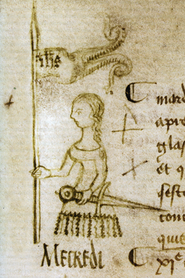
Jeanne d’Arc (c. 1412-1431)
‘The said Jeanne attributes to God, to His angels and to His Saints instructions that are contrary to the honesty of womankind, forbidden by divine law, abominable to God and man, and prohibited under penalty of anathema by ecclesiastical decrees, such as the wearing of short, tight and dissolute male habits, those underneath the tunic and breeches as well as the rest; and, according to their bidding, she often dressed in rich and sumptuous habits, precious stuffs and cloth of gold and furs; and not only did she wear short tunics, but she dressed herself in tabards and garments open at the sides, whilst it is notorious that when she was captured she was wearing a loose cloak of cloth of gold, a cap on her head and her hair cropped round in man's style. And in general, having cast aside all womanly decency, not only to the scorn of feminine modesty, but also of well-instructed men, she had worn the apparel and garments of most dissolute men, and in addition, had borne weapons of offence. To attribute this to the bidding of God, His holy angels and virgin saints, is blasphemy of Our Lord and His saints, setting at nought the divine decrees, infringement of canon law, the scandal of her sex and womanly decency, the perversion of all modesty of outward bearing, the approbation and encouragement of most reprobate examples of conduct.’

Slide 14
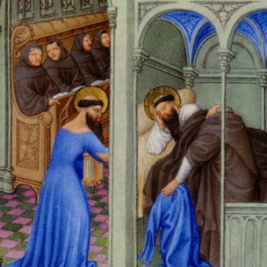
Cross-dressing men
Farce or play: female characters played by men
‘The feast was the most beautiful one in one hundred years of feasts and tournaments, and they imitated the Round Table and the reign of Femenie, that is, knights dressed as ladies, and they jousted together. Then they played nuns that had with them monks and they jousted with each other; and they impersonated Lancelot and Tristan and Palamedes, and played many other splendid, delectable, and pleasant games’ (Philip of Novara, describing festivities at coronation of Henry II as King of Cyprus and Jerusalem)
To shame, mock or criticise e.g. Saint Jerome

Slide 15
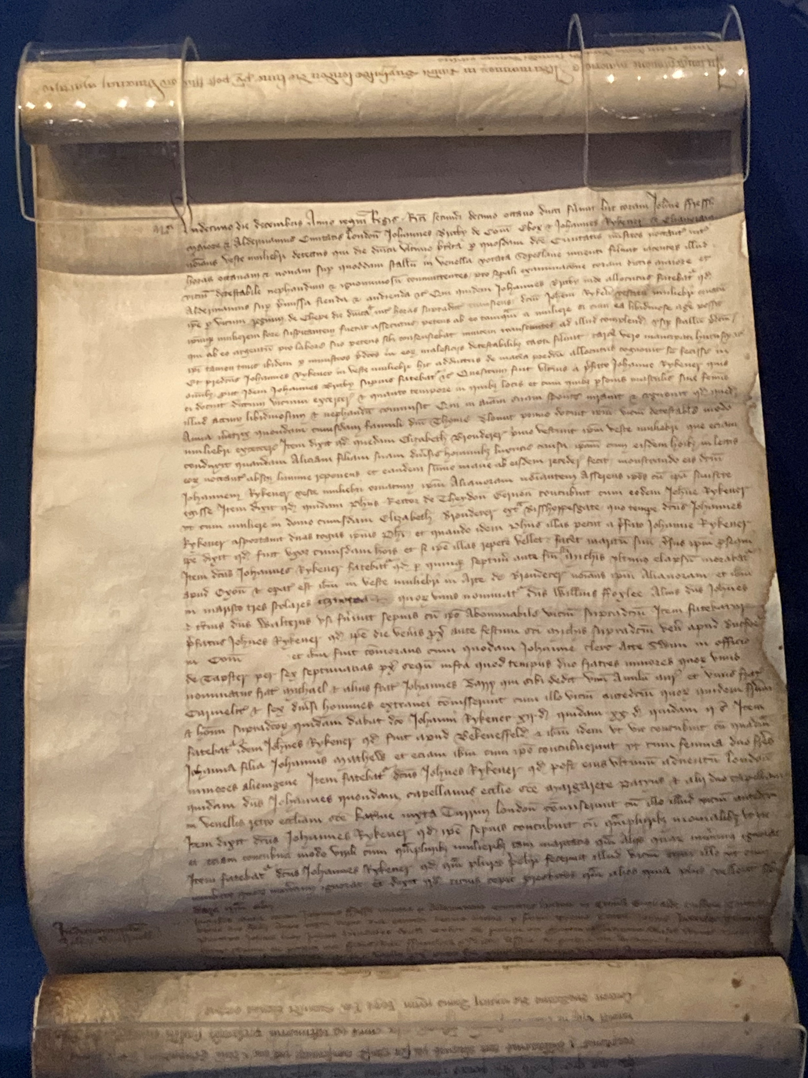
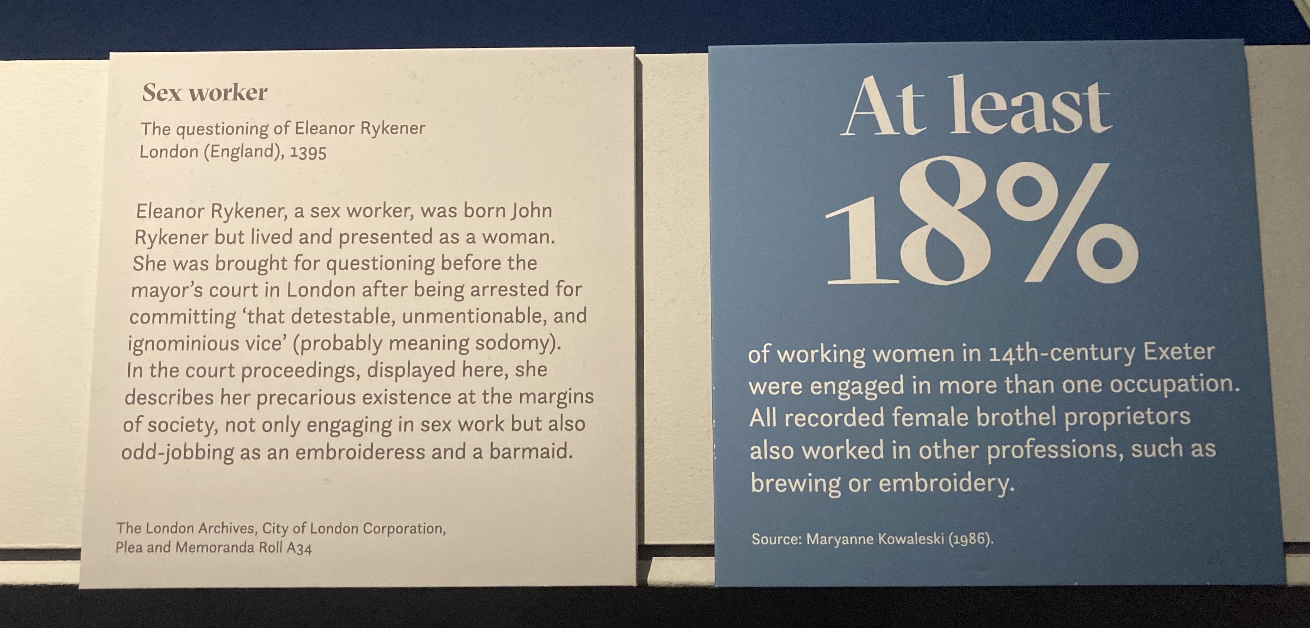
Eleanor/John Rykener: sex worker in C14th London
‘Rykener further said that he often had sex as a man with many nuns and also had sex as a man with many women both married and otherwise, how many he did not know. He further confessed that many priests had committed that vice with him as with a woman, how many he did not know, and said that he accommodated priests more readily than other people because they wished to give him more than others’.

