Slide 1
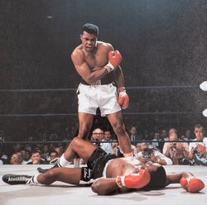
A Global History of Sport (HI2H4)
Tutors
Website and Moodle
Assessment: Essay (80%) Seminar contribution (20%)
Negotiated curriculum weeks 7 and 8 (discuss in early seminars)
Source preparation and discussion, weeks 9 and 10
Read, think about how contemporary sport reflects history
Enjoy!

Slide 2
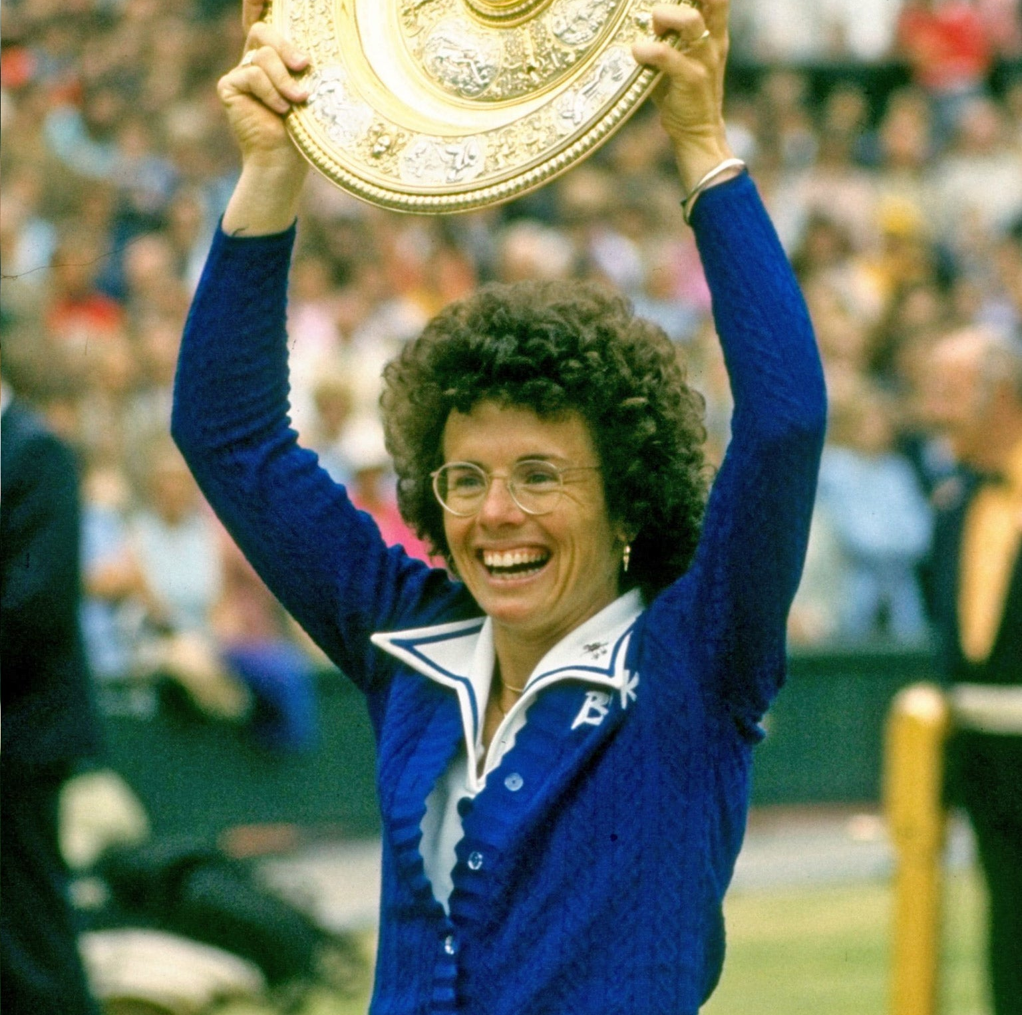
Studying Sports History
Important in popular culture, yet less attention than literature, film or music
Sport interdisciplinary: (history/politics/economics/sociology)
Industrialization, class, internal and external migration, racism, gender, local and national identities, traditions (real and invented), power, agency, corruption, religion and politics, Media (journalism, tv and internet)
Globalisation of popular culture and the local within the global. Significance is difficult to ignore

Slide 3

Journalism, fiction and film: Representing sport
Cricket has always attracted a lot of considered writing
Sports more generally
Football journalism from the 1890s, e.g. ‘Pink Paper’
Biographies, fan writing
1992 Important (Sky, Premier League)
Popular, considered writing: Simon Kuper, Football Against the Enemy (1994))
Nick Hornby, Fever Pitch (1992) and subsequent film (1997)
Journalists and freelancers write on football: Legacy media, radio, podcasts, blogs.
Sports writing massive.
Film, tv and streaming

Slide 4
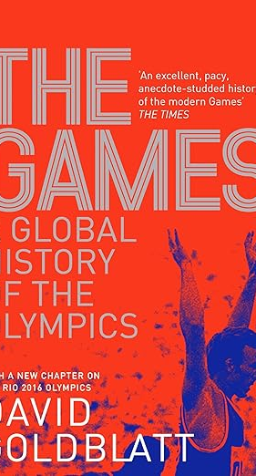

Academic Writing
Growing interest in academia
Cultural Studies, Sports Studies, History, Sociology, Anthropology
Influenced by movements in social history/cultural studies
Class and modernity
Fan cultures and hooliganism
More recently LGBTQ
Increased attention to gender and sport
Marxism (opiate of the masses- more nuanced views), Post modernism etc
Local, national, international
Countercultural and mainstream?
Sets of rules, parallel.

Slide 5
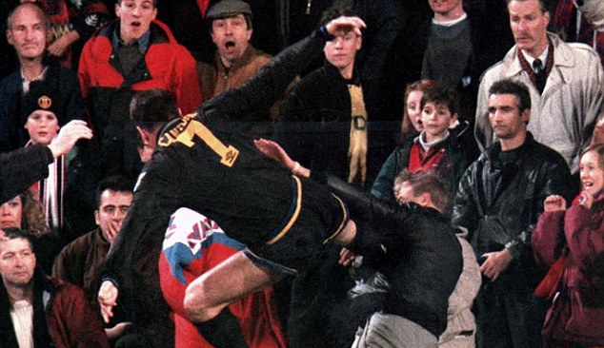

Sport goes global
Sport followed alongside empire and capitalism, more recently as soft power.
Football in the 1980s. Bradford fire (May 1985), Heysel (May 1985), Hillsborough (April 1989). Attendances 41m 1948-9, dropped to 16.5 million by 1985-6. Football violence
Italia 1990. Premier League and Sky ‘revolution’ 1992 – ‘golden triangle’ television, advertising, sponsorship
£304m for five years. 2019-22 Sky and BT £4.5 Bn
Cable and Satellite tv spreads to other sports
Netflix series inc ‘Drive to Survive’

Slide 6
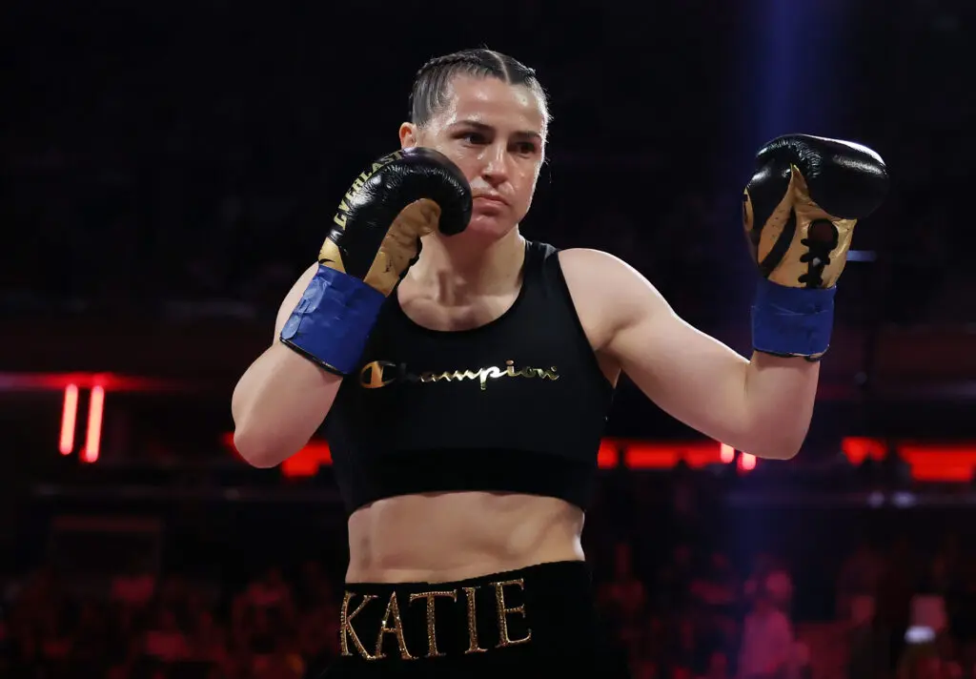
Women’s Sport
Women’s Rugby
Tennis (Billie Jean King)
Olympics
Cricket
Boxing
Women’s sport is getting more coverage and support.
Will pick this up in later lecture

Slide 7
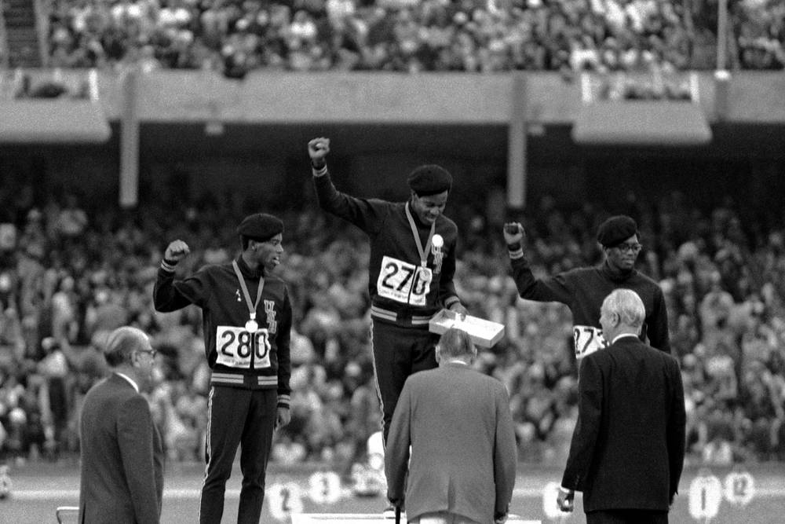
Racism and Politics
Cricket, Empire and post colonialism
Black Lives Matter
Raheem Sterling
Fascism and Sport (Italy/Germany)
More recent examples e.g. Coco Gauff
Civil Rights Movement and Black Power: Muhammad Ali

Slide 8
Conclusion
Sport emerged with industrialisation and became a mass sport
Spread around the globe
Reflects and sometimes changes society, although not political in itself.
Race, class and gender significant issues. Becoming more inclusive
Hyper capitalism and mass media
To understand modern sport, we need to understand history
Football is important, but other sports too. Boxing, Cricket, Formula One, Rugby Union and League.
Can study in an academic manner, but still enjoy
Warwick is well placed geographically to watch sport: Cricket (Edgbaston, Trent Bridge), Football (Coventry, Coventry United, Leamington FC), Rugby (Coventry), Tennis (Priory Club) London not that far.

