Slide 1
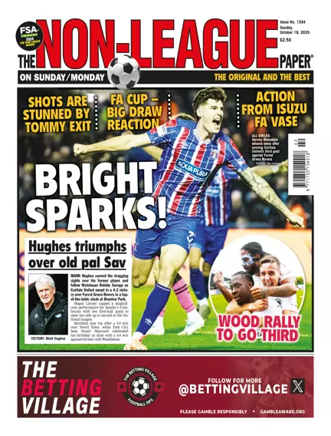
Sport and the Media

Slide 2
Themes
Sport and media interlinked
Printed media
Radio
Television
Internet, social media
Streaming
Podcasts, video casts
Too much media?

Slide 3
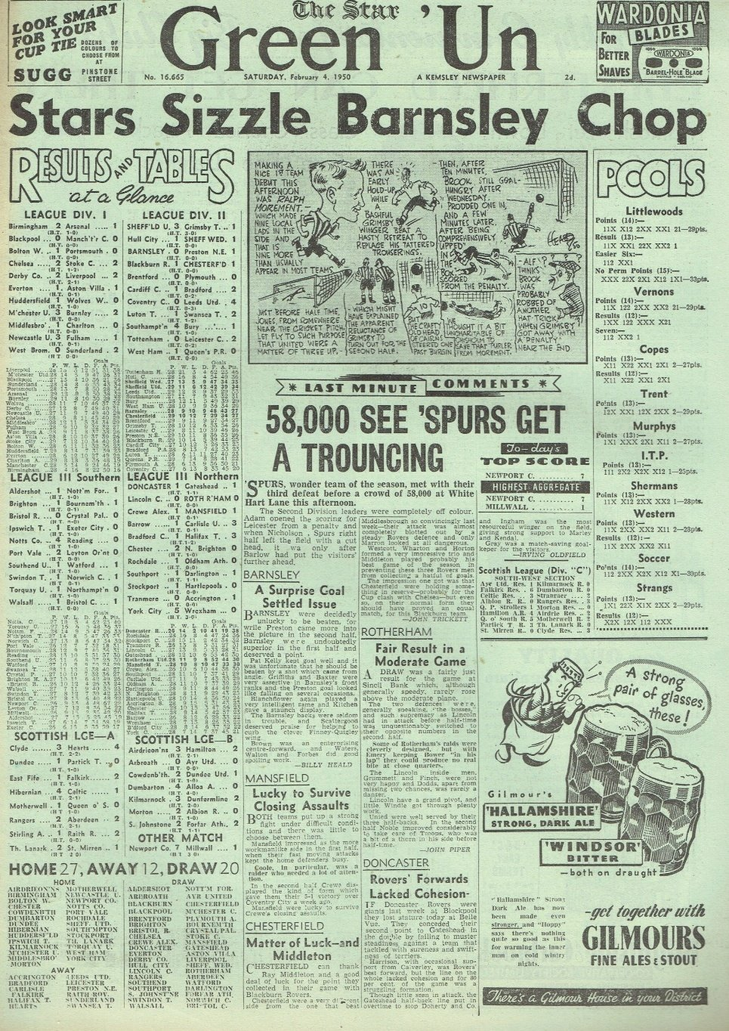
Newpapers
Manchester ’Athletics News’ from 1875. Circulation of 50,000 by 1891.
‘Green’ un and ‘Pink un’
Tabloids and broadsheets
Media on Stars, George Best and Paul Gascoigne. Newsworthy beyond football
Former stars as columnists
Across all sports inc. athletics, tennis

Slide 4
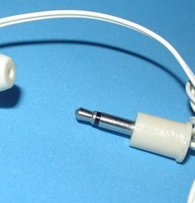
Radio
Major source of information on sport from the 1920s
April 1921First live broadcast, Pittsburgh, boxing Johnny Dundee v Johnny Ray (US)
1922 Cricket in Australia
Jan 1927 BBC England v Wales, Arsenal v Sheffield United
Live commentary on radio 2, then 5 (1990) and eventually 5 extra.
Technology including smaller transistor radios and earphones
Car radio
Digital pluses and minuses. (phones, reception, size)

Slide 5
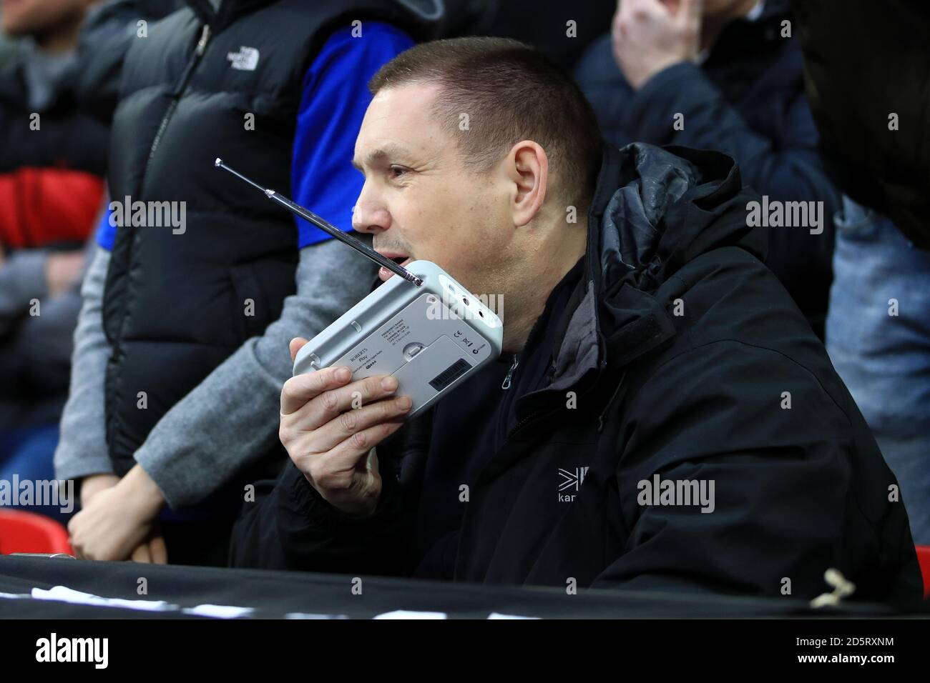
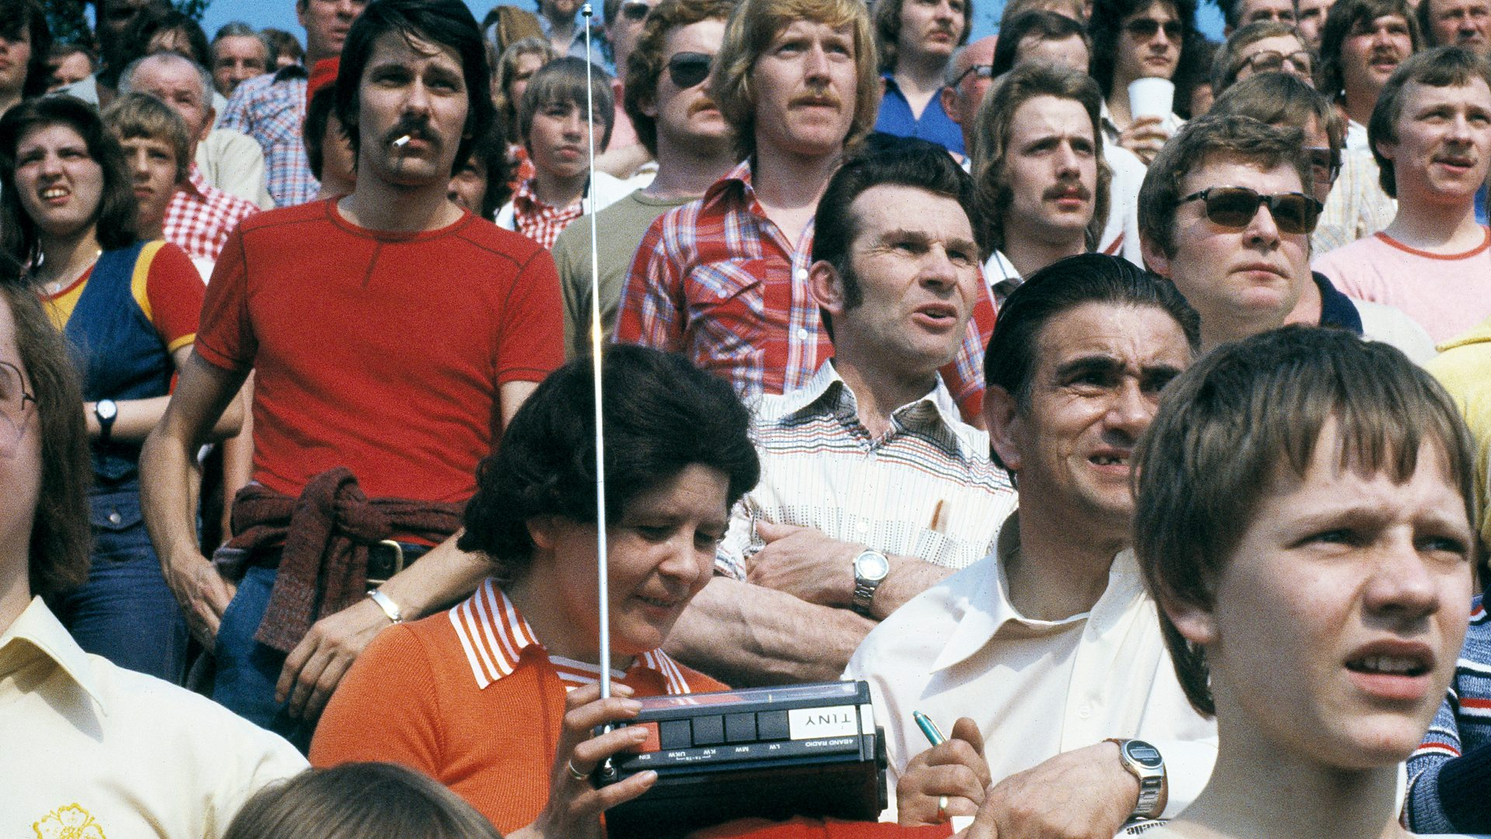
Transistor Radios at games

Slide 6
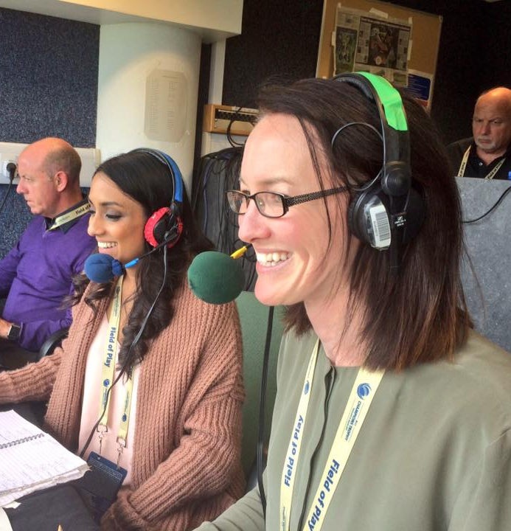
Test Match Special
Becomes an institution, suited to radio
1957 Radio 3
1992-4 Radio 5
1994-2023 Radio 4 longwave
2002 Sports extra (digital)
TMS and overseas tests. Listening to Ashes etc. Popular even when tv has begun sports coverage
Humour, cakes, guests and digressions!
https://youtu.be/xSPgtG1-FYY?si=O_cxrUXTjwEjUcMj
Still popular
Isa Guha and Alison Mitchell.

Slide 7
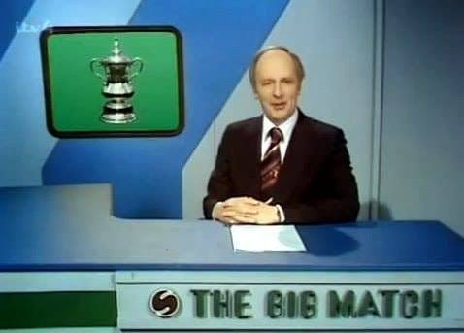
1966 World Cup and Television.
Television – coverage and money
https://youtu.be/VPQvekloS8U?si=fVzeWc7i1nYVsylY
Television ownership increases in UK post 1945. Coronation in 1953 important.
BBC and MOTD (Aug 1964) David Coleman, Des Lynam
1966 World Cup
ITV and regional Big Match (1968-92) Brian Moore
Former stars among presenters, summarisers and commentators e.g. Jimmy Hill, Bob Wilson and Gary Lineker

Slide 8
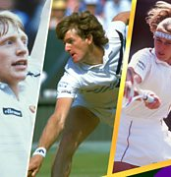
BBC and Wimbledon
Radio from 1920s
Wimbledon from 1937. First day, Bunny Austin v George Lyttleton Rogers, but broadcast for only 25 minutes.
Highlights evening show from 1960s
1967 Professionalism and First colour broadcast on British TV
Olympics
Terrestrial v Satellite/Streaming
BBC and austerity
WSL

Slide 9
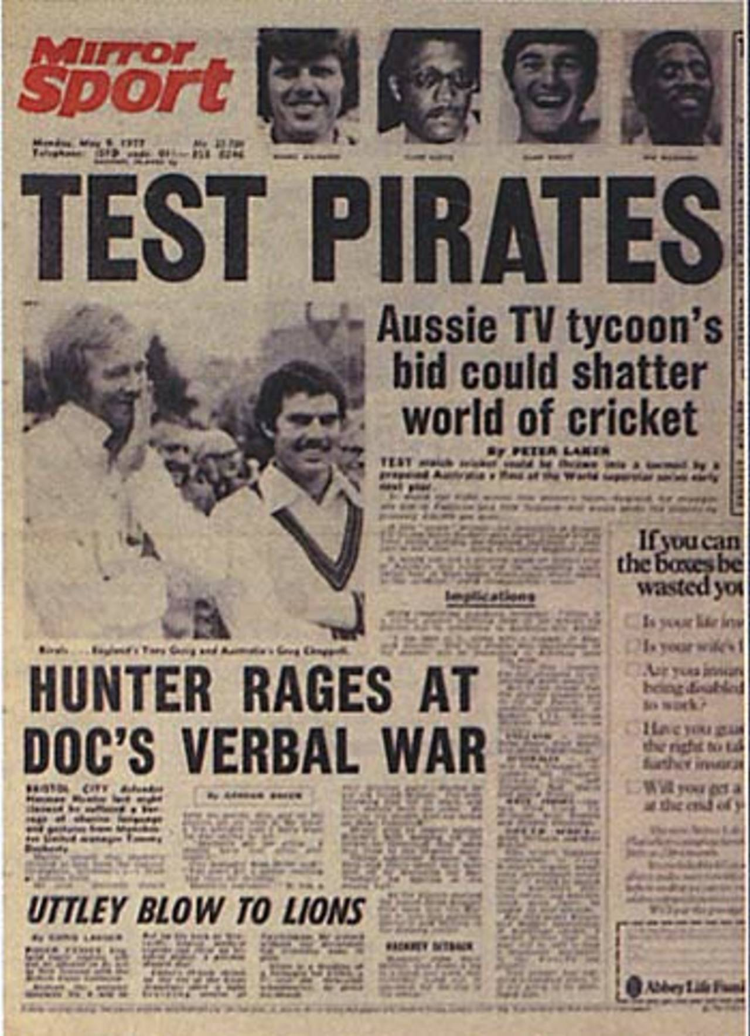
Kerry Packer and World Series Cricket (WSC)
Kerry Packer, powerful media tycoon
1977 WSC
Players feel they are not getting a fair share of tv and commercial revenues
Last 17 months and causes discord within world cricket (including bans)
White ball, evening games, coloured kits
Better quality tv coverage
Compromise and integration
Players paid more and professionalisation underlined.
Link to Elite breakaways in other sports

Slide 10
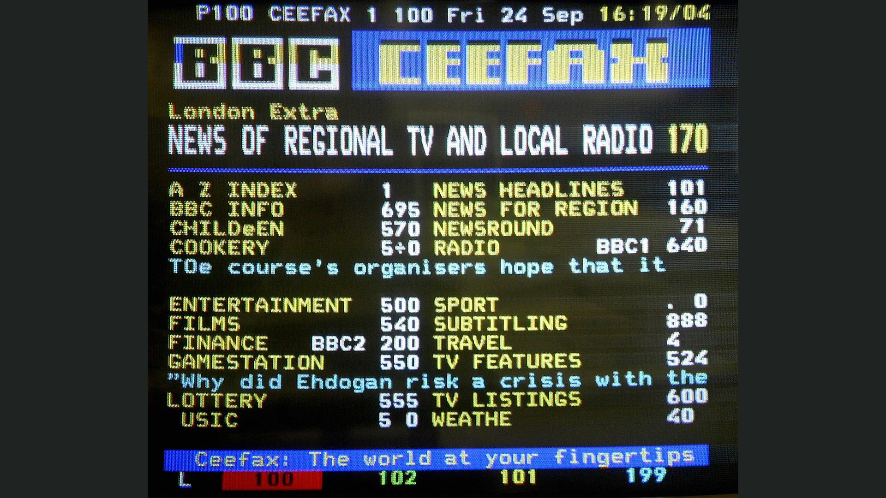
Ceefax
Sept 1974
Information at fingertips
Sports and entertainment
Up to date results

Slide 11
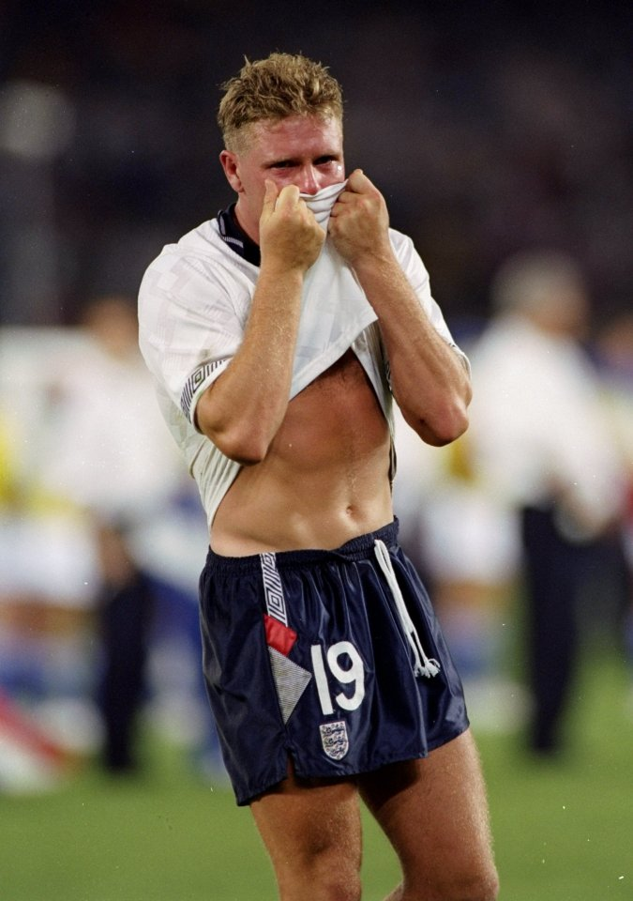
Sky, The Premier League and the TV revolution
The Football context:
Football in the 1980s. Bradford fire (May 1985), Heysel (May 1985), Hillsborough (April 1989).
Attendances 41m 1948-9, dropped to 16.5 million by 1985-6
Football violence e.g Luton v Millwall FA Cup quarter final 1985
https://youtu.be/emkW_QdMahg?si=v-E-kbyjGRGv1nTN
Italia 1990; Heroic failure, Gazza, ”Nessum Dorma’

Slide 12
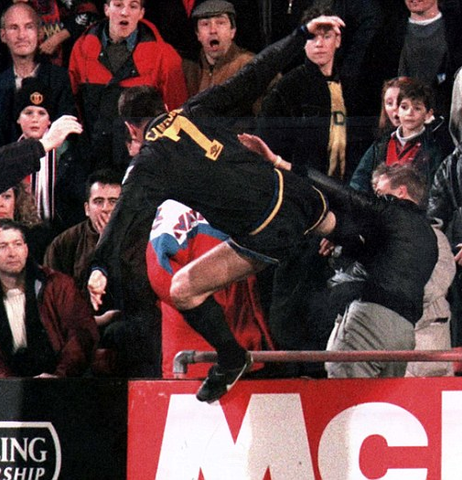
Things step up
Premier League formed 20 Feb 1992, first games August 1992
Sky satellite tv started 1989, 1990 coverage of cricket (1990 World Cup), tennis and other sports.
Deal to cover Premier League from start of 92-3 season. £304m for five years
Super Sunday and Monday Night Football (worst of lot!)
‘golden triangle’ television, advertising, sponsorship
The Importance of Eric Cantona and foreign players (including Jan 1995)
https://youtu.be/C7PSY7KYThk?si=x9xY3XSCxe9isZAi
‘Sky Four’ Utd, Arsenal, Chelsea and Liverpool
Utd dominate…….
Lockdown.
2025-6 deal for four years: £.6.7 BN, 270 Games a year, Sky, TNT and Amazon. BBC highlights on website and MOTD (Lineker)

Slide 13
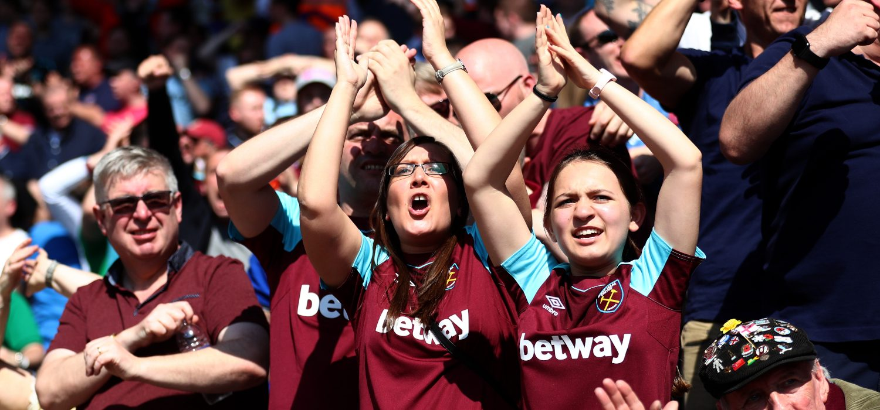
Fans lose their importance?
Changed kick off times and days
Trains unreliable and more so since lockdown. Expensive, also parking likewise if drive.
Replica shirts
Food and drink
New Stadia, clubs don’t own?
Running tracks…
Crowds just for atmosphere?
Cost of streaming
Confusion over who controls and owns?

Slide 14
Punk Football: Taking Back Control
German model: fan ownership rules kept them in the majority
’Supporter’s Direct’ (2000) – Andy Burnham MP early chair. Advice and support on fan ownership.
Football Supporters Federation (FSF) (2002) (UEFA funds) Representation on board, safe standing, lower ticket prices.
AFC Wimbledon, Lewes FC, Exeter City, Newport County and others ‘fan’ owned. 50
Some successes e.g. 2016 -19 Premier League agree £30 limit on away tickets. Just renewed
Government and independent regulator
Newcastle and Sports washing
WSL and affordable football

Slide 15

Non League football in a global media age
Non-League as an alternative. ‘Non League day’ from 2010 during International Break
FC United of Manchester (2005) in response to Glazer’s takeover of Utd
Attendances increased since the pandemic
2025 weekly attendances across the top four non-league tiers reached an all-time high of 117,58, marking an increase of 43% over the past five years and 89% in a decade.
The Wrexham effect (Netflix)
Leamington FC Lost ground in 1988, Re-founded in 2000. Several promotions and now in Conference North (two below the Football League) 600 average attendance. New stadium 5k maybe? 1931?)
Money filtering down e.g. Real Bedford: Bitcoin funding
Hashtag Utd (YouTube/social media), Lewes FC (global fan ownership), AFC Croydon Athletic (Stormzy and Zaha)
What does football and community mean?

Slide 16
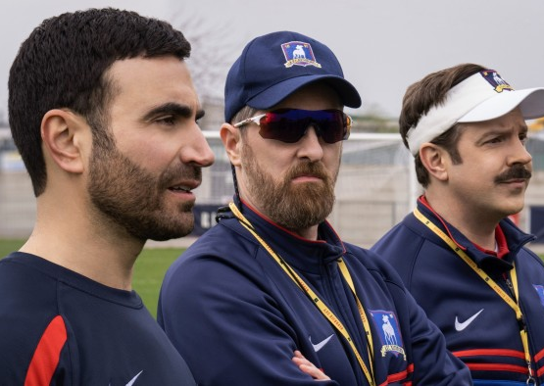
Streaming
Streaming, dramatic increase in volume of programmes on sport (not always quality)
Documentaries e.g Formula 1: Drive to Survive
Welcome to Wrexham
All or Nothing
The Last Dance
Sunderland Till I Die
How true? How scripted? Boring?
Comedy/Drama: Ted Lasso, Friday Night Lights, Stick, Glow

Slide 17

Social Media
Connect with fans
Personal, although media officers
Trolls and bots
Particularly for women in sport
Information
Up to date news
Connect with fans around the world
Can impact policy and jobs
But echo chamber
Negative louder than realistic or positive.

Slide 18
Podcasts
The Game Changers
Tailenders
The Grade Cricketer
Athletic Women’s Football podcast
Totally Football
Guardian Football/Guardian Women’s football
Etc etc

Slide 19
Conclusion
Media and Sport intertwined
Technology developed for sport used in wider society. Sometimes vice versa
Demand, interest and money explain link between sport and media. Hyper capitalism
From printed word to streaming
Sponsorship and advertising and ownership
Money trumps fans interests
Changing the rules and structures to attract media and money e.g Hundred. European Super League proiposal and US Sport – no relegation?
Changing the basic structures is dangerous.
County championship and non league
Football

