Slide 1
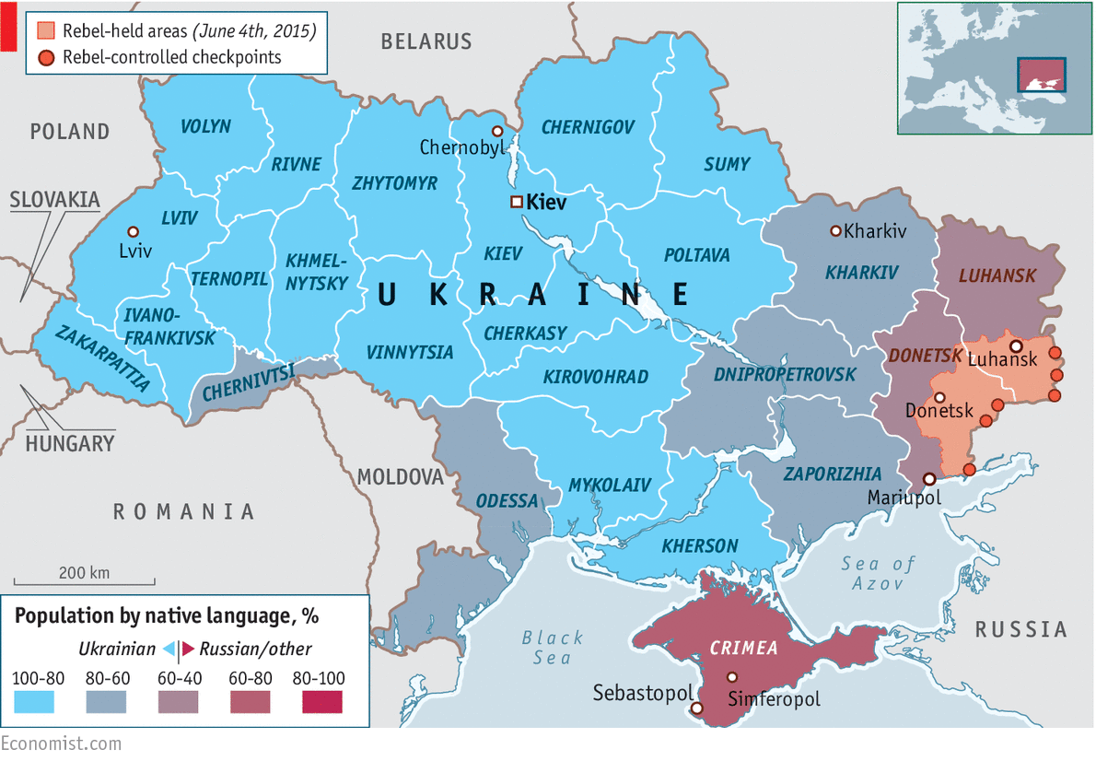

Slide 2
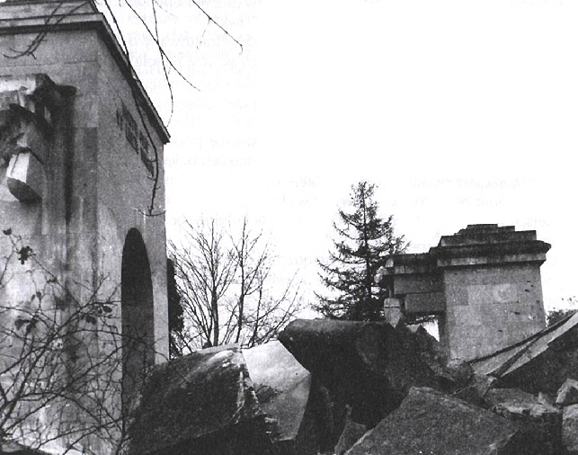

Slide 3
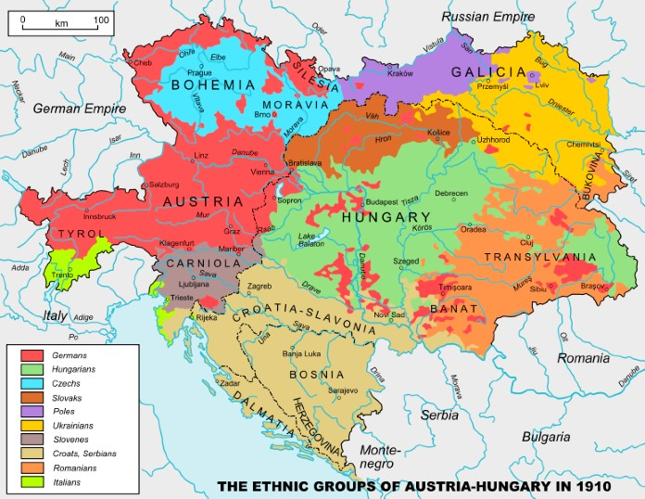

Slide 4
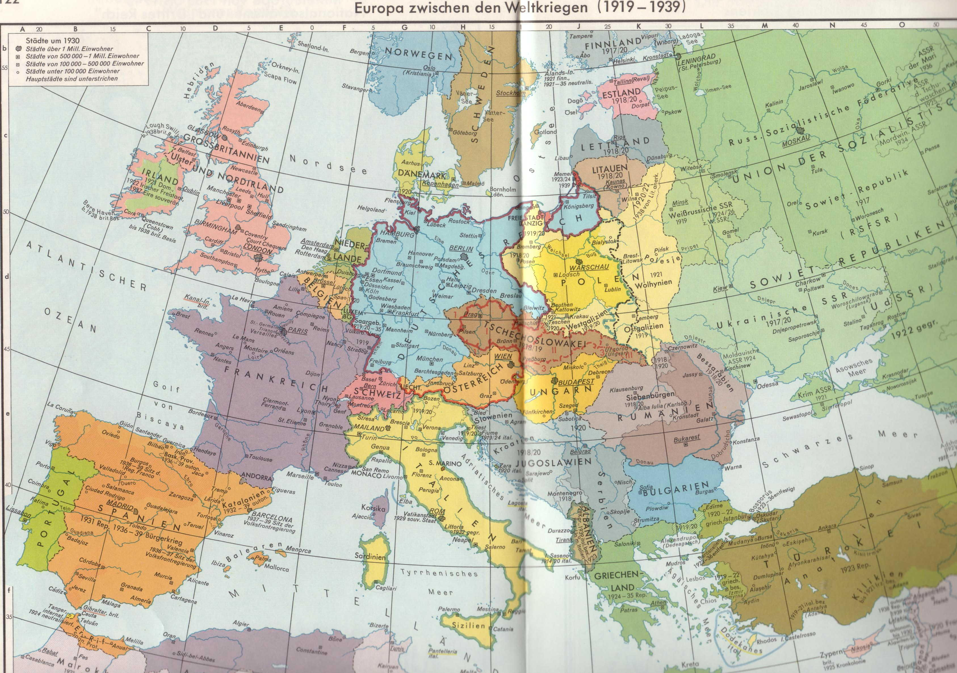
Putzger, Historischer Weltatlas, pp. 122-123

Slide 5
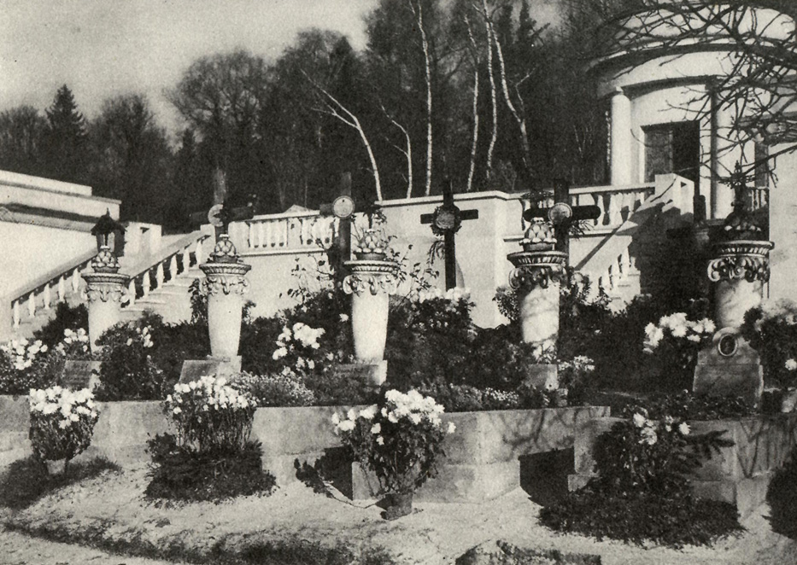
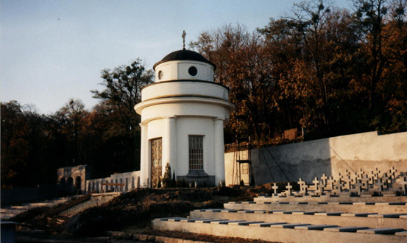
1930
Polish military cemetery in L‘viv,
Original burial place of the
Polish Unknown Soldier
2001

Slide 6
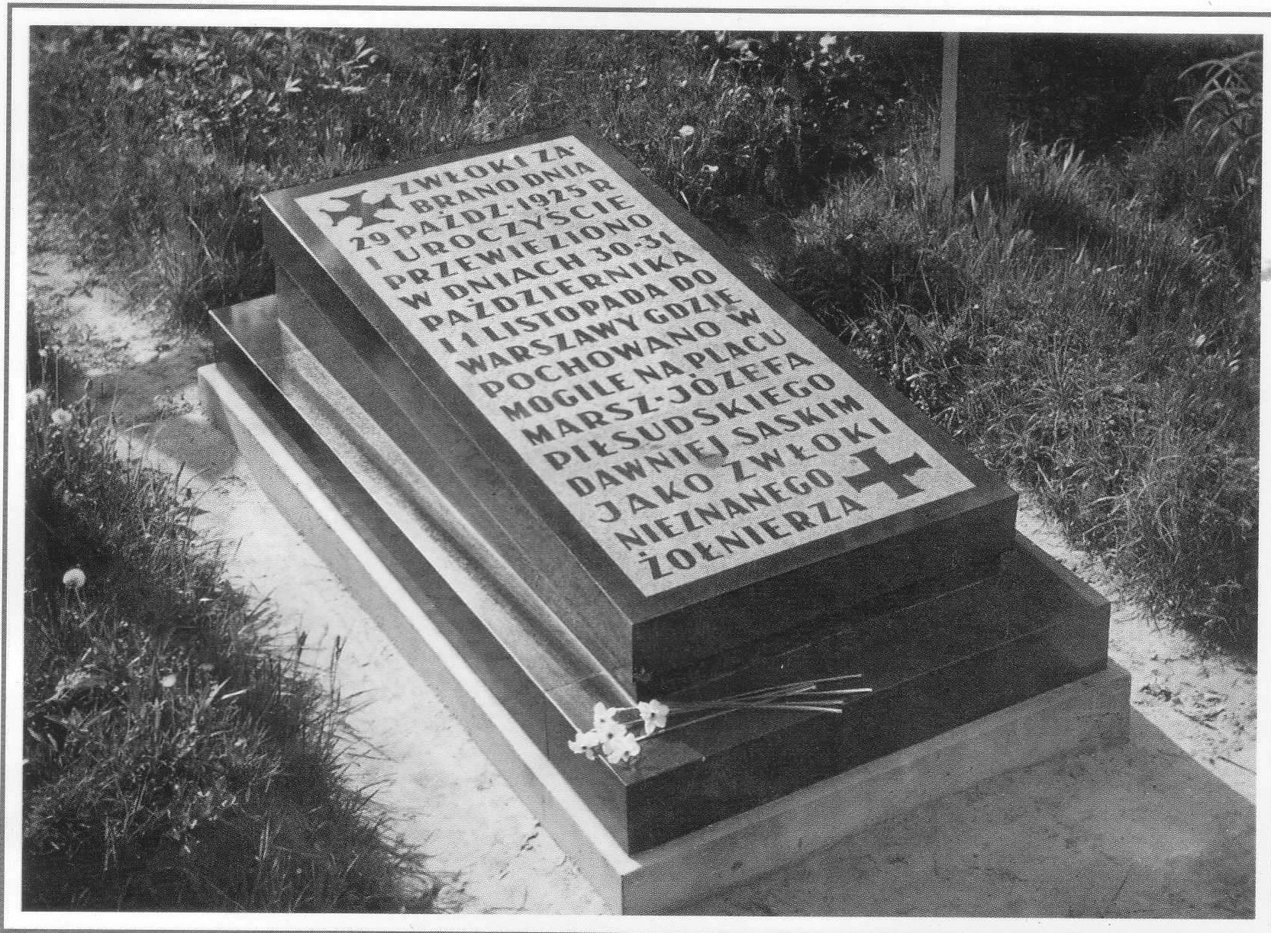
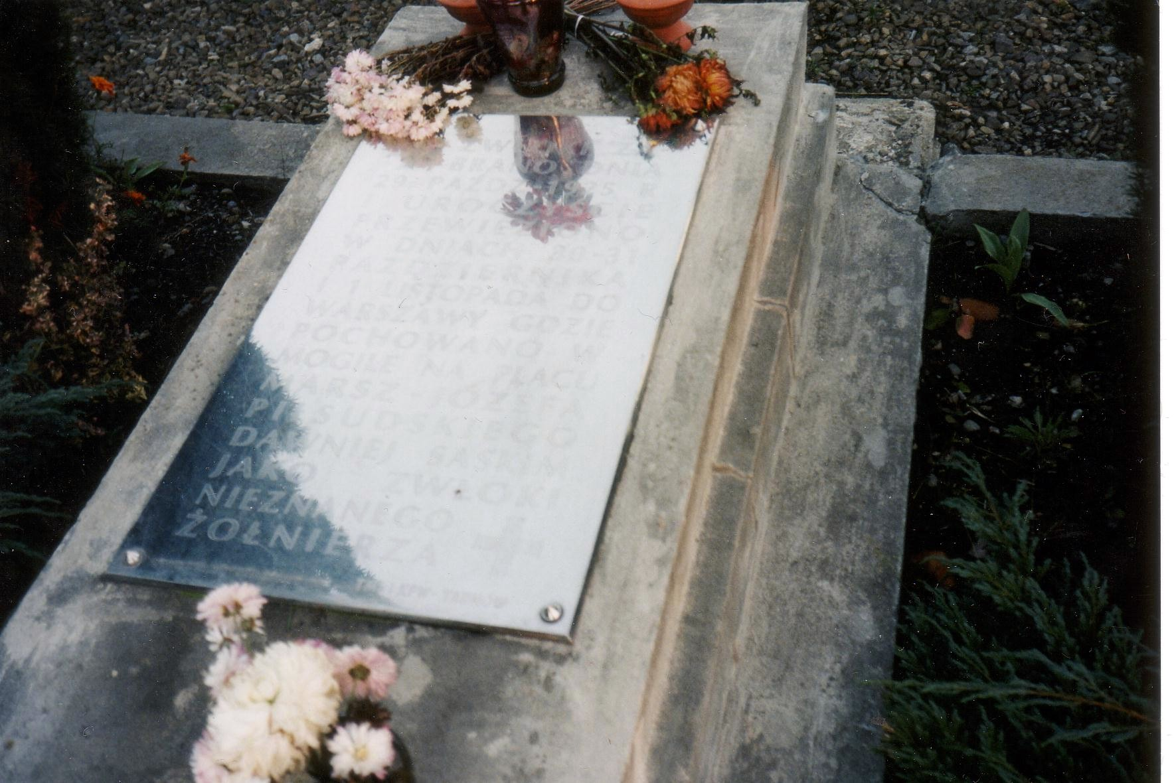
1930
2001
Grave where the remains of the Polish Unknown Soldier originally rested, Cemetery of the Defenders of Lwów, L‘viv

Slide 7
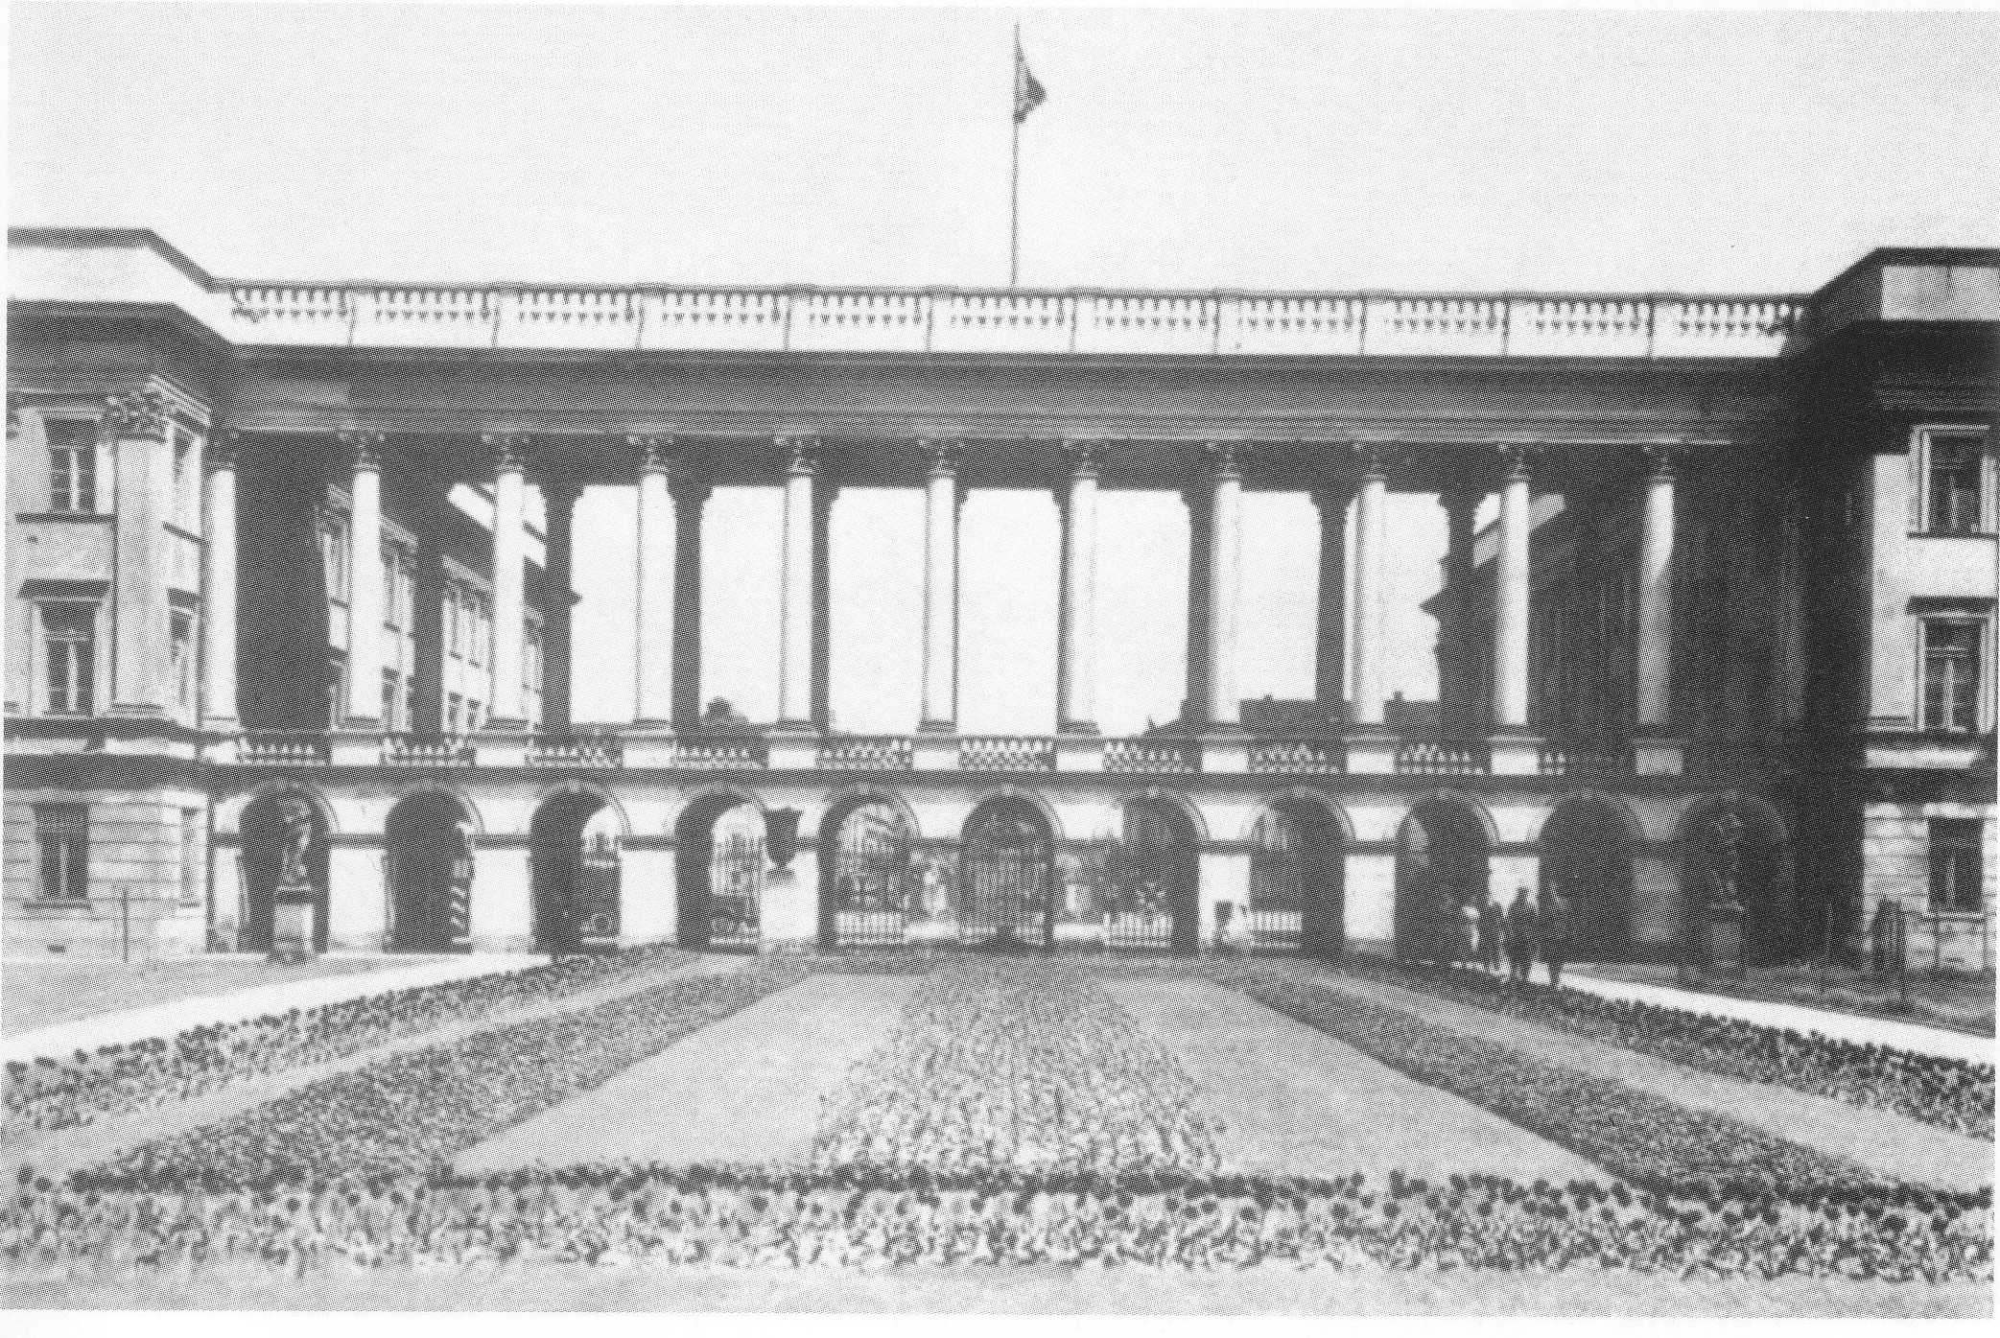
The Saxon Palace, Warsaw
Tomb of the Polish Unknown Soldier in the central arcades, 1925

Slide 8

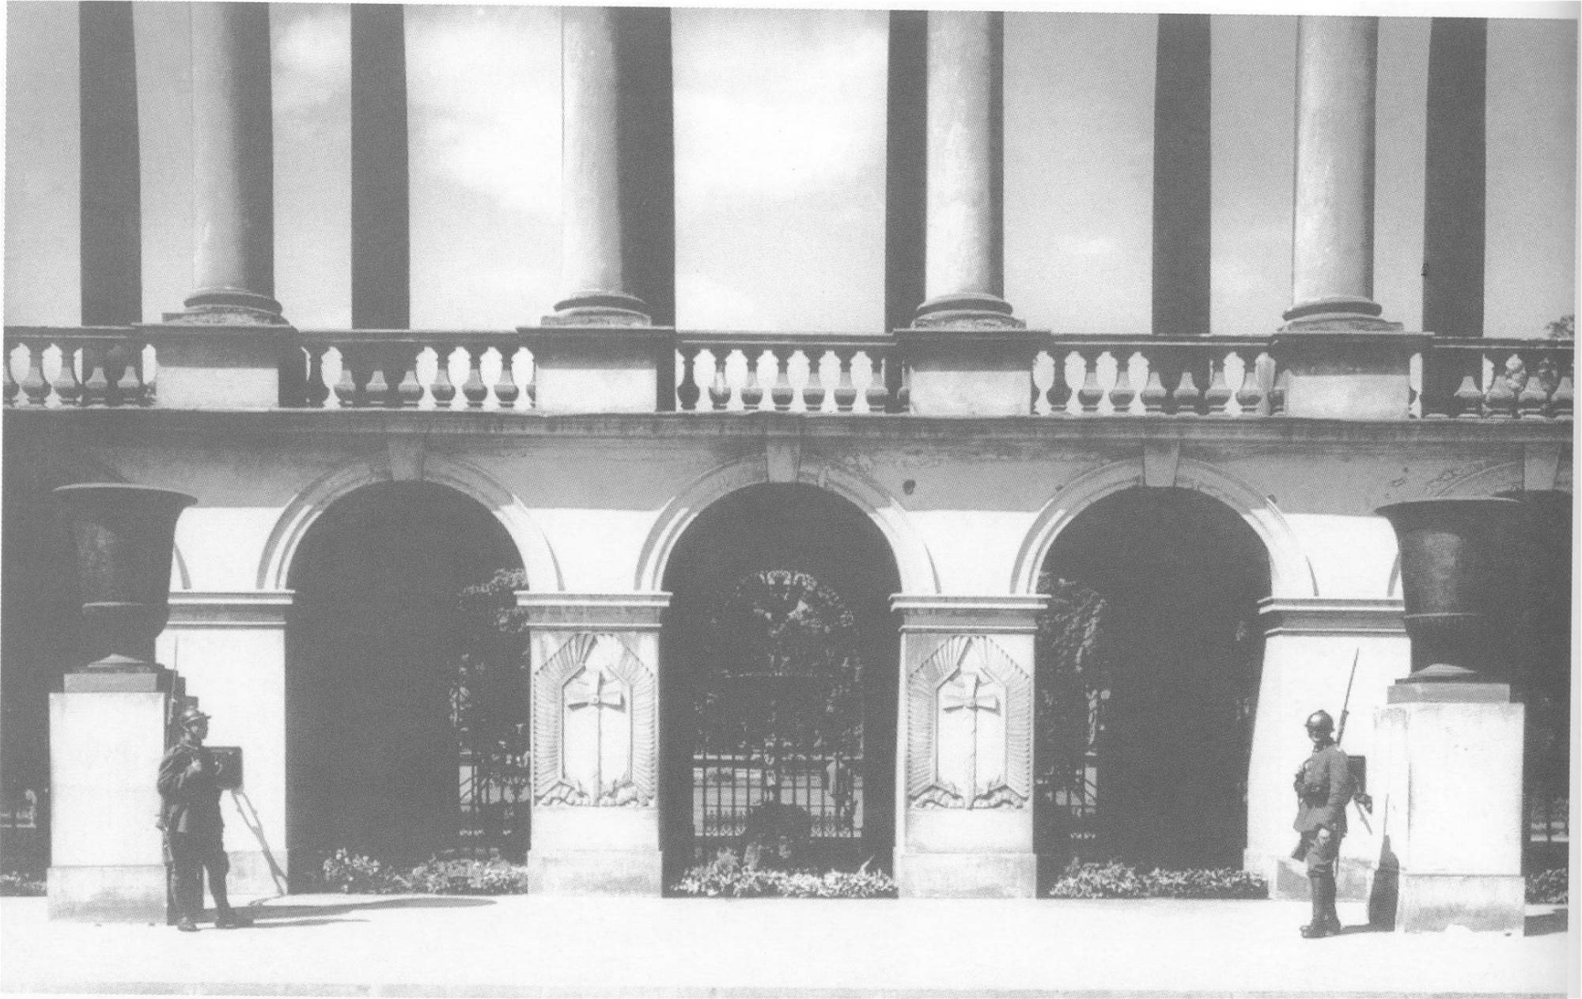
Der Sächsische Palast in Warschau. In den zentralen Arkaden das
Grab des Unbekannten Soldaten, 1925

Slide 9
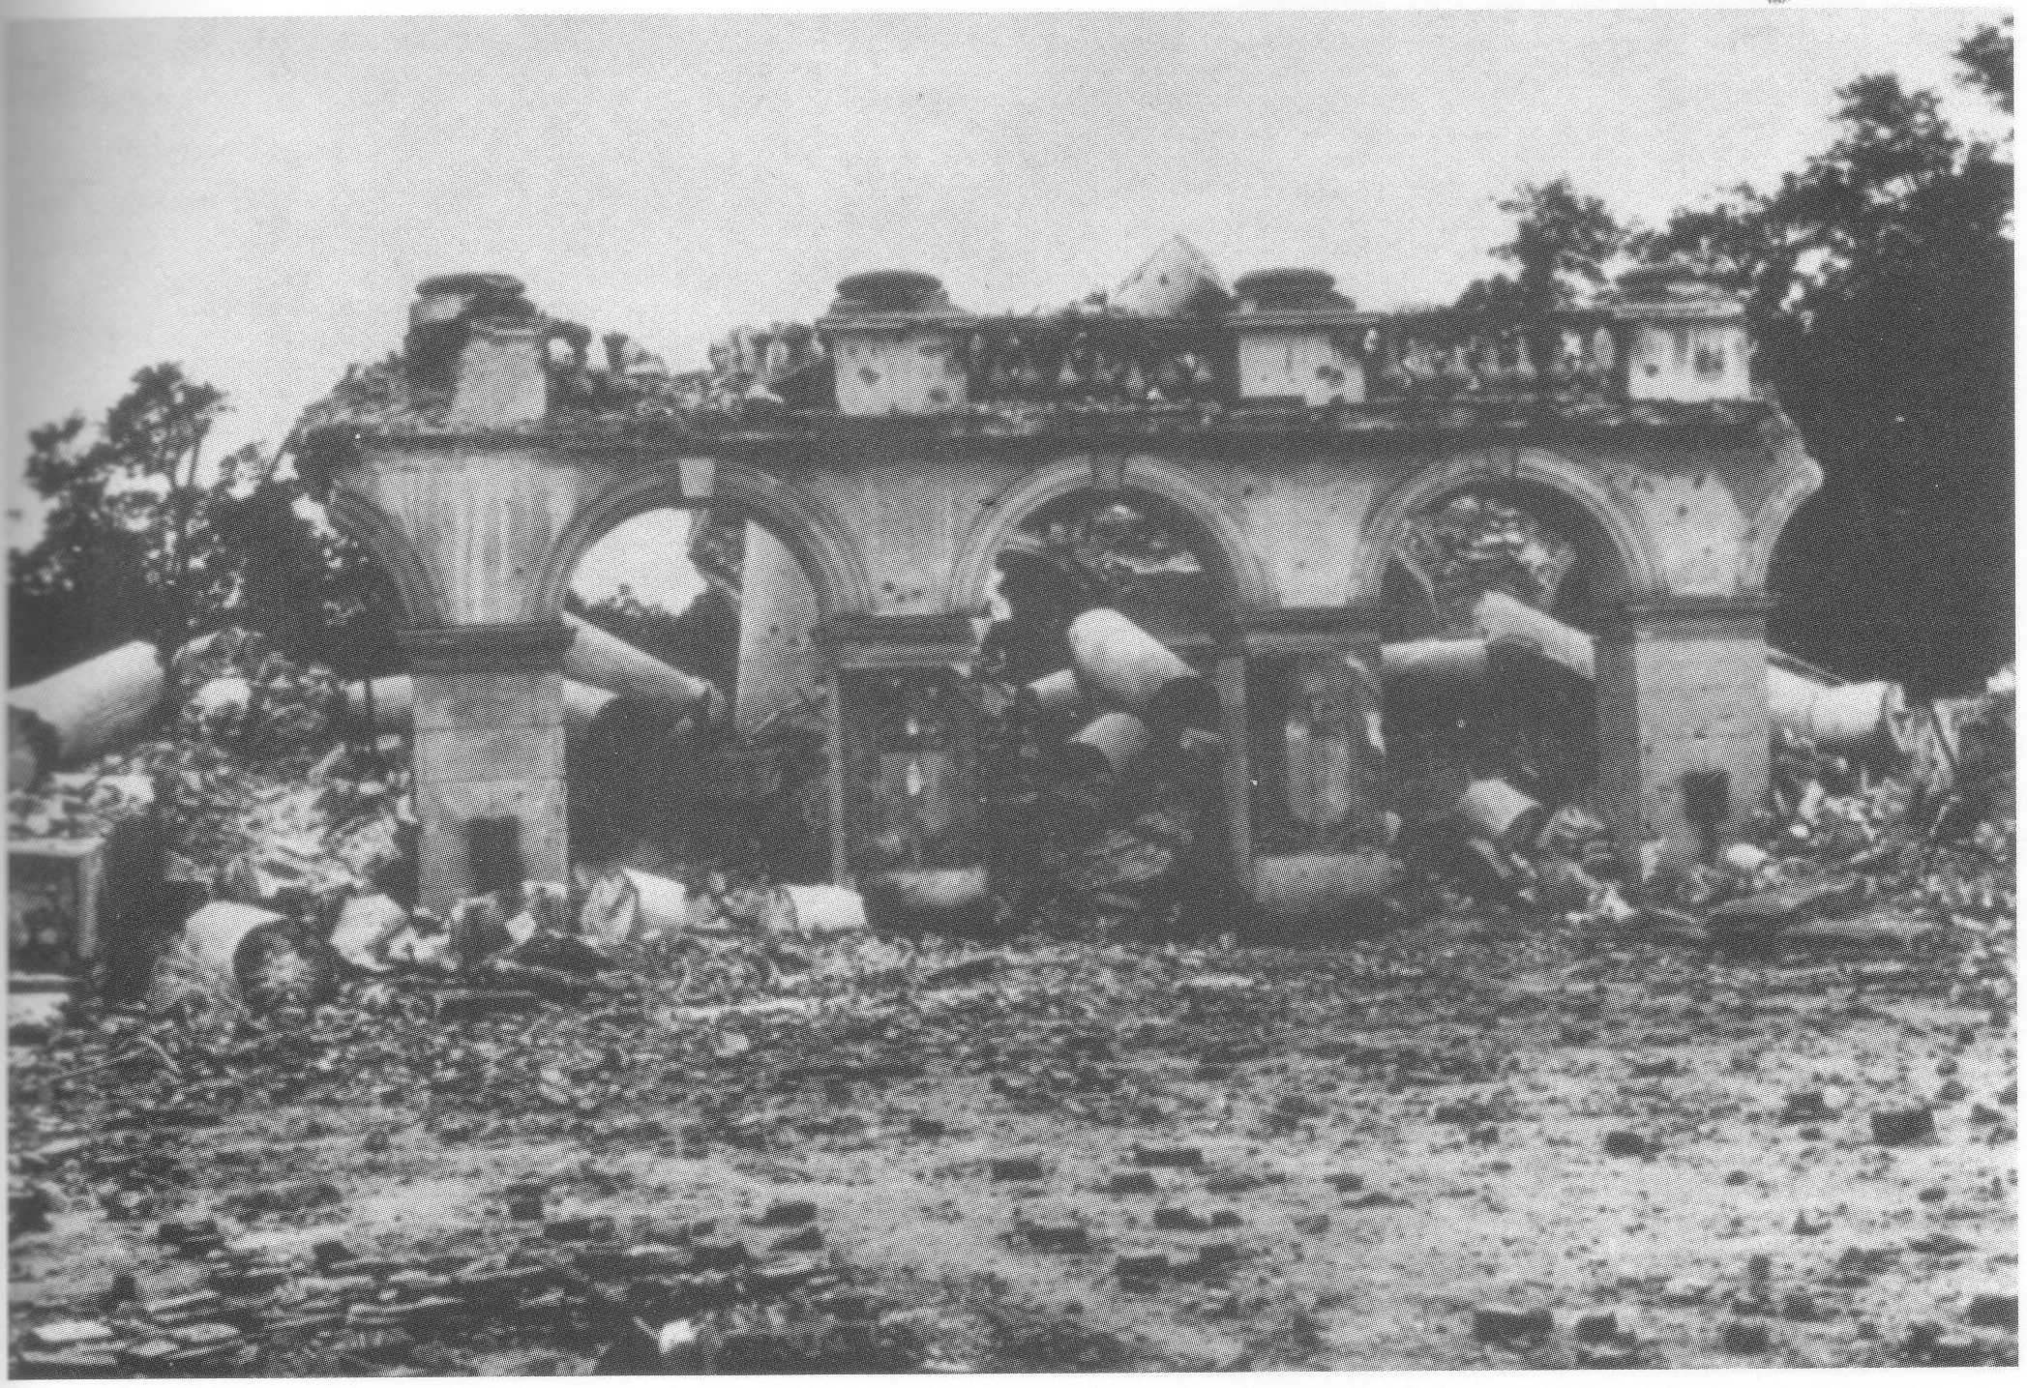
Ruins of the Saxon Palace and Tomb of the Unknown Soldier, Warsaw, 1945

Slide 10
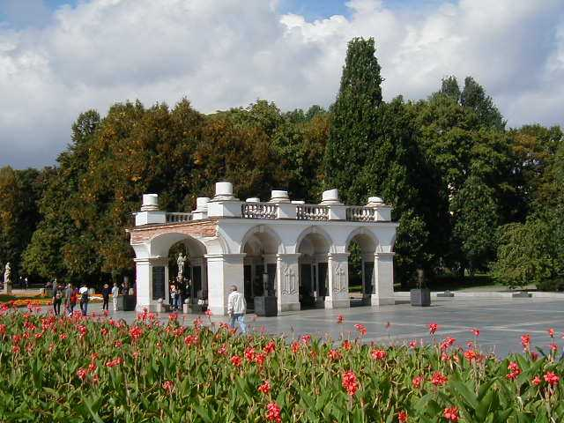
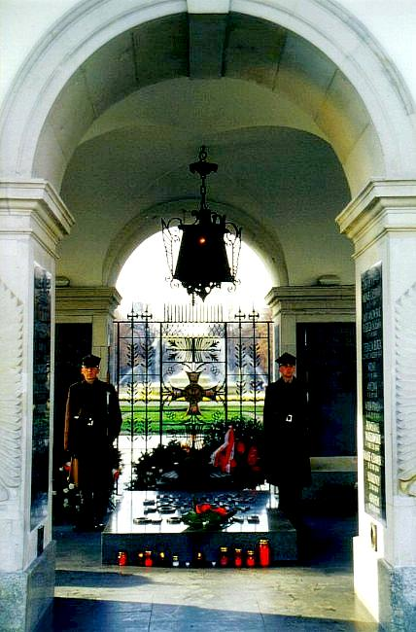
Tomb of the Unknown Soldier, Warsaw, 2001

Slide 11
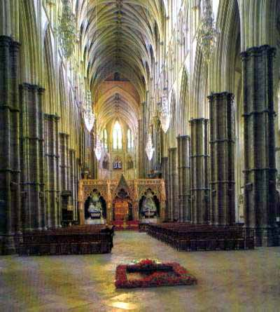
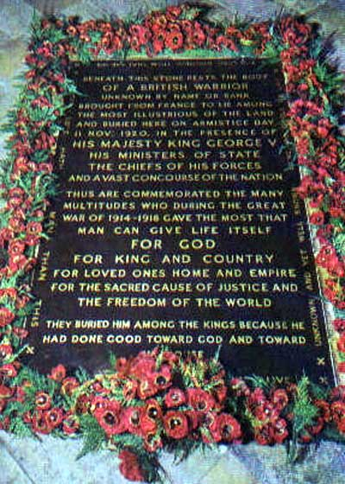
Tomb of the Unknown Warrior, Westminster Abbey, London

Slide 12
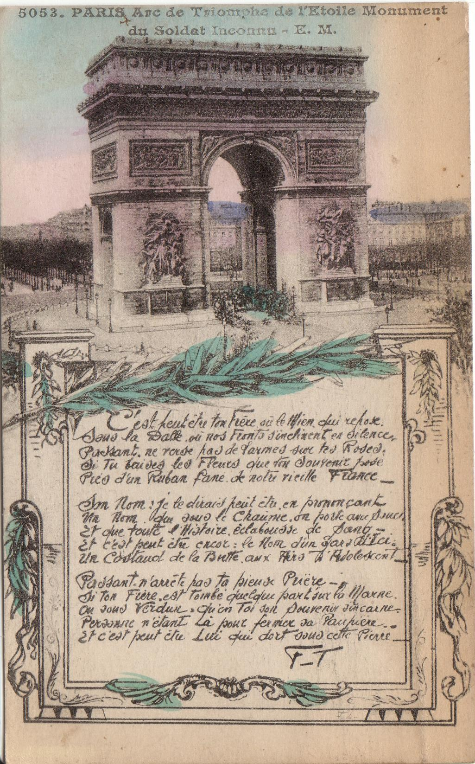
Postcard of the Tomb of the
French Unknown Soldier beneath
the Arc de Triomphe, Paris, 1920

Slide 13
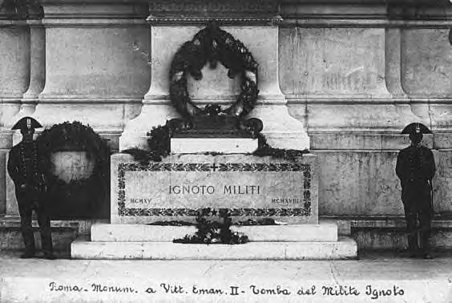
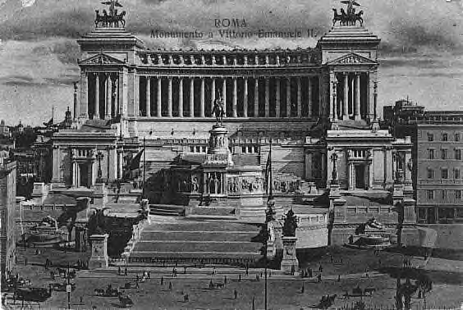
Italy, Rome, Altare
Della Patria (Vittorio
Emanuel Monument)

Slide 14
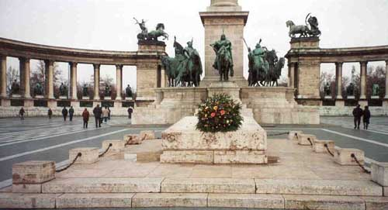
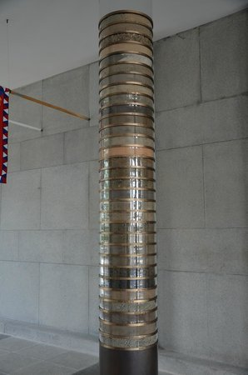
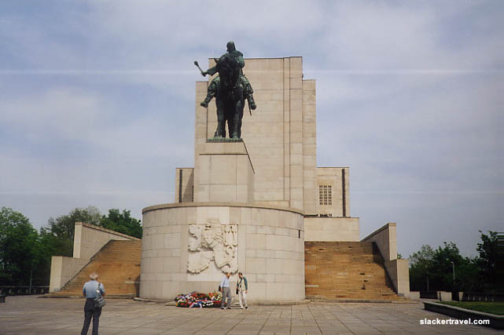
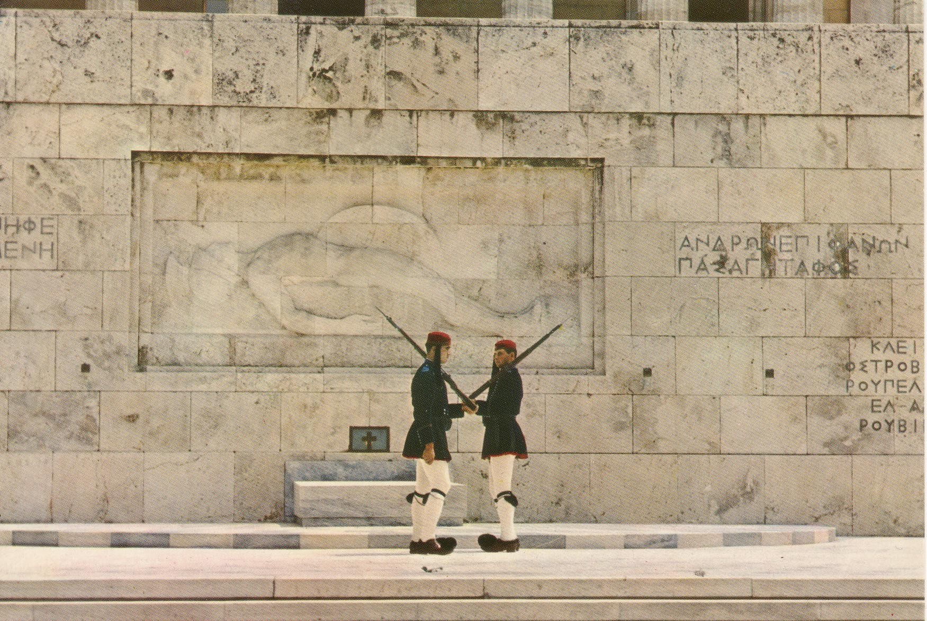
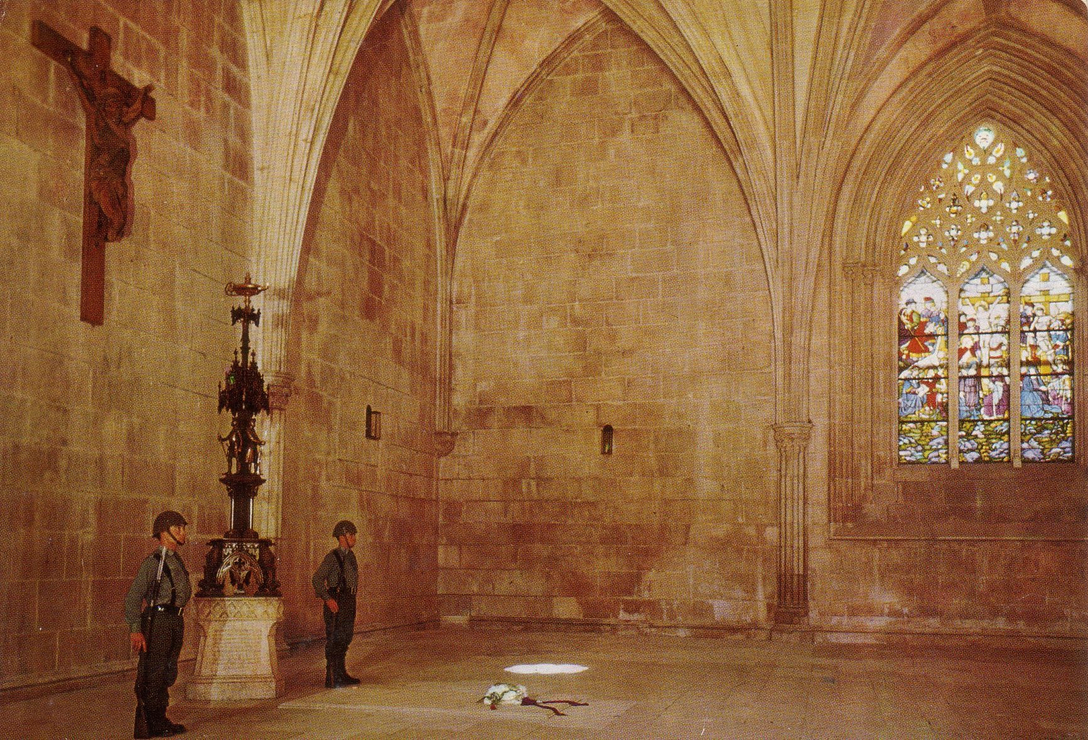
Hungary, Budapest, Monument
of National Heroes, Heroes’ Square
Czechoslovakia/Czech Republic,
Prague, Monument of Jan Zizka
Greece, Athens, Syntagma Square
Portugal, Batalha Monastery

Slide 15
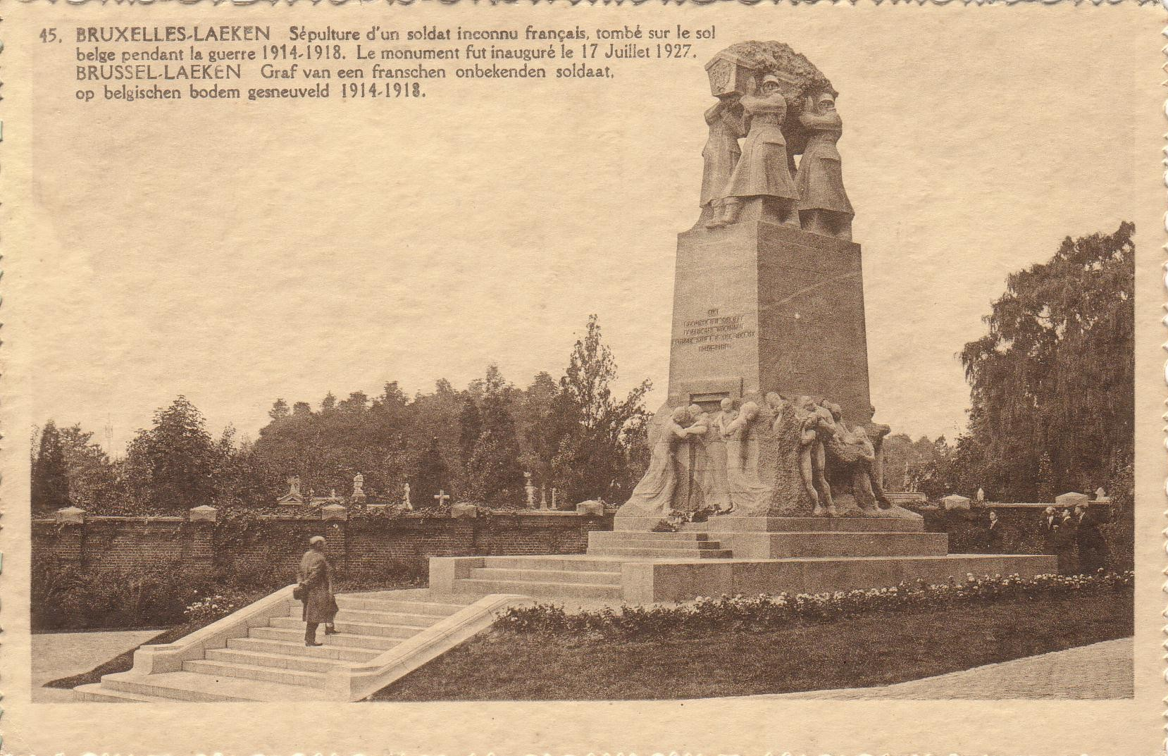
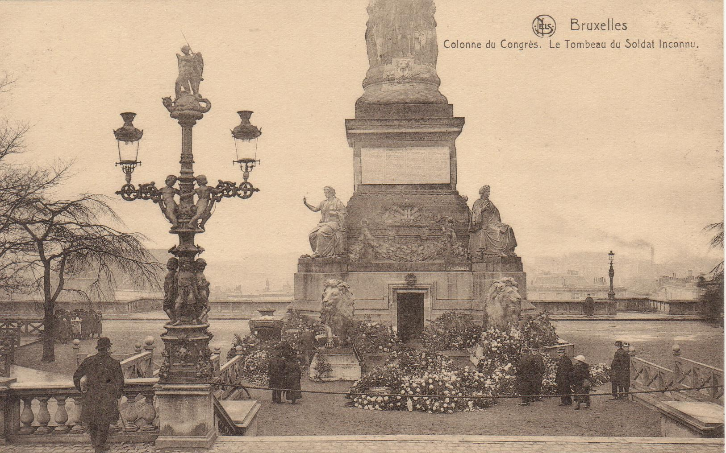
Postcard of the Tomb of the
French Unknown Soldier who fell in the defence of Belgian independence, Belgium, Brussels-Laeken,
inaugurated on July 17, 1927
Postcard of the Tomb of
the Belgian Unknown Soldier,
Brussels, 1923

Slide 16
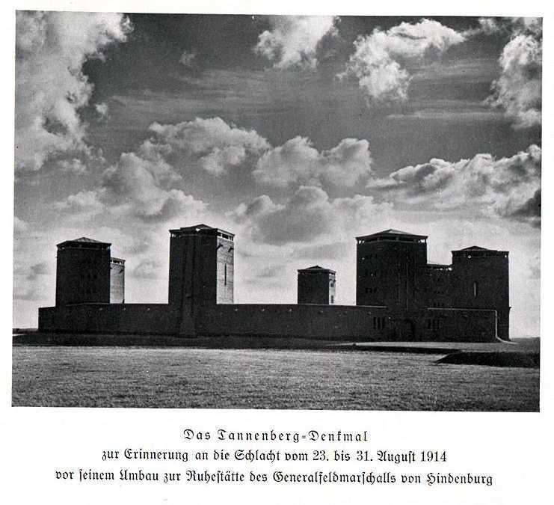
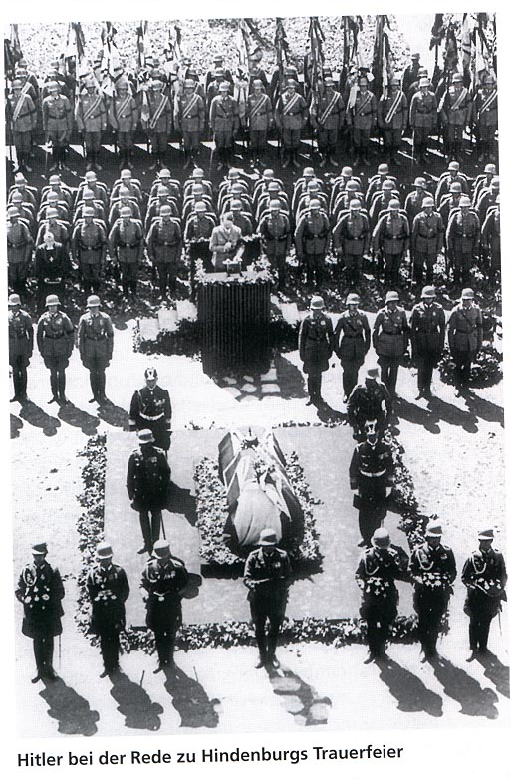
The Tannenberg monument: Nationaldenkmal and Reichsehrenmal

Slide 17
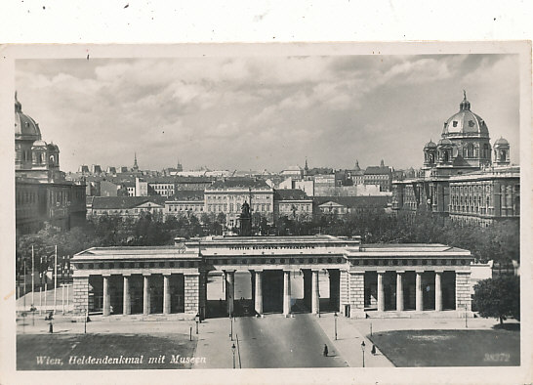
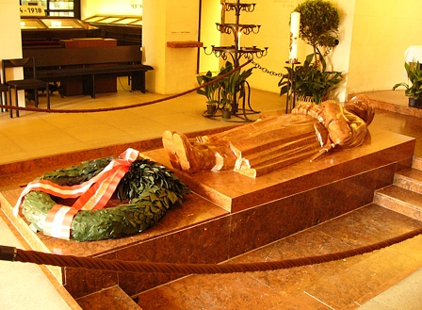
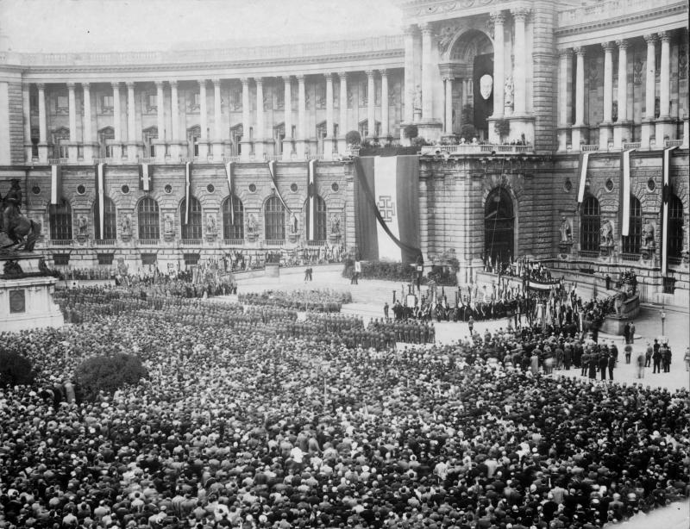
Vienna: Äußeres Burgtor, Heldendenkmal

Slide 18
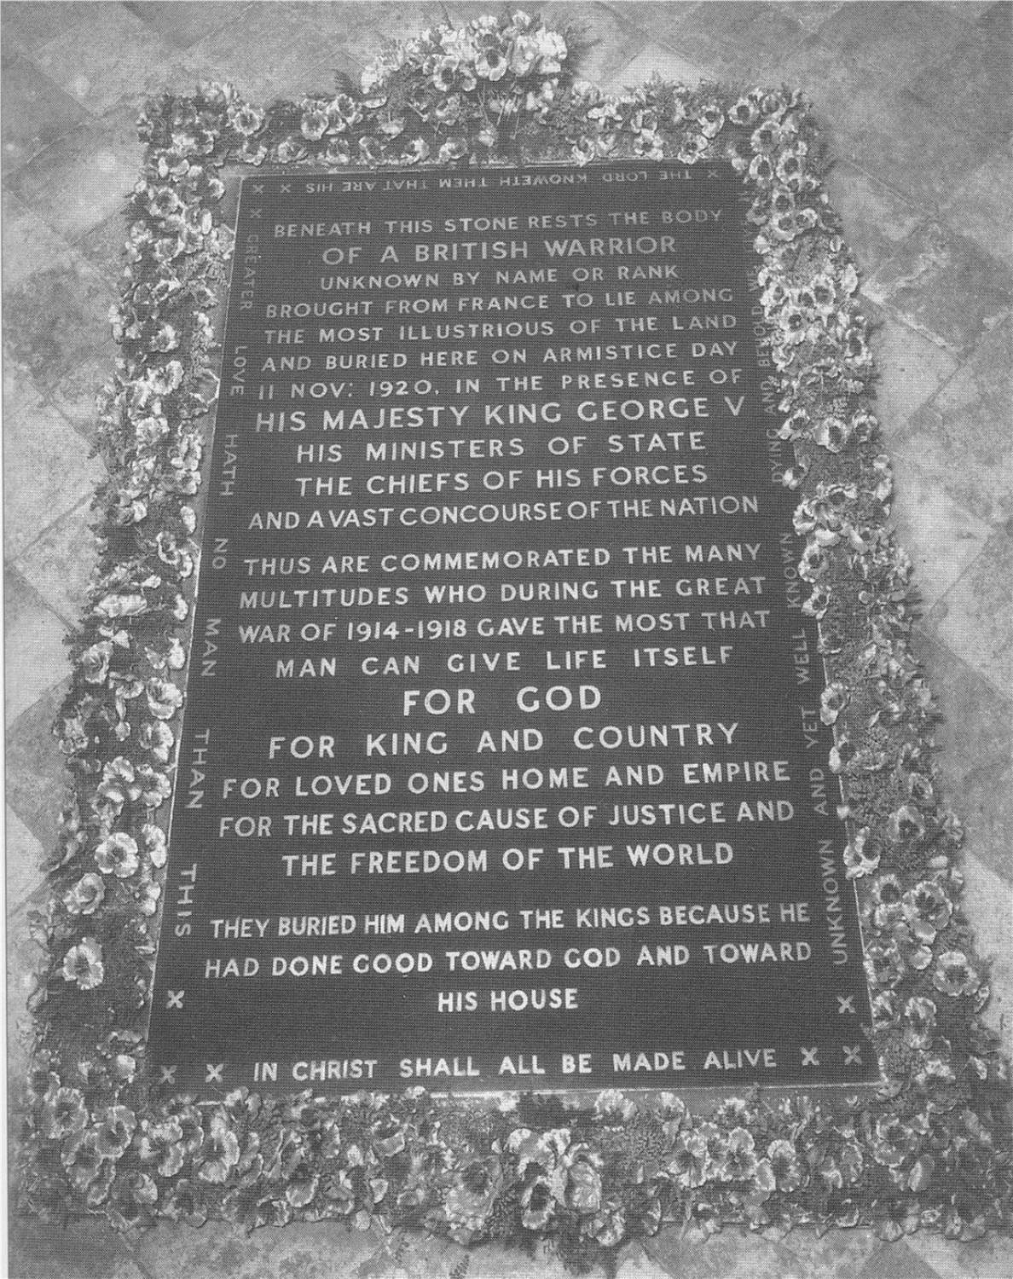
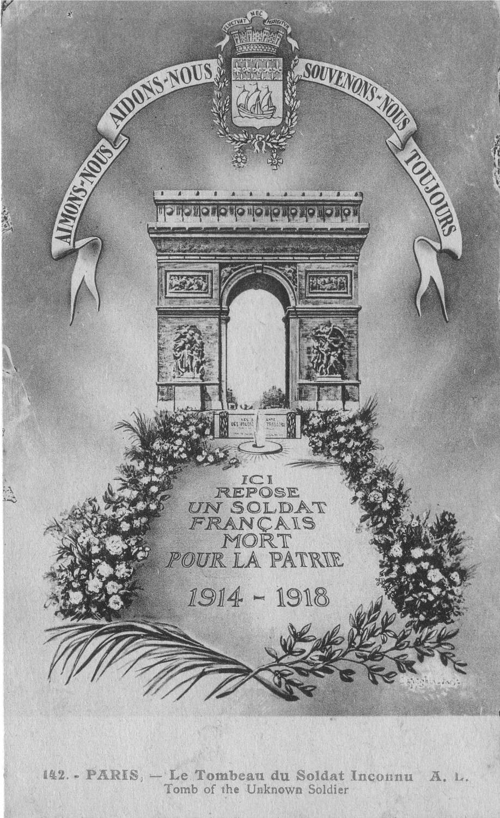
"BENEATH THIS STONE RESTS THE BODY OF A BRITISH WARRIOR UNKNOWN BY NAME OR RANK BROUGHT FROM FRANCE TO LIE AMONG THE MOST ILLUSTRIOUS OF THE LAND AND BURIED HERE ON ARMISTICE DAY 11 NOV: 1920, IN THE PRESENCE OF HIS MAJESTY KING GEORGE V HIS MINISTERS OF STATE THE CHIEFS OF HIS FORCES AND A VAST CONCOURSE OF THE NATION THUS ARE COMMEMORATED THE MANY MULTITUDES WHO DURING THE GREAT WAR OF 1914 - 1918 GAVE THE MOST THAT MAN CAN GIVE LIFE ITSELF FOR GOD FOR KING AND COUNTRY FOR LOVED ONES HOME AND EMPIRE FOR THE SACRED CAUSE OF JUSTICE AND THE FREEDOM OF THE WORLD THEY BURIED HIM AMONG THE KINGS BECAUSE HE HAD DONE GOOD TOWARD GOD AND TOWARD HIS HOUSE "

Slide 20
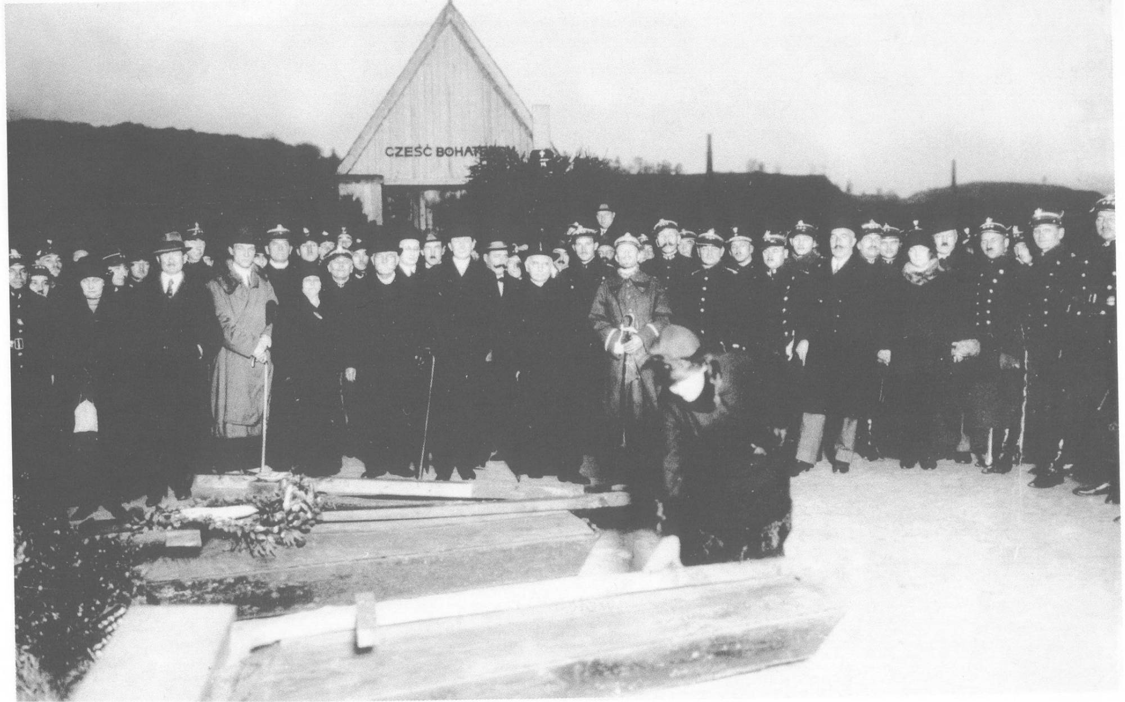
Lviv, 29/10/1925

Slide 21
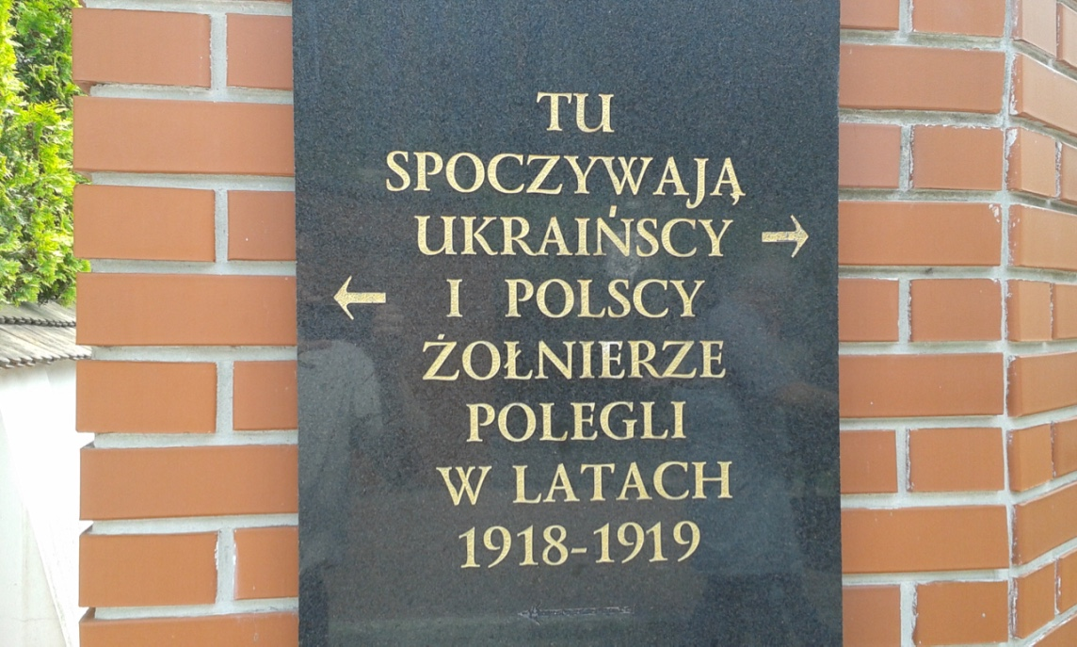
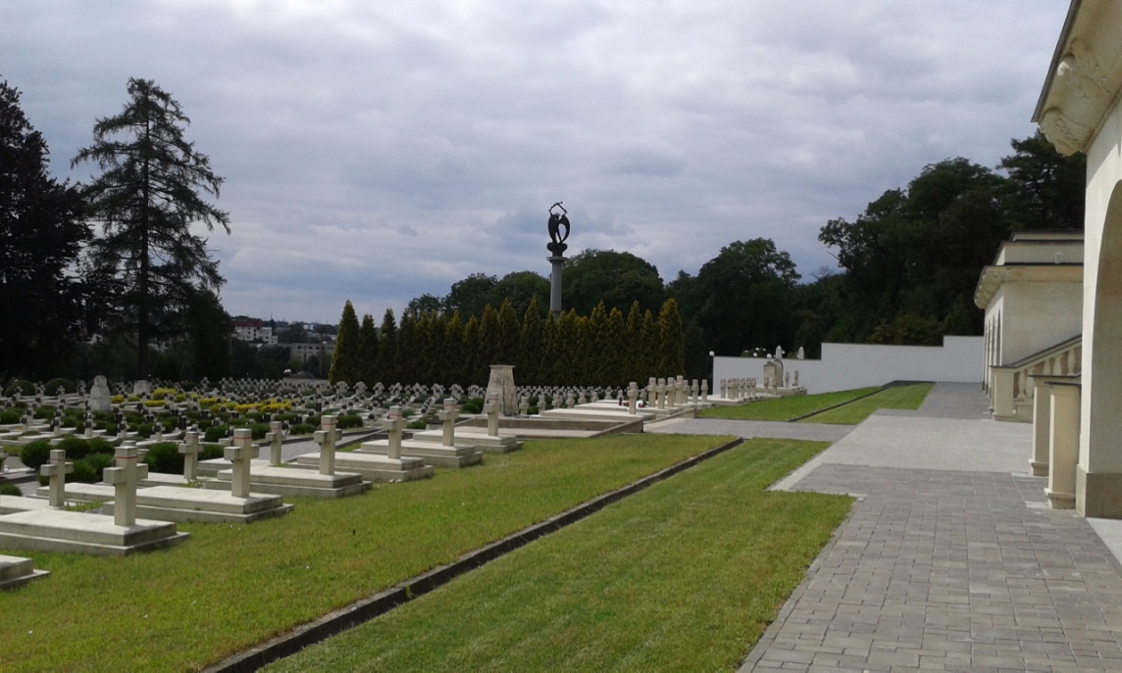
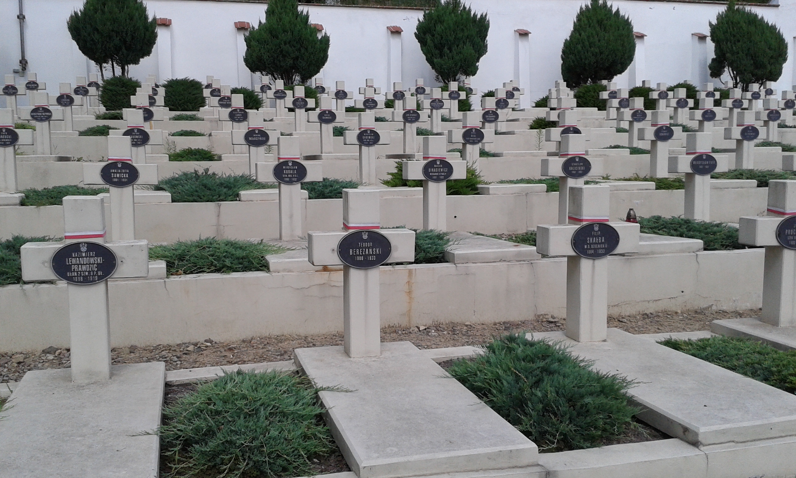

Slide 22
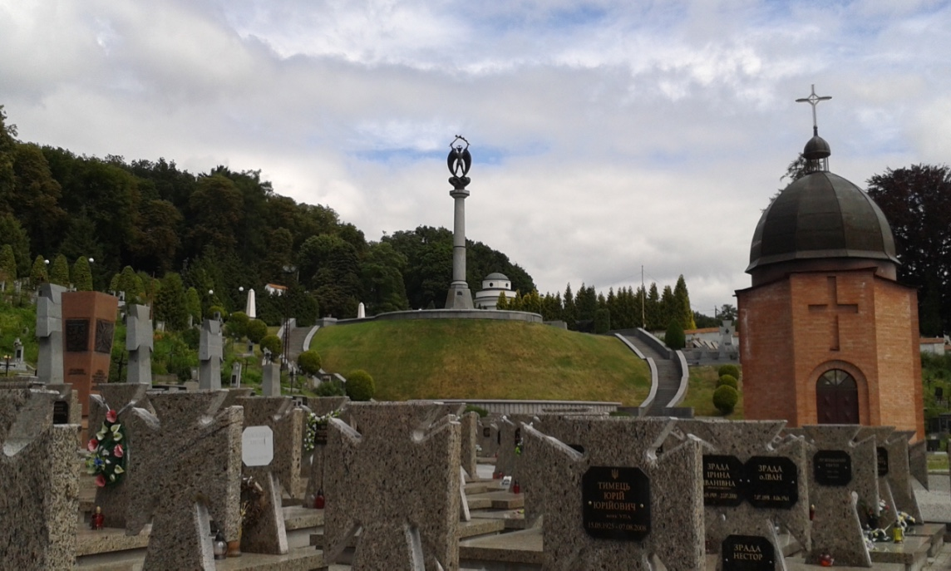

Slide 23
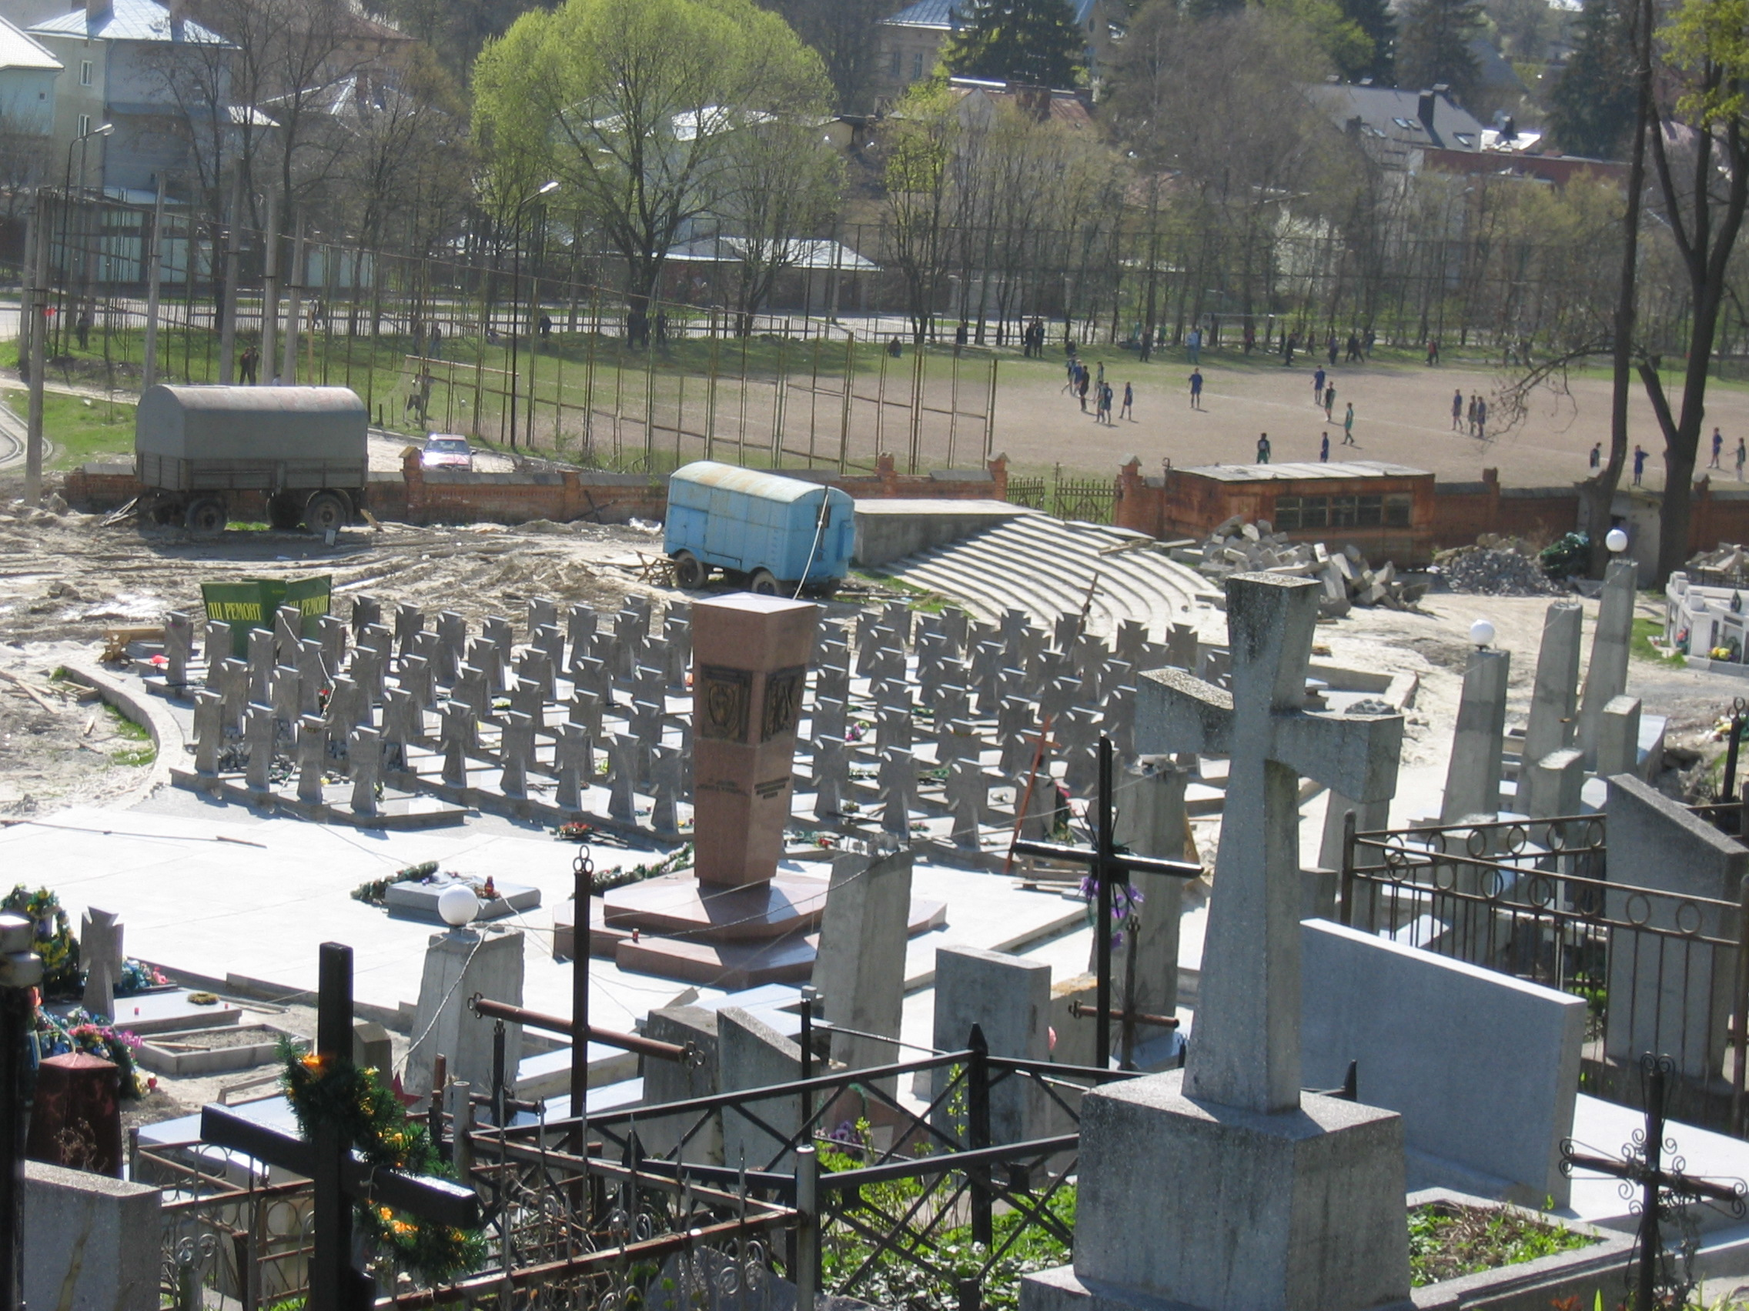
Lviv - Monument and cemetery of the soldiers of the two Ukrainian divisions – formed 1943 as SS divisions

Slide 24
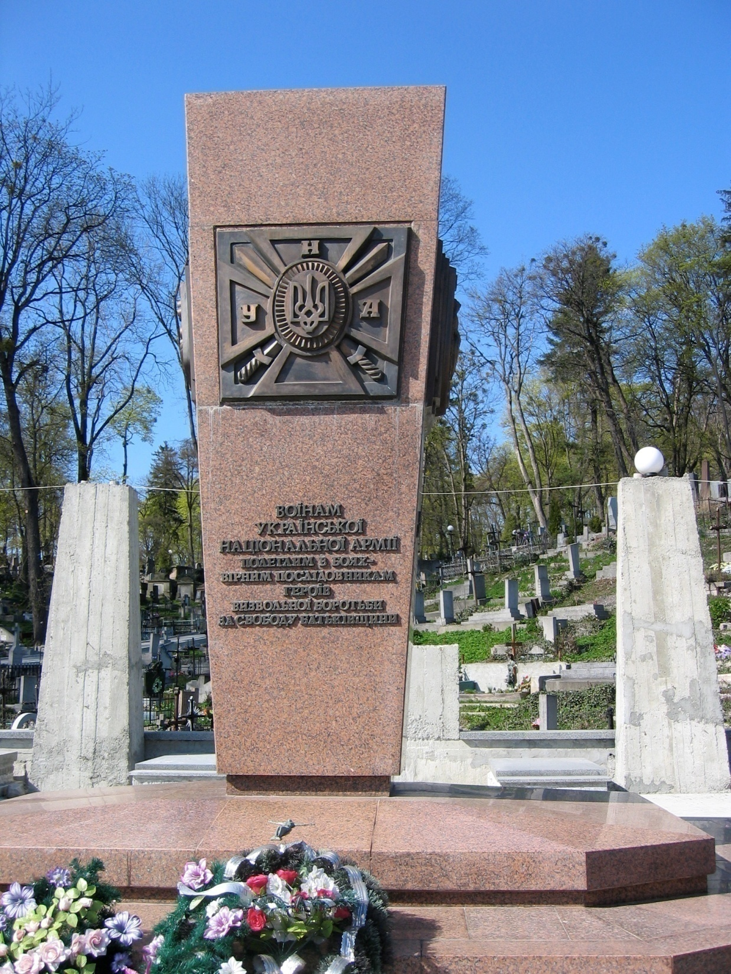
Lviv - Monument on the new Ukrainian memorial
„To the soldiers of the Ukrainian National Army, fallen in battle - faithful successors of the heroes of the fight for liberation for the freedom of the Fatherland“
Notes:
24

Slide 25
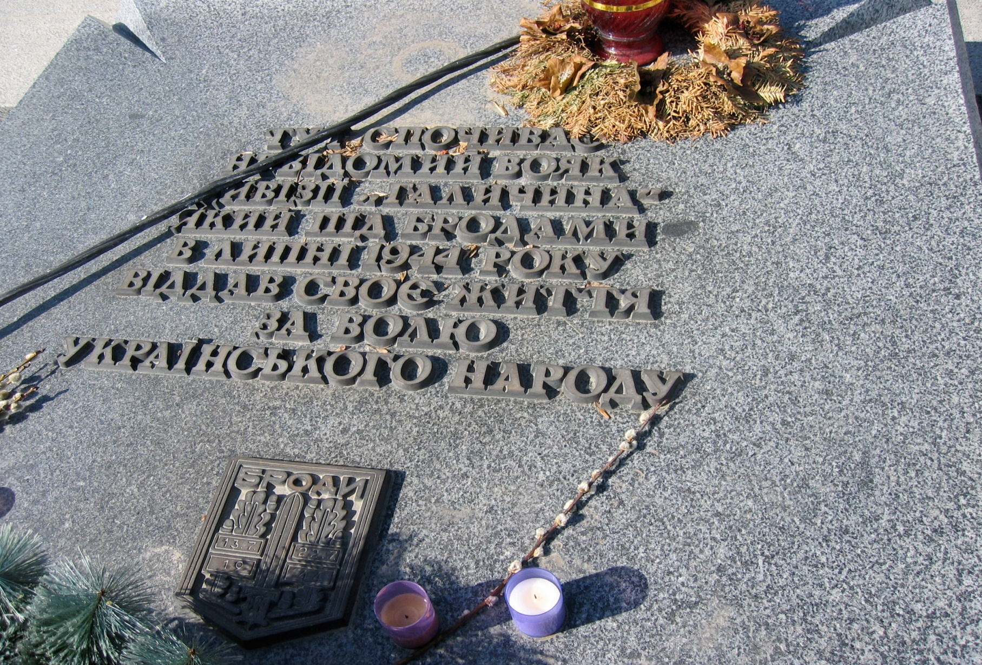
Lviv - tomb of a soldier of the SS Division Galicia
„Here rests an unknown warrior of the division „Halychyna“ who gave in July 1944 at Brody his life for the freedom of the Ukrainian nation“
Notes:
25

Slide 26
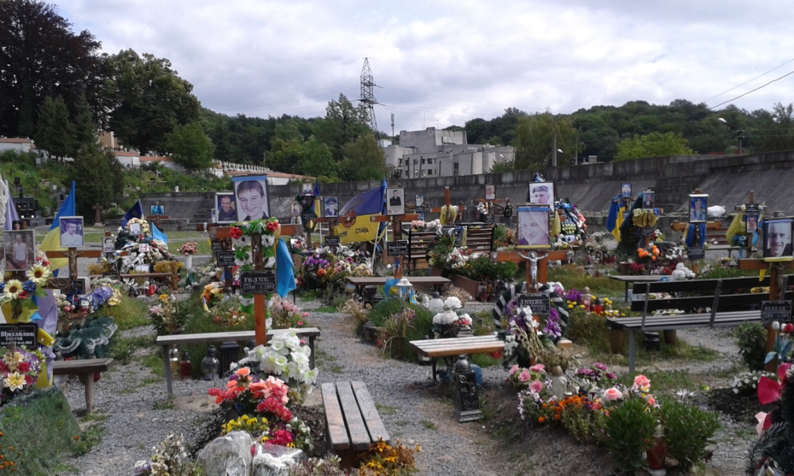
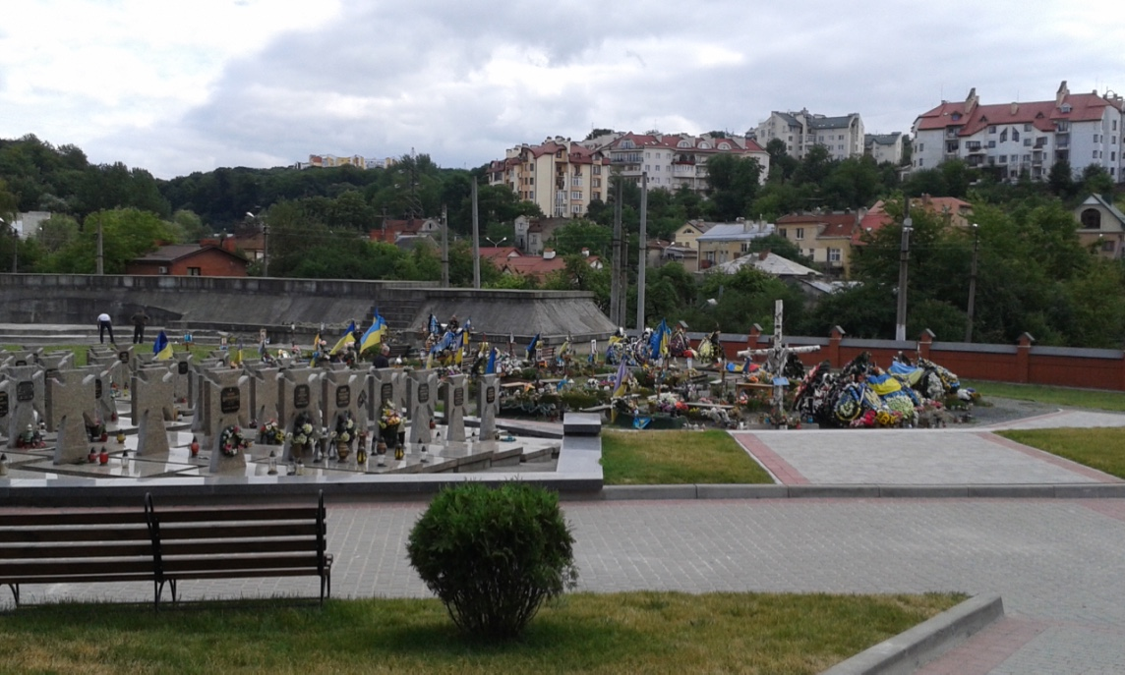

Slide 27
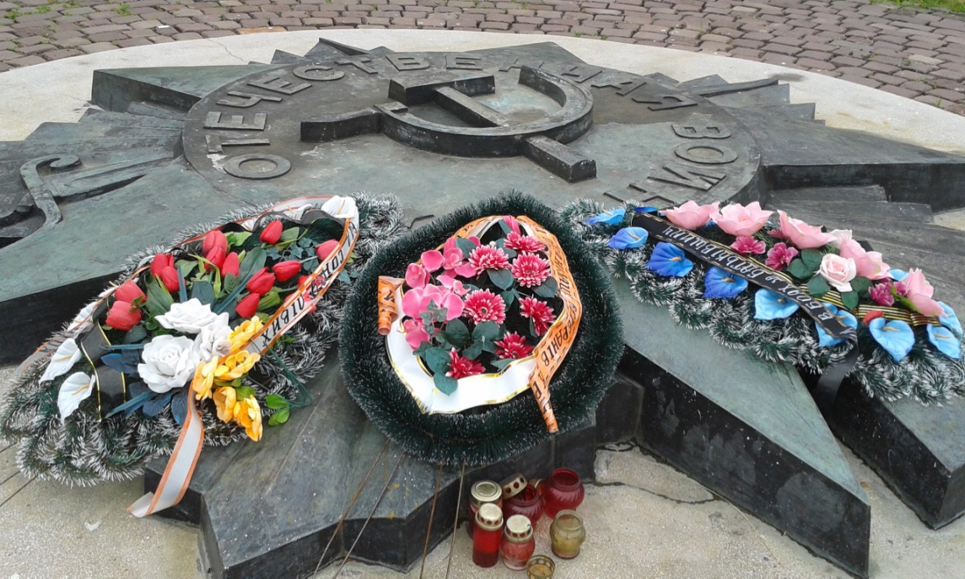
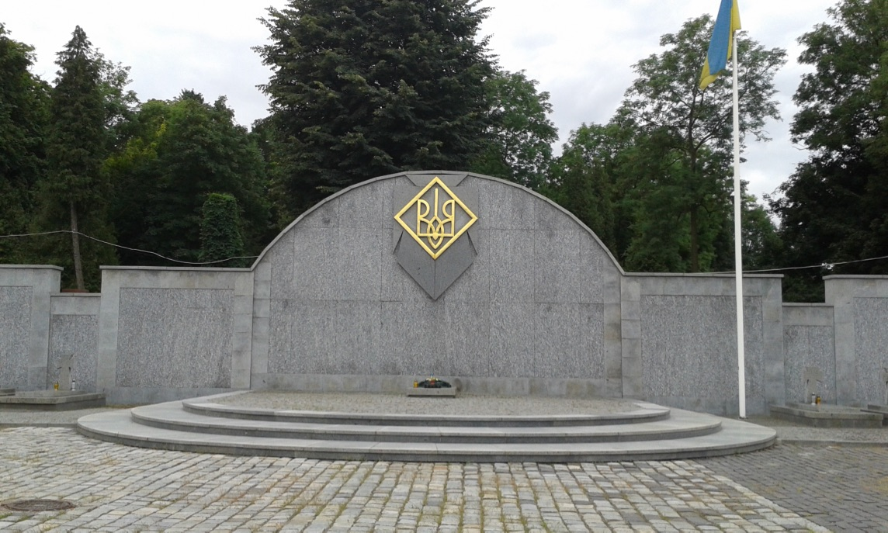
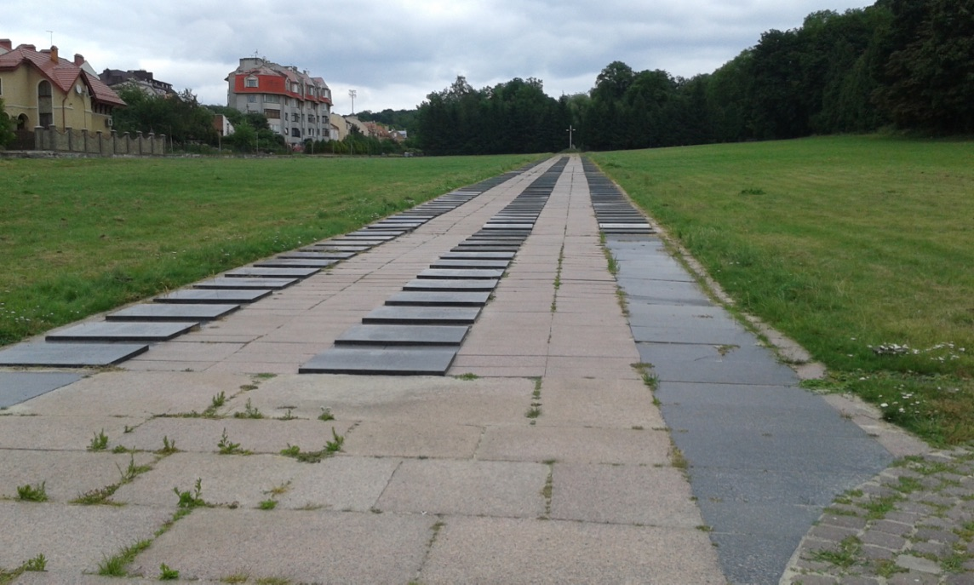
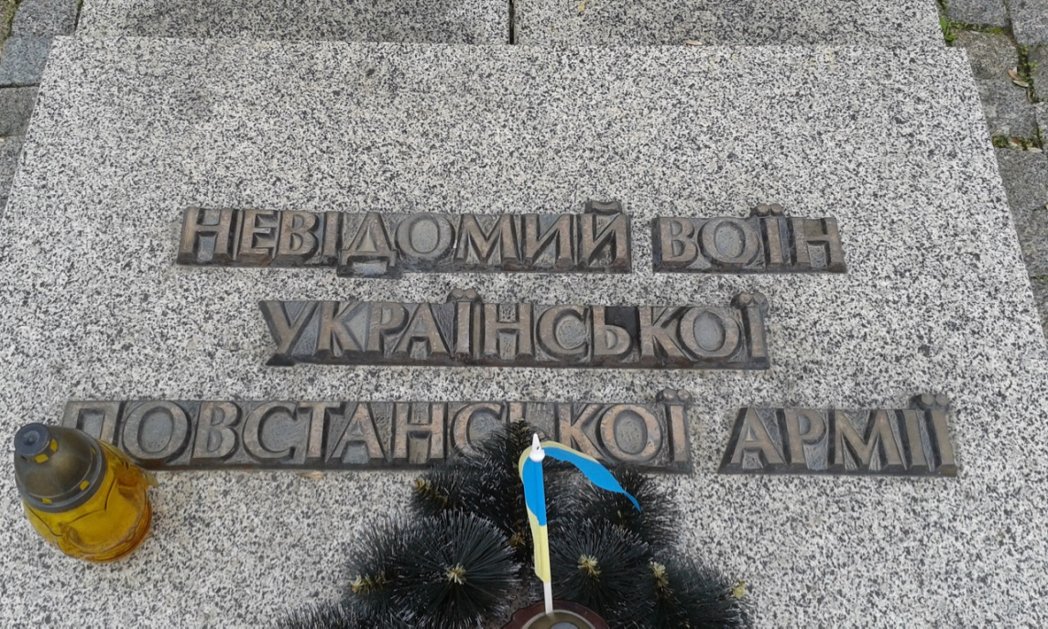
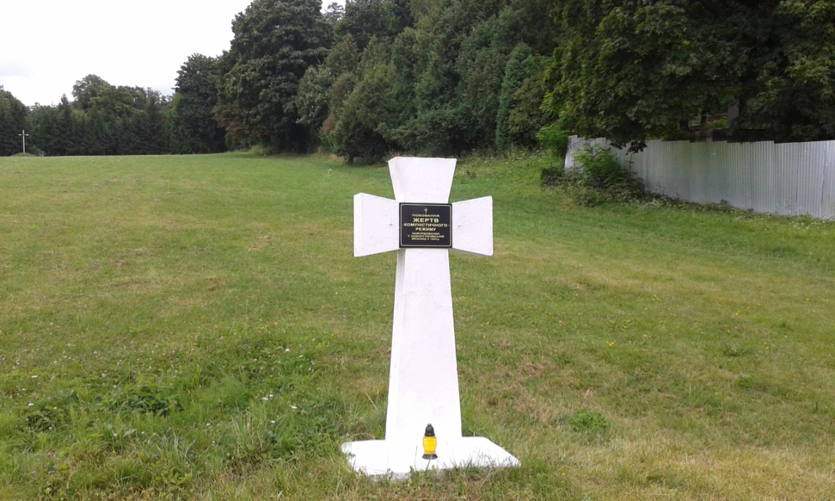

Slide 28
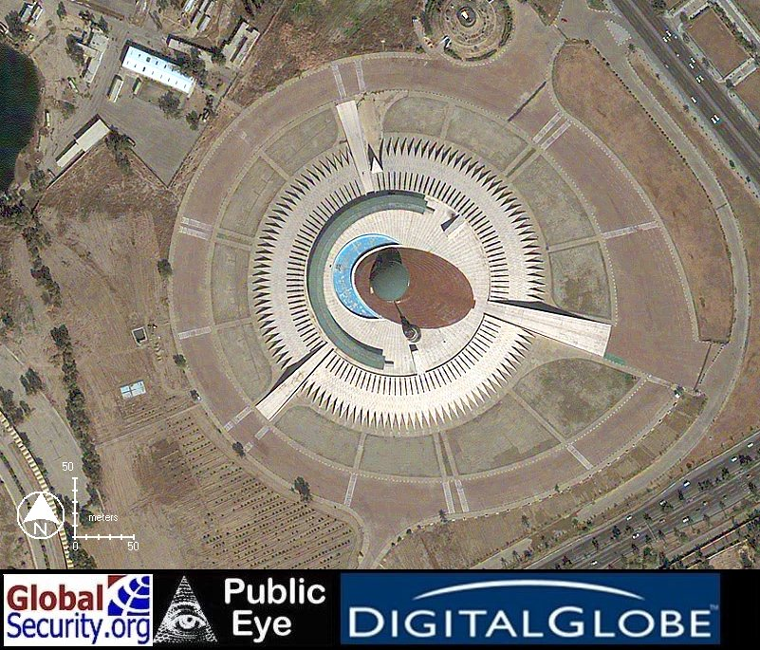
The End
The Iraqi Unknown Soldier, Baghdad

