Slide 1
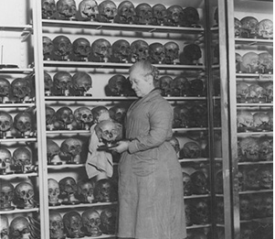
Collecting the Dead:
Human Remains in Museums
HI2L2: Life After Death—A History of Human Remains
Week 4
Image credit: Hunterian Museum, Royal College of Surgeons

Slide 2
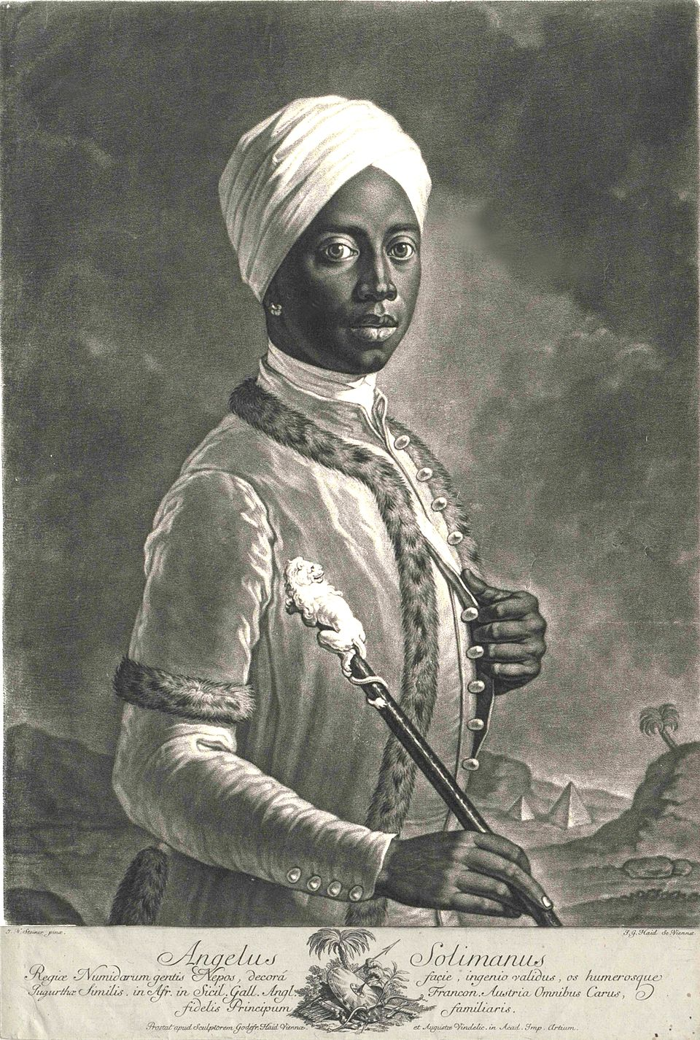
Angelo Soliman (c.1721-1796)
Born Mmadi Make in the Bornu Empire (Nigeria/Cameroon) and captured and enslaved as a child.
Educated in Sicily and ‘gifted’ to Prince von Lobkowitz, governor of Sicily, becoming his valet (saving his life), and then later served Prince Wenzel von Lichtenstein.
Married Magdalena Christiano 1768, ascended ranks of Viennese society, including becoming a Freemason in 1782.
Denied a Christian burial when he died in 1796 despite his daughter Josephine’s petitions.
J. G. Haid, Angelo Soliman (1750)

Slide 3
A Daughter’s Plea
‘Josepha Solimann […] states that, before she had time to recover from the first shock over the sudden death of her beloved father, Angelo Solimann, another grievous piece of news—namely, that his body had been delivered to the medical faculty in order for anatomical experiments to be carried out—had thrown her into even greater distress. This distress soon reached its highest degree and turned into a kind of numbness and melancholy when she learned with certainty that they would not even grant peace to the already mutilated body, but had delivered it, at the request of the Reverend Abbé Eberl, who then completely flayed it, stuffed the skin, and proposed to exhibit it, alongside other animals, in the Imperial and Royal Cabinet of Natural History for display and public viewing. She requests that the skin be placed with the rest of the body in the grave and in consecrated earth […]
-Begleitschreiben von Offizial und erzbischöflischem Konsistorium der Erzdiöcese Wien (9 Dec 1796),” Diözesenarchiv (Wien), Diözesanarchiv Wien, Ordinariatsakten, Priesterpersonalia “alt”, Karton 37, fasc. 1.

Slide 4
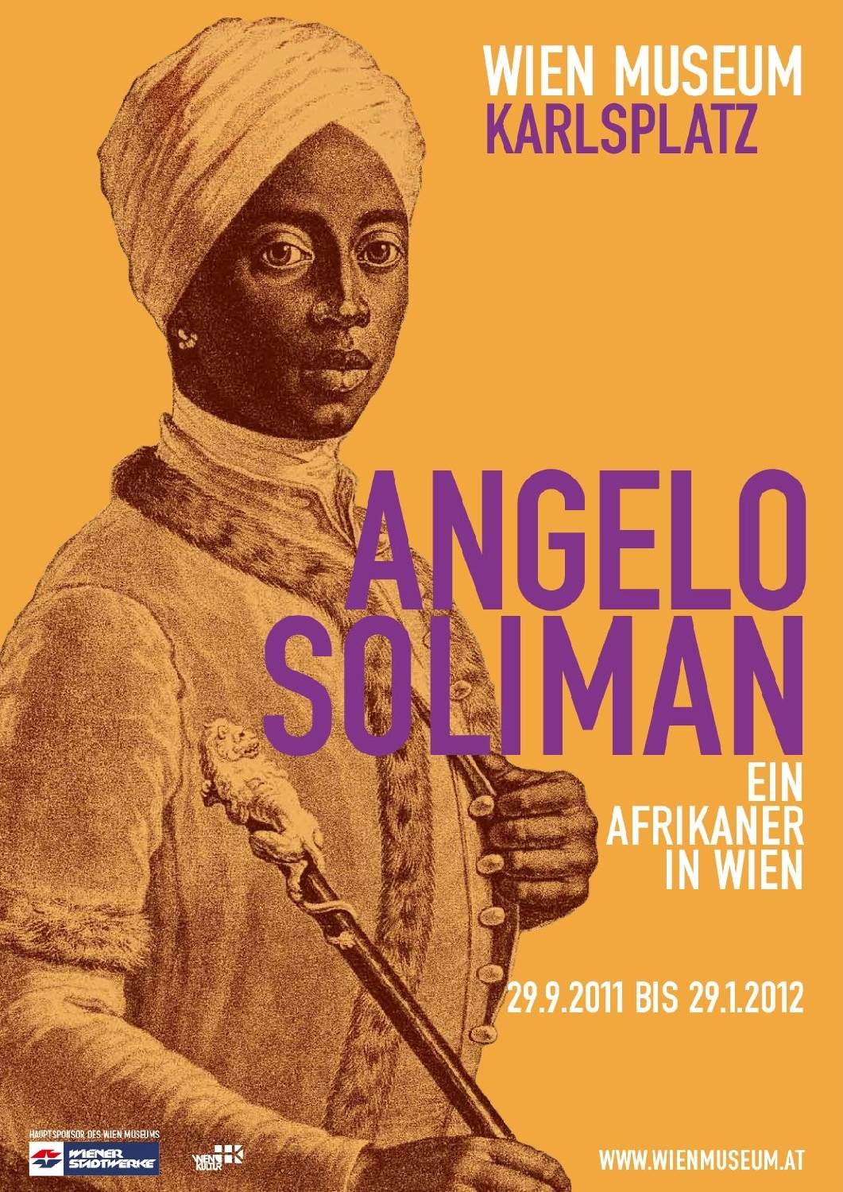
Exhibition
Soliman’s taxidermied remains and death mask were exhibited in a cabinet at the Royal Natural History Collection, private ‘cabinet of curiosities’ of the Habsburgs (Emperor Franz II).
Displayed amongst tropical foliage: ‘standing upright with right foot drawn back and left hand outstretched, a belt of feathers around his waist and crown of feathers on his head, each composed of alternatingly juxtaposed red, white, and blue ostrich feathers. Arms and legs were adorned with a string of white pearls and a wide, delicately braided necklace made of cream-colored coin-porcelain snails hung down to his chest.’
        Quoted in Wigger/Hadley (2020)
Soliman’s remains were destroyed in a fire in 1848. Face mask held by Rolettmuseum, Austria.

Slide 5
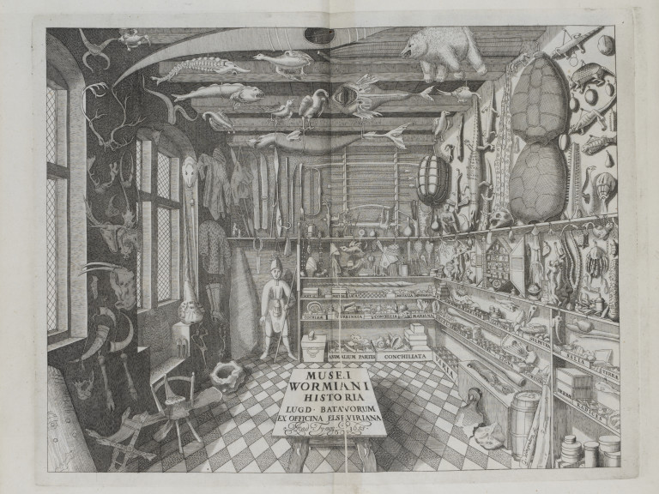
Context: Cabinets of Curiosity
-Origins in the C17, private collections focused on display of ‘exotic’ specimens from around the world.
-Aided by exploration and imperialism.
-Interest in diversity and classification.
-By the C18, represents growth of natural history, Enlightenment taxonomy.
-Cabinets increasingly become the nucleus of public museums.
-Soliman’s display both exoticized and racialised him, making him an exemplar of a ‘primitive’ African type.

Slide 6
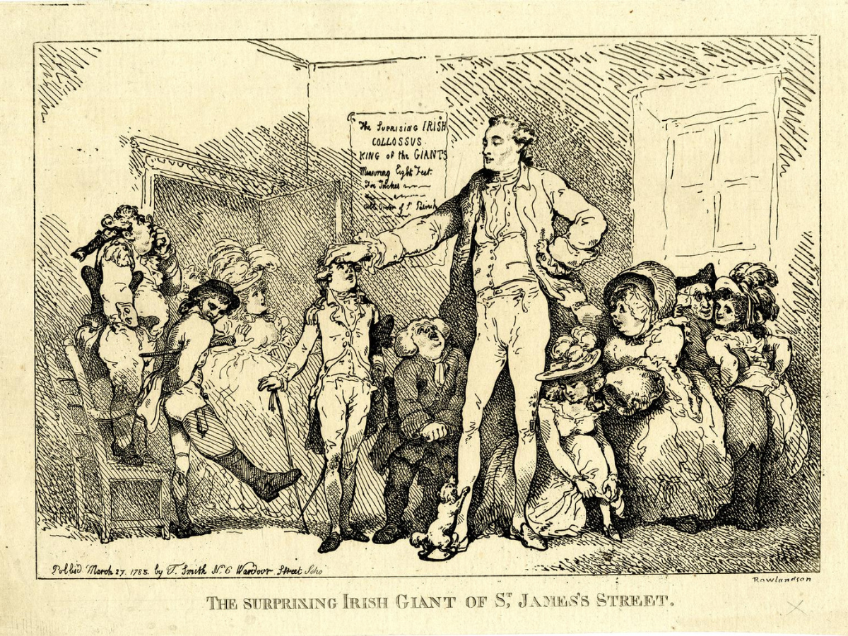
Charles Byrne (c.1761-1783)
From County Londonderry, Ireland and had a rare pituitary disorder (acromegalic gigantism). 2.31m/7’7” tall.
Moved to Scotland and then England, arriving in London in 1782 where he became a popular performer.
Died following year aged 22 due to health complications.
Made arrangements for his body to be buried at sea, but his corpse was acquired by John Hunter.
Hunter prepared and mounted Byrne’s skeleton, and put it on display in his home museum, 1787.

Slide 7
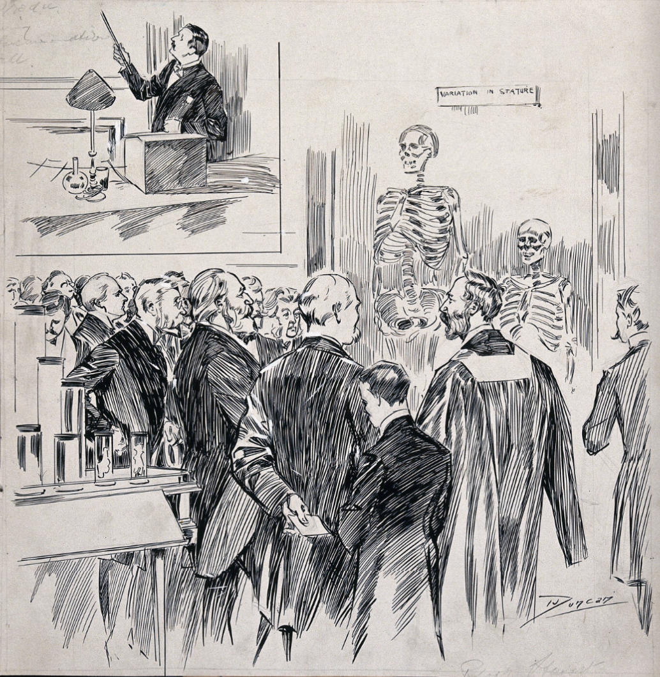
Sketch of RCS spectators and specimens, by J. A. Duncan, 1900

Slide 8
Context: Rise of ‘Museum Medicine’
By late C18, preserved wet and dry anatomical specimens critical for teaching anatomy given lack of cadavers for dissection.
Anatomists built up private collections of specimens for their teaching and research needs, using them to attract students.
John Hunter’s collection was purchased by the state in 1799 and given to the Royal College of Surgeons (London) for use of members, students, and opened to the public in 1813.
As with dissection, pedagogic justifications cited for preservation and display of specimens, particularly rare examples such as Byrne’s skeleton.
Byrne’s case an infamous example of explicit lack of consent for display being dismissed, and his skeleton was removed (but retained by the museum) in 2023.

Slide 9
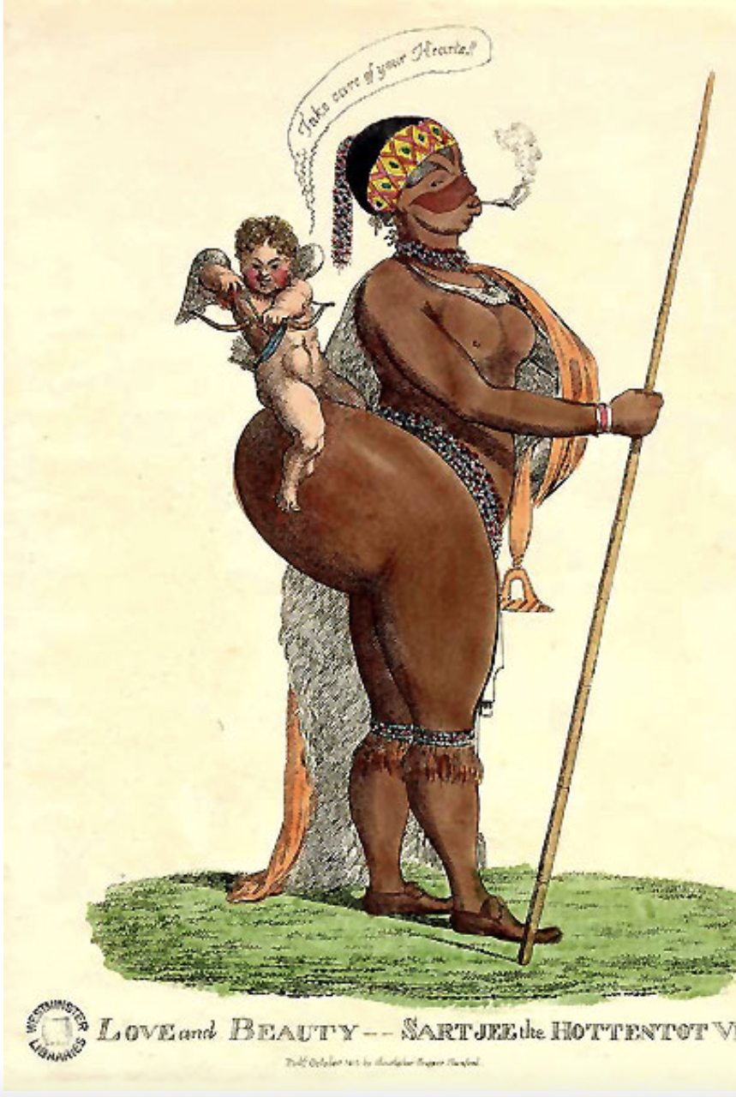
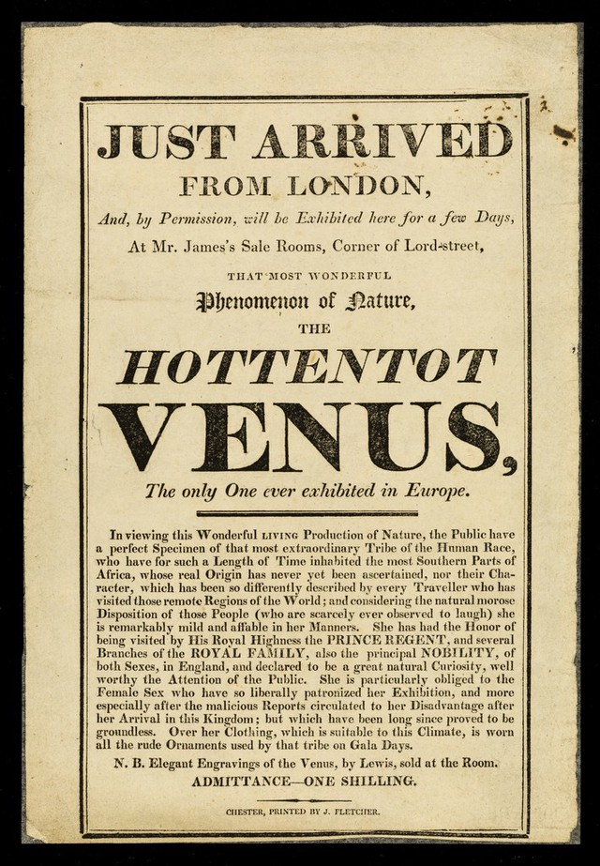
Sarah (Saartjie) Baartman (c.1789-1815)
Born in Eastern Cape of South Africa into a Khoekhoe family. Worked in Cape Town and her steatopygia attracts attention of surgeon Alexander Dunlop, who takes her to Europe to be exhibited.
Arrives in London in 1810, and displayed as the ‘Hottentot Venus’, drawing attention to ‘singular’ sexualized characteristics.
Popularity attracts attention of Abolitionists, but Baartman testifies that she was exhibited by her own consent.
Moves to Paris in 1815 under more controlling conditions, attracts attention of French scientists such as comparative anatomist Georges Cuvier.
Declined to be displayed or studied nude, but on her death age 25, Cuvier performs full autopsy.
Her remains displayed at the Museum d’histoire naturelle and the Musee de l’Homme until 1974.

Slide 10
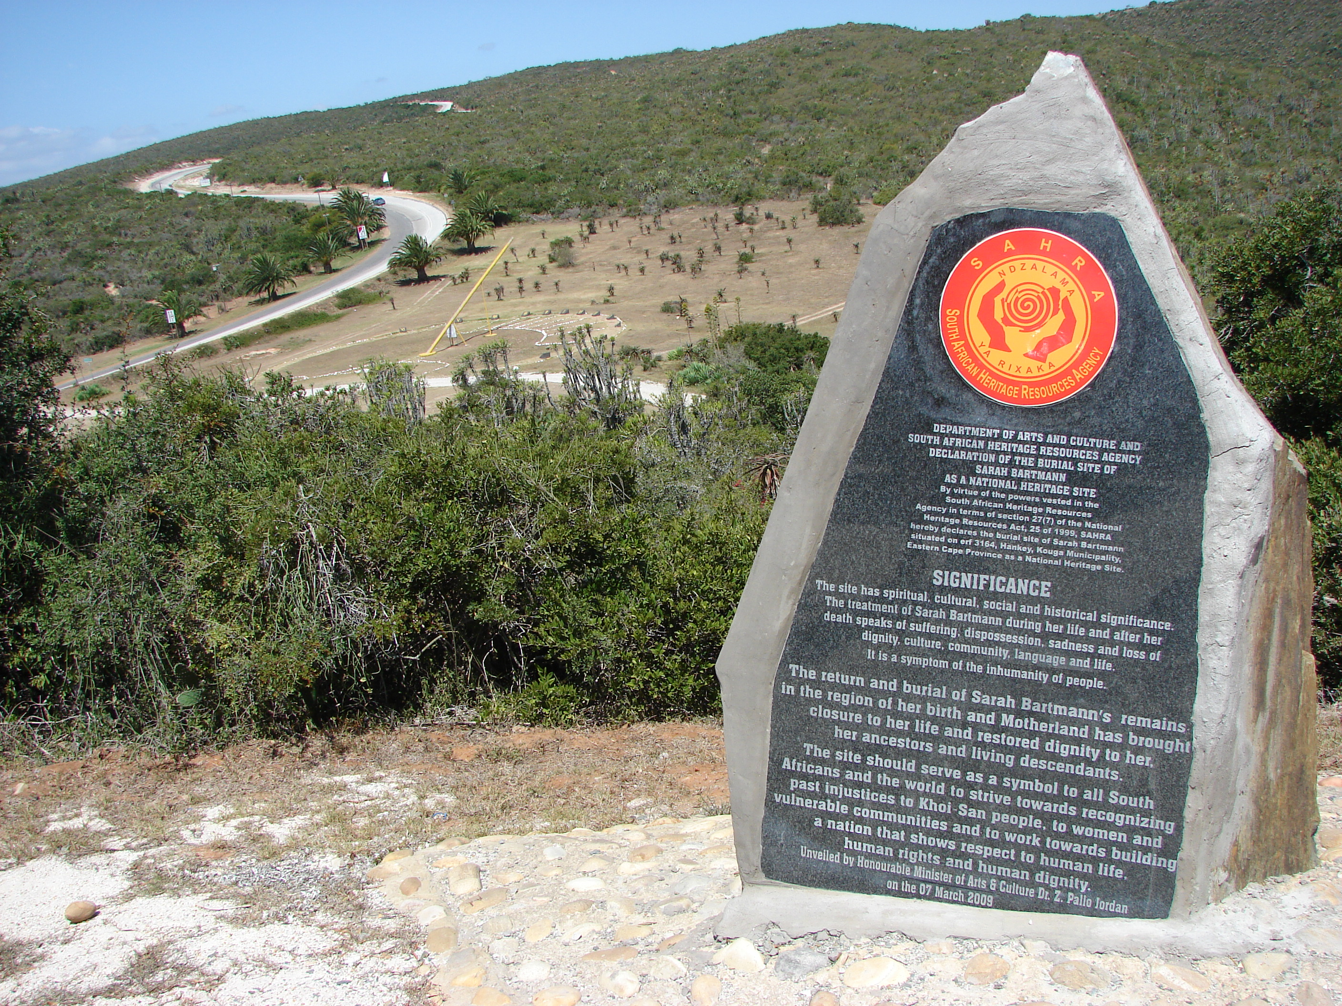
2002 Repatriation
After ANC victory in 1992, South African president Nelson Mandela formally requested return of Sarah Baartman’s remains.
French national assembly agrees in 2002, and Sarah Baartman was buried in Hankey, Easten Cape.

Slide 11
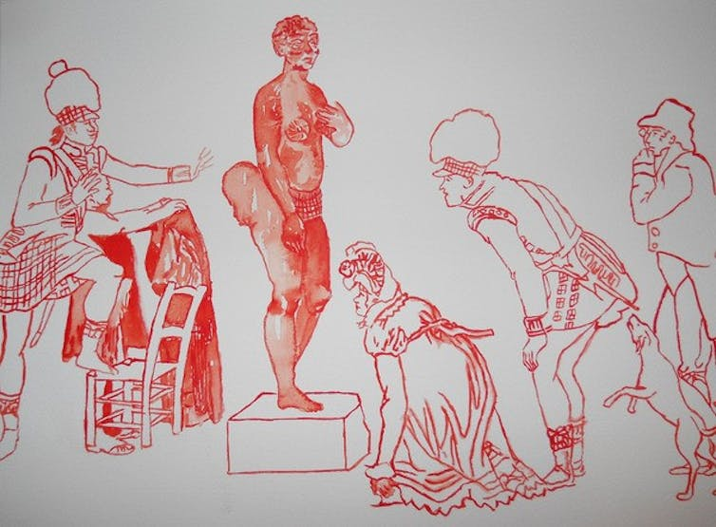
Context: The Rise of State Science
Sarah Baartman’s display presaged popular interest in ‘ethnological exhibitions’ of the nineteenth century, which combined spectacle and scientific racism, curiosity and expertise.
The growth of state science in post-Revolutionary France meant there was institutional support for Georges Cuvier’s racial research, which was an extension of his interest in comparative anatomy.
Baartman’s remains and cast were exhibited in state museums: the Natural History Museum and the Museum of Man.
Covering the Venus Hottentot, by Senzeni Marasela

Slide 12
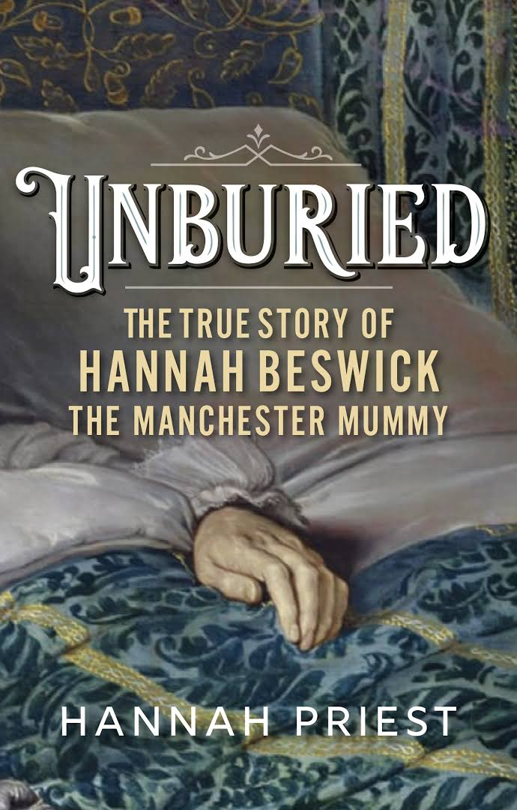
Hannah Beswick (1688-1758)
Born into an affluent family, at Cheetwood Hall near Manchester, Beswick was a wealthy, independent property holder.
Astute at business and managed family’s financial affairs, patronized the newly established Manchester Infirmary and the work of her physician, Charles White (1728-1813).
Her body was embalmed by White after her death in 1758. Sometimes attributed to taphophobia (fear of being buried alive).
Beswick’s mummified body was displayed in a clock at White’s residence, and then at the Museum of the Natural History Society (c.1830s-1860s).
Remains were buried in Harpurhey Cemetery in 1868.

Slide 13
Context: Natural History Collections and Scientific Societies
Natural history collecting became a popular pursuit in the early nineteenth century.
Local natural history societies emerged, particularly attracting middle class membership and patronage. ‘Amateur’ science, but lines blurry.
Regional societies built museums to house their members’ finds, and opened them to the public to help support running costs.
Human remains, such as mummified Egyptians, formed part of these eclectic collections—curiosities that particularly attracted the public.
These collections later integrated into academic museums, and objects and arrangements refined to meet ‘scientific’ principles.
Scarborough Rotunda Museum

Slide 14
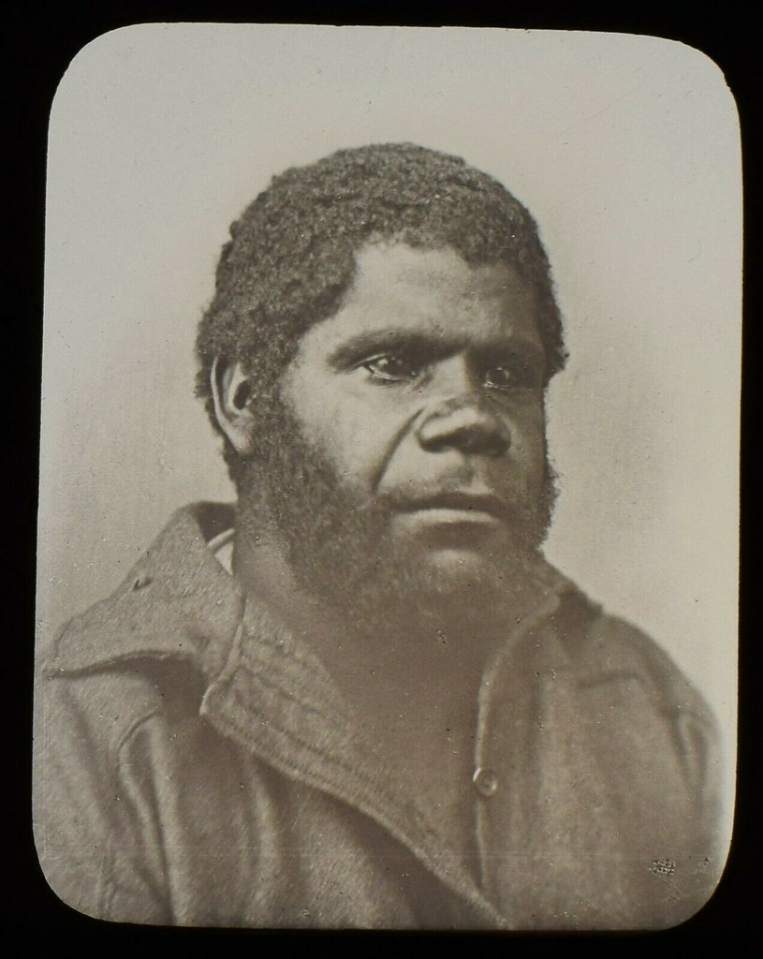
William Lanne (c.1836-1869)
Indigenous Tasmanian of Tarkinener clan, born in aftermath of ‘Black War’.
Lanne’s family was removed to Wybalenna, Flinders Island with 180 remaining Tasmanians.
William moved with 47 survivors to Oyster Cove on the mainland, and found work as a whaler.
Died aged 33, considered the ‘last’ Tasmanian male.

Slide 15
Competing Claims
Lanne’s status as the ‘last’ Tasmanian male made his remains particularly desirable. Surge of scientific interest in ‘racial extinction’ theory.
William Crowther wanted to send remains to the Royal College of Surgeons in London, but members of the Royal Society of Tasmania wanted them kept in Tasmania.
Crowther broke into morgue, stole Lanne’s head, and replaced it with other remains.
Outrage over theft, but Crowther later made premier of Tasmania.
Fate of Lanne’s head remains unknown.

Slide 16
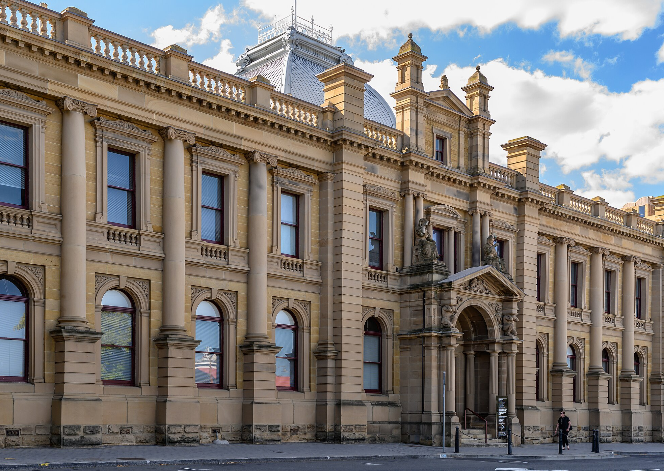
Context: The Rise of Colonial Museums
Scientific research independence emerged gradually in British colonies such as Tasmania, and ultimately disrupted traditional colonial supply networks to British museums.
Lingering sense that scientific patronage and prestige still stemmed from London slowed growth of colonial museums.
By late nineteenth century, idea that colonies should represent their own history (and natural history) in their own museums took hold, and gradually gained support amongst local elites.

Slide 17
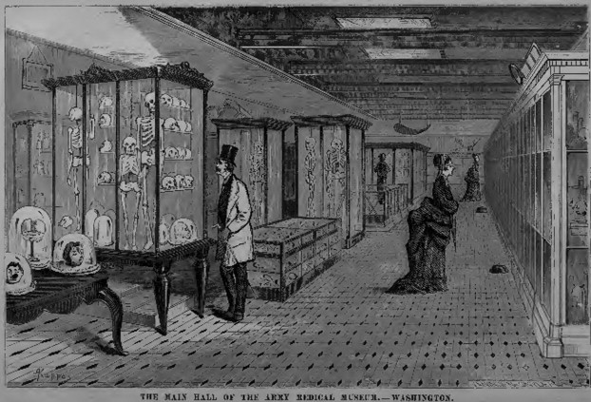
The United States Army Medical Museum, c.1868-1800
1868 order to US Army Surgeons to collect Native American crania for the Army Medical Museum in Washington.
State intervention led to collection of c. 1,000 skulls from battlefields and gravesites.
Collection was open to the public and occasionally consulted, but ultimately little used for research and sold to the Smithsonian for $1.

Slide 18
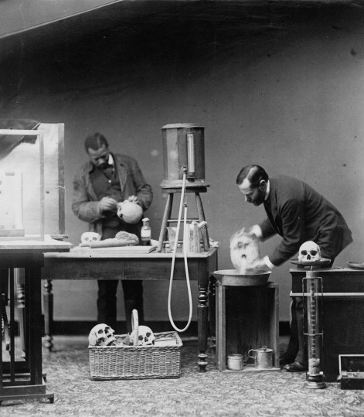
Context: Colonial Violence
Rise of craniometry as a branch of racial science encouraged the widespread collection of foreign skulls.
Colonial wars provided access to bodies, but producing specimens still laborious in the field.
Military surgeons a key supplier of racialized human remains to collections in America and Britain (Museum of Military Medicine, Chatham).
Anthropology tangential to military medicine and such collections generally transferred to other research institutions.

Slide 19
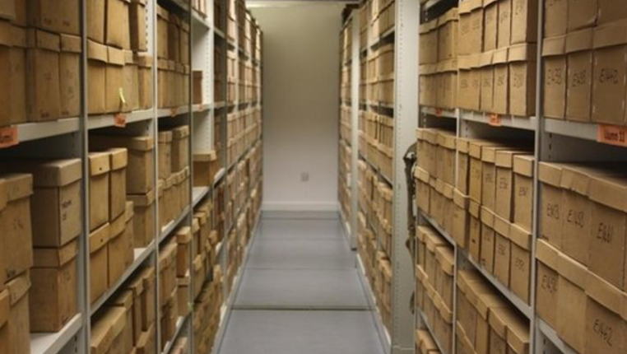
A skull from Bombay
Stores, Cambridge Duckworth Laboratory
‘Whilst in Bombay I paid a visit with a few friends to a Hindoo Burying ground. There were several bodies being then burnt in various parts of it. Whilst strolling about I came to a heap of ashes which I kicked about with my foot & found that they covered the bones of a Hindoo whose corpse had lately been consumed. The natives standing round looked hard at me as much as to shew their displeasure at my proceedings. However I picked up several of the bones which were of a moderate size. But on coming across the skull my attention was excited by observing the curious shape as well as the porous appearance of the crown. So I thought I would take it away with me. I walked with it in my hands towards the gates when several natives came up & tried to take it away. They began to shout & holler to collect a crowd, but by the resistance of my friends I managed to reach a Buggy. The driver, however, seeing the skull, which I was trying to hide, refused to move an inch, & a mob of natives came round the Buggy wanting me to give it up to them. My friends advised me to comply with their wishes, but I thought it was strange they should make such a fuss about it, & as I had had such a bother to get it I resolved to try & keep it if possible. So I asked one of my friends to jump up & drive which he did much to the discomfiture of the Buggyman who shouted aloud for help but soon became quiet when we were clear of the ground.’
Letter, Henry Paley Gurney, attached to Specimen 471, Cambridge Museum specimen accession catalogue (1870s.)

Slide 20
Context: Academic Collections
The collection of human remains by universities accelerated as anatomy and anthropology professionalized as academic disciplines.
Professors no longer required to have private specimen collections, but were supported by universities to purchase, store, and display human remains for their teaching and research.
Universities explicitly made use of academic and alumni networks to procure remains from abroad.
Size/scope of collections increasingly a sign of prestige amongst research institutions.

Slide 21
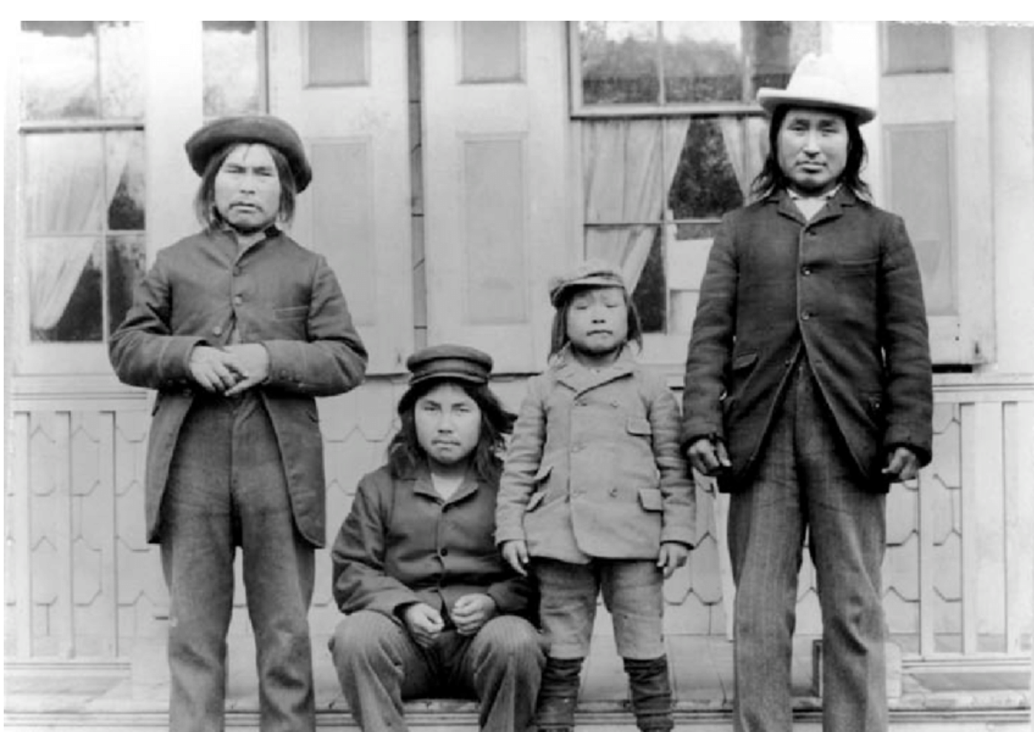
Qisuk (c.1858-1898)
Born in northern Greenland into Inughuit community. A hunter, father and widower by 1897, when he came into contact with Robert Peary’s Arctic expedition.
Peary brought six Inuit people from Greenland, including Qisuk and his son Minik, to New York City to be studied by anthropologists at the American Museum of Natural History.
Qisuk and other Inuit displayed to the public in Museum’s basement. All but Minik died of TB within a few months.
Fake burial organized so Minik could observe funerary rites.

Slide 22
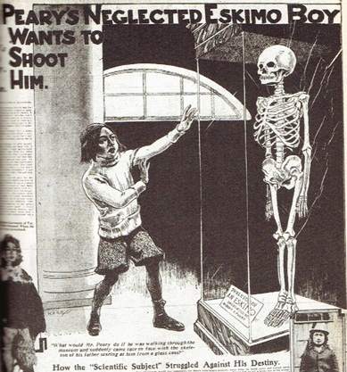
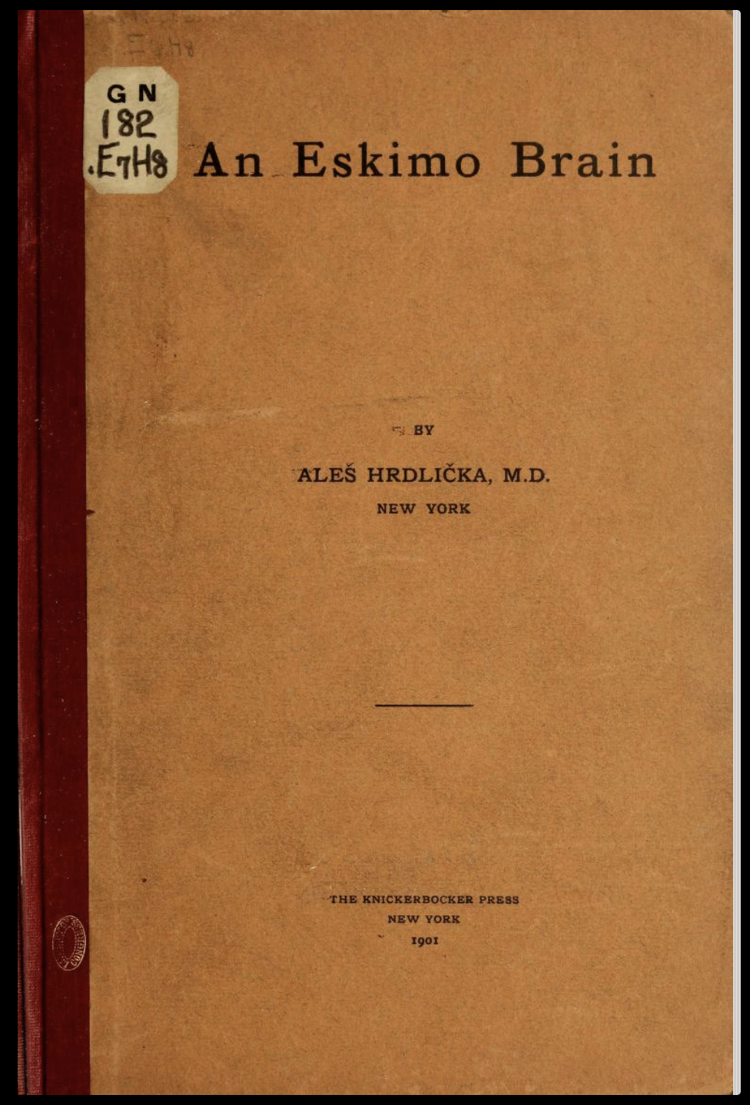
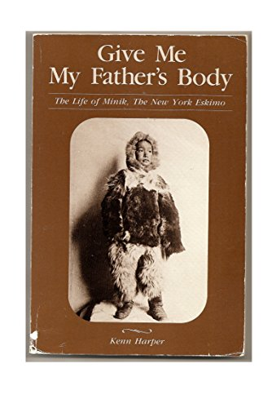
‘Give Me My Father’s Body’
Qisuk and other casualties dissected at Bellevue Hospital, brains preserved and measured.
Qisuk’s skeleton also preserved and mounted as a museum exhibit.
Minik adopted and learned of deception in 1907, and petitioned for return of his father’s body.
Qisuk’s remains taken off display but not returned to Minik, who returned to Greenland in 1909.
‘I am homesick and disgusted… after all, my own people are more human and kind, and I am going home. Your civilization has done nothing more but harm me and my people.’ (Minik, 1909)
Qisuk’s remains (and others from group) repatriated to Greenland in 1993 and given Inuit funerary rites.

Slide 23
Context: Twentieth-Century Museum Collecting
State-supported natural history museums were well-established as research institutions and public attractions by 1900.
While the display of human remains continued into this period, there was increasingly a tension between research functions of museums and their public profile.
Bodies/skulls/brains of racialised/pathologised individuals still sought by researchers, but public sympathy towards research subjects as individuals increasingly in evidence, fueled by the popular press.
Many human remains taken off display and put in storage as research priorities changed.

Slide 24
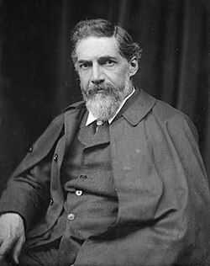
Flinders Petrie (1853-1942)
Renown Egyptologist, first Professor of Egyptology in the UK, at UCL.
Famous for many excavations, and identification of Proto-Sinaitic script.
His collection of Egyptian artefacts donated to UCL (Petrie Museum of Egyptian Archaeology).
Donated many Egyptian remains to Cambridge
Donated his own remains for scientific study after his death in Jerusalem in 1942 (body buried but head/brain sent to Royal College of Surgeons, London.

Slide 25
Context: Voluntary Donation
Several prominent researchers who worked with human remains donated their heads/brains for research.
Extension of beliefs about genius: phrenology, craniology, and eugenics.
On the part of donors, represents an expression of their commitment to scientific research.
See also Edward Drinker Cope (1840-1897), American paleontologist who donated his skull for the explicit purpose of being measured to establish racial/intellectual superiority.

Slide 26
Human remains are especially potent objects with complex meanings. The collections they constituted were complex, dynamic entities, growing and shrinking, changing over time and place both physically and conceptually. Like other collections, the medical museum was an entangled assemblage, and like all assemblies, it was deeply political: a parliament of monsters indeed.
-Sam Alberti, Morbid Curiosities.

