Slide 1
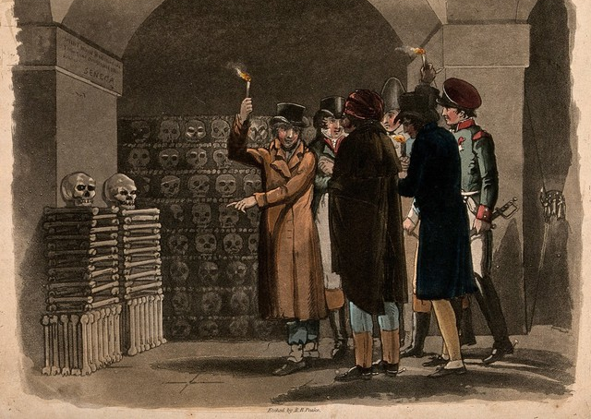
Disposing the Dead:
Cemeteries and Ossuaries
HI2L2: Life After Death—A History of Human Remains
Week 7
R.B. Peake, ‘Gentlemen carrying torches visiting catacombs in Paris’ (1816)

Slide 2
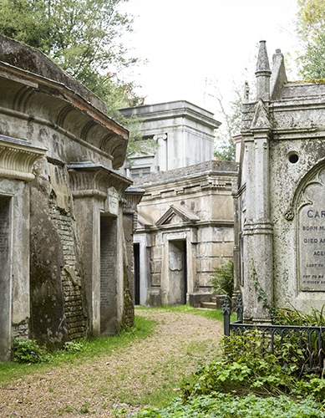
Lecture Outline
Traditional practices
Ossuaries and charnel houses
C18-19 ‘tipping point’
The rise of the cemetery
State control of the dead
Cremation
Highgate Cemetery, London

Slide 3
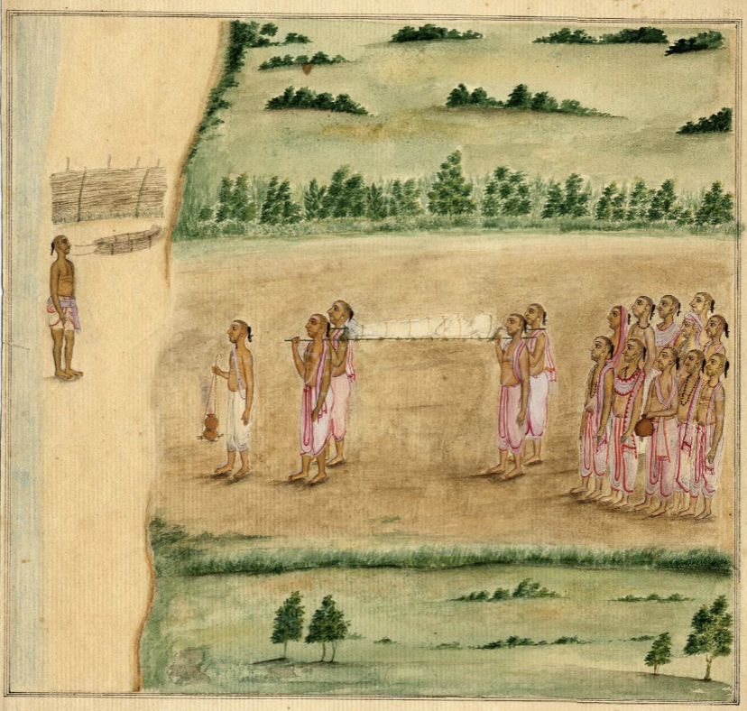
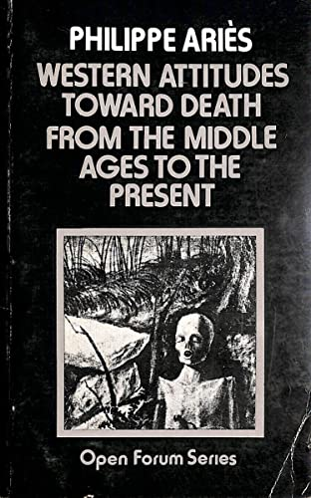
Disposing the Dead: Traditional Practices
Indian Funeral Procession, c.1820
Methods of disposal reflect religious/spiritual beliefs about death and/or the afterlife, invested with communal meaning and are often accompanied by funerary rites or mourning processes.
Some belief systems require bodies to be whole/intact to facilitate resurrection, some require cremation for reincarnation, some require rapid disposal, some a waiting period, etc.
European trajectory (from Philippe Ariès): from ‘tamed death’ (pre-C11) to ‘one’s own death’ (C11-17) to ‘thy death’ (C18-19) to ‘forbidden death’ (C19-present). From normalisation of death to fear.
There is a rupture in European traditions in the late C18/early C19 that disrupt these trends, leading to a ‘new regime’ of treating the dead that is exported through colonization and globalization around the world.
1974

Slide 4
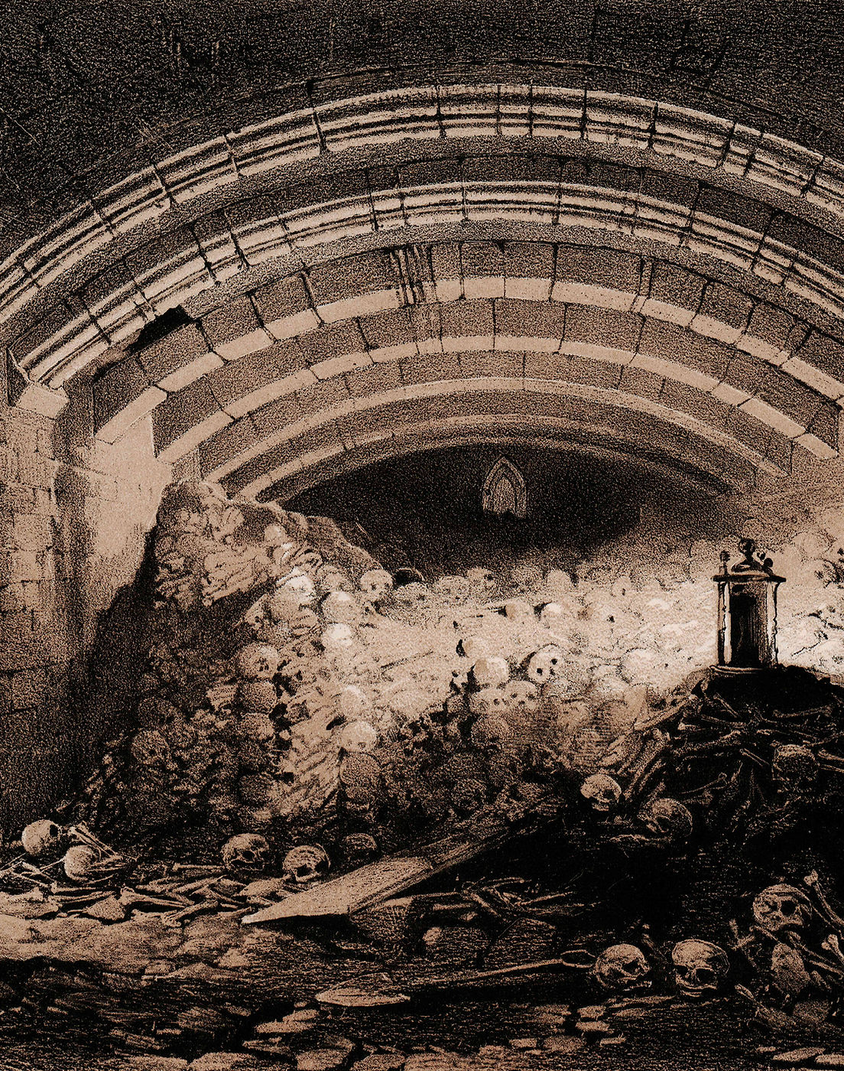
Temporary Burial, Removal, Storage: Ossuaries
Across Europe, dominant Christian tradition generally required ground burials in consecrated land, typically church graveyards.
In places with space limitations, churches typically removed skeletal remains and stored them in charnel houses and ossuaries.
These were spaces within churches (crypts) or on church lands that allowed storage and display of remains in a manner that was spiritually sanctified, respectful of the dead, and instructive to the living.
Protestants rejected the use of ossuaries following the Reformation, but continued as a Catholic and Eastern Orthodox tradition.
Burials as permanent and fixed relatively modern invention.
St. George's Church at Doncaster (1855)

Slide 5
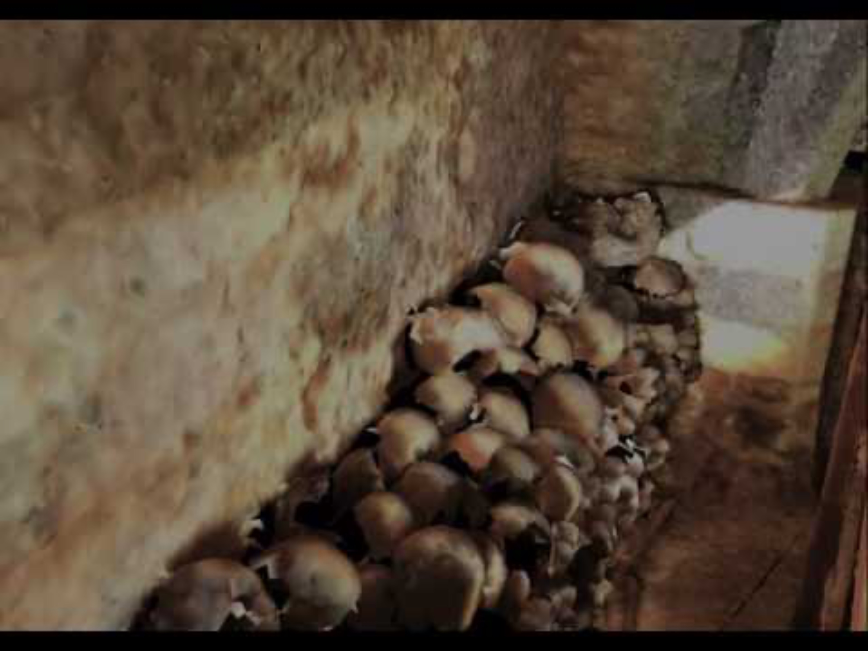
Rothwell Charnel Chapel

Slide 6
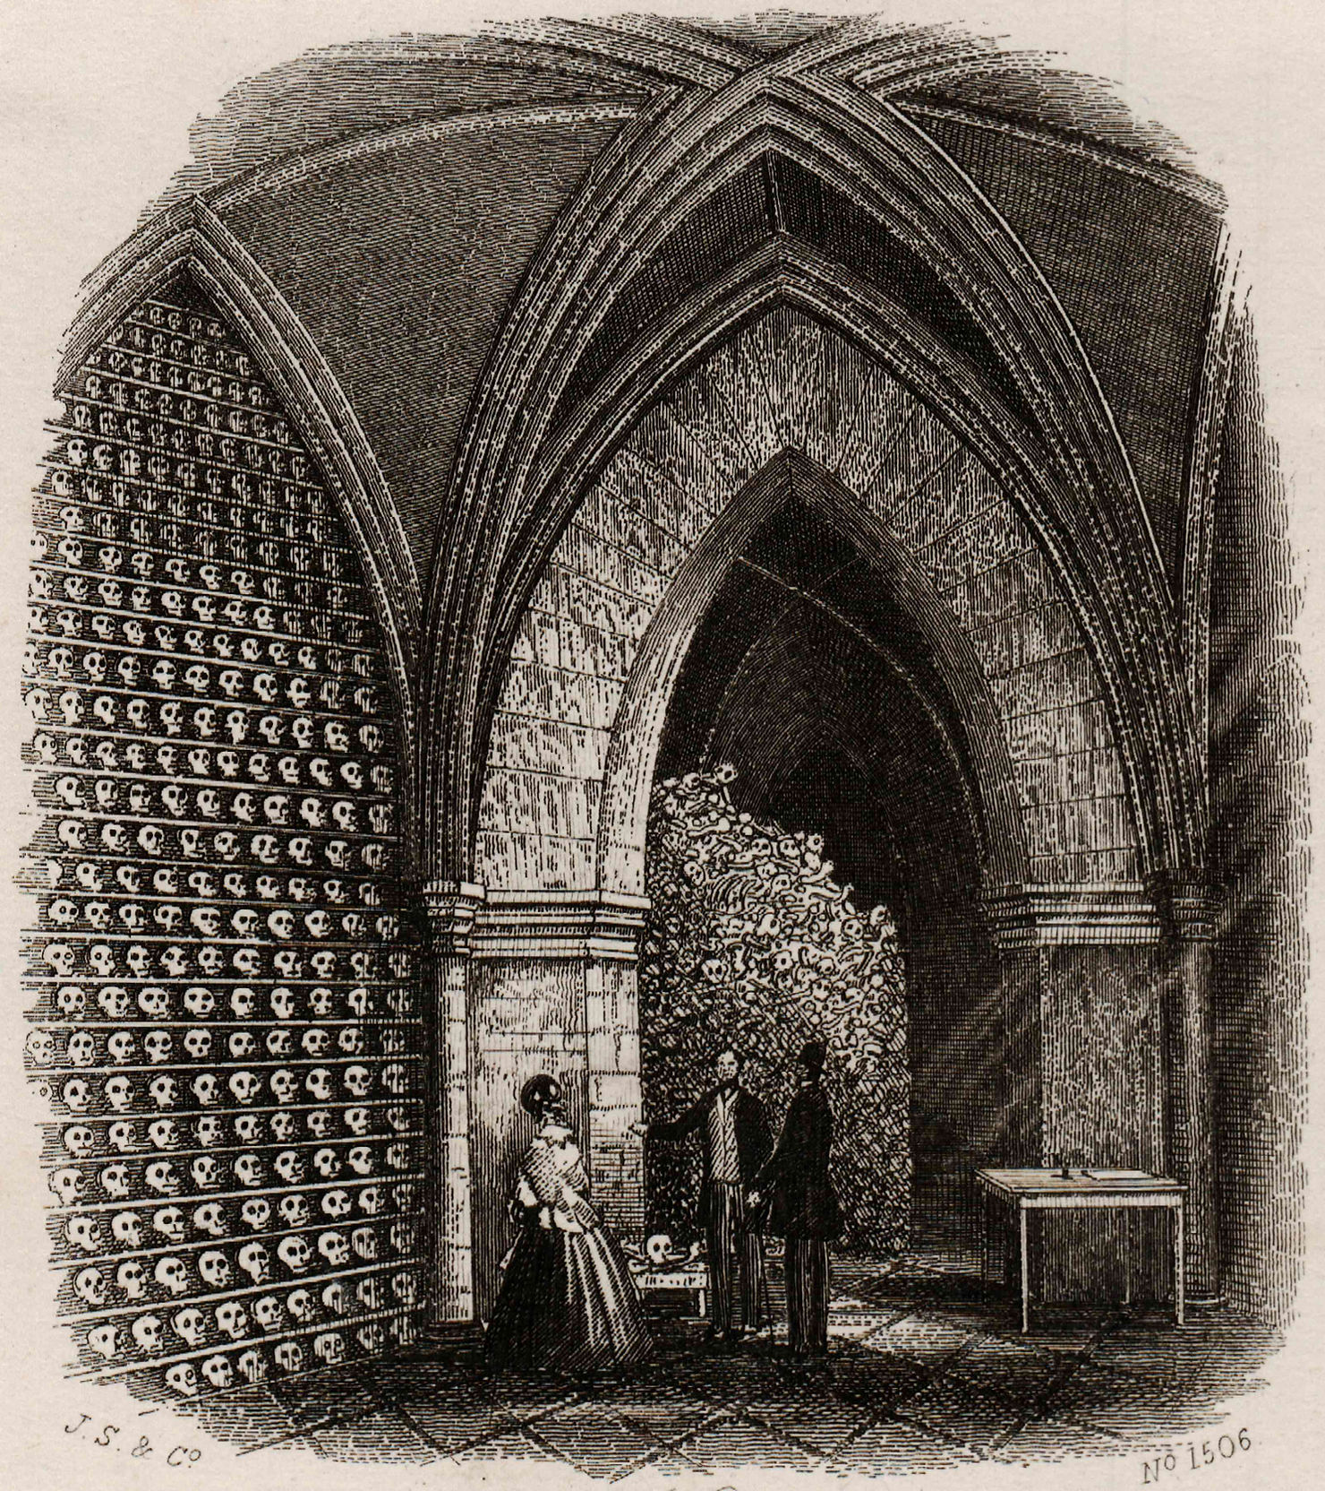
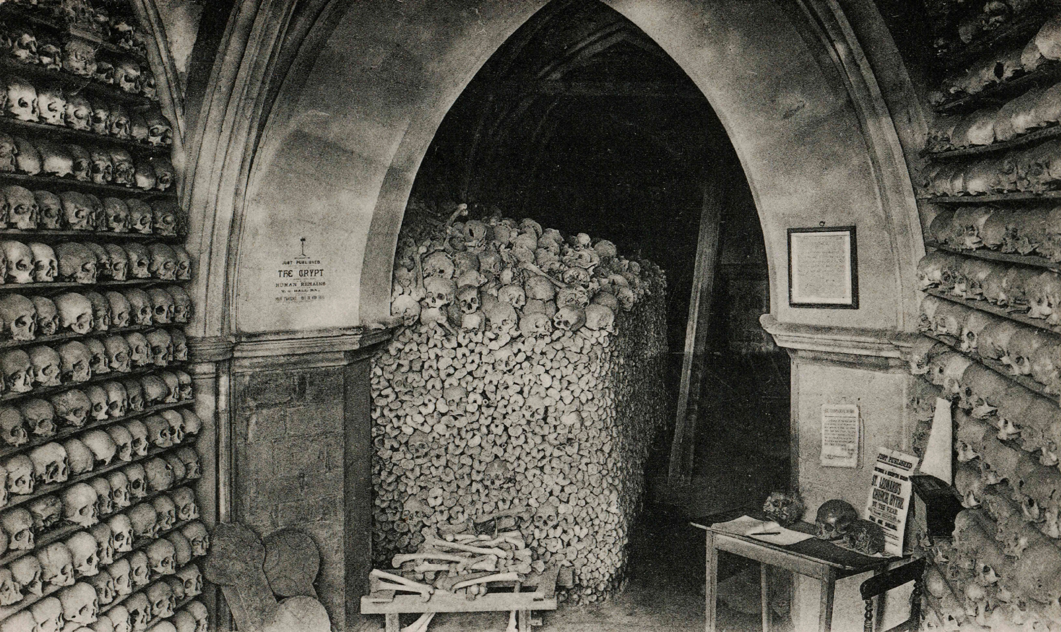
St Leonard’s Church, Hythe, Kent
Hythe Ossuary, 1865
c.1910

Slide 7
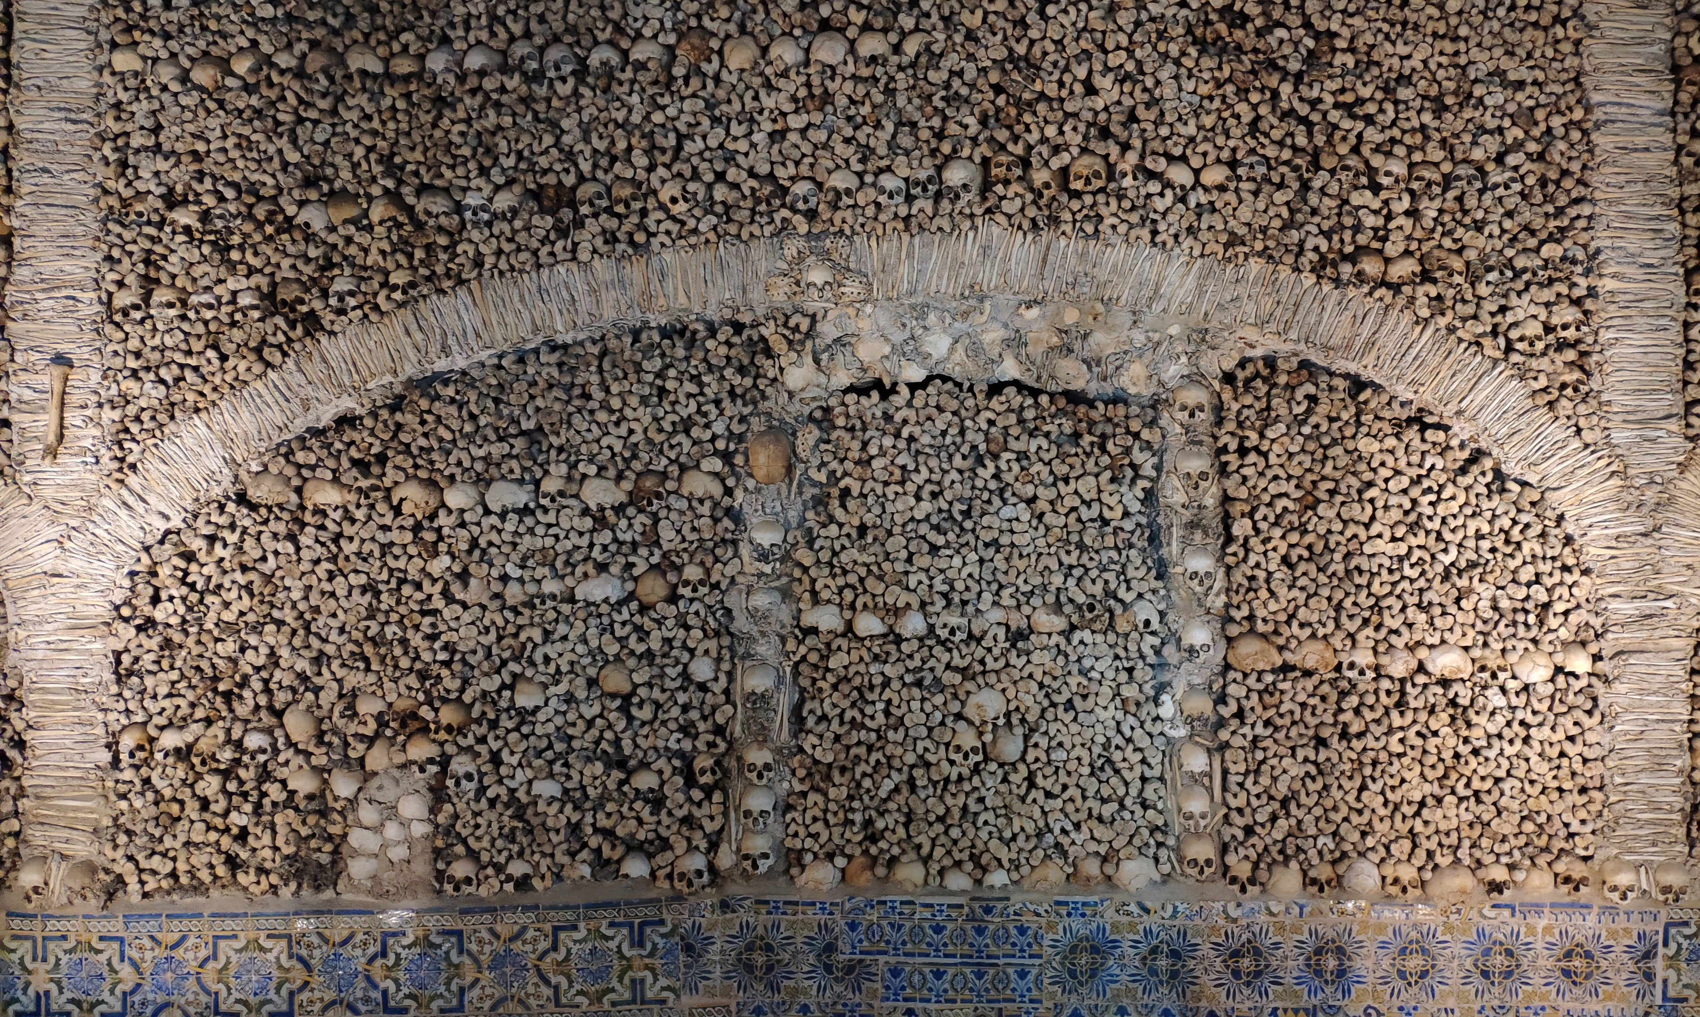
Afterlife of ossuaries
Post-Reformation, charnel houses in many protestant countries were sold, destroyed, or sealed off. Bones lost or discarded.
In C19, urban infrastructure projects such as road, sewer, and railway constructions led to rediscovery of ossuaries.
Many bones given to museums (e.g Museum of London’s 20,000 human remains drawn from all eras of the city’s history).
In Catholic countries, ossuaries survived and continued to be built into the modern era.
Wall of the C16 Capela dos Ossos (Chapel of Bones), Évora, Portugal

Slide 8
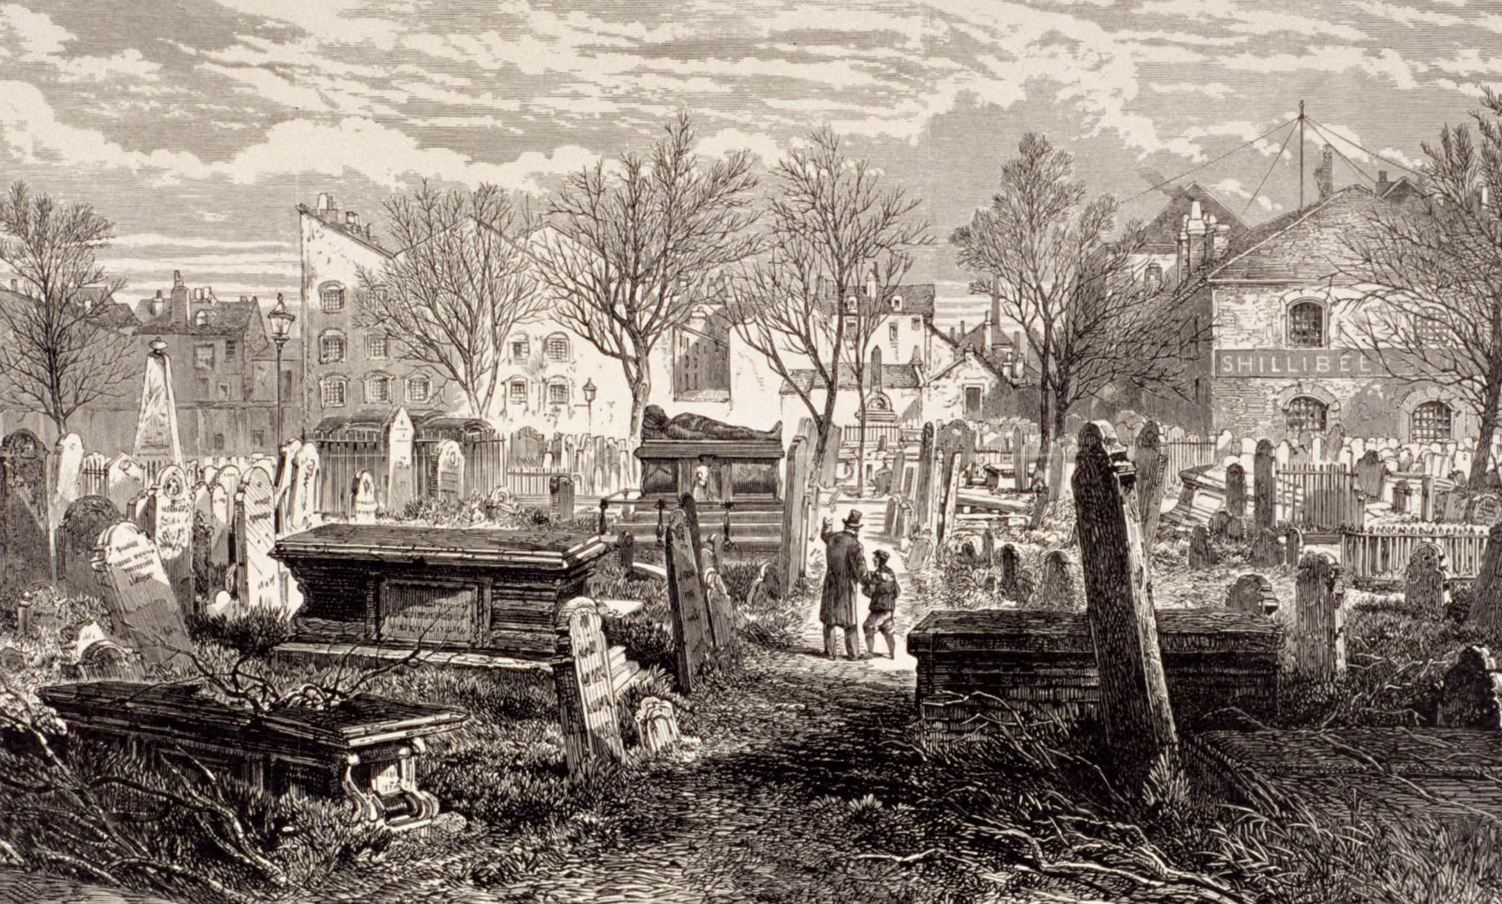
The Graveyard Crisis (c.18th-19th centuries)
Urban expansion and population explosion exerts pressure on existing church burial grounds.
Traditional graveyard burials unsustainable (or were they??)
Land in city centres becomes more valuable.
Essential infrastructure (railways, sewage systems) require space.
Dead bodies and smell of putrefaction increasingly seen as signs of contamination/pollution. A change in sensory tolerance.
Rise of non-conformist churches means old monopoly on burial space by established church fades.
Cemetery at Bunhill Fields, Finsbury, London, 1866

Slide 9
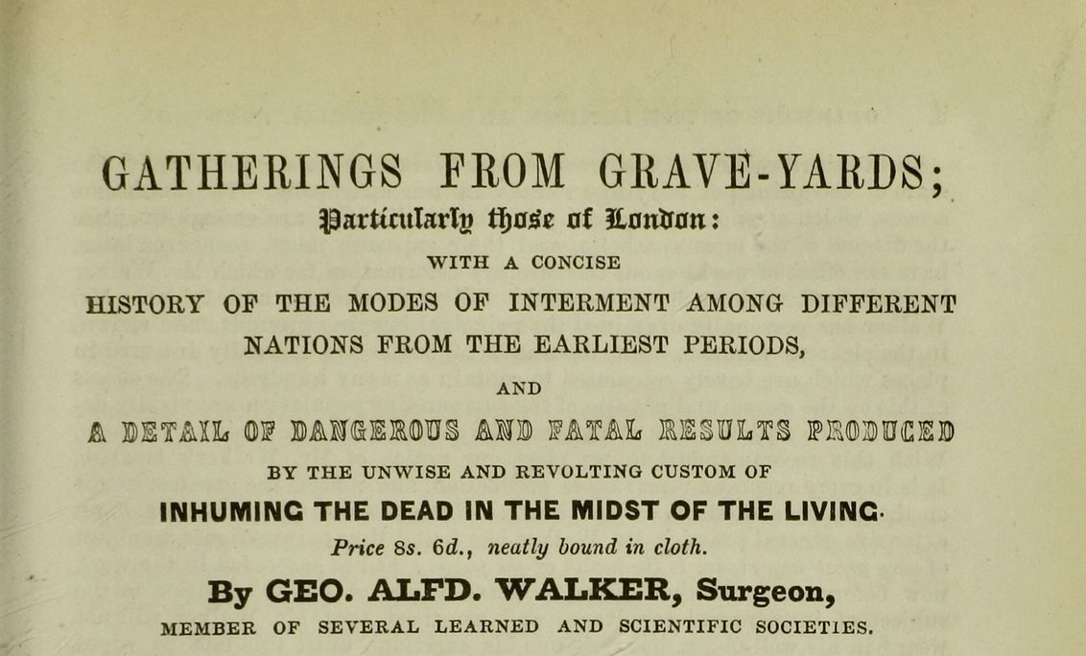
Gatherings from Graveyards and Public Health
George Alfred Walker’s Gatherings from Graveyards (1839) draws attention to overcrowded, unsanitary and disrespectful burial practices in London.
Links to miasmatic theory of disease: illness caused by putrefaction (rotting organic matter).
Edwin Chadwick’s Supplementary Report on the Results of a Special Inquiry into the Practice of Interment in Towns (1843) reinforces impression of unsanitary urban graveyards posing a threat to public health.

Slide 10
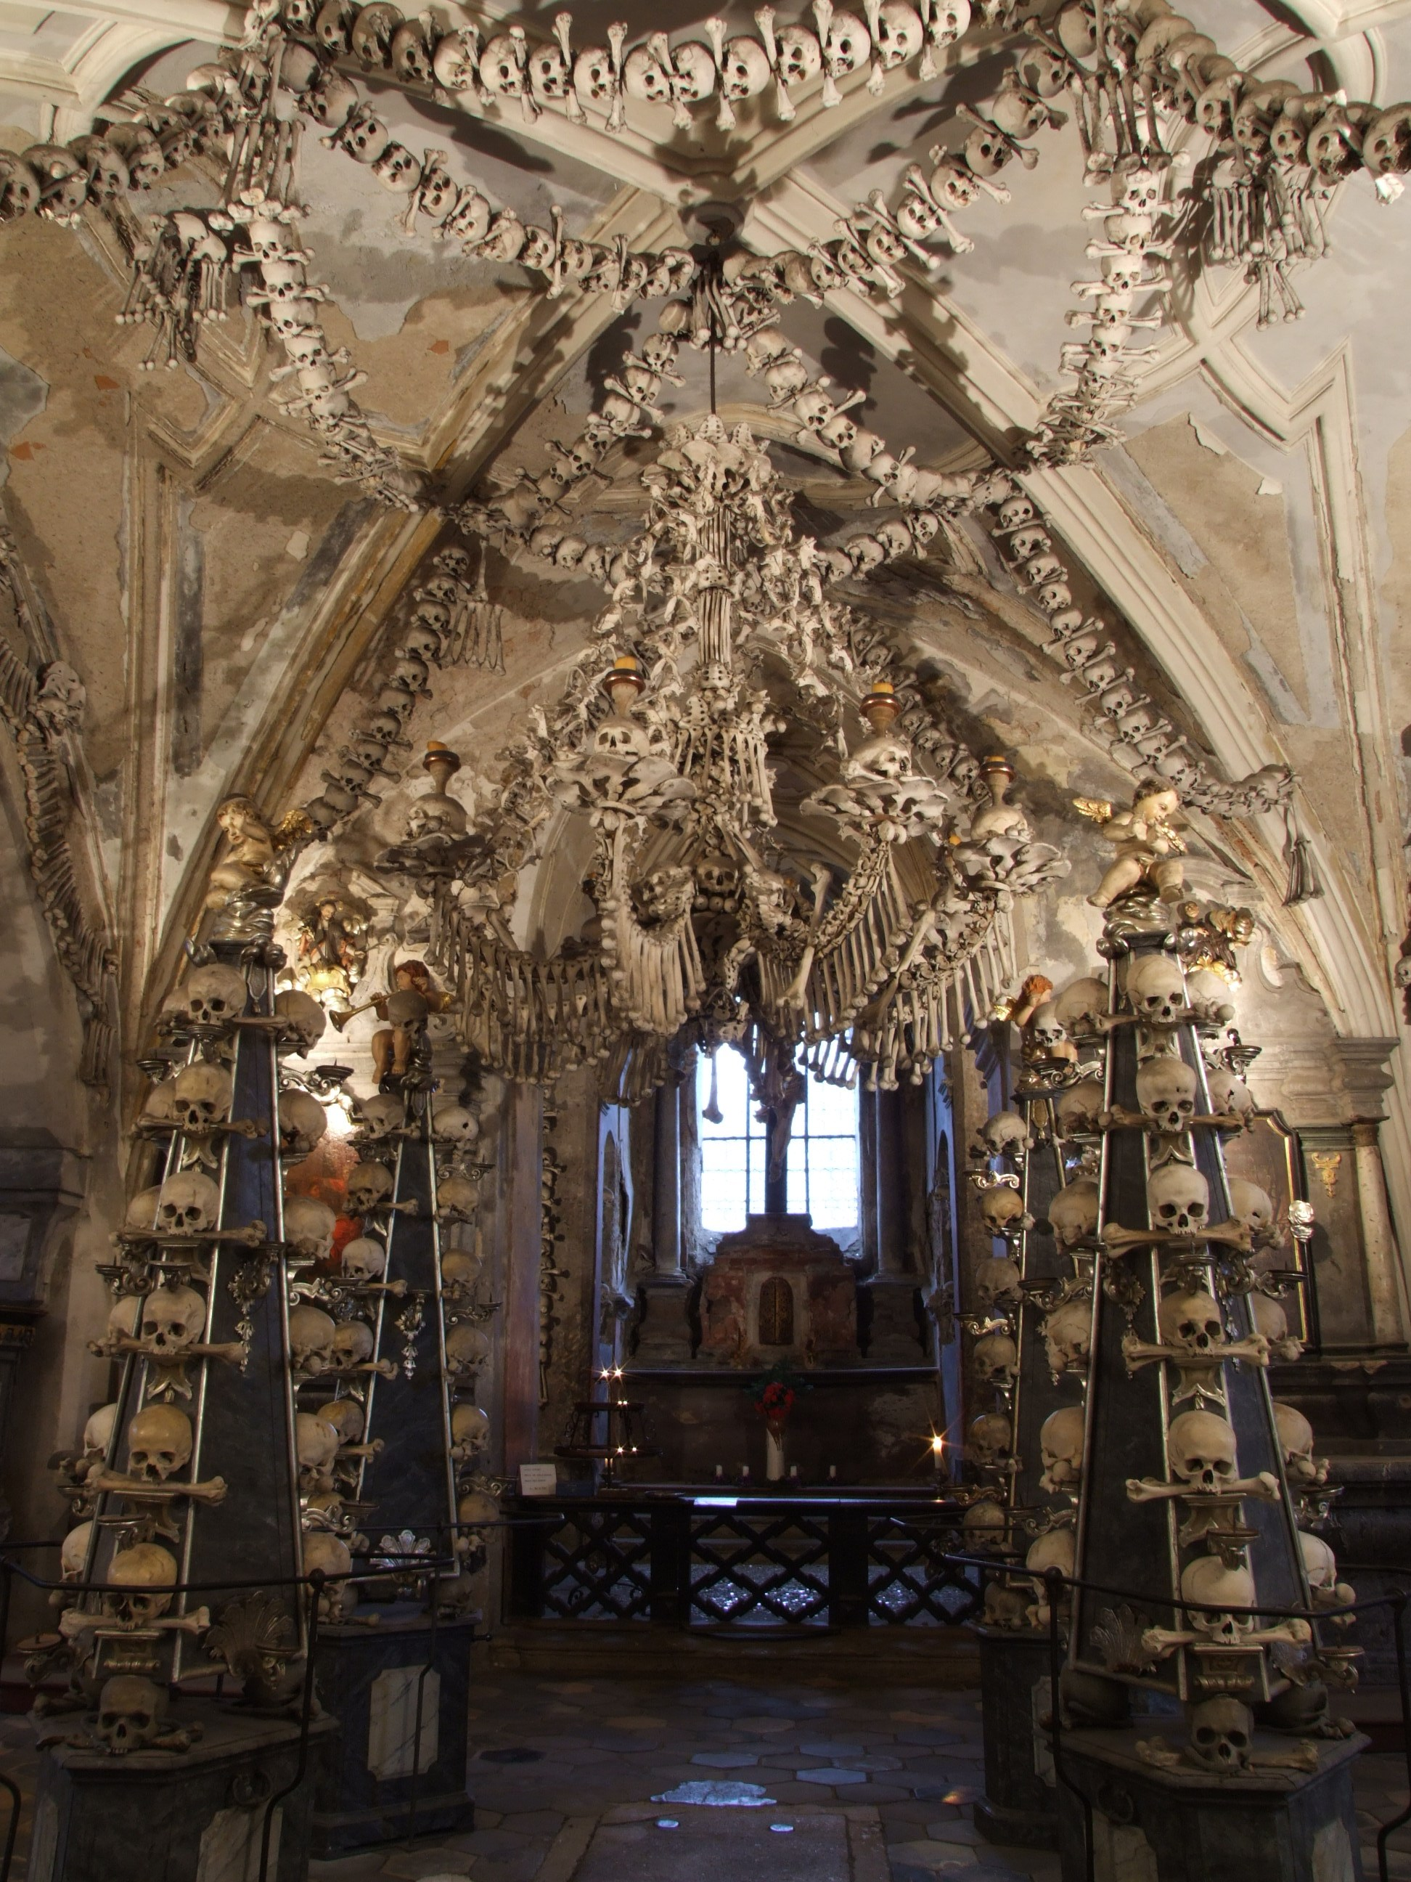
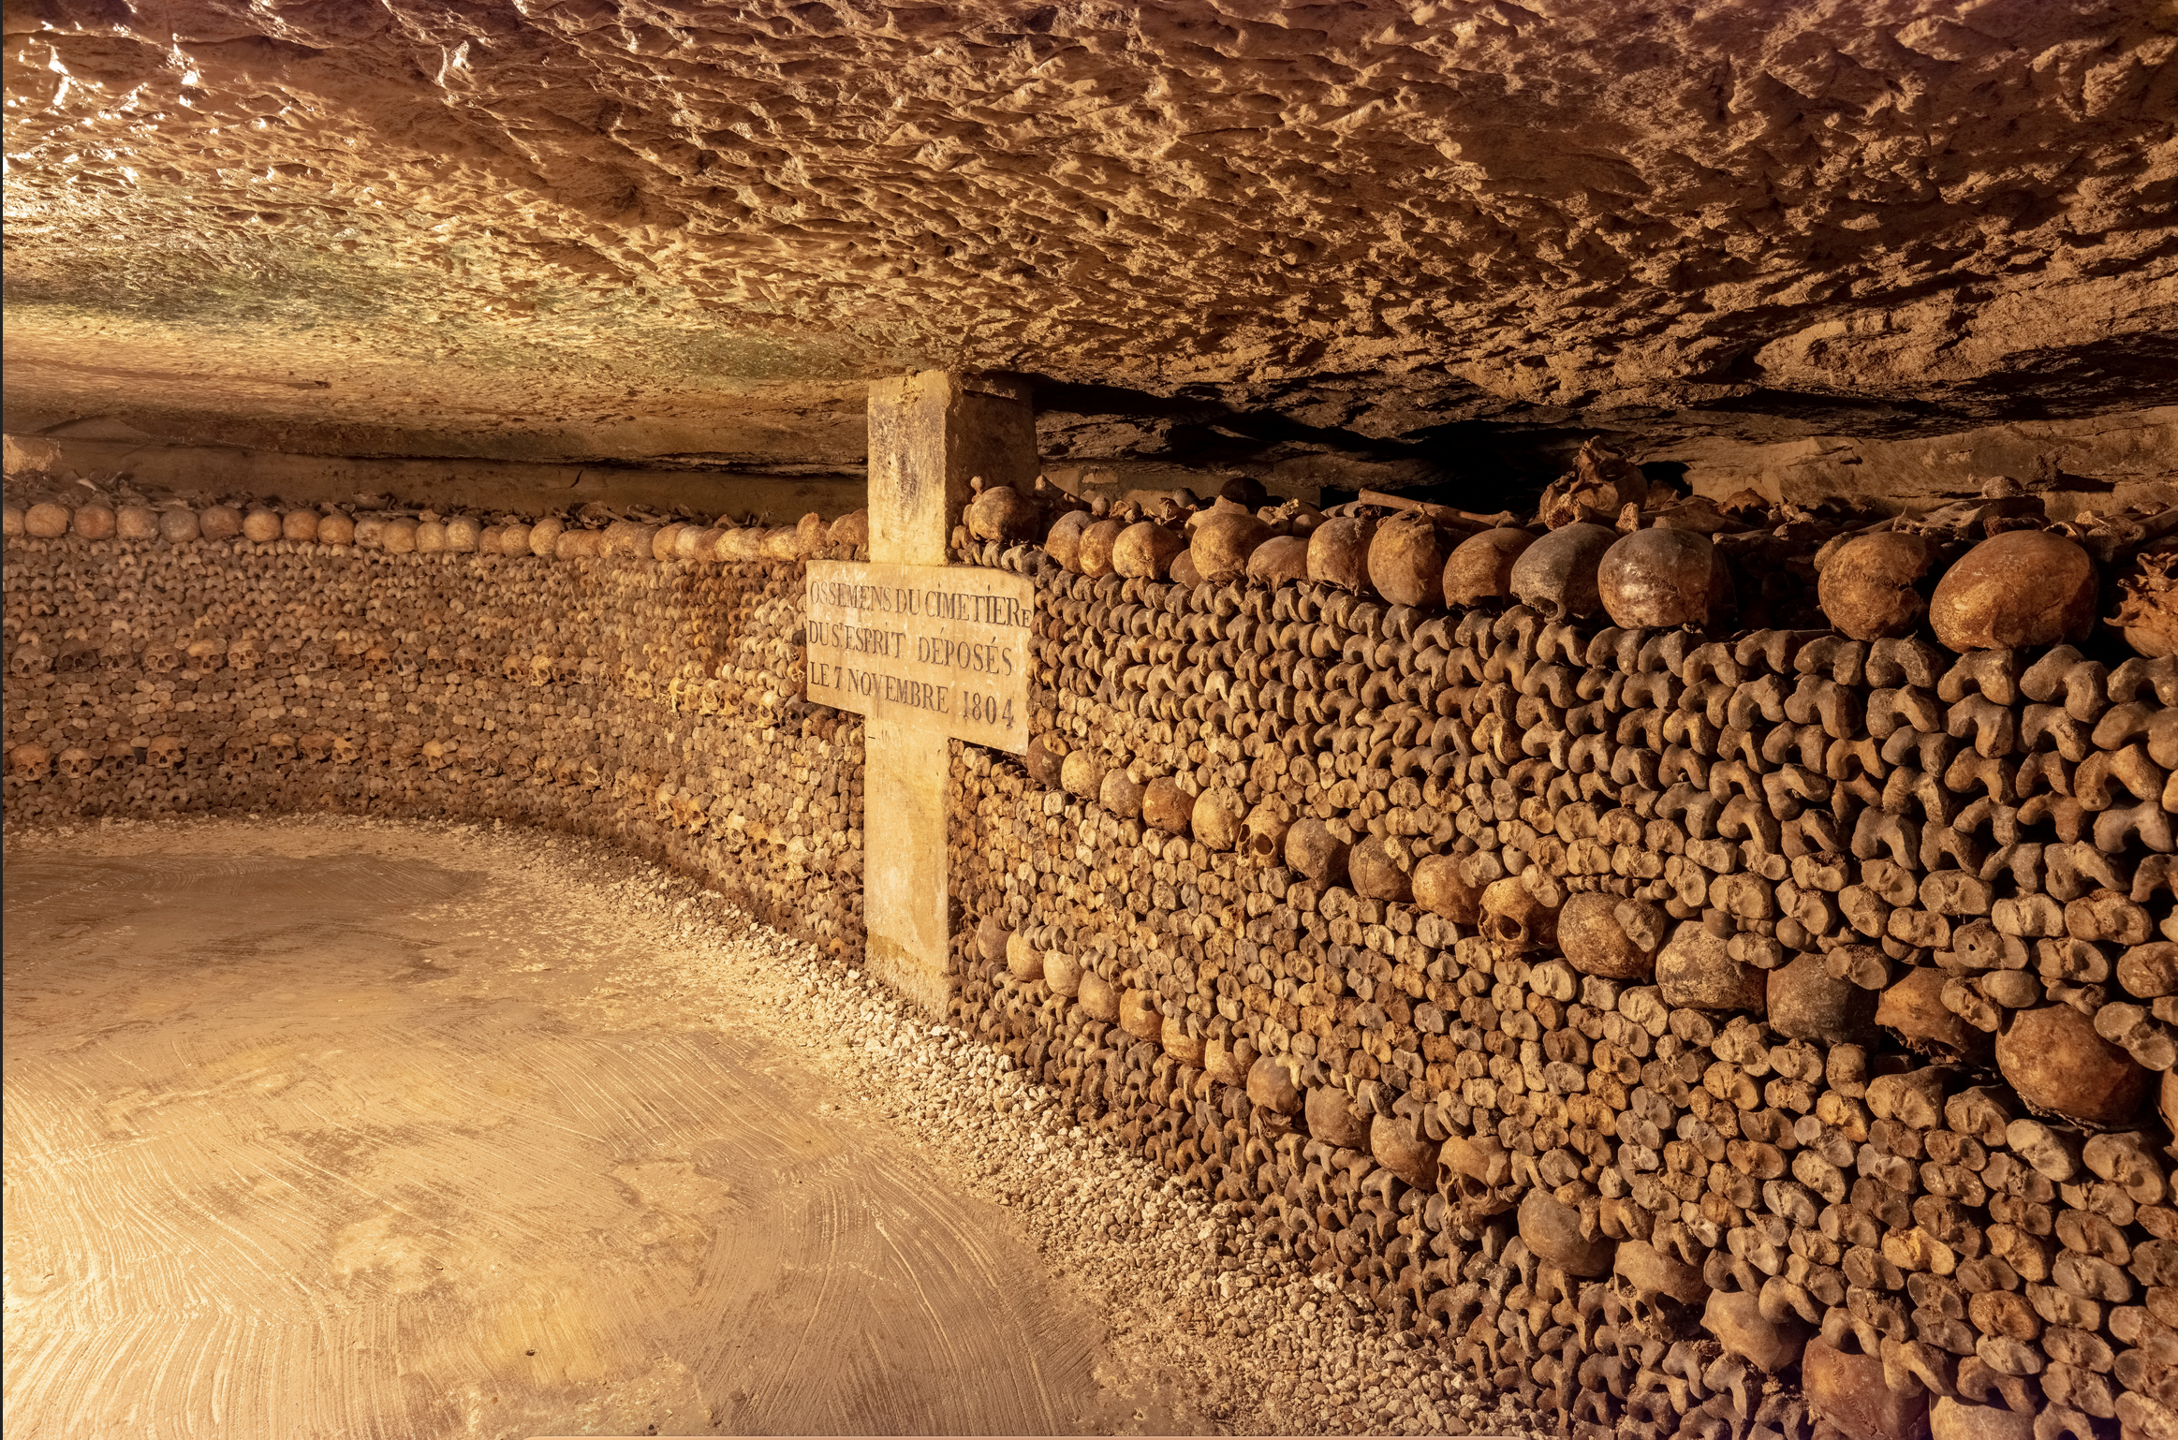
Solution: More Ossuaries
Paris Catacombs: up to 6 million remains, taking up 280 km (174 m), of which a small section is open to the public. Construction began in 1780 following overuse/collapse of Cimetière des Innocents.
Sedlec Ossuary, Cemetery Church of All Saints, Czechia: 40-70k remains, many exhumed c.1400, arranged in 1870.

Slide 11
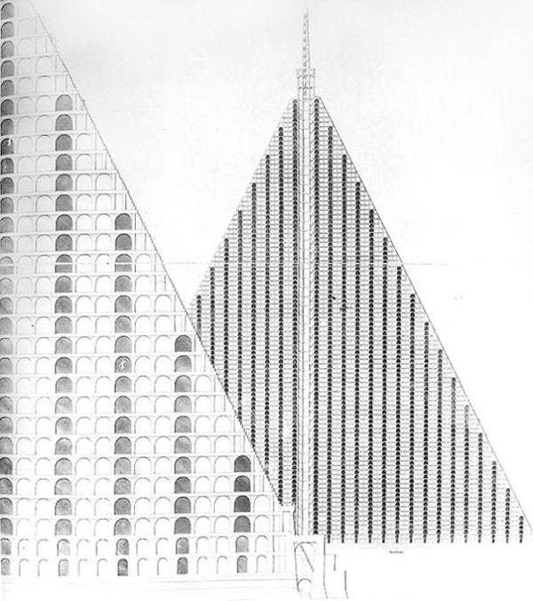
Solution: Urban Planning
Ambitious C19 projects to house the dead, forecasting further growth of cities.
Architectural vision: Willson’s Metropolitan Sepulchre designed for 5 million dead (anticipating 40K burials/year). 94-storey tall pyramid on Primrose Hill.
Akin to infrastructure investments in bridges, railways, etc. as cities like London expanded outwards and created opportunity for designed solutions.
Lack of feasibility due to size/scale.
Thomas Willson’s ‘Metropolitan Sepulchre’ (1829)

Slide 12
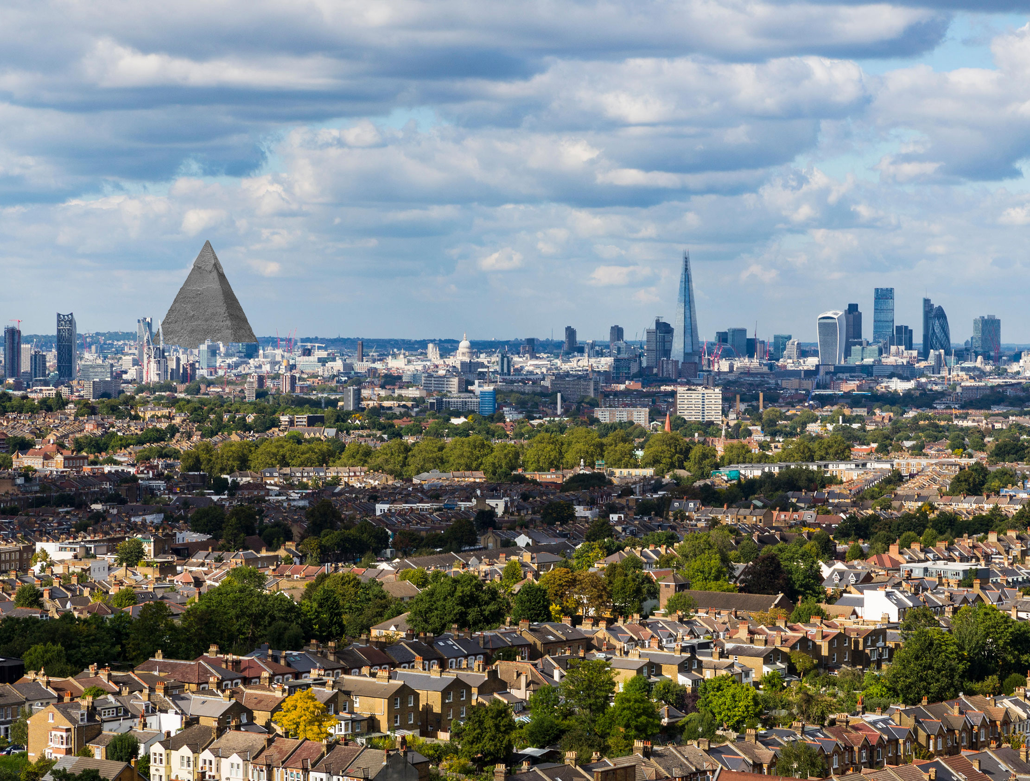

Slide 13
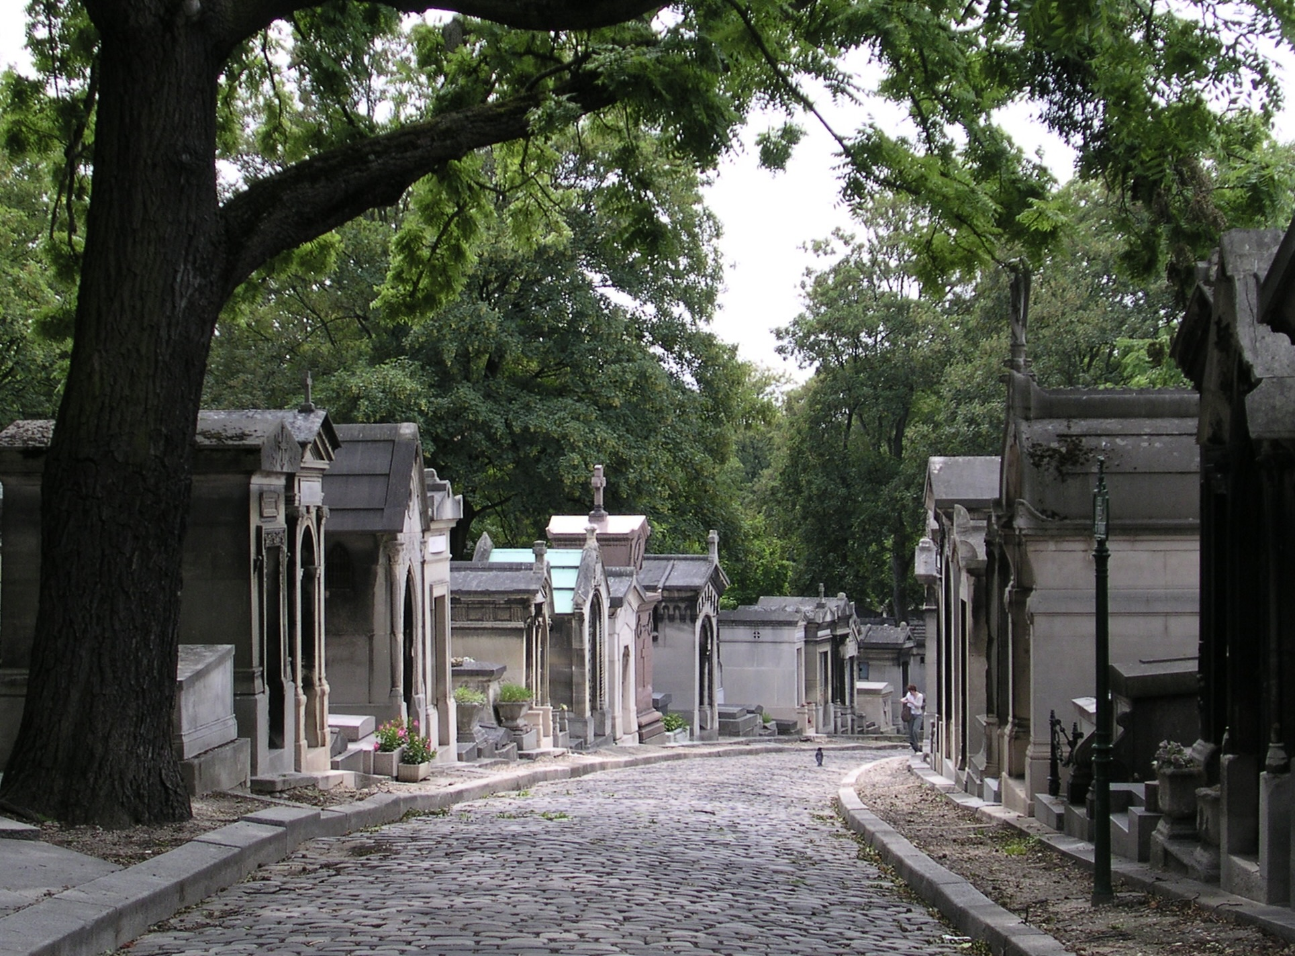
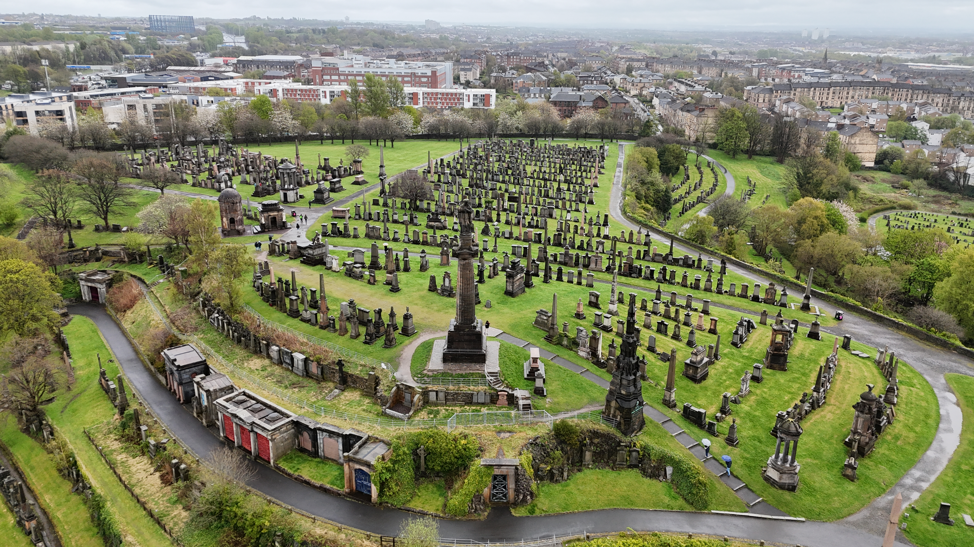
Solution: Cemeteries
Following closure of Holy Innocents’ Cemetery in 1780, burials prohibited with Paris city walls and new cemeteries are built in outer precincts: Père Lachaise (1804), Passy (1820), Montparnasse (1824), Montmartre (1825). Remains of La Fontaine and Molière moved to Père Lachaise in 1817 to raise its prestige.
Cemeteries become fashionable: tourist sites. Landscaping and impressive tomb architecture accompany growth and reflect ostentatious C19 mourning culture. The dead are increasingly named.
British emulation of this model leads to creation of for-profit cemeteries: the ‘magnificent seven’ in London, Glasgow Necropolis, etc.
Designated areas for religious dissenters/minorities to be buried.
Cemeteries as peaceful, natural, aesthetic spaces for the dead and mourners alike.
Père Lachaise (founded 1804)
Glasgow Necropolis (founded 1833)

Slide 14
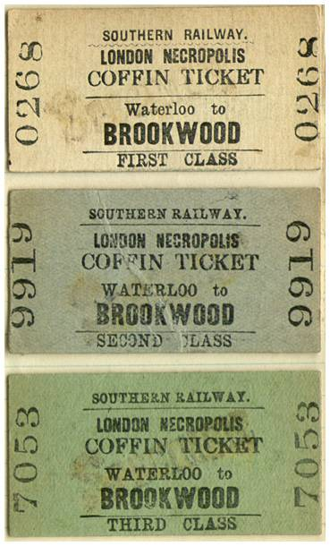
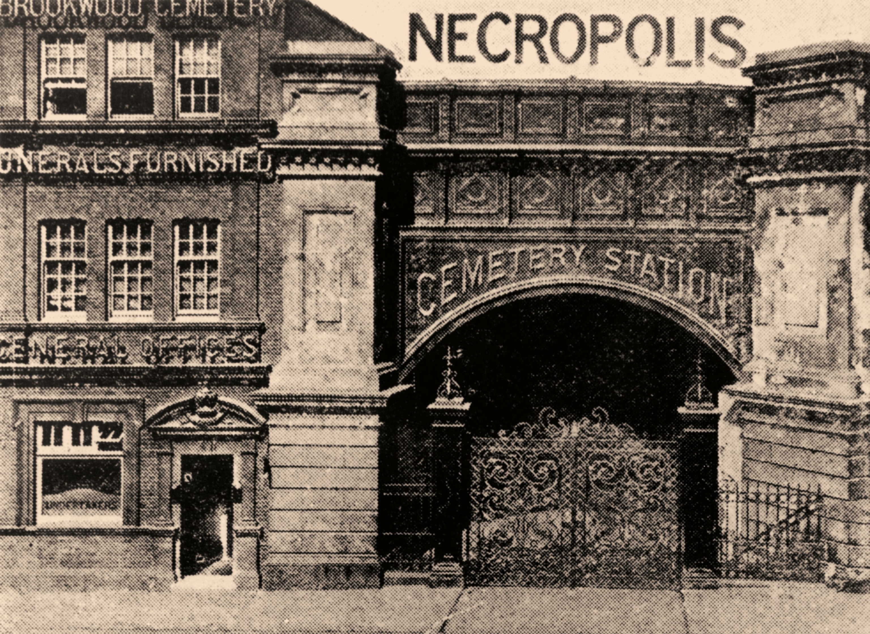
New solutions, new problems
Necropolis railway (1854-1941) brought deceased in coffins and mourners from central London (Waterloo) to Brookwood Cemetery, Surry (est. 1854), 23 miles away.

Slide 15
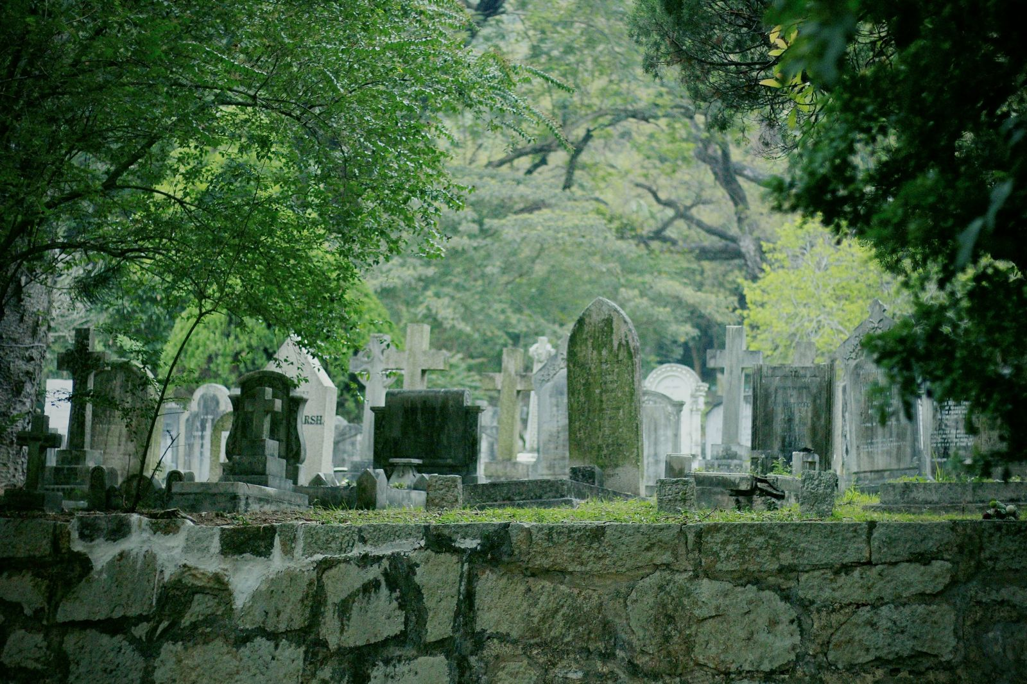
Exporting cemeteries
The construction of cemeteries a staple of many European colonies in the 19th century, e.g. Hong Kong Colonial Cemetery, est. 1845.
‘Cemeteries as projection of Christian, imperialist values, contrasted with ‘native’ burial practices which were viewed as distasteful and unhygienic.
In some settings (e.g. Gold Coast), cemetery burials mandated to displace traditional modes of disposal.
Exerting sovereignty over the dead to control the living.
Hong Kong Colonial Cemetery

Slide 16
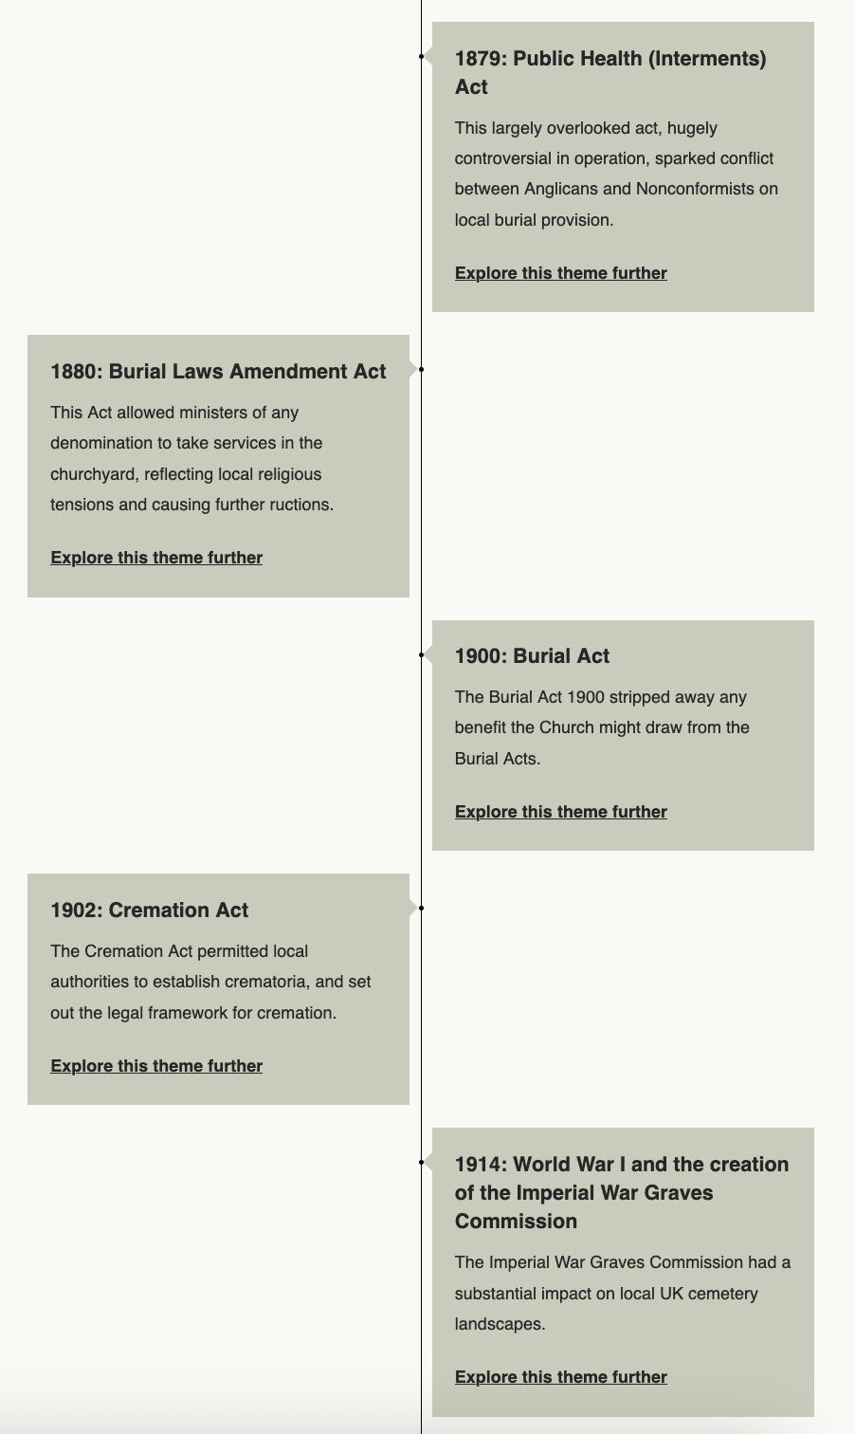
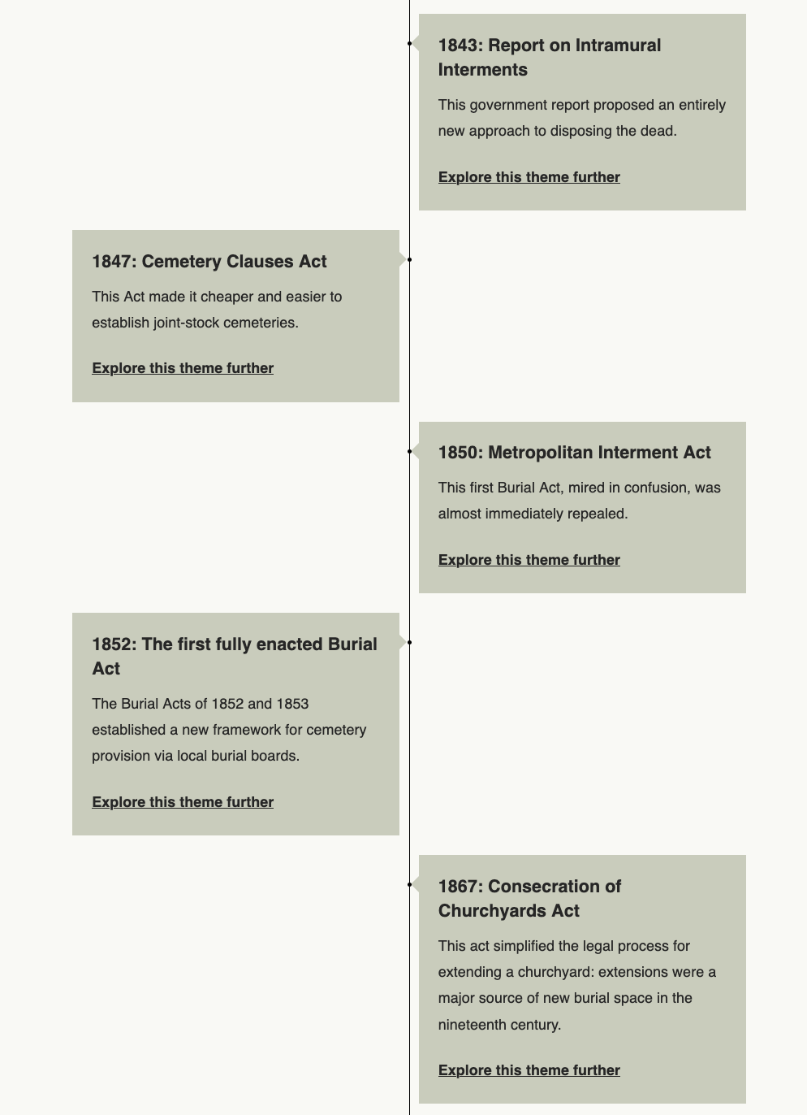

The state control of the dead

Slide 17
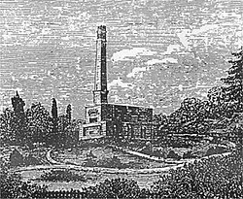
The rise of cremation
Widely practiced in antiquity, the resurrection of cremation c.1870 in Europe could be represented in neoclassical terms.
Represented a form of ‘disenchantment’ towards the dead body: culmination of Enlightenment secularisation and materialism.
Reflects scientific knowledge of decomposition: cremation a means of hastening a natural process (turning the body to dust).
Space and cost of funerals, as well as the risk of spreading disease and keeping remains secure, all contributed to the cremation movement, and its legalization, in the late C19.
Immigrant demand further drove cremation movement, but distinction between European and South Asian cremation evident in use of enclosed crematoria, speed, efficiency, complete carbonisation of body.
70% of British dead now cremated (25% for Americans).
Woking Crematorium, 1870s

Slide 18
Parting thoughts
The notion of ‘eternal rest’ in one spot (a marked cemetery plot) is comparatively recent. In many parts of Europe, human remains have traditionally been anonymized, moved, and displayed.
Modern methods of disposing the dead (cemeteries and cremation) have created a distance between the living and the dead, with implications for how we view death and the treatment of the deceased.
The ‘new regime’ of death has given the state authority over dead bodies, a fundamental change from domestic/religious forms of disposal.

