Slide 1
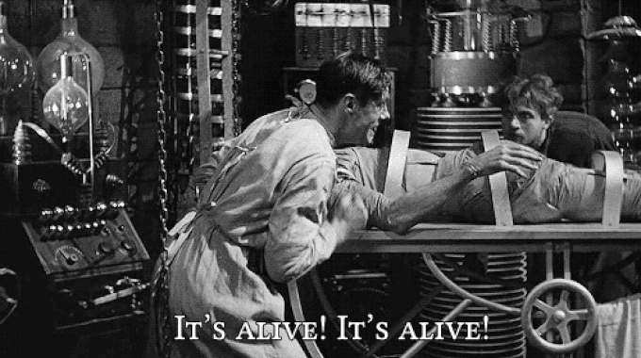
Resurrecting the Dead: Transplantation and Tissue Research
HI2L2: Life After Death—A History of Human Remains
Week 9
Frankenstein (1931)

Slide 2
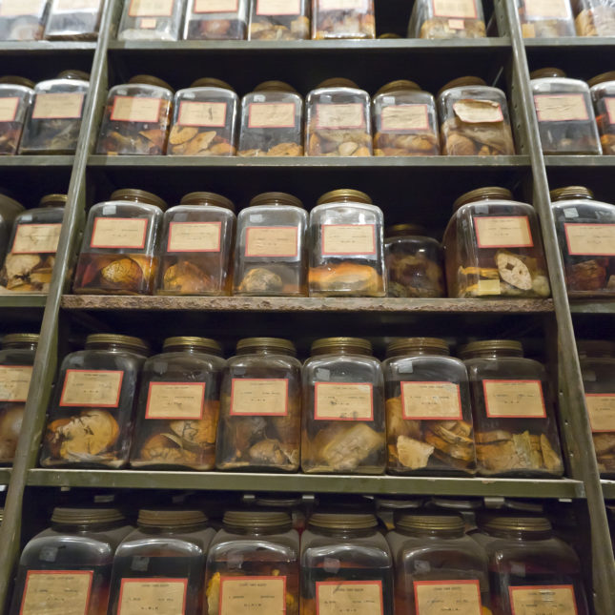
Lecture Outline
Redefining life and death
Galvinism
Experimental medicine
Tissue research
Organ transplantation
Ethics
Cushing brain collection, Yale University (credit).

Slide 3
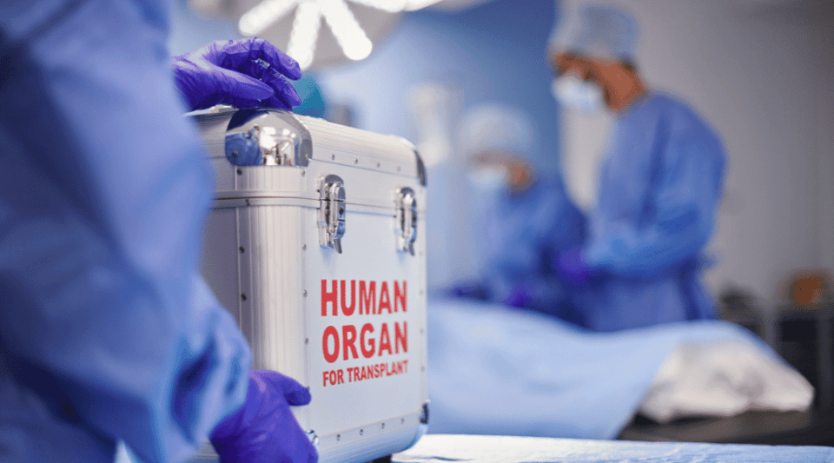
The boundary between life and death
From the C18 to the modern day, tissue research and transplantation have redefined life and death.
When does consciousness cease? Does brain activity constitute life? Is transplantation a form of second life? Is resurrection possible?
The potential to transcend death through scientific and medical research raises significant ethical issues, anticipated in fiction and experienced in practice.

Slide 4
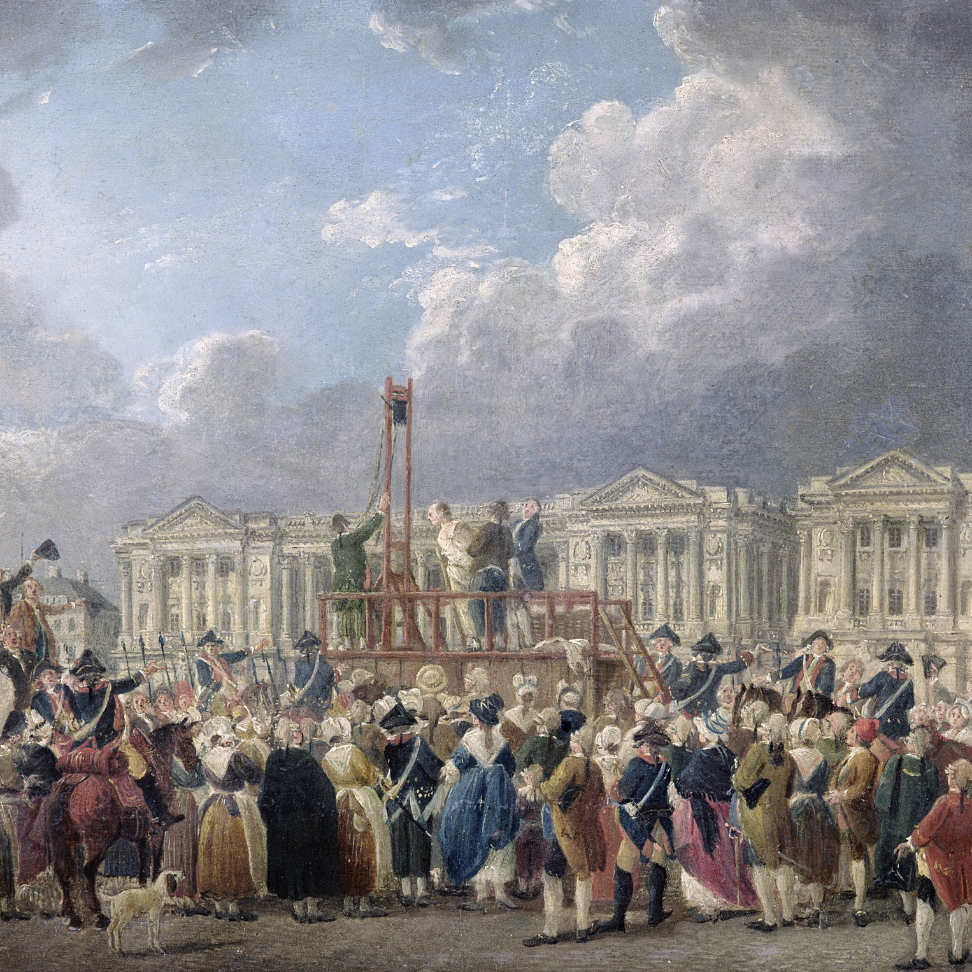
Humane executions
The ‘Terror’ following the French Revolution, when c.15-17k people were guillotined, provided opportunities for research on dead bodies.
The claim that decapitation provided a painless, instantaneous death was investigated.
  Did consciousness persist after decapitation?
Bodies also used for galvanic research.
Pierre-Antoine Demachy, Une exécution capitale, place de la Révolution (1793)

Slide 5
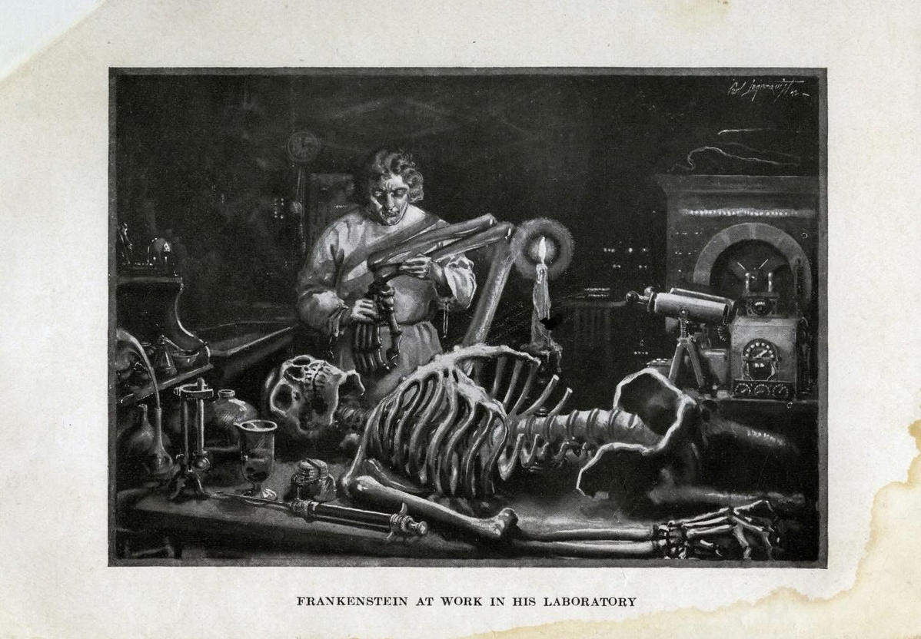
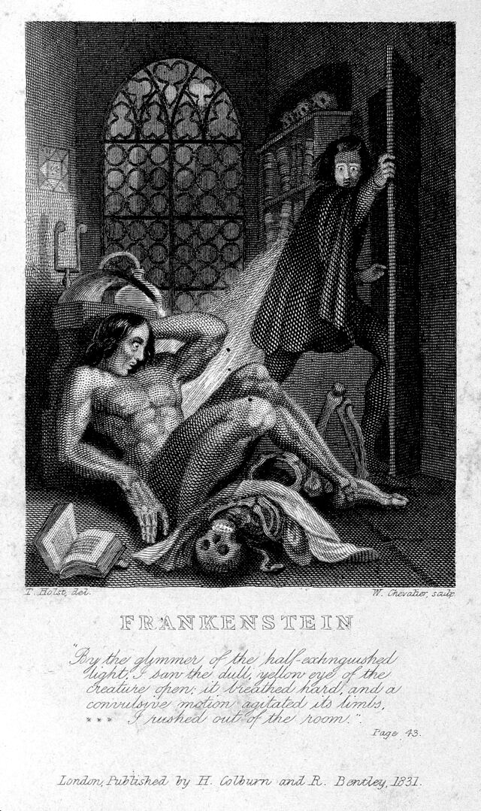
Frankenstein
Plate by Carl Lagerquist (1922 edition)
Mary Shelley’s Frankenstein (1818) depicted the resurrection of dead body parts into a living composite through electrical stimulation.
The novel anticipated aspects of transplantation, and drew on research on galvanism.
A cautionary tale about scientific hubris, and the ethical implications of making new life out of the deceased.
Frontispiece to Frankenstein by Theodor von Holst (1831 edition)

Slide 6
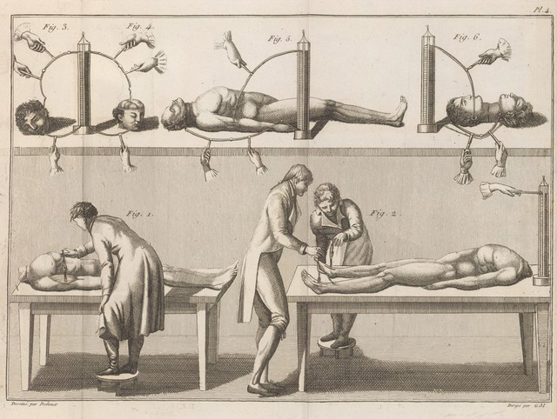
Galvanism
A form of electricity produced by chemical action, also used to refer to currents produced in biological organisms, and the contraction of muscles when electrified.
Associated with discoveries by Alessandro Volta (1745-1827) and Luigi Galvani (1737-1798).
Galvanism demonstrated on frogs, but research on humans also performed (e.g. cadavers from the guillotine).
Potential for revival of the recently drowned/suffocated, and as therapy for the insane.
Essai theorique et experimental sur le galvanisme by Giovanni Aldini (1804)

Slide 7
GEORGE FOSTER
Executed at Newgate, 18th of January, 1803, for the Murder of his Wife and Child, by drowning them in the Paddington Canal; with a Curious Account of Galvanic Experiments on his Body
“He died very easy; and, after hanging the usual time, his body was cut down and conveyed to a house not far distant, where it was subjected to the galvanic process by Professor (Giovanni) Aldini, under the inspection of Mr Keate, Mr Carpue and several other professional gentlemen. M. Aldini, who is the nephew of the discoverer of this most interesting science, showed the eminent and superior powers of galvanism to be far beyond any other stimulant in nature. On the first application of the process to the face, the jaws of the deceased criminal began to quiver, and the adjoining muscles were horribly contorted, and one eye was actually opened. In the subsequent part of the process the right hand was raised and clenched, and the legs and thighs were set in motion. Mr Pass, the beadle of the Surgeons' Company, who was officially present during this experiment, was so alarmed that he died of fright soon after his return home.
Some of the uninformed bystanders thought that the wretched man was on the eve of being restored to life. This, however, was impossible, as several of his friends, who were under the scaffold, had violently pulled his legs, in order to put a more speedy termination to his sufferings. The experiment, in fact, was of a better use and tendency. Its object was to show the excitability of the human frame when this animal electricity was duly applied. In cases of drowning or suffocation it promised to be of the utmost use, by reviving the action of the lungs, and thereby rekindling the expiring spark of vitality. In cases of apoplexy, or disorders of the head, it offered also most encouraging prospects for the benefit of mankind.
The professor, we understand, had made use of galvanism also in several cases of insanity, and with complete success. It was the opinion of the first medical men that this discovery, if rightly managed and duly prosecuted, could not fail to be of great, and perhaps as yet unforeseen, utility.
                The Newgate Calendar, Part III (1800-1842)

Slide 8
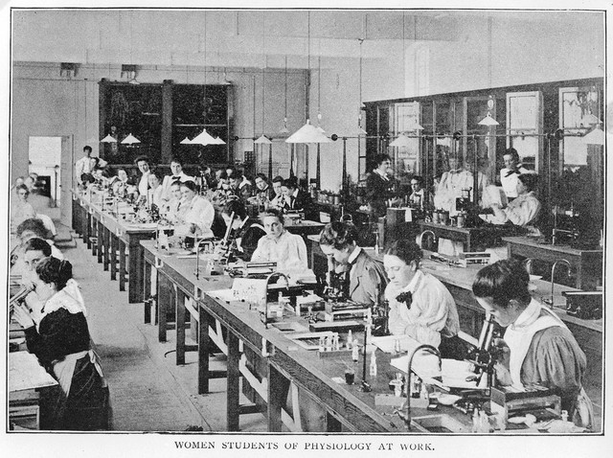
Experimental medicine
Associated with French clinical medicine, and the approach of Francois Magendie (1783-1855) and Claude Bernard (1813-1878).
Physiology: the study of mechanisms/processes within the living body, the function of tissues and cells.
The experimental approach, articulated in Bernard’s 1865 work, An Introduction to Experimental Medicine situates the laboratory as the proper site of medical research.
Emphasis on vivisection (dissection of live animals), but also anatomy/pathology, microscopic techniques involving cadavers/tissue.
Physiology Laboratory at the London School of Medicine, c.1899 (Wellcome Collection)

Slide 9
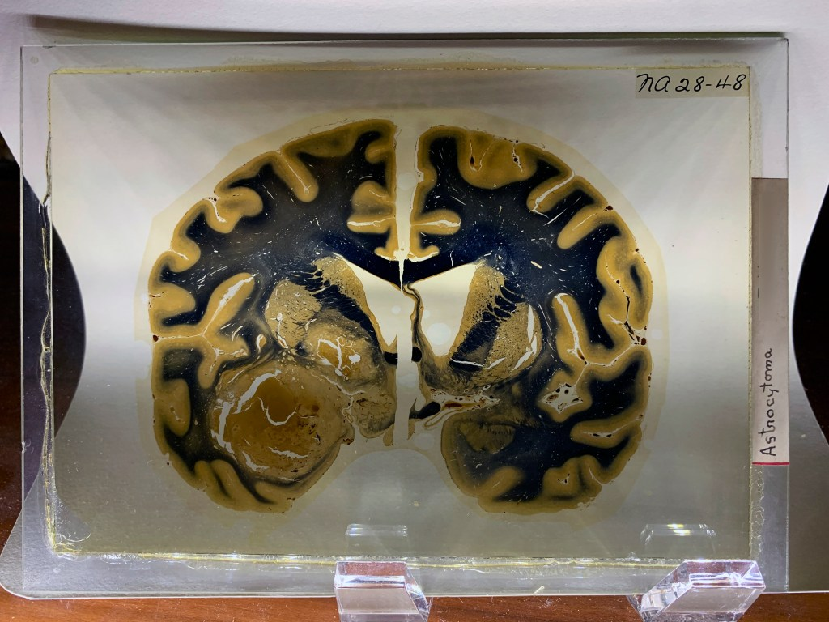
Brain research
Brain research contributed to physiological and pathological studies in the C19.
Louis Victor Leborgne (1809-1861)’s and Lazare Lelong (1790-1865)’s brains were studied by Paul Broca to identify cerebral localisation of speech (and impediment known as ‘Broca’s aphasia’).
Leborgne’s brain retained in Dupuytren museum and remains a research specimen (e.g. subjected to MRI analysis).
Brains of geniuses also collected (e.g. Smithsonian Collection, and Wilder brain collection at Cornell University, which held up to 1,200 specimens from late C19).
Harvey Cushing (1869-1937) brain collection at Yale used to teach neuroscience and surgery. (Cushing’s disease: malfunction of the pituitary gland).
Thinly sliced human brain tissue whole mounts (Cushing Collection)

Slide 10
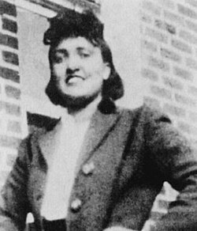
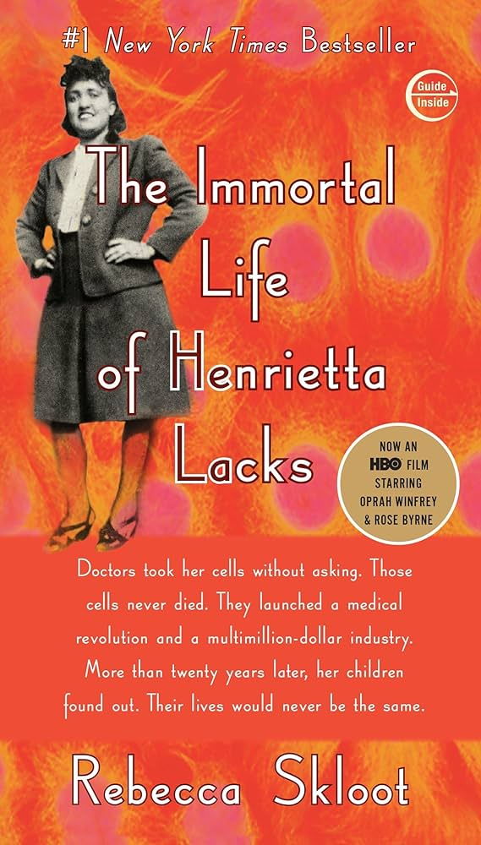
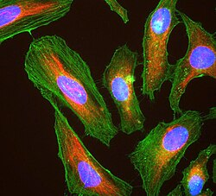
HeLa Cells
Cancer cells named for Henrietta Lacks (1920-1951), an African American woman who was treated for cervical cancer at Johns Hopkins Hospital (Baltimore, USA).
Cancer cells taken without consent during treatment and cultured to produce the world’s first immortalized human cell line.
Cells will reproduce indefinitely under controlled conditions, allowing for decades of cancer research.
Lacks’ family unaware of this trajectory until they were asked for DNA samples in 1973 to find uncontaminated cell lines.
Pharmaceutical companies have profited from sale of HeLa cells, prompting lawsuits from Lacks’ family.
While in the US human tissue taken for research is legally not the property of the subject (1990 ruling), the Common Rule (1991) requires subjects to be informed and allows them to be anonymized.
Immunofluorescence image of HeLa cells grown in tissue culture and stained with antibody to actin in green, vimentin in red and DNA in blue

Slide 11
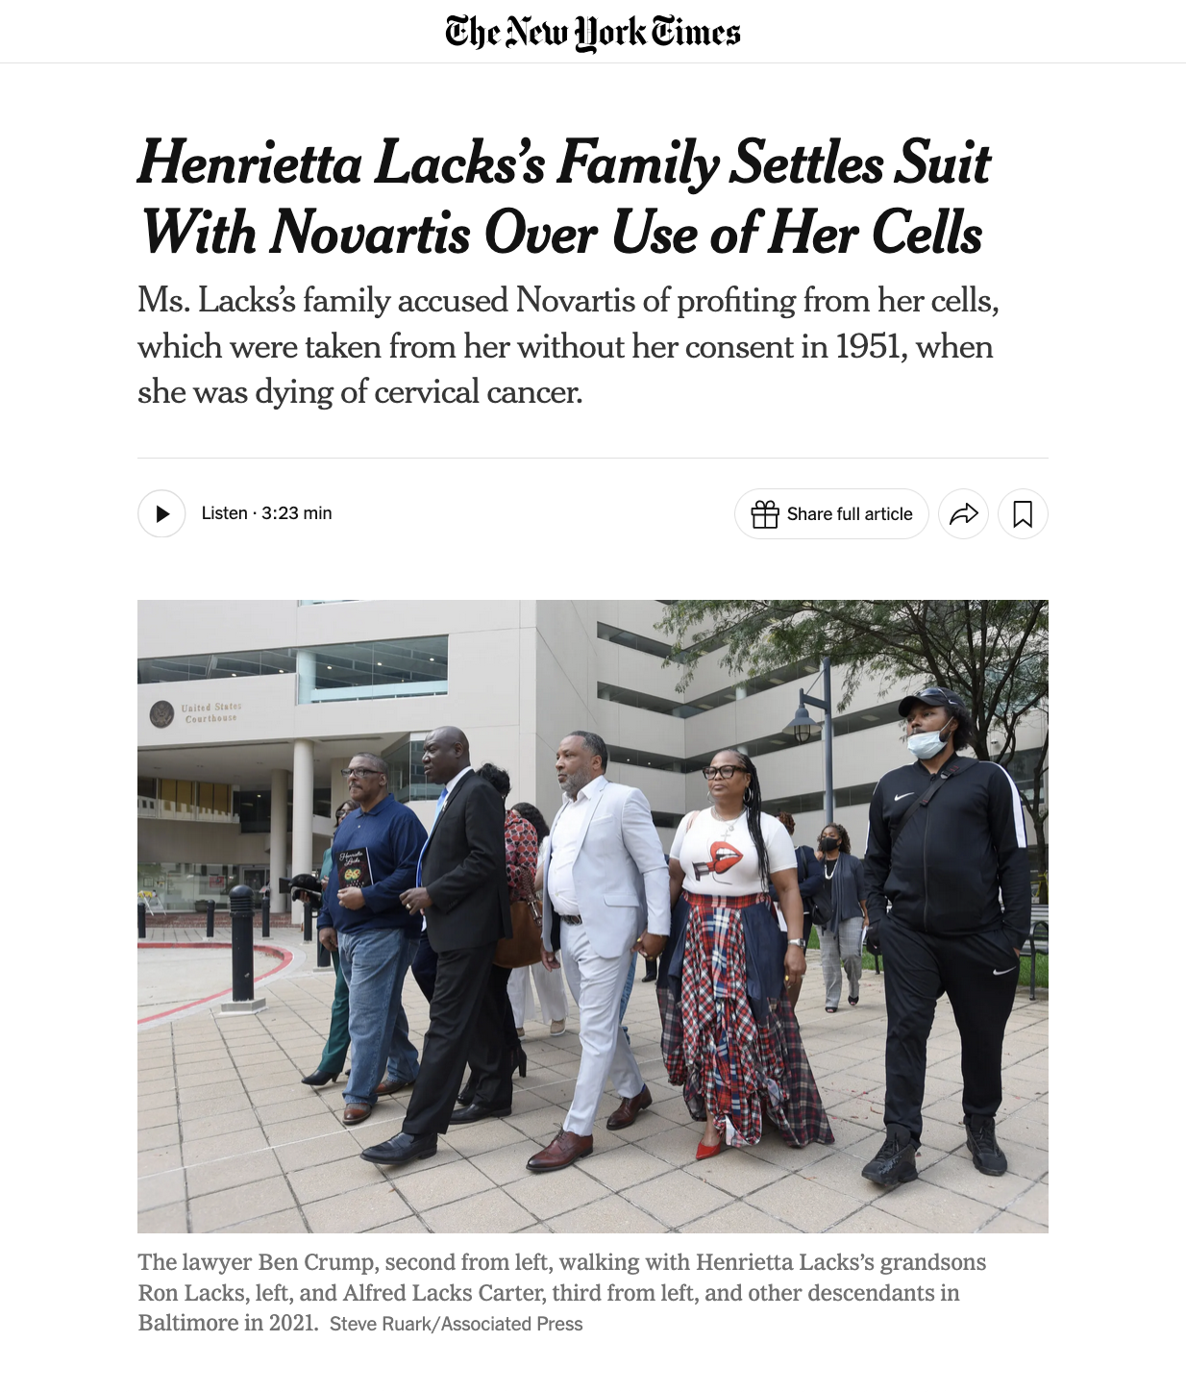
New York Times, 27/02/2026

Slide 12
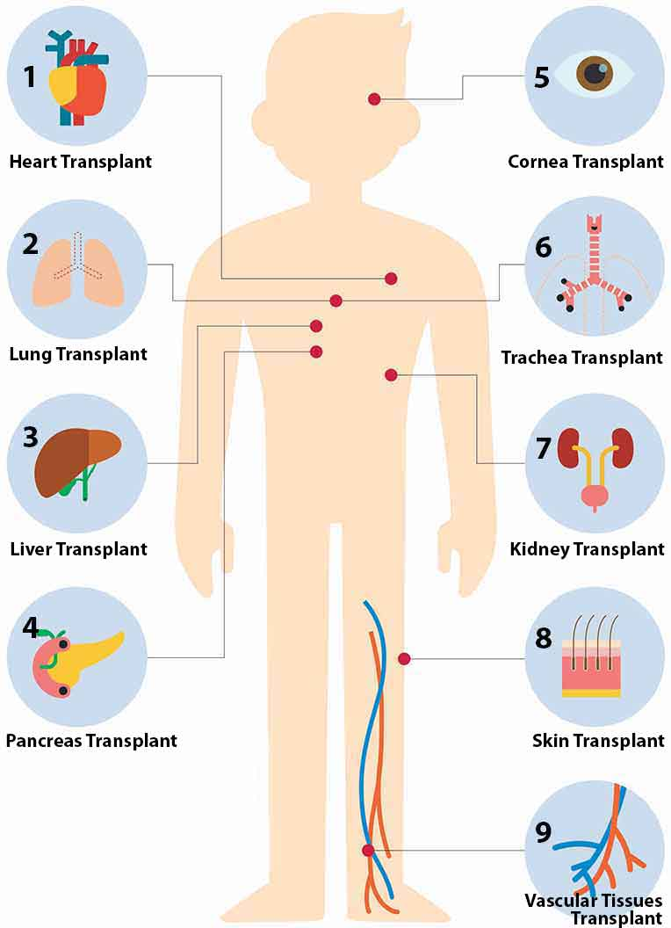
Transplantation
Ancient roots in principle: e.g. ‘miracle of the black leg’ in C3, where saints Damian and Cosmas replaced Justinian’s diseased leg with an Ethiopian’s.
Skin grafting (especially autografts) successful in the renaissance, allografts in the C19.
In the nineteenth century, diseases are linked to organ failure and organ replacement tested in animals (e.g. thyroid transplant, performed by Theodor Kocher in 1883).
Problem of rejection in allografts identified in early C20.
1950: first kidney transplants between relatives.
Discovery of immunosuppressants in the 1950s paved the way for allograft transplants, including from the deceased.
1967: First heart transplant performed in South Africa by Christiaan Bernard: Denise Darvall’s heart transferred to Louis Washkansky, who died 18 days later.
(source)

Slide 13
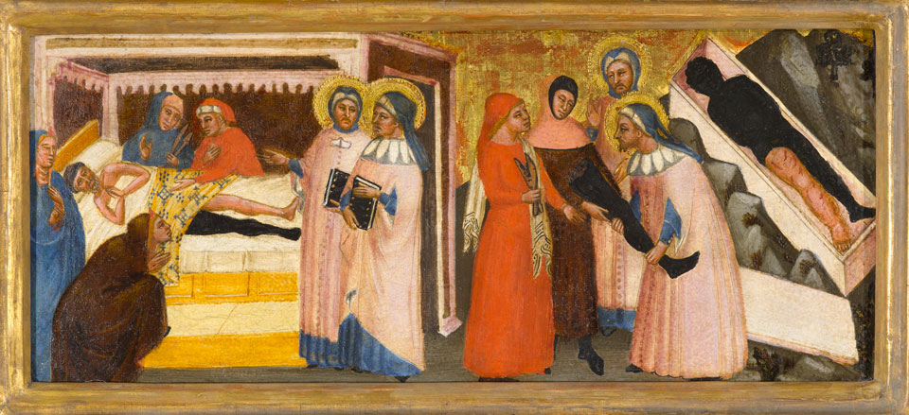
, “Miracle of a Black Leg.” Sts. Cosmas and Damian, ca. 1370–75, Master of the Rinuccini Chapel (Matteo di Pacino) (Italian, active 1350–75), tempera and gold leaf on panel. North Carolina Museum of Art, Raleigh

Slide 14
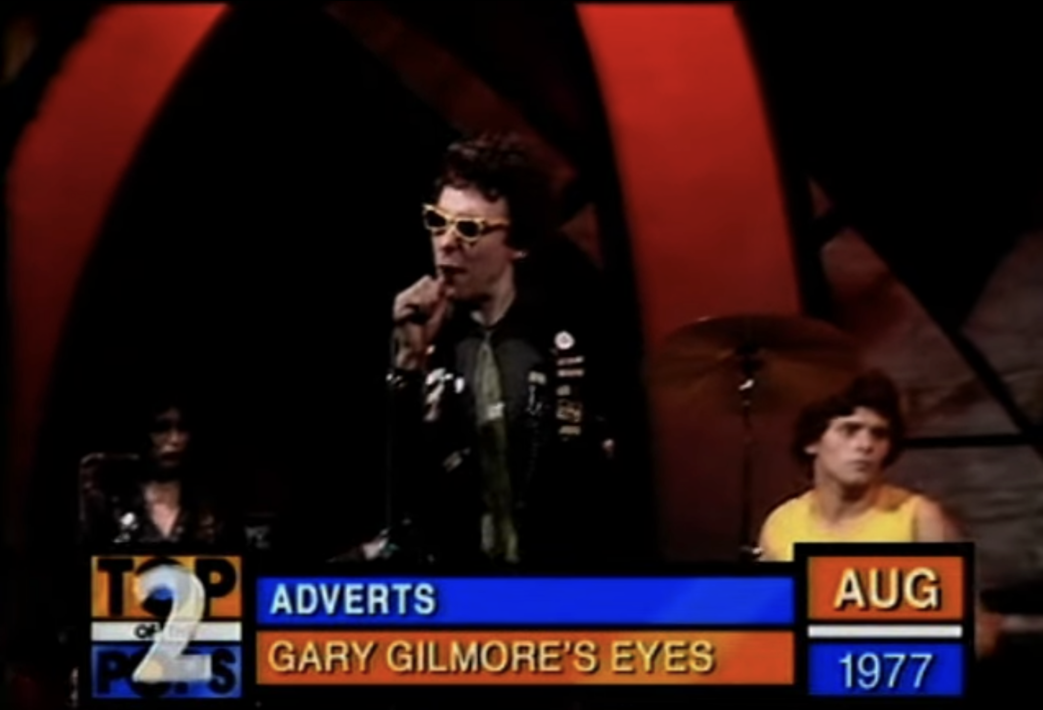
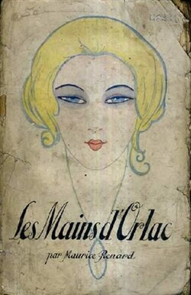
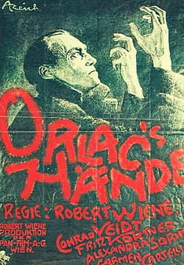
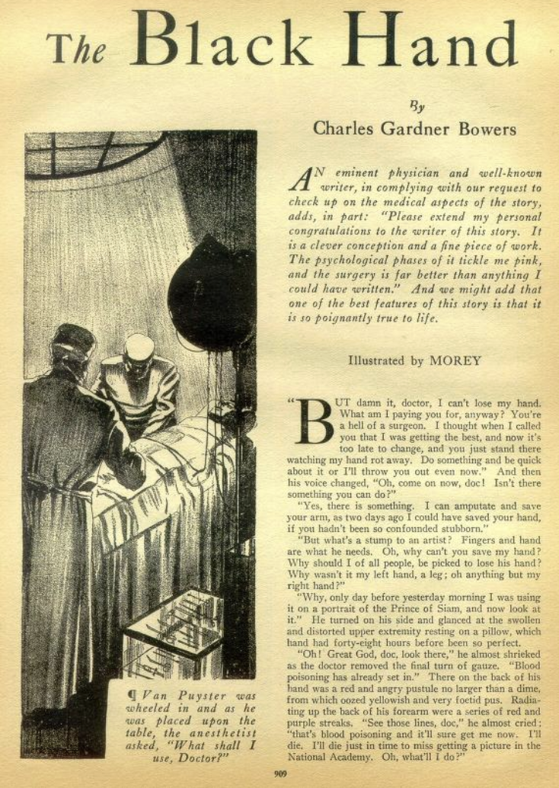
Transplantation anxieties
1920
1924
Amazing Stories (1931)

Slide 15
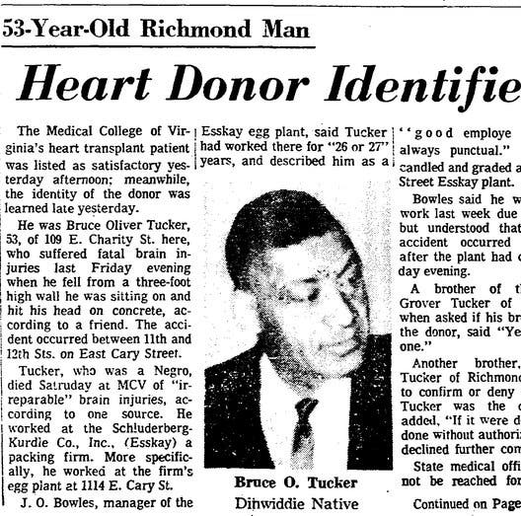
Brain death
1968 transplant of Bruce Tucker’s heart into Joseph Klett at the Medical College of Virginia: one of the first American heart transplants, performed without Tucker’s family’s knowledge or consent.
Tucker had suffered ‘neurological death’ from a fall but heart still functioning, leading to family lawsuit.
1972 court ruling that ‘brain death’ was equivalent to death even if other body parts were technically ’alive.’
Redefinition of ‘brain death’ served medical interests, enabled more transplants.

Slide 16
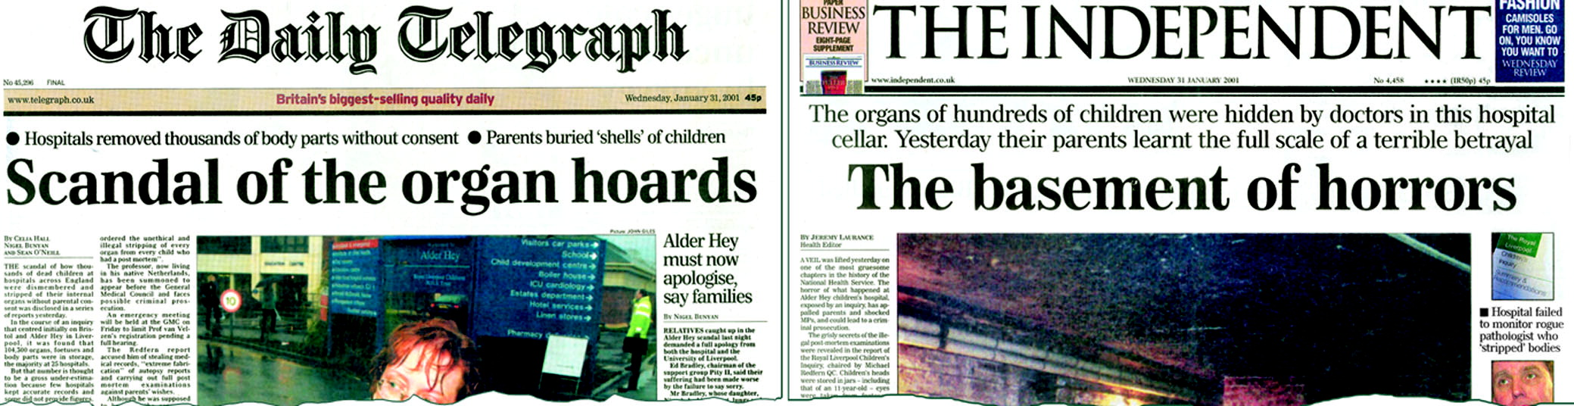
Scandals (UK)
Alder Hey Hospital (Liverpool) organs scandal: 1999 public inquiry revealed that NHS hospitals were retaining the organs without family’s consent, including children’s. Between 1981-1996, Alder Hey had kept c.2,000 organs, including those from 850 infants, as well as 1,500 foetuses.
Bristol heart scandal: Bristol Royal Infirmary kept children’s hearts without parents’ permission.
1999 inquiry revealed NHS facilities held over 100,000 body parts (including foetuses) and 480,600 samples of tissue from cadavers.
2003: £5 million compensation paid to Alder Hey parents.

Slide 17
Legislation: 2004 Human Tissues Act
In response to scandals involving retention of human remains, establishes framework for ethical organ donation and tissue research.
Regulates ‘the removal, storage, use and disposal of human bodies, organs and tissue.’
Clauses allow for anonymous organ donation, prohibits sale of organs, requires ‘appropriate’ consent for tissue donation and research, requires licenses for the display of human remains, and mandates restitution of ancestral remains.
Established the Human Tissues Authority to monitor compliance.

Slide 18
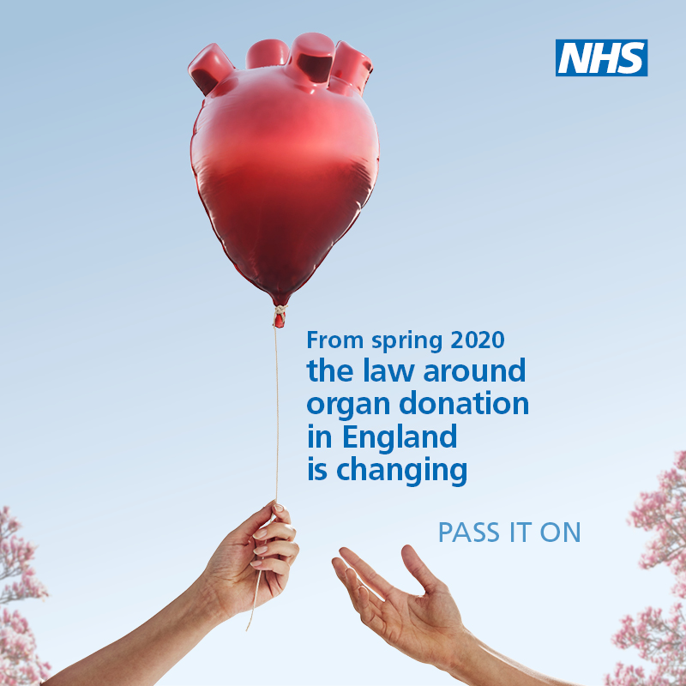

Slide 19
Conclusions
Tissue research and transplantation typically rely on ‘fresh’ cadavers, raising questions about when life ends and death begins.
As a consequence, this work not only has medical/biological implications, but also philosophical, moral, and legal ones.
Exploitation of racialized individuals, criminals, and the disabled has particularly characterized these fields, prompting anxieties about what is really being ‘transferred’ during transplantation.
The retention of the identities of tissue and organ donors are fundamental to ethical practices and shifting power dynamics in these areas of research.

