Slide 1

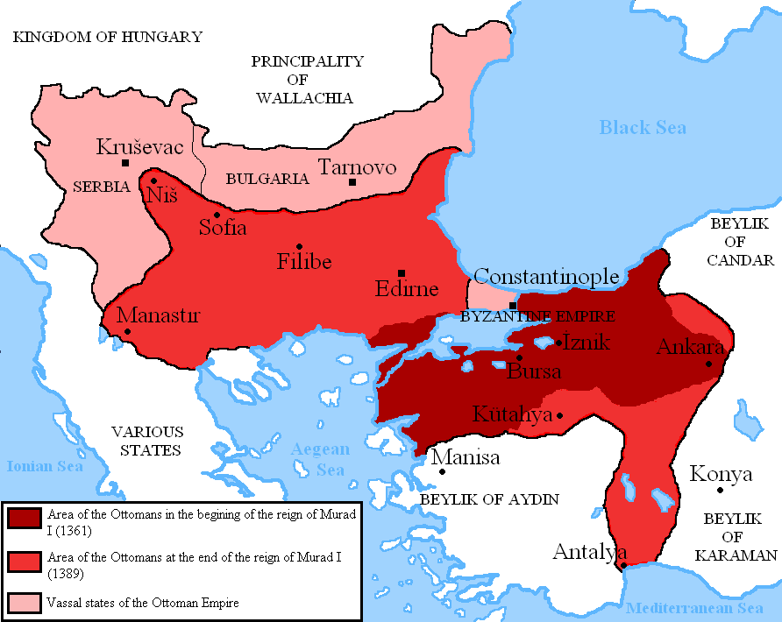
Ottoman and other non-European Networks

Slide 2
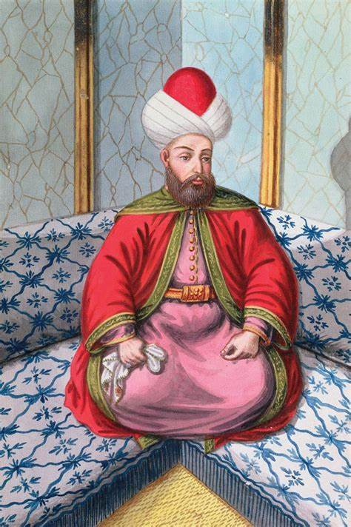
Ottoman/Christian Relations
Alliances and intermarriage with regional Christian powers (Byzantium, Genoa)
Attack rival Turkish-Muslim principalities in Anatolia
Christian warriors fought on Ottoman side without converting to Islam
Religion marginal importance on frontier: Holy War propaganda later
Multi-ethnic, multi-lingual & multi-faith state: tolerant of other communities & refugees
Non-Muslims can practice own religion as long as pay special tax
Tolerant towards other branches of Islam (e.g. Sufism)
No restrictions re entry into professions: Muslims & non-Muslims engage in crafts, agriculture etc
‘Toleration > economic & political benefits: Jewish communities, trading links; taxes & order (rebels exiled)

Slide 3
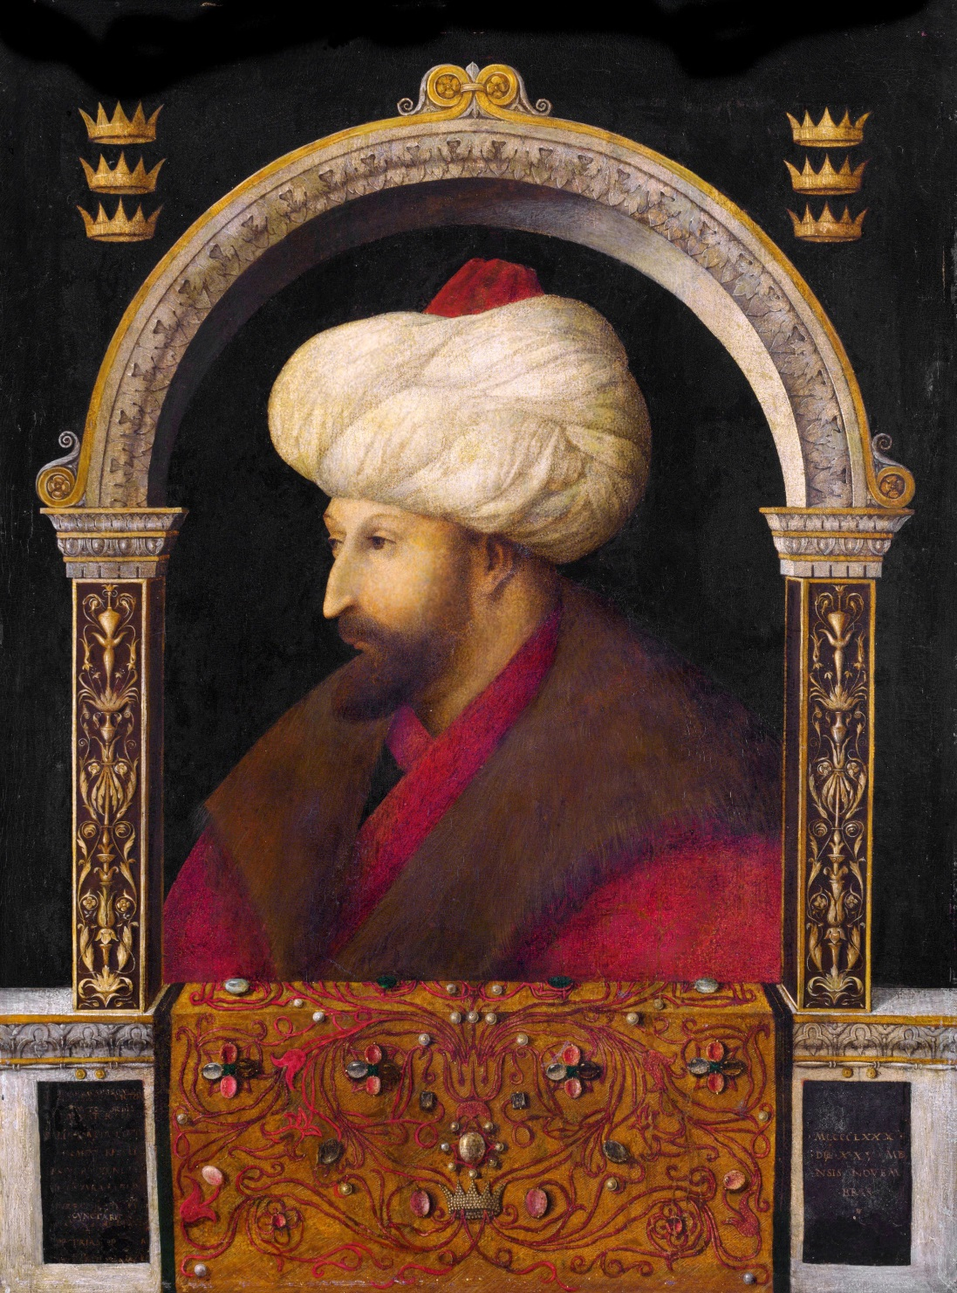
Conquest of Constantinople 1453
Constantinople: of great trading & symbolic importance (taken by Mehmed II, ‘The Conqueror’)
Titles: Kaysar (Caesar) Basileus Padishah, i.e. Ottomans = inheritors & synthesizers of Roman, Mongol, Arab, Persian & Byzantine traditions
Successors Bayezid II & Selim I expanded into Mediterranean & Middle East vs Egypt, holy cities of Mecca & Medina, & most of North Africa
Ministers, soldiers (janissaries) and women in harem drawn from Christian Balkans
Ottoman Empire under Suleiman ‘the Magnificent’ continued to be open, flexible and innovative; held together by new institutions & elite; retained eclectic character & diversity; alliances e.g. with France
Trade important: for welfare of subjects; symbiotic for good international relations > diplomacy
Portrait of Mehmed II by Gentile Bellini, 1480 (National Portrait Gallery, London)
Notes:
Almost inevitably, the Ottomans’ attention turned to Constantinople, the capital of the dwindling Byzantine Empire. Mehmed II made it his first priority, and built fortifications in the Bosphorus straits to enable the conquest. This happened in May of 1453, and it brought an end to the Byzantine Empire. The conquest of Constantinople (present-day Istanbul)
After his reign, the Ottomans started to push into the Mediterranean, against Venetian and Genoese possessions. His successors, Beyazid II and especially Selim I brought Ottoman rule to the Middle East, ending the Mamluk kingdom in Egypt and including the holy cities of Mecca and Medina, and most of North Africa in the Ottoman lands (map)

Slide 4
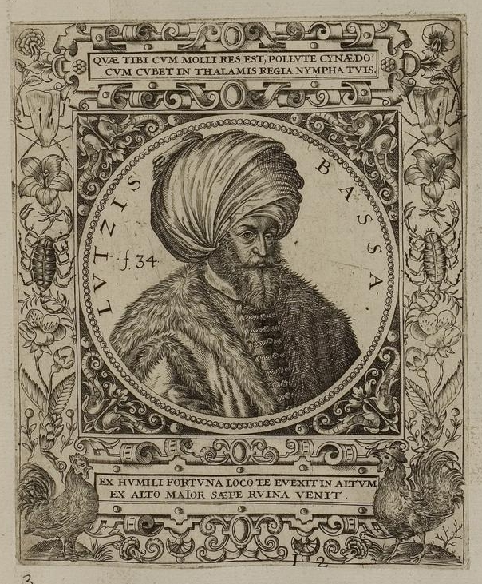
Gürkan: comparing Habsburg & Ottoman Networks
Habsburgs ‘tried to institutionalize and standardize’ secret services whereas Ottomans … maintained ‘longstanding decentralized approach’ delegating responsibility to pashas & court favourites who established own intelligence networks
Secret services different in style & administration
Cryptography vs oral transmission – both effective
Istanbul as a centre of information – porous but making
extensive & skilful use of disinformation
Empires lacked good information on each other
Both faced problem of quality in:
recruitment pool, information received & occasional reports
lack of continuity & disorganised (cf Venetians)
dependence on intermediaries; dragomans, Jews, renegades
But political elites good contact & relations, even conspired
Role of personal/corporate interests & factional rivalries;
mastery of cultural codes, kinship & self-interest
Absence of ambassadors > spies as diplomats

Slide 5
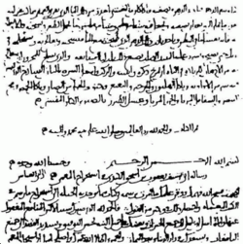
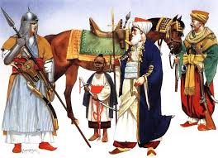
Other Islamic Examples
Prophet Muhammad: ‘a master of intelligence in war’, ‘intelligence service eventually came to rival those of Rome and Persia, especially in the area of political intelligence’ (Al-Asmari)
C9th Arab writer and philosopher Al-Jahiz: human nature ‘to seek news and intelligence’
Abbasid Baghdad (C8th–C9th): House of Wisdom & Arab philosophers e.g. al-Kindi > mathematics & science & early centre of cryptography & cryptoanalysis > Ottomans
Cf Mamluks (Egypt/Syria) vs Mongols in C13th:
gathering of information/intelligence; use of assassination, disinformation and indigenous contacts;
raids across borders, burning of grasslands and dispatch of Muslim rulers to reestablish “kingdoms”
Also espionage and subterfuge against Franks in Syria
Saracens superior to crusaders at intelligence & disinformation
Terminology an issue as with other cases

Slide 6
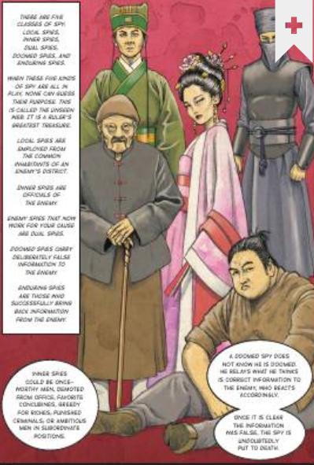
Other ‘Eastern’ Examples
Sun Tzu (c. 544-496 BCE), Art of War (or Sunzi bingfa), ‘On Spies’ (brief): armies dependent on intelligence can avoid danger and expense of fight cf Chinese spying today?
‘traditional Chinese intelligence practice: information coupled with active subversion’ (Sawyer)
Kautilya (c. 350-283 BCE), Arthashastra (Mauryan Empire) on ‘Covert Operations’ = central & integral
‘domestic counter-espionage, criminal intelligence plus covert political and psychological operations … all feature in the work of Kautilya’s ‘‘institutes’’ of spies’ (Davies)
1st to call (in enormous detail) for professional intelligence service: ‘29 main cover occupations (with 50 sub-types) of a huge network of spies at home and abroad’ (Andrew)
Russia: heir of traditions of insecure Byzantine Empire > paranoid Ivan IV ‘the Terrible’: highly bureaucratized and institutionalized intelligence and security culture

Slide 7
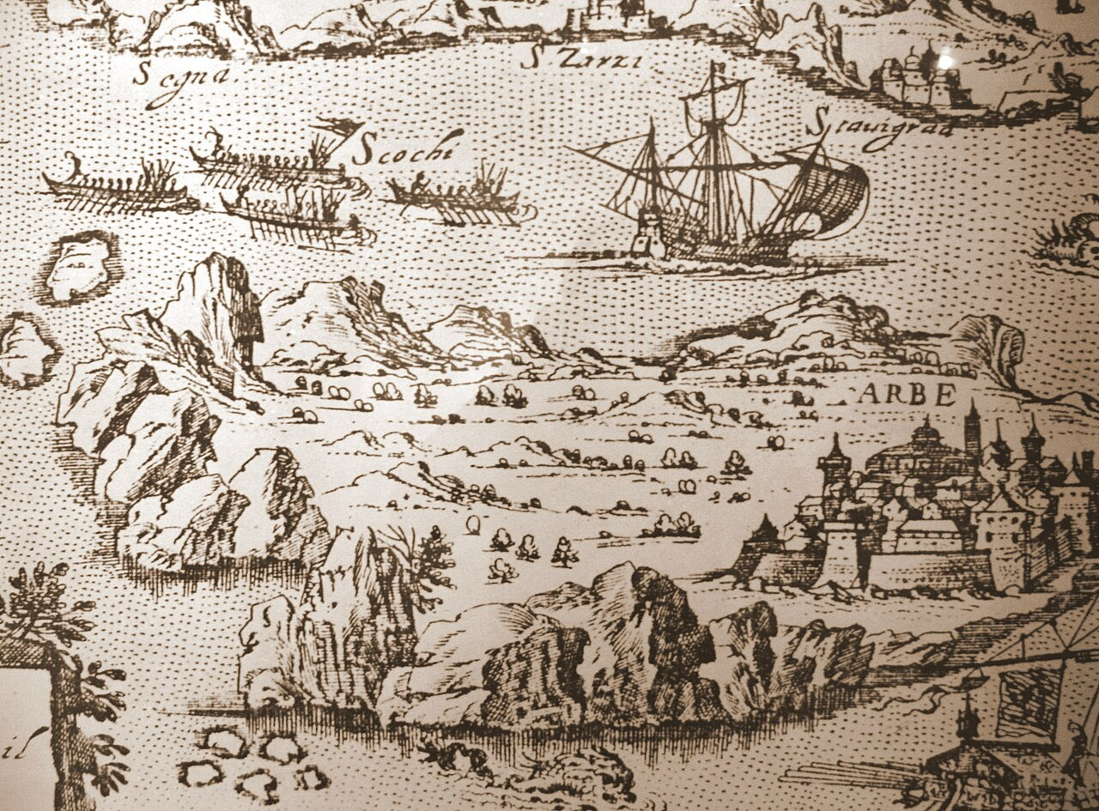
The Grey Zone between War and Peace
The Grey Zone: modern post Cold War concept re ‘eastern enemies’ Russia & China clearly applicable to Western covert activities too through the ages:
= ‘competitive space between war and peace in which states and non-state actors pursue strategic objectives through activities that fall short of open armed conflict’, so include intelligence operations & espionage, subterfuge & interference
Characteristics: ambiguity & deniability, sabotage & coercive tactics, use of proxies & agents
Early Modern Cultural & Diplomatic Encounters between Europeans & non-Europeans: French in Tunis; Dutch & Portuguese in China & Japan; Prussians in Cape Verde; Spanish in Philippines

Slide 8
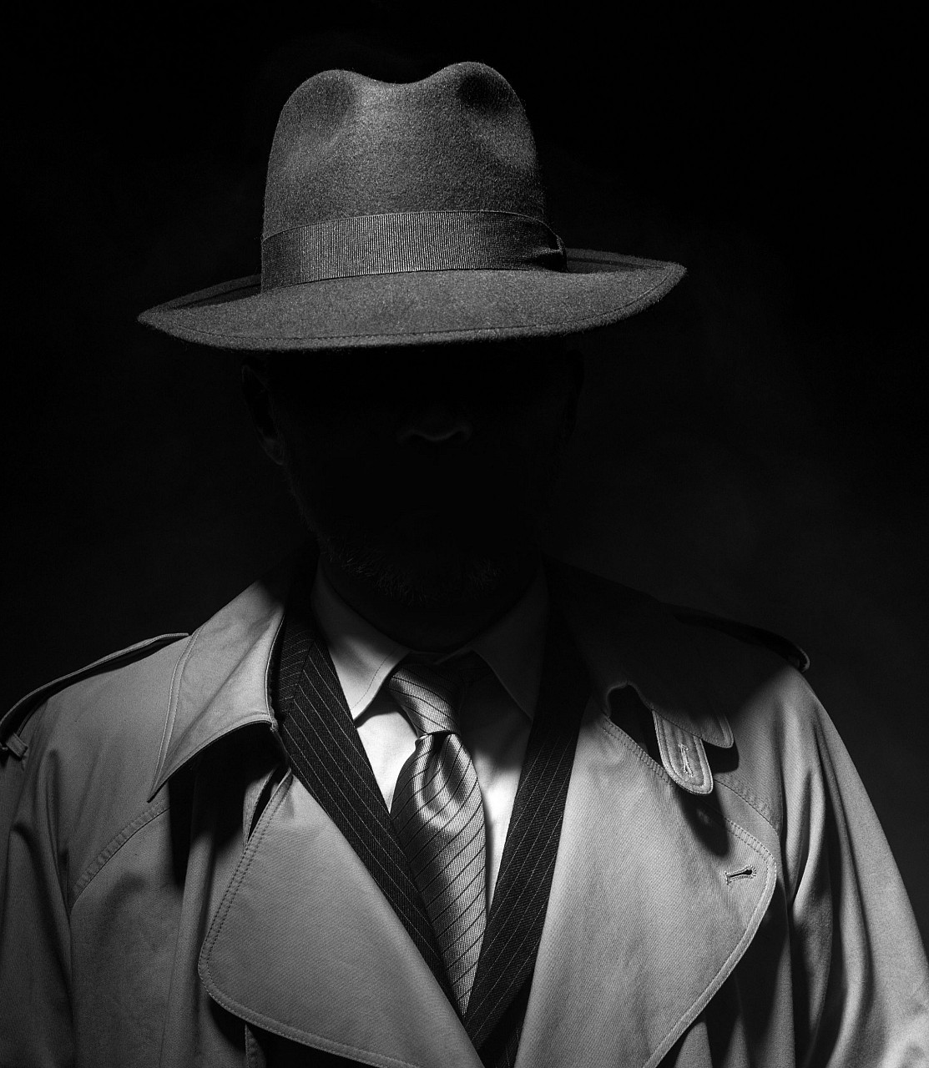
Conclusions: European & non-European?
Differences: in context, approach, actors, administrative systems, cultures, strategies (true of all comparisons)
Similarities: motivations, targets, agents, types of activity, subterfuge, disinformation; military, economic, political/ religious
False Distinction: West vs East (orientalism), political & religious dynamics of time (historic & contemporary); distinctions more pronounced now read backwards?; autocracies vs democracies?; C20th bias (9 out of 10 ‘famous’)
Learn from each other: either side ahead in developments often lead to imitation in response to threat; how to keep up with/outflank opponents; counter-espionage; disinformation; cryptoanalysis (again true of all comparisons)

