Slide 1
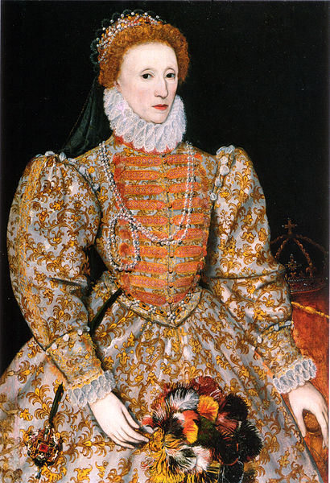
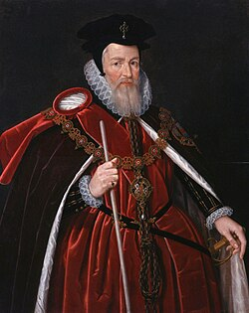
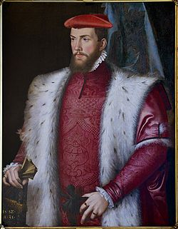
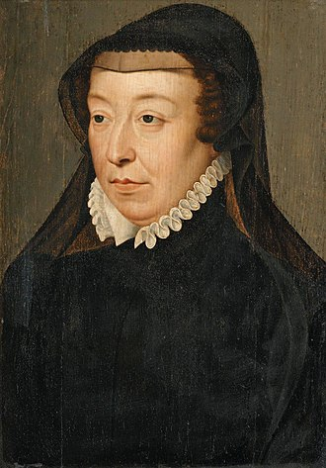
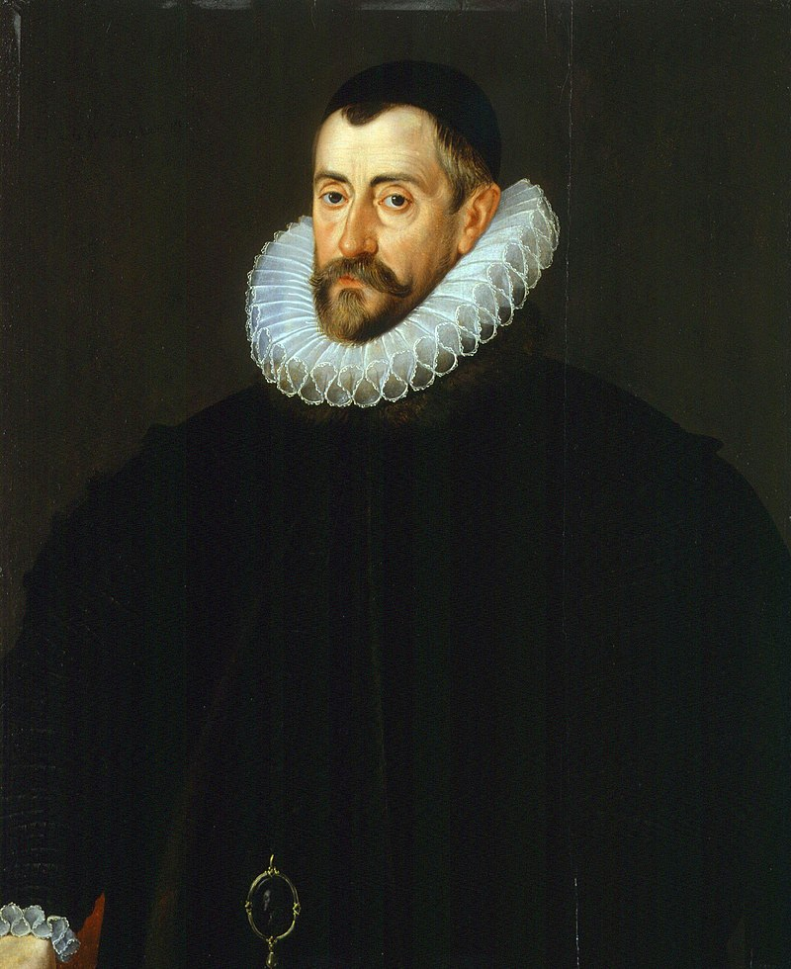
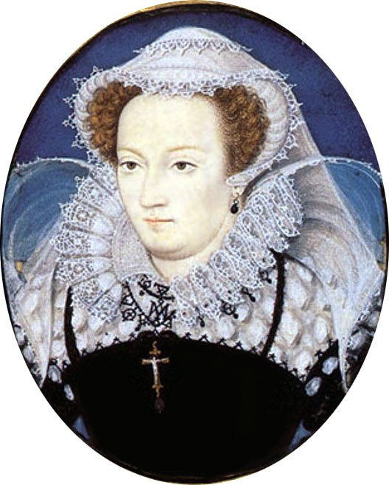
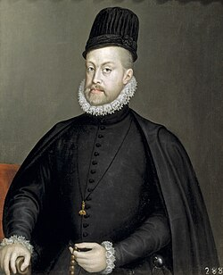
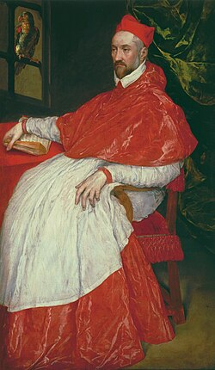
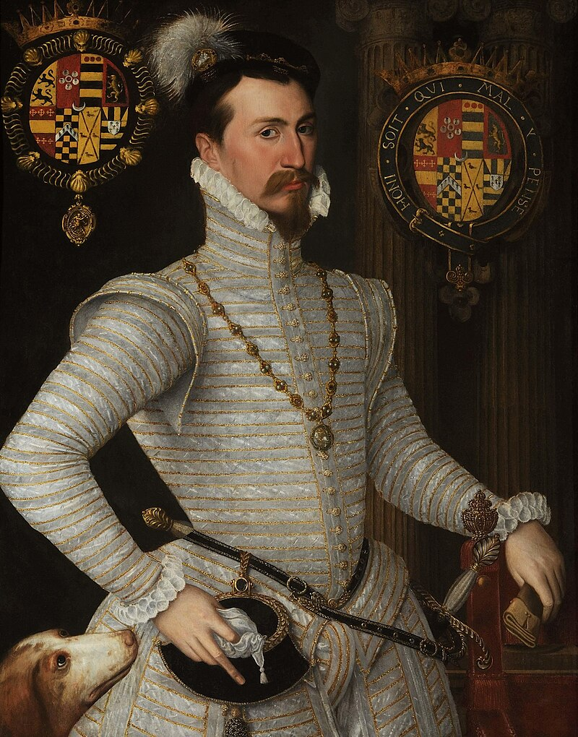
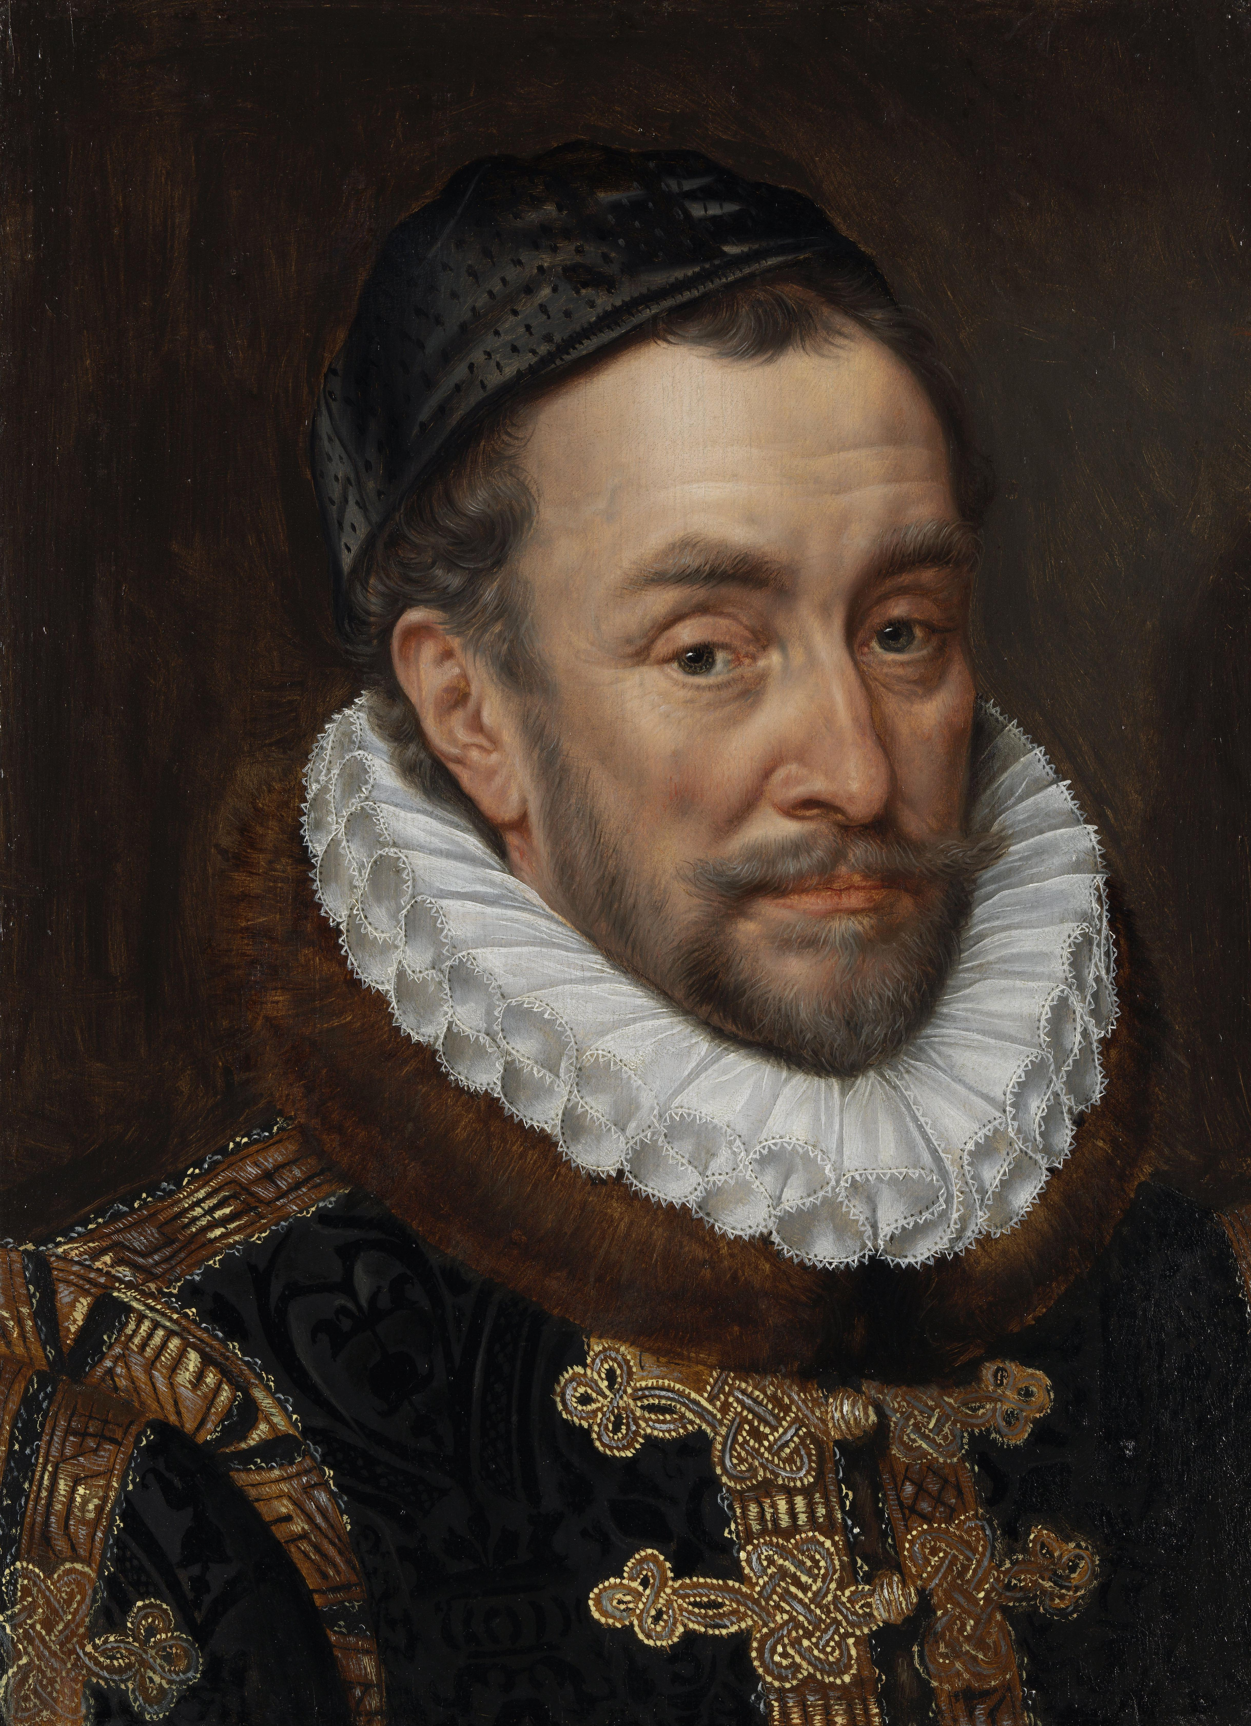
(Challenging) The Elizabethan Paradigm

Slide 2
William Cecil (1520-1598) from 1571, Lord Burghley
A survivor!
Principal Secretary (1550-1553 under Edward VI & 1558-1572), succeeded by protégé Francis Walsingham
Lord High Treasurer (1572-1598)
Clashes with Walsingham & Robert Dudley, Earl of Leicester (1532-1588), Queen’s favourite, over foreign policy & Elizabeth’s marriage
Cecil more moderate/pragmatic like Elizabeth?
Robert Cecil (1563-1612), his son, Lord Salisbury, succeeded as Lord Privy Seal, Secretary (1596) & Lord High Treasurer (1608); ‘Spymaster’ (to Elizabeth & James I) e.g. vs Gunpowder Plot (1605)

Slide 3
Francis Walsingham
(1532-1590) ‘the Spymaster’
Called ‘father of modern espionage’ & credited with ‘creating’ international spy network!
From 1568, active in network of predecessor as Secretary, William Cecil/Burghley
Ambassador to France, 1571-1573
Principal Secretary to Elizabeth I, 1573-1590
Kept diary/journal of coming and going of visitors & ‘The book of secret intelligences’ (since lost)
Made name from ‘discovery’ of Catholic plots vs Elizabeth e.g. Ridolfi (1571), Throckmorton (1583), Babington (1586), Spanish Armada (1588)
Reputation as ruthless & ‘Machiavellian’
Contemporaries fascinated: dispatches published as The Compleat Ambassador (1655) later translated

Slide 4
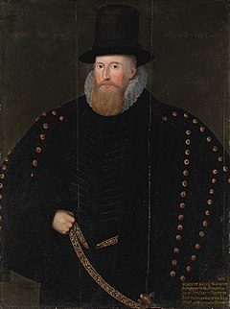
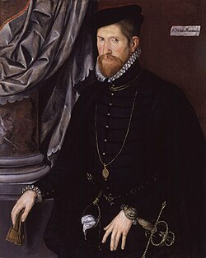
Walsingham and his predecessors as ambassador to France, Henry Norris & Nicholas Throckmorton

Slide 5
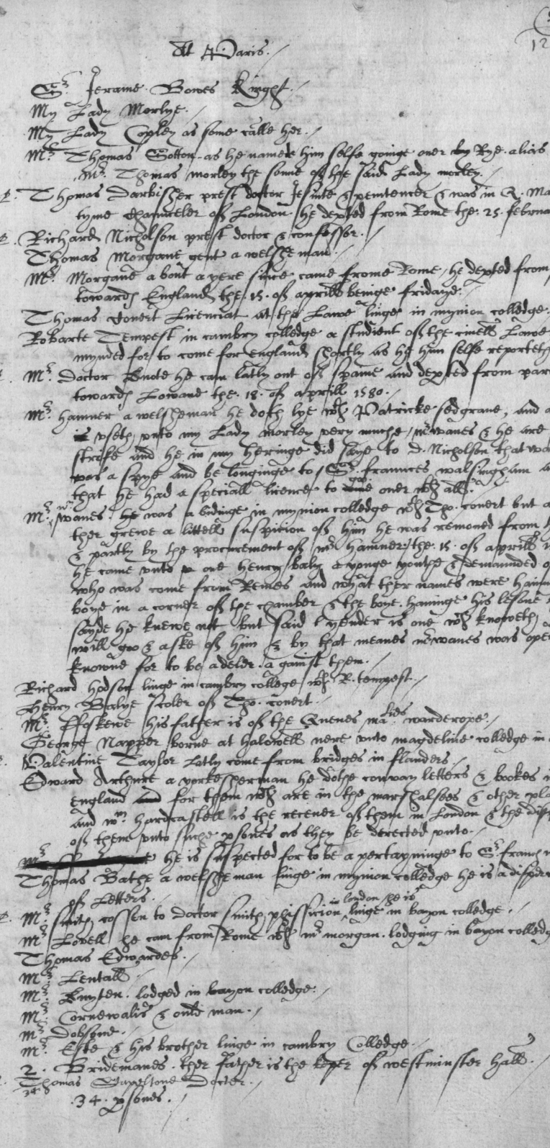
State Papers (the National Archives) exceptional repository of correspondence
1568:
Walsingham to Cecil, ‘there is less danger in fearing too much than too little’
Throckmorton to Cecil about ‘Frenchman named Pygett, who is come to do many evil offices, as to play the cunning spy’
Walsingham to Cecil, ‘there is a Frenchman and an Italian who secretly are lodged’ in London & need ‘to understand what they are … in this dangerous time’ (descriptions of complexions, facial hair & stature)
1569:
Norris to Cecil, suspicions re two servants: an Italian & a bearded, red-headed apothecary; rumours of poisoning etc
List of suspects in 1580, with name of spy in Paris, ‘appertaining to Sir Francis Walsingham’, inked out

Slide 6
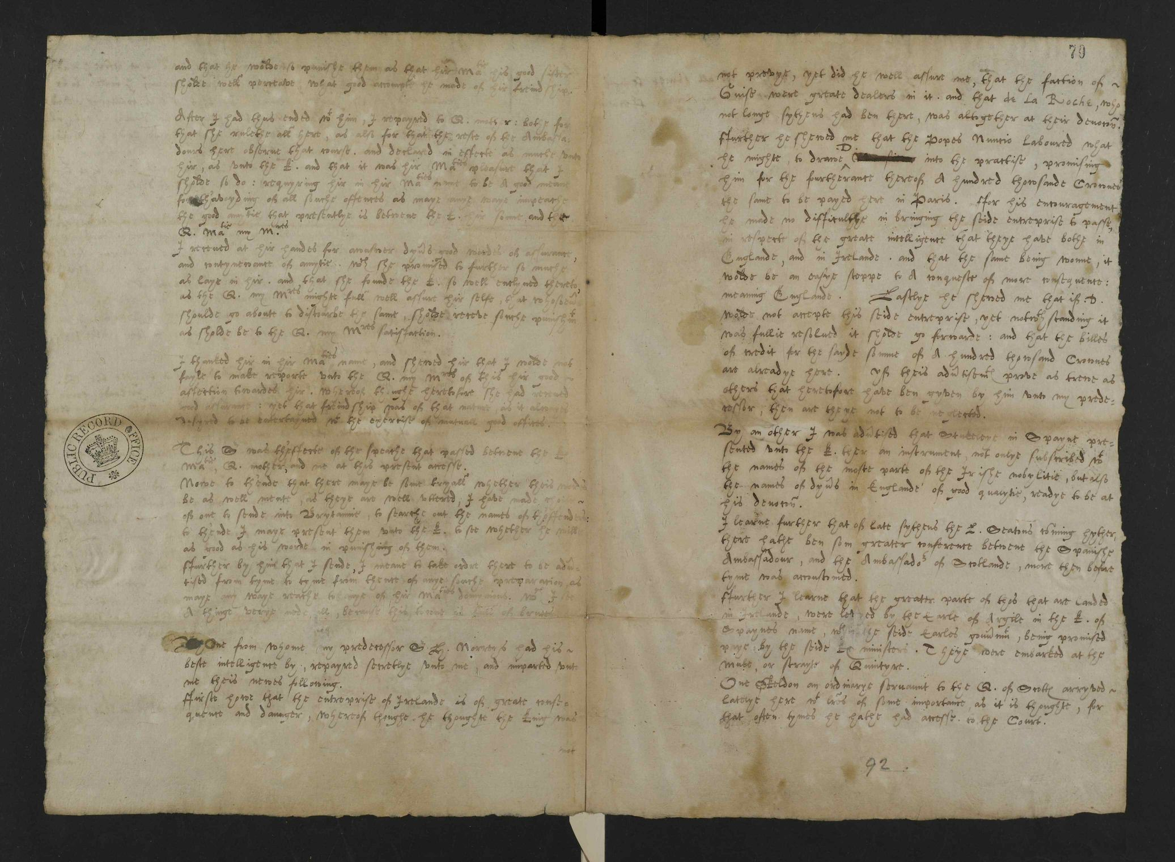
Walsingham to Cecil (Feb.1571) when ambassador to Paris: note blotting out of names & pasting over another

Slide 7
Importance of international context especially Reformation!
Tudor England marginal, vulnerable and insecure after long period of upheaval reflected in intelligence activities
1560s-1570s particular focus on Charles de Guise, Cardinal of Lorraine’s support for Mary Queen of Scots
England assisted by international Protestant network, including presence of exiled Huguenot leader, Odet de Coligny, Cardinal of Châtillon, at Elizabethan court, 1568-1571
Walsingham as fanatical Protestant shaped approach: exile on continent in 1550s & as ambassador in Paris during Saint Barthlomew’s massacre 1572; ally of Robert Dudley
Built on existing Protestant networks used e.g. by predecessor as ambassador to France, Henry Norris (1567-1571)
From 1580s, greater concern re Spain & major Catholic plots; assassination of William of Orange (1584); threat of invasion
Cardinal of Lorraine (1524-1574)
Cardinal of Châtillon (1517-1571)

Slide 8
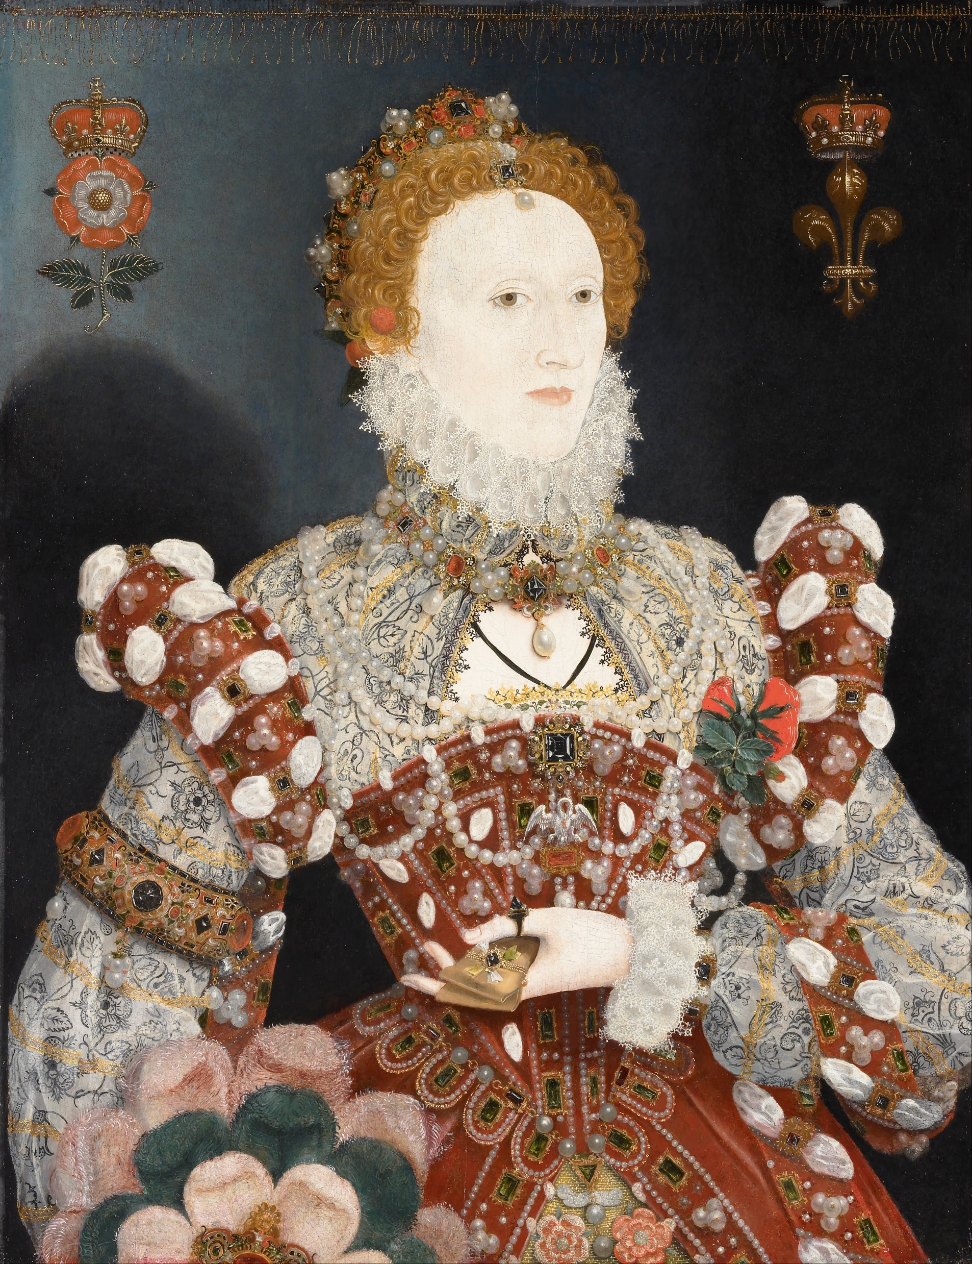
Protestant Queen Elizabeth (1533-1603) and
Catholic Mary Queen of Scots (1542-1587)
Cousins (once removed), but never met
Queens – Mary of Scotland (1542-1567) and (briefly) of France (1559-1560); Elizabeth of England (1558-1603)
Both experienced political imprisonment: Elizabeth early in life, Mary later
Contrasting experiences:
Elizabeth never married; Mary had 3 disastrous marriages
Mary spent nearly 20 years under house arrest at various, mostly English properties
Focus of Catholic plots against Elizabeth who pope excommunicated in 1570
Mary executed for plotting to kill and replace
Mary’s son James (already King of Scotland) succeeded childless Elizabeth

Slide 9
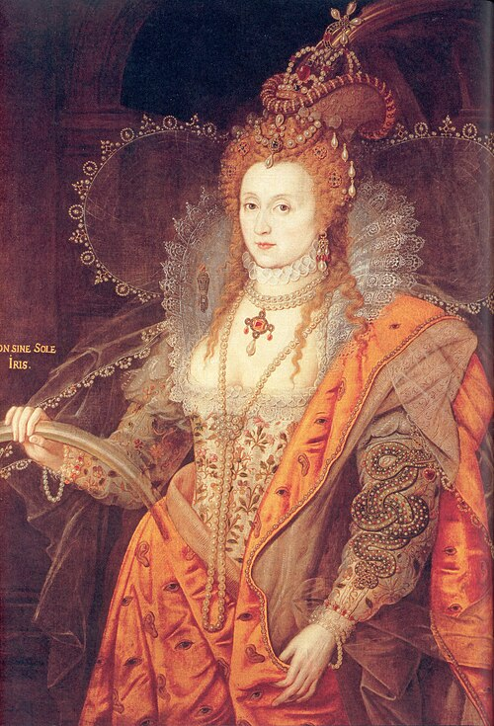
Symbolism in Portraits of Elizabeth
Magnificence of royal status
Focused on role as Virgin Queen (pearls) cf goddess Astraea
Power, strength & femininity
Peace & stability
Victory (e.g. over Armada)
Survivor of many plots (insecurity)
The Rainbow Portrait c. 1600 (Hatfield House) holding symbol of peace, so she is the sun & that dress covered in eyes and ears!
Queen of successful intelligence & espionage?

Slide 10
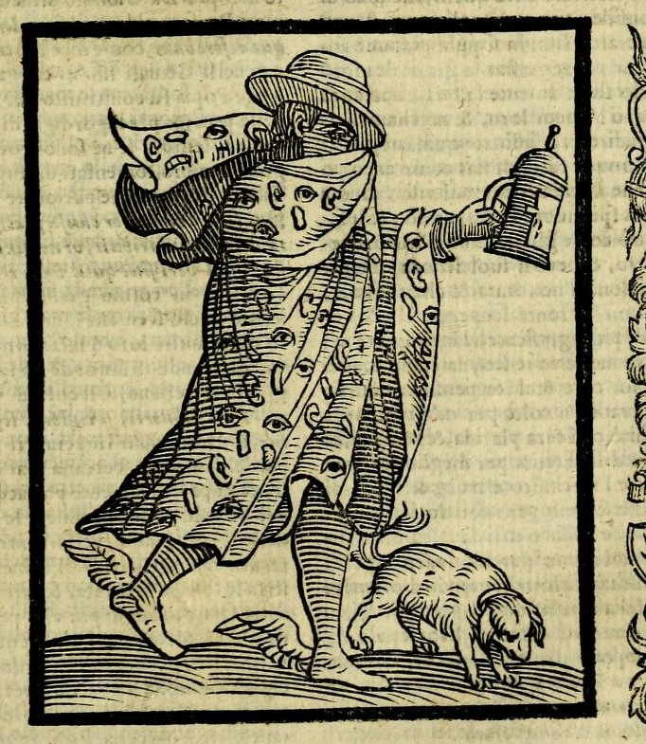
Conclusions
Walsingham worked closely with others at home and abroad both before & after appointment as Secretary in 1573, building on existing networks
Fortunate in longevity of Elizabeth’s rule to establish role, uncovering of plots established reputation
Importance of international agents/ diplomats/ scholars inc Dutch, Flemish, French & German contacts
Only just beginning to uncover full extent of comparable intelligence networks e.g. for France, Spain & Dutch
Protestant and Catholic clergy as go-betweens
Role of secretaries, servants, couriers, soldiers, gaolers
Even English spies/agents only know of as result of involvement in supporting or undermining plots, e.g. Anthony Standen, William Herle, Thomas Phelippes etc
Many more remain hidden

