Slide 1

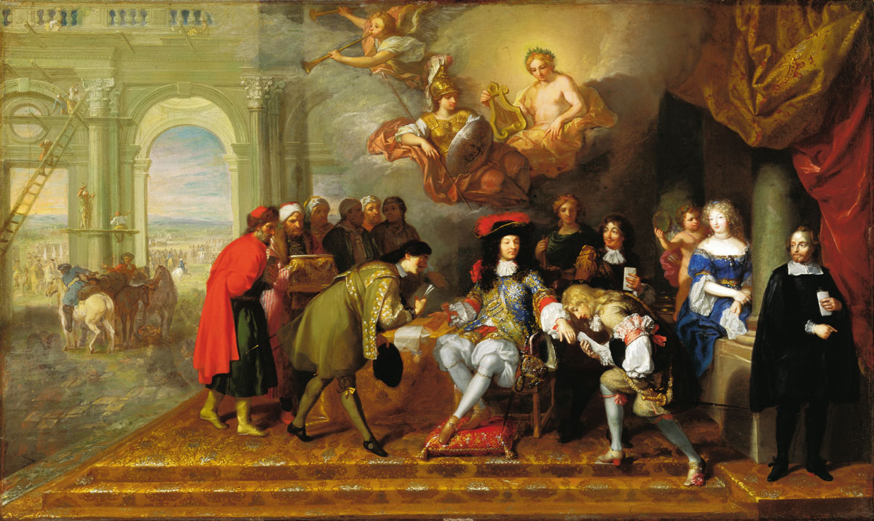
Diplomats, Women & Other Agents

Slide 2
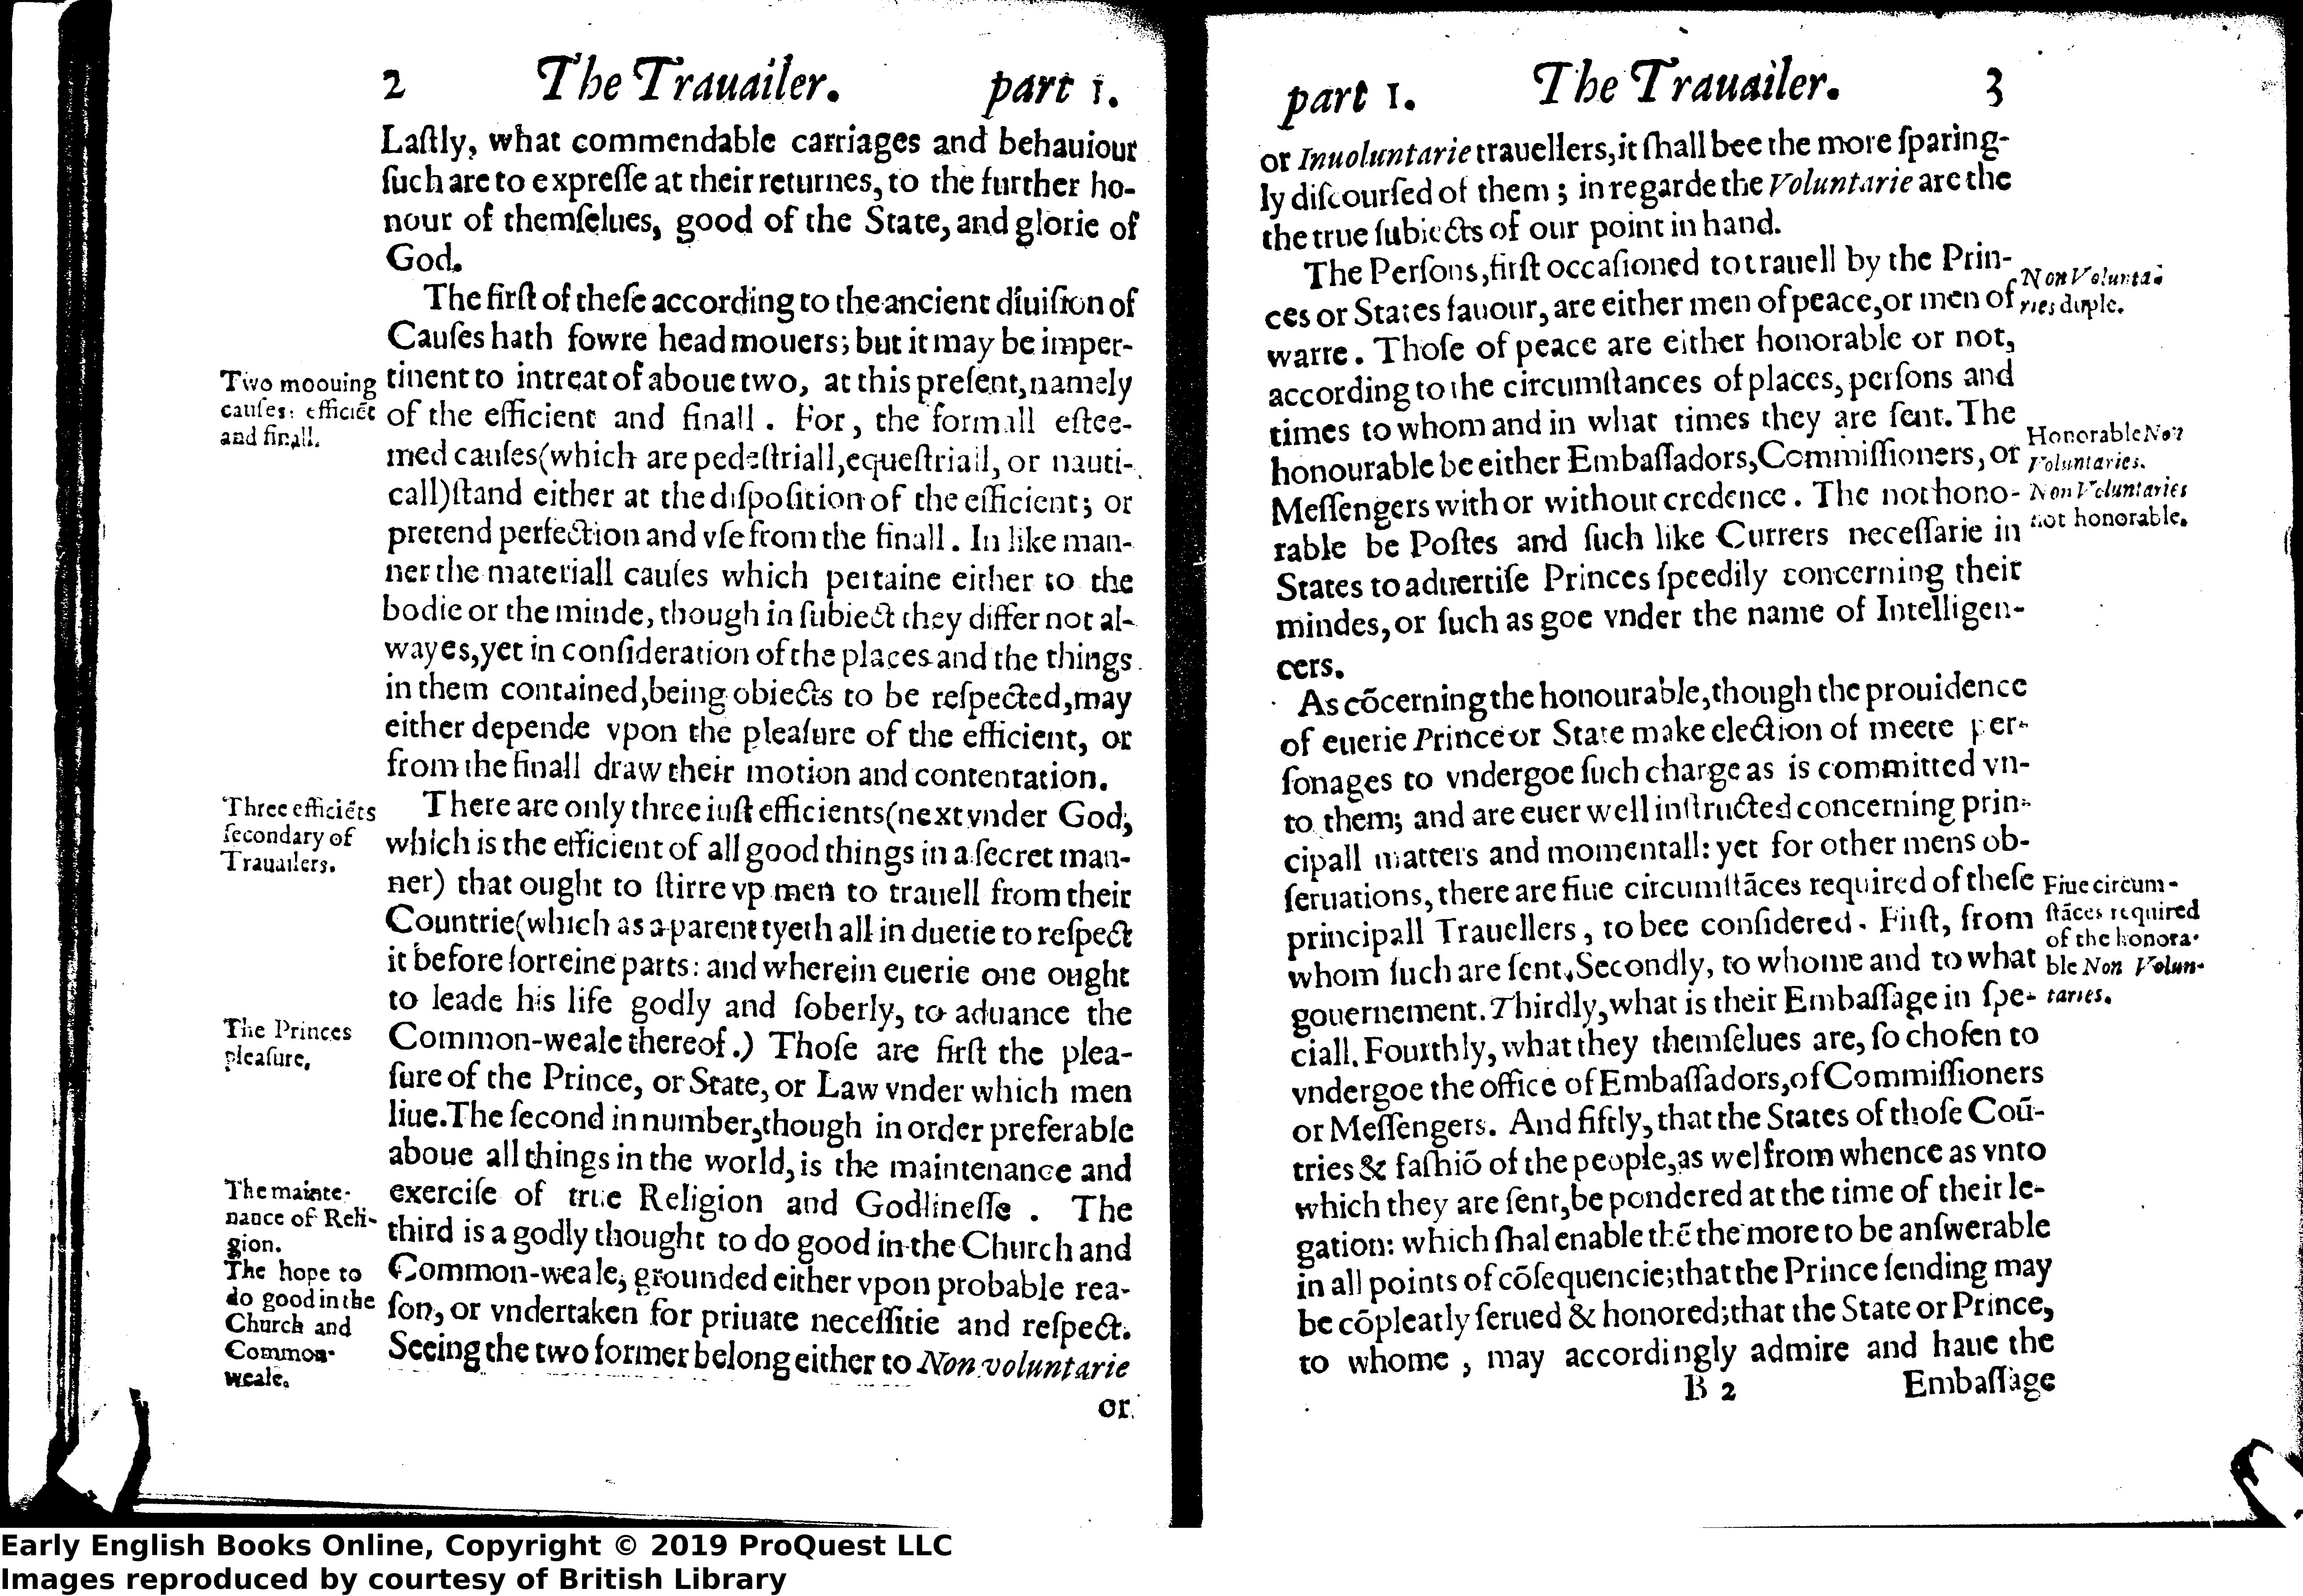
Sir Thomas Palmer’s essay on ‘The Traveller’ (1606)
The Persons, first occasioned to travel by the Princes or States favour, are either men of peace, or men of war. Those of peace are either honourable or not, according to the circumstances of places, persons and times to whom and in what times they are sent. The honourable be either Ambassadors, Commissioners, or Messengers with or without credence. The not honourable be Posts and such like Couriers necessary in States to advertise Princes speedily concerning their minds, or such as go under the name of Intelligencers.

Slide 3
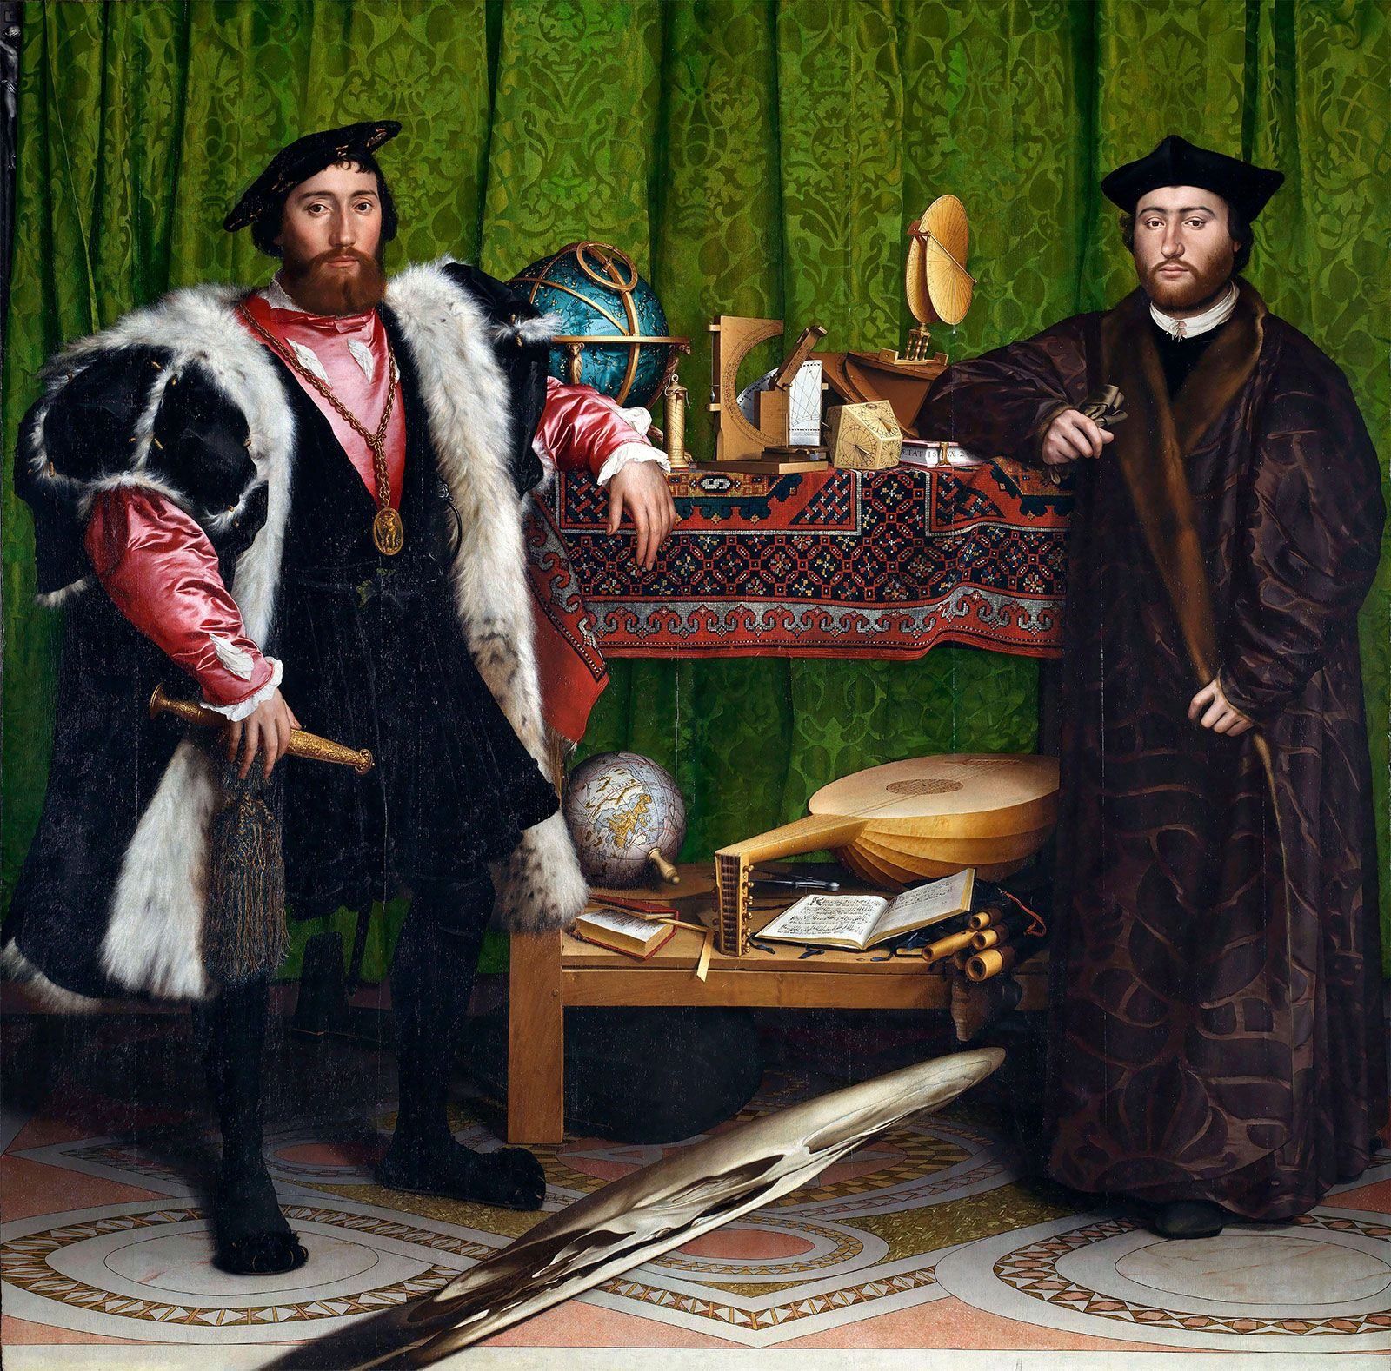
A Multitude of Actors…
‘… ranging from non-elite envoys to chartered companies, Catholic friars and ministers on ships, to foreign courts, and behind their desks’
Ambassadors/diplomats/envoys but what if excluded as Spanish ambassador to England (1584), work through other contacts
‘Cultural contact zones’: especially for merchants & other travellers e.g. missionaries, scholars, migrants & exiles, ‘accidental’ diplomats or intermediaries
Military & commercial: soldiers, sailors, interpreters, intelligencers
No formal qualifications: patronage, experience, opportunity important
Spying but not spies? Amateurs?
Hans Holbein, The (French) Ambassadors, 1533
Mysterious & secretive/hidden meanings

Slide 4
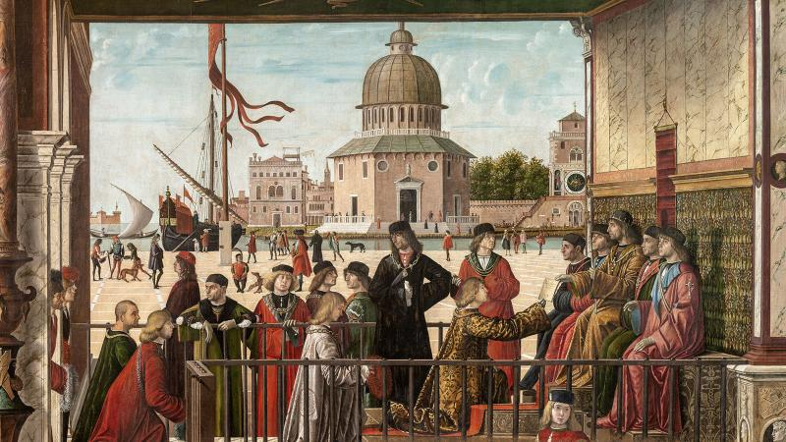
‘This was a news-hungry world in which information was power and where, precisely because much of the news was inaccurate or fragmentary, with irregular time-lapses in its transmission, it was vital to accumulate as many overlapping reports as possible in order to sift out the truth, or something close to it.’ (Noel Malcolm, Agents of Empire, 2015)

Slide 5
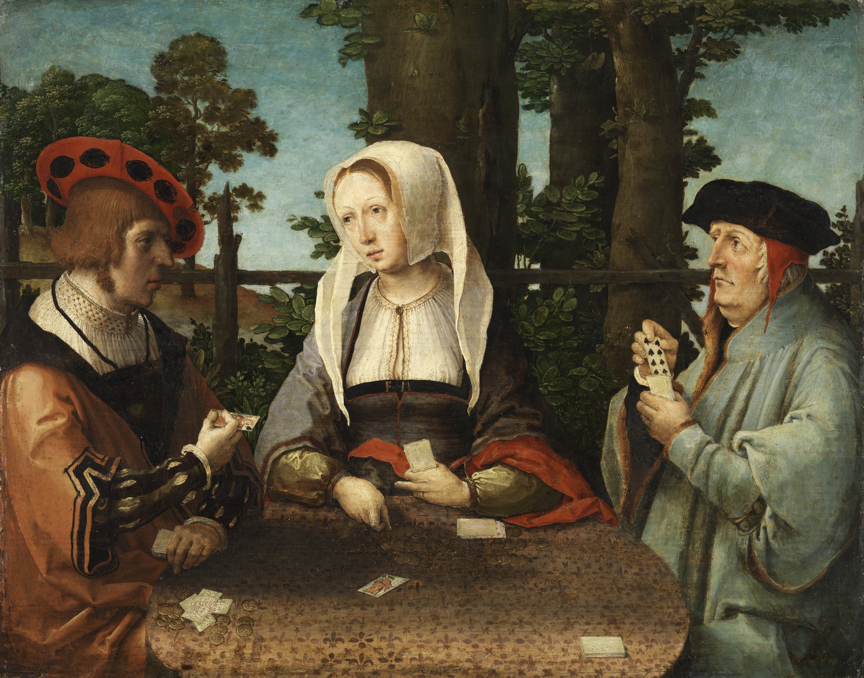
Accidental Opportunism?
‘Unofficial informers played a crucial role that often evolved over time’, so more useful/reliable?
Different backgrounds, attitudes & functions, sources & kinds of information, more effective?
Integrate, supplement & duplicate work of official agents
Less easily identified > greater freedom of action
But also more precarious & insecure
Rewards & future careers dependent on news/info able to provide, dispensable

Slide 6
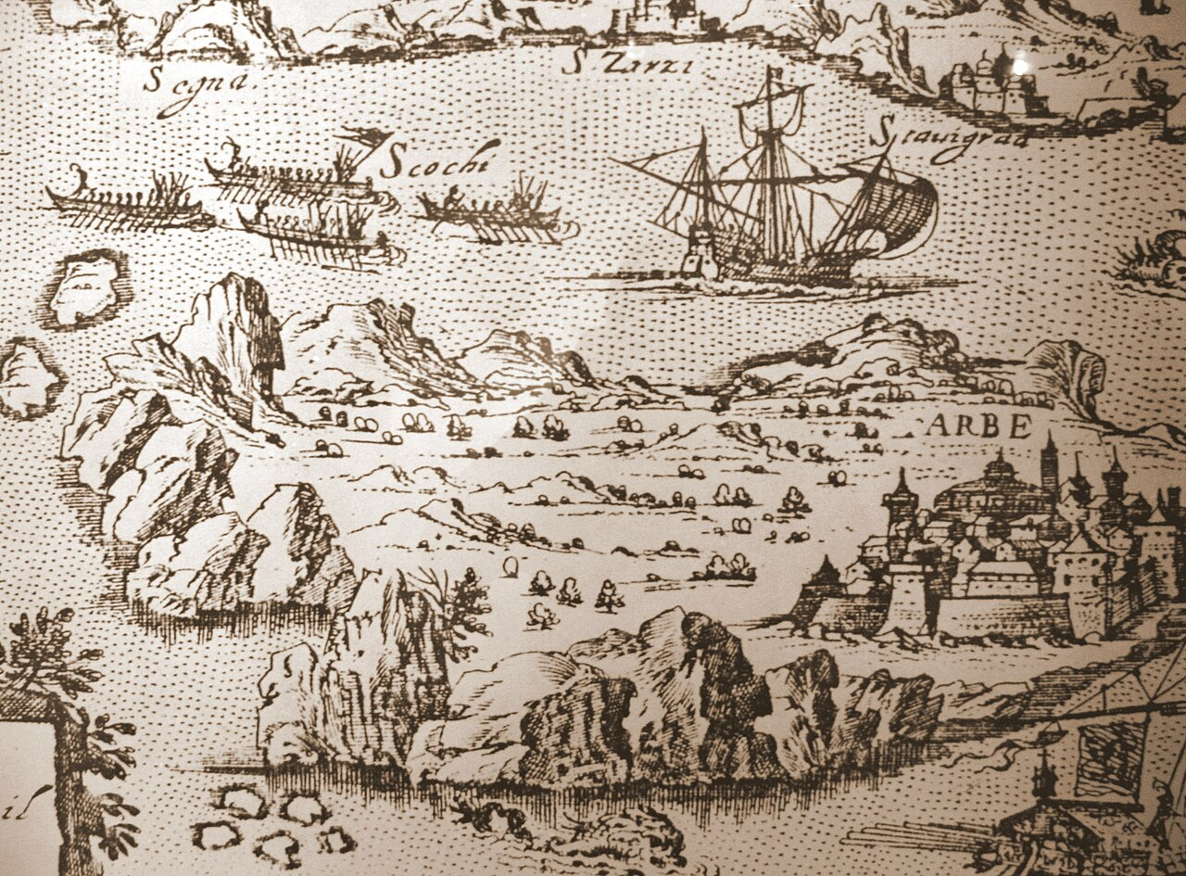
Transnational networks
1560s, Albanian Antonio Bruti used by Venetian authorities ‘as a negotiator, local diplomat and all-purpose fixer’ (Malcolm)
Importance of personal trust, local connections & relationships, on ground, acting in own right
In Croatia: Dubrovnik passing on intelligence to Ottomans as well as papacy & Spain
Uskoks: bandits & pirates ambushing & seizing goods & prisoners in borderlands between empires
White brothers from Ireland, military contracts > operate between Spain, England & France

Slide 7
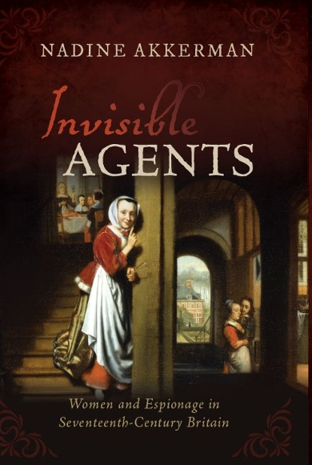
Women as diplomats, agents & (she-)spies
Focus on women of high social status:
Wives of ambassadors acting in absence: household visitors & messengers, sustaining networks
Ladies-in-waiting at courts actively passing on intelligence & news, familial/foreign connections
Unofficial role & influence? Dependent on status?
Move round more easily at times of war, during sieges and as intermediaries & brokers
Visiting prisoners, communicating with family members in exile, crossing borders
‘Women were able to operate through networks of family and other social contacts’ (Daybell)
Role in underground confessional/political networks
Independent; use of seduction; leniency

Slide 8
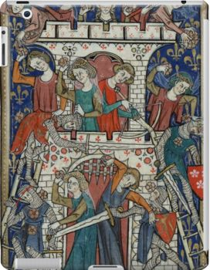
Women not always of high social status
Medieval Flemish and Burgundian Wars
C16th: ‘wife of corporal’ of Dieppe carrying letters regularly to Scottish ambassador to England, including from Cardinal of Lorraine, and to Queen of Scots ‘under cover of selling her some pieces of linen’, travelling via boat of sister living in Rye
C17th Dieppe: female innkeeper acting as go-between to smuggle Huguenots across Channel
As maids, washerwomen, at market…
Able ‘to operate below the radar of surveillance’ (Daybell)
Visible yet invisible?
Less likely to be searched or suspected?
Could claim innocence/coercion/ignorance
Attach blame to others vs agency/expectation

Slide 9
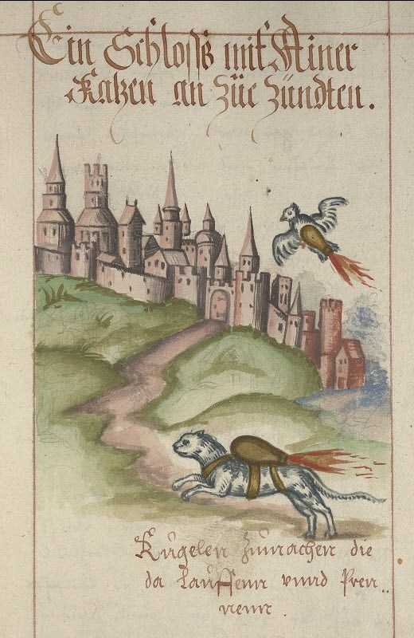
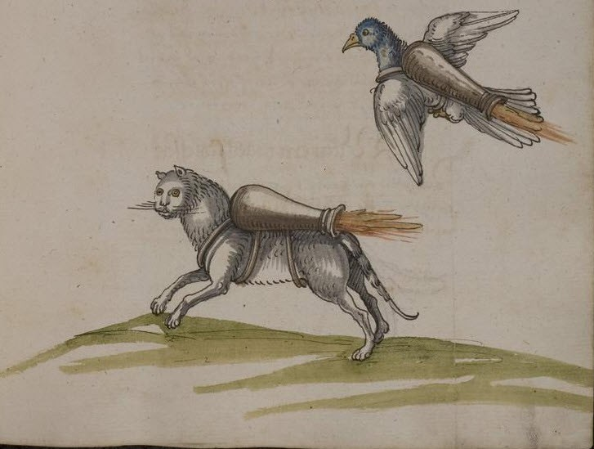
Unexpected agents: the Rocket Cat (and Bird)

Slide 10
Who are the Spies?
‘The most effective spies will remain undiscovered’ (Akkerman)
Yet (French) historians draw up typologies of & categorise, including motivation e.g. Lucien Bély, Espions et ambassadeurs (pp. 182-200), defining as money, love and faith or ‘religious passion’
Alain Hugon, Au service du Roi Catholique (chaps viii-x & annex), provides comprehensive statistical analysis: out of 233 (fifth unknown), largest no. = nobles + military, lettered inc secretaries, clergy & merchants; third in exile (most religious + political, or criminal); motivation = money, religion, + service & vengeance; duration often brief, up to 5 years common
Will be looking at motivation next especially in the context of religious division > need for secrecy in communication

