Slide 1
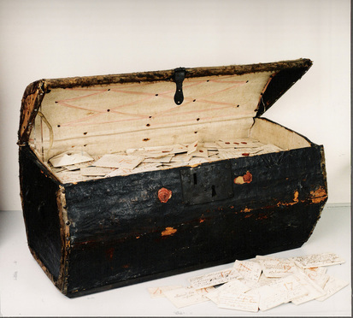
Material Culture and Cryptography
2600 letters (around 600 unopened), mostly from France, preserved in trunk belonging to late C17th postmaster & postmistress in the Hague because returned, refused or ‘unknown’ (i.e. not paid for)
Survival extraordinary and analysis ongoing
C17th Brienne Letters: ‘Signed, Sealed and Undelivered’

Slide 2
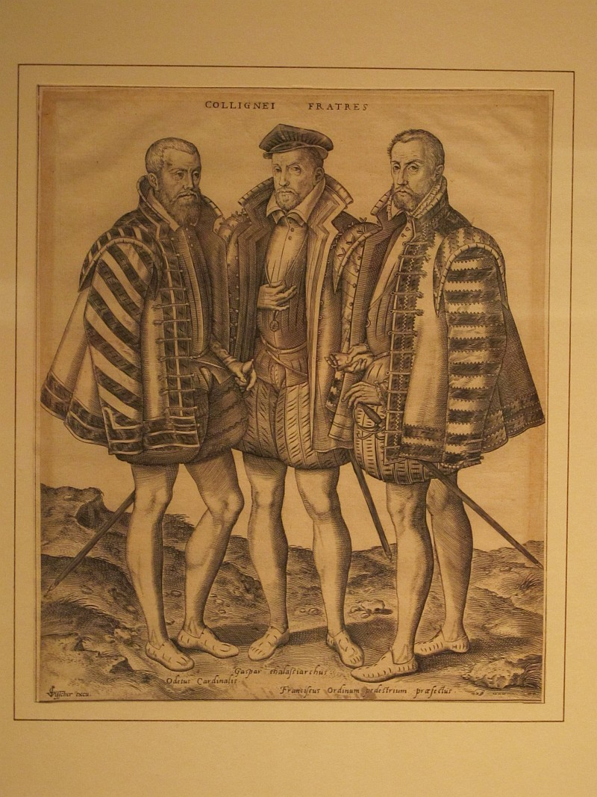
Methods & hazards of concealment
Clandestine messages hidden in or sewn into clothing (hose, doublets etc), carried in pockets, bags (sometimes sealed), baskets etc
Often just from descriptions, actual evidence fragmentary; interception or retention; practice of burning & destruction & loss
‘Letters and other documents, the objects most needed to be kept confidential, are the items recorded as having been most commonly carried around in pockets. But pockets were not inviolable spaces, with men tending to have their pockets searched when they were captured or killed’ (Rebecca Unsworth on early modern dress)

Slide 3
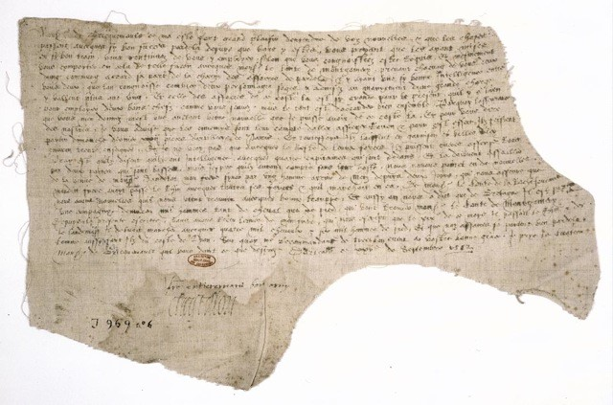
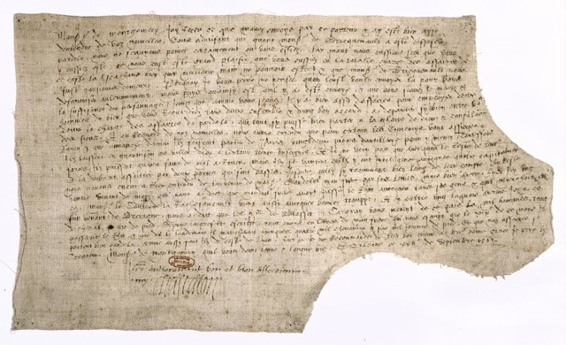
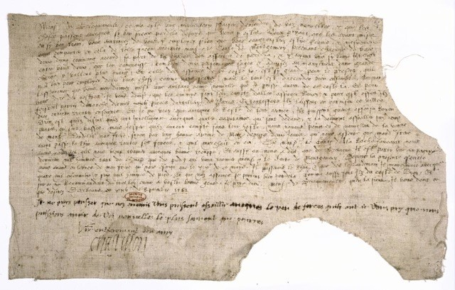
Letters written on the lining of doublets, siege of Rouen, Sept. 1562 (Archives nationales, Paris)

Slide 4
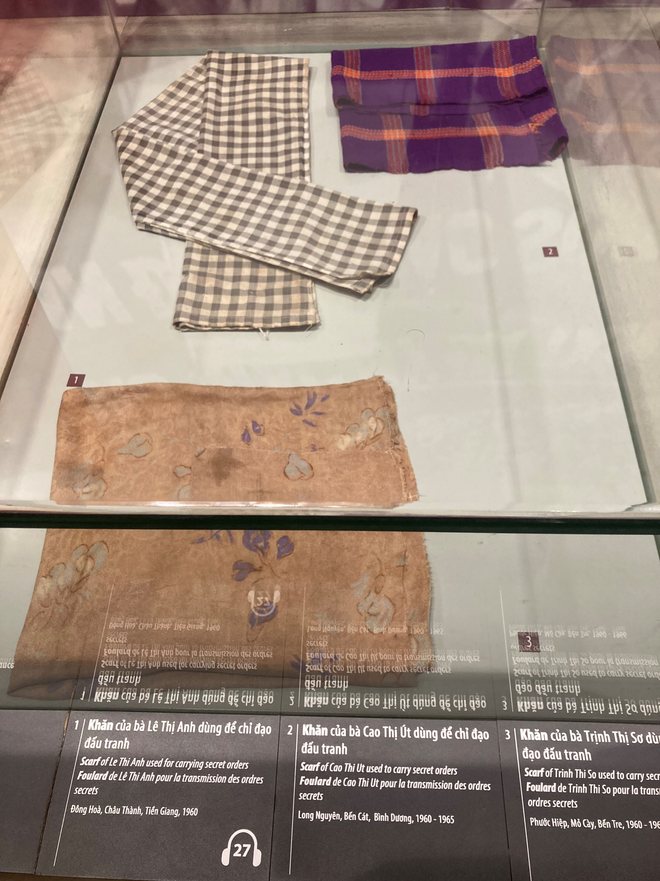
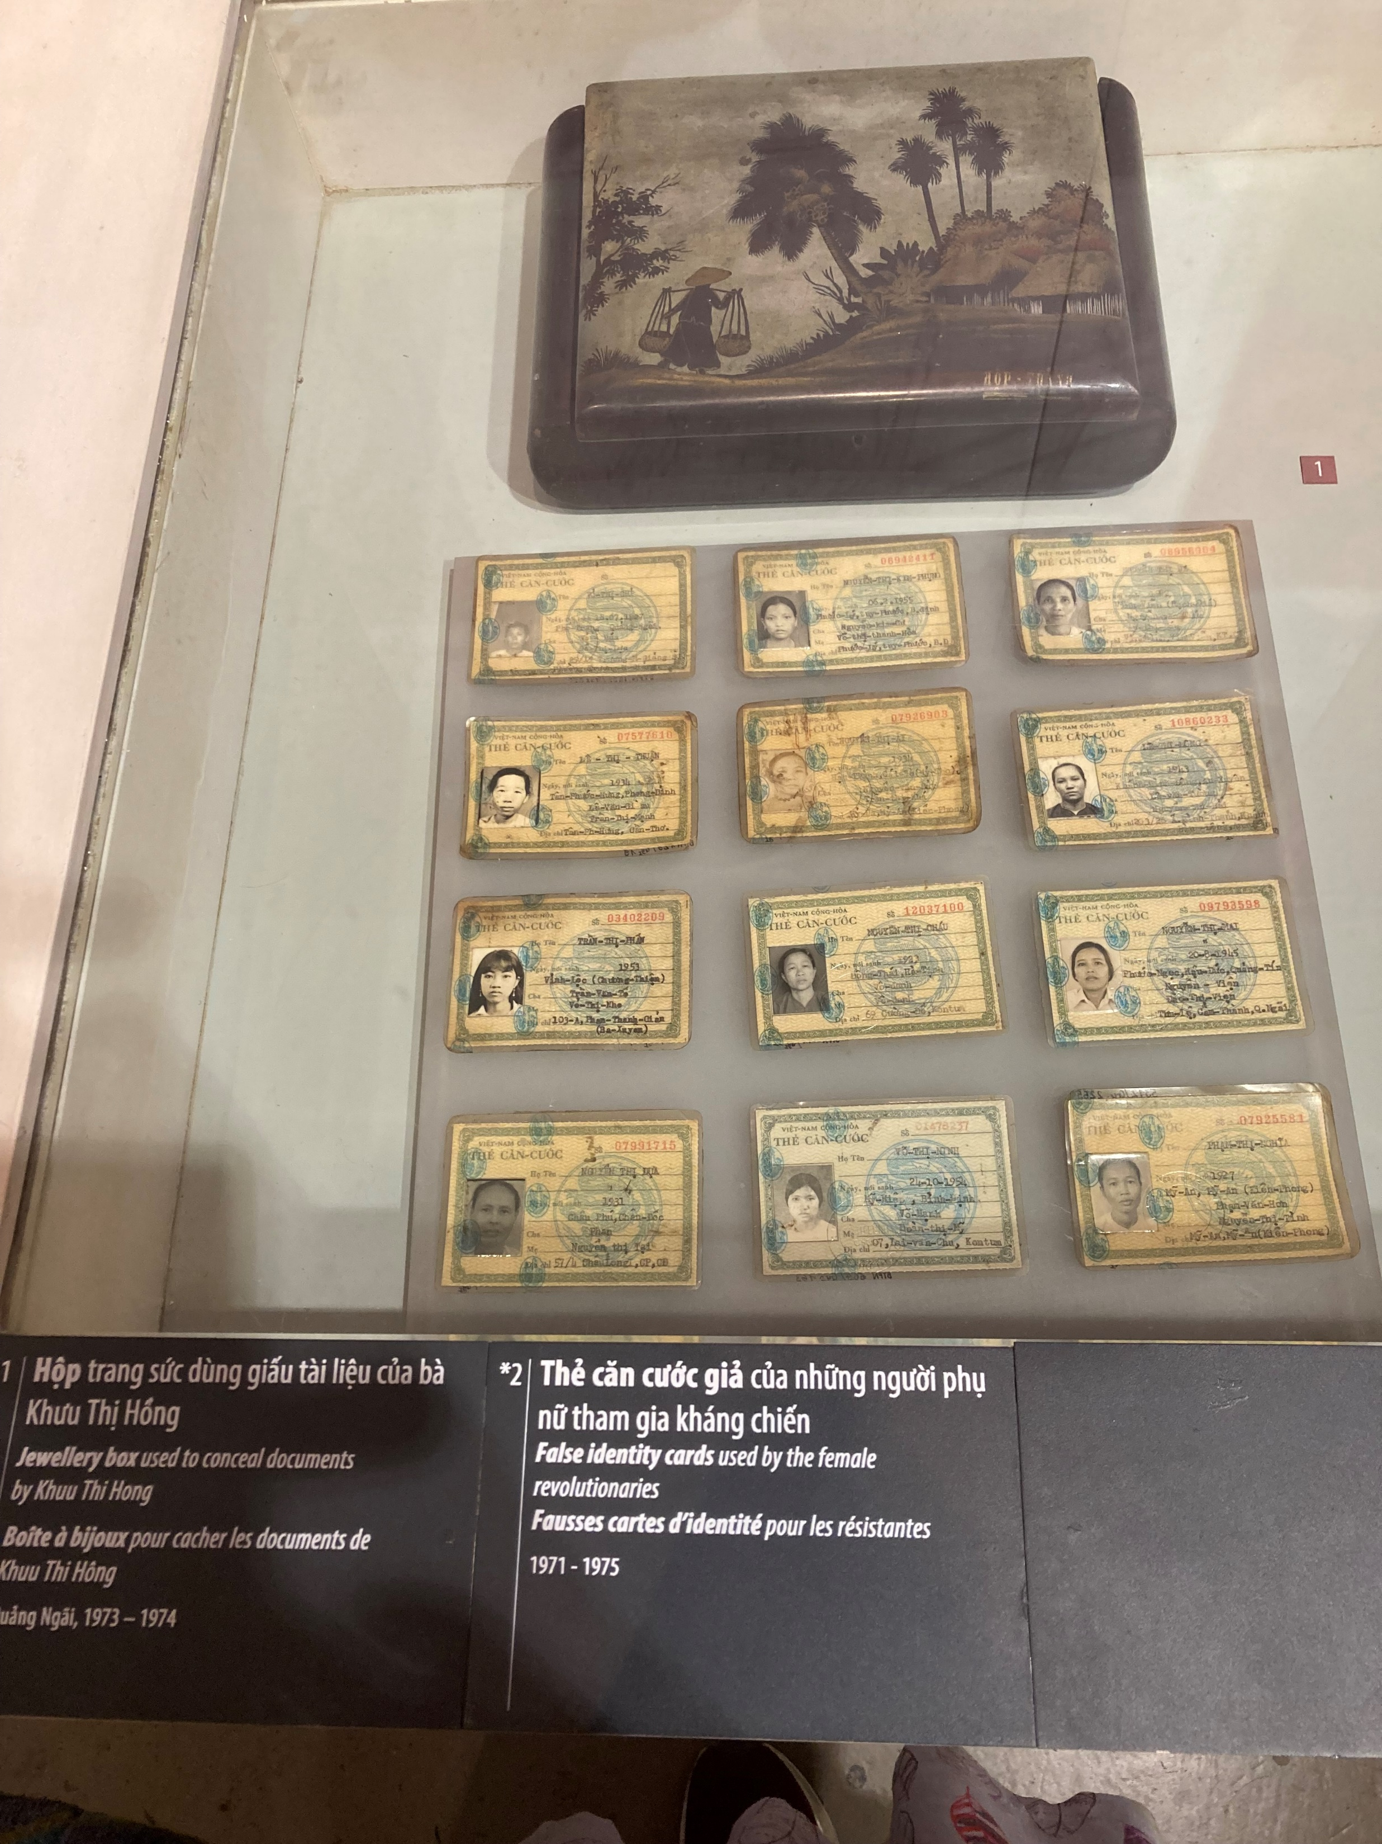
Vietnam War
Scarves used to carry secret orders
Jewellery box to conceal secret documents
Forged identity cards of agents

Slide 5
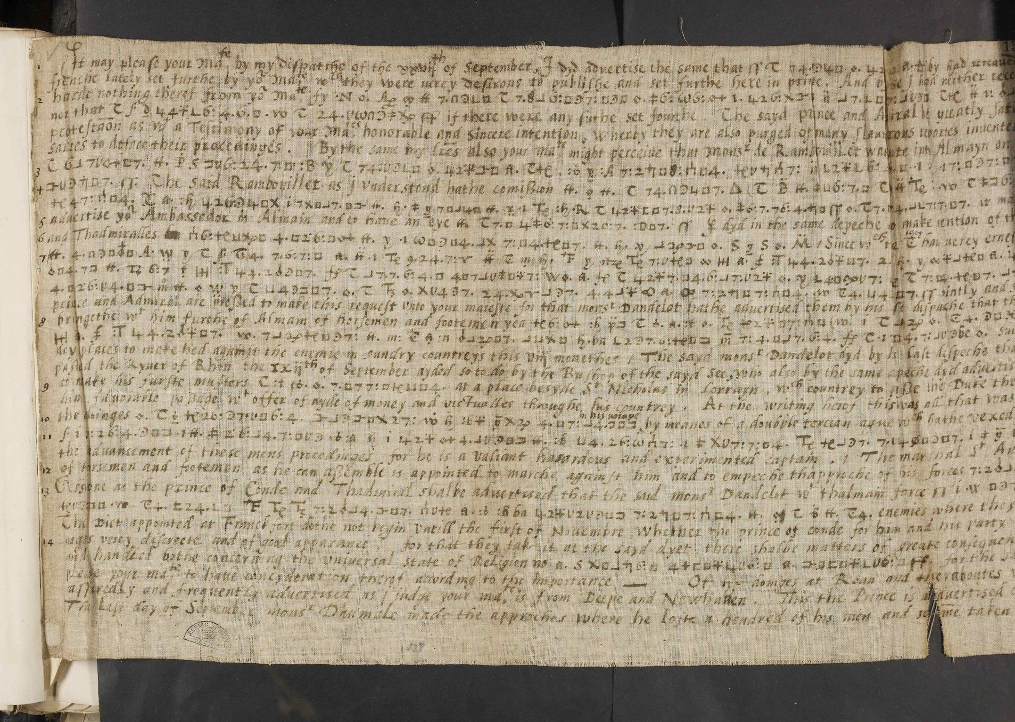
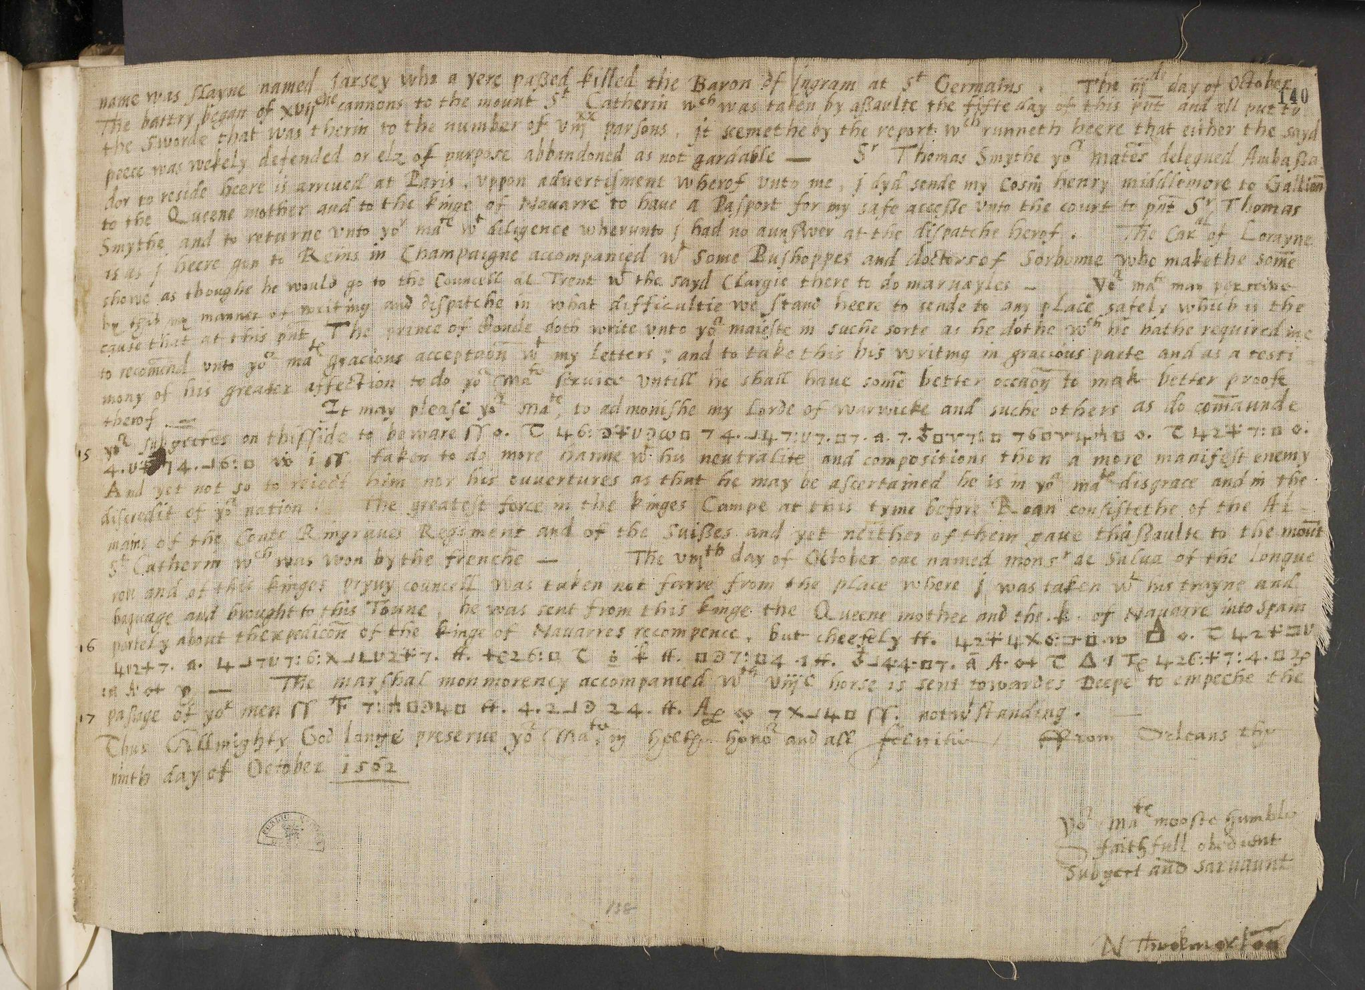
Nicholas Throckmorton to Queen Elizabeth on pieces of linen, Orléans, Oct. 1562 (State Papers, The National Archives, Kew)

Slide 6
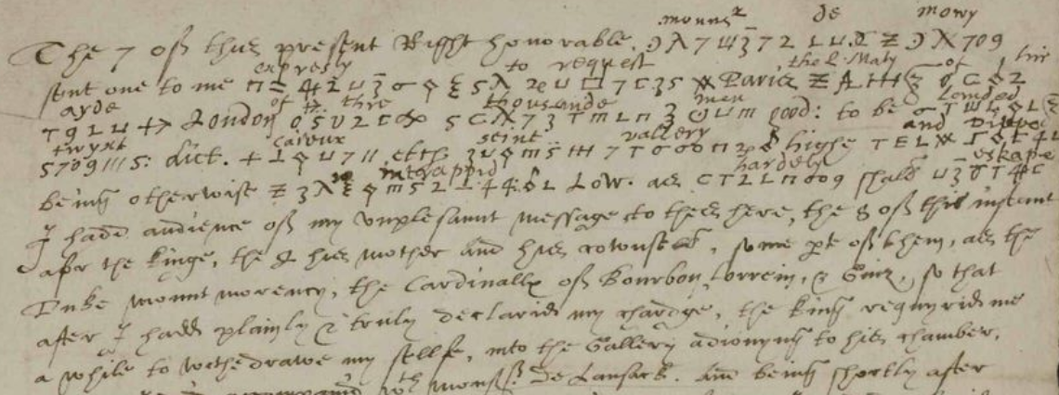
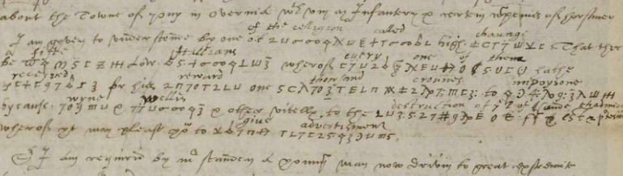
Cryptography: use of codes, but also pseudonyms
Need for specialised codebreakers, translators & counterfeiters
Invisible ink (lemon or orange juice, milk, urine + heat or water)

Slide 7
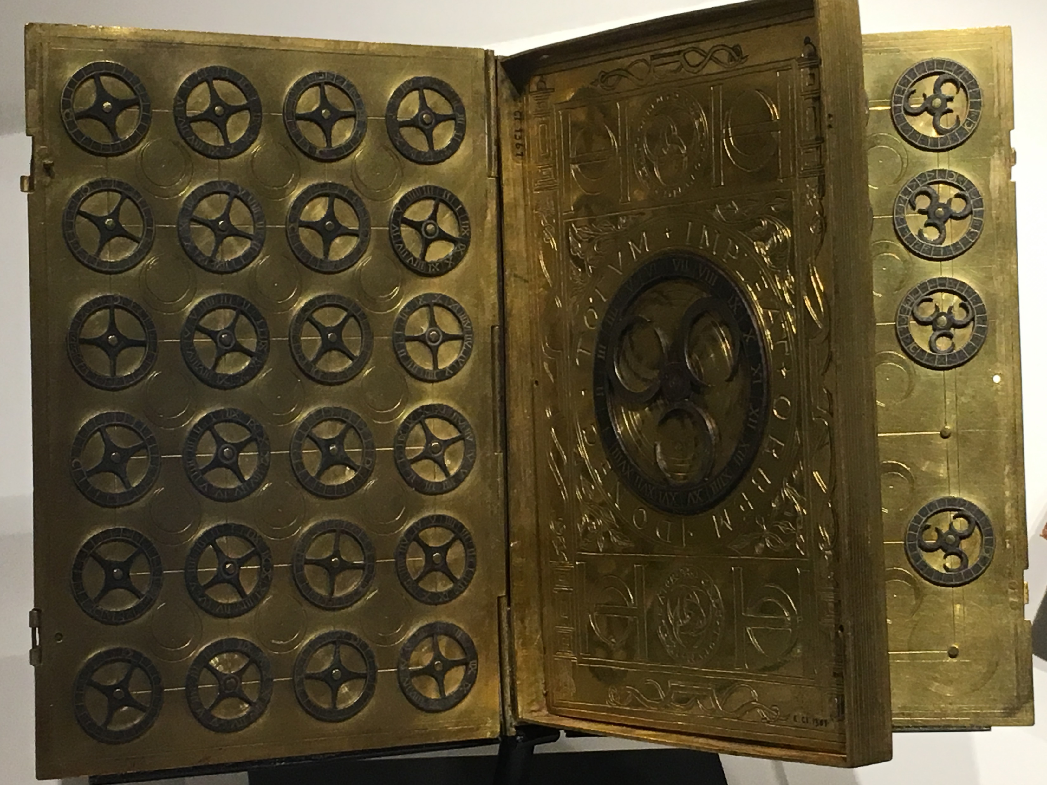
Ciphers, codes & cryptography
‘it is arguably the sixteenth century that witnessed the most marked increase and development in secret forms of letter-writing, attested by the publication of significant numbers of printed cryptographies, the invention of sophisticated manuscript cipher systems, and by thousands of extant manuscript letters employing ciphers or codes’. (Daybell)
‘Each ambassador had his own cipher or multiple ciphers … frequently updated, added to and supplemented; they were also prone to problems, often lost or stolen and needed replacing’.

Slide 8
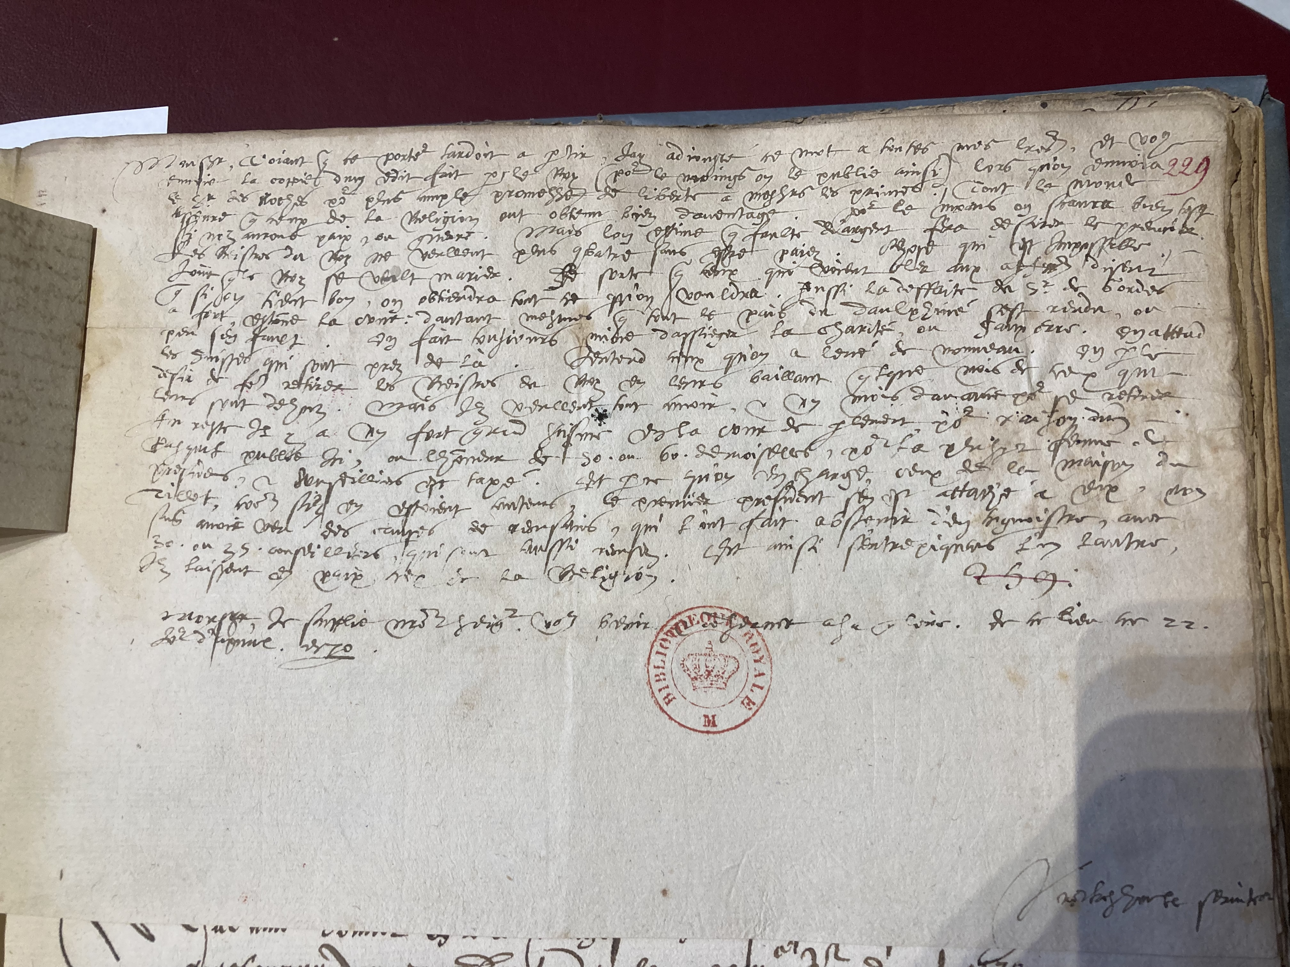
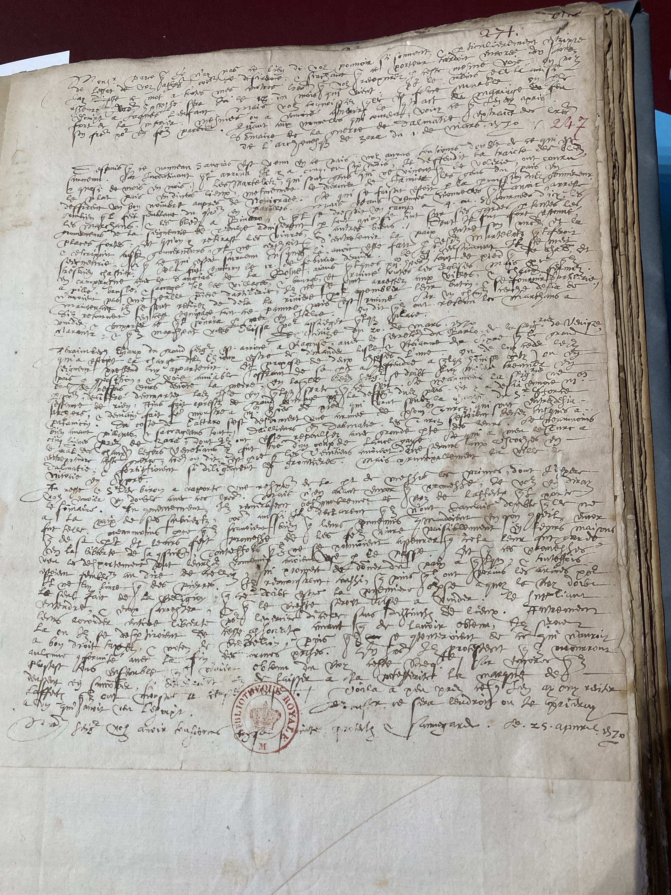
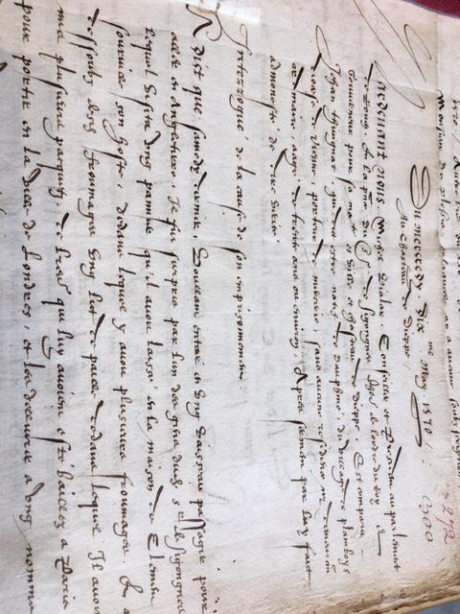
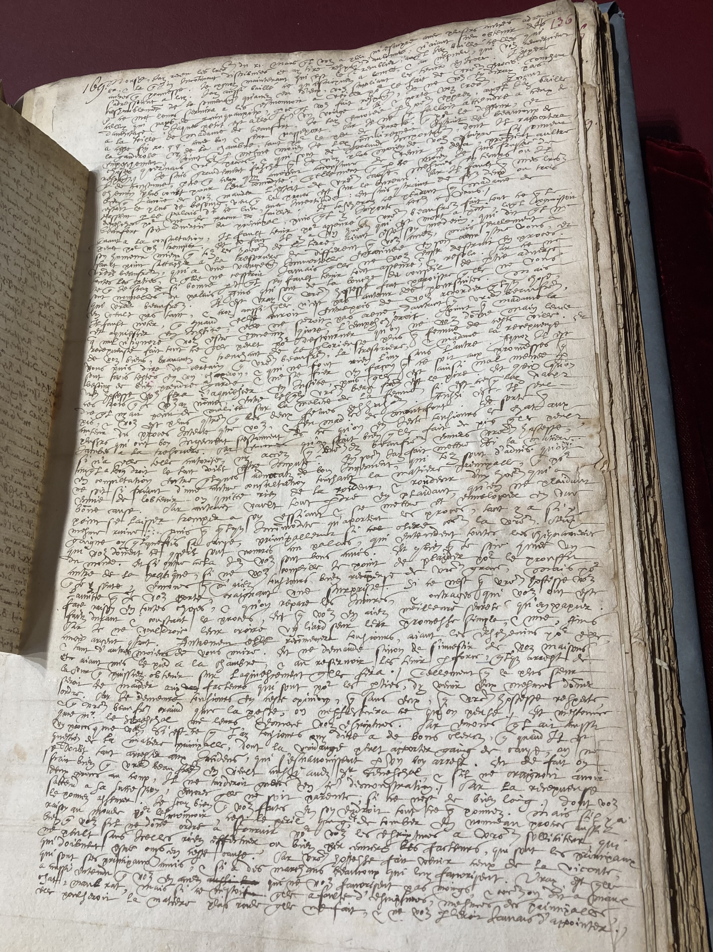
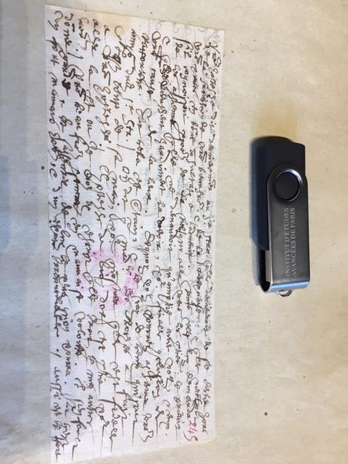
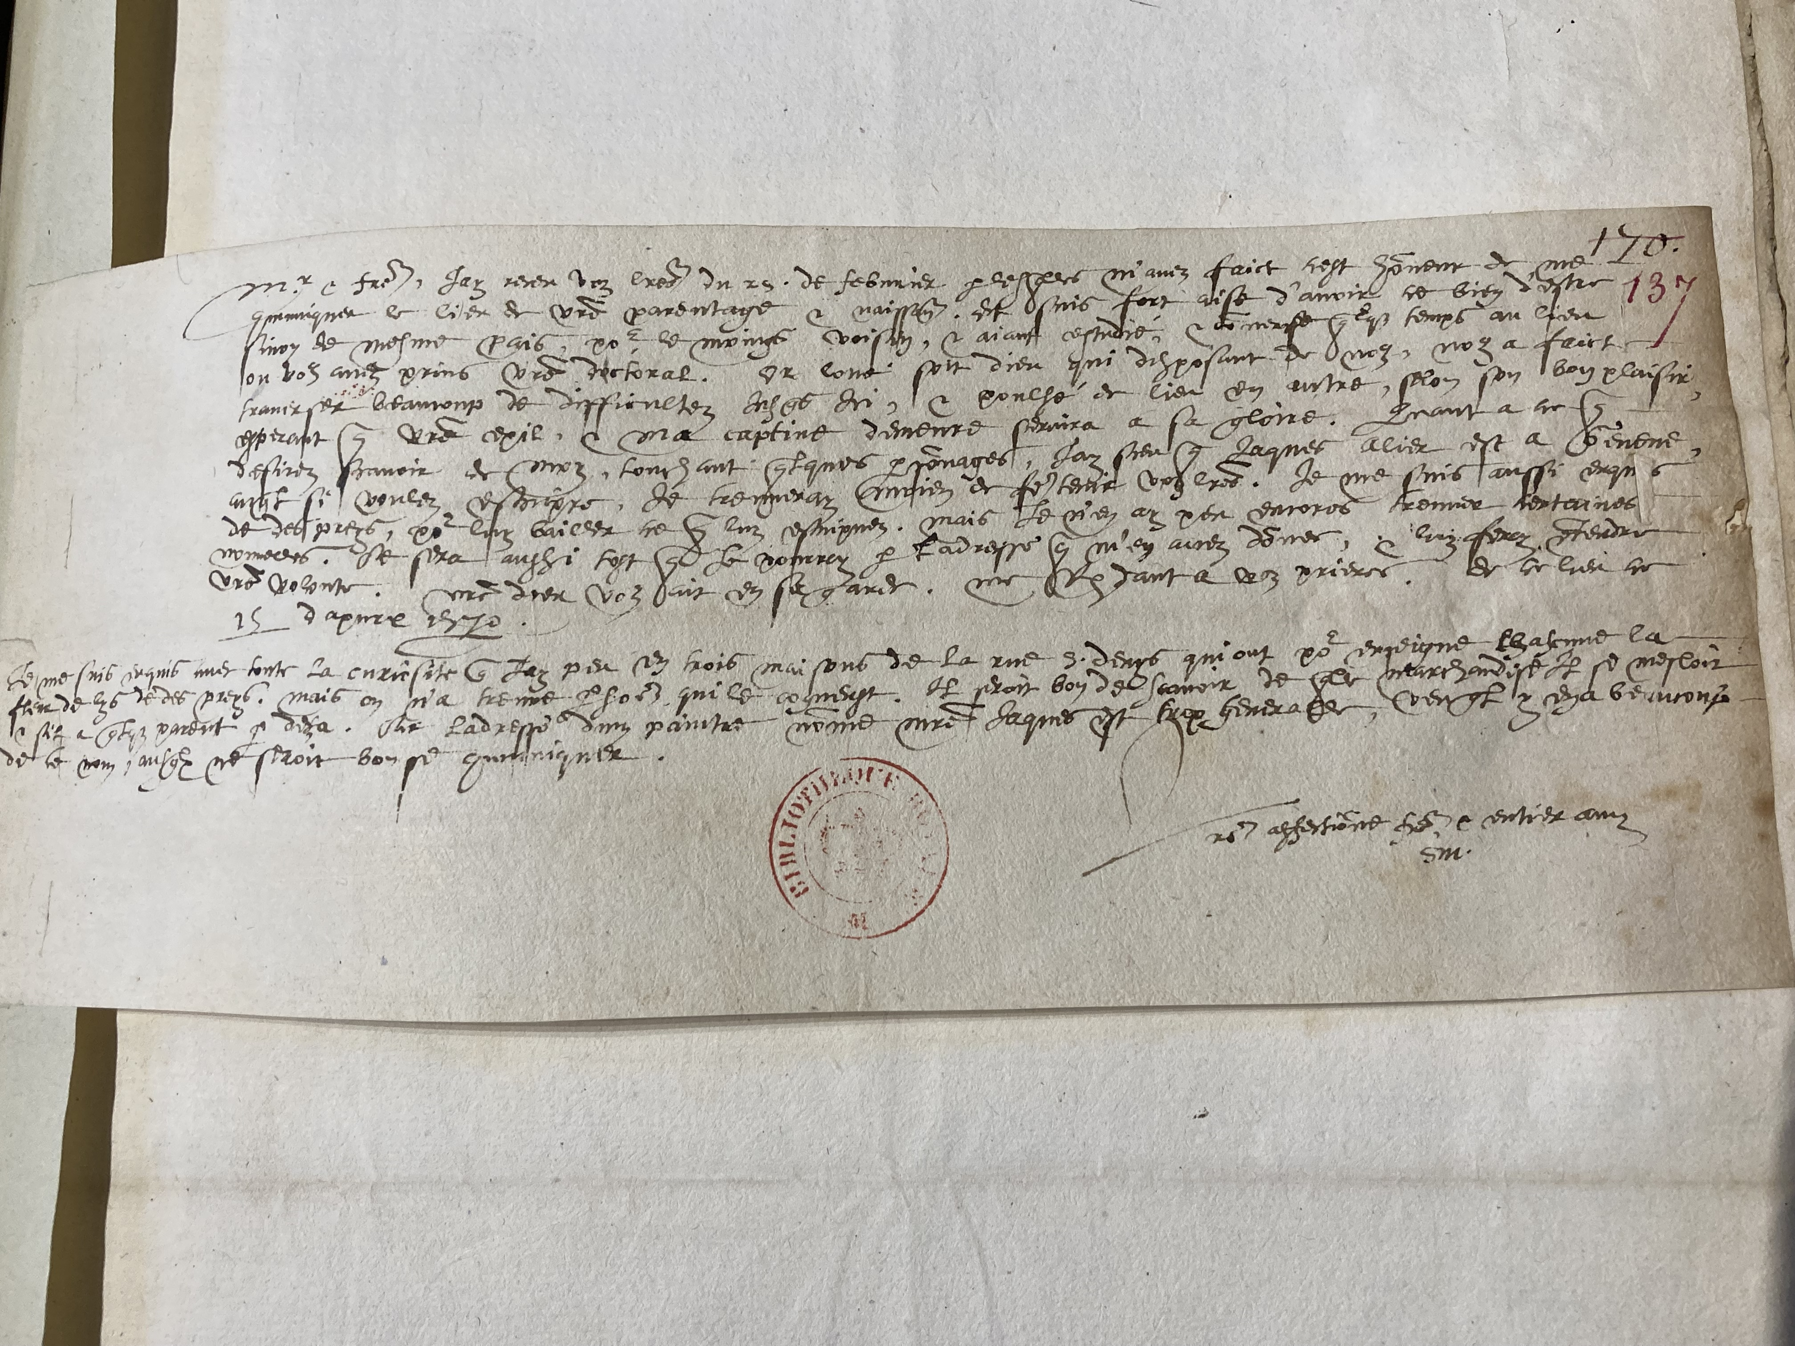
Interrogation & intercepted letters (May 1570)
(Bibliothèque nationale, Paris)

Slide 9
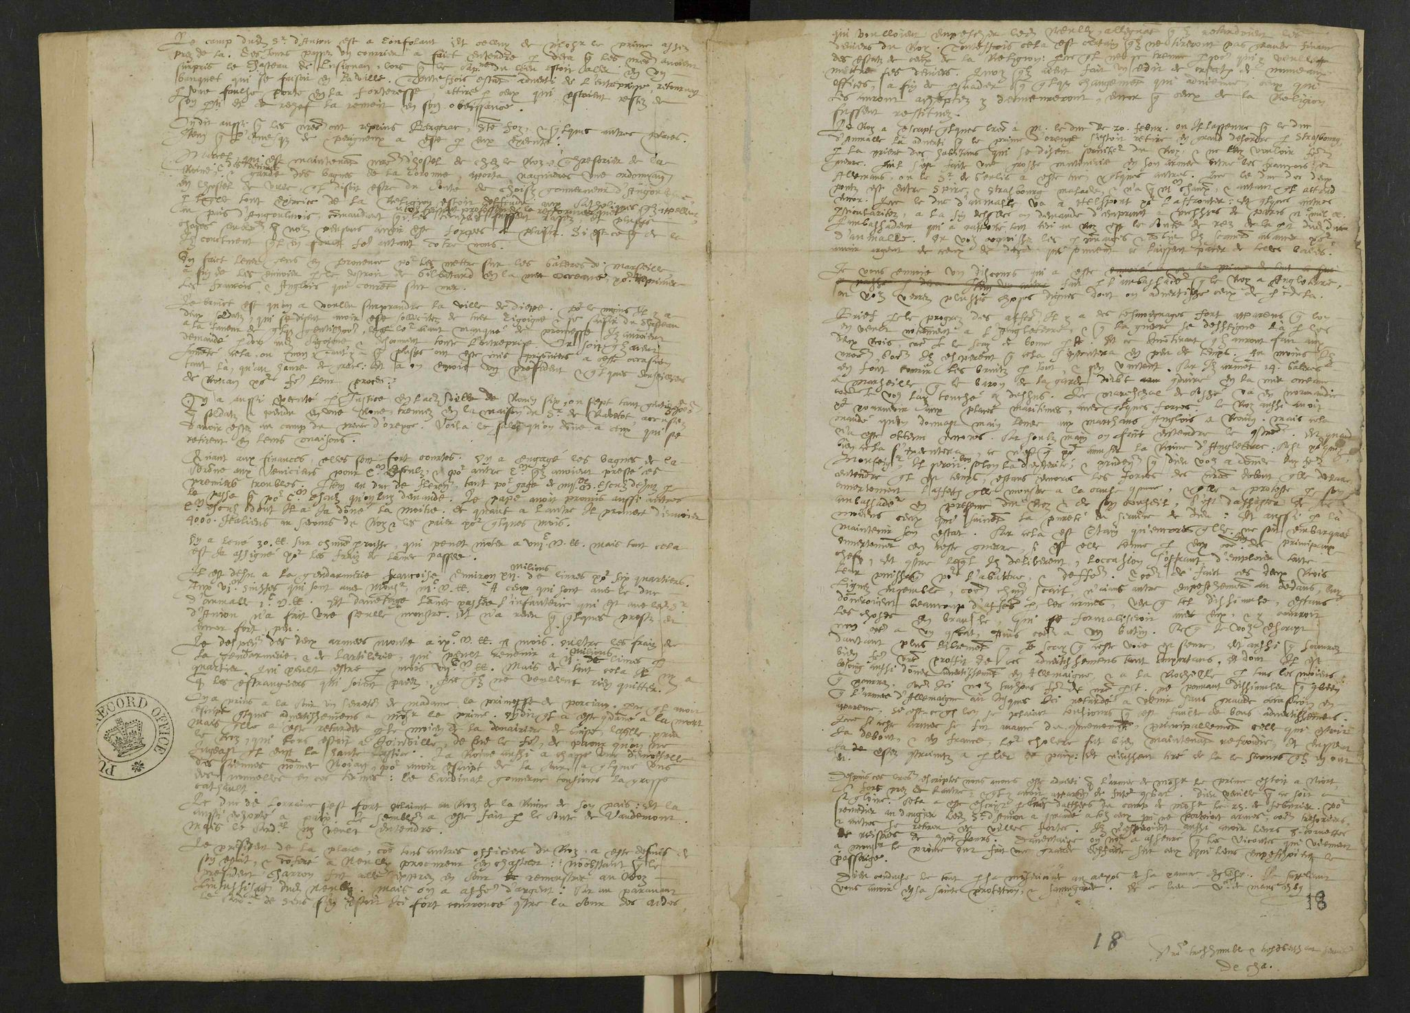
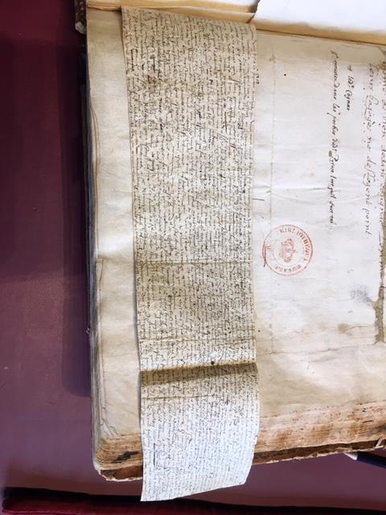
Identifying Handwriting in Other Letters

Slide 10
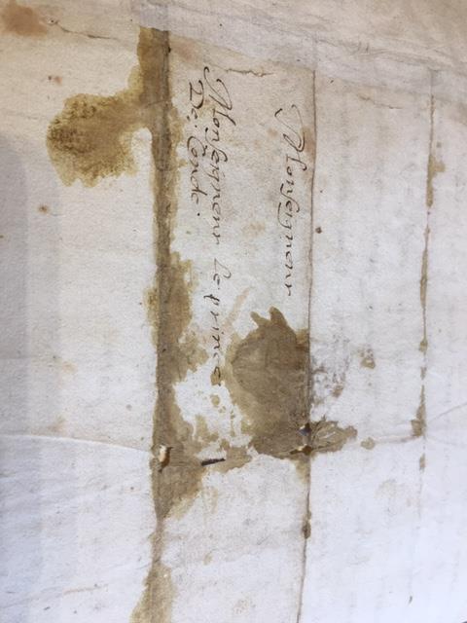
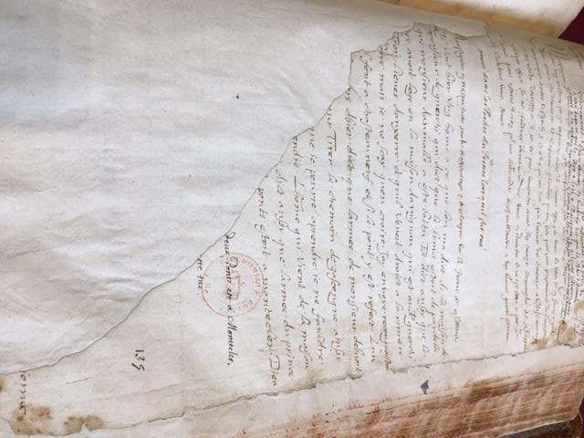
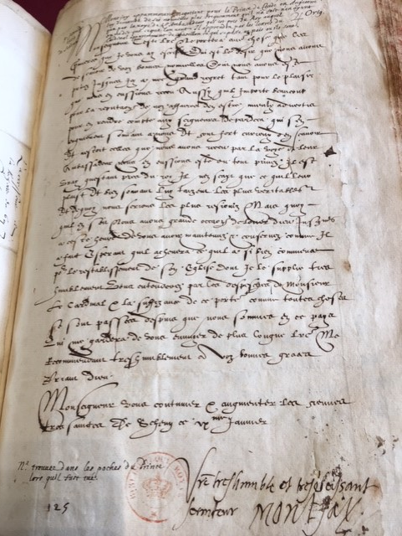
4 of up to 10 letters found on Louis, Prince of Condé’s body after the Battle of Jarnac, Mar.1569

Slide 11
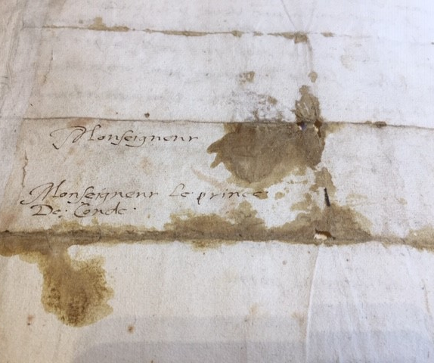
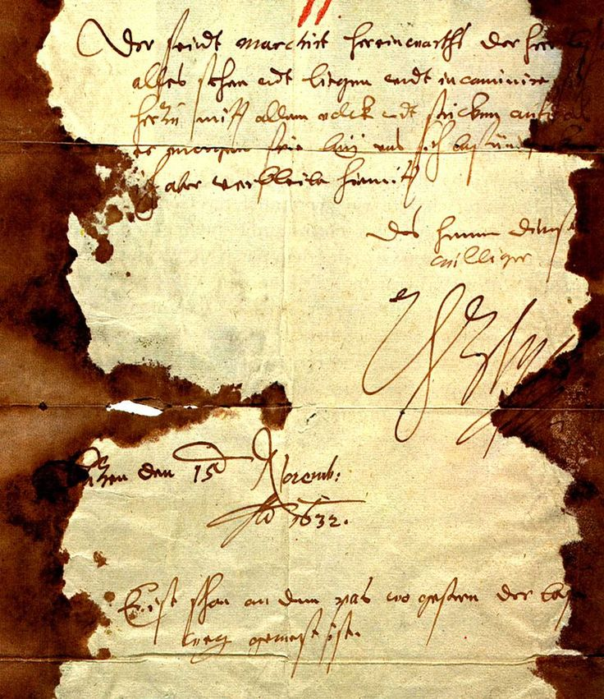
Stained letters taken from corpses
Jarnac, 1569 Lützen, 1632

Slide 12
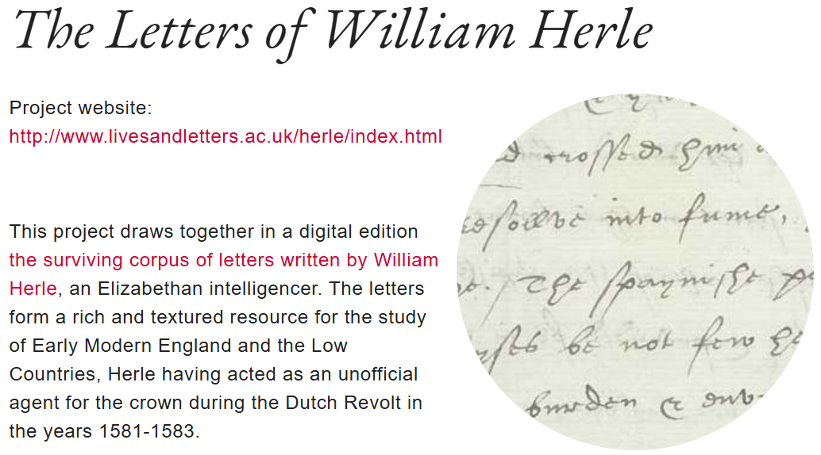

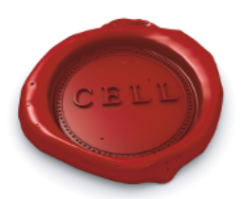
Early Modern Letters Online
Centre for Editing Lives and Letters
The Centre for Editing Lives and Letters (CELL) develops projects focused on making archives matter, concentrating on the years 1500 to 1800

Slide 13
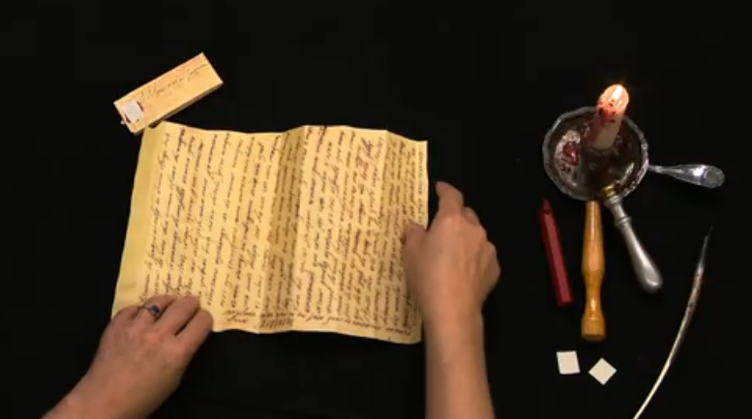
Cryptiana: Articles on Historical Cryptography
Letterlocking: Walsingham’s anti-spy letter to Sir Ralph Sadler, England (1584) (UH0132)
Catherine de’ Medici’s concealed spiral-locked letter to Raimond de Beccarie (c.1570) (UH0224)
Letterlocking: Mary Queen of Scots’ last letter, a spiral lock, England (1587) (UH0135)
Letterlocking: A rare spiral lock, France (1638)
Akkerman & Langman, Spycraft (2024), contains ‘Lessons: the School of Spycraft’, including recipes for invisible inks & poisons! (with disclaimer)

