Slide 1
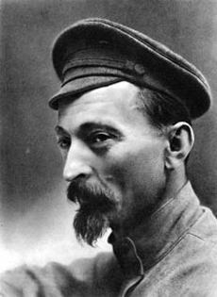
Felix Dzerzhinsky (1877-1926), head of the Cheka (Extraordinary Commission)

Slide 2
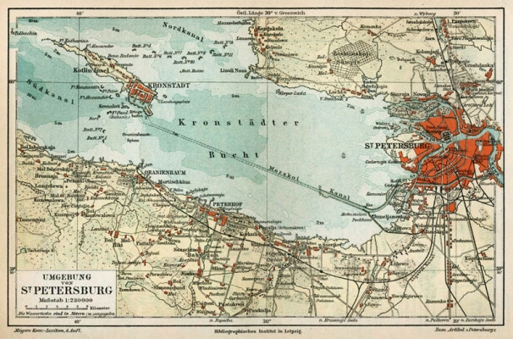

Slide 3
1921, X. party congress
Debates on Decision
Role of trade unions Subordinated to party, tools
Socialist democracy Outlawing of all other parties
Intra-party democracy Outlawing of factions in the party
Democratic centralism

Slide 4
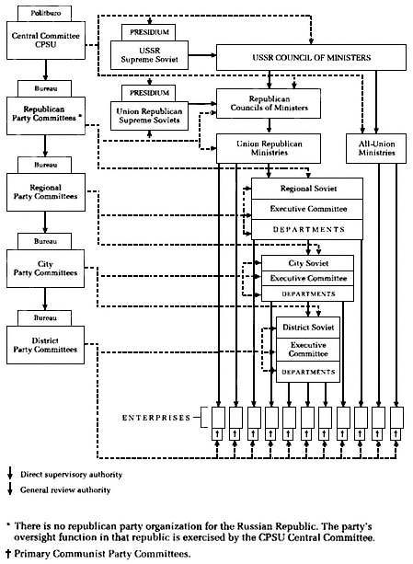

Slide 5
New Economic Policy (NEP)
Economic Policy end of war communism
end of requisitions of agricultural products
small enterprises can be in private hands
private retail and small trade accepted
natural tax – later money tax for agricultural products
Foreign trade, large enterprises and industry state-controlled
Urban society ‘byvshie liudi’ (former people), many “bourgeois” intellectuals emigrate or are forced to leave the country
old managers needed in factories
old civil servants needed to run state
workers not satisfied, but improvement of living standard and working conditions
Peasants 1921 famine in Volga region, return to old peasant commune, improvement after 1923,
grain procurement difficult – scissors crisis, very expensive consumer goods and low prices for agricultural products

Slide 6
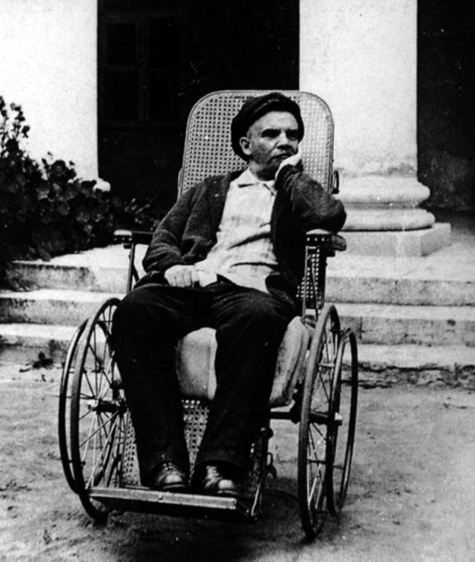
Lenin in Summer 1923

Slide 7
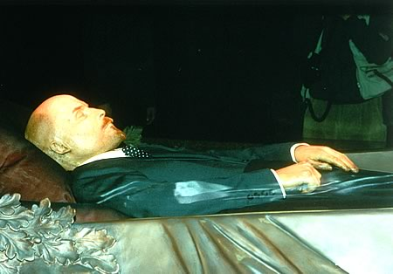
Lenin in his mausoleum on Red Square

Slide 8
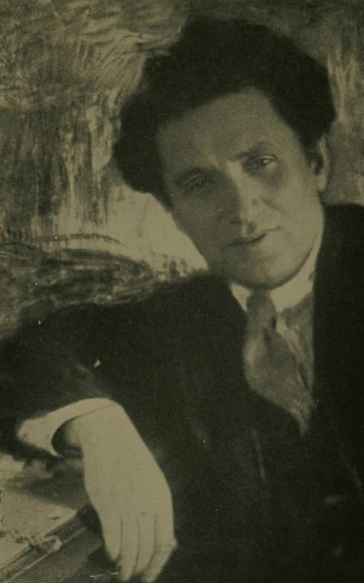
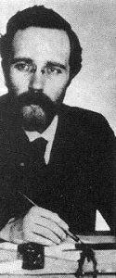
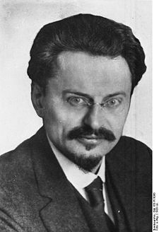
Grigory Y. Zinoviev (1883-1936)
Lev B. Kamenev (1883-1936)
Lev D. Trotsky (1879-1940)

Slide 9
No world revolution – “relative stabilisation of capitalism”
Socialism in one country (Stalin) Permanent revolution (Trotsky)
Continuing with NEP (1925) Change necessary, replace market relations by planned economy
(Bukharin, Stalin) (Trotsky, Kamenev, Zinoviev)
Industrialisation by improving quick transfer of resources from
agriculture, moderate taxing of agriculture , focus on heavy
wealthy peasants (Kulaks) industry (Preobrazhensky and
(Bukharin) left opposition)
Continuing with NEP, (1928) End of NEP, collectivization and smychka peasants and workers rapid industrialisation
(Bukharin, Rykov, Tomsky) (Stalin, Molotov, Ordzhonikidse)

Slide 10
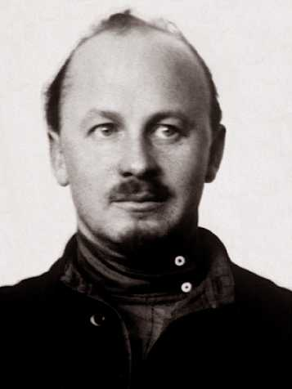
Nikolai I. Bukharin (1888-1938)

Slide 11
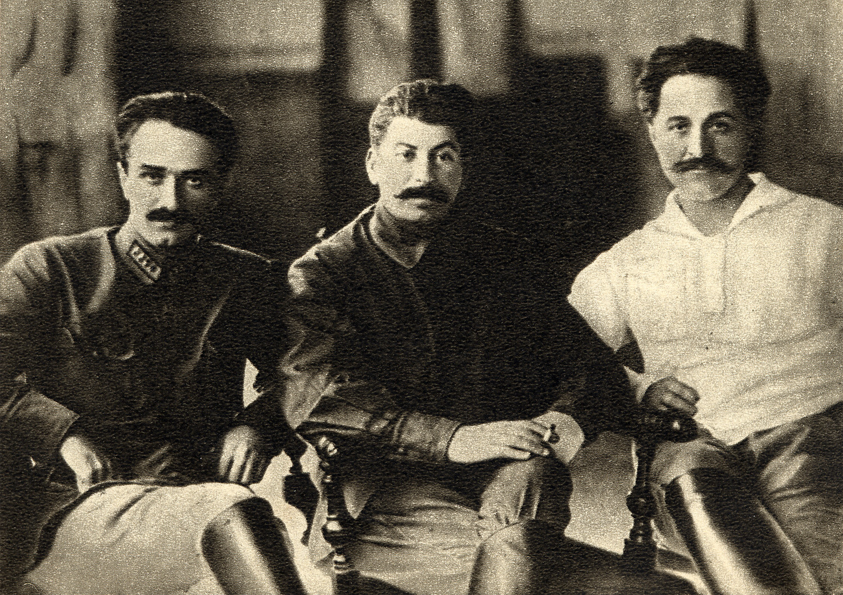
Ordzhonikidze, Stalin and Mikoyan in 1925

Slide 12
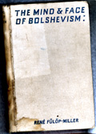
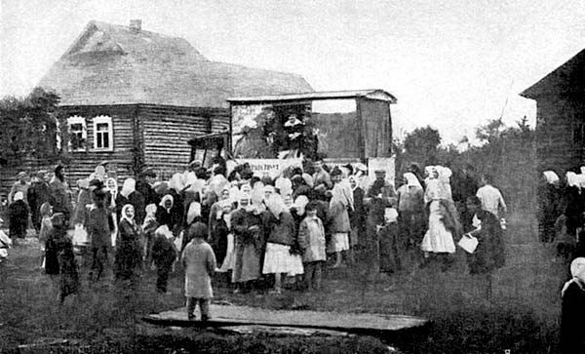
Soviet propaganda car, 1920s

Slide 13
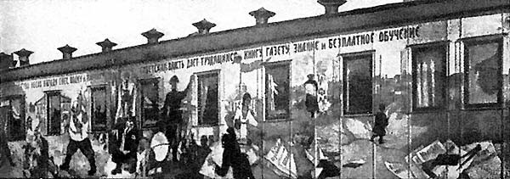
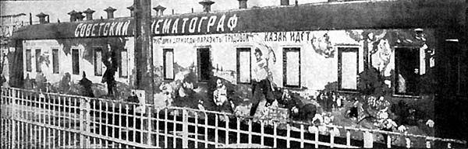
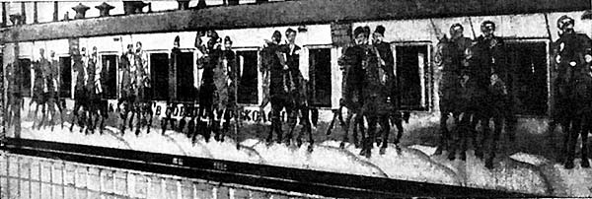
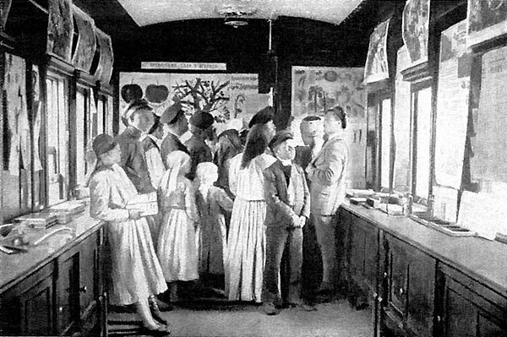
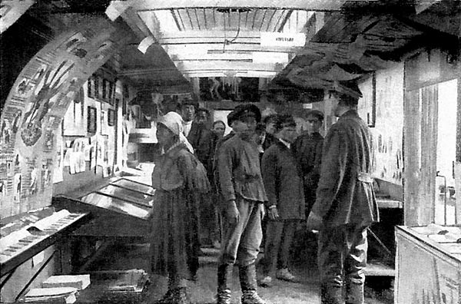
Inside a Soviet propaganda car, 1920s

Slide 14
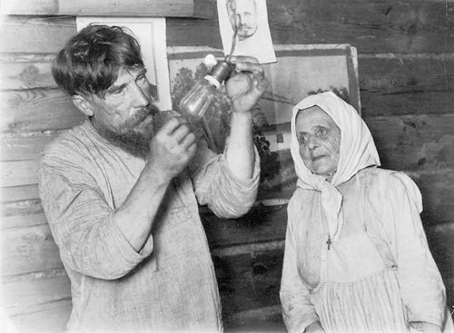

Slide 15
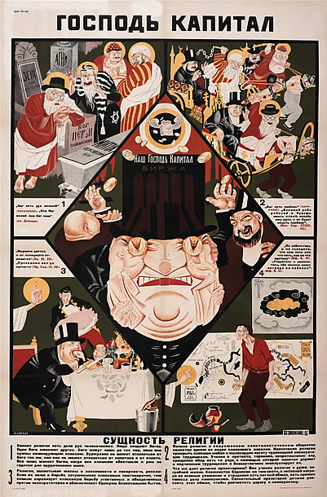
Lord Capital – The essence of religion, Soviet propaganda poster 1928/29

Slide 16
