Slide 1
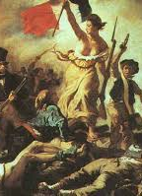
The French Revolution HI31J
Origins

Slide 2

Phases of Revolution – for later lecture
Liberal Phase – 1789-1792 (constitutional monarchy)
Radical Phase – 1792-1794 (republic, terror)
Thermidor – 1794-1795 (republic, reaction)
Directory – 1795-1799 (unstable republic, repeated coups, increasingly corrupt and authoritarian)
Consulate & Empire – 1799-1814 (Napoleon)

Slide 3
What was the Ancien Régime
Society of Orders
1st Estate: clergy (pray)
2nd Estate: nobles (fight)
3rd Estate: commoners (work)
Divine-right Absolutism (religion, fiscality)
Feudalism / Seigneurialism
Privilege (private law)
Birth, purchase, geography
Venality (purchase of public offices)
Clientage/Patronage

Slide 4
France
28 million people in 1789
3.5x population of Britain in 2x land mass
85% live in countryside
Paris: 600K in 1789

Slide 5
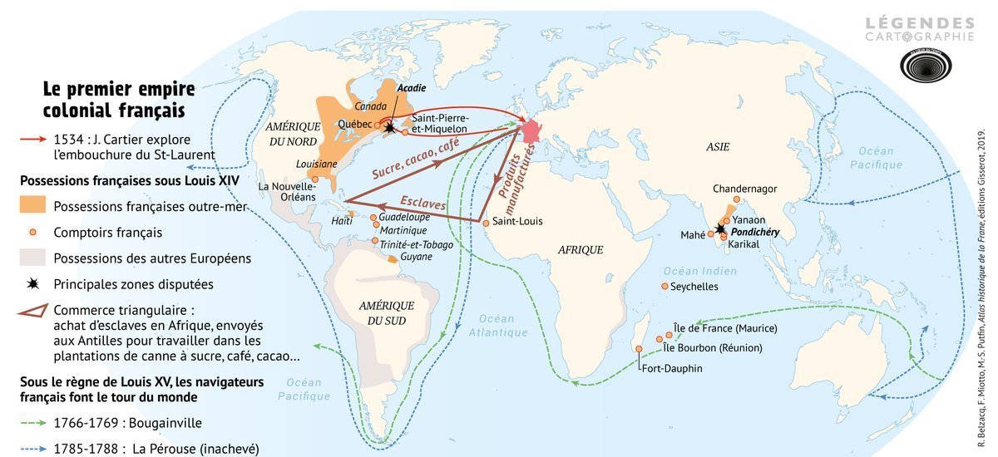
French empire (orange) before Treaty of 1763 (Seven Years’ War)

Slide 6
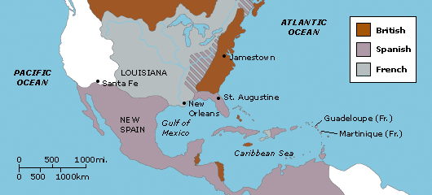
Grey=French
Before Treaty of 1763.

Slide 7
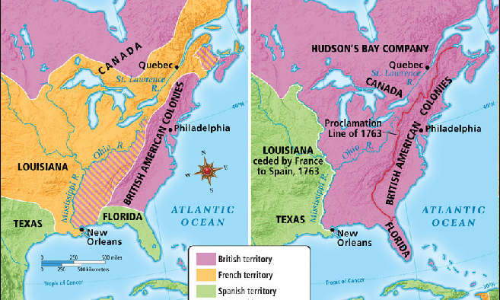
French Empire before and after Treaty of 1763 (orange)

Slide 8
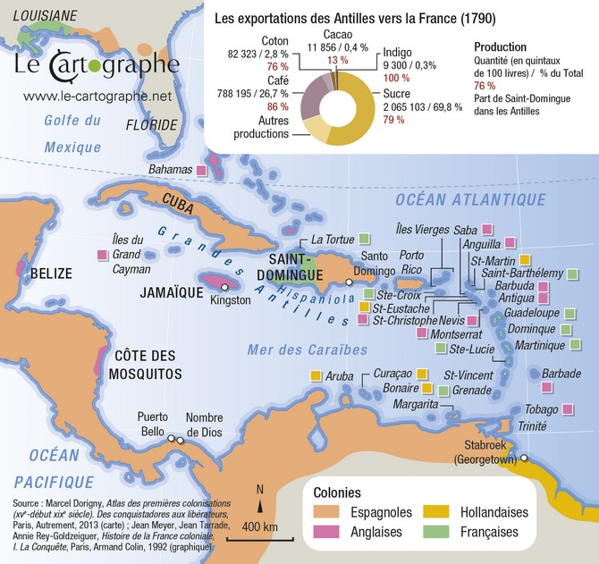
French Caribbean 1763-1790 (green)

Slide 9
Metropolitan France
Patchwork of jurisdictions
Pays d’état (red)
had provincial estates (i.e., assemblies of clergy, nobles and third estate) that negotiated their relationship and taxes w/crown
Pays d’élection (white)
under direct royal rule
no provincial estates

Slide 10
Three Orders of Society (metropole)
1st Estate - Clergy (those who pray) – 0.6% population
2nd Estate – Nobles (those who fight) – 0.5%
3rd Estate – Commoners (those who work) – 99%

Slide 11
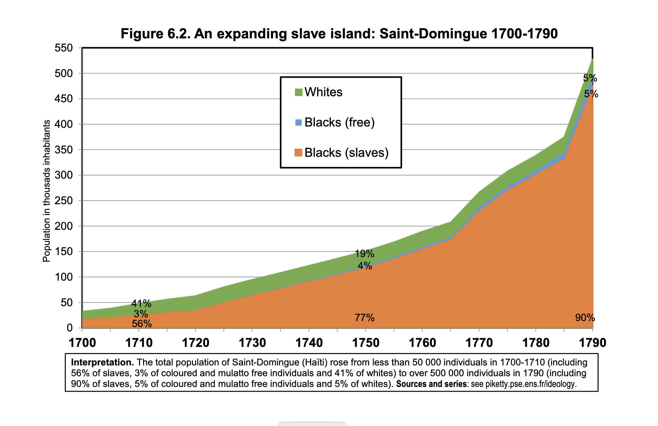
Saint-Domingue

Slide 12
Key institutions
Monarchy
Church
Parlements
Guilds/Corporations

Slide 13
Key Institutions
Monarchy
Court of Versailles (circa 1670)
Ministers - government
Venal offices (purchased)
Intendants (non-venal, salaried, immense authority in the provinces)
Military (centralizing)

Slide 14

Church
Catholic
Owned 12% of all property in metropolitan France
Feudal owner of land and urban property
Cathedrals, Bishops (wealth, power)
Parish priests (often poor, well-liked, pastoral care)
Monasteries and Convents (un-useful orders in an Enlightenment age of ‘utility’)
Religious deviance
Protestant ‘Huguenots’ – outlawed in 1685
Jansenists – outlawed in 1713 but ever-present in the Church. Parlements defend them against the will of the crown.

Slide 15

Parlements
13 sovereign courts of magistrates. Magistrates were nobles, often owned land and often defended Jansenists. Thorn in crown’s side
Responsible for registering royal decrees (might refuse – political clashes – forced shutdowns by crown)
High courts (appellate courts for most; first courts for nobles)
Parlement of Paris covered more than half the French population – most important one. Other parlements tended to follow its lead.

Slide 16

Corporate society Privilege at the core
Lettres patentes from the king authorizing their existence
Monopolies over certain functions and/or markets
Sometimes had their own courts and political structures
Examples: trade guilds, but also barristers, magistrates
Growing commercial pressures made them appear less legitimate to some – obstacles to free markets

Slide 17

Seigneurialism
Vertical chain of ownership – rights and duties not the same for all
Seigneurs hold public powers (seigneurial courts and administration)
Rent-seeking (dues, fees. Use of armies to collect them)
Absenteeism: lords need more money… squeeze the peasantry further
Hire management companies to run administration and justice
Commercialisation – sell off privileges and associated revenue streams
Indebt peasants then seize their property
Feudalist – lawyers who try to find old dues on the books and revive them

Slide 18
Marxist framework?
Bourgeoisie versus the aristocracy?
Class conflict?
or
Class fusion into ‘notables’
Seigneurs behaving like capitalists (albeit rent-seeking ones, using instruments of feudalism to extract more wealth from peasants)
Bourgeois buy ennobling land, ennobling offices, and marry into noble families

Slide 19
Changes in the 18th century
Socioeconomic changes
Commerce and consumption – marketisation of society
Demographic rise (thanks to potato and bumper crops before mid-century
Fiscal military commitments (expensive), regime debt rises
New worldviews: Enlightenment
Political ideas
Change in sentiment/emotions
Public Opinion

Slide 20

Marketisation of Society
Consumer demand outstrips guilds/corporations’ capacity to meet it
But crown needs the guilds/corporations for fees and loans
(Crown had bad credit, so it forced officeholders and guilds to borrow on its behalf)
Customs duties – both internal and external
Revenue for crown but population hated them

Slide 21
Can markets change worldviews? (From subjugation to reciprocity)
From social hierarchy to civic equality
A society of producers and consumers rather than masters and subjects
Value of the individual: from birth to productivity
Need for legal system to enforce business contracts between legal equals
Sumptuary Laws decline: anyone with money can look like a noble… fashion reinforces the measure of money rather than blood

Slide 22
Marketisation of Society
Market demand outstrips guilds/corporations
Tensions between masters and workers
Tensions between guilds and consumers
Global trade – colonialism
Losses of empire upon defeat in the Seven Years’ War (1756-1763)
Intensifies slavery in Caribbean, especially Saint-Domingue
Tensions between guilds and non-guild production

Slide 23
Demographic growth
1700–1721
21 million
not much higher than in 1300
1789
28 million
Last plague in Provence in 1720 – well contained)
End of religious wars (last flare-ups in early 1700s)
Favourable climatic conditions between 1710-1739)
Introduction of the potato – ended mass starvation

Slide 24
Demographic growth Mixed blessing?
More economic productivity, but
Strains on resources
Inheritances divided amongst more heirs, impoverishment
Higher landless population, indigence
Peasants borrow to get by – greater indebtedness

Slide 25
Financial Debt
Crown borrows from officeholders, church, guilds and corporations. Why? They can borrow at lower interest rates than the crown. Debt runs through the whole society.
Regime debt becomes marketized. It becomes harder for the crown to default on a mass of creditors than it used to be on a few wealthy financiers, who can be bullied or bribed.
By 1787, 50% of state's revenues are going to debt-servicing

Slide 26
Effect of commercialization and rising indebtedness
Public opinion matters more to crown, especially public perceptions of the regime’s credit-worthiness
People begin to see each other as producers and consumers (horizontal) rather than masters and subjects (vertical). Civic equality becomes thinkable.
Those who don’t produce appear as leeches on society (high clergy, nobles).

Slide 27
Three paths through the French Enlightenment
1. Voltaire -- thèse royal – enlightened government and individual freedom
2. Montesquieu -- thèse nobiliaire – republican checks-and-balances
3. Rousseau -- thèse populaire – democratic republicanism, equality, virtue

Slide 28
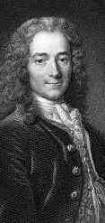
Enlightened absolutism
Voltaire (1694-1778)
Hated noble privileges, religious fanaticism, censorship
Sought to replace divine-right absolutism with enlightened absolutism
Militated for universal taxes (since nobles did not pay as much as others)
Rational government (not democratic)
Hated Rousseau!!!

Slide 29
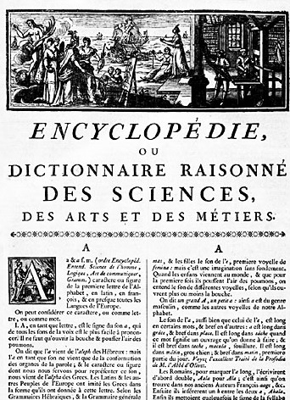
Thèse royal
Failure of ‘enlightened’ reform, or ‘enlightened despotism’
All subjects equal before the (superior) king
Govern through reason
Need for secular knowledge, improved civility

Slide 30
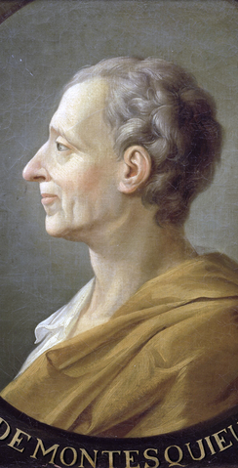
Montesquieu (1689-1755)
The Spirit of the Laws (1749)
Vatican puts on the Index (i.e., banned)
Magistrate in one of the French sovereign courts (parlement), which opposed absolutism
Checks-and-balances (parlements should check the absolute monarchy)
Newtonian of society: society is guided by general laws
Two kinds of laws
Positive law (decreed, promulgated)
General laws (the ones dictated by nature and found in the historical evidence from societies around the world)
The first sociologist?

Slide 31
Thèse nobiliaire Montesquieu
Ideal types of societies and their animating principle
Monarchy → honour
Republic (aristocratic and democratic) → virtue
Despotism → fear
You identify the type of society then discern its animating principle, the way that Newton discerned the law of gravity: observation, induction, reason, test cases

Slide 32

How Montesquieu was read
Justified the parlements claims to co-sovereignty with king; magistrates represent the nation
Parlements (sovereign courts) historically appointed the first king
Rule of law rather than absolutist will of king
But parlementary magistrates were noble!

Slide 33
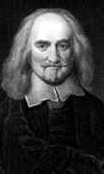
From Hobbes to Rousseau: The Social Contract
Thomas Hobbes (1588-1679)
Fled English Civil War, to Paris
Witnessed the Fronde in France (a civil war)
Thirty Years War, deadliest until WWI
Violence everywhere!!
‘Life is nasty, brutish and short’
Struggle of all against all

Slide 34
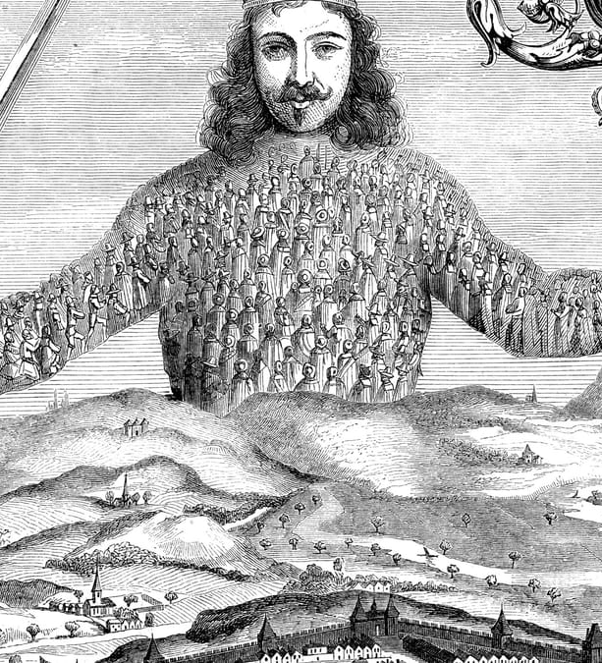
Hobbes’ Leviathan (1651)
Thomas Hobbes (1588-1679)
Social contract: consent of all to confer absolute power to a sovereign
Secular justification for absolutism; differed from divine-right justifications
Coercion in his philosophy of society is taken for granted

Slide 35
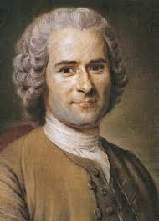
A century after Hobbes… Jean-Jacques Rousseau Du contrat social (1762)
Moral reciprocity replaces subjugation
Republicanism (obsessed with virtue)
Since we can’t return to the happy state of nature (peace, equality), how shall we live together in society?
Solution: collective sovereignty, the ‘general will’ based on each individual’s appreciation of the ‘general interest’

Slide 36
A century after Hobbes… Jean-Jacques Rousseau Du contrat social (1762)
How to harmonize particular wills with the ‘general will’?
Prioritise the ‘general interest’ over particular interests
Teach people to see the general interest
Civic morality, education, festivals, civil religion
Alternative to the Leviathan
Social bonds are moral, not coerced

Slide 37
New emotional regime?
Rise of empathy with novels and plays
Sentiment – a requirement of elites
Tears, open-mouths, crying with friends

Slide 38

Rousseau
Julie, or the New Héloïse
Readers cried their way through the book
Sentiment -- a means to achieve authenticity and true social bonds
Rejection of cold-hearted social relations based on hierarchy
Celebration of intimacy, sincerety, affection and true friendship

Slide 39
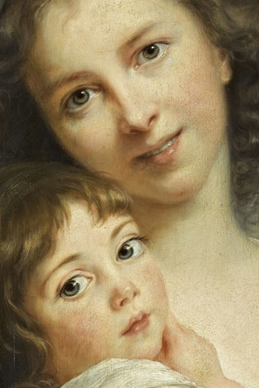
Sentiment in art
Self-portrait: Elisabeth-Louise Vigée Le Brun et sa fille
Notice sentimental eyes
Notice smile (it was new to show teeth… thanks to 18th century advances in dentistry)

Slide 40
The Enlightenment
New ideas and sentiments (discussed)
Campaign to reform state and society (to be discussed in narrative section later)
Climate of Opinion
The tribunal of ‘public opinion’

Slide 41
What is the public sphere?
Jürgen Habermas
German social theorist
The Structural Transformation of the Bourgeois Public Sphere (1962)

Slide 42
The public sphere
a space of rational-critical debate
where private individuals come together to form a ‘public’
where ‘public opinion’ is formed and expressed, often in critical opposition to the state or ruling elite.

Slide 43
Where was public opinion generated?
Print culture
High and low (treatises and libels/pornography)
Literacy rates double over 18th century
Newspapers
Nouvelles ecclésiastiques (underground Jansenist newspaper, 1728-1803
Mobilised public against monarchy’s efforts to impose the Bull of Unigenitus (which condemned Jansenism)
Theatres
Who decides playbills? Who decides what a good script is?
Street theatre politics against the monopolistic privileges of elite theatres (Comédie-française)

Slide 44
Where was public opinion generated?
Clubs
Technically banned since not authorized and given a formal privilege
But freemasons and literary societies proliferated anyway
Drinking publics
cafés, taverns, pubs
Salons
where cultural trends were set and patronage occurred

Slide 45
A reading revolution
Literacy rates rise dramatically between 1686 and 1789
Men = from 29% to 47%
Women = from 14% to 27%
Shift in what people read
from devotional literature to works on law, science, criticism and fiction
Shift from intensive, reverential reading to extensive critical reading
Seditious literature – libels, pornography
draw on Enlightenment epistemology to ridicule church and state

Slide 46
Tribunal of Public Opinion
Rising authority of ‘public opinion’
Seen as a legitimate voice in public affairs between 1720s to 1780s
Political impact of its content
-- Political libels in the form of histories of the regime
Authorities unwittingly contribute to its rise
By policing it, public becomes aware of its own power
By addressing it (through authorities’ covert propaganda)
By invoking the concept of ‘public opinion’

Slide 47
The ‘public’ ≠ ‘people'
Rise of popular agitation in late 18th century
1
peasant revolts
urban rebellions
Fear of the masses intensifies as elites retreat into wealthy enclaves
2
Need to ‘enlighten’ the people into a rational public
3

Slide 48
The Ancien Régime: Narrative of Events
16th-17th centuries
Wars of Religion (1562-1598)
Concludes with Edict of Nantes (Henri IV, first Bourbon)
Fronde (1648-1653)
Revolt of parlement, Parisians, nobles
Louis XIV boyhood
Shaped his authoritarian inclinations

Slide 49
Machault Affair (1749)
Controller-General Machault d’Arnouville (finance minister)
Permanent vingtième tax (1/20th) imposed on all subjects per year after end of war (usually war taxes would be suspended after a war)
Undermined noble privilege
Voltaire supported Machault
Parlementary magistrates objected
Crisis of 1750s

Slide 50
Billets de confession 1749-1754
Archbishop of Paris, Christophe de Beaumont, requires suspected Jansenists to submit to the Bull of Unigenitus (which condemned Jansenism) or be denied the sacraments, including last rites (without which one goes to hell).
Parlement pursues Archbishop Beaumont in 1752, seizing his property
Several ‘laws of silence’ and lits de justice by king, exiling the magistrates until they agreed

Slide 51
Damiens Affair (1757)
Attempted assassination of Louis XV
Damiens: servant for a parlementary magistrate (risked making the Parlement and Jansenists look like regicides)
Spectacular execution of Damiens – attitudes about punishment change. Being drawn and quartered begins to look barbarous
Encyclopédie goes underground

Slide 52
Maupeou Coup & Constitutional Crisis 1771-1774
Maupeou disbands Parlements
Replaced by new non-venal courts
Puts magistrates on the state payroll
Resistance
Parlements draw on Montesquieuian language:
Checks and balances
Representing the nation

Slide 53
Physiocrats
Rise of political economy
Invention of a science of ‘the economy’
Attempt to de-personalise it and make it seem like the product of natural market forces
Physiocrats
Believed that agriculture was the basis of all productivity and wealth
Tax land, not people; spur agricultural production
Free markets, abolish guilds/corporations
Adam Smith took inspiration from them but differed: didn’t think agriculture was the sole basis of national wealth. Importance of trade and commerce.

Slide 54
Economy
Attempts to implement free-market economy between 1760s and 1780s
Often resisted by local officials and police, who sympathised with the plight of the hungry and believed in market regulations
Revolts increase in regime’s final decades
Attempts to implement free-market policies led to backpedaling into paternalistic regulation between 1760s and 1780s
Erratic and reversed policies weaken the bonds between governing elite and the population… agitation, criticism.

Slide 55
A regime of credit
Two kinds of credit
1. Cash to crown → favour → opportunities
(opportunities = patronage, privileges, offices)
2. Anonymous forms of financial credit: markets for bonds and rentes
3. Easier to default on identifiable creditors (Louis XIV) than anonymous swathes of the population and foreign investors (Louis XVI)

Slide 56
Financial strains
Debts accrue from wars
1748, 1763, American War of Independence
Baroque tax collection system (venal collectors, tax farms)
Venality – reached saturation point
Privileges – Parlement tries to protect its tax privileges

Slide 57

Thesis: A redistributive crisis?
Crown can no longer satisfy redistributive demands for
patronage: Courtiers
rents on public debt: Financiers
subsidies, protections: Manufactures
For food: the population
No redistribution → no power
Collapse

Slide 58
Redistributive Crisis
Crisis over the principles of ‘who gets what?’ & ‘who owes what to whom?’
Age-old privilege vs rational political economy
Can self-regulating ‘free’ markets take care of distributional demands?

