Slide 1

The French Revolution Radical Phase
Charles Walton

Slide 2
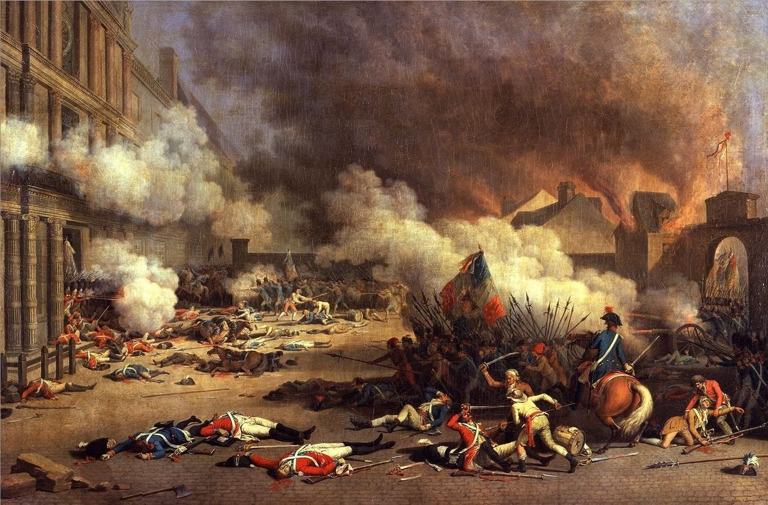
1792
War is going badly
July 25: Brunswick Manifesto
Threatens Paris
August 10: Fall of the Monarchy.
Storming of Tuileries Palace. King and Queen arrested.

Slide 3
1792 La Marseillaise
Music pre-dates Revolution
Revolutionary lyrics by Rouger de Lisle: ‘Chant de guerre pour l’Armé du Rhin’ 1792, in defense by invasion of First Coalition armies (Prussia and Austria)
Renamed La Marseillaise: difficult to sing.
Competed with the Ça ira! until 1795, when the more martial La Marseillaise became the national anthem.
Conveys discipline and glory, compared to folksy Ça ira!

Slide 4
1792
Special Tribunal of August 17 to punish royalists
Prussians take Verdun (Sept 2) – on their way to Paris
Panicked, Parisians storm prisons – September Massacres (Sept 3-6)
Prison massacres spread to provinces
Tension between moderates (Girondins) and radicals (Jacobins, sans-culottes) over legitimacy of massacres
October: ‘Girondins’ or ‘Brissotins’ expelled from Jacobin Club

Slide 5
1792
General Lafayette defects to Austrians
Victory at the Battle of Valmy (Sept 20)
French win with a rag-tag army of sans-culottes and National Guardsmen.
National Convention created (Sept 21)
Now a republic, no longer a constitutional monarchy
Must draft new ‘republican’ constitution (completed in June 1793)
Discovered: secret correspondence between monarchy and Girondins before August 10 – Girondins look treasonous

Slide 6
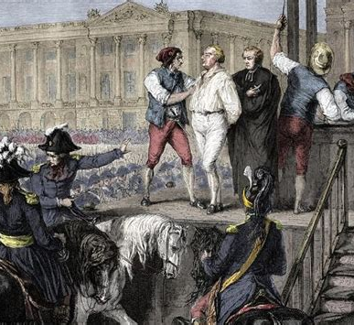
1792-93 Trial of Louis XVI
Trial of the King starts (Dec)
Girondins favoured exile or lenient punishment
Leading Jacobins favoured execution
Two votes
Culpable of treason? (overwhelmingly ‘yes’)
Death or other punishment (divided)
King’s execution on January 21 in the Place de la Révolution

Slide 7
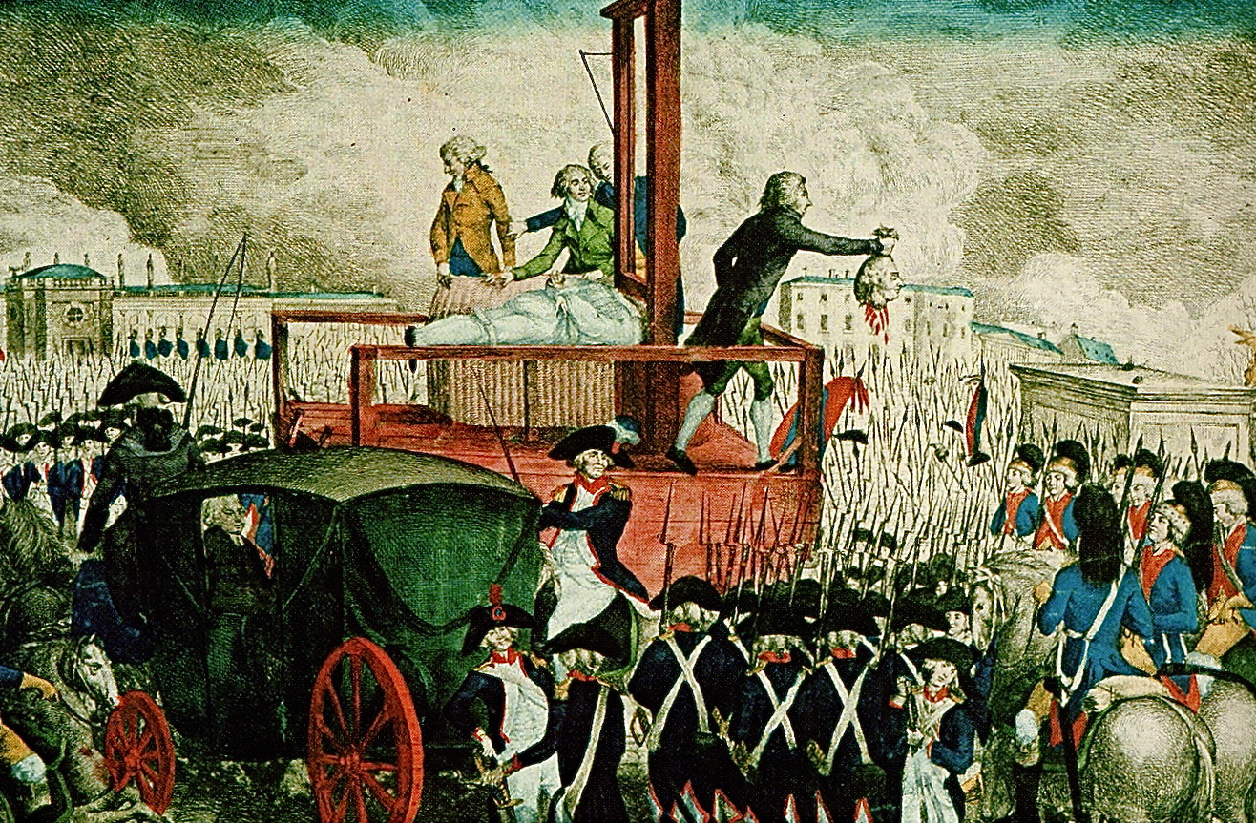
Guillotine Execution of Louis XVI (Jan 21, 1793)

Slide 8
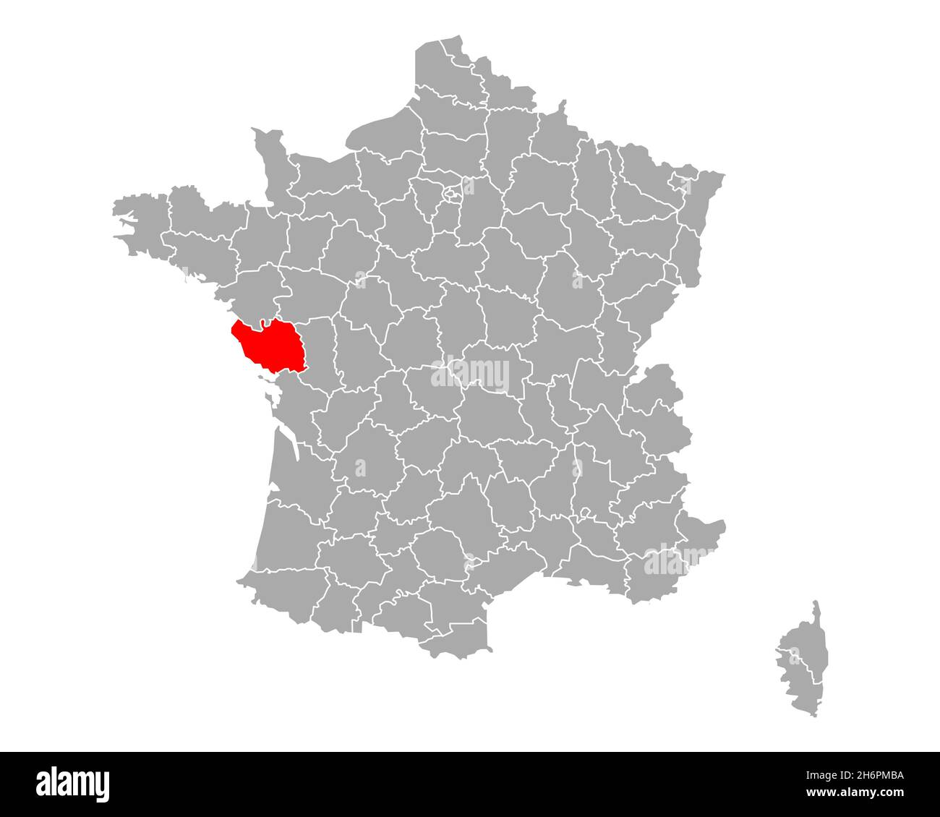
1793 Vendée Revolts
Triggered by conscription in February/March
Long resistant to Revolution
Deeply Catholic region
Poor nobles
Nantes bourgeois buying up countryside

Slide 9
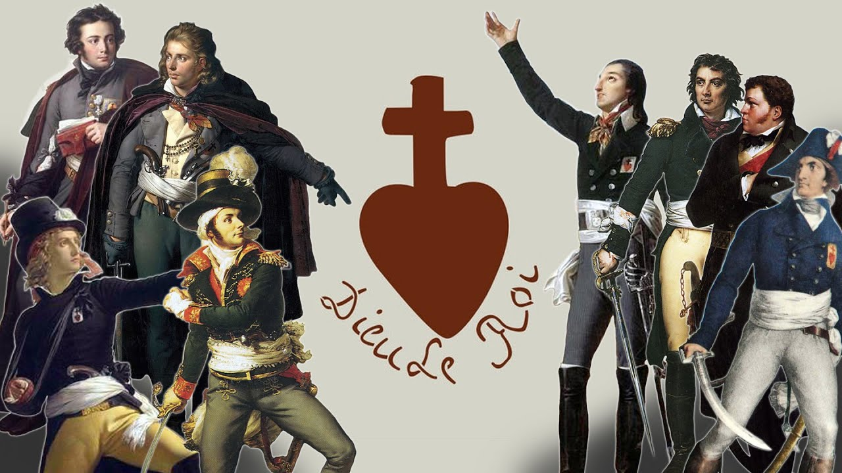
1793-1796 Vendée Revolts
Horrible massacres
‘Scorched earth’
Sinking victims in boats
‘Hell Columns’ destroyed everything in their path
Reynald Secher: ‘A French Genocide’?
Genocide or civil war?
250,000 casualties
vs. 17,000 victims of judicial terror
“God and King”

Slide 10
1793
Paris
Bread revolts (late Feb/March – Marat seen as instigator)
Attack on Girondin/Brissotin presses (March 10)
Danton (March 10): ‘Let us be terrible to dispense the people from being so!’
North
Defeat of Dumouriez – he defects
Close to Girondins – they are further compromised

Slide 11
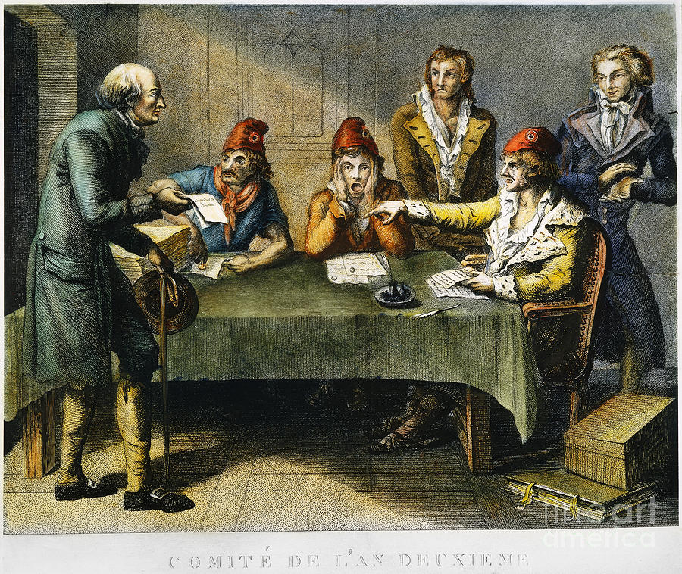
1793 Terror institutions
National
Committee of Public Safety (executive)
Committee of General Security (police)
Revolutionary Tribunals
(political justice)

Slide 12
1793 Terror institutions
Local/regional
Representatives on mission (recruited from Convention)
Committee of surveillance/revolutionary committee (radicals)
Local Jacobin clubs
Revolutionary Tribunals
Revolutionary armies (not to be confused with Republican Army) Bands of sans-culottes who roamed countryside to conscript, requisition, and terrorise perceived enemies. ‘Terror’ squads, active especially in the autumn.

Slide 13
1793 Purge of Girondins (June)
Montagnards vs Girondins
The ‘Mountain’: radical Jacobins in the Convention
Girondins: associated with moderates, wealth, free markets and now a traitorous general (Dumouriez)
Law of March 29
Targets royalists and anarchists
ie, counterrevolutionaries and radical sans-culottes
Trial of Marat for provoking bread riots – acquitted
Vengeance: Call to try Brissot and other Girondins - stalls

Slide 14
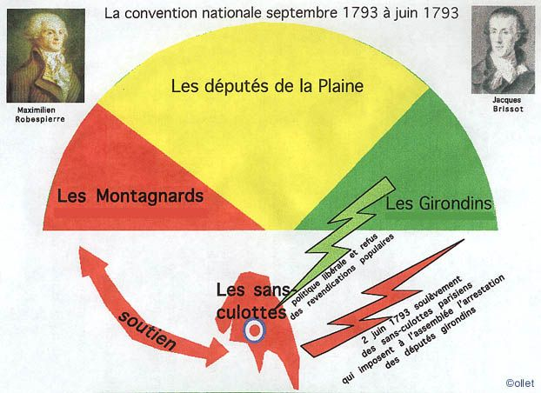
1793 Convention composition Mountain, Plain, Girondins. Sans-culottes aligned with Mountain, at odds with Girondins

Slide 15
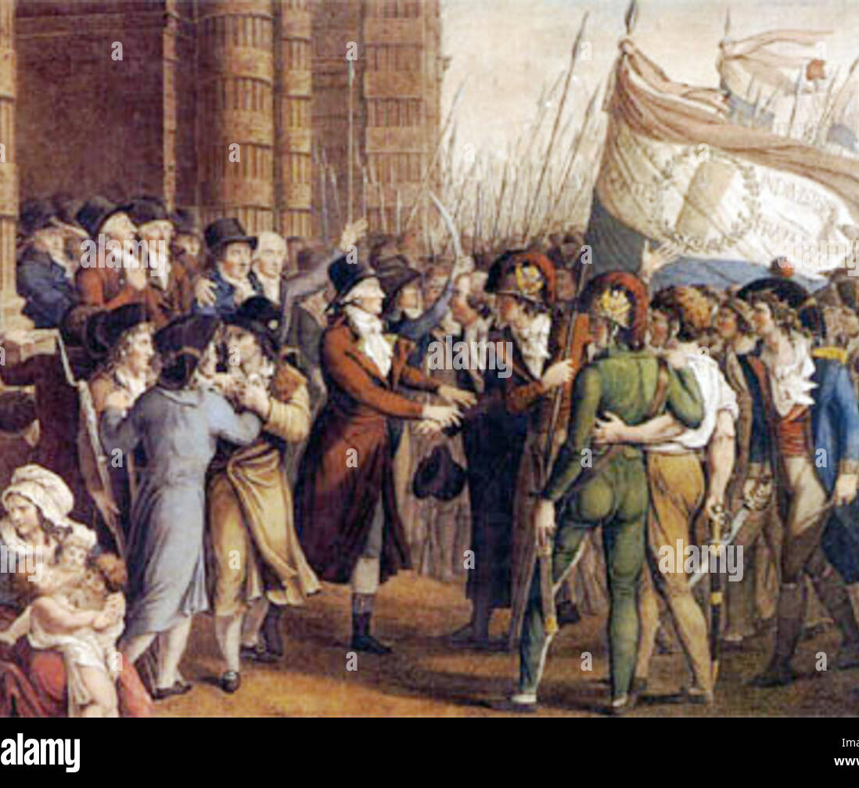
1793 Purge of Girondins
May 31: sans-culottes surround the Convention
Demand arrest of Girondins
June 2: 29 Girondins are declared under arrest
Some flee, others commit suicide, still others go to the guillotine in the autumn (Brissot).

Slide 16
1793 Constitution of 1793
Constitution of 1793 declared on June 24
Republic
New Declaration of Rights, including social rights and right to insurrection
Short-lived – will be suspended in October

Slide 17
1793 Federalist Revolts
Anti-Jacobin response to Girondin purge
Mercantile cities: Caen, Lyon, Marseille, Toulon, Bordeaux
Failed to attract counterrevolutionaries (since the Federalists remained republican)
Failed to attract popular support
Failed to coordinate amongst themselves
Brutal terror imposed on Federalist cities in late summer, autumn
‘Lyon made war on Liberty. Lyon is no more.’

Slide 18
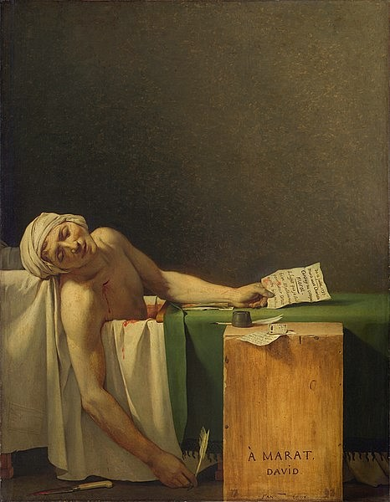
1793
13 July: Marat assassinated by Charlotte Corday (a Girondin sympathizer from Caen)
State funeral (had to be held earlier due to heat and rotting corpse)
Heart removed and enshrined in the Cordelier Club in Paris
Cults of Marat and Corday

Slide 19
1793 Sans-culottes
What was a ‘sans-culotte’. More an image than social reality. Plebeian, radical.
Their demands → legislation
Levée en masse (16 August)
All men 18-25 conscripted into Army
Requisitioning
National identity strengthened; first universal national draft in history
By mid-1794, 750,000 soldiers. Much larger army than those of enemies. Bonaparte’s instrument to later conquer Europe

Slide 20
1793 Sans-culottes
Demands
Law of the General Maximum (September 17)
Price ceilings on staples (grain, flour, meat, oil, onions, soap, firewood, leather and paper)
Later: ceiling on wages (sans-culottes not so happy about this part!)
Historical debate over the General Maximum
Led to black markets; wholesalers lose incentives; harsh punishments
But some degree of trust restored between people and government. People did manage to eat. Starvation occurred only after the law was repealed and free-markets restored in 1795.

Slide 21
1793 Sans-culottes
Demands
Terror: punishment of counterrevolutionaries
Law of Suspects (17 September)
Those who ‘by their conduct, relations, words or writings show themselves to by the partisans of tyranny or of federalism and enemies of freedom.
Those who cannot prove their means of existence and acquittal of their civic duties (including taxes!!)
Those who have been denied a certificate of civism.
Scrutiny of Intentionality, but not targeting external traits (race, religion, regional identity, etc.)

Slide 22
1793
Revolutionary government declared. (Two steps: Oct/Dec)
Constitution thus suspended ‘until the end of the war’.
Aim: to centralise gov’t and to channel/control ‘anarchy’from below
‘Revolutionary armies’ (marauding bands) authorized by Convention to requisition and terrorise countryside to supply the cities and republican armies

Slide 23
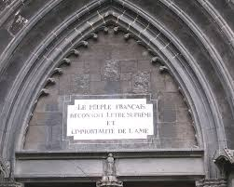
1793 De-christianisation
Pushed by Paris Commune
Cathedral of Notre-Dame and other churches becomes ‘Temples of Reason’
Denounced priests - deported or executed
Clerical dress is banned
Priests and ex-nuns forced to marry or take care of orphans and elderly
‘The French People recognize
The Supreme Being and the
Immortality of the Soul’

Slide 24
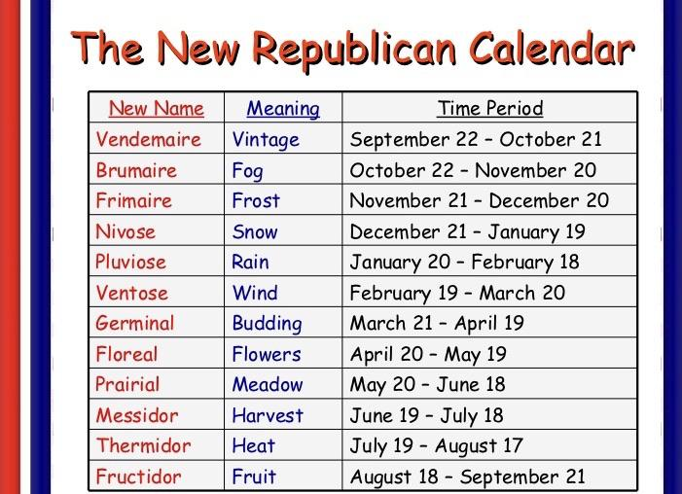
1793 Revolutionary Calendar
10 day week
Months names after nature
Brumaire (la brume=fog
Plûviose (la pluie=rain)
Thermidor (therm=heat)
Year 1 = Sept 22 1792 to Sept 20 1793
First year of Republic

Slide 25
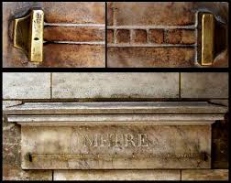
1793 Metric system
Enlightenment rationality
Based on decimals rather than non-standard measures that varied across France.
Universality (the point, like human rights and natural law)
Example ‘metre’ for public to use
Installed in colonnade near
Jardin Luxemburg

Slide 26
1793-94 Politicians’ Terror
Compagnie des Indes Scandal (Nov-Jan)
Company’s assets had to be liquidated since it was a privileged monopoly/state chartered company, and such entities were no longer legal
Corruption in liquidating involving key Jacobins
Danton’s friend, Fabre d’Églantine, is charged with corruption; Danton defends him while criticizing the Terror government – risky (suspicions he might be guilty by association?)!
Robespierre tries to persuade Danton and Desmoulins (Indulgents) to back the government.

Slide 27
1794 Politicians’ Terror
Indulgents – Danton, Desmoulins, want to halt Terror. (Why? Are they in on the corruption as well?)
Hébertistes – Want to push the Terror further.
Abolition of Slavery (Feb)
Robespierre’s ‘Virtue and Terror’ speech
Trial and liquidation of the Hébertistes (late March)
Trial and liquidation of Danton and the Indulgents (early April)

Slide 28
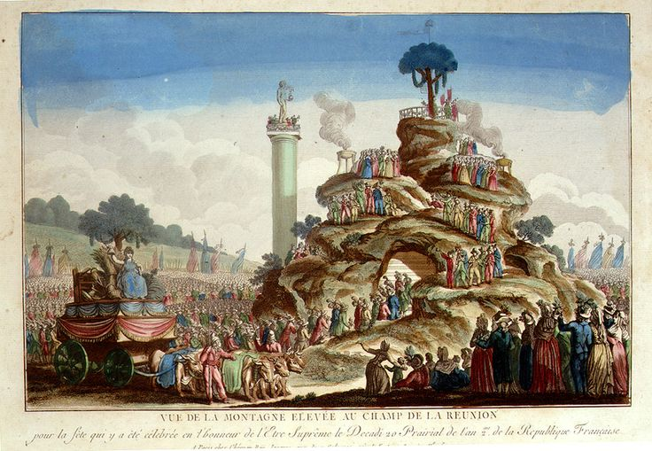
1794 High Terror and Civic Religion
Festival of the Supreme Being (May)
Greater isolation of Robespierre
Consolidation of revolutionary justice to Paris-transfer of prisoners there.
Packed prisons, fear of prison uprisings

Slide 29
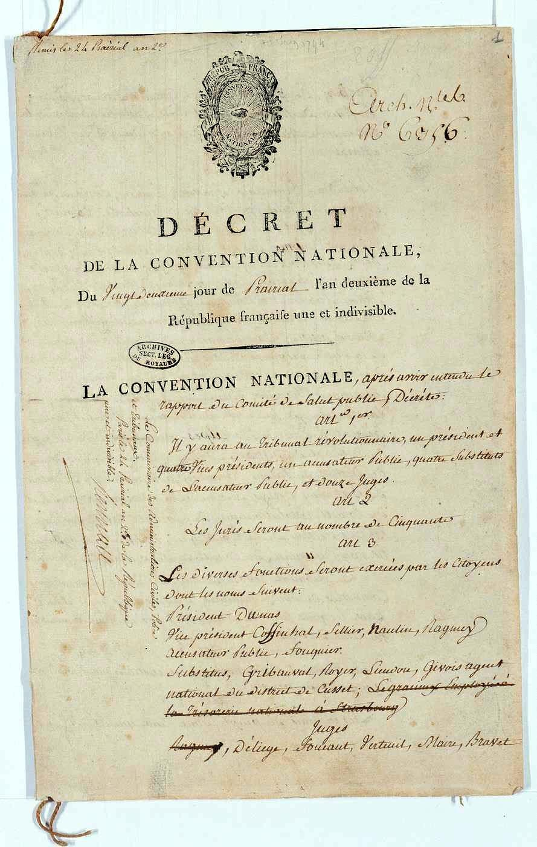
1794 High Terror
Assassination attempts on Robespierre (May)
22 Prairial Law (June 10), ratchets up the Terror
Factionalism runs through Committees of Public Safety and of General Security – paranoia, fear

Slide 30
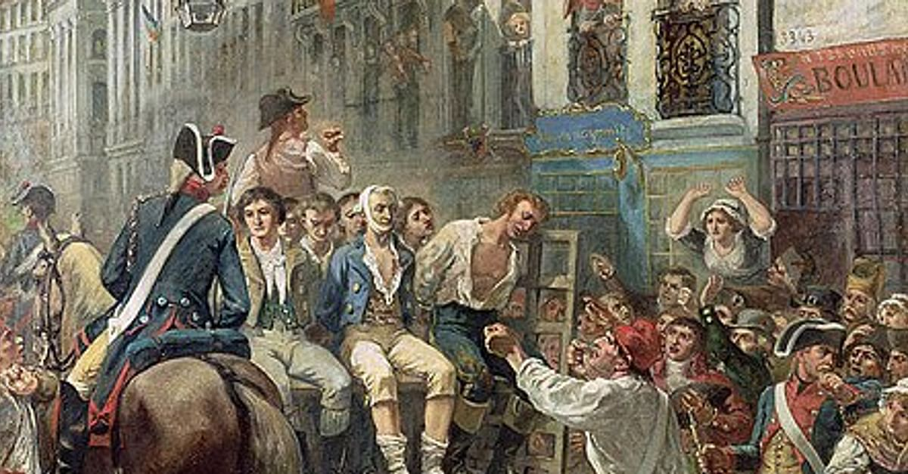
1794 Fall of Robespierre-9 Thermidor
Robespierre stops attending meetings
of the Committee of Public Safety and
the National Convention.
He DOES continue to appear at the Jacobin
Club meetings and is actively seeking the
continued support of Paris Commune officials.
Appears finally in the Convention on 8 Thermidor
announcing that he has a list of deputies who are
‘suspect’ in his eyes.
The next day, he is arrested. A day of struggle between some in the Commune and the Convention
begins, but the Convention manages to secure the support of Parisians by the day’s end. Robespierre
and his allies are executed the following morning. But is this really the end of the Terror??

