Slide 1

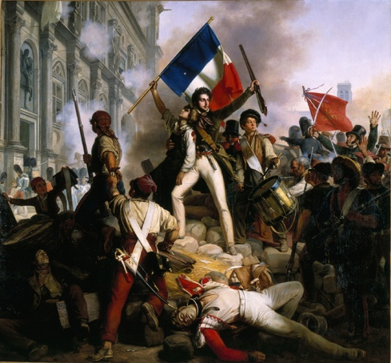
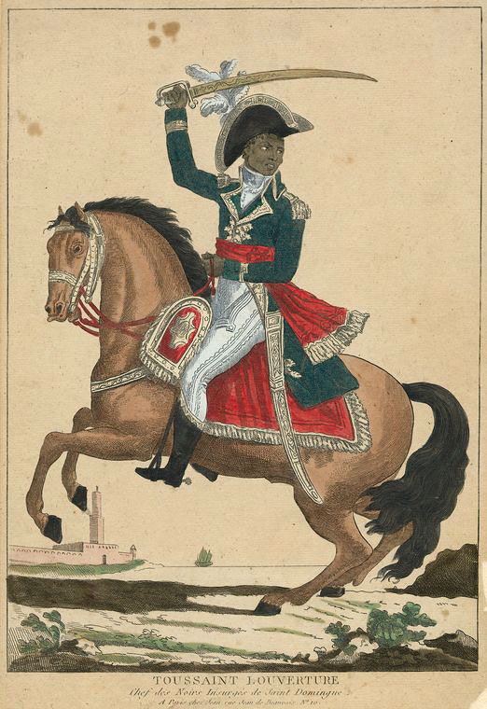
The French and Haitian Revolutions

Slide 2

French Revolution timeline
1789–1792
Liberal Phase (Constitutional Monarchy)
Rights of Man, Representation, Free markets
1792–1794
Radical Republican Phase (Jacobin period)
War, civil strife, radical equality, market controls
1795–1799
Directory (Conservative Republic)
1799–1815
Napoleonic era

Slide 3
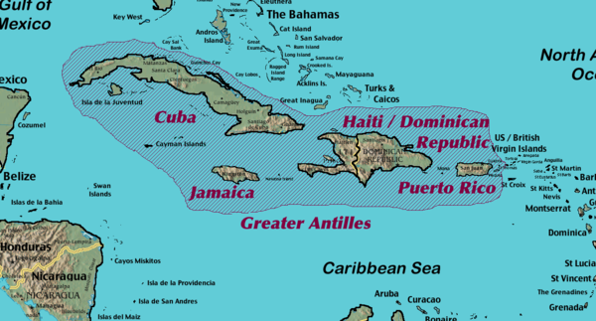
Saint Domingue (western Hispaniola)
French slave colony
Sugar, coffee, indigo
Whites: 31,000
Free blacks: 28,000
Slaves: nearly 500,000
In 1789: over 50K slaves traded
Average lifespan of slave: 7-10 yrs

Slide 4
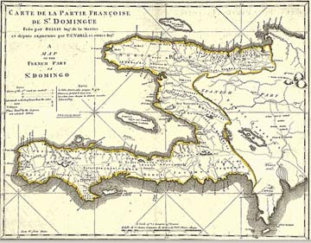
Saint Domingue (Haiti)
Context
- White minority want greater freedom from Exclusive with France
- Free black minority want civil rights
- Large slave majority want better conditions and freedom

Slide 5
Enlightenment views
Free-market Physiocrats
For wage labour rather than slavery
Against the Exclusive (free-trade)
Raynal’s Histoire des deux Indes (1770s) → encyclopedia of colonialism
Ten different authors
Diderot: foretold a black uprising to avenge enslaved Africans
Louis-Sébastien Mercier’s L’An 2440 (1770)
Abolitionist, even decolonisation
Against the Exclusive (free-trade)

Slide 6
Attitudes about Race
The scientific racialization theories → more the 19th century
Enlightenment ideas → more fluid, but tilted towards unity of the human race (human ‘sameness’ more important than ‘racial differneces’

Slide 7
Exception: abbé Sieyès
Two levels in society
Citizens
Workers
Cross breeding
To achieve workforce: chimpanzees, monkeys, gorillas and orangutans with blacks

Slide 8
Society of Friends of the Blacks
Founded in 1788 -- cosmopolitan
Somewhat British → movement to undermine slavery in America
Elitist, philanthropic → future Girondins (Brissot, Clavière)

Slide 9
Planters’ lobby: Club Massiac
Founded in Paris in the Hôtel Massiac in August 1789
Saint Domingue deputies horrified by anti-slavery sentiment in National Assembly
NA almost abolished slavery on 4 August 1789 (along with privileges)
Opposed to extending rights to free men of colour (some who were rich and owned slaves themselves)

Slide 10
White colons vs. Free men of colour
1790-1791: In Saint Domingue, revolts and struggles for political enfranchisement of free men of colour (FMC)
Revolt of free men of colours October 1790
Led in the North by Vincent Ogé and Jean-Baptiste Chavannes (FMC)
Refused the help of slaves (though it was offered)
Publicly tortured and executed in Feb 1791 – broken on the wheel

Slide 11
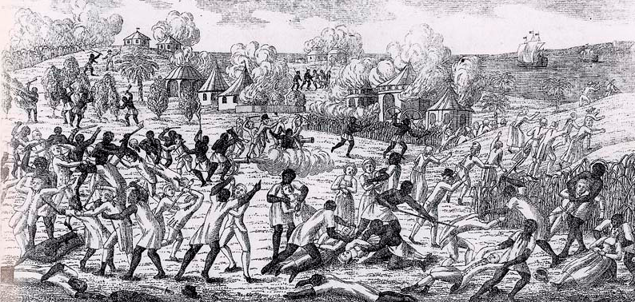
Slave Revolt 1791
15 May: France grants citizenship to free men of colour (limited: those whose parents were both free; but still enough to anger the racist white planters)
Summer: White plantation owners reject this
August: Violent uprising of slaves (north and east) and men of colour (west, south)

Slide 12
Civil War (1791 – 1793)
Rumours in 1791
The king would offer slaves 3 free days per week
Slaves believe in king, despite courtiers’ close ties to white planters
Slaves abandon their plantations in droves

Slide 13
1791 – from slaves to soldiers
White colons and FMC both recruit slaves
Slaves-soldiers on each side
15 May 1791: NA gives FMC political rights
September 1791: NA revokes the May decree, but news arrives too late in Saint-Domingue. Revolt well underway
November 1791: Port-au-Prince (west) on fire from fighting between colons and the FMC

Slide 14
Bois-Caïman oath and voodoo (1791)
How much is myth? No first-hand accounts from the time.
Took place just days before slave big insurrection of August
Boukman: leader
‘The god of the white man calls him to commit crimes; our god asks only good works of us. But our god who is so good orders revenge!’
Sacrificed a black pig

Slide 15
1792
April - NA ends racial discrimination in colonies but maintains slavery.
August – fall of the monarchy in France
September – France becomes a republic. Worried about losing Saint-Domingue to rival European powers
Oct-Dec – Commissioners arrive from France to impose new order
Form alliances with FMC
Many whites emigrate

Slide 16
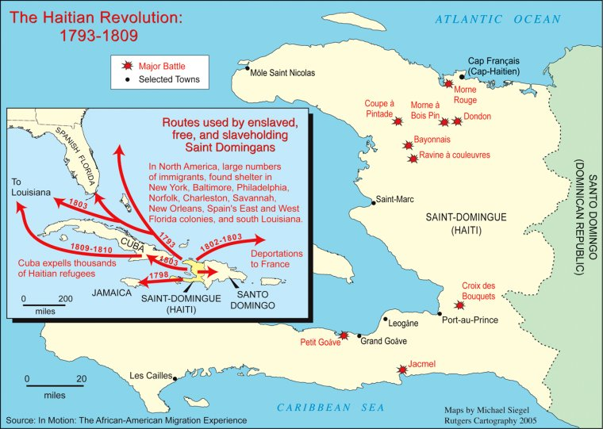
Saint Domingue Cities and emigration flows

Slide 17
1793 War with Britain and Spain
King executed in January
France declares war against Britain on 1 February
Many white colons (royalists, racists) side with Britain and Spain over France.
Recall that many wealthy courtiers of Louis XVI had major financial interests in Saint-Domingue. Closely aligned with white planters.

Slide 18
A lost colony?
Britain occupies areas of West for 5 years
Spain occupies most of the North
Pivotal moment: Summer 1793

Slide 19
Summer 1793 Le Cap français (north port city)
June: Imprisoned royalist governor and counterrevolutionary sailors invade to overturn Republican control of city
Republican Commissioners: Sonthonax and Polverel
- Any slave who helps will be freed and given citizenship
- Republicans regain control of the city, thanks to intervention of self-freed slaves in surrounding area

Slide 20
Summer 1793 – Feb 1794
August 1793
Initial promise: Abolition for slave-soldiers and slaves of masters who had fled
Slaves of republican masters still enslaved but to be given some land
August 29: Pressure, negotiations → Sonthonax agrees to issue a general abolition decree. National Convention will decree this on 4 Feb 1794 (16 Pluviôse Year 2)
Effect: blacks fighting for Spain switch sides, including Toussaint
Convention abolished slavery in all French colonies

Slide 21
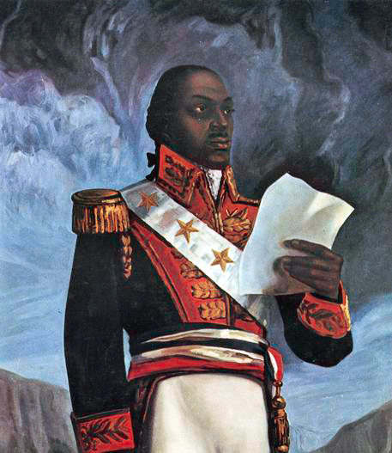
Toussaint Louverture
Former slave, freed by 1776
Owned slaves
Rose through military ranks during rebellions
Royalist, later republican
Intellectual, strategist, diplomat
Leader of Haiti 1798-1802

Slide 22
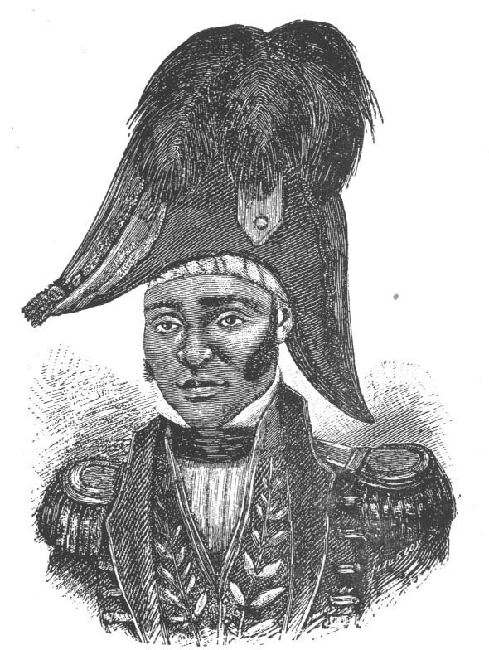
Republic of Haiti
Napoleon attempts re-enslavement in 1802
Toussaint is arrested
Dessalines (black) declares Haitian Republic Jan 1, 1804.
Massacre of whites on island
First successful slave revolt
First black republic
Punishment: economically marginalized for centuries

Slide 23
Context of Toussaint’s letter (primary source)
Violent uprising in 1796 when a popular commander (Étienne Datty) is relieved of his command against the locals’ wishes
Toussaint seeks to restore order
The people air their grievances
Toussaint reprimands them

Slide 24
Two historical debates Who was Toussaint? How were human rights conceived?
Was Toussaint a ‘Black Jacobin’? (See CLR James for this important interpretation)
Or was he deeply hierarchical, conservative and authoritarian?
Were human rights considered ‘natural’ and ‘inalienable’ – what you receive for being human?
Or were rights contingent upon upholding duties? Were they something to be earned?

Slide 25
Toussaint’s letter to General Laveaux (1796)
How does race figure in this account? Are some ‘more equal’ than others?
What did freedom mean?
Were rights, freedom and citizenship ‘inalienable’ or did they have to be earned?

