Slide 1
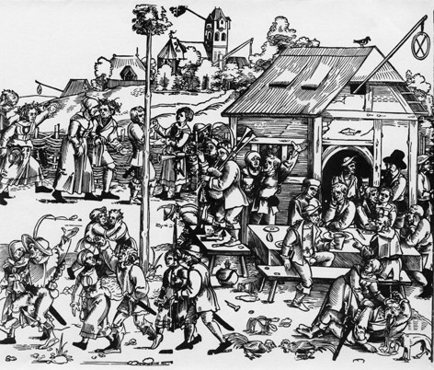
T+L Showcase Theme 1: Interdisciplinarity
Exploring the early modern
‘World of the Tavern’
Year 3 Advanced Option
Beat Kümin
History

Slide 2
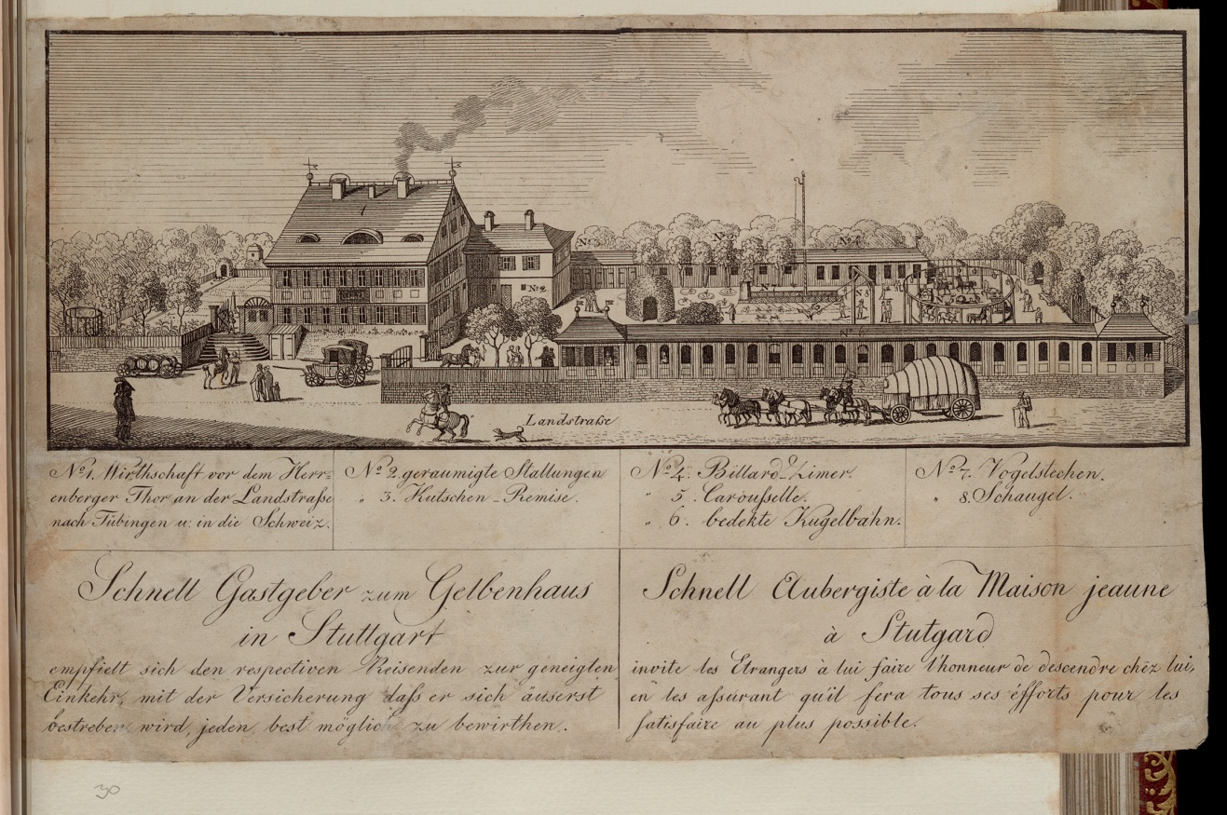
What’s it all about?
Trade card of the ‘Yellow House’ inn
at Stuttgart (late 18thC)
Hospitality
Sociability
Services
Early modern ‘golden age’

Slide 3
A conducive theme
Early modern cultural history
Food studies
Social status and social exchange
Politics and economics
Gender roles
Written, visual and material evidence

Slide 4
Dilemma
As with fostering ‘skills’:
integrate seamlessly into all tasks?
highlight in designated sessions?

Slide 5
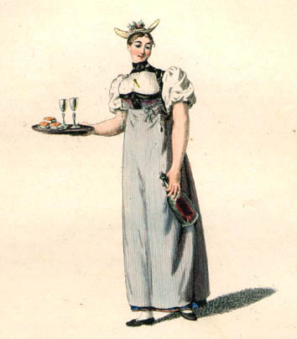
‘Tavern’ Approach
2 special sessions
1 field trip
Review presentations
Franz Niklaus König,
‘Waitress in Bernese Costume’
(coloured etching, 1806)

Slide 6
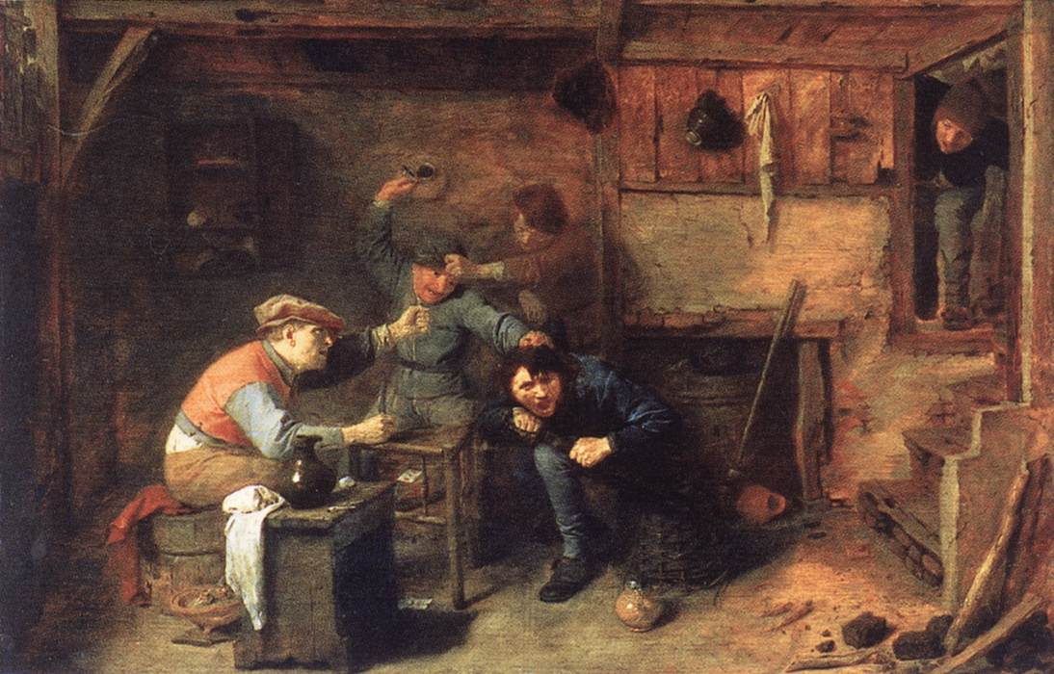
Early modern voices
Texts
  normative, administrative, literary …
Images
  woodcuts, paintings, maps, floor plans …
Music
  harmonia mundi: ‘Trinkt und singt’ (drink & sing)
Material culture
  buildings, signs, glasses, tables …
Adriaen Brouwer,
‘Peasant Brawl’
(oil on oak, c. 1630)

Slide 7
Field Trip
Preparation
  History: Moody, Inns of Burford
    Local facts, figures and trends
  Sociology: Gieryn, ‘A space for place’
    ‘placemakers’ and the social constitution of space
  Architecture: Pearson & Richards, ‘Perceptions’
    space syntax (e.g. access analysis)
    space symbolism (location, threshold, ornaments)

Slide 8
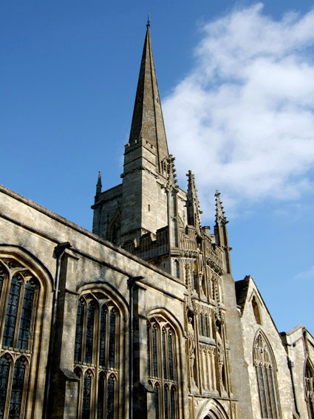
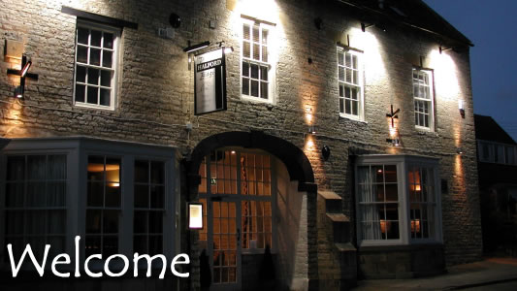
The Burford
Experience
‘School trip’
Sightseeing
Student perspective
Getting a drink!

Slide 9
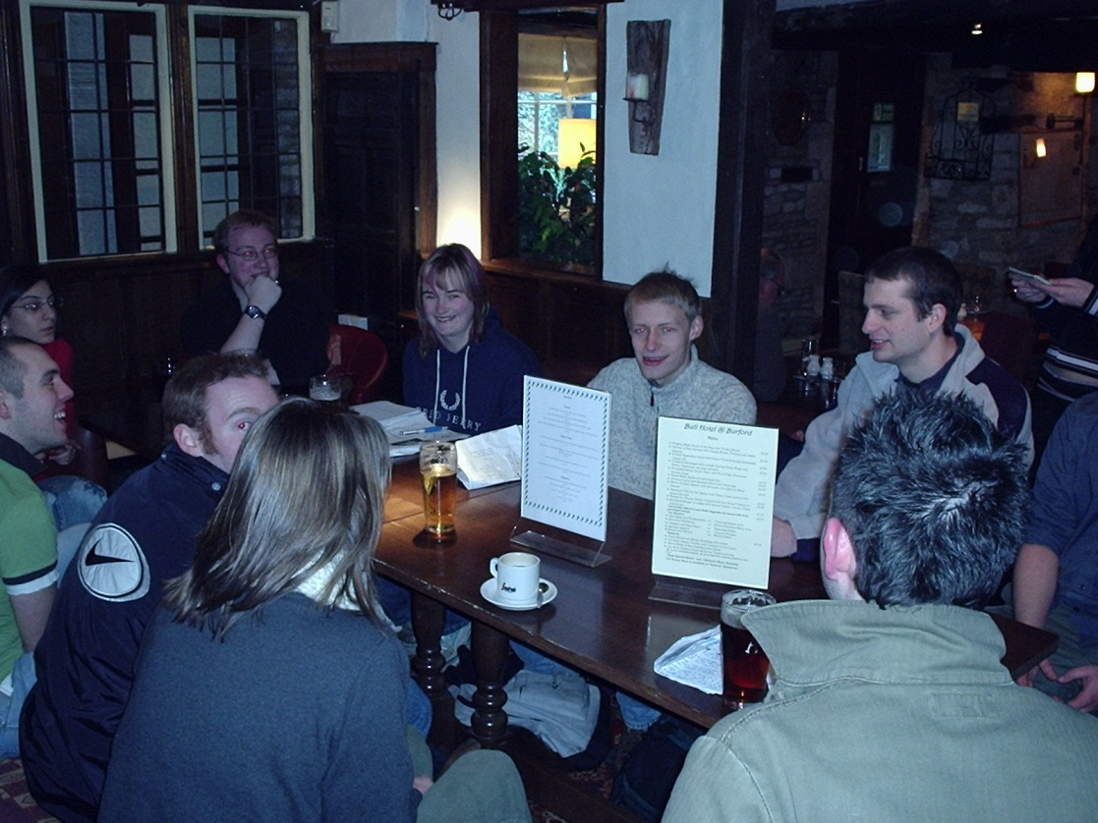
Gastro-Seminar
Hands-on experience:
- building
- sociability
- meal ritual
Recapitulation of walkabout: location, size, features, layout …
Wider sociological and architectural insights
Introduction to spatial theory (from mere container to relational construct; ‘Bear court’)

Slide 10
Tutor Evaluation
Different dynamic, personal encounters
Relaxed atmosphere, pretty setting
Unusual learning environment
Key variables: students, timing, weather ...
Some inspiring discussions, others basic
Tutor’s limitations (style, jargon, theory): historicized ‘informed layman’ approach
Risk assessment !
Yet thoroughly worthwhile

Slide 11
Student Evaluation
Average questionnaire score: 4.5 out of 5
Qualitative feedback:
  More field trips !
  Some struggle to understand/see relevance of non-history texts

Slide 12

Future opportunities?
Warwick Drinking Studies Network
Interdisciplinary
All periods
Annual Symposium
External Conference
Collaborative research
Teaching initiatives?

Slide 13
Thanks !
Questions, suggestions ...

