Slide 1
The politics of hunger
FOOD AND FEEDING IN OCCUPIED GERMANY AND JAPAN

Slide 2
FOOD
In what different ways does food matter to humans?
If food was a political issue under postwar occupation, what other kinds of questions did hunger pose?
How does the need for nourishment intersect with other fundamental human needs?
Why is hunger such a ‘slippery’ topic?

Slide 3
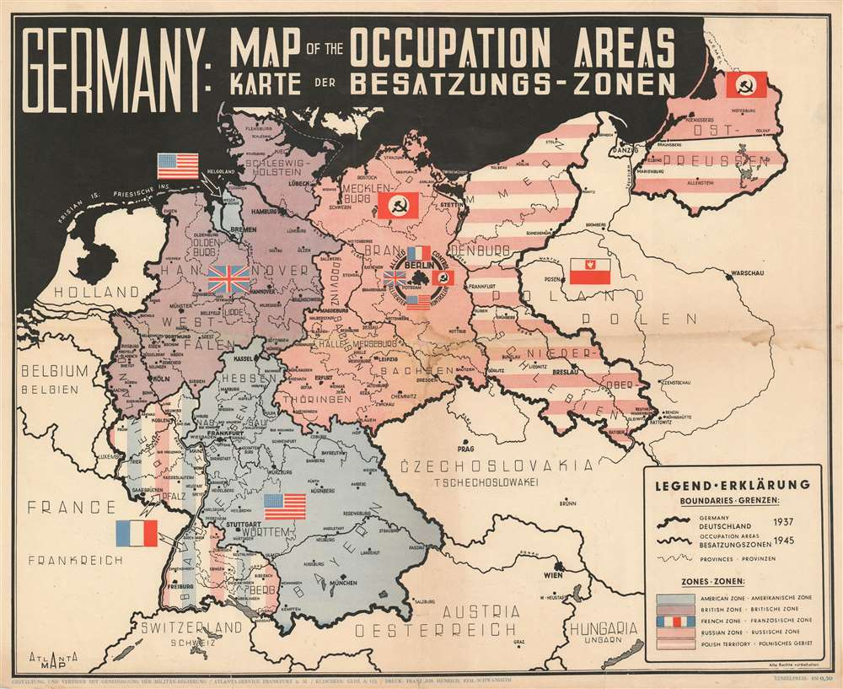
The Occupation and Division of Postwar Germany
From 1 January 1947 the US and British zones merged to become the Bizone (or Bizonia), joined by the French occupation zone on 1 August 1948.
This area became the Federal Republic of Germany (West Germany) on 23 May 1949 with the passage of the Basic Law.
Germany’s division

Slide 4
Training for occupation
Officer trainees study
a map of Japan
at the School of
Military Government,
University of Virginia,
Charlottesville, VA
OWI
Library of Congress

Slide 5
‘Expert knowledge’ in total war
Propaganda and psychological warfare: Ministry of Information (UK);
Office of War Information; SHAEF/PWD (Psychological Warfare Division)
‘Knowing the enemy’– the better to manipulate psychological susceptibilities
and encourage defeatism
Understanding allies and enemy-occupied territories the better to
manage the anticipated ‘chaos’ following Axis military defeat
Knowledge as key to postwar control of liberated [ie formerly Axis occupied] and
defeated enemy territories

Slide 6
Margaret Mead
born Dec. 16, 1901, Philadelphia, U.S.—died Nov. 15, 1978, New York
a student of Franz Boas and Ruth Benedict
author of 23 books, several earlier volumes based on field work/observation undertaken in the South Pacific
Coming of Age in Samoa (1928)
‘The most famous anthropologist who ever lived’, Peter Mandler, Return from the Natives: How Margaret Mead Won the Second World War and Lost the Cold War (Yale University Press, 2013)

Slide 7
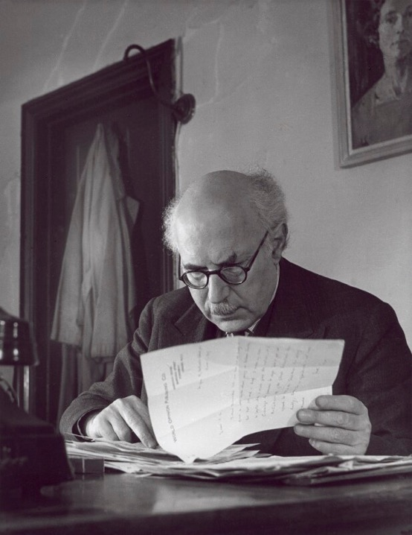

Victor Gollancz (1893-1967)
Sir Victor Gollancz
by John Gay bromide fibre print, 1947
National Portrait Gallery

Slide 8
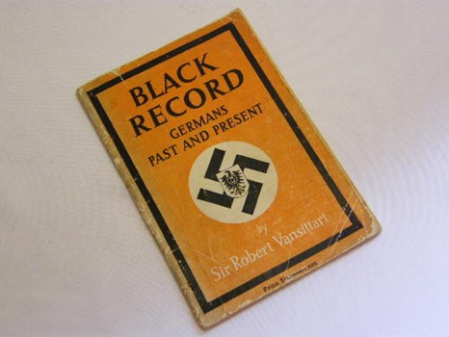
Save Europe Now
A fierce opponent of ‘Vansittartism’
September 1945: starts ‘Save Europe Now’– supported by prominent figures including George Orwell
Later campaigns against poverty & capital punishment
And on behalf of Palestinian refugees after 1948
A plea against Germans’ collective guilt

Slide 9
‘I find myself loving the Germans in general’, Gollancz wrote home to his wife on day one of the trip, ‘just because they're despised and rejected’.
Gollancz taking notes
on his visit to Germany,
Autumn 1946
Gollancz papers, MRC

Slide 10
Gollancz
visits the British
Zone of
Germany
Oct-Nov. 1946
1st edition,
Jan. 1947

Slide 11
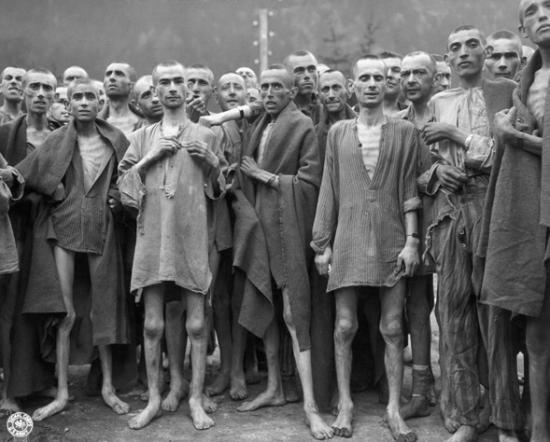
Photography as advocacy—the accusatory starved body
Survivors of Ebensee concentration camp

Slide 12
“Children chosen for a ‘recovery home’ at
an elementary school in Hamburg.”
”The same.”

Slide 13
‘This Misery
of Boots’
The symbolic
potency of
broken
footwear
Children’s kaputten
footwear in Hamburg
Gollancz papers
Modern Records
Centre,
University of Warwick

Slide 15
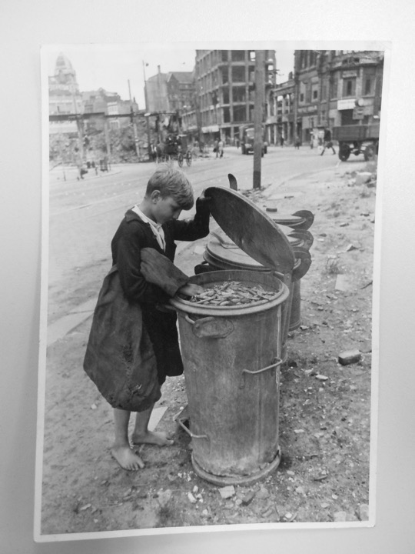

Slide 16
Abundance amid scarcity
Gollancz’s menus
St. Germain Soup
__
Braised Beef
Cauliflower au Gratin
Fondant Potatoes
__
Apple Tart
Cream
__
Welsh Rarebit
__
Coffee
Schloss Friedrichshof-Kronberg: US officers’ mess

Slide 17
What do motivated Gollancz’s intervention on behalf of hungry Germans?
How effective a piece of advocacy do you consider In Darkest Germany?
What does Gollancz’s activism suggest about shifting British attitudes towards
‘the Germans’?
Why do you think German hunger seemingly became a much more
dominant postwar preoccupation—at least in North America and
Western Europe– than Japanese hunger?
What role did food play in sustaining ‘victim narratives’ in postwar Germany?

Slide 18
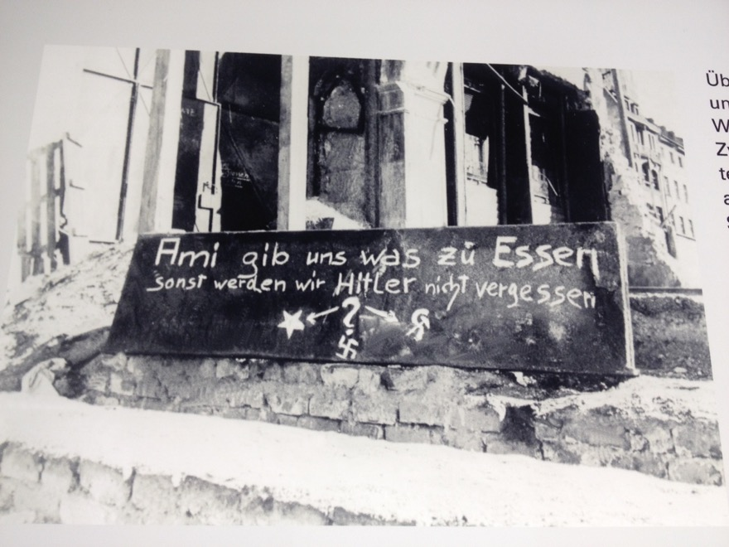
Graffiti in Munich,
Winter 1945-46
On display at the
National Socialism
Documentation Centre,
Munich

Slide 19
Illicit economies
What is a black market and how does it work?
Why were black markets so pervasive in both Germany and Japan
after the war?
How are postwar black markets best understood? Immorality vs ingenuity?
Why did the occupation authorities in Germany and Japan struggle to
eradicate illicit buying and selling?

Slide 20
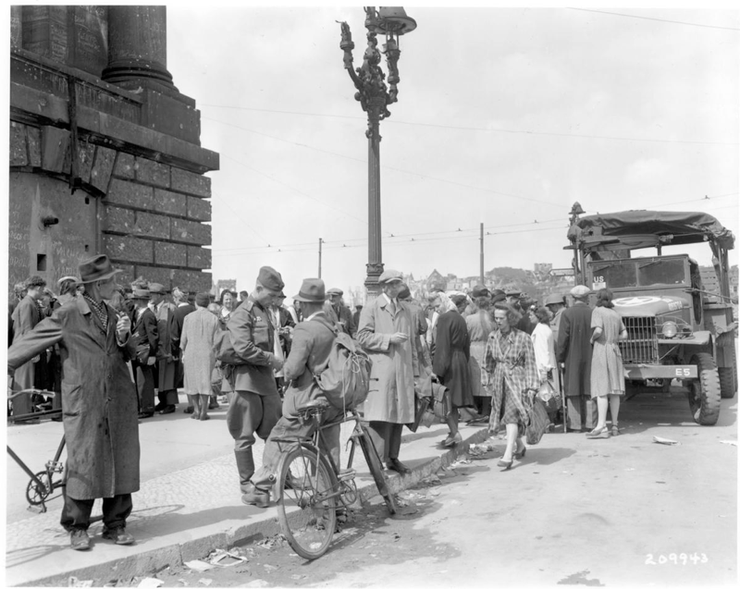
Berlin black market,
August 1945
‘U.S. and Soviet soldiers and German citizens at a Berlin black market, August 15, 1945. Allegations that American military personnel profited from such markets created a serious public relations problem for the military.’ (NARA, 111-SC-209943)
https://www.archives.gov/publications/prologue/2002/fall/berlin-black-market-1.html

Slide 21
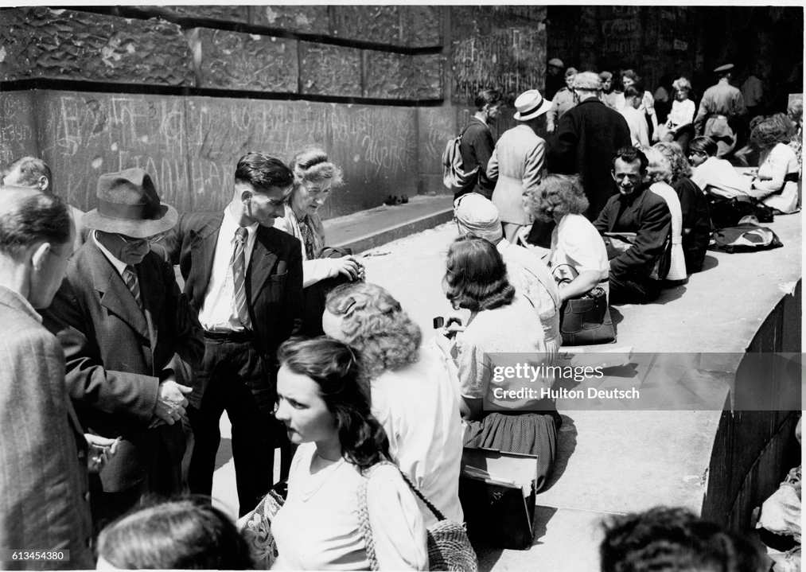
German Civilians Sell Belongings to Allied Soldiers, Berlin 1945
German civilians exchange items such as cameras and watches with allied soldiers for goods such as chocolate and cigarettes on Berlin's black market.
(Photo by Hulton-Deutsch/Hulton-Deutsch Collection/Corbis via Getty Images)

Slide 22
Tokyo Times, Nov. 7, 2002
Tokyo’s Ueno district may well be home to some of the city’s most important museums, but it’s also where many of the poorest call home too. The area’s park in particular shelters an increasingly obvious number of the capital’s growing homeless population, creating an odd environment where day-trippers and the destitute show utter indifference to one another.
Thrown into this unusual mix is also Ameyoko; a decidedly working class shopping district that in post-war Japan was a well-known black market — elements of which are really not hard to imagine even today.
http://wordpress.tokyotimes.org/shadowy-ueno/

Slide 23
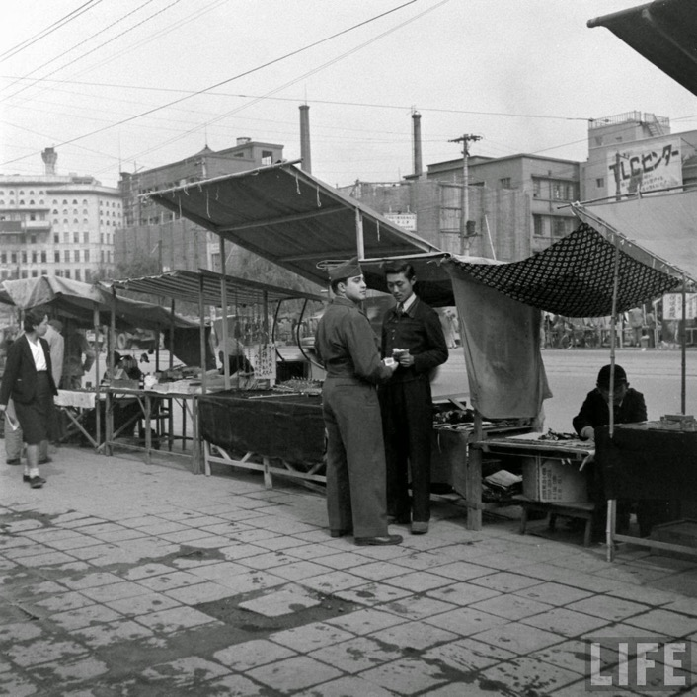
John Florea for
Life, 1946

Slide 24
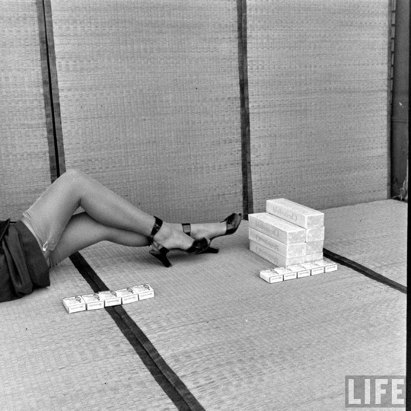
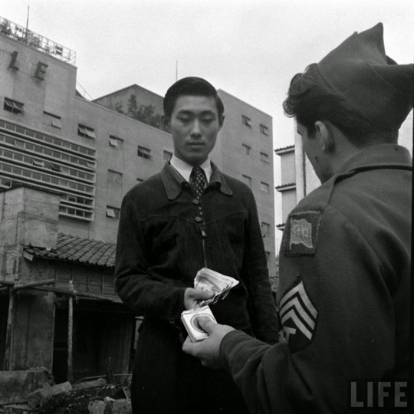

Slide 25
Tokyo, Photograph by Jesse W. Scott, “Junction Ginza and 2nd avenue. The PX has been moved to a large building. It gets shot over and over a ‘landmark’ for Ginza prowlers”
https://munzerfamilyarchives.wordpress.com/2015/01/27/tokyo-buildings-streets-and-bridges-1946-1949/

Slide 26
Further questions:
1) Drawing on all the readings, how much agency do you think ‘ordinary’ Germans and Japanese enjoyed in securing access to basic necessities in the immediate postwar years?
2) In what ways was gender implicated in the politics of food?
How does the topic of food– and this week’s sources—
resonate with earlier sources we’ve encountered?

Slide 27
More primary sources:
NB: Google has digitized Life magazine, which ran
many illustrated photo-stories about the postwar occupations:
https://books.google.co.uk/books/about/LIFE.html?id=N0EEAAAAMBAJ
Pathe newsreel:
“Germany’s Food: The Truth” (1946):
https://www.britishpathe.com/video/germanys-food-the-truth

