Slide 1
Week 7: Slavery and Environmental History

Slide 2
Reading
Karl Offen, "Environment, Space, and Place: Cultural Geographies of Colonial Afro-Latin America," in Afro-Latin American Studies: An Introduction, eds. Alejandro de la Fuente and George Reid Andrews, CUP, 2018
Yuko Miki, Frontiers of Citizenship: A Black and Indigenous History of Postcolonial Brazil. ch 5, "Fleeing into Slavery."
Kevin Dawson, Undercurrents of Power: Aquatic Culture in the African Diaspora (University of Pennsylvania Press, 2018), Introduction (or whichever chapters take your interest)
David Silkenat, Scars on the Land: An environmental history of Slavery in the American South (OUP 2022), Introduction

Slide 3
Questions
What connections are historians drawing between slavery and environmental history?
How did enslavers and enslaved interpret or ‘live’ natural or built environments differently?
How might natural or built environmental features become tools of resistance?
How might the kinds of sources used by environmental historians help shed light on enslaved lives?

Slide 4
Film: Living Between Hurricanes: Climate, Commodities, and Sustainability
Dir. Michael Chanan, written by Jean Stubbs, Jonathan Curry-Machado
https://www.livingbetweenhurricanes.org/the-film/film-in-3-parts/
Film available online & accompanying open-access book: https://www.livingbetweenhurricanes.org/the-book/

Slide 5
Please complete your NSS survey!
Finalists’ feedback has led to:
Increased study spaces in the FAB
Changes to assessment: more applied tasks, focus on research skills, spread workload over the year
Improved module allocation process so that finalists get their first or second choice
Projects to diversify and decolonise the curriculum
Appointment of a Director of Student Experience for History and Politics
Incentives!
* University prize draw!
History Department prize draw: EdenRed vouchers. The Department contribution per student will increase if we can get completion over the rates of 50% and then 75%.

Slide 6
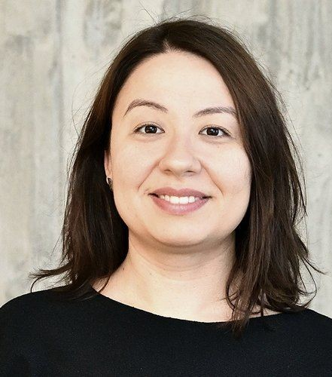
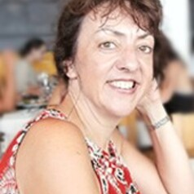

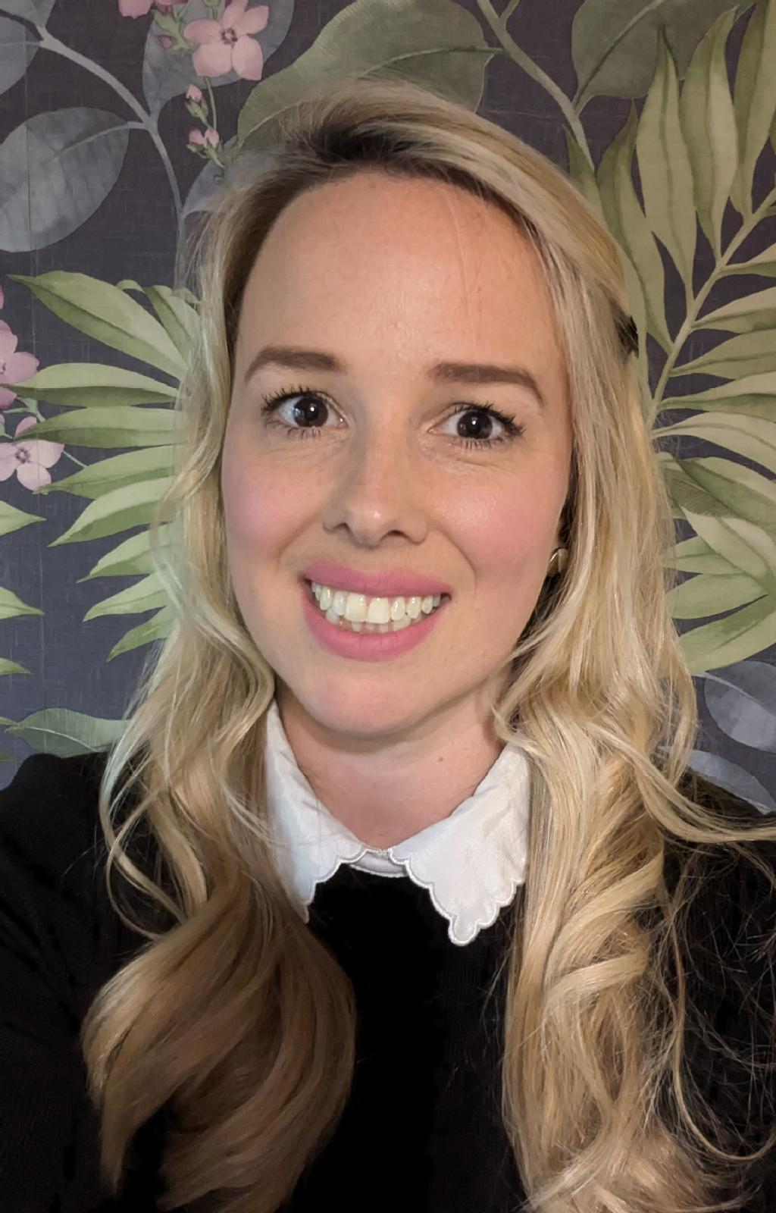
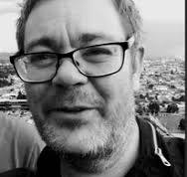

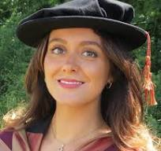
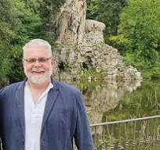
75%: Dr Anca Cretu will show you what she’s learned from decades of Eurovision choreographies
80%: Pierre Purseigle will summon the spirit of French guinguettes and flonflons
At 85%: Prof Penny Roberts will put the great back into Grand Siècle…
90%: Prof Ben Smith will show Bad Bunny’s dancers what’s what
Joint Honours: at 85%: Dr Rebecca Stone will reveal why the White House really needs a new ballroom
Renaissance finalists 95%: you will be treated to a double act by Dr Liana Valerio and Dr Jonathan Davies. This may or may not be performed on a gondola.
When the Department hits 100% or comes top across the University, Professor Tim Lockley, our Head of Department, will bring out his best dad moves

Slide 7


