Slide 1
Practice
Theory, Skills and Methods
Dr. Michael Bycroft
28/10/2024

Slide 2
Practice v. theory
Practice v. the match
Practising v. retired
Practical v. useless

Slide 3
The conditionings associated with a particular class of conditions of existence produce habitus, systems of durable, transposable dispositions, structured structures predisposed to function as structuring structures, that is, as principles which generate and organize practices and representations that can be objectively adapted to their outcomes without presupposing conscious aiming at ends or an express mastery of the operations necessary in order to attain them.
-- Pierre Bourdieu, “Structures, habitus, practices,” in The Logic of Practice (1990, first published 1980), p. 53

Slide 4
Michel de Certeau, L'invention du quotidien. Vol. 1, Arts de faire (1980), translated as The Practice of Everyday Life, 1984
Pierre Bourdieu, Le sens pratique, 1980, translated as The Logic of Practice, 1990
Roger Chartier, « Les historiens et les mythologies », 1992, translated as « Discourses and Practices: On the Origins of the French Revolution », in On the Edge of the Cliff, 1997

Slide 5
Rulers (pre-Foucault)
Techniques (Foucault)
Tactics (Certeau)

Slide 6
Quotes
Terms
Conditions
Cases

Slide 7
The conditionings associated with a particular class of conditions of existence produce habitus, systems of durable, transposable dispositions, structured structures predisposed to function as structuring structures, that is, as principles which generate and organize practices and representations that can be objectively adapted to their outcomes without presupposing conscious aiming at ends or an express mastery of the operations necessary in order to attain them.
-- Pierre Bourdieu, “Structures, habitus, practices,” in The Logic of Practice (1990, first published 1980), p. 53

Slide 8
Habitus = a set of practices that get good results even though no-one aims for these results nor is able to say how to get good results

Slide 9
Rules (structural anthropologists, eg. Claude Levi-Strauss)
Reason (existentialists like Jean-Paul Sartre, and economic theorists)
Habitus (Bourdieu)

Slide 10
A habitus is self-validating in the sense that members of the habitus are not exposed to counter-examples
A habitus is self-fulfilling in the sense that it creates the conditions for its own apparent success

Slide 11
“…practices, articulated with but not homologous to discourses, are not reducible to discourses, can be considered the fundamental partitioning principle in all cultural history”
-- Chartier, in The Edge of the Cliff, 1997

Slide 12
Great books and their ideas (Peter Gay, The Enlightenment, 1966)
Not-so-great books and their representations (Robert Darnton, The Forbidden Bestsellers of Pre-Revolutionary France, 1995)
Subversive societies (Fred E. Schrader, Augustin Cochin et la République française, 1992)
Irreducible practices (Arlette Farge, Subversive Words: Public Opinion in Eighteenth-Century France, 1992)

Slide 13

2018 book

Slide 14

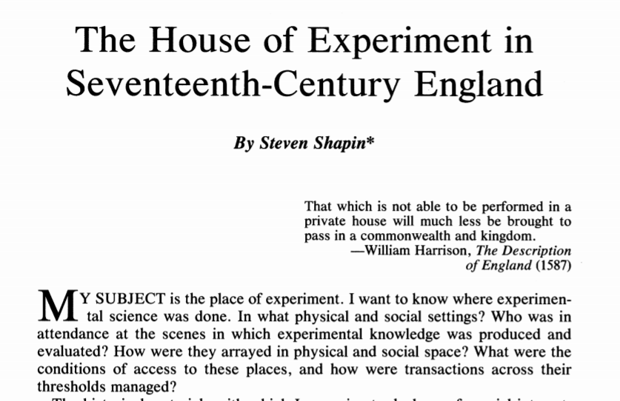
1988 article
2014 book

Slide 15
2018 book

Slide 16
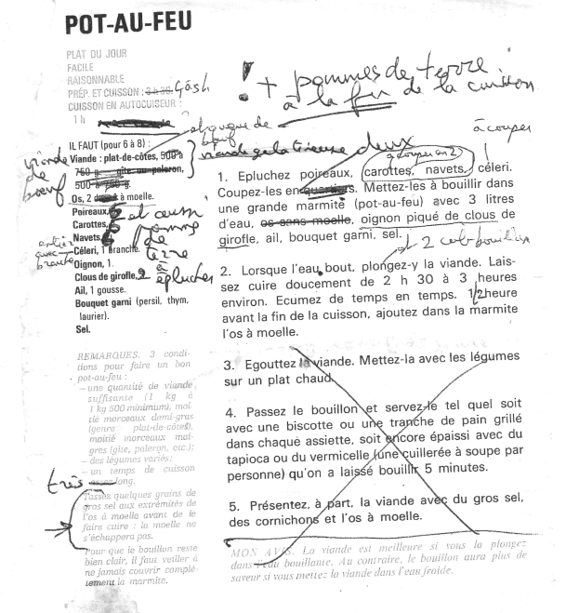
Twenty-first-century recipe, with testing

Slide 17
Are these theories new?
Are they true?
Are they complete?

