Slide 1
Week 7
The Linguistic Turn (1970/80): Language, Truth and Human Experience in History Writing
Dr Claudia Stein

Slide 2
Linguistic Turn
The term was first used by the American philosopher Richard Rorty in an edited volume, entitled The Linguistic Turn (1967).
At its core stands a new focus in academia after WWII on the relationship between language, language users, and the world – perceived through human ‘experience’ and expressed through language.
The ‘linguistic turn’ is rooted in philosophy and literature studies/literary criticism and later spreads to other subjects in the humanities. Its most radical versions emerged in postwar France philosophy/semiotics. These theories only ‘travelled’ to the Anglo-American world during the 1980s and came into heavy use by American academics during the 1990s.

Slide 3
The ‘linguistic turn’ in history writing
‘It has become ‘a catch-all phrase for divergent critiques of established historical paradigms, narratives and chronologies, encompassing not only poststructuralist linguistic criticism, linguistic theory, and philosophy but also cultural and symbolic anthropology, new historicism and gender history.’
(see Kathleen Canning, Feminist History after the Linguistic Turn: Discourse and Experience, Sign, 19,2 (1994), p. 147.

Slide 4
The ‘linguistic turn’ as an intellectual response to the conditions of postmodernity
Def. Postmodern-ity:
This term refers to a set of perceived (sociological, cultural, political, economic,
Technological etc.) conditions of everyday life, which are perceived as distinctly
different from the conditions of ‘modernity’. The discussion of postmodernity is
the discussion of these conditions. The debates intensify during the 1960s and they coincides with the rise of post-industrial societies in the West, which was marked by a transition from a manufacturing-based economy to a service-based economy.
Def. Postmodern-ism:
Postmodernism is the intellectual response to the conditions of postmodernity. The linguistic turn is one of these many responses.
By questioning human experience, it also questions all human knowledge production (scientific, economic, political, sociological, historical, anthropological and so on) which is based on language.

Slide 5
Central issue: What is human ‘experience’? Is human ‘experience’ prior to the use of language?
Central issue in Anglo-American history writing from the late 1980s/early 90s:
‘The seemingly simple recognition that the category of experience (out of which historians such as E.P. Thompson argue comes class consciousness) is in fact not prior to and constitutive of language but it is actively constituted by language, has been increasingly been recognized as having far-reaching implications.’
(Patrick Joyce, Visions of the People: Industrial England and the Question of Class, 1884-1914), p. 9.
Claim: language constitutes ALL human experiences. Language ‘makes’ all our experiences – that includes what we now call our ‘lived experience’! There is nothing ‘authentic’ about your very own experience but is constituted by language.
Ergo, human experience is not universal or transhistorical (as new social historians claimed). As humans use language to express their ‘experience’, experience is not suitable to link the past and the present. Our experience is not shared by those in the past. It is constituted in entirely different ways.
Which theories stand behind these view?

Slide 6
So, once again, what is at stake in postmodernism and its ‘linguistic turn’?
Human experience
Central claim:
Can humans represent ‘the reality’ of human experience through language? Can history represent the experiences of people in the past?
Note: Remember that we talked about historians who claimed to be able to ‘resurrect’ the experience of the ‘forgotten people’ of the past (E,P. Thompson) or to ‘make-meaning’ of past experiences (Darnton).
There were different answers given by theorist of the ‘linguistic turn’. Not all denied the existence of some sort of reality in the present or the past but they all questioned the issue of ’truth’ in the human knowledge production.

Slide 7
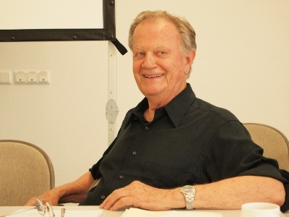
Part 2: American Literary Criticism and ‘the Linguistic Turn’
Is history writing simply literature? The ‘linguistic turn as the ‘narrative turn’
Metahistory: The Historical Imagination in
Nineteenth-Century Europe (1973).
‘My own analysis of the deep structure of the historical imagination of nineteenth- century Europe is intended to provide a new perspective on the current debate over the nature and function of historical knowledge.’
(Metahistory, p. 2).
White contradicts the view that "historiography can be objective or truly scientific in itself, unaffected by anything."
Hayden White, 1928-2018
Note: His work reflects the widespread Anglo-American
‘misunderstanding’ of Ranke’s critical method as being ‘scientific’ (i.e. empirical, objective). Like a method in the natural sciences. That is clearly wrong.

Slide 8
Metahistory considers eight major figures of 19^{th -}century history writing, among them Leopold von Ranke. The histories of these men, White argues, are characterized by four modes of linguistic prefiguration (Metaphor, Metonymy, Synecdoche, and Irony), four theories of truth (Formism, Mechanism, Organicism, Contextualism), four archetypal plot structures (Romance, Tragedy, Comedy, Satire), and finally four ideologies (Anarchism, Radicalism, Conservatism, and Liberalism).
Main points:
“to deconstruct a mythology, the so-called ‘positivistic science of history.’
History is not neutral, rather it entails “entails ontological and epistemic choices with distinct ideological and even specifically political implications.”
Narrative is thus “inextricably bound to issues of authority.”
In sum: Metahistory tossed the entire concept of historical ‘science’ out the window, claiming that historians are fundamentally ‘artists’ who imbue historical action – empirically collected in the archives -- with aesthetic and ethical purpose. The book urged historians to grapple with whether and how their writing creates rather faithfully represents reality.
BUT: White never rejects the idea of some sort of historical ‘reality’.

Slide 9
The Linguistic Turn as ‘the Narrative Turn’
White believes in a historical ‘reality’ but claims that historians have mistaken the product of their tropological encoding of the past for the past itself.
Difference between reality itself and what is intellectual construction by the historian
White compels us to think about how narrative works and how it tends to conceal the contradictions within a given society by framing a unifying story that emphasizes continuity

Slide 10
Part II: ‘Linguistic Turn’ in France
Context of the linguistic turn:
Vichy regime, 1941-1944; collaboration with the occupier Nazi-Germany
Postwar conservative governments; but communism widespread, especially among intellectuals
Decolonisation (e.g. Algerian War of Independence 1954-1962)
Economic crisis of the 1970s
Civic rights movements, 2nd wave feminism, student revolts, anti-war movements etc.

Slide 11
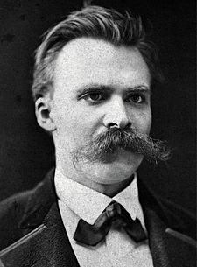
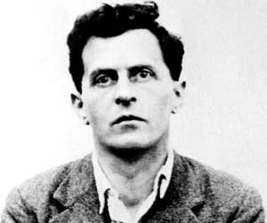
Intellectual responses take up late 19th and early 20th critiques of modernism
Focus on language
Ludwig Wittgenstein (1889-1951)
Friedrich Nietzsche (1844-1900)

Slide 12
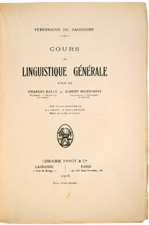
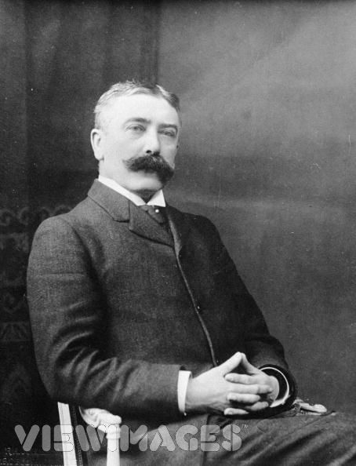
In their search for predecessors, they discovered a forgotten hero in the 1950s.
Cours de linguistique générale (1916)
Linguistics: scientific study of language in broadly three aspects: language form, language meaning, and language in context
Ferdinand de Saussure, 1857-1913

Slide 13
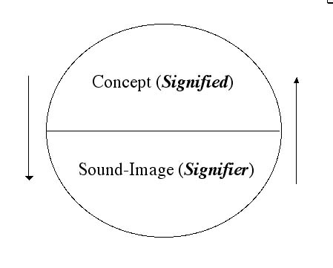
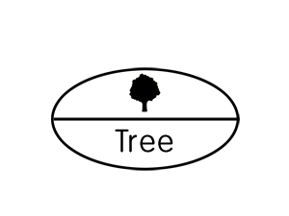
Saussure replaces the term ‘word’ with ‘signs...
Sign, signifier, signified: The sign is constituted by the relationship of a ‘signifier’ (a medium, such as a word, a road sign, a gesture etc) to a ‘signified’ (also known as the referent, the ‘thing’ being signed.)
Note: The ‘signified’ is not the thing itself, only a mental concept of it which the ‘speaker’ and ‘listener’ share.

Slide 14
Saussure’s central structuralist claims:
Languages are not confined to words but include any system of communication that uses ’signs’ (traffic signs, sign language).
A sign is composed of a ‘signifier’ (vocal sound, image, gesture) and a‘signified’ (the mental concept that speaker and listener share).
The mental concept/structure (signifified’ precedes the ‘signifier’ in existence (according to Saussure) It is the hidden ‘structure’ of and that is what ‘structuralists’ follow (and what later poststructuralists reject)
The relationship between ‘signifier/signified’ is established arbitrarily. and bears no resemblance to the’ signified’ (different language use different ‘signifiers’ for the same mental images)
Every sign acquires meaning only by belonging to a network of other signs. There is in every sign a suggestion of another, oppositional sign (binary relations: women/man; child/adult; animal/human etc.)

Slide 15
Significance of these claims:
Relationship to knowledge becomes uncertain by undermining the connection between a ‘word’ (signifier) and a ‘thing’ (signified) with no relation to the real thing. ‘Meaning’ and ‘sign’ are separated.
The notion of arbitrariness of the sign deeply challenged the correspondence theory of truth: if words relate only to each other within an own structure, how could language be deemed to refer to the world out there? And how would historians argue that their discourse about the past matched up with ‘what really happened’ as Ranke, for example, had famously argued?
During the ‘linguistic turn’ Saussure’s ideas about language were applied to wider human culture (politics, social life etc.)

Slide 16
What are the consequences for the understanding of human experience and knowledge?
Reality is NOT representable in any form of human culture (whether written, spoken, visual or dramatic)
Because ‘reality’ is not representable in any form, no authoritative account can exist of anything)
Nobody (including historians) can make claims of possessing a ‘universal’ truth of anything. There is never a single single authority on a given subject of knowledge (this includes claims made in the natural sciences!)

Slide 17
Why are they so keen on showing that there is no universal truth and no authority?
Target of the linguistic turn enthusiasts:
the hidden ‘metanarratives’ of modernity that originated in the Enlightenment – the ‘grand narratives’ or ‘metanarratives’ of modernity
‘Simplifying to the extreme, I define postmodern (scholarship) as incredulity toward metanarratives. ... The narrative function is losing its function, its great heroes, its great dangers, its great voyages, its great goal. It is being dispersed in clouds of narrative language ... Where, after the metanarratives, can legitimacy reside?’
(Jean-François Lyotard, The Postmodern Condition: A Report of Knowledge (1979))
The overall aim is to destroy the ‘myth of the Enlightenment: progress, science/technology, reason/rationality, the
autonomous human being who willfully creates the world (e.g. Adorno/ Horkheimer, Dialectic of the Enlightenment, 1947)
Again, to understand such ‘destructive’ visions, we need to take the wider social, cultural, economic and political
context of the immediate postwar period into account.

Slide 18
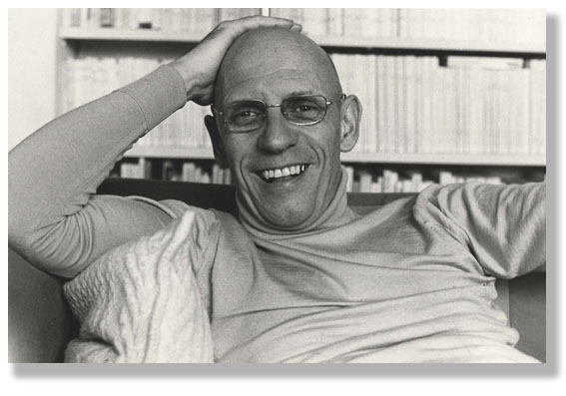
Attacking Enlightenment ‘metanarratives’: the human subject
Foucault is the most
Influential theorists of the ‘linguistic turn’ for historians because he writes ‘histories’ – although very differently from historians of historians of this time.
Michel Foucault 1926-1984

Slide 19
Towards the end of his life, he identifies the key concern that runs through all his work as….
A history of the human subject and ‘the self’
‘… the interaction between oneself and others and in the technologies of individual domination, the history of how an individual acts upon himself (or herself);
I am interested in the technologies of the self and a history of the subject.’
Claim: What we experience as our ‘selfhood’ or our ‘identity’ is not authentic but a construct of knowledge/power.

Slide 20
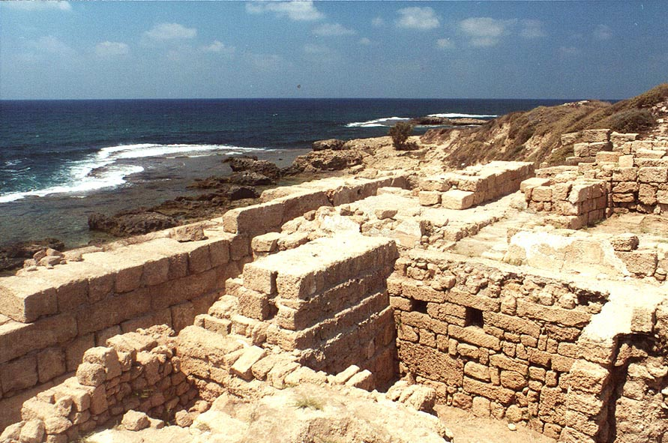
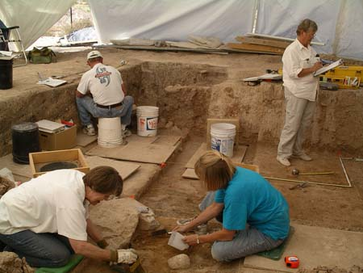
The history of the human subject
Phase I
All works are based on his close engagement with some of the central claims of the French ‘linguistic turn’.
I. Method of Archaeology (early works until ‘Crime and Punishment’)
Investigation of the rules of
language at a given moment
in time. These rules, he argues, ‘create’ a certain kind of reality about the human subject and the world. They create certain experiences.

Slide 21
Method of Archaeology
Explores the conditions of possibility what can be said and thought at a particular moment in time
Is concerned with the analysis of language as a system of the possibility of human expression; it is synchronic – at one moment in time
It does never try to explain historical change or the origin or distribution of power; power is not discussed in his books which are written with the method of archaeology
Inspired by ‘structuralism’ and de Saussure in this phase
Foucault’s idea is that every mode of thinking is based on the structure and rules of language and involves implicit rules (maybe not even consciously formulated by those following them) that materially restrict the range of possible thoughts an individual is able to have.
Note: This is the case for the past as it is for the present: you can only speak what the current rules of language allows you to think and speak!

Slide 22
New Periodisation in History Writing : Epistemes
‘In any given culture and at any given moment there is always only one episteme that defines the conditions of possibility of all knowledge, whether expressed in theory or silently invested in a practice.’
Renaissance Episteme (1450-1650)
Classical Episteme (1650-1800)
Modern Episteme (1800-1966)
Postmodern Episteme (late1960s -?)
Where are we now? Post-Postmodern Episteme?

Slide 23
The historian as an archaeologist
digs up ‘the episteme’
An historian-archeologist uncovers the underlying rules (maybe not even consciously formulated by those following them) that materially restrict the range of possible thoughts
(He goes here beyond a mere analysis of language systems suggested by Saussure)

Slide 24
The archaeologist-historian uses ‘discourse analysis’ to uncover
the invisible rules of language that organize what we can say and
not say at a particular moment in time
What makes thought possible at a particular moment in time? How do people speak about it? Analysis of the rules of what is possible to say?
‘Discourse’ and ‘discourse’ analysis aims to overcome the
problems of traditional history writing which takes what is ‘said’ as a given.

Slide 25
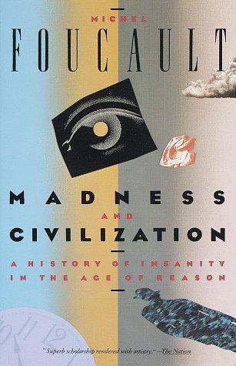


Use of this method in the following books:
Examination of the evolving meaning of madness in European culture, law, politics, philosophy and medicine from the Middle Ages to the end of the eighteenth century, and a critique of historical method and the idea of history and its ideas of tracing origins
Developing the themes explored in his previous work, Madness and Civilisation, Foucault traces the development of the medical profession, and specifically the institution of the Clinique; the rise of the modern ‘medical gaze’ in the eighteenth century
Excavates the origins of the human sciences, which have their root in "life, labour, and language", that is: biology, economics, and linguistics; puts forward the idea of ‘epistemes’

Slide 26
Foucault’s Phase II :
Realisation: It is not language speech and thinking that make people ‘act’ but also ‘everyday practices’ and their engagement with the material world (e.g. objects). ‘Reality’ is not only constituted by language!
And he is dissatisfied with traditional explanations for historical change in history writing of his time:
‘The traditional explanations as the spirit of the time, technology, social cultural influences struck me for the most part as being more than magical effective’.
He is particularly questioning Marxist ideas of power and knowledge.

Slide 27
2. Method of Genealogy (early 1970s)
How can we think ‘power’ differently?
The individual dies not hold power
It is concerned with the analysis of historical ‘emergence’ – not search for ‘origins’
A historical causal explanation that is material, multiple, and corporeal.
It is conceptualised not as a ‘discovery’, the culmination of events, or as the end of a process of development but rather as a particular momentary manifestation of chances or as a struggle between forces of power.
Note: At the time Foucault develops his new ideas on power, Marxists theories of power are en vogue in France of the 1970s! His ideas of power entirely contradict those of Marxists.

Slide 28
Genealogy involves an investigation of how human knowledge (and its production) and power are always linked.
knowledge/power
Aim of all knowledge/power strategies:
to discipline the individual human body and to regulate large numbers of human bodies in form of populations

Slide 29
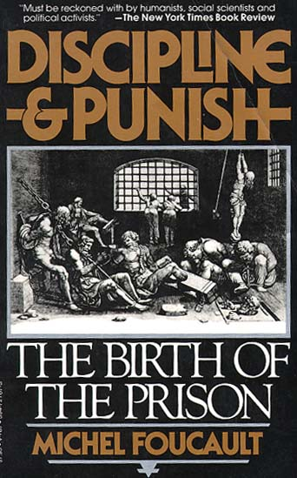
What is power? And how does it work?
1. Discipline and the individual body
Claim: Disciplinary power is a modern form of power emerging in the course of the seventeenth-century
(note: the time of what we call traditionally ‘the Enlightenment’! So, his book is a critique of an Enlightenment ’myth’ )
Overarching question:
Are modern forms of punishment (prisons and attempts at rehabilitation) really more ‘humaine’ than direct corporeal punishment in the pre-modern era?
What knowledge/power strategies are hiding in the ‘grand meta-narrative’ of Western humanitarianism?

Slide 30
What is ‘discipline’ as a form of power?
‘Discipline’ (or disciplinary power) may be defined neither with an institution nor with an apparatus; it is a type of power, a modality for its exercise, comprising a whole set of instruments, techniques, procedures, levels of applications, targets.’
Ultimate goal of all disciplinary measures:
Discipline produces ‘docile’ bodies. These are bodies which act without being told to act in a particular way. The do it voluntarily and even ‘like’ doing it.
Docile bodies feel pleasure when they discipline themselves!

Slide 31
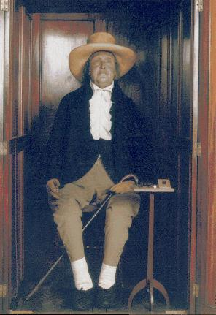
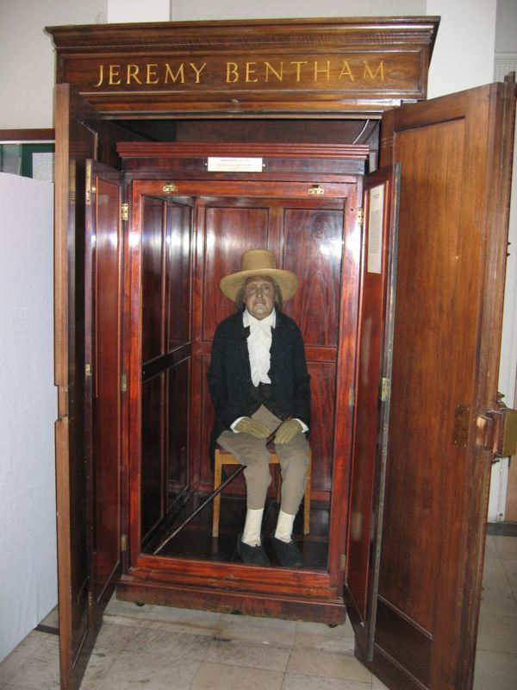
Discipline and Punish investigates the 3 forms of ‘discipline’ directed at individual body
1. Hierarchical Spatial Observation
Foucault uses ideas of Jeremy Bentham, the founder of British utilitarianism to show this in form of a specific architecture….

Slide 32
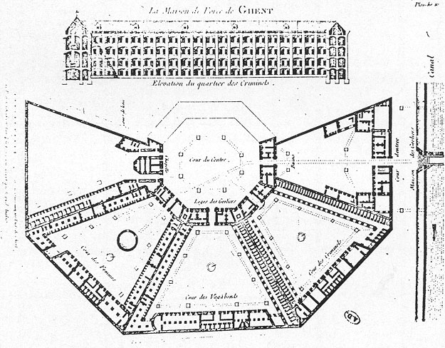
Bentham’s idea of the prison panopticum
‘Discipline’
inbuild in
architecture

Slide 33
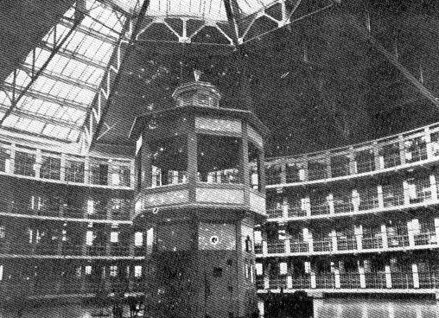
‘….we induce in the inmate a state of consciousness and permanent visibility that assures the automatic functioning of power.’
They discipline themselves
Question can you detect this sort of ‘discipline’ in our award-winning
FAB building?

Slide 34
Individuals are judged not by the intrinsic rightness or wrongness of their acts but by where their actions are placed on a ranked scale that compares them to everyone else.
2. Normalising Judgement
We are subjected to a whole set of micro-normalising judgements (regarding time keeping, speech, body practices). We use ‘discipline’ to punish those who do not conform to the ‘normalizing judgement’.
Question: In what ways is the marking system a form of ‘normalizing judgement’? What are the punishments?

Slide 35
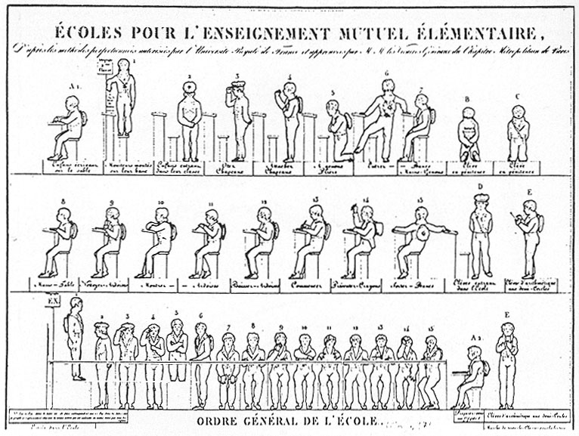
Example of how power works: micro-management of the body in 19th
School

Slide 36
Normalising judgement of your mind turning you into a ‘docile’ body
https://www.writerstoolbox.com/about/blog/why-peel-is-causing-good-schools-to-underperform
Question: Why do school educators still embrace PEEL (and its following systems) although they know that it is reduces human capacities of ‘thinking’ to a one fits all model – a model that has failed long ago and didn’t deliver what it promised.

Slide 37
3. Examination
This form of discipline combines ‘normalising judgement’ with ‘hierarchical observation’ to create a ‘normalising gaze’ through which individuals may be classified or judged. The ultimate form of discipline to turn bodies into ‘docile bodies’.
The medical examination in a doctor’s office is a prime locus of modern power/knowledge.
There is no knowledge without power and vice-versa (medical knowledge is the most striking example)

Slide 38
Example:
Homosexuality was classified as a ‘disease’ until it became ‘normal’ in
the 1970s:
In 1973, the American Psychiatric Association (APA) removed the diagnosis of “homosexuality” from the second edition of its Diagnostic and Statistical Manual (DSM). This resulted after comparing competing theories, those that pathologized homosexuality and those that viewed it as normal.
Question: Which medical classifications (diagnoses) did you encounter? What does it mean when you are classified as ‘a medical case'? Can you identify ‘normative judgement’ and ‘hierarchical observation’ in a medical classification (e.g. diagnosis)? What if you resist such a medical classification (diagnosis (e.g. in school, at university, at the workplace)? Where is ‘knowledge/power’ hidden behind a medical diagnosis?

Slide 39
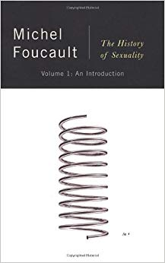
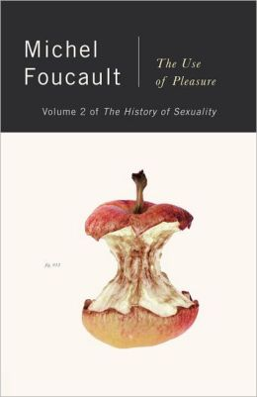
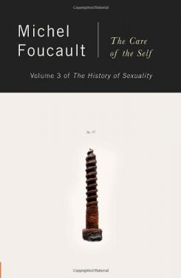
He moves from individuals and disciplinary power to the investigation of regulatory power directed at ‘populations’
Human sexuality becomes THE central mechanism to exercise power over individuals and larger population; the nexus of power/knowledge that creates certain kind of subjects

Slide 40
Biopower:
‘I mean a number of phenomena that seem to me to be quite significant, namely, the set of mechanisms through which the basic biological features of the human species became the object of a political strategy, of a general strategy of power, or, in other words, how, starting from the 18th century, modern Western societies took on board the fundamental biological fact that human beings are a species. This is what I have called biopower.’

Slide 41
The rise of biopower in
17th and 18th century

Slide 42
Power: is directed at the human living body
1.Disciplinary (acts on the individual and make it ‘docile’)
2. Regulatory power (acts on a
whole population)
The nature of such power strategies is not necessarily restrictive but promises pleasure.

Slide 43
The End

