Slide 1
Popular Democracy, Conservative Liberalism: The Practice of Politics in the Nineteenth Century
Latin America: Themes and Problems
Week 3
Nicolás Gómez Baeza
PhD candidate
History Department, University of Warwick
ANID Chile Scholar

Slide 2


We will answer the following questions:
How democratic were Latin America’s post-Independence nations?
Who participated in politics, and in what ways?
What was liberalism and how did it change over the century?
How did issues of race and slavery affect the development of Latin America’s post-Independence nations?
By analysing examples of:
1. The nation state building processes after independence.
2. The participation of popular groups in democratic processes in new South American republics.
3. The practices of “conservative liberalism” in the expansion of territories, capitalism and “whitening”.

Slide 3
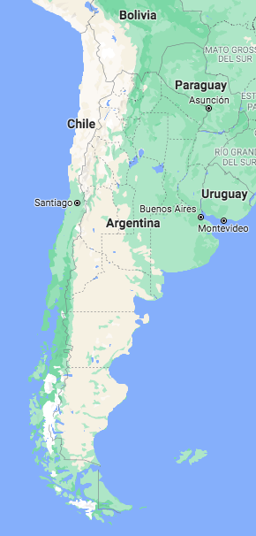
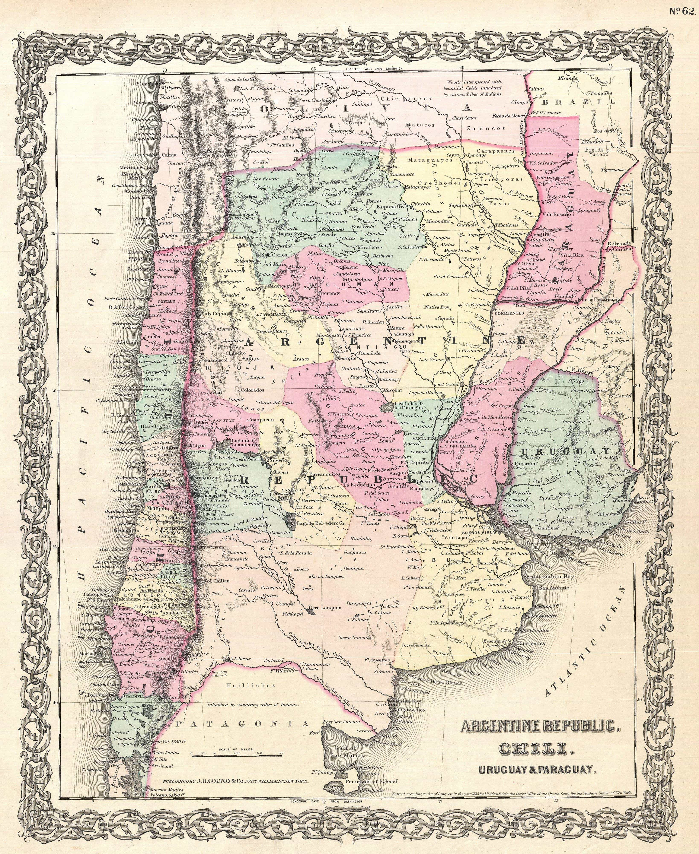
https://www.geografiainfinita.com/2016/10/la-historia-de-argentina-vista-a-traves-de-los-mapas/

Slide 4
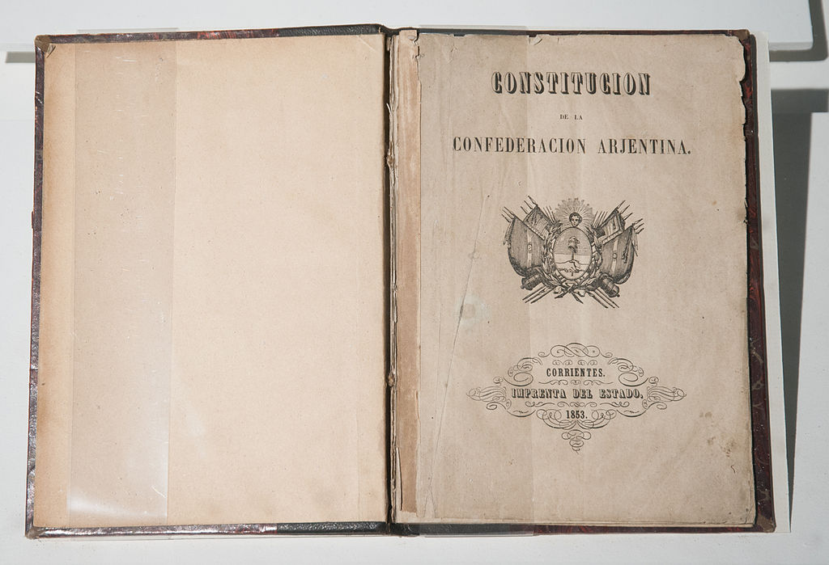
First… some general features of Latin America after independence
Enlighted local landowning (“latifundista”) creole elite (“criollos”), and mostly-military and charismatic leaders (“caudillos”), ruled the new countries from cities.
Increasing alliance with foreign capitalist, bankers and merchants in an increasing new (imperialist) free trade scenario.
Majoritarian rural population with low literacy.
Heritage of a widespread Catholicism.
Heritage of cast hierarchy with racialistic classification with different ethnic groups, but with strong ethnic mixture (“mestizaje”). Ruling class was mostly European descendant.
The difficulties to construct nation-state in the view of the elites.
Constitución de la Confederación Argentina

Slide 5
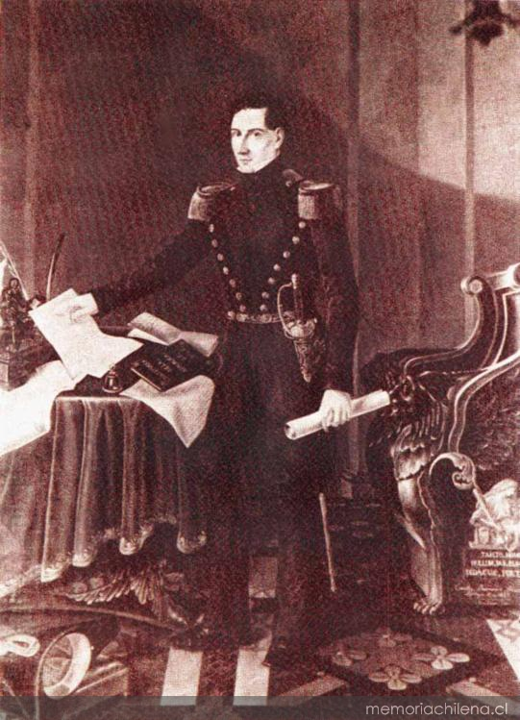
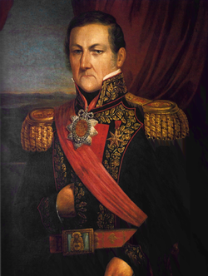
1. The nation-state building: not so different experiences from Argentina and Chile
The role of the military and the political factions (for Chile see: Ossa, 2014 and Baeza, 2020).
Chile, triumph of centralism: post-independence period traditionally called “anarchy” and the “órden Portaliano” as an authoritarian-repressive order. Provincial revolutions defeated.
Argentina, triumph of federalism: the role of the authoritarian “caudillo” Juan Manuel de Rosas to defeat unitarians (centralists).
Diego Portales
Juan Manuel de Rosas

Slide 6
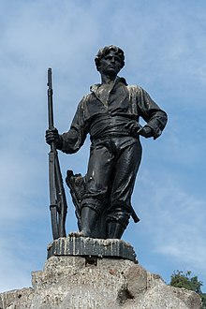
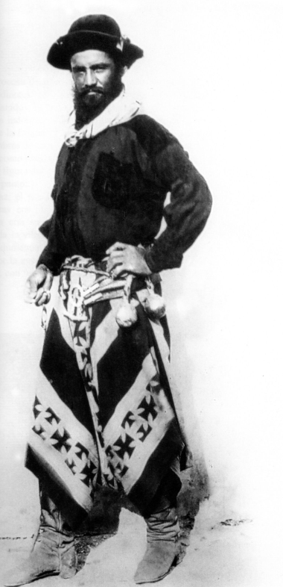
2. Popular democracy: what was the role of the popular groups?
Traditional visions that popular sectors were not part of political processes: in Chile, the “peso de la noche” (weight of the night). The exclusion from the idea of “citizenship” (limited liberalism and practice of suffrage).
However, popular sectors’ agency in the nation-state building (for example, the “plebe” in Buenos Aires). Politization of the majorities. The importance of the “roto” and the “gaucho”.
Popular liberalism? Comparing with the Afro-Colombian at the Caucas (James Sanders, 2009)
Roto statue (Santiago de Chile)
Gaucho

Slide 7
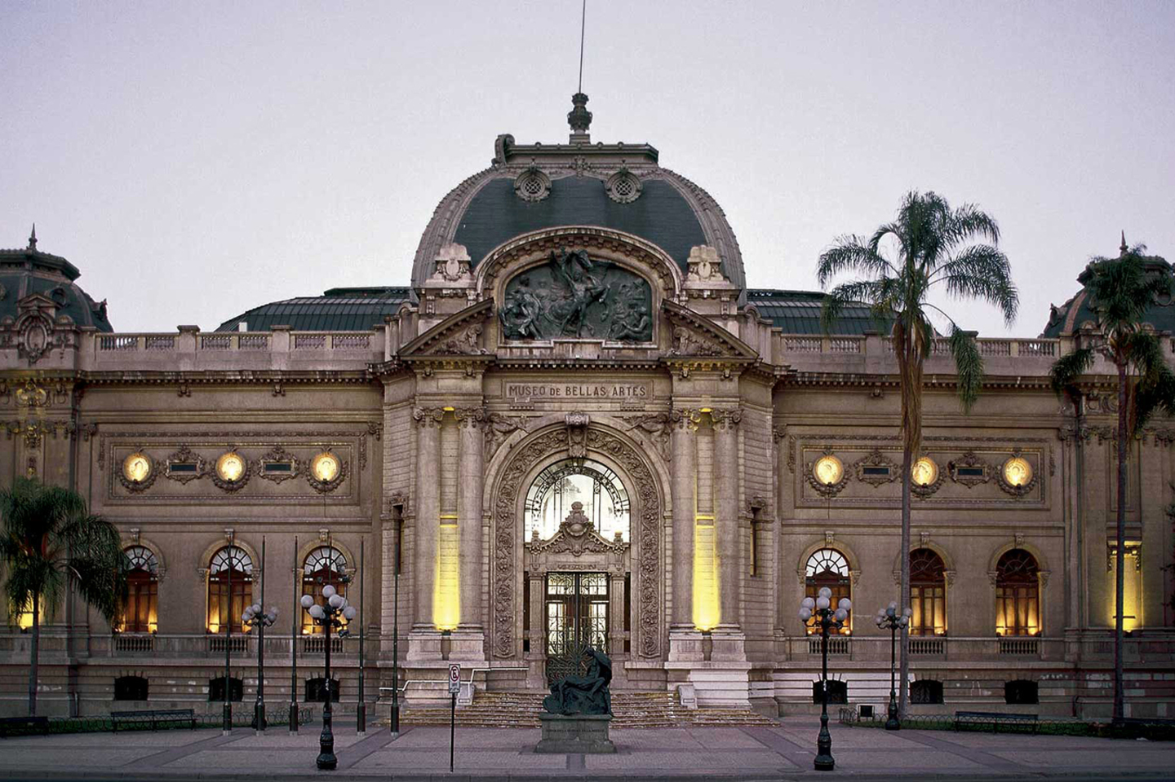
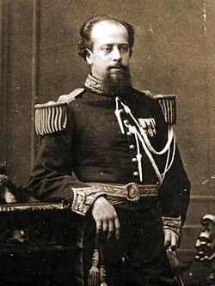
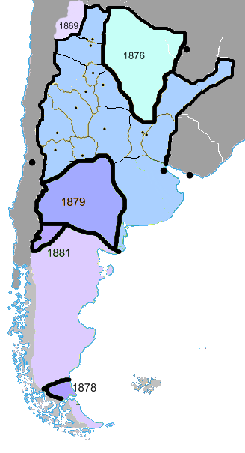
3. Conservative liberalism: the decline of popular notions of liberalism
Eurocentrism: ”modernization” in an European model. “Whitening” (racist) policies even until twentieth century.
Chilean and Argentine expansionism: Occupation of Araucanía (“Pacificación de la Araucanía”), Conquest of the Desert (“Conquista del Desierto”) the colonization of Patagonia, among others with border disputes.
Resistance: the agency of the indigenous population (Mapuche, Selk’nam, among others), the peasants and the working class.
Museo Nacional de Bellas Artes, Chile
General Julio Argentino Roca
”Conquista del Desierto”

Slide 8
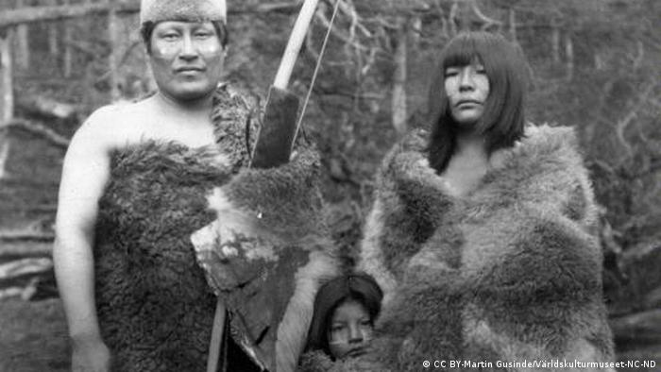
Selk’nam population from Tierra del Fuego.
Picture took by Martin Gusinde.
Map in: Harambour, 2019

Slide 9
Some reading suggestions:
Romero, Luis Alberto. A history of Argentina in the twentieth century. Penn State University Press, 2021.
Collier, Simon, and William F. Sater. A history of Chile, 1808-1994. Vol. 82. Cambridge University Press, 1996.
Collier, Simon. Chile: the making of a republic, 1830-1865: politics and ideas. Vol. 89. Cambridge University Press, 2003.
Lynch, John. Argentine Caudillo: Juan Manuel de Rosas. Rowman & Littlefield Publishers, 2001.
Crow, Joanna. "Troubled Negotiations: The Mapuche and the Chilean State (1818-1830)", Bulletin of Latin American Research, vol 36. 2017, pp. 285 298.
Wood, James A. The Society of Equality: Popular Republicanism and Democracy in Santiago de Chile, 1818-1851. University of New Mexico Press, 2011.
Santa Cruz, Juan Luis Ossa. Armies, Politics and Revolution: Chile, 1808-1826. Oxford University Press, 2014.
Rock, David. The British in Argentina: commerce, settlers and power, 1800–2000. Springer, 2018.
Ruz, Andrés Baeza. Contacts, collisions and relationships: Britons and Chileans in the Independence era, 1806-1831. Oxford University Press, 2019.
Harambour-Ross, Alberto. "Sheep Sovereignties: The Colonization of the Falkland Islands/Malvinas, Patagonia, and Tierra del Fuego, 1830s–1910s." Oxford Research Encyclopedia of Latin American History. 2016.

Slide 10
