Slide 1
Week 4: The US in Latin America

Slide 2
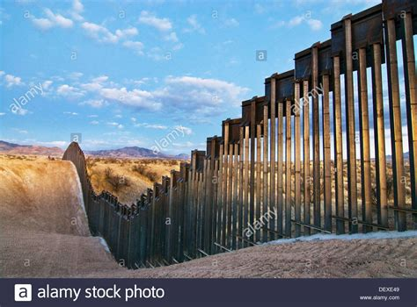
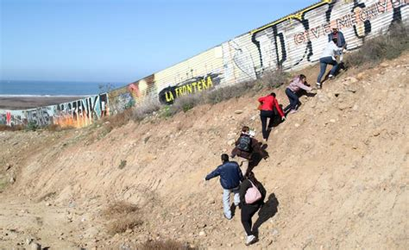

Slide 3
An increasingly unequal relationship
LatAm as US’s “backyard,” Caribbean as an “American lake”
US industrialised; LAm “fell behind” in terms of industrialisation/ modernization; economically unequal relationship
Lat Am as a market for US goods
Sense of US MORAL superiority; need to ‘help’ LAm countries; “white supremacy” approach in C19; “modernising” in C20
Concern for dominance: keep out European powers (especially Britain, in C19)

Slide 4
First phase: 1780s-1840s
regional vulnerability
Determination to protect new independence, with vulnerable frontiers
against Britain, France (and Russia)
> Monroe’s declaration of policy
The ‘Monroe Doctrine’ (1823)…….

Slide 5
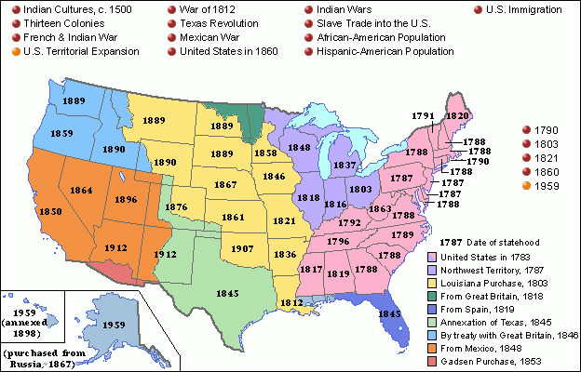
US territorial expansion in the nineteenth century

Slide 6
The Monroe Doctrine, 1823
‘The American continents, by the free and independent condition which they have assumed and maintain, are henceforth not to be considered as subjects for future colonization by any European powers.’

Slide 7
Significance of the Monroe Doctrine?
Aimed at Britain (in Cuba) and Russia (in Alaska)
i..e not predatory (at the time) but defensive
A statement of intent rather than real policy
Did not oppose existing colonialism
Unable to enforce the policy (yet)
Based on republican, liberal ideology (forged through independence from Britain)

Slide 8
Second phase, 1840s-1890s
More confident (after 1812 ‘victory’ over Britain)
More extensive territorially
a growing private interest in Latin America, sometimes backed by the state, e.g. William Walker in Nicaragua in 1850s
Texas: 20,000 US settlers move to Texas from 1820s; 1836 rebellion against Mexico and Texan Republic 1836-45;
Mexican War 1846-8: loss of California, Arizona, New Mexico.. Profound impact on Mexico

Slide 9
Manifest Destiny?
Term first used by a journalist in the 1830s
strengthened by…
victory in Mexican war
US Civil War 1861-5: new confidence
rising industrial and military power of USA
Linked to deterministic notions of race supremacy - ‘Social Darwinism’ – and from there, idea of “tutoring” non-white peoples/ countries (link to post-emancipation segregation in the US South)

Slide 10
Third phase, 1890s- early 1930s: Cuba, 1898
Spain left with Cuba, Puerto Rico, Philippines
Cuba: major sugar producer
Slavery keeps elites loyal (outnumbered by population of colour by mid-C19)
But: growing separatism
US repeatedly tries to buy Cuba, sees as “natural” acquisition
Long anticolonial struggle, forging of black-white alliances and nationalism in Cuba: Ten Years’ War (1868-78) and War of Independence: 1895-8
US intervention; final end of Spanish empire; Cuba officially a protectorate to 1902 but unofficially US-controlled in many ways for decades afterwards.

Slide 11
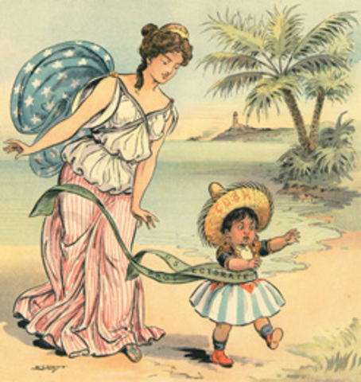
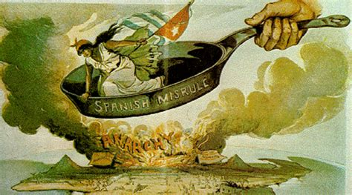
Cuba, 1898: images of imperialism

Slide 12
The Roosevelt Corollary (1904) and the “Big Stick” era
Declaration to ‘protect’ Latin America – vs ‘threat’ of European intervention in the region
i.e. Monroe Doctrine used to justify intervention,
In reality protecting Latin Americans against themselves – ‘protective imperialism’
“speak softly and carry a big stick,”

Slide 13
After the U.S.-Spanish war, U.S. armed forces openly intervene in Latin America many times…
1903: The Platt Amendment inserted into the Cuban constitution grants the U.S. the right to intervene.
1903: U.S. sends warships to acquire land for Panama Canal from Colombia.
1904: U.S. sends customs agents to take over finances of the Dominican Republic to assure payment of its external debt.
1905: U.S. troops invade Honduras for the first of 5 times in next 20 years.
1906: Marines occupy Cuba for two years in order to prevent a civil war.
1907: Marines intervene in Honduras to settle a war with Nicaragua.
1908: U.S. troops intervene in Panama for first of 4 times in next decade.
1909: U.S. forces President Zelaya of Nicaragua to resign for suggesting that U.S. companies pay taxes. The new president is former treasurer of U.S. mining company.
1910 U.S. Marines occupy Nicaragua to help support the new regime.
1911: U.S. backs overturning of Honduran government by U.S. mercenaries and U.S. banana company.

Slide 14
1912: U.S. Marines intervene in Cuba to put down a rebellion of sugar workers.
1912: Nicaragua occupied again by the U.S.
1914: U.S. occupies Mexican port of Veracruz.
1915: U.S. Marines occupy Haiti to restore order, and establish a protectorate which lasts till 1934. The president of Haiti is barred from the U.S. Officers' Club in Port-au-Prince, because he is black.
1916: Marines occupy the Dominican Republic, staying till 1924.
1917: U.S. troops invade Mexico to pursue Pancho Villa.
1917: Marines intervene in Cuba, to guarantee sugar exports during WWI.
1918: U.S. Marines occupy Panamanian province of Chiriqui for two years to maintain public order.
1925: U.S. Army troops occupy Panama.
1926: Marines occupy Nicaragua again.
1932: The U.S. rushes warships to El Salvador in response to a communist-led uprising.
"There is no room for any outside influence other than ours in this region. We could not tolerate such a thing without incurring grave risks... Until now Central America has always understood that governments which we recognize and support stay in power, while those which we do not recognize and support fall. Nicaragua has become a test case. It is difficult to see how we can afford to be defeated." --Undersecretary of State Robert Olds

Slide 15
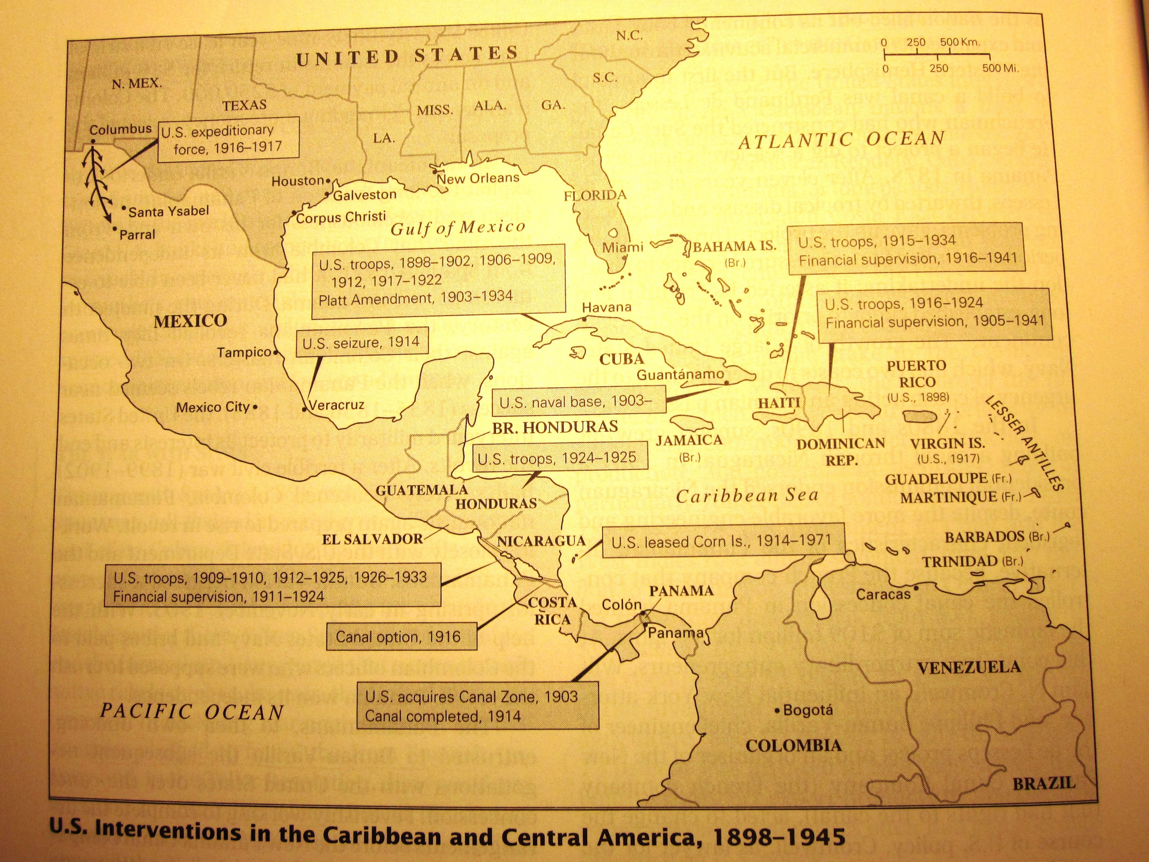

Slide 16
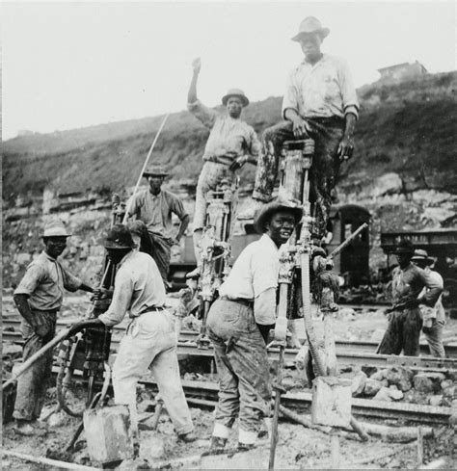
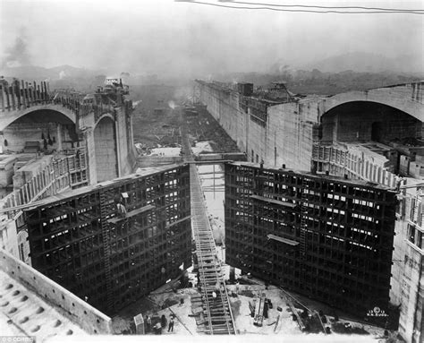
Building the Panama Canal

Slide 17
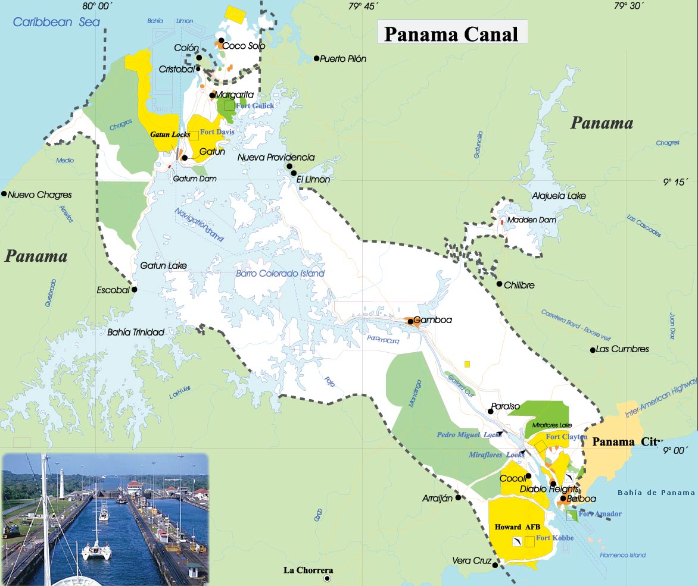

Slide 18
Fourth phase: 1930s-1940s: from ‘Big Stick’ to ‘Good Neighbour’
3 decades of interventions in: Cuba, Mexico, Dominican Republic, Haiti, Panama, El Salvador, Honduras, Nicaragua;
rising Latin American resentment (esp. 1920s)
But the election (1932) of Franklin Roosevelt, plus…
The Depression and growing isolationism in USA >
new policy of non-intervention in Latin America: ‘Good Neighbour’ policy, 1933

Slide 19
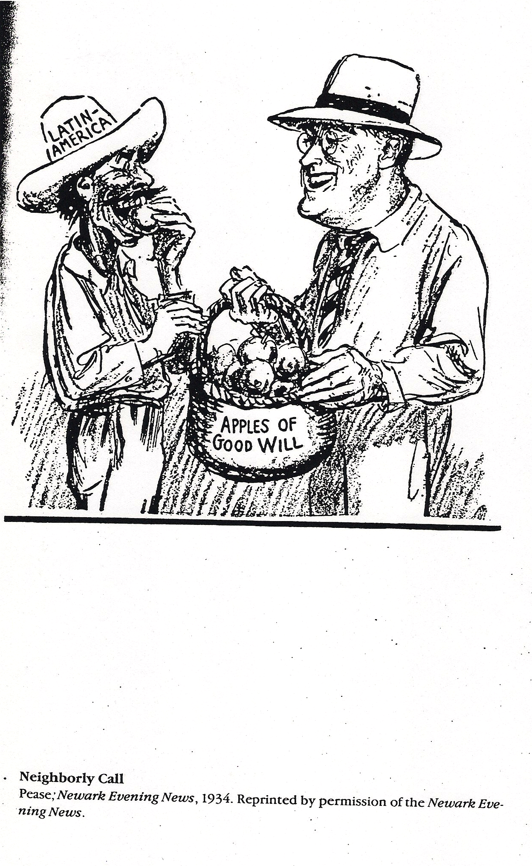
“Neighbourly call,” 1934

Slide 20
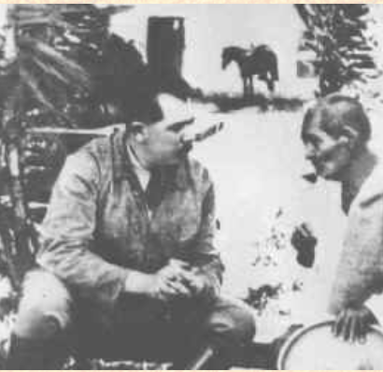
Growing strength of left-wing governments
Lázaro Cárdenas in Mexico (1934-1940)
Juan José Arévalo and Jacobo Arbenz in Guatemala (1945-1954)
José Luis Bustamante y Rivero in Peru, (1945-1948)

Slide 21
Fifth phase, from 1945: The Cold War
‘National Security Doctrine’: only the military can be trusted to defend Latin America against communism—democracy unreliable
Left-wing governments and communism often grouped together. ‘The real threat of communism is the economic transformation of the Communist powers in ways which reduce their willingness and ability to complement the industrial economies of the West.’ (Woodrow Wilson Foundation, Harvard University, 1955)
School of the Americas 1946, in the US-controlled zone in Panama (now located in Georgia): has trained over 57,000 Latin American military officers.
1947-8: Rio Treaty & Organisation of American States

Slide 22
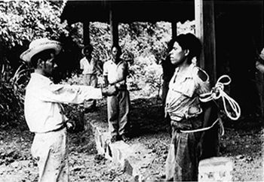
1954
US-supported overthrow of the democratically-elected government of Jacobo Arbenz in Guatemala

Slide 23
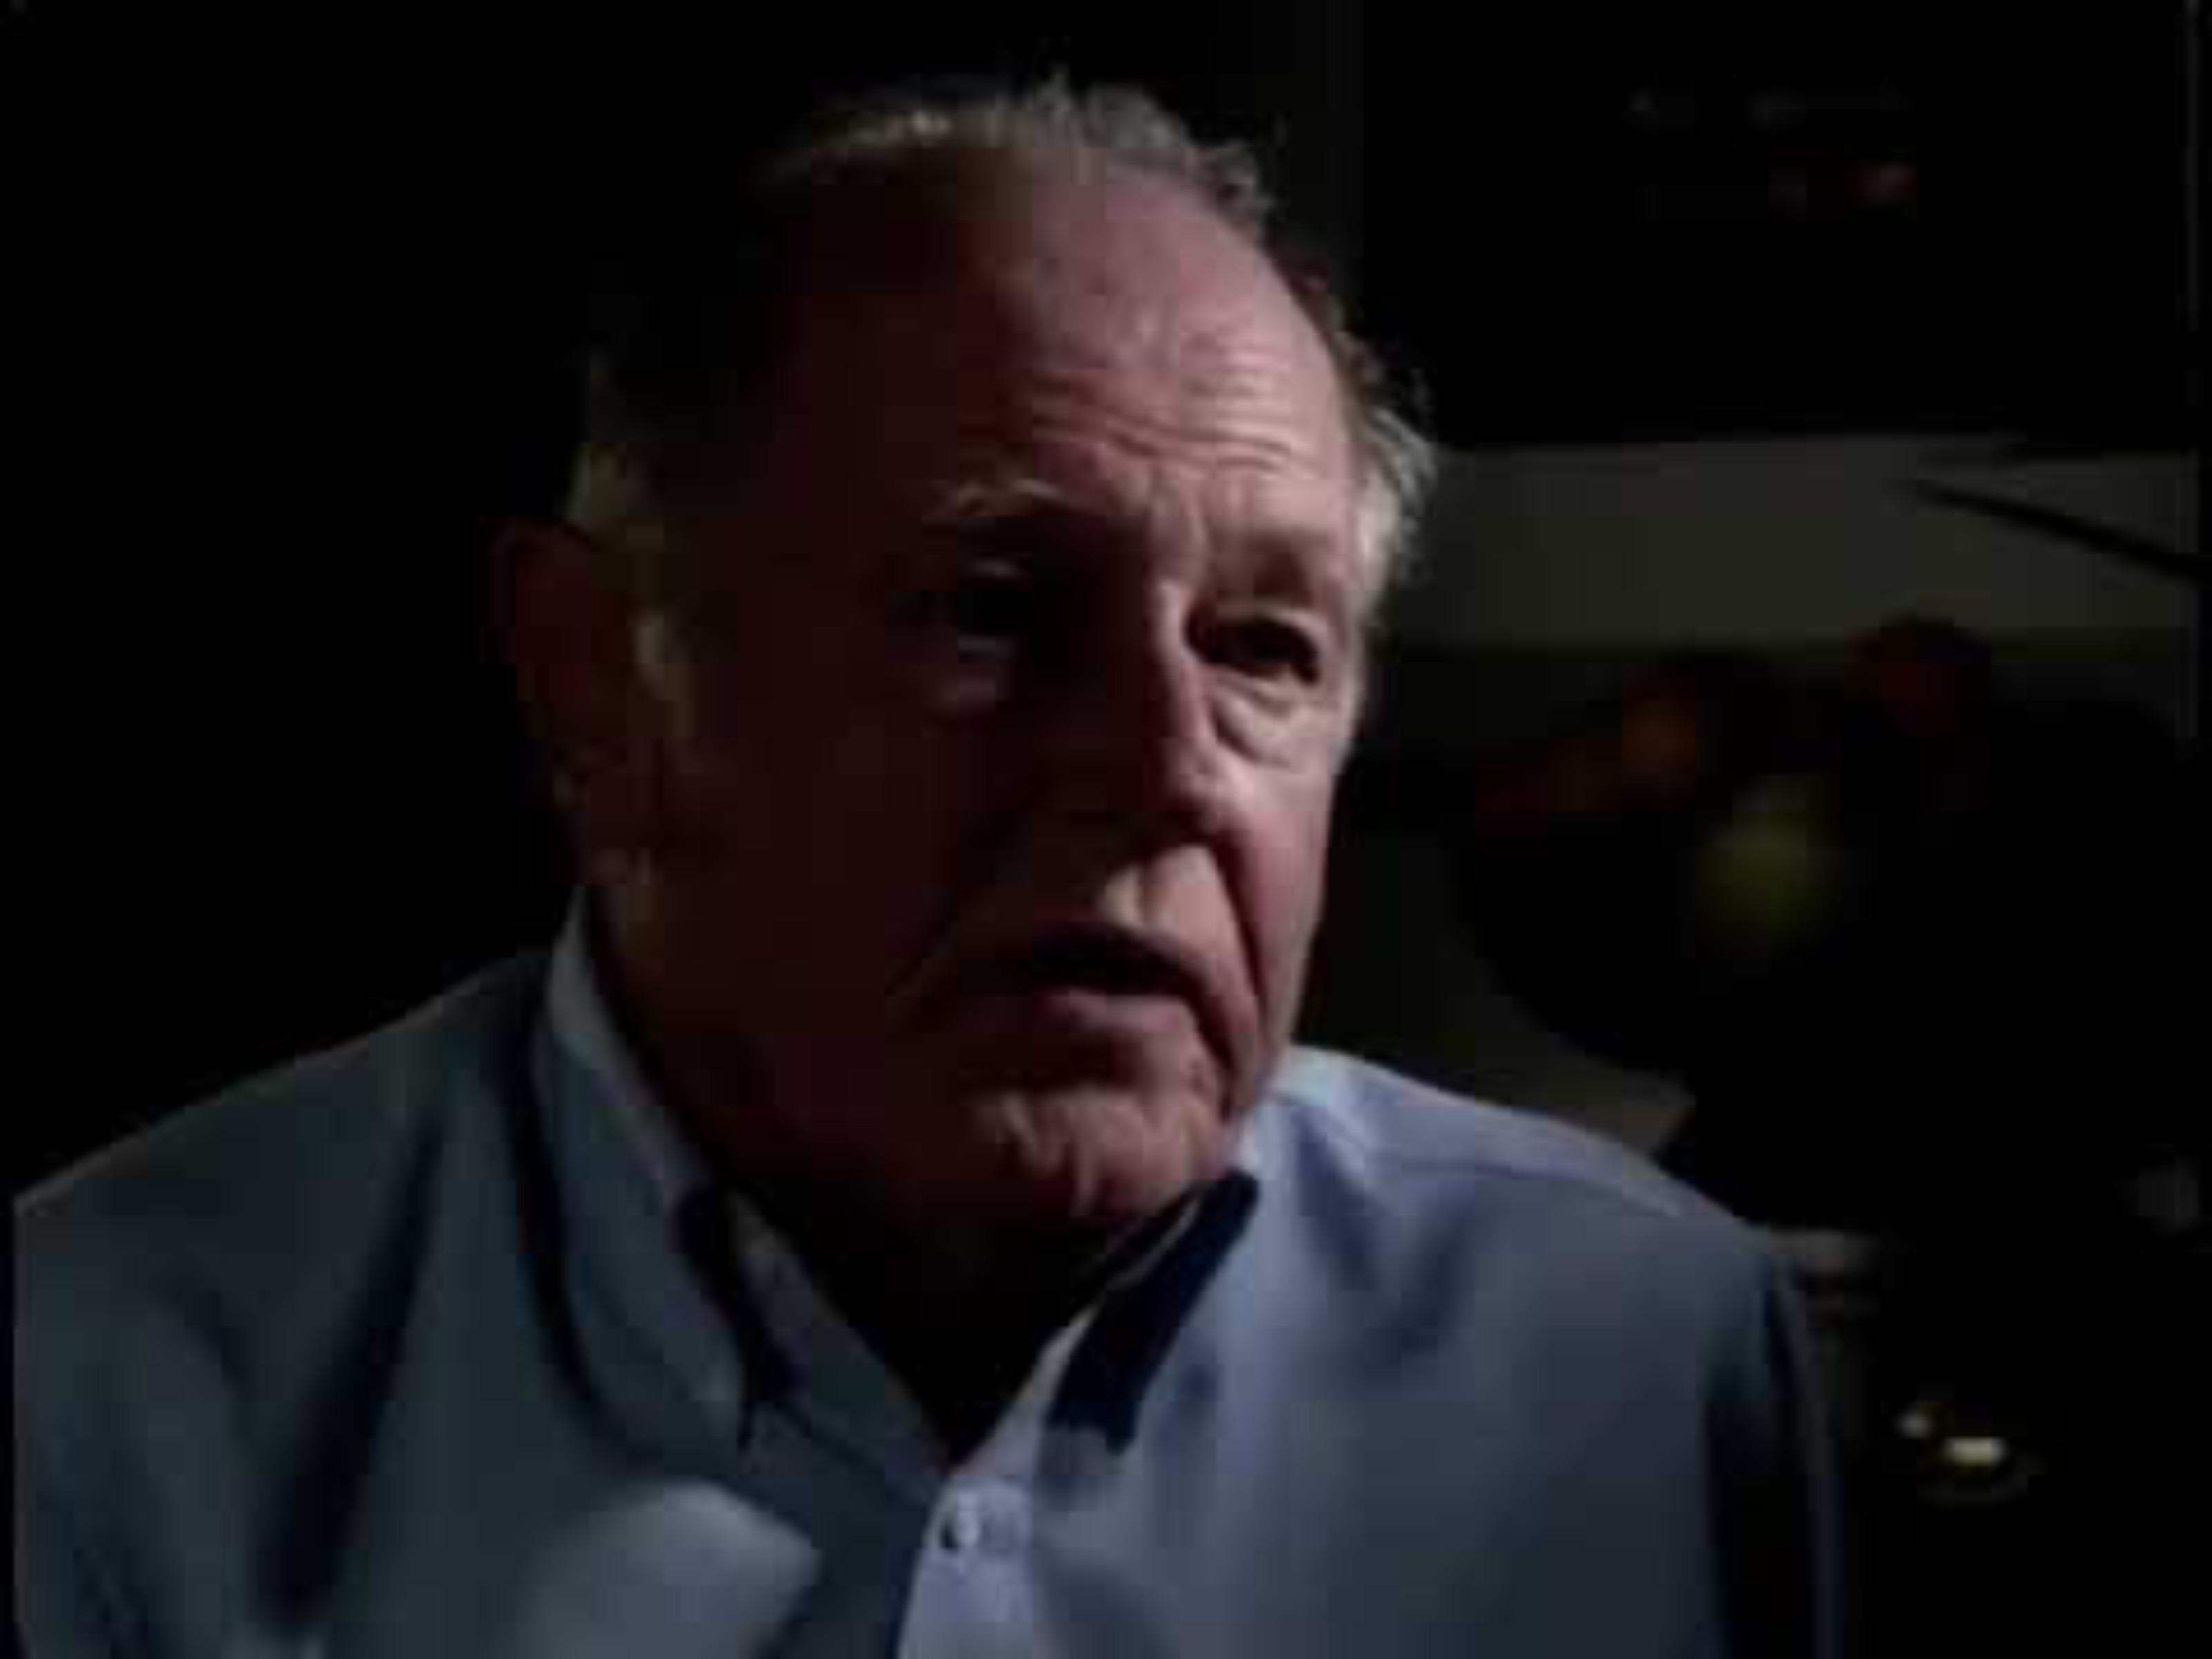

Slide 24
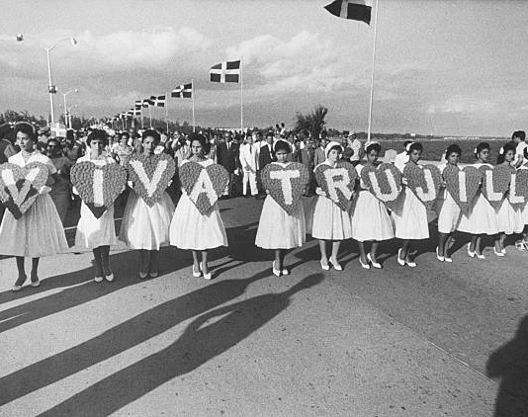
Dictators backed by the US
Rafael Trujillo, Dominican Republic, 1930-1961

Slide 25
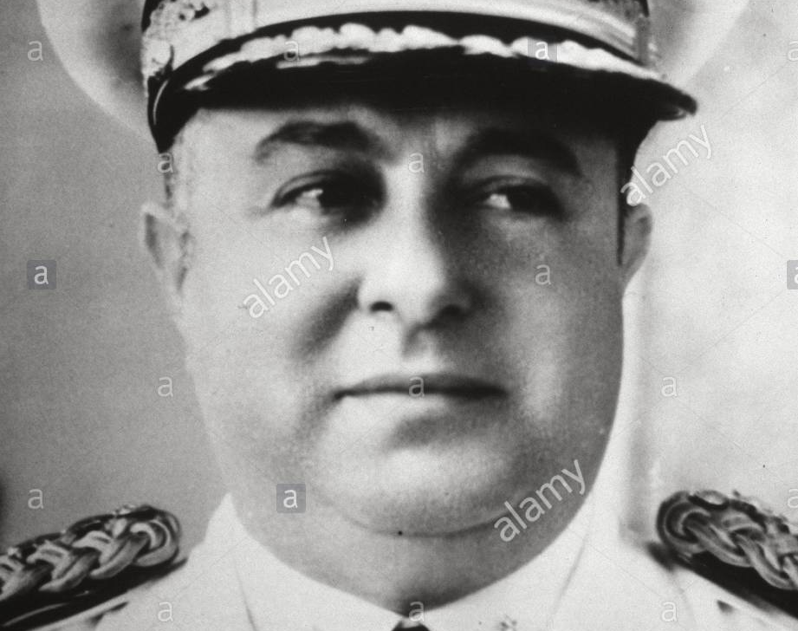
Anastasio Somoza, Nicaragua, 1936-1956

Slide 26
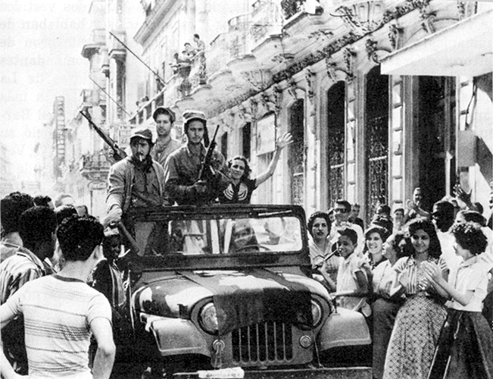
The Cuban Revolution (1959)
Cuban revolutionaries ride into Havana on 1 January 1959

