Slide 1
HI266
Deviance and Non-Conformity
Folk Beliefs and Magic
Stephen Bates
s.m.j.bates@warwick.ac.uk

Slide 2
Aims of today
Thinking about popular beliefs
Consider their relationship to Christianity
Was their a ‘disenchantment of the world’?
Were popular beliefs marginalised by either the Reformation or the Enlightenment?

Slide 3
Whig teleology of progress
Superstition and credulity
Protestant Reformation
Modernity
(triumph of reason)
Catholicism
(organising framework)
Enlightenment scepticism

Slide 4

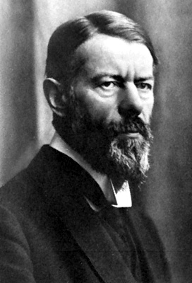
The Protestant Ethic and the “Spirit” of Capitalism
Max Weber (1904-05)

Slide 5
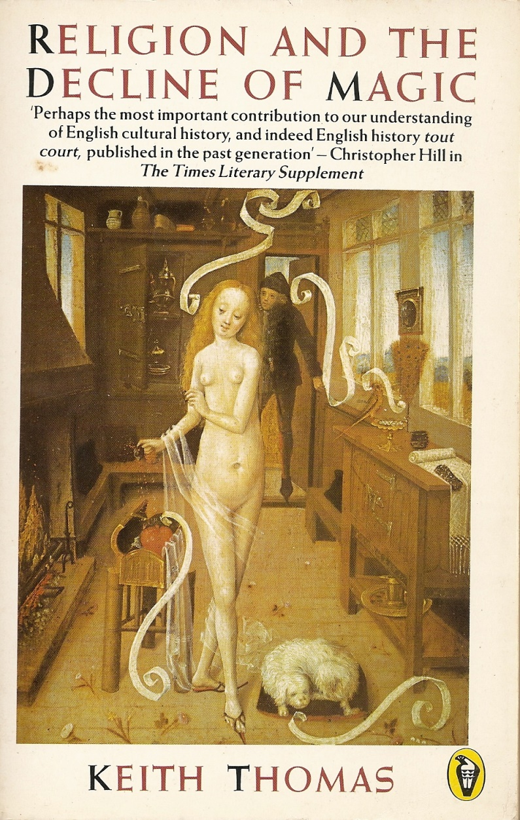

Religion and the Decline of Magic
Keith Thomas (1971)

Slide 6
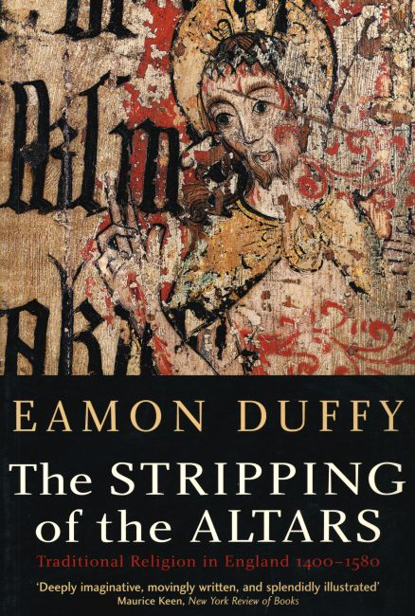

The Stripping of the Altars
Eamon Duffy
(1992, 2nd ed. 2005)

Slide 7
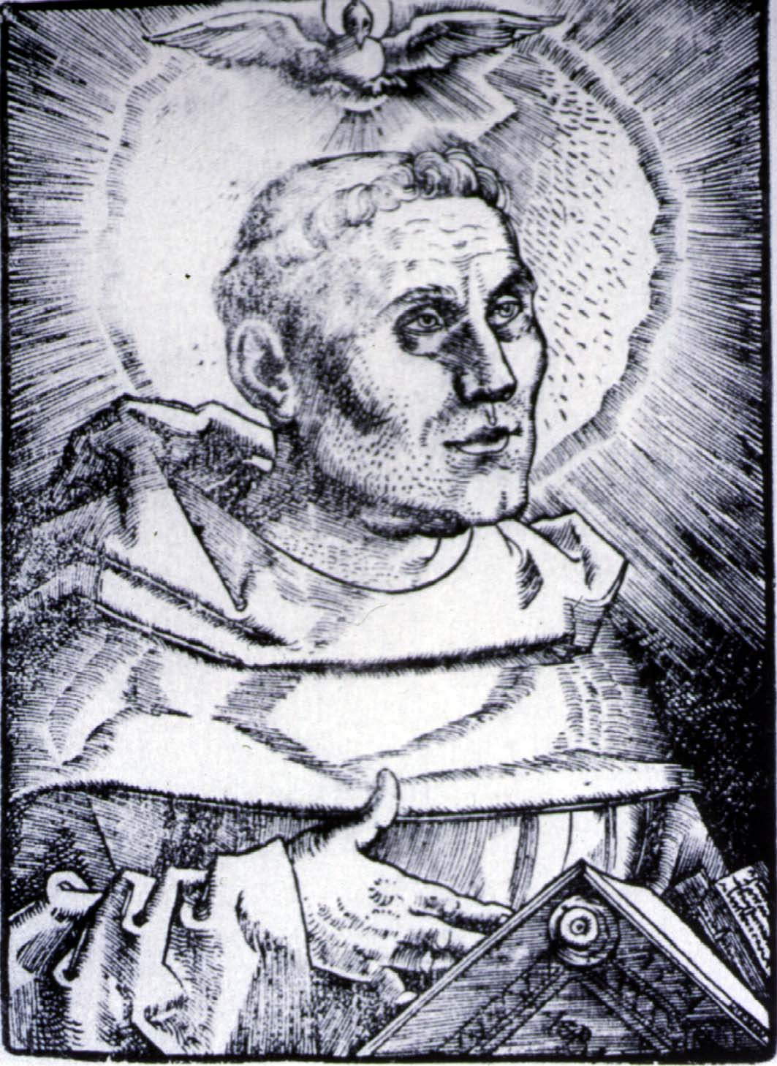
Luther as Monk
Hans Baldung Grien
(c.1521)

Slide 8
The past is a foreign country: they do things differently there.
~ L. P. Hartley, The Go-Between (1953)

Slide 9
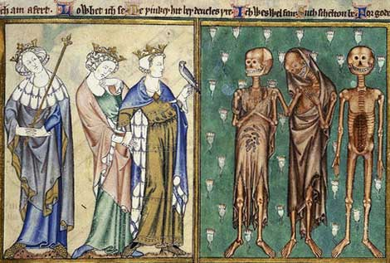
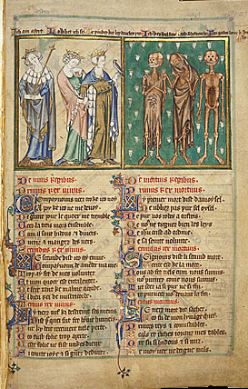
The three living and the three dead
Robert de Lisle’s Psalter (c.1310)

Slide 10
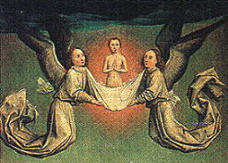
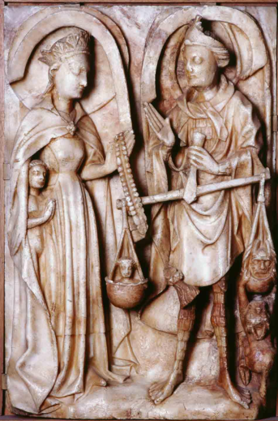
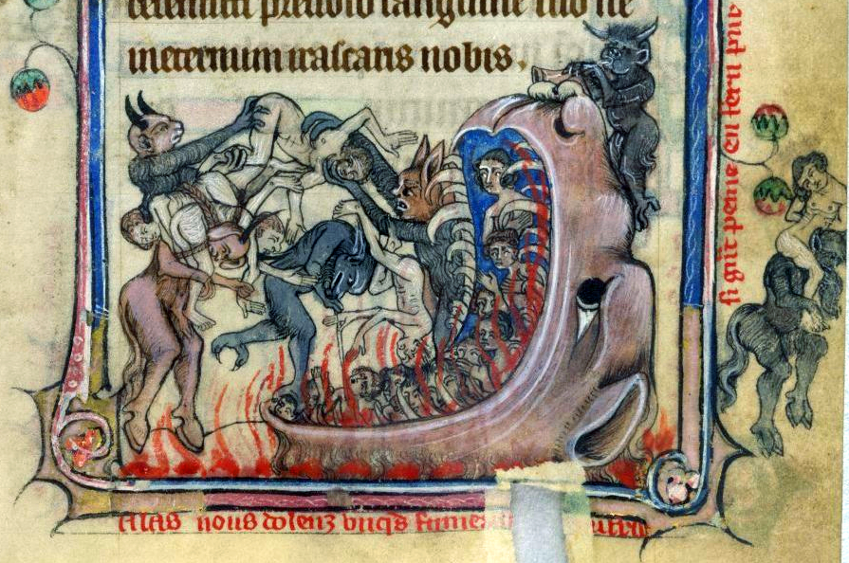
Heaven
Purgatory
Death
Judgement
Hell

Slide 11
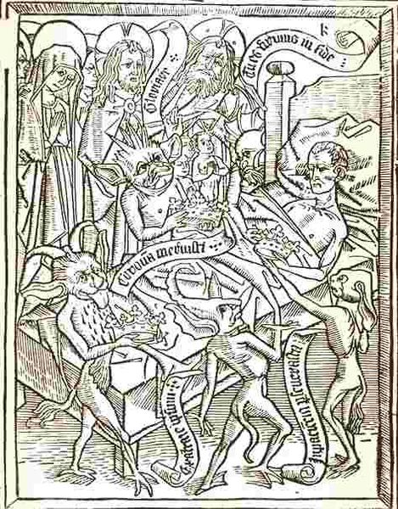
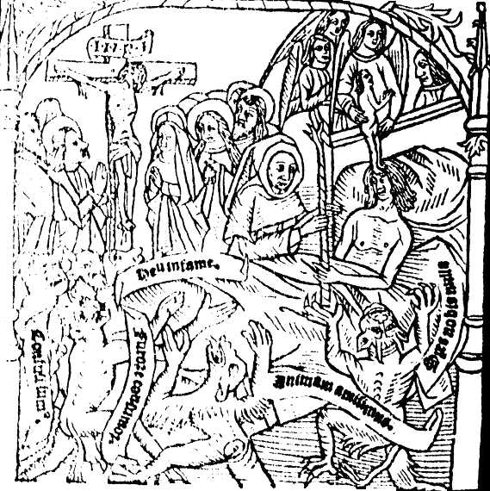
Ars moriendi
(⇦ Flemish, c.1460)
( English, 1506)

Slide 12
None oughte to haue despayre in noo wyse, how moche felon and euyll he hath ben, though that he had commyted as many murthers and theftes as there ben dropes of water and smalle grauell in the see ... god dyspyseth neuer a contryte herte and humble, and also the pyte and mercy of god is moche more than ony iniquyte or wyckednes.
~ The arte and crafte to knowe well to dye (1490)

Slide 13
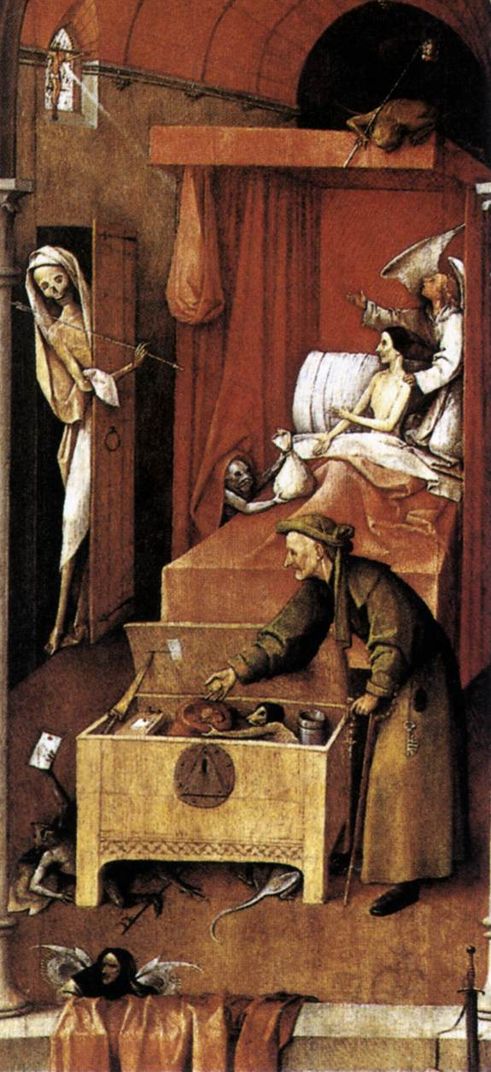
Death and the Miser
Hieronymus Bosch
(1490)

Slide 14
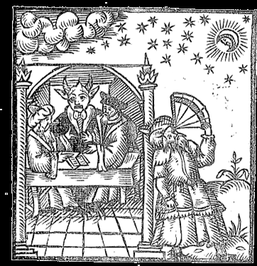
Studie in the arte of magick
Giovanni Cipriano
(1595)

Slide 15
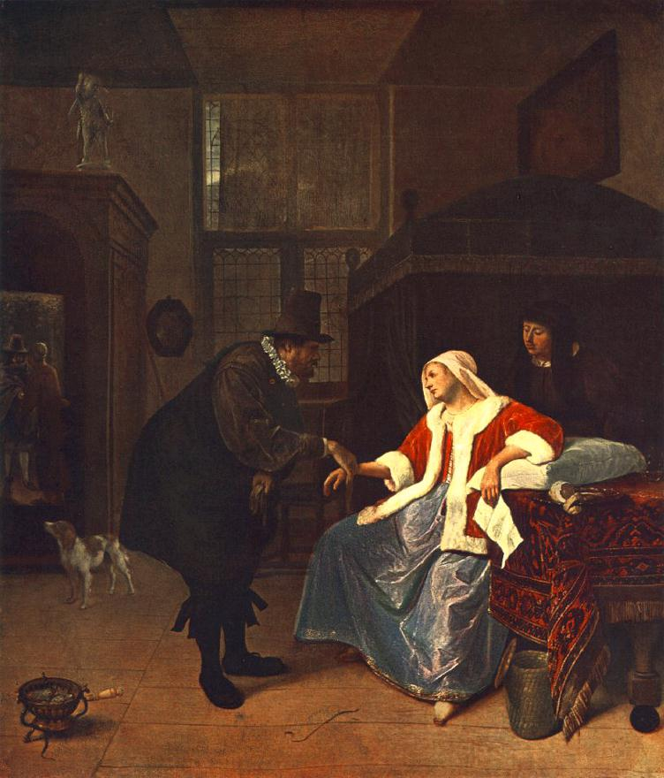
Love sickness
Jan Steen
(c.1660)

Slide 16
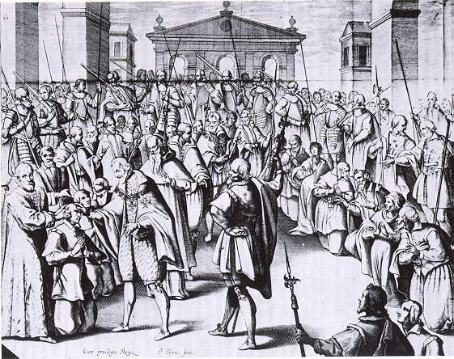
Henry IV of France touching for King’s evil
André Du Laurens (1609)

Slide 17
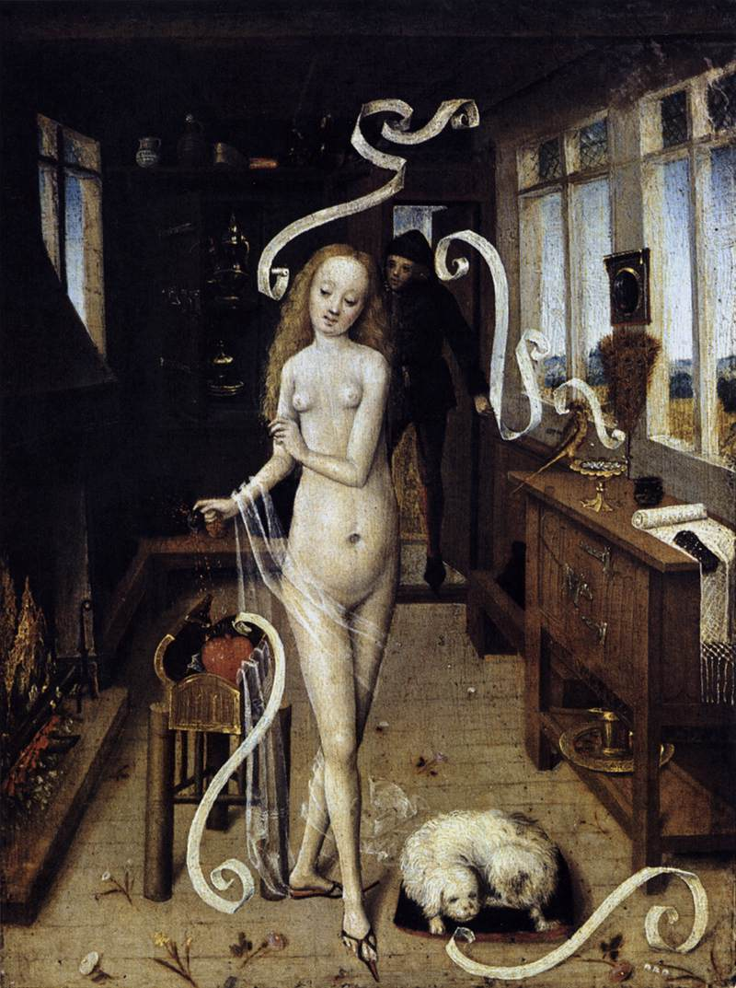
Love Magic
(c.1500)

Slide 18
Allso if in ony swerde or in a basen
Or in a thombe or in a cristall
Thow made ony childe to loke therein –
Witchcraft men cleped this all
Beware of this, it woll have a fall
~ Peter Idley, Instructions to his son (1473)

Slide 19
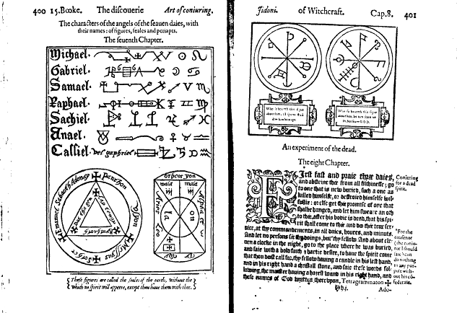
Reginald Scot, The discouerie of Witchcraft
(1584)

Slide 20
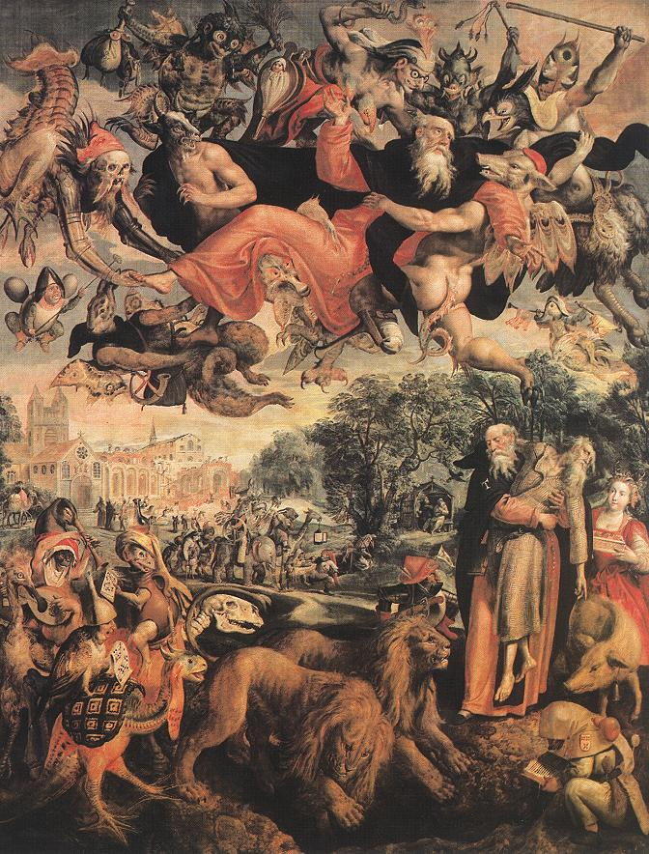
The Temptation of St Anthony
Marten de Vos
(c.1594)

Slide 21
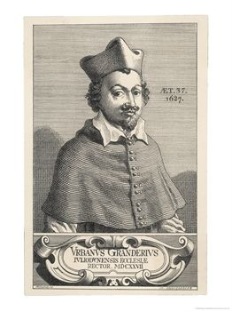
Urbain Grandier
(1627)

Slide 22
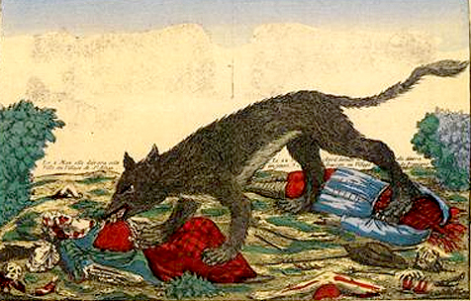
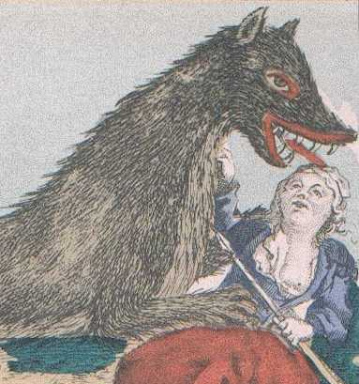
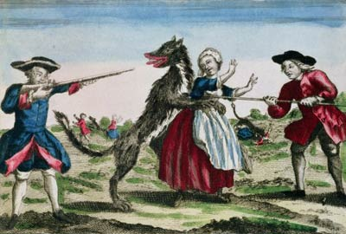
The Beast of Gévaudan
(1764-77)

Slide 23
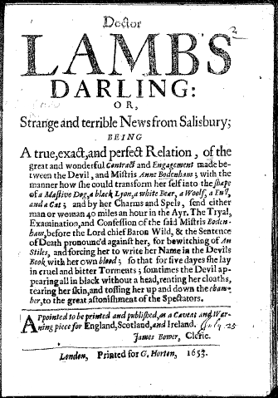
Doctor Lamb’s Darling
(1653)

Slide 24
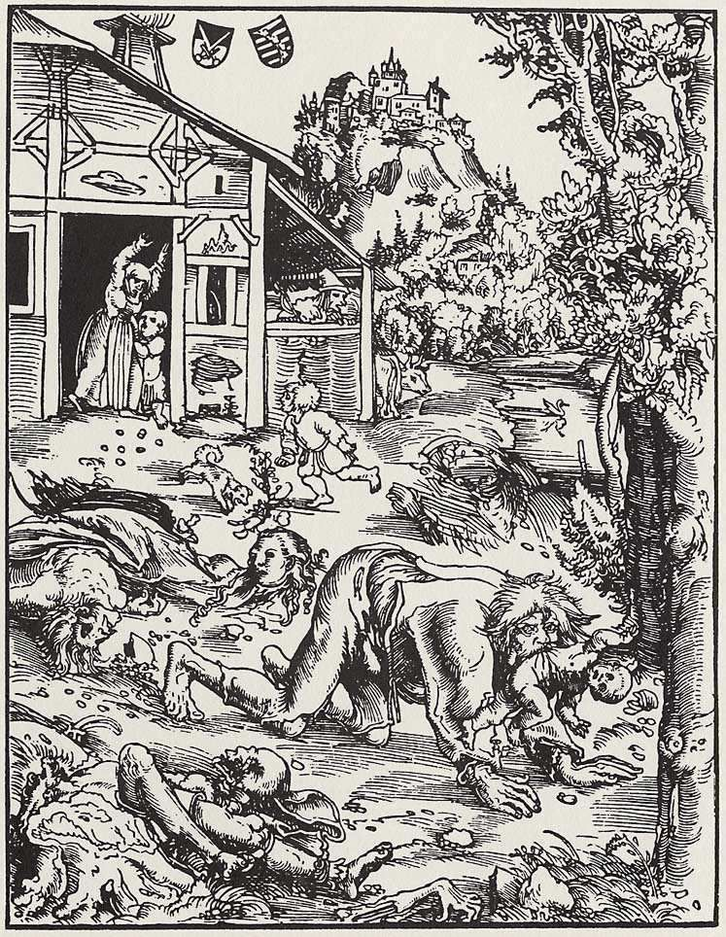
Werewolf
Lucas Cranach
(sixteenth-century)

Slide 25
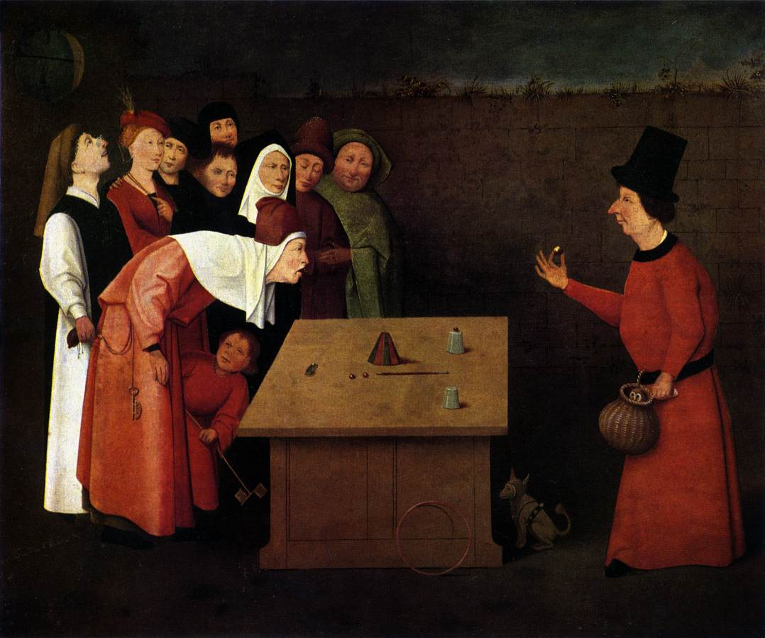
The Magician
after Hieronymus Bosch (c.1480)

Slide 26
Conclusions
Tension between Christianity & folk-belief not new
Intellectual culture always moving – incl. theology
Coexistence of beliefs but not syncretism
Long-term change – world increasingly predictable
Nevertheless, beware of progress!

