Slide 1
HI266
Deviance and Non-Conformity
Poverty as Deviance
Stephen Bates
s.m.j.bates@warwick.ac.uk

Slide 2
Aims of today
Think about deviance as a consequence of poverty
Consider ways of distinguishing ‘the poor’
What methods of poor relief existed?
What could they do to alleviate their own poverty

Slide 3
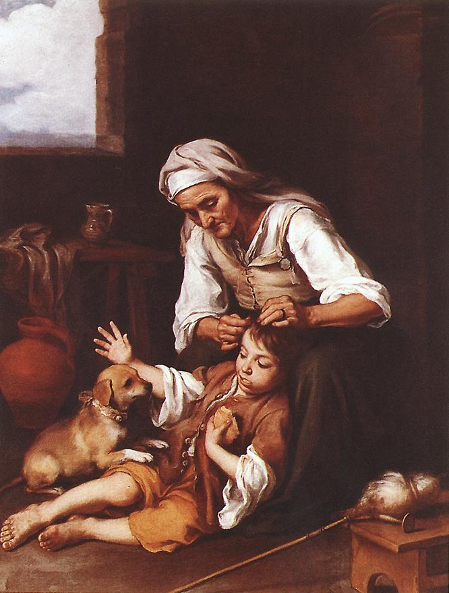
The Toilette
Bartolomé Esteban Morillo
(1675)

Slide 4
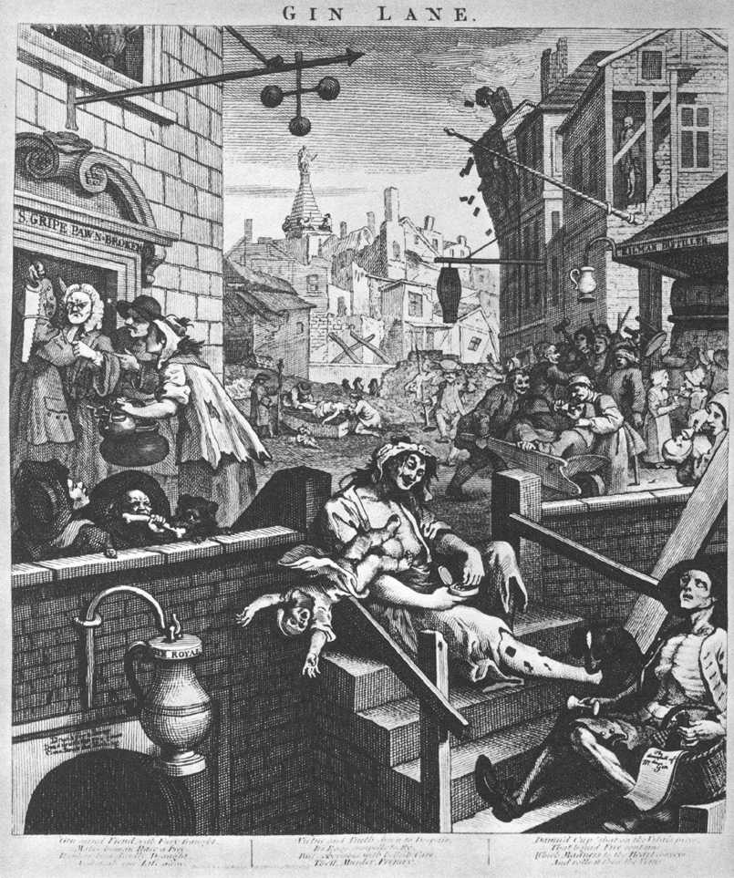
Gin Lane
William Hogarth
(1751)

Slide 5
Society
Nobility
The richer
Upper class
Middling sort
The rich
Middle class
Peasantry
The rest of us
Working class

Slide 6
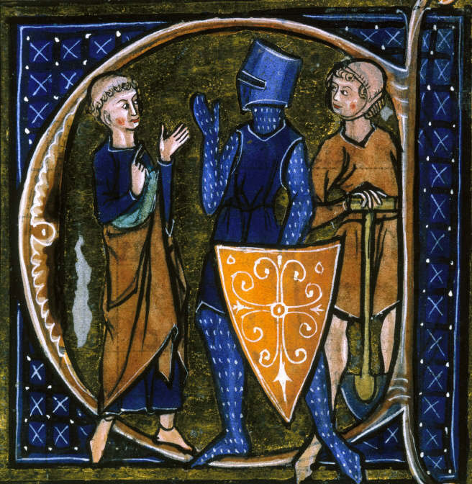
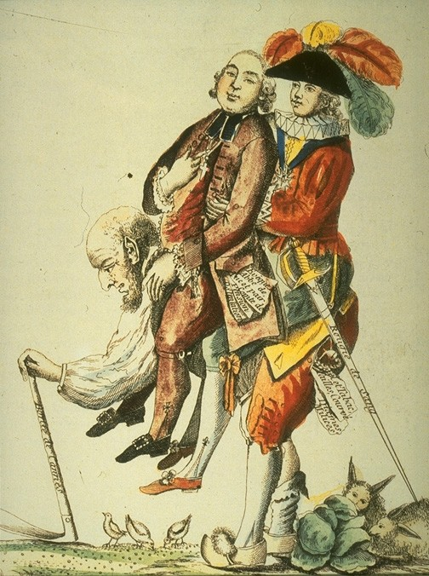
The Three Estates
Li Livres dou Santé
BL Ms Sloane 2435
(thirteenth century)
‘Hope that this game will soon be over’
(1789)

Slide 7
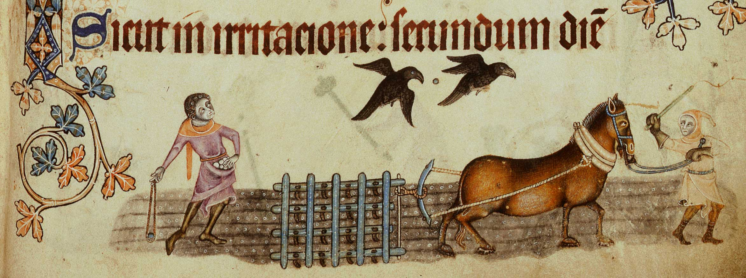
Peasantry
Luttrel Psalter
BL Ms Add. 42130
(thirteenth century)

Slide 8
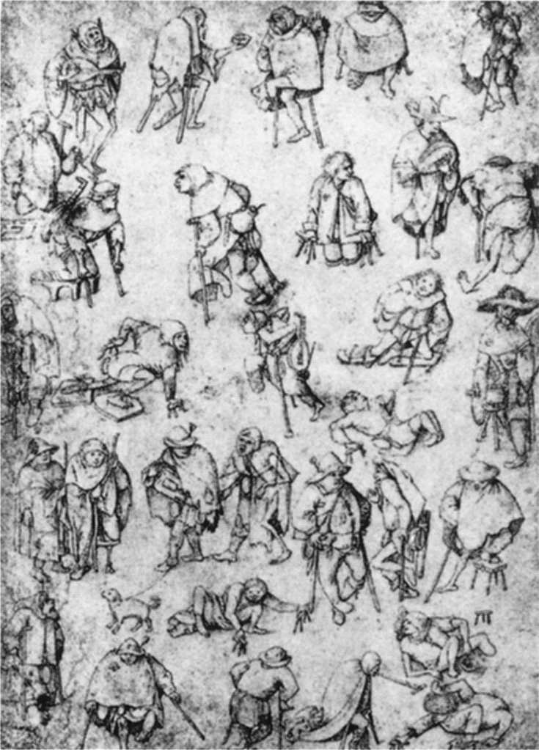
Beggars and Cripples
attributed to Hieronymus Bosch
(c.1450)

Slide 9
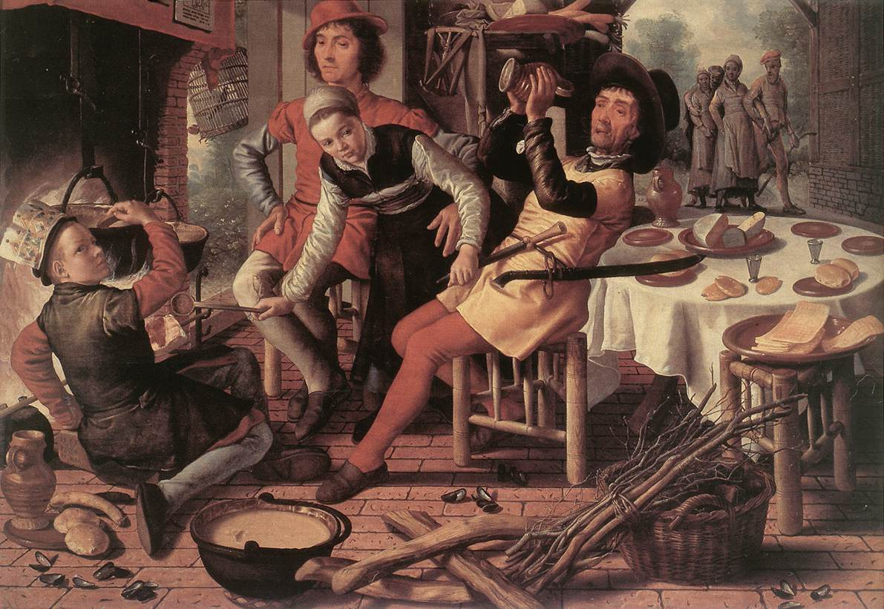
Peasants by the Hearth
Pieter Aertsen (c.1560)

Slide 10
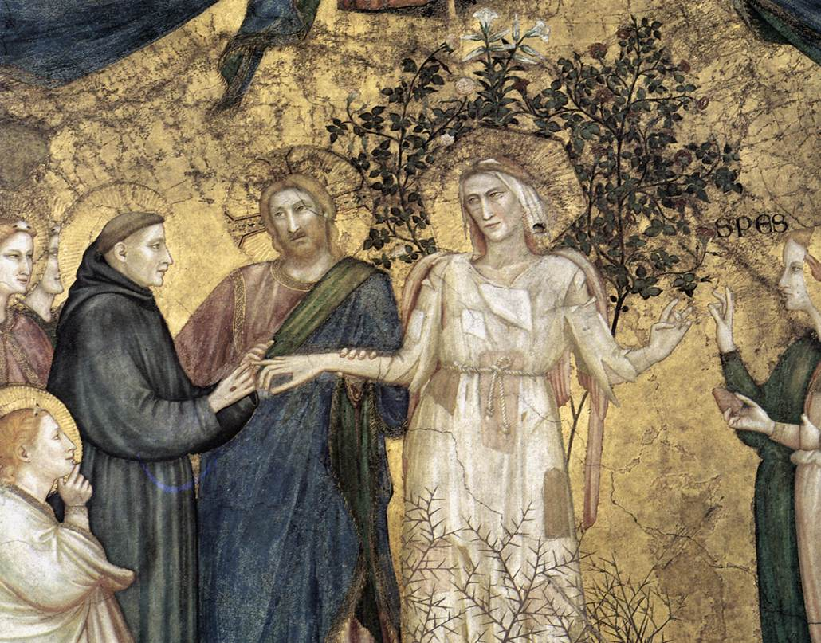
Allegory of Poverty
Giotto (c.1330)

Slide 11
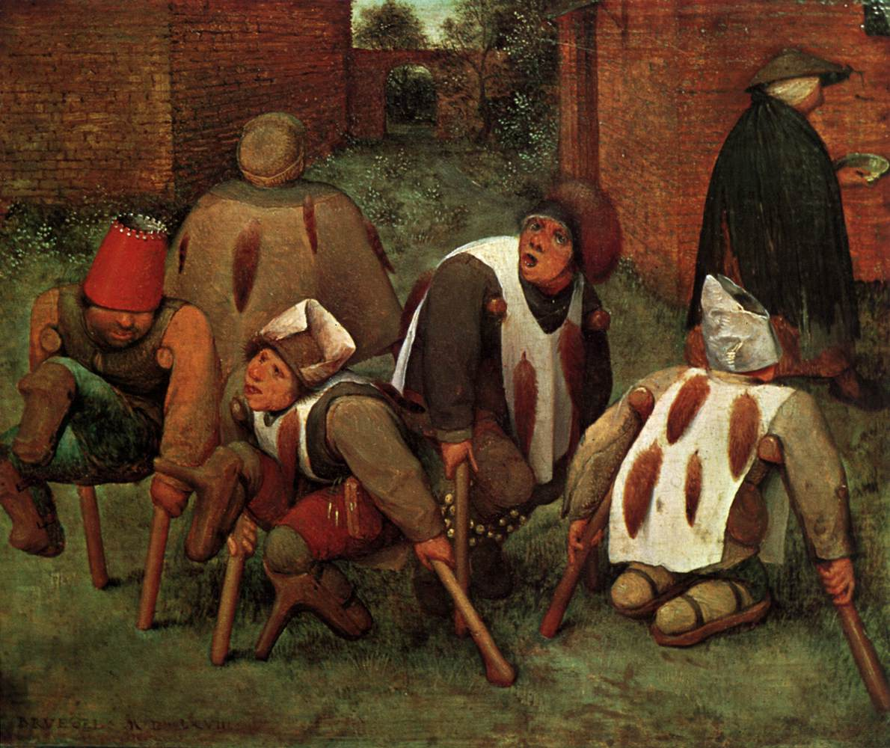
The Cripples
Pieter Bruegel the Elder (1568)

Slide 12
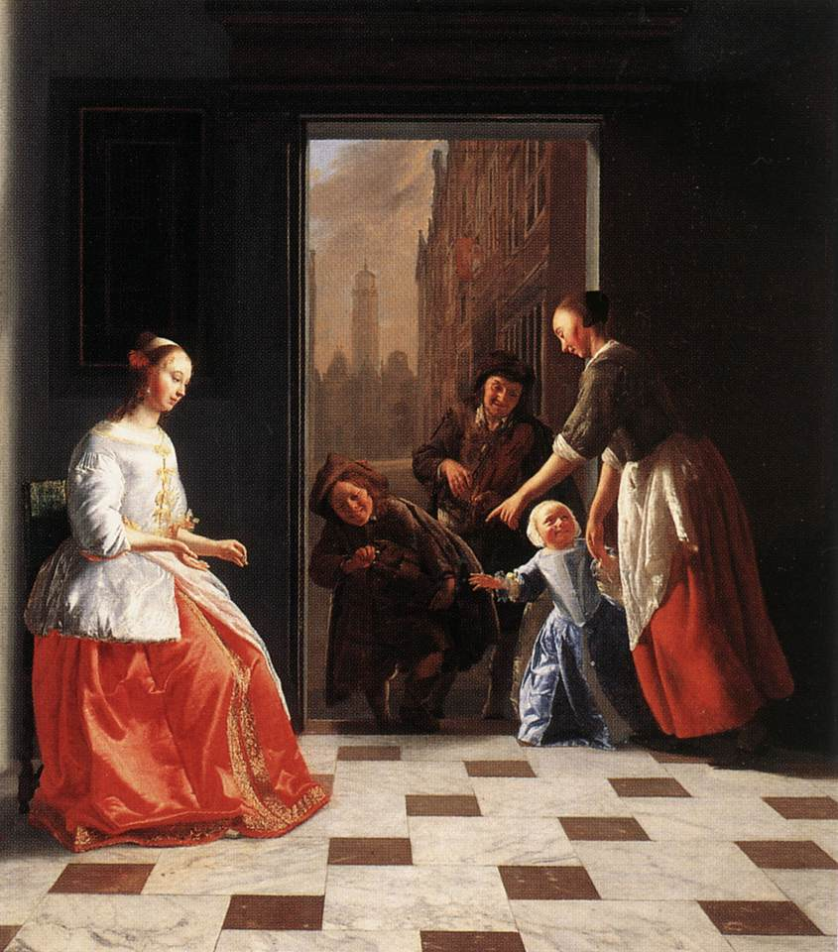
Street musicians at the doorway
Jacob Ochtervelt
(1665)

Slide 13
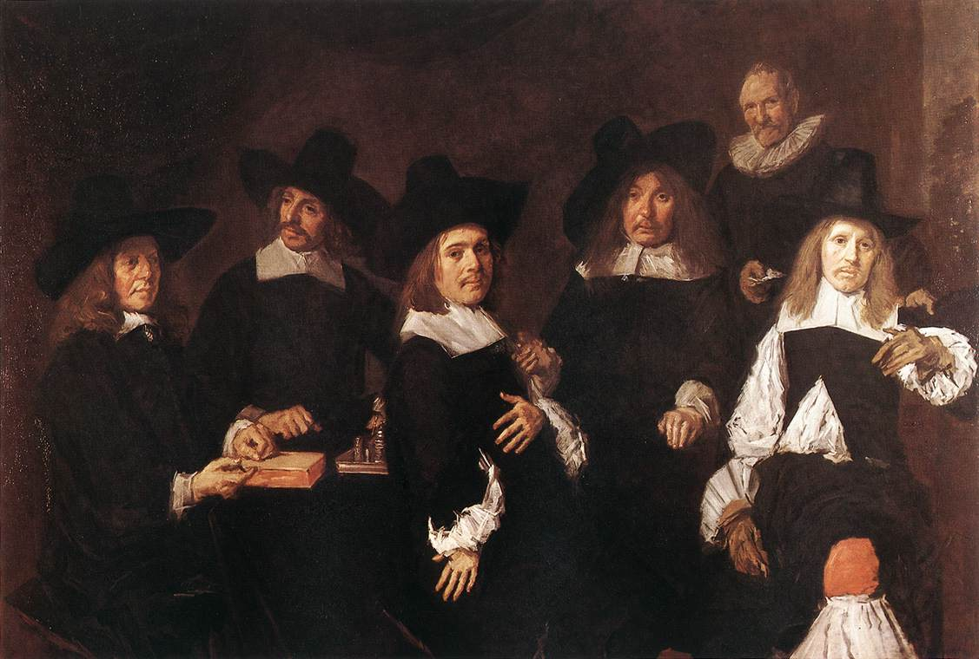
Regents of the Old Men’s Almhouse
Frans Hals (1664)

Slide 14
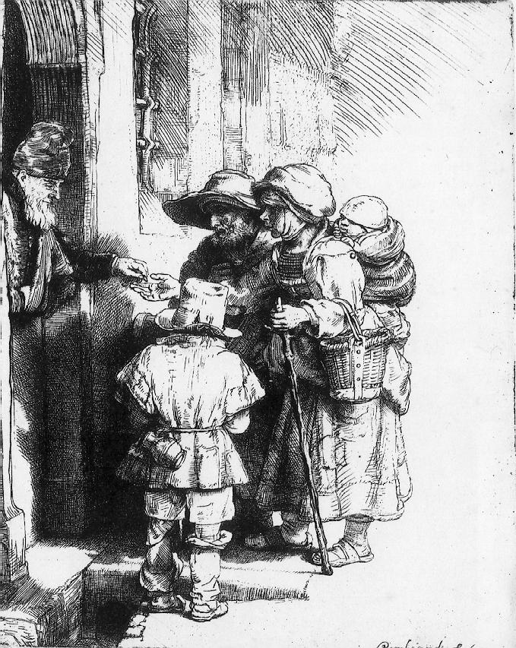
Beggars receiving alms
Rembrandt van Rijn
(1648)

Slide 15
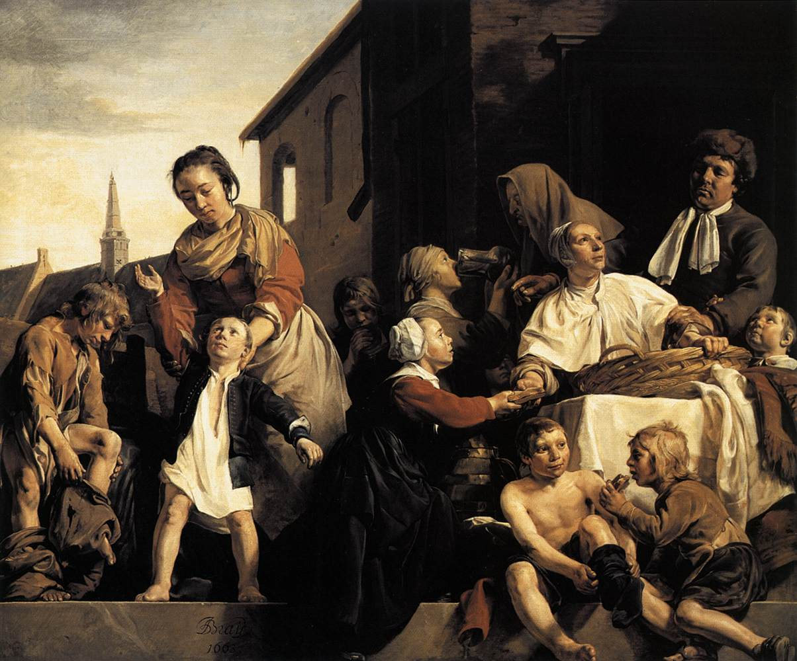
The Orphanage in Haarlem
Jan de Bray (1663)

Slide 16
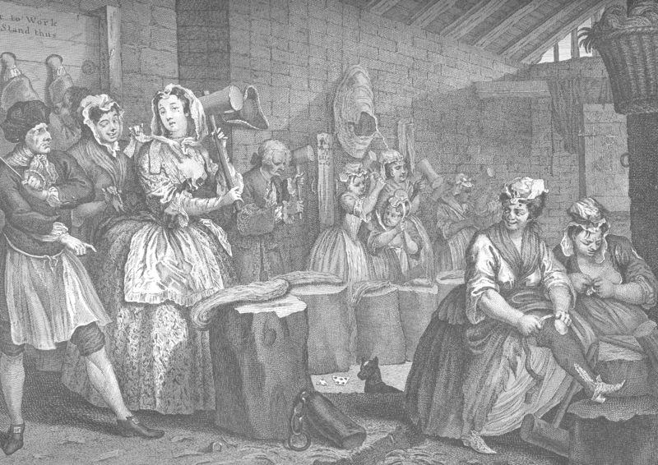
Moll in the Bridewell (from the Harlot’s Progress)
William Hogarth (1732)

Slide 17
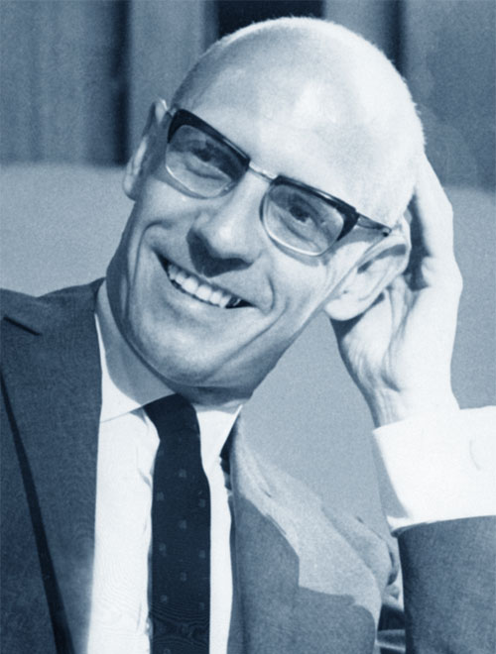

Madness and Civilisation
Michel Foucault
(1961)

Slide 18
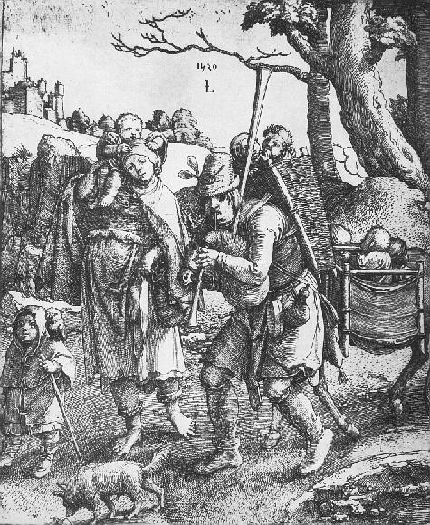
Wandering Beggars
Lucas van Leyden
(1520)

Slide 19
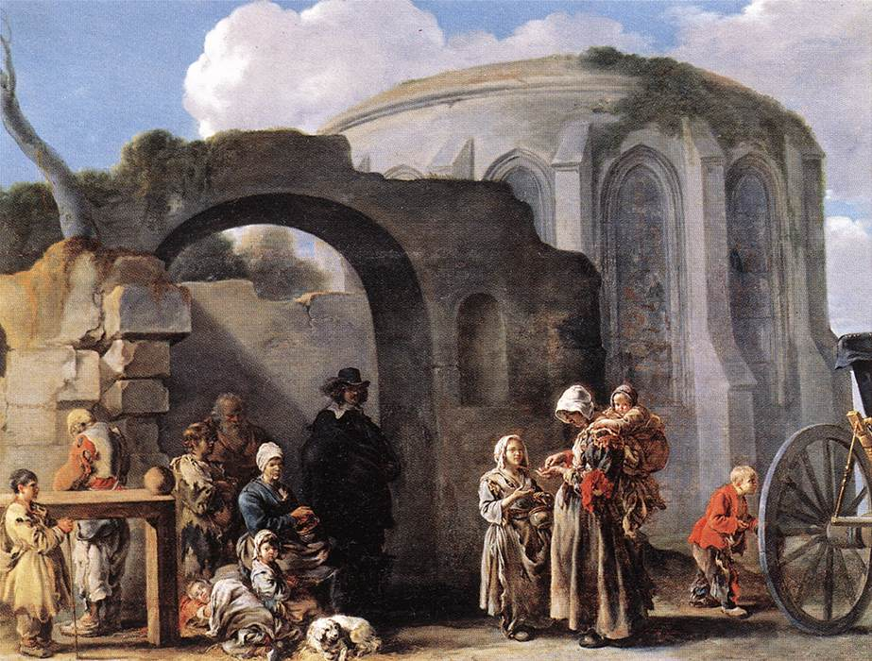
The Beggars
Sébastien Bourdon (c.1640)

Slide 20
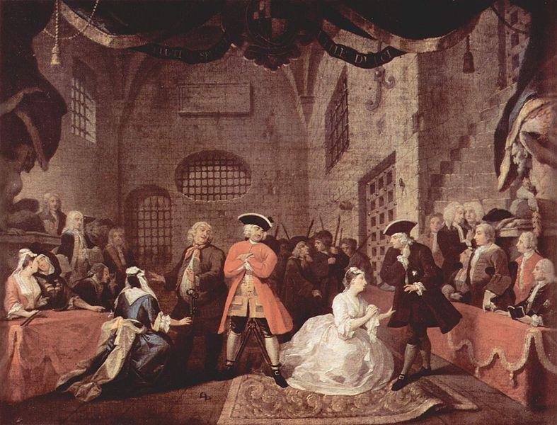
The Beggar’s Opera (Scene V)
William Hogarth (c.1728)

Slide 21
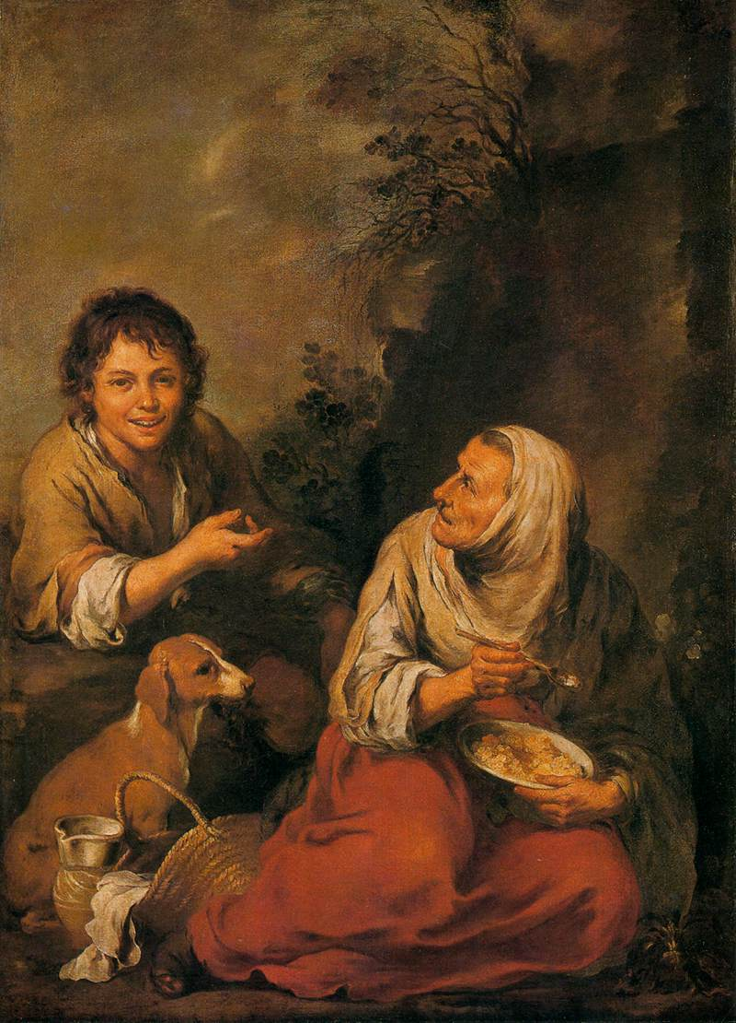
Old Woman and Boy
Bartolomé Murillo
(c.1650)

Slide 22
Conclusions
Important to differentiate between types of poverty
Include life-cycle poverty and disability
Increasing assumption of poor relief by secular society
Continuity of moral judgements and association of vice
Increased institutionalisation – workhouses &c.

