Slide 1
HI266
Deviance and Non-Conformity
Criminalising the Margins
Stephen Bates
s.m.j.bates@warwick.ac.uk

Slide 2
Aims of today
How was crime understood in pre-modern period?
How did the treatment of criminals change?
Is criminality a product of power relationships
What was the state of law enforcement?
How marginal was early modern crime?

Slide 3
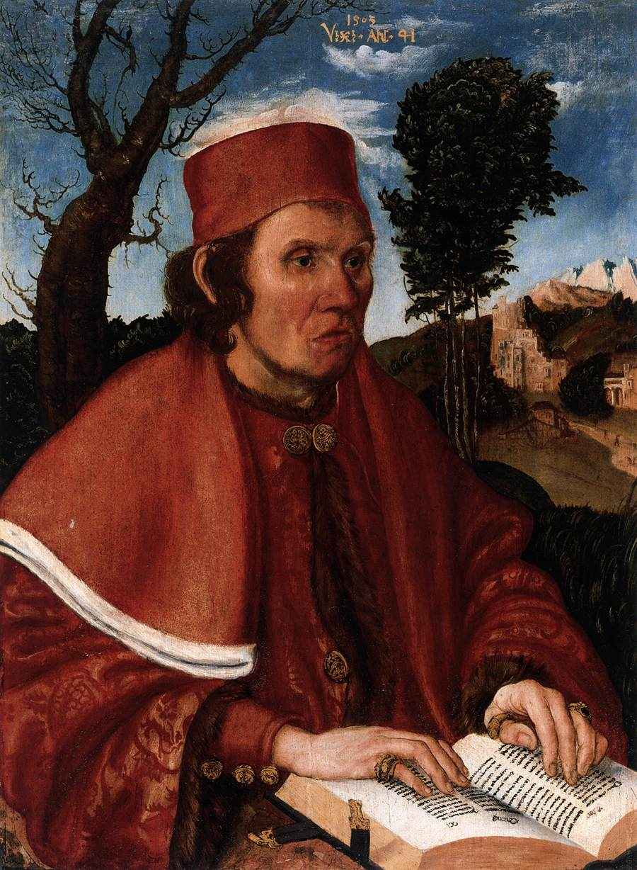
Portrait of a Jurist
Lucas Cranach
(1503)

Slide 4
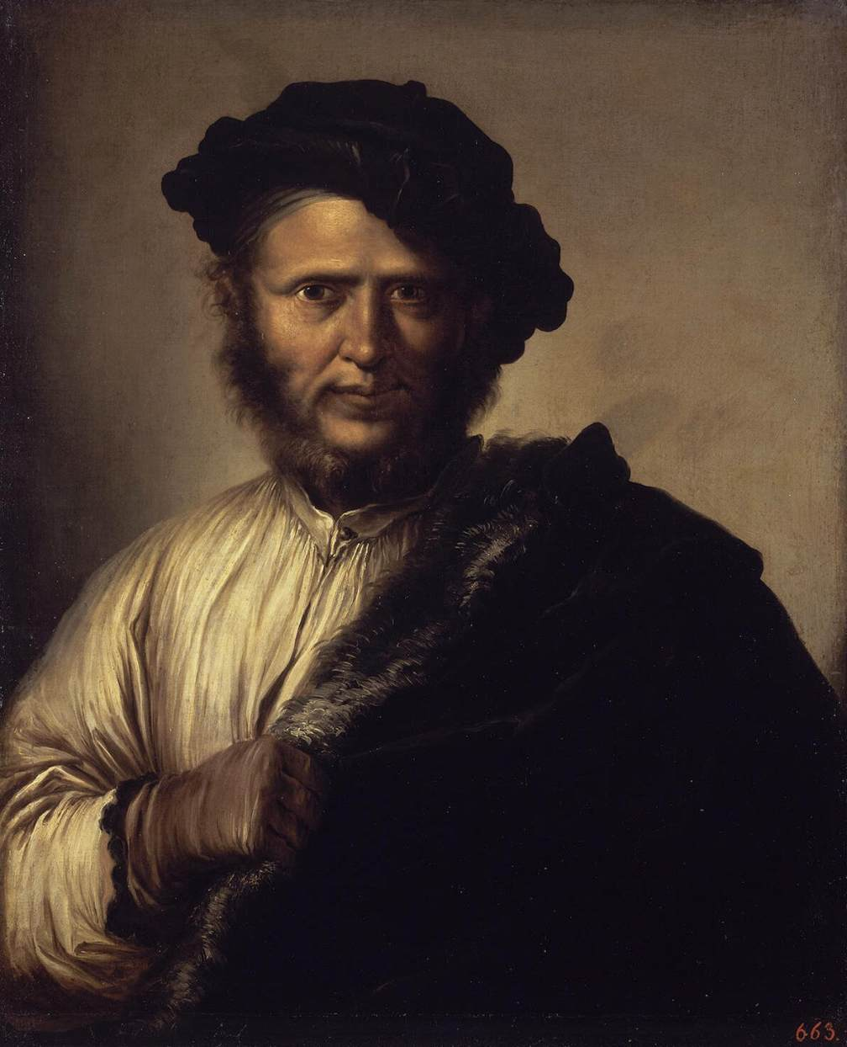
Portrait of a Brigand
Salvator Rosa
(c.1640)

Slide 5
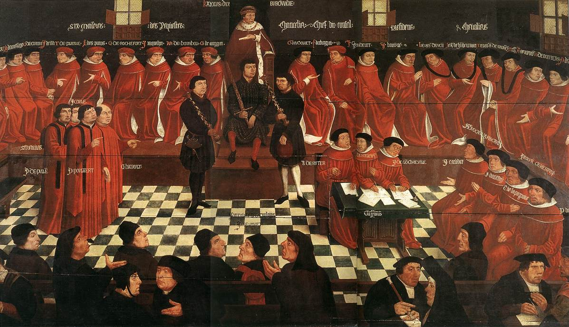
Opening Session of the Parliament of Burgundy
Jan Coessaet (1587)

Slide 6
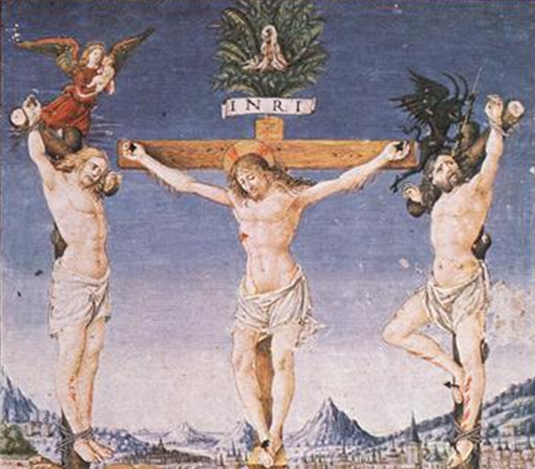
Christ crucified alongside two thieves
(fifteenth-century manuscript)

Slide 7
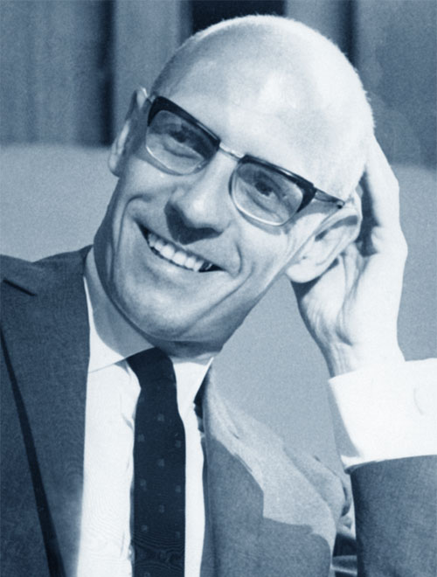
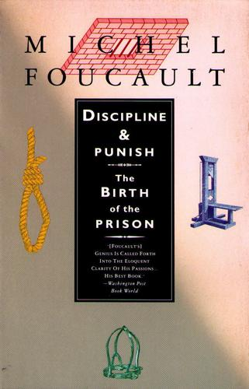
Discipline and Punish: the Birth of the Prison
Michel Foucault (1975)

Slide 8
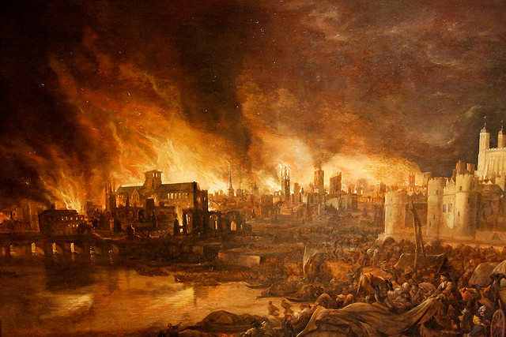
The Great Fire of London

Slide 9
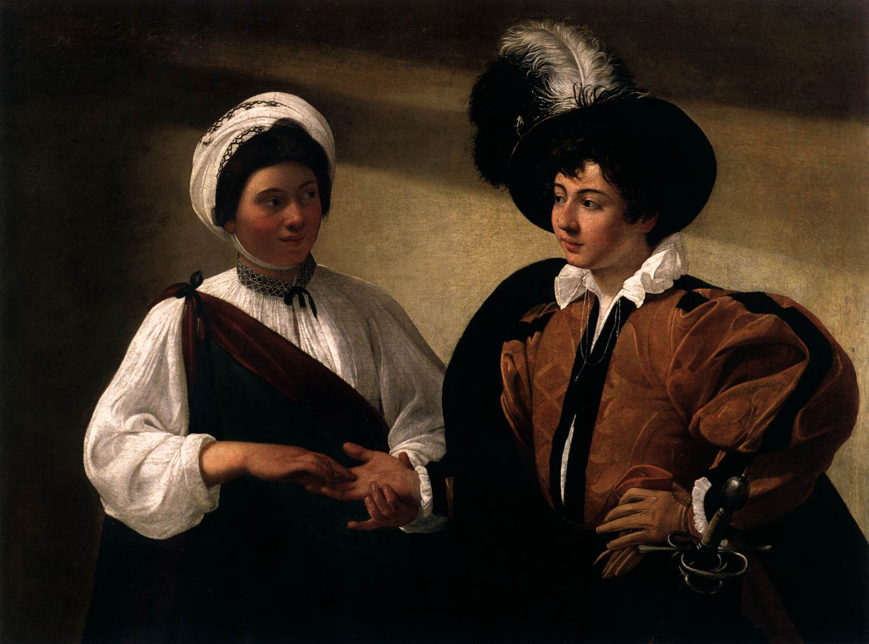
The Fortune Teller
Caravaggio (c.1597)

Slide 10
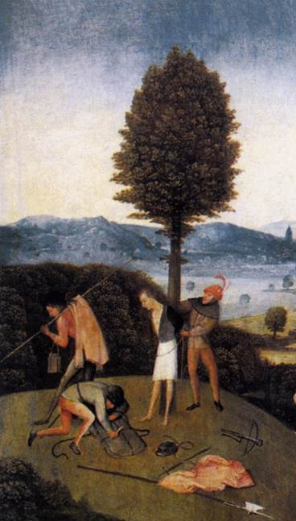
Haywain Triptych (detail)
Hieronymus Bosch
(1502)

Slide 11
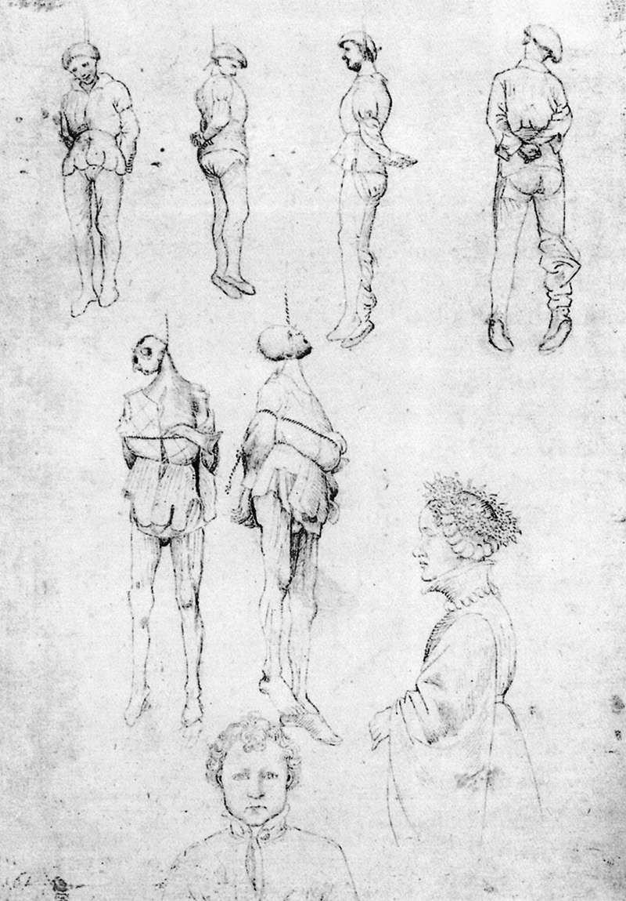
Hanged men
(and two portraits)
Pisanello
(c.1430)

Slide 12
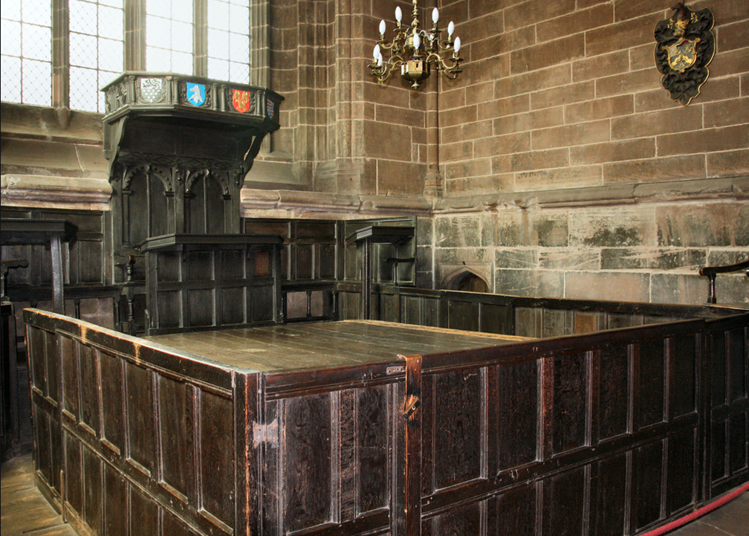
Chester Consistory Court
(seventeenth-century)

Slide 13
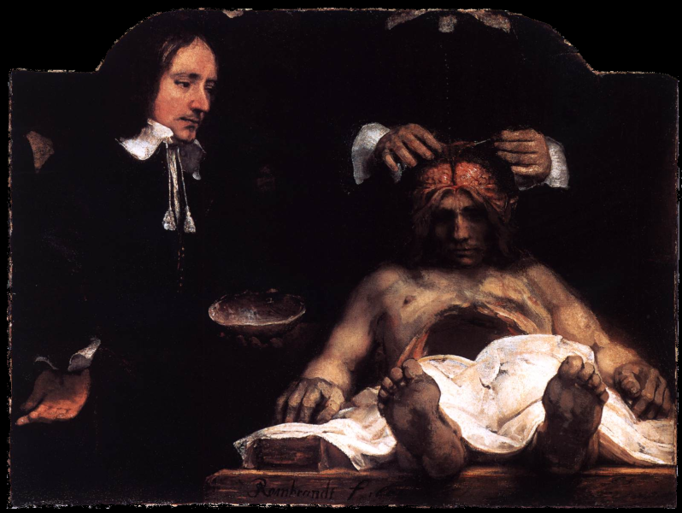
The Anatomy Lesson
Rembrandt van Rijn (1656)

Slide 14
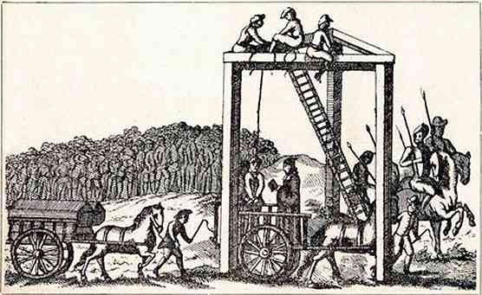
The Tyburn ‘Tree’
(1680)

Slide 15
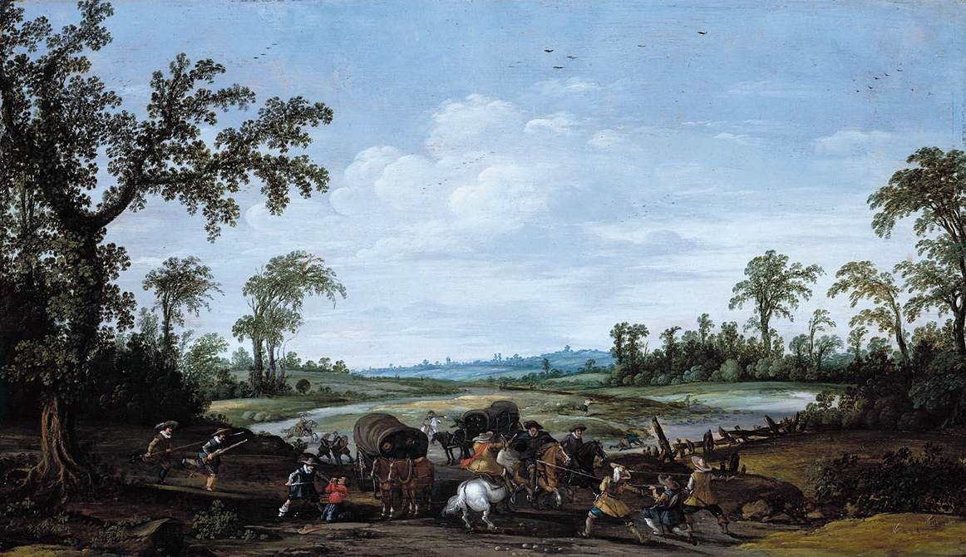
Bandits attacking a Caravan of Travellers
Esaias van de Velde (1629)

Slide 16
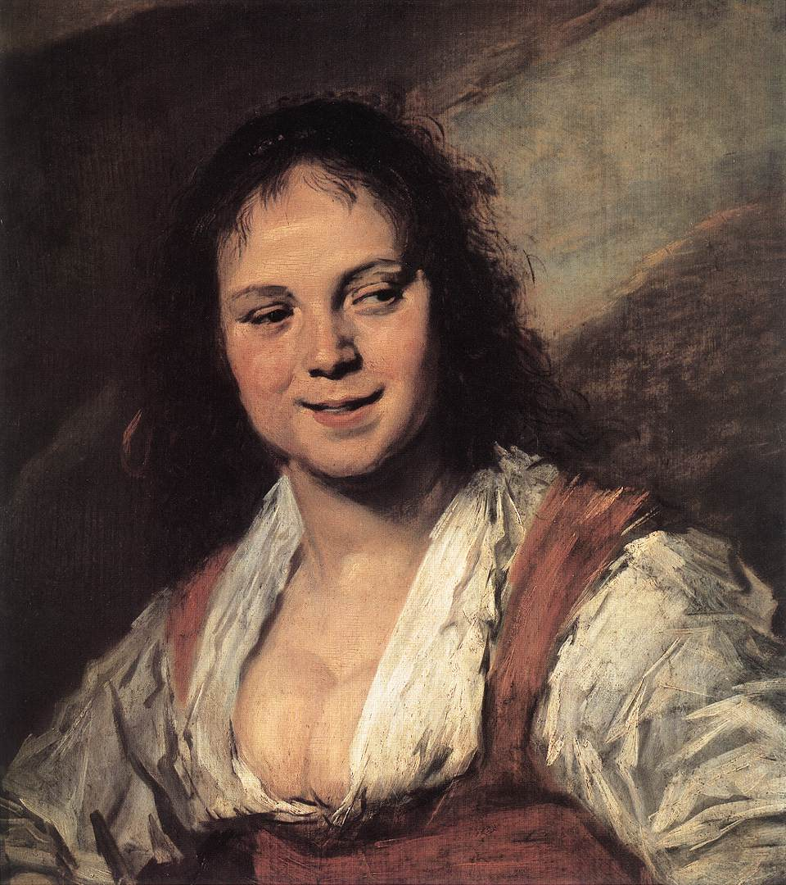
Gypsy Girl
Frans Hals
(1630)

Slide 17
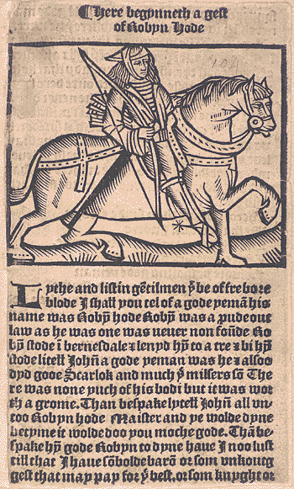
Here begynneth a gest of Robyn Hode
(c.1510)

Slide 18
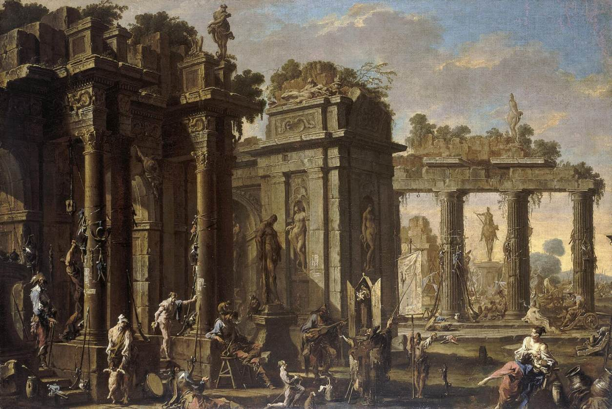
Bandits at rest
Alessandro Magnesco (c.1710)

Slide 19
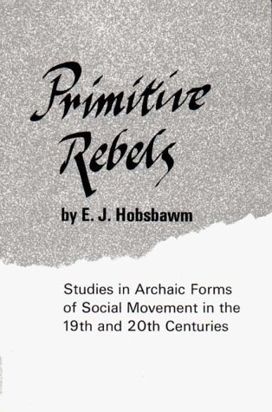
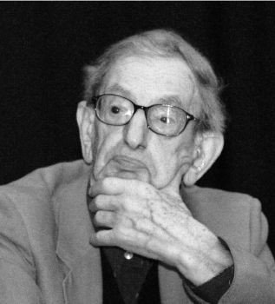
Primitive Rebels
Eric Hobsbawm
(1959, revised 1971)

Slide 20
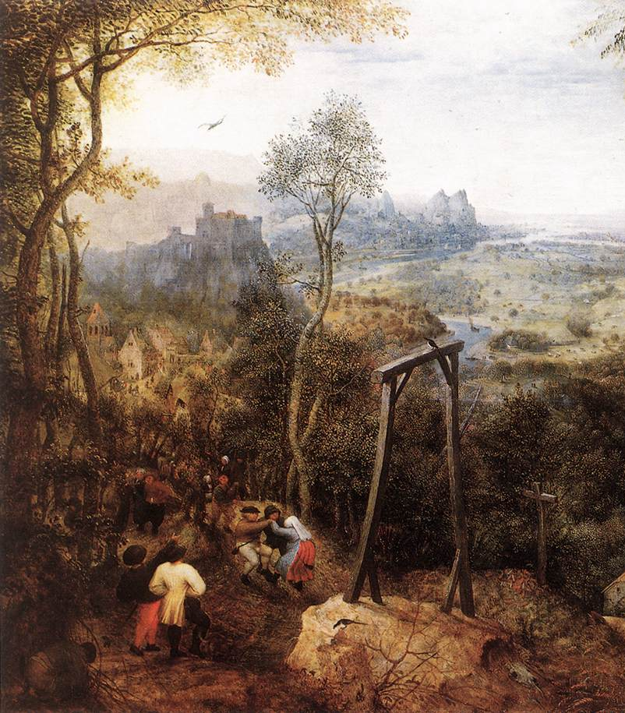
Magpie on the Gallows
Pieter Bruegel the Elder
(1568)

Slide 21
Conclusions
Crime closely associated with poverty
Generally period characterised by lack of empathy
Criminals can be ‘brought in’ from the margins
Development of magisterial and penal institutions

