Slide 1
HI266
Deviance and Non-Conformity
Jews
Stephen Bates
s.m.j.bates@warwick.ac.uk

Slide 2
Aims of today
Contextualise the Jewish people
Consider how they were integrated into society
Examine the character of their persecution
Identify regional variations in their treatment

Slide 3

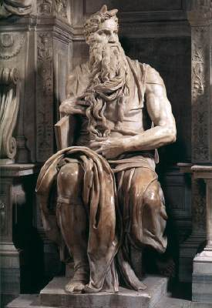
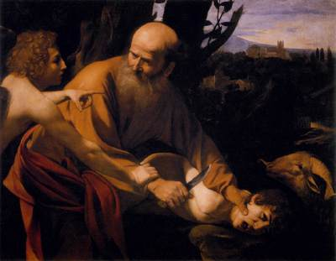
Exiles
The Fertile Crescent
Jerusalem ●
Canaan ●
BABYLONIA
EGYPT
● Ur
● Sinai
The Sacrifice of Isaac
Caravaggio
(1602)
Moses
Michelangelo
(1515)

Slide 4
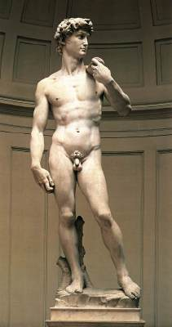
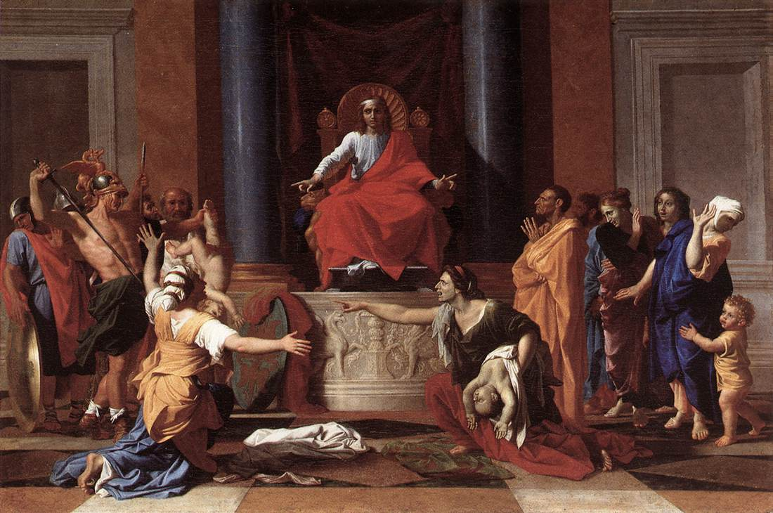
Israel’s Golden Age
The Judgement of Solomon
Nicholas Poussin
(1649)
David
Michelangelo
(1504)

Slide 5
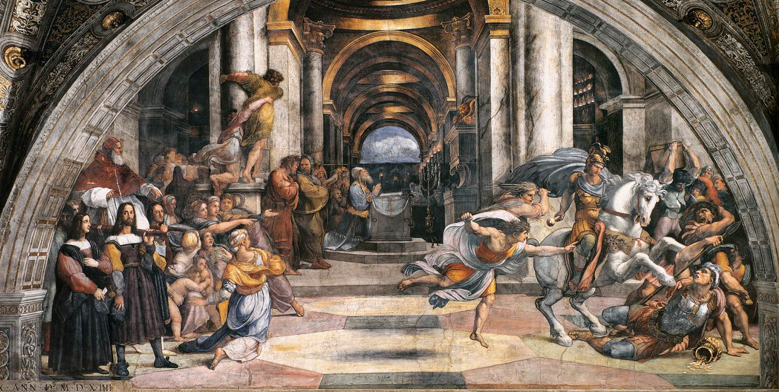
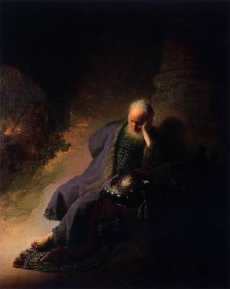
Exiles
Nineveh ●
Samaria ●
ASSYRIA
Jerusalem ●
BABYLONIA
Jeremiah Lamenting the Destruction of Jerusalem
Rembrandt van Rijn
(1630)
The Expulsion of Heliodorus from the Temple
Raphael (1512)

Slide 6
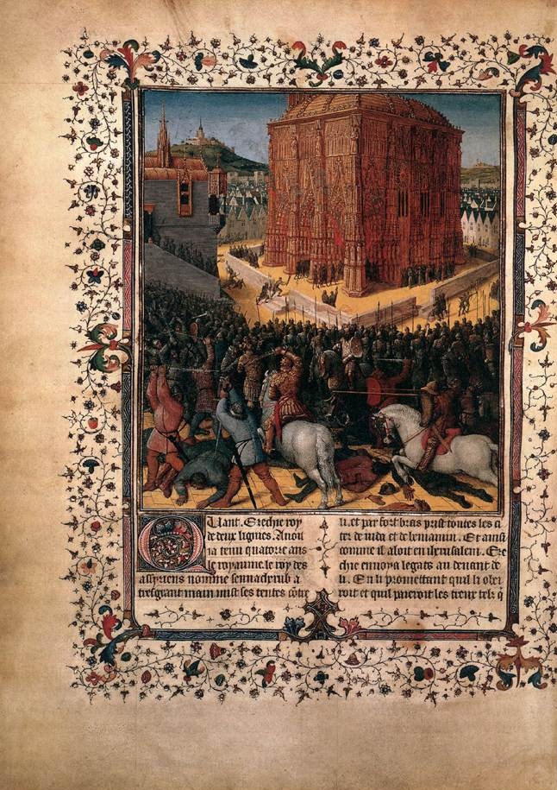
Exiles
Rome ●
Jerusalem ●
Siege of Jerusalem
Jean Fouquet
(Ms. De antiquitatibus Iudaeorum, c.1476)

Slide 7
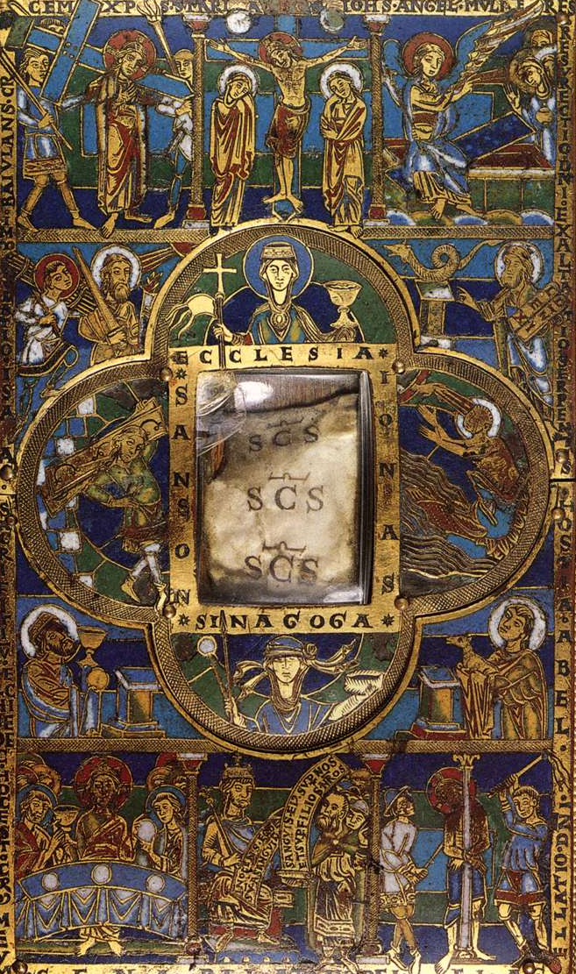
Ecclesia et Sinagoga
Portable Altar
(c.1160)

Slide 8
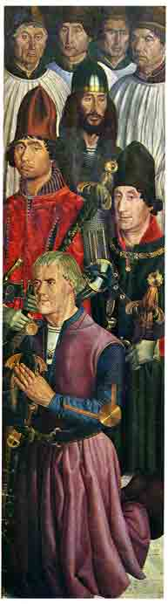
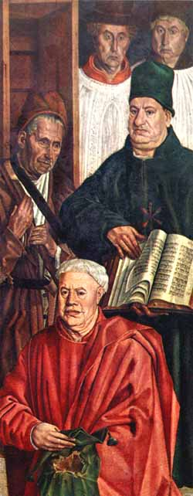
Moorish knight and Jewish scholar

Slide 9
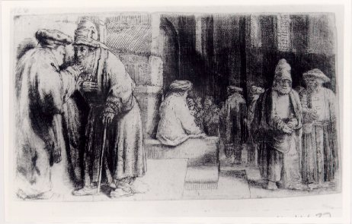
Jews in the Synagogue
Rembrandt (1648)

Slide 10
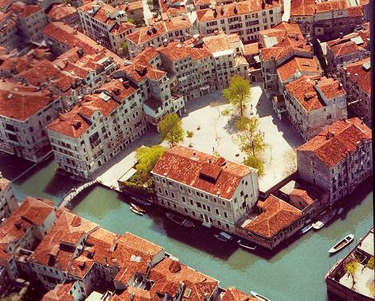
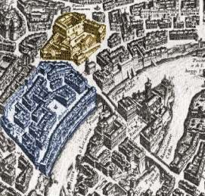
Jewish Ghettos
(Venice and Rome)

Slide 11
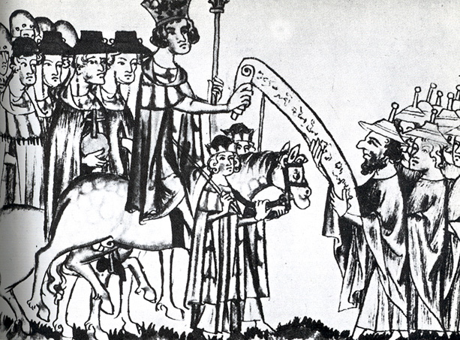
Protection of the Jews

Slide 12
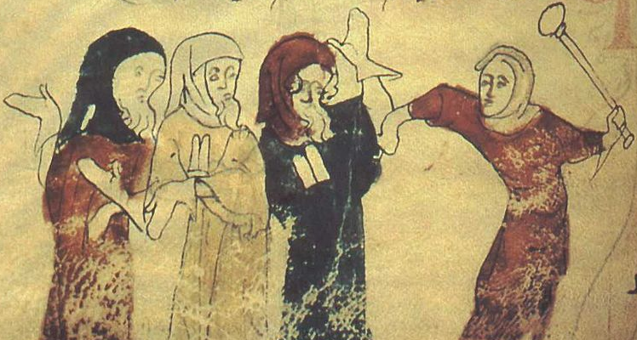
Persecution of Jews
Matthew Paris (thirteenth century)

Slide 13
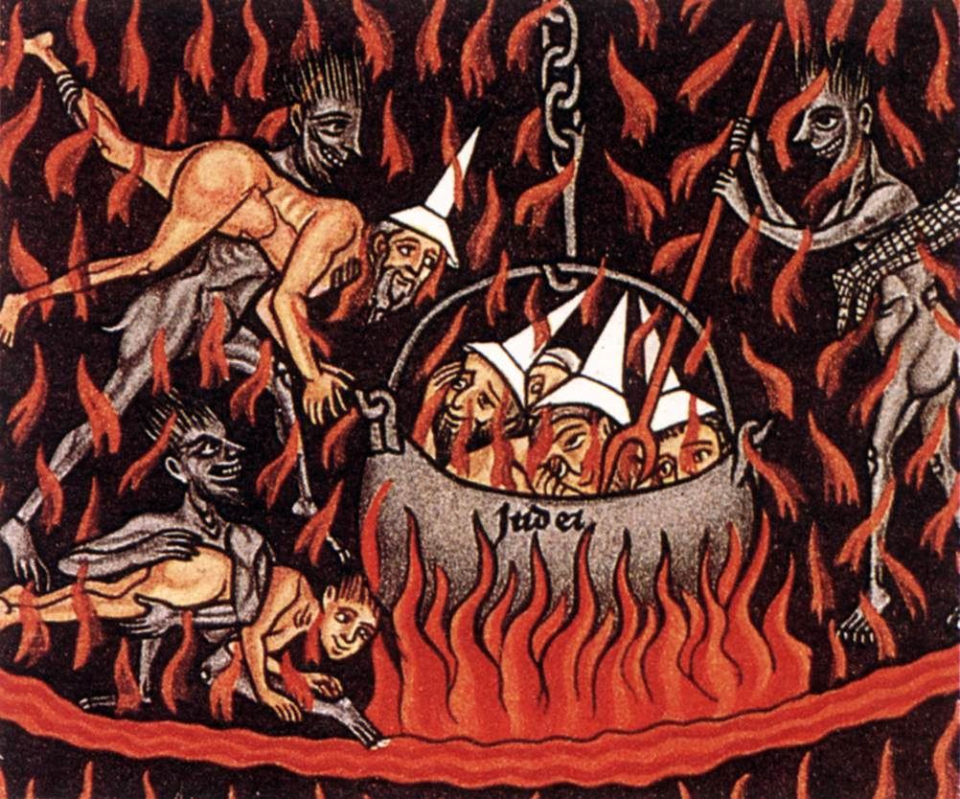


Hortus Delicarum
(the Garden of Delights)
Detail from the Last Judgement
(c.1180)
Jews
Darmstadt Haggadah
(c.1430)

Slide 14
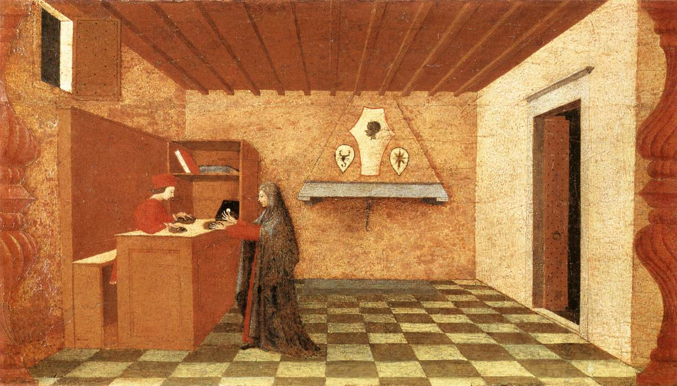
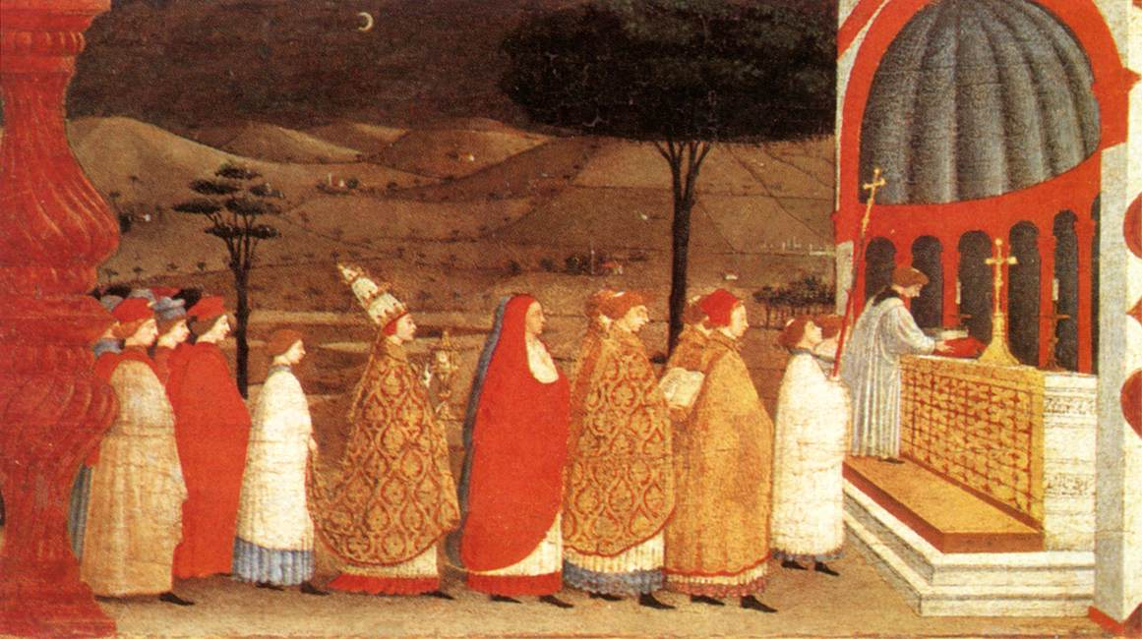
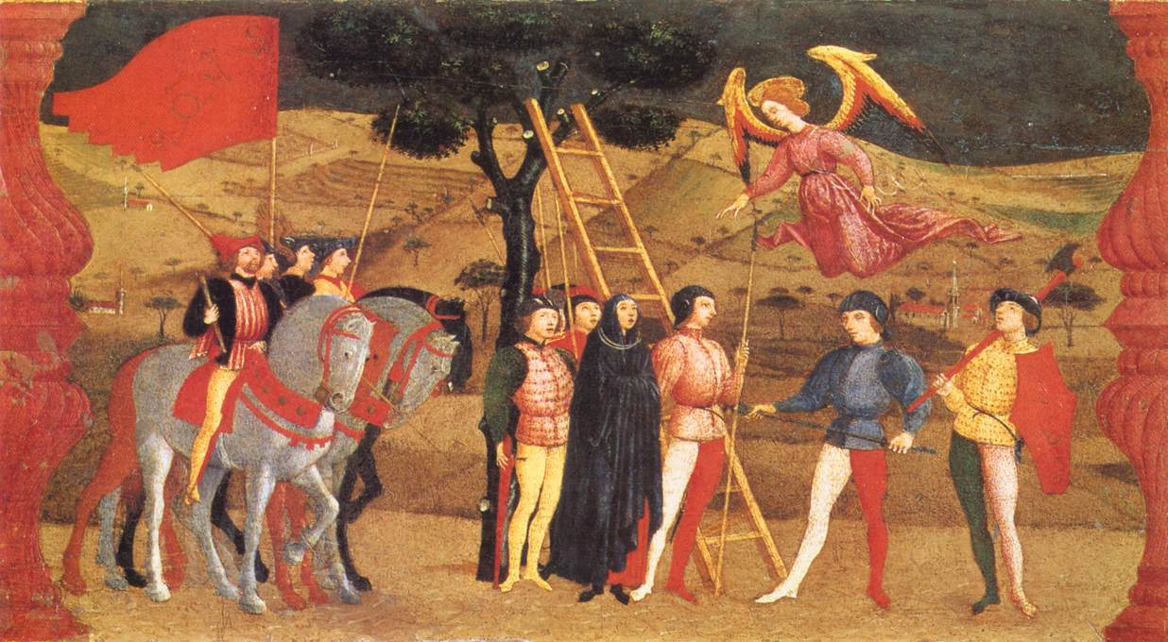
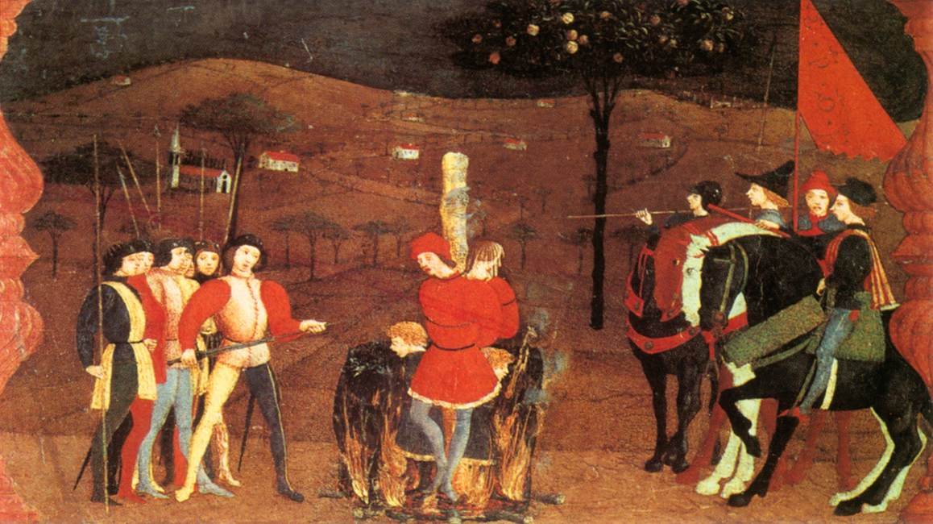
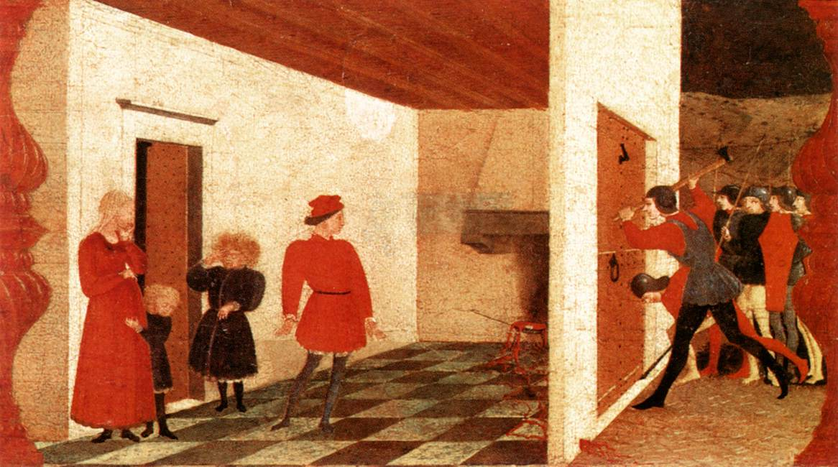
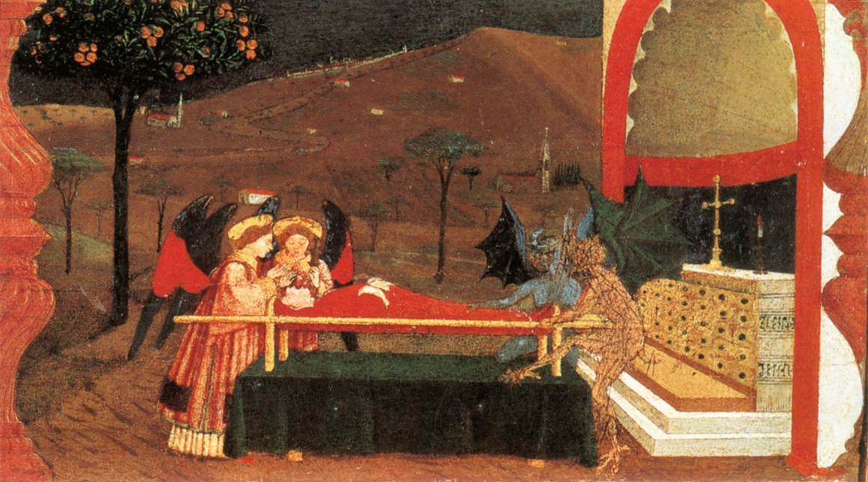
Miracle of the Desecrated Host
Paolo Uccello (1465-69)

Slide 15
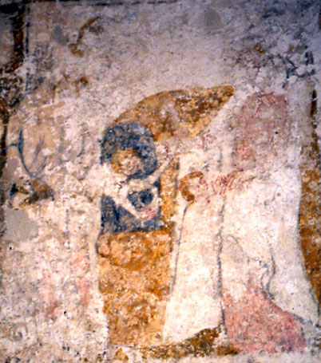
Virgin rescuing the Jewish boy from the furnace
(fourteenth-century)
St Giles, Chalfont St. Giles, Buckinghamshire

Slide 16
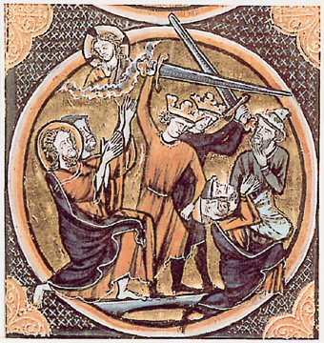
Massacre of Jews

Slide 17
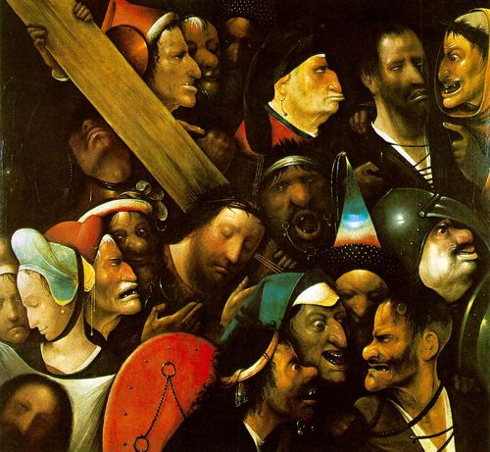
Christ Carrying the Cross
Hieronymous Bosch
(1510)

Slide 18
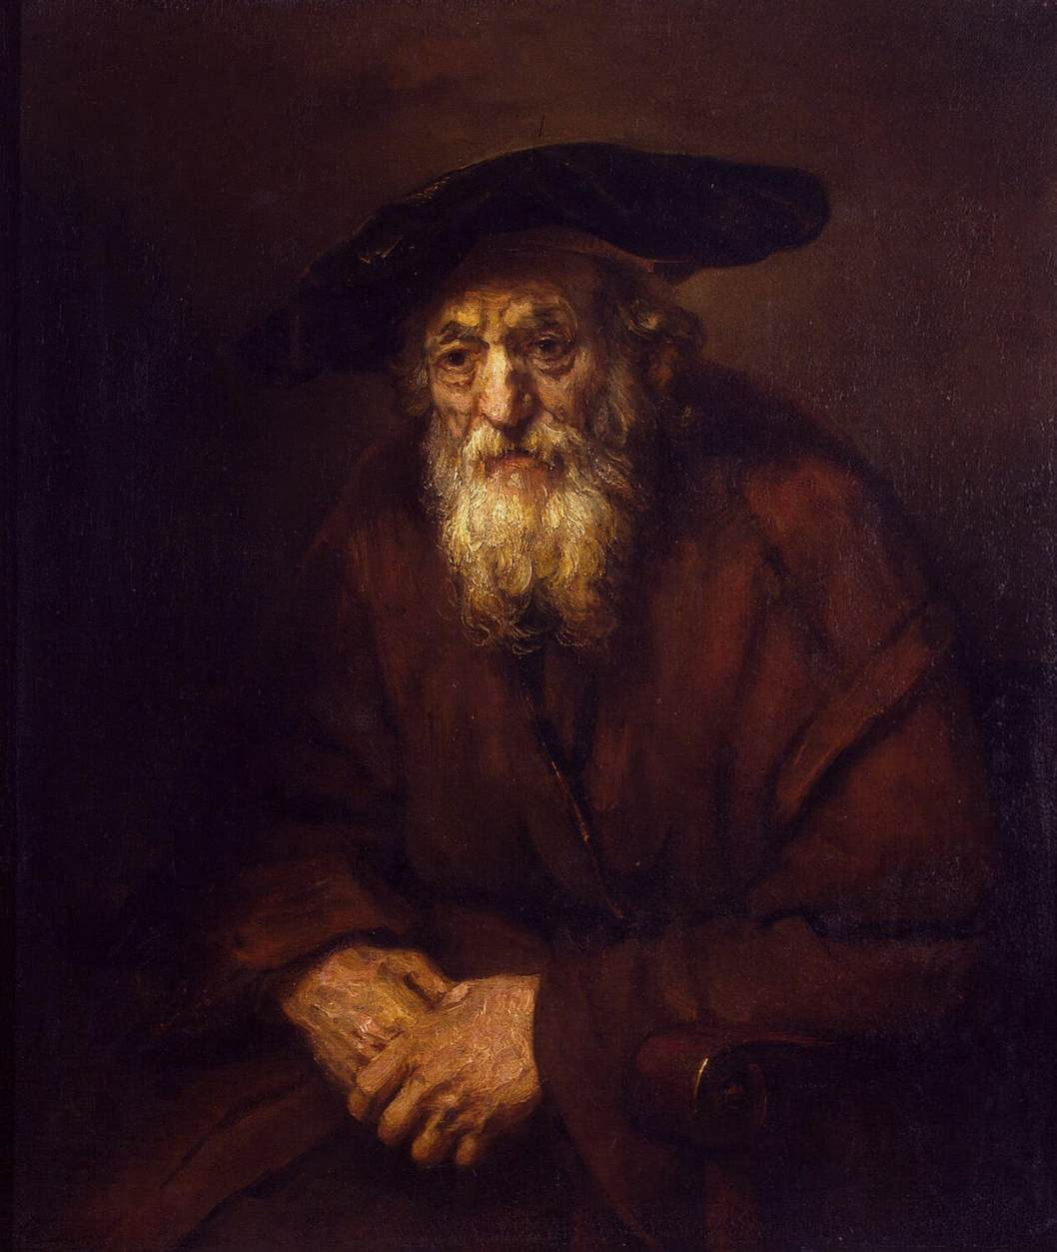
The Old Jew
Rembrandt
(1654)

Slide 19
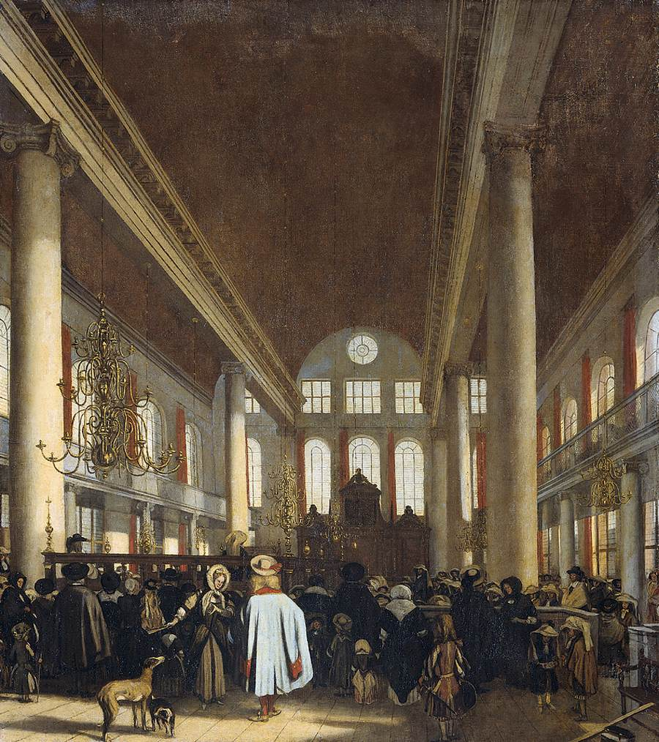
Interior of the Portuguese Synagogue in Amsterdam
Emanuel de Witte
(1680)

Slide 20
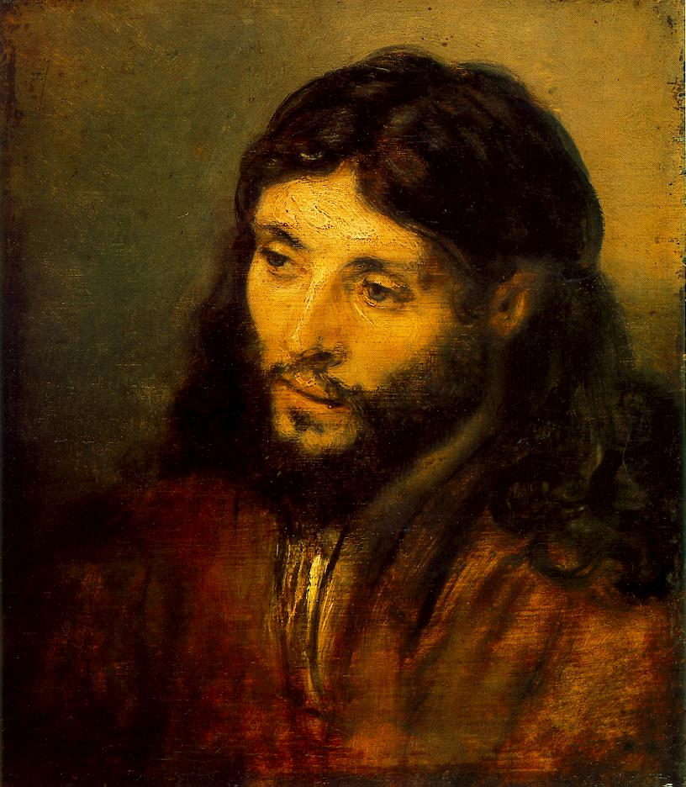
Young Jew as Christ
Rembrandt
(c.1656)

Slide 21
Conclusions
Rulers had inconsistent policies toward Jews
Motivations socio-economic as well as religious
Increasing acceptance of Jews with Enlightenment
Antisemitism established in European culture

