Slide 1

HI266
Deviance and Non-Conformity
Muslims
Stephen Bates
s.m.j.bates@warwick.ac.uk

Slide 2
Aims of today
Thinking about medieval/early modern Islam
Disaggregate different groups of Muslims
Consider their relationship with Europe’s Christians
Assess their representation and treatment

Slide 3
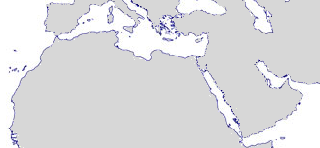
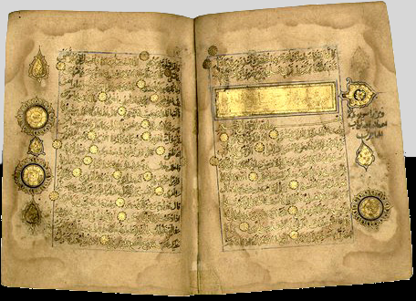
Islam
● Constantinople
Cordoba 711 ●
Palermo 831 ●
ANATOLIA
Damascus 635 ●
● Baghdad
Tripoli 647 ●
Jerusalem 638 ●
SYRIA
● Ctesiphon
HEJAZ
Medina ●
● Mecca
Qur’an
(1203)

Slide 4
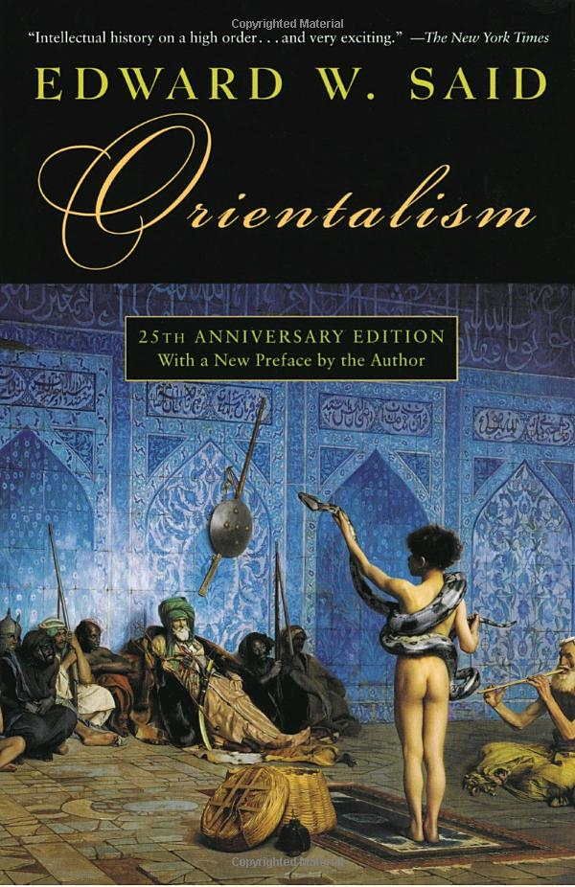
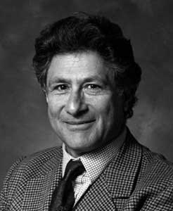
Orientalism
Edward Said (1978)

Slide 5
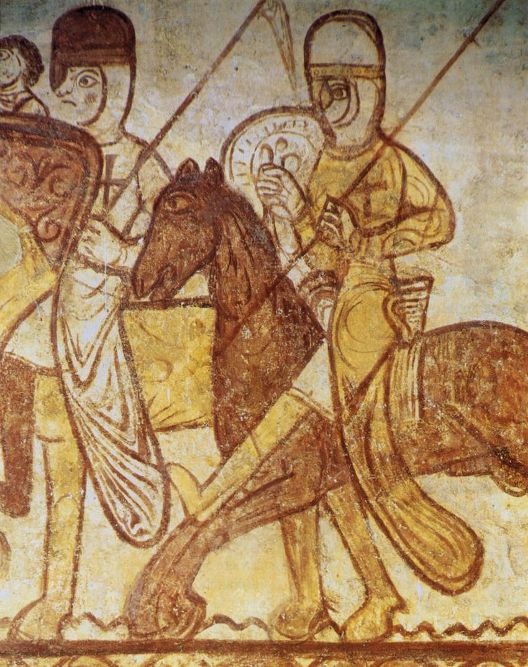
Crusaders
Templar Chapel, Cressac-Saint-Genis
(twelfth century)

Slide 6
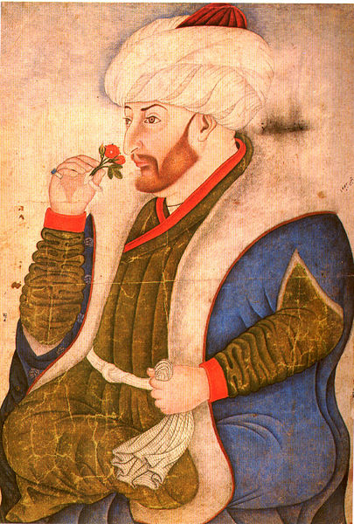
Mehmed II
(fifteenth century)

Slide 7
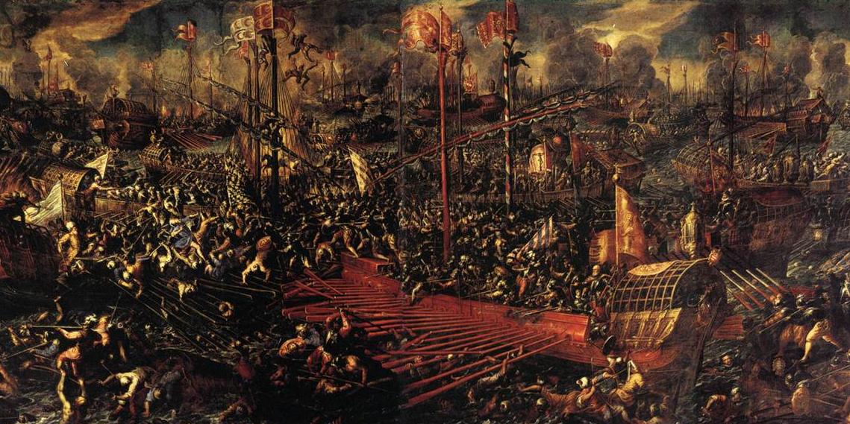
Battle of Lepanto
Andrea Vicentino (1603)

Slide 8
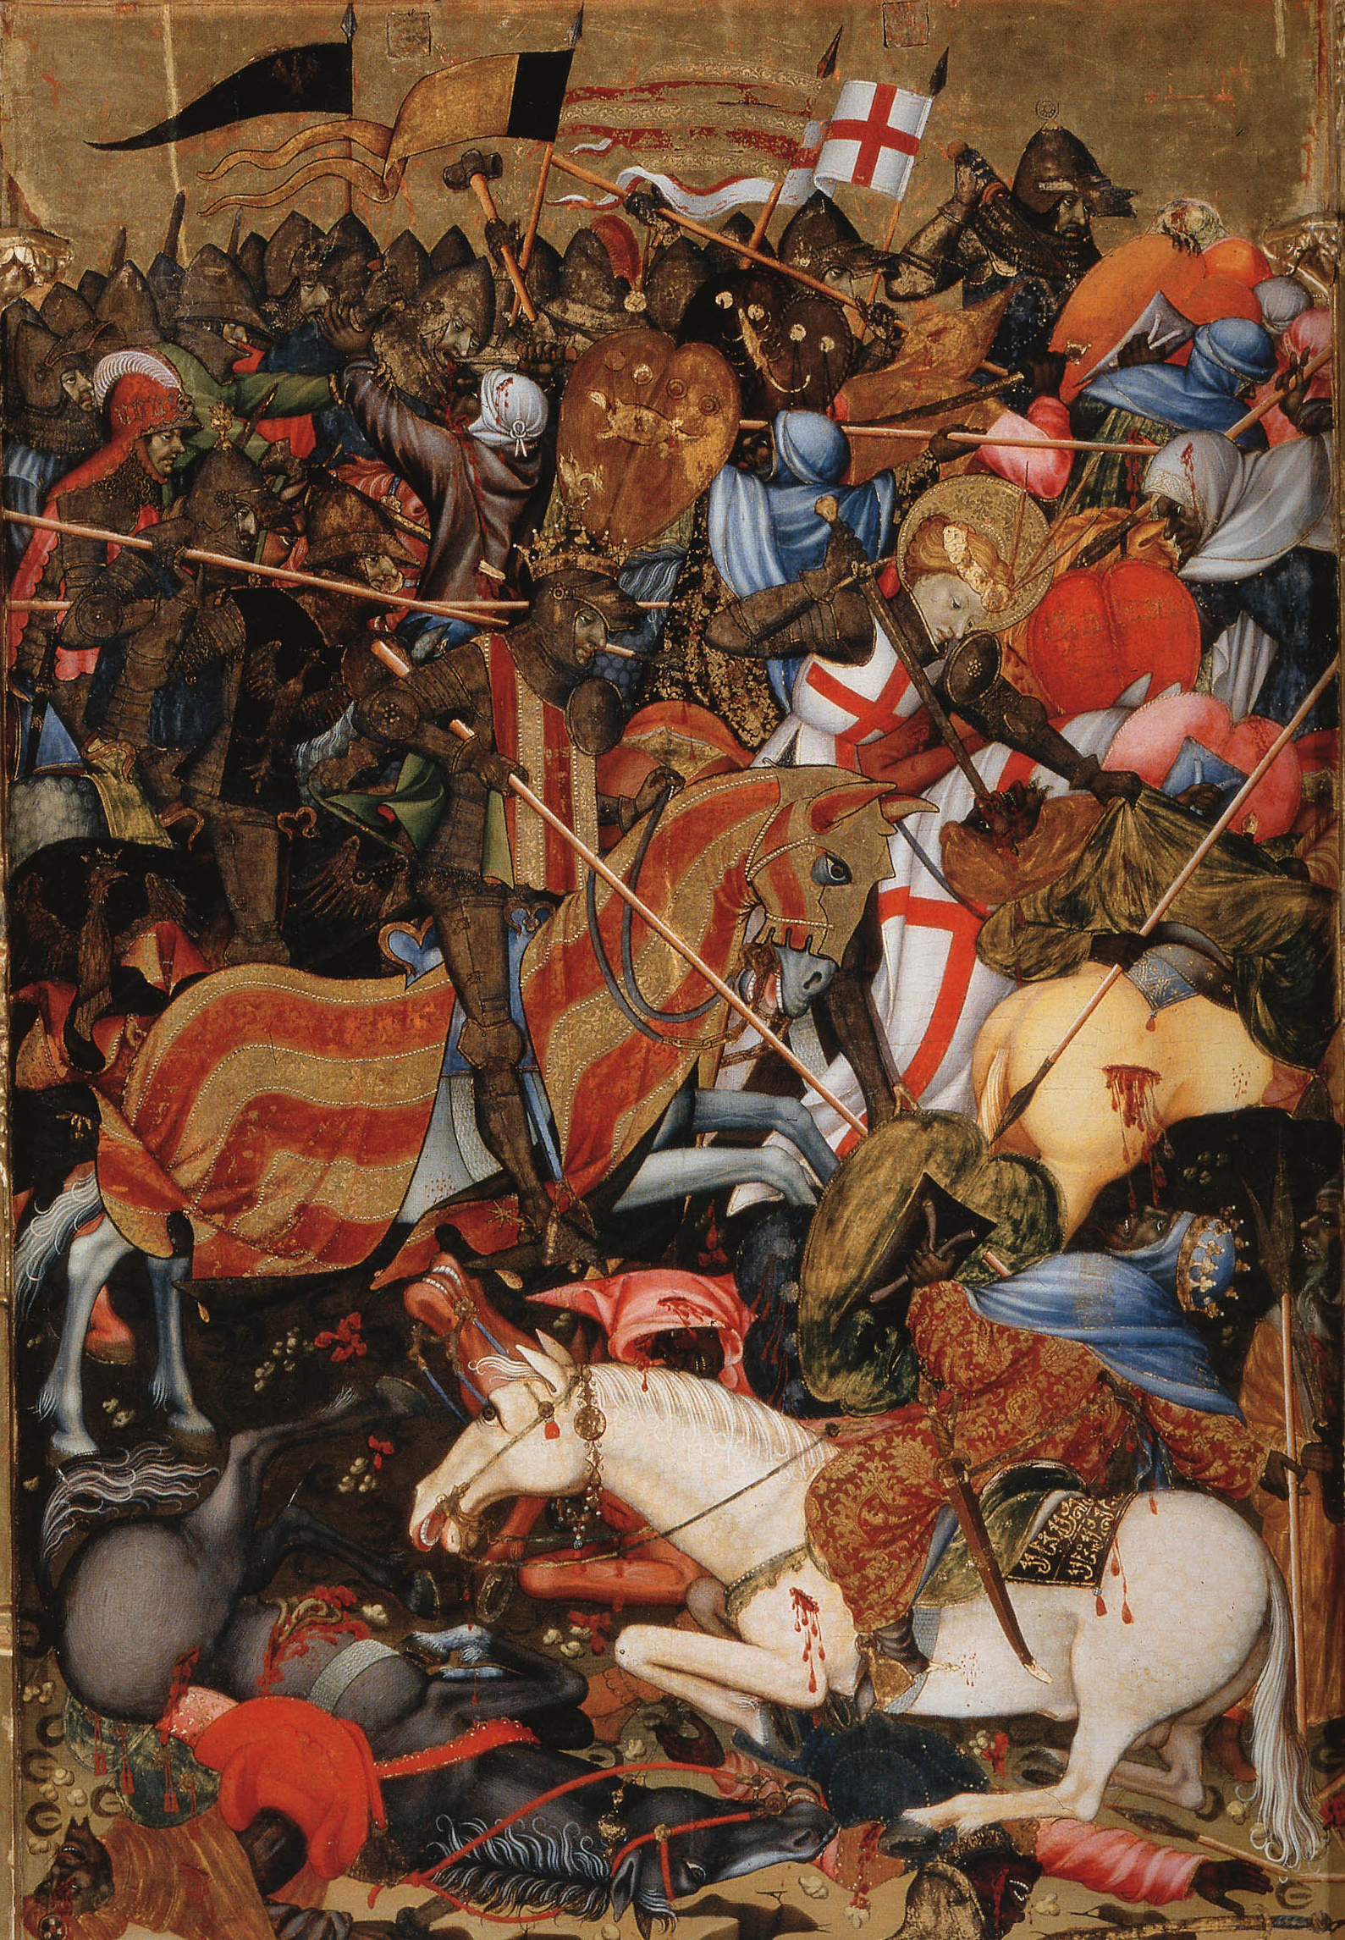
James I of Aragon defeating the Moors at the Battle of El Puig
Altarpiece of St George
V&A (c.1410)

Slide 9
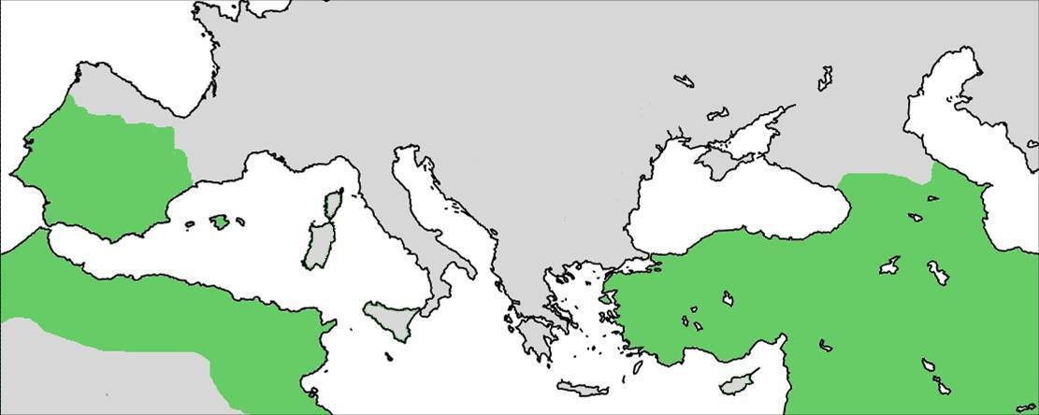
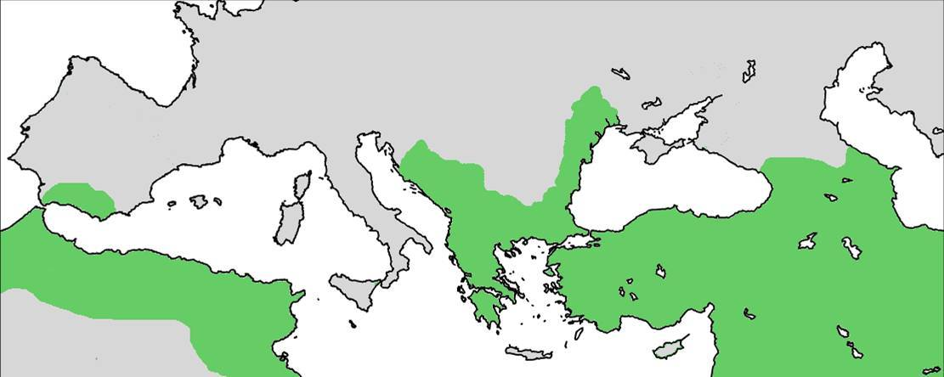
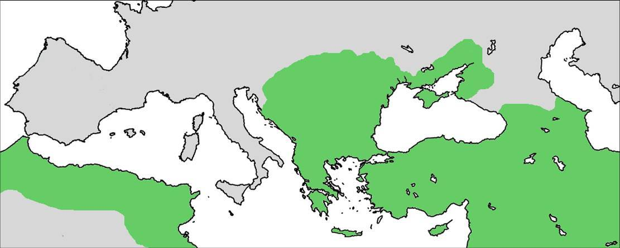
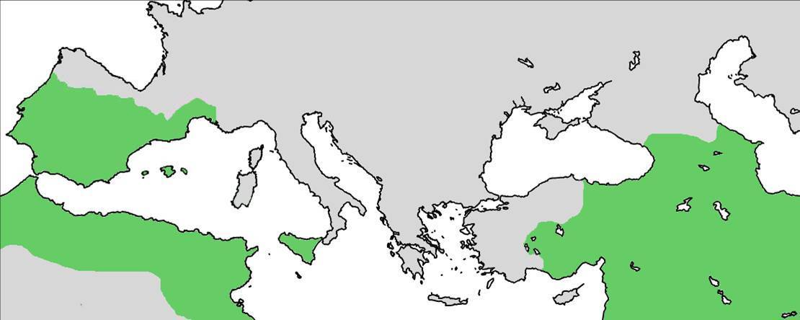
Islam as an external threat
Vienna ●
● Toledo
Granada
●
Constantinople
●
●
Algiers
Palermo
●

Slide 10
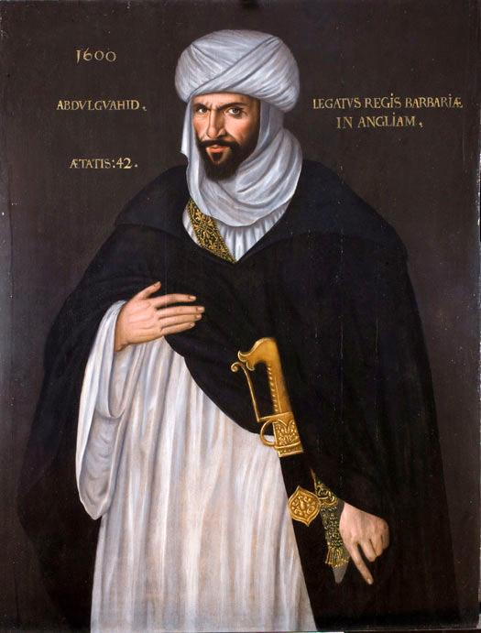
Abdul Guahid
Barbary ambassador to Elizabeth I
(1600)

Slide 11
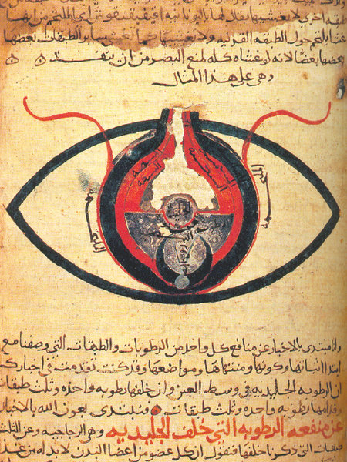
Arabic treatise on the eye
(thirteenth-century)

Slide 12
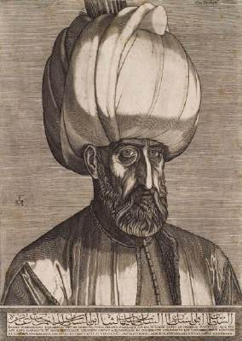
Suleyman the Magnificent
Melchior Lorck
(1559)

Slide 13
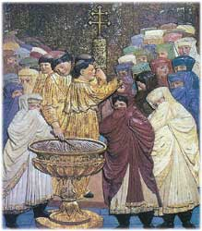
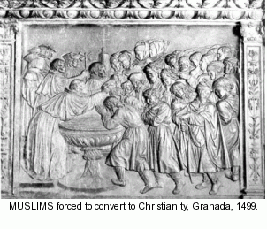
Baptism of converts (Moriscos)

Slide 14
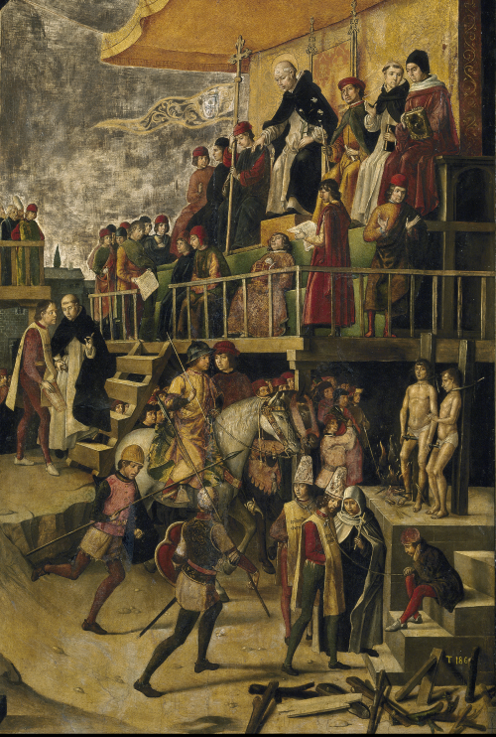
Auto-da-fé
Burning of the Heretics
Pedro Berruguete
(c.1500)

Slide 15
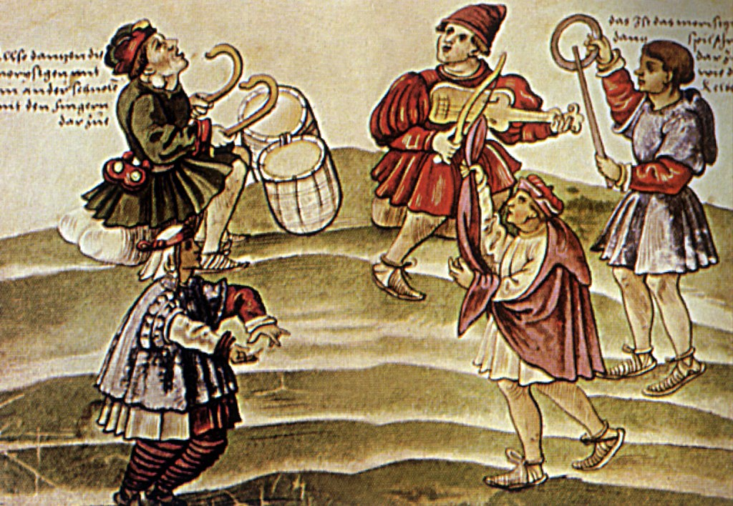
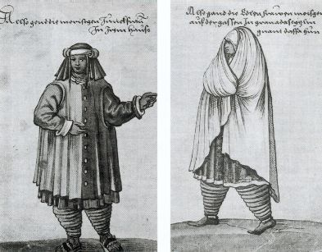
Moriscos

Slide 16
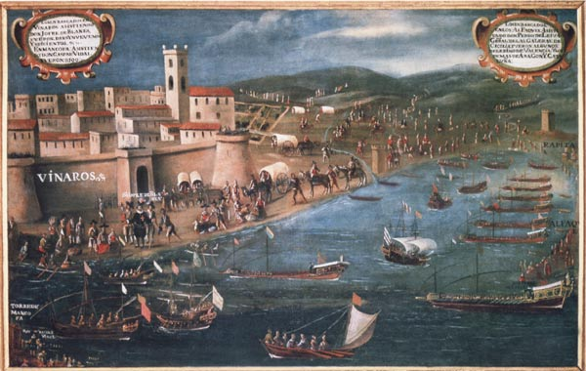
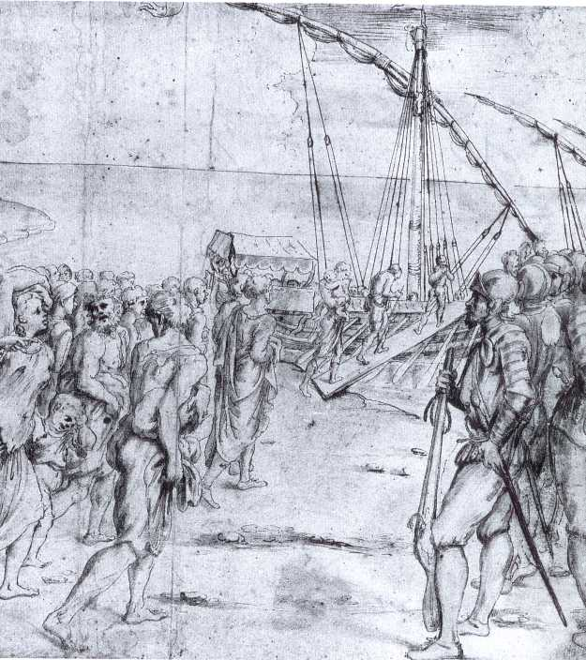
Expulsion of the Moriscos

Slide 17
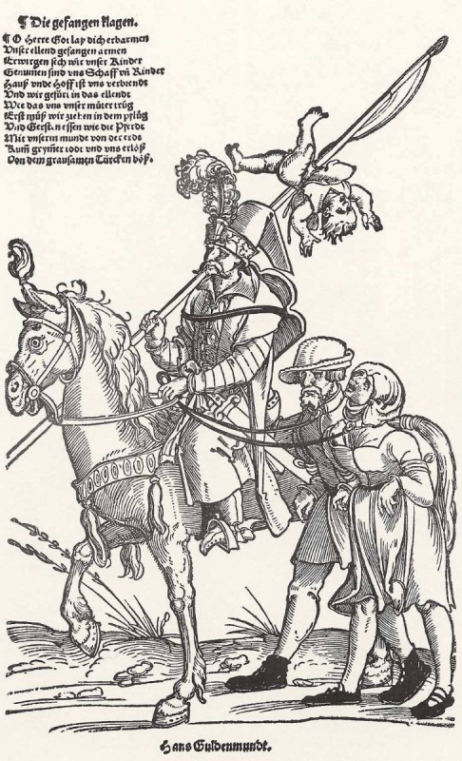
Turkish horseman with Christian captives
Erhard Schoen
(1540)

Slide 18
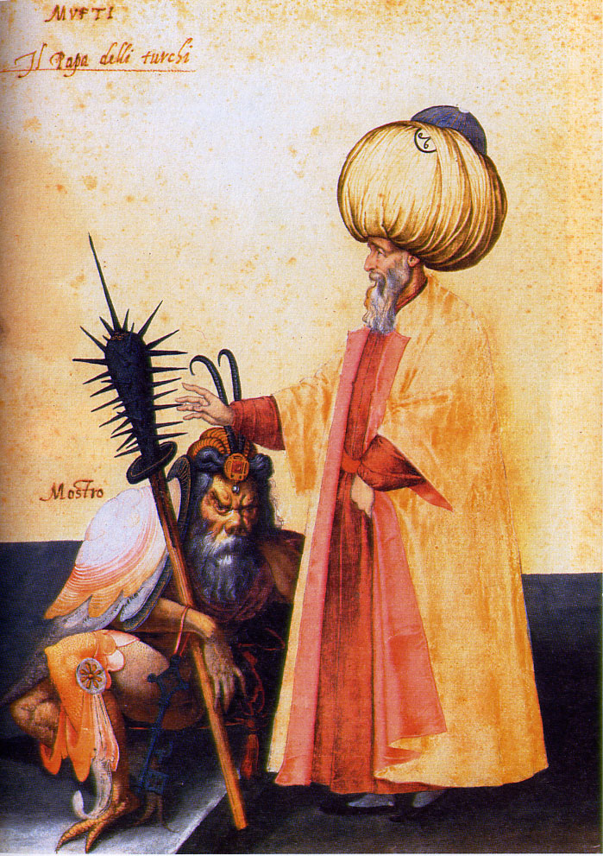
The Mufti and the Monster
Jacopo Ligozzi
(1580)

Slide 19
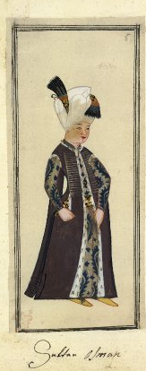
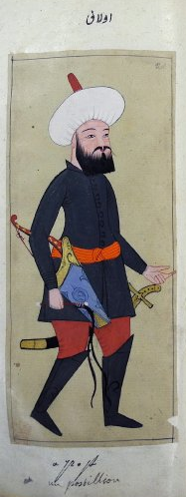
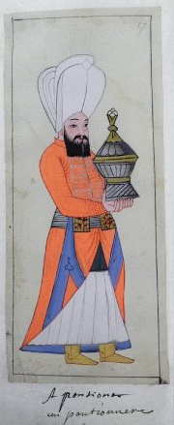
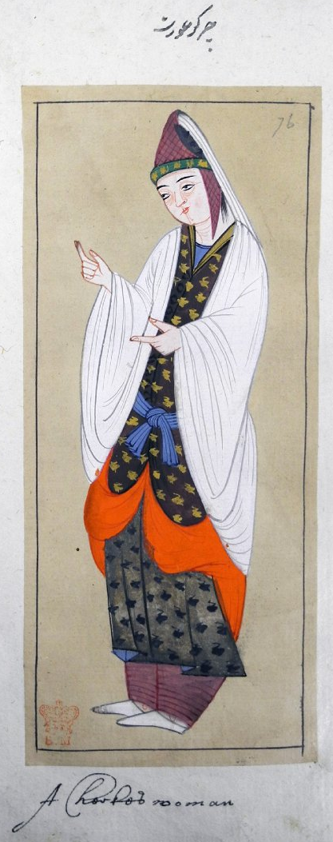
The Habits of the Grand Signor’s Court
British Museum, Sloane Ms. 5258 (c.1620)

Slide 20
Conclusion
Irresistible expansion of Islam in medieval period
Generally, Muslim territories exercised tolerance
Christian Europe concerned by external threat
European Muslims suspected, persecuted, expelled
Paradoxical legacy of Orientalist representation

